Slide 1
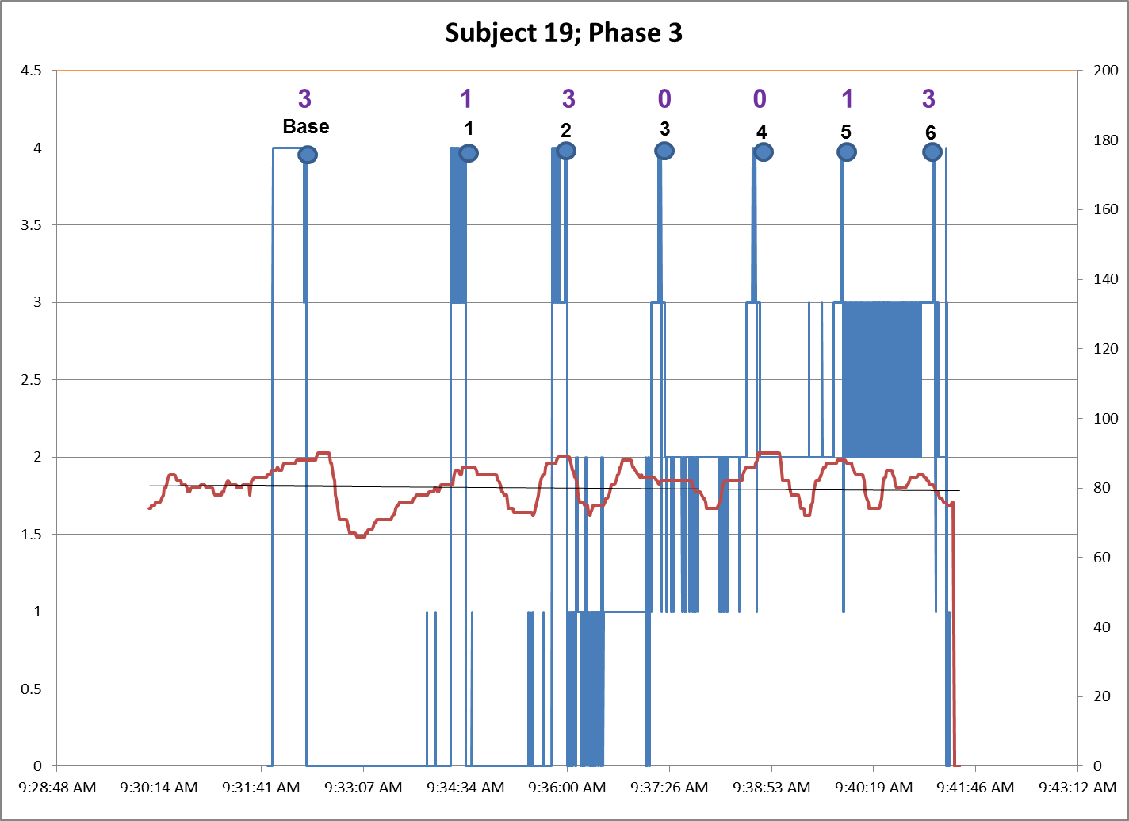
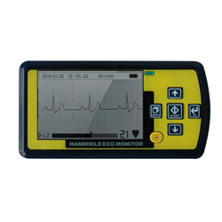
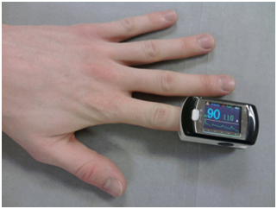
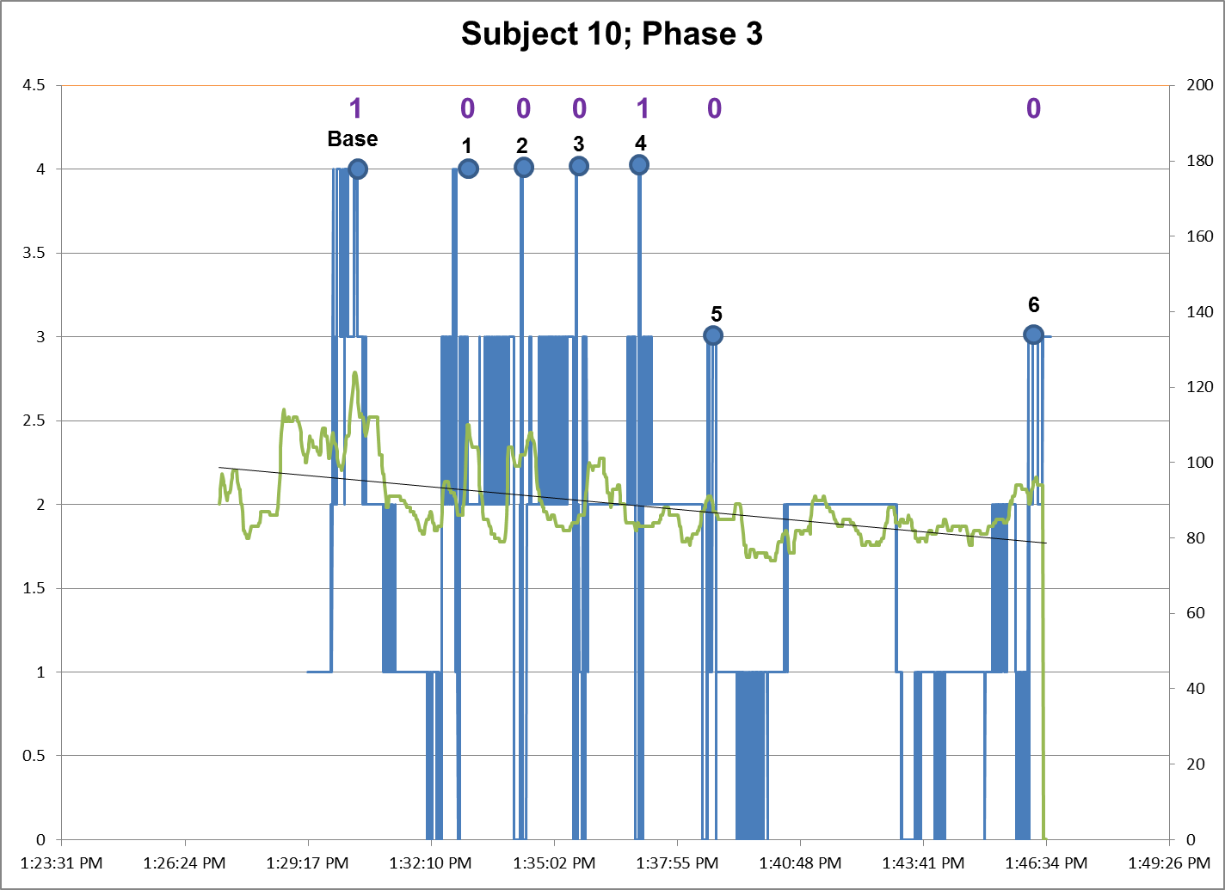
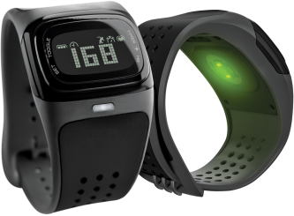


Measuring heart rate variability: a comparison of devices
B. Krekeler¹, K. Mallon¹, M.R. Chapman¹, D.R. Scarborough¹, M. Bailey-Van Kuren²
¹Department of Speech Pathology and Audiology, ²Department of Mechanical and Manufacturing Engineering, Miami University, Oxford, OH, USA
Introduction
Heart rate (HR) and heart rate variability (HRV) have both been extensively examined in terms of effects on general health and stability of countless areas of the body. Inseparably linked to parasympathetic regulation, HRV responds to external stimuli within the context of psychological activation and regulation to maintain arterial blood pressure and flow to the brain and other vital organs (Thayer et al., 2012). Needless to say, HRV is crucial to the proper functioning of the regulation system of the body and a lack of HRV due to stress, anxiety, and absence of vasovagal stimulation/response can lead to a host of arterial disorders (Friedman, 2007; Malpas, 2002). Previous work in the Dysphagia Research Lab has lead to a detailed examination of HRV in relation to a series of gag studies. As a result, the most accurate and efficient device for HR measurement must be identified in order to further explore this topic. This proposed study aims to conclude which of several HR measurement devices provide the most accurate and easily manipulated data allowing the continued study of HRV in terms of the clinical use of a device developed by said lab.
Results of Initial Series Study
Proposed Study
In order to execute continued research on how the hand-glove device affects HRV in long-term clinical use, the most efficient HR monitoring device must be identified. Based on our current information and peer feedback, we have determined purpose of this preliminary study is to compare accuracy of data from an ECG monitoring system to that of other less cumbersome and cost effective devices available on the market. Between 16-30 subjects will be recruited for the study with a 95% probability of representing 2-3 of the autonomic groups characterized in the original study. The devices we will be examining are a pulse oximeter, portable ECG, wrist watch, and Valencell Earbuds (Figure 4-7). Data collected from all four devices will be loaded into tracer DAQ computer program and analyzed for statistical difference.
Figure 1. The average heart rate across all subjects for all treatment designs was found to be 81 (SD, 11) beats per minute (bpm). Average heart rate variability was calculated by taking the maximum, minimum, and average heart rate values throughout the duration of the trial for each subject then graphed in a histogram.
Number of subjects
Number of subjects
Beats per minute (bpm)
Figures 2 & 3. represent graphically heart rate (red/green) measured in beats per minute and (y-axis-right side) is time linked (x-axis) to exact times that a subject is gagged. The ordinal number of each gag in the trial period is represented in black while the GTPI is recorded above (purple/blue).
Significance
The importance of understanding the autonomic responses, especially in terms of decreased HRV in subjects who use the hand-glove device, are due to the numerous negative side effects implicated with low HRV. The causes of decreased HRV are numerous including psychological stressors, genetic factors, and even coffee drinking can interfere with this parasympathetic response (Friedman 2007; Stewart, Buffett-Jerrot, & Kokaram, 2001; Wang et al., 2009). In our study, the anticipatory, psychological stress involved with knowing the gag will be occurring may potentially play a role in the decreased HRV among subjects. Additionally in relation to the pressure applied by the hand-glove, another mechanism has been proposed for the decrease in HRV. The influence of the parasympathetic system at the level of the tractus solitarius, specifically the ventrolateral portion within the medulla is affected so that by applying pressure to specific loci in the palamar region, both the gag and HR are affected (Scarborough et al., 2012). While further research must be conducted in order to explore the underpinnings of such mechanisms, however, this proposed study must first be carried out in order to identify the paramount HR measurement devices.
Figure 4. This Autonomic Response Heat Map was generated based on observed autonomic responses (AR) in subjects in phase 3 of the original study. Data from 4 individual, blinded observers was coded and rated on a scale of 0=response absent to 1=response present. Each subject was then assigned an agglomerative cluster of similar AR: group 1 medium gray, low AR; group 2 light-gray, medium-low AR; group 3 dark gray, strong AR.
Figure 5. Numerical summaries of Baseline GTPI by ARG. The GTPI scale runs from a 0=no motor response (posterior pharyngeal probe placement) to 8=probe elicited response on internal cheek. Superimposed on ARG clustering, a significant difference can be seen between the mean GTPI scores of the low-moderate groups and the high group. Difference between the low and moderate groups, while present, is less significant, suggesting these groups may be more autonomically similar.
Preliminary Findings
The initial experimental question informing this research involves a three-phase study testing a theoretical model related to altering the afferent limb of the gag reflex by applying pressure to a point on the palm of neurologically intact adults (Scarborough, Bailey-Van Kuren, & Hughes, 2008). A total of 120 subjects were fitted with a hand-glove device, which applies pressure at specific predetermined loci on the palm of the hand: significant results were found related to the posterior movement of the gag reflex. The Gag Trigger Point Index (GTPI) Scale was used to rate the strength each gag recorded throughout individual subject trials. A drop in GTPI score is indicative of a decreased response, represented by a posterior movement of the trigger point of the gag in the oral cavity. During data analysis, three statistically significant groups were identified in terms of autonomic response of the subject during the gag trial (Figure 4). By superimposing GTPI scores on these autonomic response groups (ARG), the relative differences in gag sensitivity between the low and high ARG become apparent (Figure 5). Additionally, several specific patterns of HR and HRV were observed amongst subjects throughout the trials. In addition to collecting average HR and HRV (Figure 1), individual subject’s HR data were graphed in comparison to gag instances for the duration of the trial (Figures 2 & 3). Due to the potential effect the hand-glove device has on HRV, continued testing must occur in order to ensure the safety of clinical use. Finally, to further define the ARG, HRV and GTPI must be factored into the categorization of subjects into these autonomic clusters.
Figure 2. Participant demonstrates normal heart rate variability throughout the treatment trials. A person with normal HRV would be expected to show spikes in heart rate in response to repeated stressful stimuli of a gag trial series. The stressful treatment trials would stimulate the sympathetic nervous system, causing an increase in heart rate with subsequent drops in HR. This pattern of HRV has been linked to healthy emotional regulation abilities (Thayer et al., 2012).
Devices to be Tested
Literature cited
Friedman, B. H. (2007). An autonomic flexibility—neurovisceral integration model of anxiety and cardiac vagal tone. Biological Psychology, 74, 185-199.
Malpas, S. C. (2002). Neural influences on cardiovascular variability: Possibilities and pitfalls. American Journal of Physiology-Heart and Circulatory Physiology, 282, H6-H20.
Scarborough, D.R., Hankins, K., Bailey-Van Kuren, M., Hughes, M., Lanham, A., Mallon, K., & Steiner, S. (2012) Altering the afferent limb of the gag reflex via a hand pressure point: Report of preliminary findings. Poster presentation, Dysphagia Research Society Meetings, Toronto, Canada.
Scarborough, D. R., Bailey-Van Kuren, M., & Hughes, M. (2008). Altering the gag reflex via a hand pressure point. Journal of the American Dental Association,139, 1365-1372.
Scarborough, D. R. & Isaacson, L. G. (2010). Median nerve stimulation alters the afferent limb of the gag reflex: A hypothetical model to explain a hand to mouth connection. Poster presentation. Dysphagia Research Society Meetings, New Orleans, LA.
Stewart, S. H., Buffet-Jerrott, S. E., & Kokaram, R. (2001). Heartbeat awareness and heart rate reactivity in anxiety sensitivity: A further investigation. Anxiety Disorders, 15, 535-553.
Thayer, J. F., Ahs, F., Fredrikson, M., Sollers III, J. J. & Wager, T. D. (2012). A meta-analysis of heart rate variability and neuroimaging studies: Implications for heart rate variability as a marker of stress and health. Neuroscience and Biobehavioral Reviews, 36, 747-756
Wang et al. (2009). Genetic influences on heart rate variability at rest and during stress. Psychophysiology, 46, 458-465.
Figure 6. Pulse oximeter, Contec CMS 50E device, fitted on the index finger of either the right/left hands or potentially both hands.
Figure 7. The MD100A1-E Portable ECG Unit is a portable version of a typical ECG. The device includes software, a USB cord, and provides a less invasive form of the typical ECG.
For further information
Contact Donna Scarborough at
scarbod@miamiOH.edu
Figure 3. Shows initially extensive HRV. However, shows a decrease in basal heart rate levels and HRV with the application of pressure using the hand-glove device; therefore, in some individuals the hand pressure itself may be affecting the baseline HR and HRV.
Figure 8. Mio Alpha, a wristwatch that reads heart rate without the need for straps.
Figure 9. The Valencell Earbuds use groundbreaking technology from PerformTek for a hands-free way to measure heart rate.
Notes:
In response to an NIH stipulation regarding the use of ECG devices verses pulse oximetery

