Slide 1
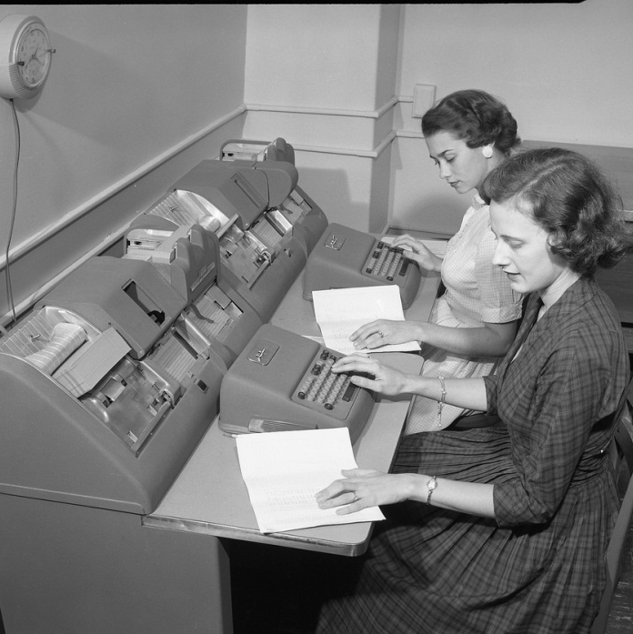
The Numbers Game: Collecting, Compiling and Utilizing Usage Data in an Academic Library
Jennifer Bazeley
Miami University Libraries
http://www.flickr.com/photos/cushinglibrary/3876088472/in/photostream
Notes:
The Numbers Game: Collecting, Compiling and Utilizing Usage Data in an Academic Library

Slide 2
“Statistics are like bikinis.
What they reveal is suggestive, but what they conceal is vital.”
-Aaron Levenstein
Notes:
Statistics are like bikinis.
What they reveal is suggestive, but what they conceal is vital.
Aaron Levenstein

Slide 3
Overview
Why do we need data?
Using COUNTER Reports
Obtaining E-Resource Usage Data
Storing/Compiling/Disseminating Usage Data
  Tools and Examples
Analyzing Usage Data
Visualizing Usage Data
  Tools and Examples
ACRL and NCES Statistics
Notes:
Overview of presentation
Why do we need data?
COUNTER Code of Practice
Obtaining E-Resource Usage Data
Storing/Compiling/Disseminating Usage Data
Tools and Examples
Analyzing Usage Data
Visualizing Usage Data
Tools and Examples
Data for Decision Making
ACRL and NCES Statistics

Slide 4
“In God we trust.
All others must bring data.”
-W. Edwards Deming
Notes:
In God we trust. All others must bring data.
W. Edwards Deming
The data which gets the most attention in our libraries and in our literature are e-resource usage statistics.
Why obtain usage data?
As our academic library budgets evolve, librarians have to make difficult decisions about what resources to spend that money on every year. Looking at patron usage of our resources, both tangible and electronic, can help us to make these decisions.
Last year, our library undertook a serials review (for both print and online formats) which utilized usage data for both print and online materials to aid in making decisions regarding cancellation and format change. Following that review, we have continued to compile usage for our online materials for a variety of purposes. These purposes include reviewing print serials for potential format changes, compiling ACRL and NCES statistics, and making purchase decisions on new resources. Our presentation will focus on the mechanics of obtaining usage reports from our vendors, the best methods of making usage data available to our librarians, the challenges of working with usage reports in multiple formats (including the COUNTER (Counting Online Usage of Networked Electronic Resources) format), and how subject librarians use this data in the decision making process for cancellations, format changes, and new purchase recommendations.

Slide 5
Why usage data?
Realistic budgets
Saving money
Marketing & promotion opportunities
Justification of new purchases
The bigger picture

Slide 6
Using COUNTER Reports
Counting Online Usage of Networked Electronic Resources
  http://www.projectcounter.org/code_practice.html
Bucknell, Terry. “Garbage in, gospel out: twelve reasons why librarians should not accept cost per download figures at face value.” The Serials Librarian, 63 no. 2 (2012): 192-212.
  The good: consistent, credible, compatible
  The questionable: differences in platform design; extent of content, disciplines, and content type; usage spikes; publisher/platform transfers; title changes; group titles; hybrid journals.
Notes:
COUNTER Code of Practice (what is it and pros and cons)
COUNTER, what is it?
COUNTER caveats
Terry Bucknell published an article in August 2012 in The Serials Librarian titled “Garbage in, Gospel Out: Twelve Reasons Why Librarians Should Not Accept Cost per Download Figures at Face Value”. There is a computing phrase “garbage in, garbage out” which refers to the fact that computers process whatever data you input, regardless of whether or not the data (and subsequent analysis) makes sense. The title of his article, “Garbage in, gospel out” is a more recently coined phase that expresses the tendency people have to trust numbers at face value without question. Bucknell’s article points out some of the pitfalls of COUNTER reporting, and while I don’t think that they invalidate the data we use, we should definitely be aware of the limitations.

Slide 7
COUNTER Code of Practice
Release 4
http://www.projectcounter.org/r4/COPR4.pdf
  Journal and Book DOI
  Gold Open Access articles
  Journal Report 2 Expansion
  Journal Report 5 Modifications
  Database Report Modifications
  Book Report 2 Type of Section
  New Report: Multimedia Report 1
  New Report: Full text use of all formats on single platform
  New Report: Content Usage on Mobile Devices
  Flexibility in reporting period
Notes:
COUNTER release 4
The deadline date for implementation of Release 4 is 31 December 2013.
Enhancements:
Enhancement of SUSHI Protocol
Requirement for journal and book DOI info to be included in reports (this helps with linking among reports from different vendors)
Requirement that usage of Gold Open Access full-text articles within journals be reported separately in a new report: Journal Report 1 Gold Open Access
An expanded Journal Report 2, which now includes ‘access denied: content item not licenced’, in addition to the ‘Turnaways’ (access denied: simultaneous/concurrent user licence limit exceeded) covered in earlier Releases
A modified Journal Report 5, covering usage by Year of Publication (YOP), which allows customers to calculate usage of archival packages, is now a
required report. Vendors are not required to provide this report to every customer every month, but they must have the capability to provide Journal Report 5 to customers on demand
Modified Database Reports, in which the previous requirement to report Session counts has been dropped, and a new requirement to report Record Views and Result Clicks has been added. Database Report 3 has also been renamed Platform Report 1
A requirement , in Book Report 2, that the type of Section covered in the report by a particular vendor be defined
A new report, Multimedia Report 1, which covers the usage of non-textual multimedia resources, such as audio, video and images, by reporting the number of successful requests for multimedia full content units
A new set of optional usage reports, the ‘Title’ reports that enable the reporting of usage of full-text items in journals, books and reference works that are published on the same platform in a single COUNTER report.
A set of new optional reports that enable usage of content on mobile devices to be reported separately.
Flexibility in the reporting period for all usage reports, which allows customers to specify a date range for their usage reports

Slide 8
“We are drowning in information and starving for knowledge.”
-Rutherford D. Roger
Notes:
We are drowning in information and starving for knowledge.
Rutherford D. Roger

Slide 9
Obtaining E-Resource Usage Data
Who?
What?
When?
Where?
Notes:
Obtaining E-Resource Usage Data
Who?
Mostly library selectors and library administrators. Occasionally useful at the consortial level.
Who collects stats is trickier, because it’s a time consuming job and it does require a little bit of training and special knowledge to get started. Currently in my department, I am the gatherer of statistics, largely because we have a small staff. In the near future, I hope to train my periodicals assistant to do much of the gathering work.
What?
What resources do I need stats for? When I began the process of getting statistics, I focused on the aggregator database we subscribed to, as well as the platforms where we had the most subscriptions. For example, we have many titles on the Highwire Press platform, and so that was a priority. The bottom priority for me was for the platforms where we only have a handful of titles, as those are asked for least frequently.
At your institution, you may want to focus on packages or titles within a specific subject area or from specific vendors, depending on how you spend your resources.
What vendors/resources are COUNTER/SUSHI compliant? Most vendors are COUNTER compliant, or close to being COUNTER compliant at this point. Many are also SUSHI compliant. There are lists on the internet of vendors who comply with the standards—the URLs are on the resources handout. Having COUNTER compliant usage reports makes it a lot easier to compare and contrast reports between different vendors and platforms.
What formats will you focus on? In the beginning, I focused on e-journals, because that was what was most in demand. As we’ve invested heavily in e-books over the last two years, I have expanded my reports to include e-book reports, as well. We do provide database reports when they’re available, but they seem to cause the most confusion among our librarians.
When?
When are stats requested? When I first started, stats were requested for special projects and by individual librarians. As I became more comfortable with my job, librarians began asking for stats more regularly throughout the year.
How often can I harvest and update stats? Think carefully about how often you will have time to collect and update stats. My original ambitious goal was to update all my reports monthly, but after a few months I realized how unrealistic that was. Quarterly has worked out well for me—I usually spend one morning and one afternoon each quarter updating all of my COUNTER reports.
I also pull stats if someone has a special request—if it’s between quarters and a librarian is doing research or looking at usage for some other reason, it’s not a problem to update the vendor or platform list they ask about.
Where?
Where are vendor stats available?
Each vendor or platform offers a slightly different method of acquiring your usage statistics, but there are a couple of standard methods. The process of notification and acquisition of stats has gotten more streamlined over time.
In the beginning, it may be easier to focus on the platforms that offer many publisher’s titles in one report, like Highwire Press or Metapress. With a little bit of set-up, you can actually associate all of your individual Highwire Press subscriptions to one admin account so that all of your admin can be done centrally for these titles.
E-mail notifications
Scheduling for e-mail delivery
Online form submission/download
Online via IP address authentication

Slide 10
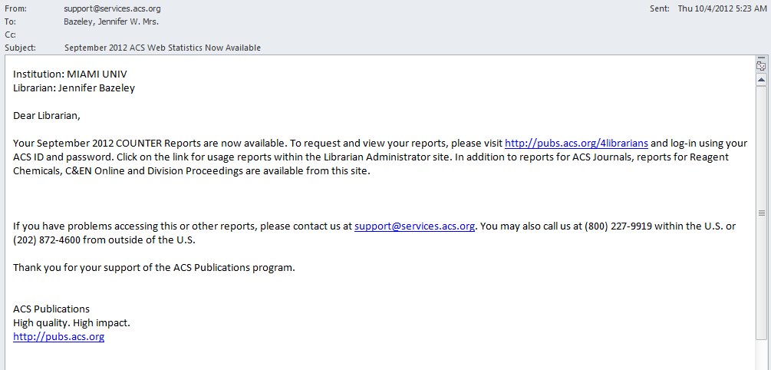
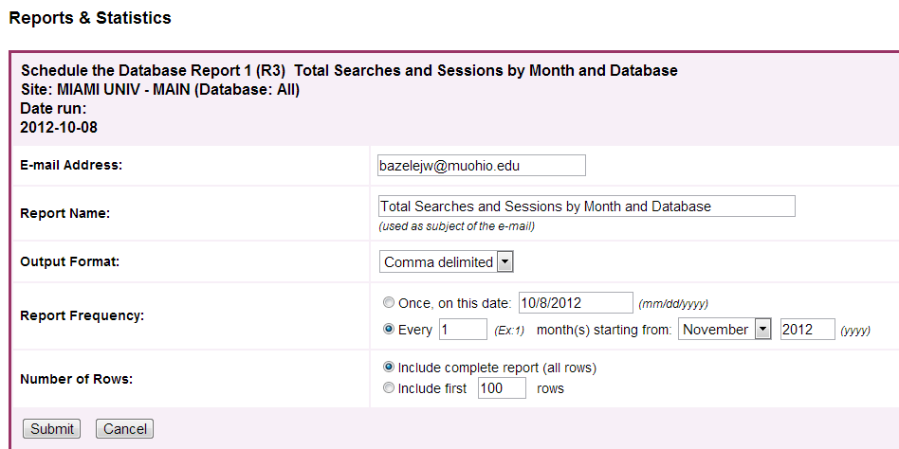
Obtaining E-Resource Usage Data
Notes:
Obtaining E-Resource Usage Data (vendors)
Email notifications with links. Most of the vendors out there offer email notifications to let you know that statistics have been updated at the end of a month. Often the emails contain a link directly to the site, so all you need to know are the log in details. Forwarding these emails to support staff so that they can retrieve stats is relatively simple. These notifications are also handy if you update your reports monthly, because each vendor updates their states on a slightly different timetable.
Getting Started: Where (Vendor) Scheduling Reports
Some of the large aggregator vendors offer the option of setting up a schedule that will e-mail a report to you each month. Once you get a schedule set up, this is a very convenient service. Upon arrival, the email and attached report can be opened and saved immediately.
Getting Started: Where (Vendor) Online Form Submission
The large majority of vendors offer an online form within your administrative account to request (or download in some cases) COUNTER compliant usage statistics in a variety of formats. You can choose to have the report emailed to the administrator or to specific recipients. This would again be a good place to direct usage reports to a support staff email account.
Getting Started: Where (Vendor) Online via IP Address Authentication
My favorite method of gathering usage stats is via IP address authentication. You receive a URL and your stats show up on that site based on the IP address you’re accessing it from. This method is not as common--JSTOR used to do this and Readex still offers this.

Slide 11
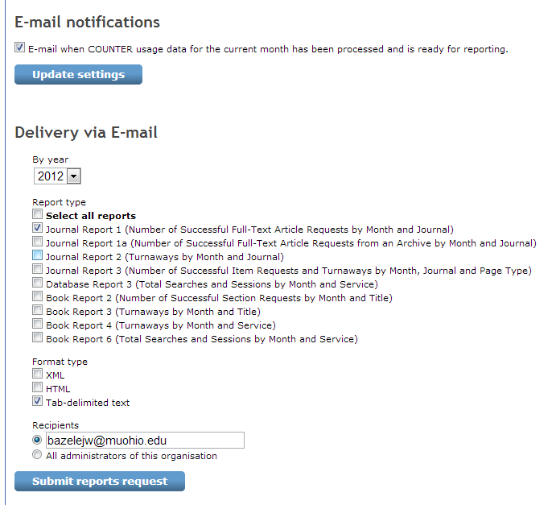
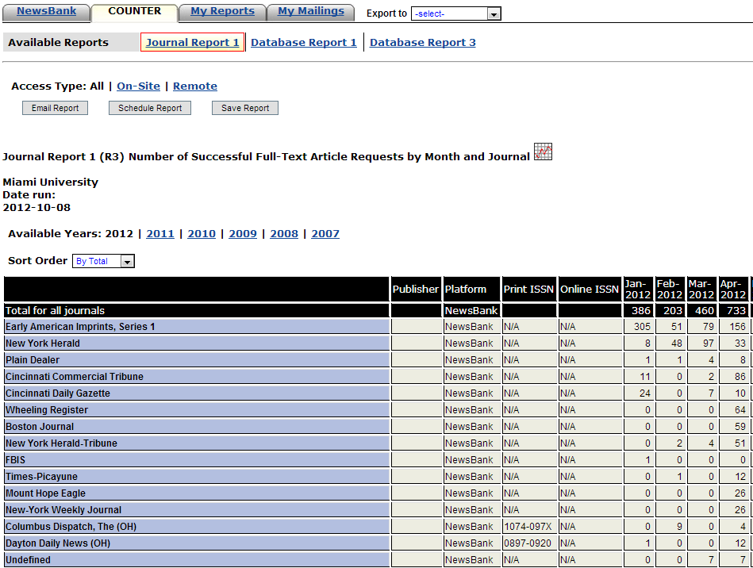
Obtaining E-Resource Usage Data

Slide 12
Storing, Compiling & Disseminating E-Resource Usage Data
Free or Low Cost Tools
Commercial Products
My Tools
Notes:
Storing, Compiling, and Disseminating E-Resource Uage Data
Once you have retrieved the statistics from the vendor, you need to think about where you will save and store your reports. You’ll also need to decide where you can place the reports to make them accessible to other staff.
Getting Started: Where (Library)
There are a number of free or low cost products that you can use in the process of saving, storing and posting stats. Some of these products are free and others are low-cost, especially for institutions. Just because you don’t have a commercial system doesn’t mean you can’t manage usage reports.
Google docs/Google cloud connect
Microsoft Excel/Access
Open Office
Dropbox
LibGuides
CORAL
ERMes
PBWiki
Course Management Software (Moodle, Sakai, Blackboard)
Getting Started: Where (Library)
There are now a number of commercial products around that handle usage statistics. I’m not going to talk about these too much, as you’ll hear more about some of these over the next day and a half.
Commercial Products
Scholarly Stats (Swets)
EBSCONET Usage Consolidation
E-Stats for Libraries (Harrassowitz)
360 Counter (Serials Solutions)
Our solution has taken two different directions, due to budgetary issues. When I started, there was no money in the budget for a usage tool, so I found other ways to make our reports available. Because I helped to develop our technical services LibGuide, I had a pretty good idea of how I could post reports or links to reports on the Guide. What took some research was in finding a way to update the spreadsheets simultaneously, so that I wasn’t having to update the same report in three different places.
Excel – Google Cloud Connect – Google Docs – LibGuide
Commercial Tools: Ebsco’s Usage Consolidation
SUSHI registry

Slide 13
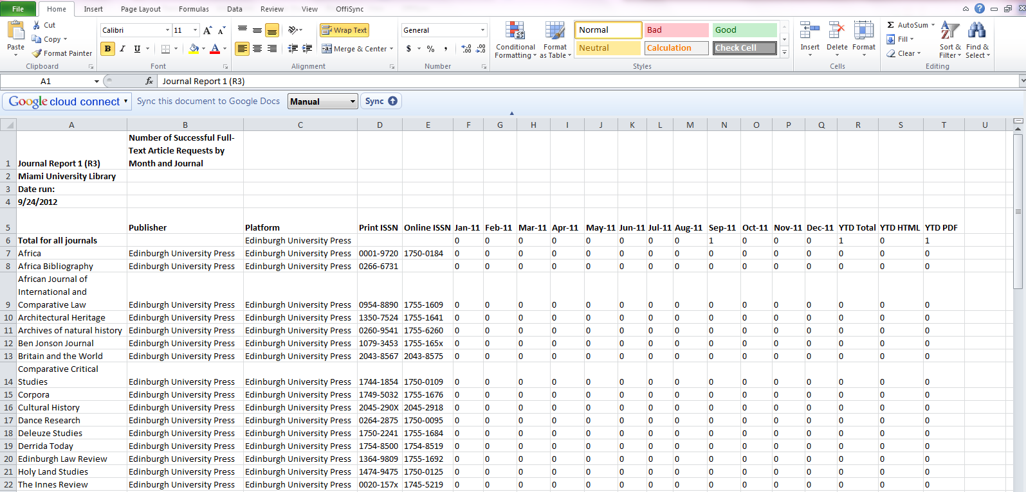
My Tools:
Excel and Google Cloud Connect
Notes:
My Tools Google Cloud Connect
When OffiSync disappeared, I discovered Google Cloud Connect, which works in a similar way. Each time you update the document after you sync it initially, it will be updated online, as well. Each time I open my COUNTER report and paste in the new data, I’m able to sync the new content in my Google doc simultaneously.

Slide 14
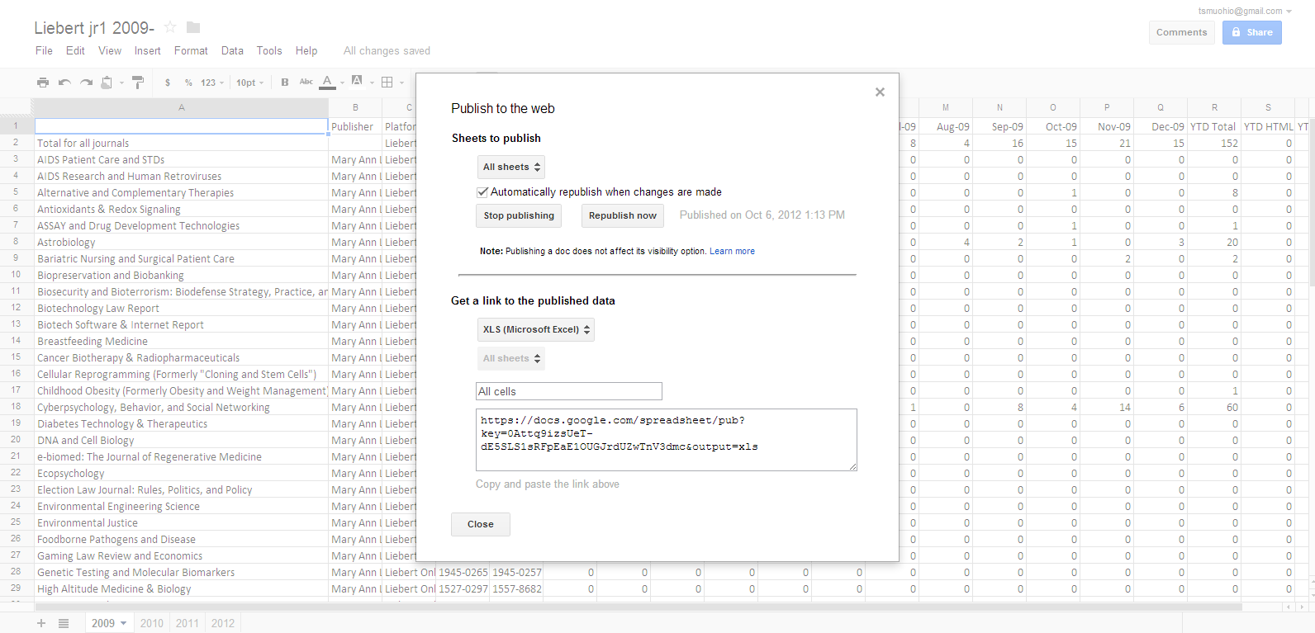
My Tools:
Google Docs – Publish to Web
Notes:
My Tools: Publish to Web
Publish and Capture Link
In order to create a link to the report to post on my LibGuide, I use the “publish to the web” feature in Google docs. Using this feature, I can generate a link which will allow the user to click and download the spreadsheet in Excel format on their own desktop.

Slide 15
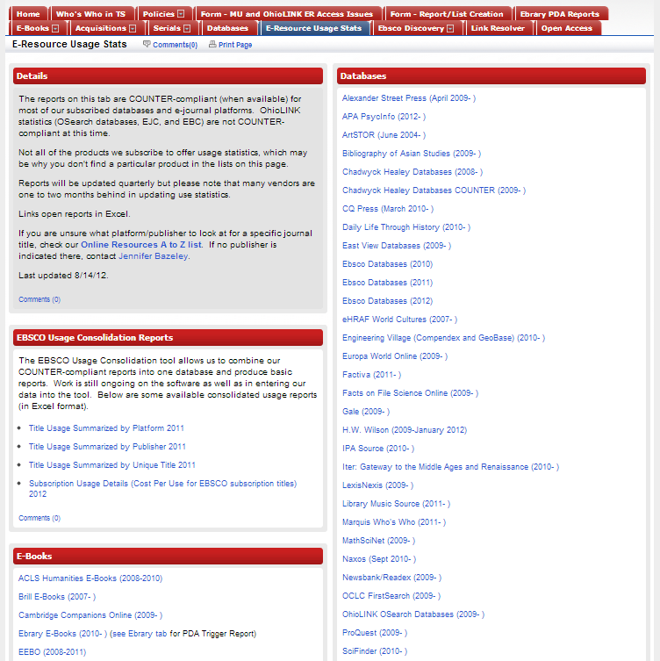
My Tools: LibGuide
Notes:
Disseminating Usage Data
LibGuide E Resources Tab
I then post my report links to my E-Resource Usage Stats tab on our LibGuide, where our selectors know they can go to find the updated reports.
http://libguides.lib.muohio.edu/content.php?pid=101466&sid=1966575

Slide 16
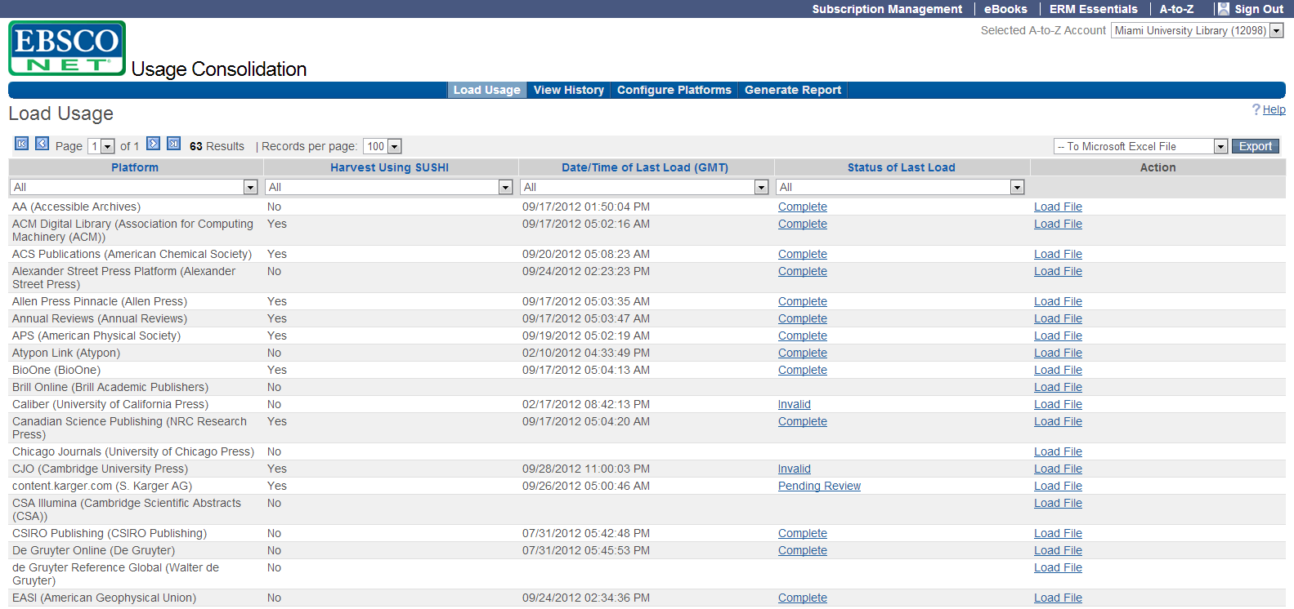
My Tools:
EBSCO Usage Consolidation
Notes:
Compiling Usage Data
Commercial Tool: EBSCO Usage Consolidation
More recently, we have been able to acquire the Ebsco Usage Consolidation tool. I won’t say a lot about this, since you’ll be hearing more about this later, but it has been interesting to compare using this to our more manual solution. This tool does streamline the process for those vendors that are SUSHI-compliant, though there is still a lot of work in doing the initial configuration. For vendors that are not SUSHI compliant, manual upload is possible. There is also a fair amount of clean-up involved in initial report loads, but this was expected. I haven’t heard of a method that doesn’t involve some manual labor.

Slide 17
“Oh, people can come up with statistics to prove anything, Kent. 14% of people know that.”
-Homer Simpson
Notes:
Oh, people can come up with statistics to prove anything, Kent. 14% of people know that
Homer Simpson

Slide 18
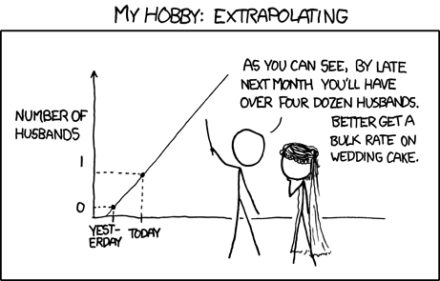
Analyzing Usage Data
Be realistic
Focus your analysis
Leverage available tools
Find partners
Keep it simple
http://xkcd.com/605/
Notes:
Analyzing Usage Data
Be realistic:
If you’ve taken a course in statistics or you have an academic background that trained you in statistics, you’re all set. If you don’t have those qualifications, like me, don’t panic. If you have the resources, take a course, and do as much as you can do with your skill set. It’s better to present analysis that you know is correct, even if it doesn’t look sophisticated.
Focus your analysis:
Determine what it is that people want or have asked for in terms of analysis. If they just want raw data so they can do analysis on their own, that’s great. If they have asked for something specific, focus on the details of their request so that you don’t get overwhelmed.
Leverage available tools:
Explore the tools that are available to you online for free or for very little money. I talked about some of those earlier—Google Docs spreadsheets allows you to do some of the same things that Excel does. Open Office spreadsheets offers similar functionality.
Also explore the tools that your university has to offer. Most institutions give all employees Microsoft office tools like Excel and Access. Many institutions have licenses for programs like SPSS, which you may be able to take advantage of if you know how to use the tools.
Find partners:
It’s likely that there is at least one librarian at your institution who has experience with analyzing data—someone with a social sciences background or someone who has taken some statistics courses may be willing to partner with you for the promise of a published paper, presentation, or some other recognition within your institution.
Think about who you know outside of the library—maybe you have a friend with a social sciences background or know a faculty member who is familiar with stats. I have some friends on the psychology faculty who are always willing to explain things to me in laymen’s terms when I’m completely confused.
Finally, keep it simple. Most of the audience who will be looking at your data are not lifelong statisticians.

Slide 19
Start Simple
Titles with Use: 23%
Titles with No Use: 77%
Notes:
There are three things I try to remember now that I’ve started looking at data more frequently.
First, start simple.
Example:
Springer E-Books Big Deal
Start with simple observations; make them visual.

Slide 20
Benchmark
Identify Existing Analysis
  Galvin, Thomas J. and Allen Kent. “Use of a University Library Collection: a Progress Report on a Pittsburgh Study.” Library Journal 102, no. 20: (1977): 2317-201
    40% of print books are unused six years after purchase
Examine My Data in that Framework
  Springer e-books: an average of 194 titles accessed for first time each year
    2008 – 209 titles used for the 1st time
    2009 – 240/308 titles used for the 1st time
    2010 – 133/213 titles used for the 1st time
  Trend shows that 54% of our e-books will be unused after six years
Notes:
Second, Benchmark.
Example:
Springer E-Books Big Deal
Benchmark against other existing research/statistics
Extrapolate, identify a trend. Discuss how your results differ from previous research and offer possible explanations for why the difference occurred.

Slide 21
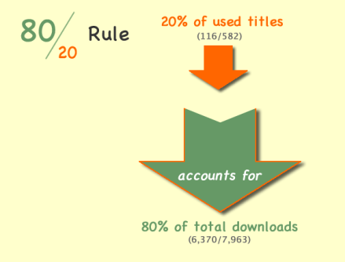
Apply an Existing Principle
Notes:
Third, apply an existing principle.
Example:
Springer E-Books Big Deal
The Pareto principle states that, for many events, roughly 80% of the effects come from 20% of the causes.
Look for universal rules or principles that might apply to your data; make them visual.

Slide 22
“If I can’t picture it, I can’t understand it.”
-Albert Einstein
Notes:
If I can’t picture it, I can’t understand it.
Albert Einstein

Slide 23
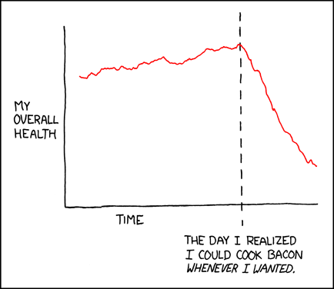
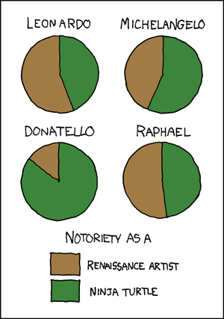
Visualizing Data
http://xkcd.com/418/
http://xkcd.com/197/
Notes:
Visualizing Data
Creating visualizations for your data is one of the best ways for gaining a better understanding of it, and for presenting it to others. Most people absorb a visual like a graph or chart more quickly than they do a table of numbers. Visualizations can be very simple or very sophisticated, and there are now a lot of tools out there that can help with all types of visualizations.

Slide 24
Usage Data Visualization: Tools
Excel
Many Eyes (IBM) –
  http://www-958.ibm.com/software/data/cognos/manyeyes/
Wordle
  http://www.wordle.net/
Google Chart Tools
  https://developers.google.com/chart/
Piktochart
  http://piktochart.com/
Create.visual.ly
  http://create.visual.ly/
Creately
  http://creately.com/
Notes:
Usage data visualization: tools.
Excel, Many Eyes (IBM), Wordle, Tableau, Creately
Creately available via Google Apps

Slide 25
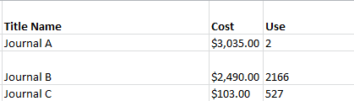
Raw Data:
Cost Versus Use
Notes:
Raw Data: Cost Versus Use
Journal A, B, C

Slide 26
Visualized Data:
Cost Versus Use
Notes:
Made in Excel
Visualized Data: Cost Versus Use (graph)

Slide 27
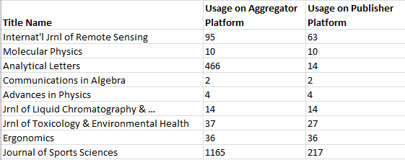
Raw Data:
Usage on All Platforms vs. Usage on Publisher Platforms
Notes:
Raw Data: Usage on All Platforms vs. Usage on Publisher Platforms

Slide 28
Visualized Data:
Usage on All Platforms vs. Usage on Publisher Platforms
Notes:
Made in Excel
Visualized Data: Usage on All Platforms vs. Usage on Publisher Platforms

Slide 29
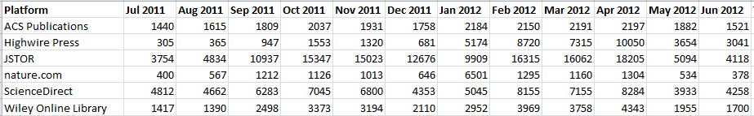
Raw Data:
Platforms with Highest Use FY12
Notes:
Raw Data: Platforms with Highest Use FY12

Slide 30
Visualized Data:
Platforms With Highest Use FY12
Notes:
Made in Excel
Visualized Data: Platforms with Highest Use FY12

Slide 31
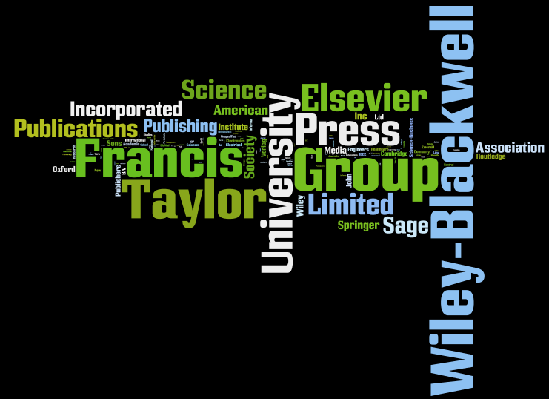
Visualized Data:
Journal Publishers with Ten or More Uses in 2011
Notes:
Wordle/Many Eyes
Visualized Data: Journal Publishers with One or More Use in 2011

Slide 32

Visualized Data:
Journal Platforms with Ten or More Uses in 2011
Notes:
Wordle/Many Eyes
Visualized Data: Journal Platforms with One or More Use 2011

Slide 33
“Do not trust any statistics you did not fake yourself.”
-Winston Churchill
Notes:
Do not trust any statistics you did not fake yourself.
Winston Churchill

Slide 34
ACRL and NCES Statistics
Create a team
Discuss the instructions
Leverage automated reporting
Document the process
Notes:
ACRL and NCES Statistics
Create a team
Discuss the instructions
Leverage automated reporting
Document the process

Slide 35

Jennifer Bazeley
Head, Collection Access & Acquisitions
bazelejw@miamioh.edu
http://www.flickr.com/photos/cushinglibrary/3877848719/in/photostream
Notes:
End

