Slide 1
The Choice Is Yours:
Collections in a Patron-Driven Climate
Eli Sullivan
@muELIbrarian | #b_c13
Miami University
Brick & Click Symposium
Friday, November 1, 2013
Notes:
Good afternoon & thank you for coming to my session.
My name is Elizabeth (Eli) Sullivan, and I’m the Psychology Librarian at Miami University in Ohio.
This session is intended to shine a light on collection development by looking at one discipline in the context of our growing and changing acquisitions options.
If you tweet and would like to tweet about this particular session, feel free to use the hashtag #b_c13
In the best interest of our environment, I opted to not provide handouts, but I will provide a URL to this presentation on the last slide if you are interested.

Slide 2

Traditionally…
https://secure.flickr.com/photos/litandmore/2430033122/
Notes:
Traditionally, collection development has been someone who may or may not look like this…

Slide 3

Traditionally…
https://secure.flickr.com/photos/litandmore/2430033122/
https://secure.flickr.com/photos/austinevan/1225274637/
Notes:
… sifting through something that may or may not look like this to determine quality and value to users.
Academic librarians in particular must build collections that support general and specialized education within their subject areas as well as research that’s occurring.
The prospect of allowing “novice” researchers or faculty focused on a very specific topic to have unbridled control in purchasing made many librarians nervous.
But most are aware of the 80/20 rule – that 20% of the collection is responsible for 80% of the circulation. In actuality, some how found this rule to be conservative. Some state it’s as high 90/10. So if we, the experts are selecting terrific, high-quality books that aren’t getting used, perhaps it’s worth considering alternatives.

Slide 4

Experiment – print books
http://www.giraffedays.com/?attachment_id=10262
Notes:
One of the first experiments allowing patrons to have a “say” in collection development came out of the University of Nebraska-Lincoln. In 2003, UNL began looking at their ILL requests and purchasing select titles that fell within a certain set of parameters (cost, publication date, no textbooks/pop fic/etc.)
What they found was that not only were users selecting relevant titles, others thought so too! Patron-selected titles had a higher circulation and renewal rate than the rest of their collection.

Slide 5
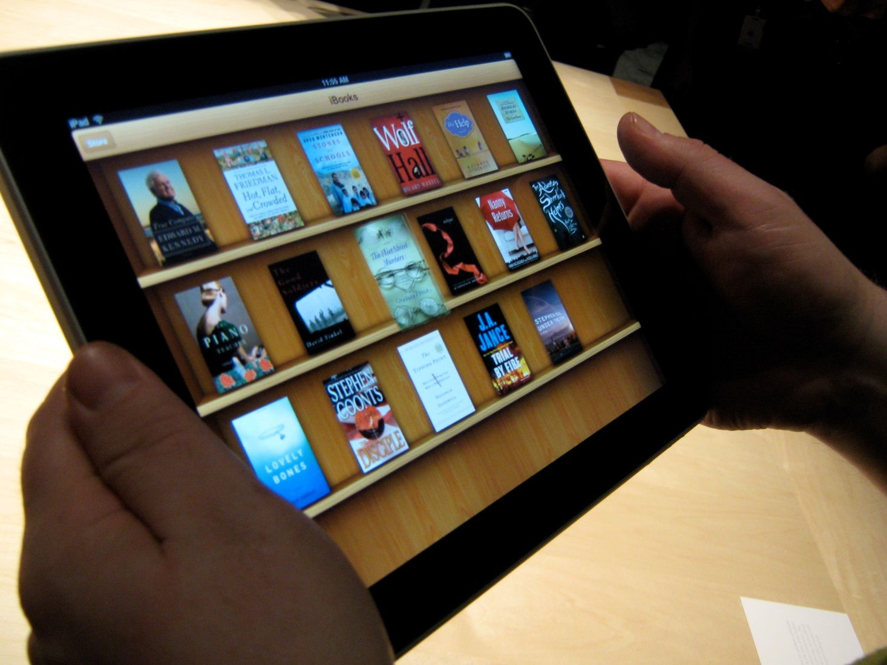
Ebooks in Academic Libraries
http://www.giraffedays.com/?attachment_id=10262
Notes:
Since UNL’s experiment in 2003, ebooks have emerged, ideally making the concept of patron selection easier than ever.

Slide 6
Terminology
Patron-driven acquisition
Patron-initiated acquisition
Demand-driven acquisition
User-driven acquisition
PDA
PIA
DDA
UDA
Notes:
Before we go any further though, I want to clear up some terminology. It’s practically in our DNA as humans to love acronyms, and librarians embrace that concept whole-heartedly.
All of these acronyms are used interchangeably…

Slide 7
Terminology
Patron-driven acquisition
PDA
Notes:
… but today I’ll be using the acronym PDA.

Slide 8


Miami University Libraries PDA
September 2010 - current
14,000+ records loaded to date
$25,000 initial investment
$75,000 total invested to date
1253 titles purchased (as of June 1, 2013)
http://bibweb.hh.se/blog-en/2011/12/07/download-entire-ebrary-e-books/
http://usain.org/conferences/2003conf/sponsors.html
Notes:
Miami University Libraries began a pilot with YBP and ebrary in September 2010. The pilot was limited to an initial investment of $25,000 and was not advertised in anyway so as to prevent abuse.
Library administrators determined it successful enough that it was continued, adding $50,000 more to date and more than 14,000 records in 3 years. In that nearly-3-year timespan, we’ve purchased over twelve hundred titles.

Slide 9

ebrary Triggers
10+ minutes viewing*
10+ pages viewed*
Print request
Copy any text
Download any portion
* excluding TOC & Index
http://library.austintexas.gov/blog-entry/ebooks
Notes:
If any of the following occur, the title is purchased.

Slide 10

Miami University
Public University in Ohio
15,000 Undergraduates
  1,000 Psychology undergraduates
2,500 Graduates
  80 Psychology graduate students
42 Psychology faculty
http://miamioh.edu/_files/images/display/footer/oxCampus.png
Notes:
Before I get too far into the presentation, I’d like to give you some basic details about Miami and its libraries.
As the primary focus of this presentation is on the psychology collection, I’ve noted the breakdown of the students and faculty that are supported.

Slide 11

Miami University Libraries
OhioLINK member
4 libraries on Main Campus
  Humanities / Social Sciences library
  Science library
  2 smaller libraries embedded in departments
http://instagram.com/p/dfgkcEKlWt/
Notes:
Miami is also a founding member of OhioLINK, a state consortium of academic libraries. It’s through OhioLINK that, until 2010, a bulk of our ebook content was obtained, sharable to all members.
The ebrary PDA pilot was Miami’s first step toward actively purchasing ebook content that couldn’t be shared statewide.
4 libraries on campus…

Slide 12
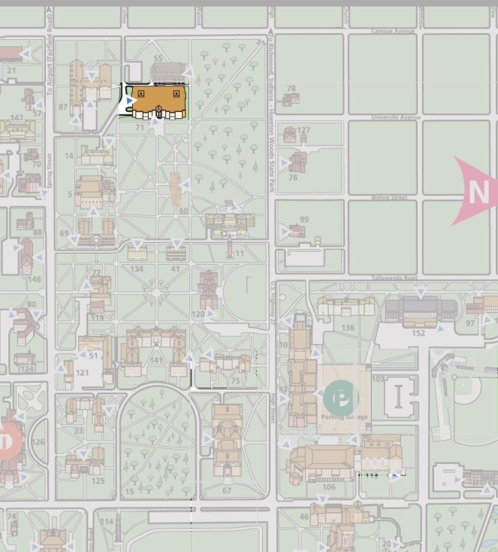
Psychology within the Libraries
Humanities / Social Sciences library
Notes:
Majority of the collection – and me – was/were based in H/SS library…

Slide 13
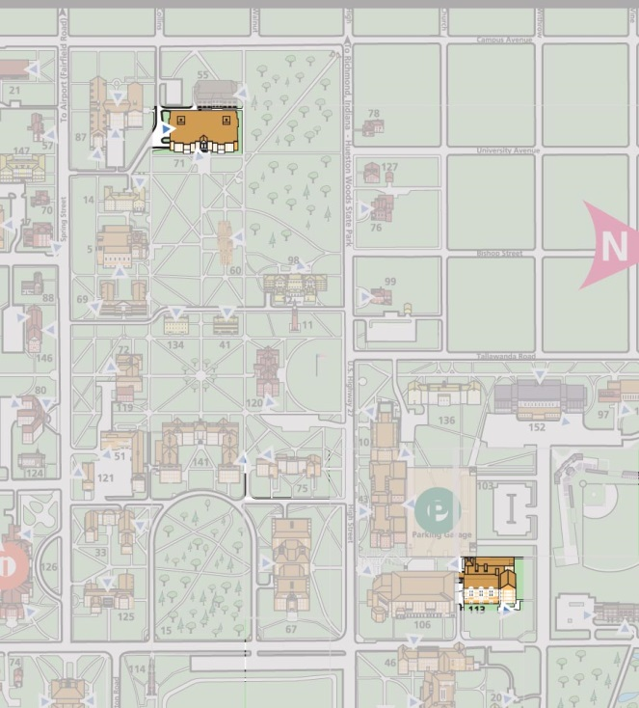
Psychology within the Libraries
Humanities / Social Sciences library
Psychology Building
Notes:
… quite a distance from PSY building

Slide 14
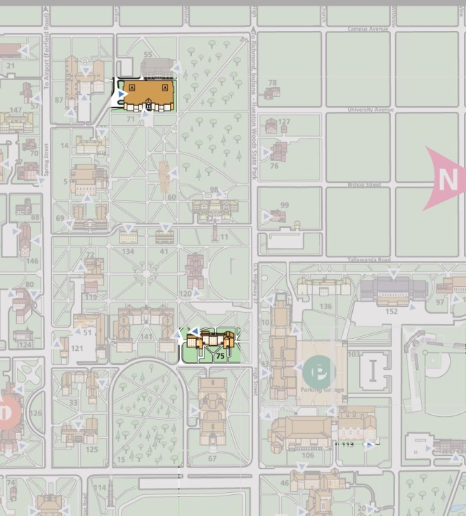
Psychology within the Libraries
Psychology (& Business) merges…
Notes:
In 2007 a plan was proposed to move the Business & Psychology collections, then housed in the H/SS library…

Slide 15
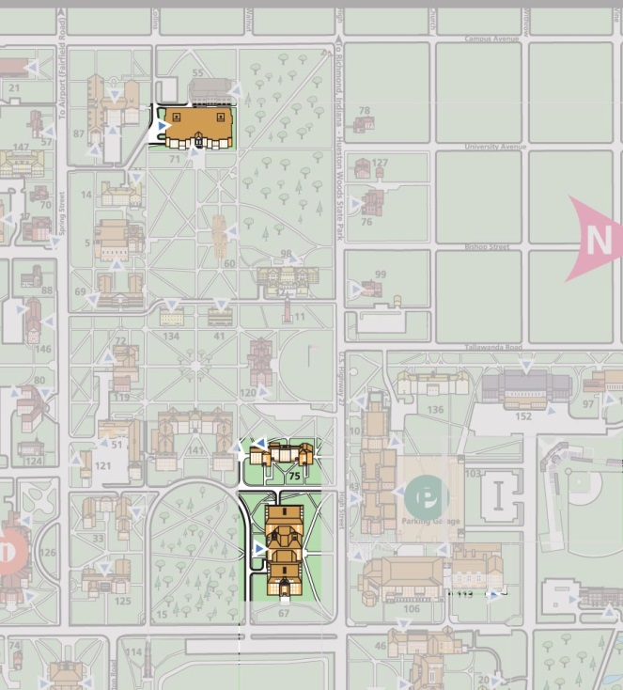
Psychology within the Libraries
Psychology (& Business) merges…
… with Science collections in smaller facility
Notes:
in with the Science collections, to the other end of campus, closer to their departments.
The renovation commenced in 2011, and that summer the move was completed…

Slide 16
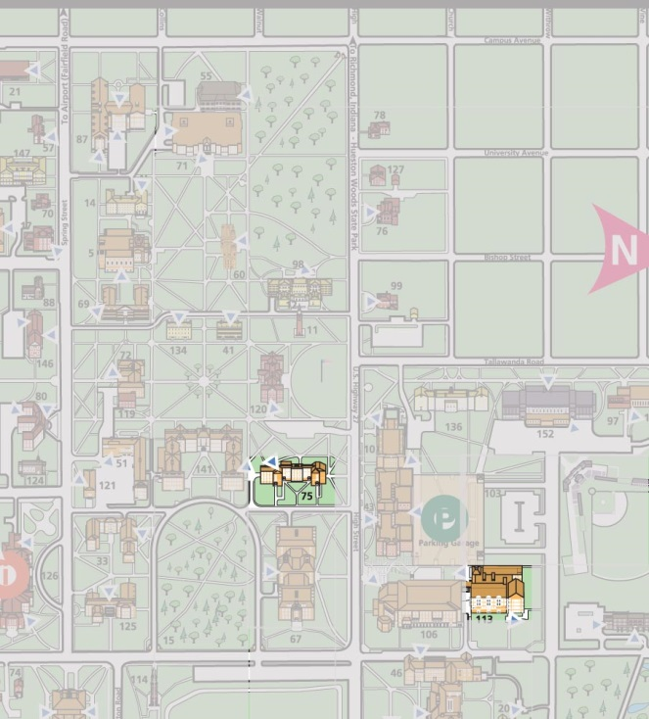
Psychology within the Libraries
Proximity to Department
Notes:
Proximity

Slide 17
Shrinkage
Notes:
This move meant drastic downsizing for all disciplines involved. Prior to moving into the new space, the Psychology collection was reduced by nearly 20%, being either sent to off-site storage or withdrawn from the collection. Because of its’ high circulation activity, weeding parameters were more rigorous than other disciplines, often setting a non-circulation parameter of 7 years vs. other disciplines’ 10 years.
Currently, our shelves are over 80% capacity and we strictly implement a zero-growth policy.

Slide 18

Ebook-purchasing Motivation
Retain quantity / diversity of resources
Accessibility
Remote / distance learners
Prevents “permanent” borrowing
http://olimex.wordpress.com/2013/10/14/nice-github-collection-of-free-online-e-books/
Notes:
This purge was a challenge *because* items that seemed to be of interest to users had to be relocated.
# & range of resources
Accessibility - when library is closed, for sight-impaired (screen-readers)
MU exploring distance learning options – forward-thinking
Prevents permanent borrowing

Slide 19
Selector-purchased breakdown
Notes:
Over 3 years Ebooks purchased by selector with discretionary funds have increased from 35% to nearly 50%.
Due to more titles being accessible…
Cost / usage analysis will only evaluate content purchased during FY10-11 and FY11-12 but will look at usage through May 2013.
Assumption that titles purchased FY12-13 didn’t have adequate time to circulate.

Slide 20

Limitations
PDA purchase = guaranteed use ; Selector-purchased ≠ guaranteed use
PDA “psychology” titles
User sessions vs. internal uses, checkouts, & renewals
Data collection time frames
http://www.thedi.ca/apples-and-oranges/
Notes:
PSY = cross-disciplinary ; ebrary categories, but some general social sciences – author judgment
… also, total PSY titles available via PDA over 3 years hard to determine as title list changes frequently.
Circ potential – checkouts = unavailable for 3 weeks; ebooks = in “use” only while browser window is open

Slide 21
Cost Comparison
 | PDA Ebooks | Selector-Purchased Ebooks | Selector-Purchased Print Books
Purchased | Sept 2010 – May 2013 | FY10 - FY12 | FY10 - FY12
Total # Purchased | 98 | 134 | 215
Cost | $8,997.06 | $10,134.19 | $16,611.86
Avg Cost Per Title | $91.81 | $75.63 | $77.26
Notes:
7.8% of total PDA titles purchased ; 8.1% of total PDA cost

Slide 22
Cost Comparison
 | PDA Ebooks | Selector-Purchased Ebooks | Selector-Purchased Print Books
Purchased | Sept 2010 – May 2013 | FY10 - FY12 | FY10 - FY12
Total # Purchased | 98 | 134 | 215
Cost | $8,997.06 | $10,134.19 | $16,611.86
Avg Cost Per Title | $91.81 | $75.63 | $77.26
Notes:
Print books are often purchased at a discount.
Selector-purchased ebooks are not. In fact, there’s a $2/ebook fee for MARC record.
Striking how similar these price points are – for better or worse.

Slide 23
Cost Comparison
 | PDA Ebooks | Selector-Purchased Ebooks | Selector-Purchased Print Books
Purchased | Sept 2010 – May 2013 | FY10 - FY12 | FY10 - FY12
Total # Purchased | 98 | 134 | 215
Cost | $8,997.06 | $10,134.19 | $16,611.86
Avg Cost Per Title | $91.81 | $75.63 | $77.26
Notes:
Average cost of PDA is 20% higher

Slide 24
Cost Comparison
PDA ebooks
$17.56
$91.81
$224.95
$79
Selector-purchased ebooks
$13.95
$75.63
$295
$60
Selector-purchased print books
$7.80
$43.96
$77.26
$4292*
Range Average Median
Notes:
PDA: Range = $17.56 - $224.95 ; Avg = $91.81 ; Median = $79.00
Selector ebooks: Range = $13.95 - $295 ; Avg = $75.63 ; Median = $60
Selector print: Range = $7.80 - $4292 ; Avg = $77.26 ; Median = $43.96
… a couple high $ items skew avg
Median print is much less than e- counterparts.
Print discounts are most apparent

Slide 25
Usage Comparison
 | PDA Ebooks |  | Selector-Purchased Ebooks |  | Selector-Purchased Print Books
Purchased | Sept 2010 – May 2013 |  | FY10 - FY12 |  | FY10 - FY12
Total # Purchased | 98 |  | 134 |  | 215
0 Uses | - |  | 78 | 58.2% | 92 | 42.8%
1 Use | 36 | 36.7% | 3 | 2.2% | 40 | 18.6%
2 Uses | 16 | 16.3% | 4 | 3.0% | 26 | 12.1%
3+ Uses | 46 | 46.9% | 49 | 36.6% | 57 | 26.5%
Notes:
As noted, PDA has an advantage in that it automatically clocks in with one use.
Ebrary potentials catalog changes periodically due to publisher negotiations so it’s not clear how many potential “psychology” titles have been loaded
Usage statistics for selector-purchased range from initial availability (i.e. shelf-ready or accessible via ebrary platform) through May 2013.
Note median usage???

Slide 26
Usage Comparison
 | PDA Ebooks |  | Selector-Purchased Ebooks |  | Selector-Purchased Print Books
Purchased | Sept 2010 – May 2013 |  | FY10 - FY12 |  | FY10 - FY12
Total # Purchased | 98 |  | 134 |  | 215
0 Uses | - |  | 78 | 58.2% | 92 | 42.8%
1 Use | 36 | 36.7% | 3 | 2.2% | 40 | 18.6%
2 Uses | 16 | 16.3% | 4 | 3.0% | 26 | 12.1%
3+ Uses | 46 | 46.9% | 49 | 36.6% | 57 | 26.5%
Notes:
Note the high number of purchased titles NOT used within the first year to two years of purchase.
Worth noting, *at least* the 78 unused selector-purchased ebooks are not taking up shelf space. :-/

Slide 27
Usage Comparison
 | PDA Ebooks |  | Selector-Purchased Ebooks |  | Selector-Purchased Print Books
Purchased | Sept 2010 – May 2013 |  | FY10 - FY12 |  | FY10 - FY12
Total # Purchased | 98 |  | 134 |  | 215
0 Uses | - |  | 78 | 58.2% | 92 | 42.8%
1 Use | 36 | 36.7% | 3 | 2.2% | 40 | 18.6%
2 Uses | 16 | 16.3% | 4 | 3.0% | 26 | 12.1%
3+ Uses | 46 | 46.9% | 49 | 36.6% | 57 | 26.5%
Notes:
Also worth noting that over 1/3 of the PDA titles only had the initial trigger use.

Slide 28
Usage Comparison
 | PDA Ebooks |  | Selector-Purchased Ebooks |  | Selector-Purchased Print Books
Purchased | Sept 2010 – May 2013 |  | FY10 - FY12 |  | FY10 - FY12
Total # Purchased | 98 |  | 134 |  | 215
0 Uses | - |  | 78 | 58.2% | 92 | 42.8%
1 Use | 36 | 36.7% | 3 | 2.2% | 40 | 18.6%
2 Uses | 16 | 16.3% | 4 | 3.0% | 26 | 12.1%
3+ Uses | 46 | 46.9% | 49 | 36.6% | 57 | 26.5%
Notes:
BUT nearly ½ of user-selected titles got 3 or more uses.
Over 1/3 of the selector-purchased ebooks had 3+ uses, more than the ¼ selector-purchased print books.
This is a positive indicator for e-format in general.
Also speaks to PDA – though costs more, used more…

Slide 29
Usage Comparison – Item level
 | PDA Ebooks | Selector-Purchased Ebooks | Selector-Purchased Print Books
Range | 1 – 41 | 0 – 1885 | 0 – 87
Average | 4.4 | 40.7 | 2.3
Median | 2 | 0 | 2
Notes:
Selector-purchased print anomaly = textbook on reserve

Slide 30
Usage Comparison – Item Level
 | PDA Ebooks | Selector-Purchased Ebooks | Selector-Purchased Print Books
Range | 1 – 41 | 0 – 1885 | 0 – 87
Average | 4.4 | 40.7 | 2.3
Median | 2 | 0 | 2
Notes:
Selector-purchased print anomaly = textbook on reserve

Slide 31
Cost per Use Comparison
 | PDA Ebooks | Selector-Purchased Ebooks | Selector-Purchased Print Books
Purchased | Sept 2010 – May 2013 | FY10 - FY12 | FY10 - FY12
Total # Purchased | 98 | 134 | 215
Cost | $8,997.06 | $10,134.19 | $16,611.86
Total Sessions/Uses | 429 | 5454 | 494
Avg. Cost Per Use | $20.97 | $1.86 | $33.63

Slide 32
Cost per Use Comparison
 | PDA Ebooks | Selector-Purchased Ebooks | Selector-Purchased Print Books
Purchased | Sept 2010 – May 2013 | FY10 - FY12 | FY10 - FY12
Total # Purchased | 98 | 134 | 215
Cost | $8,997.06 | $10,134.19 | $16,611.86
Total Sessions/Uses | 429 | 5454 | 494
Avg. Cost Per Use | $20.97 | $1.86 | $33.63
Notes:
What stood out to me!
Top 3 circulated items (or top 2%) = 1885, 1230, & 771 uses

Slide 33
Cost per Use Comparison
 | PDA Ebooks | Selector-Purchased Ebooks | Selector-Purchased Print Books
Purchased | Sept 2010 – May 2013 | FY10 - FY12 | FY10 - FY12
Total # Purchased | 98 | 134 | 215
Cost | $8,997.06 | $9,939.19 | $16,611.86
Total Sessions/Uses | 429 | 1568 | 494
Avg. Cost Per Use | $20.97 | $6.34 | $33.63
Notes:
But even adjusting for those 3 high-circulating items, the average cost per use is still <1/3 of the PDA ebooks.
As it turns out, 13 selector-purchased ebooks – or 10% - accounted for almost 90% of the uses… holding somewhat true to our rule which is still a problem.
But these numbers say to me that there’s still value in “expert” selecting.

Slide 34

Conclusions / Recommendations
Trust your users to know what is useful
… and not go on a spending spree
Ebooks of growing interest and value
Viable alternative as space becomes more of an issue
Model isn’t wasting money… at least not more than traditional model
Transferrable to other disciplines?
http://jatakacs.edublogs.org/2011/02/17/test-tutor-draw-conclusions/
Notes:
As with other studies, users do pretty well at selecting titles others are interested in. By setting some basic parameters, they select items that get used at a higher rate than those “experts” choose.
Users were conservative as far as # of items. The average cost could be explained that we’re just offering them $$ items.
At least in psychology – higher usage
--
PSY – walking that line. Perhaps results aren’t specific to PSY…

Slide 35
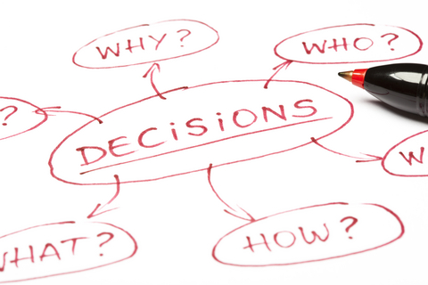
Challenges / To consider
Shareability
Ebook platforms not always device-agnostic
Device / Network required
< Monograph publications? P&T impact?
Digital preservation
http://www.kinecteducation.com/blog/2011/11/27/7-questions-to-consider-for-evaluating-gaming-in-education/
Notes:
Lack of shareability goes against 1 of the primary tenants of libraries – consortial agreements? Push licensing
Something we need to push as well
Greater reliance on high $ items to access information ; reliance on power
Smaller publishers (university presses?) go out of business?
Conscious & active in planning for the long term

Slide 36
Questions?
Thank You!
Slides: goo.gl/b_c13PDA
Contact me
@muELIbrarian
Eli.Sullivan@MiamiOH.edu

