Slide 1
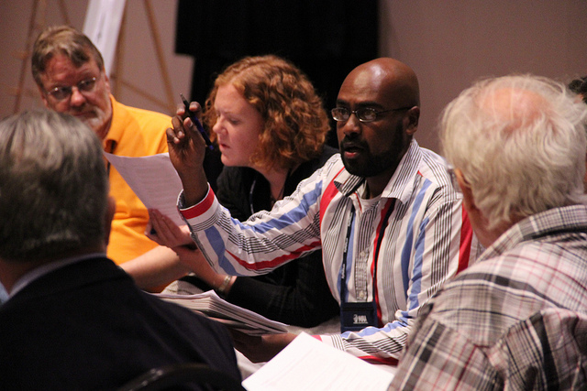

STRIKING UP A CONVERSATION,
STRIKING UP A VICTORY:
Engaging Faculty in Scholarly Communication
Jennifer Bazeley & Jen Waller, Miami University Libraries

Slide 2
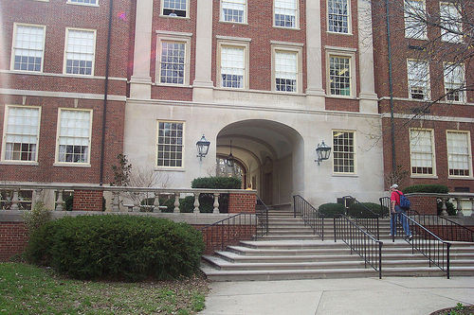
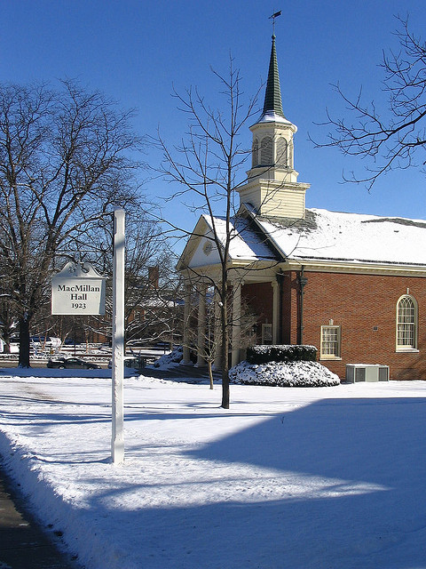
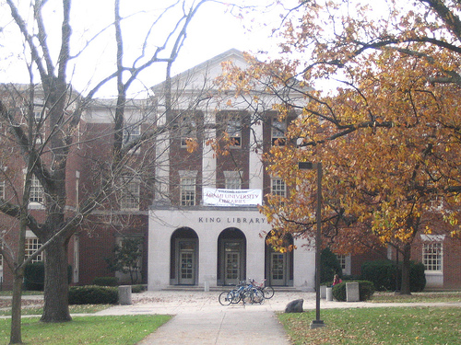
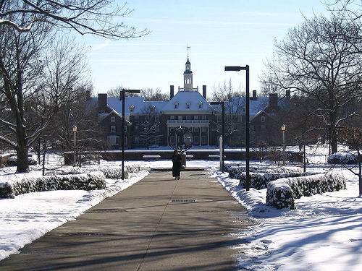
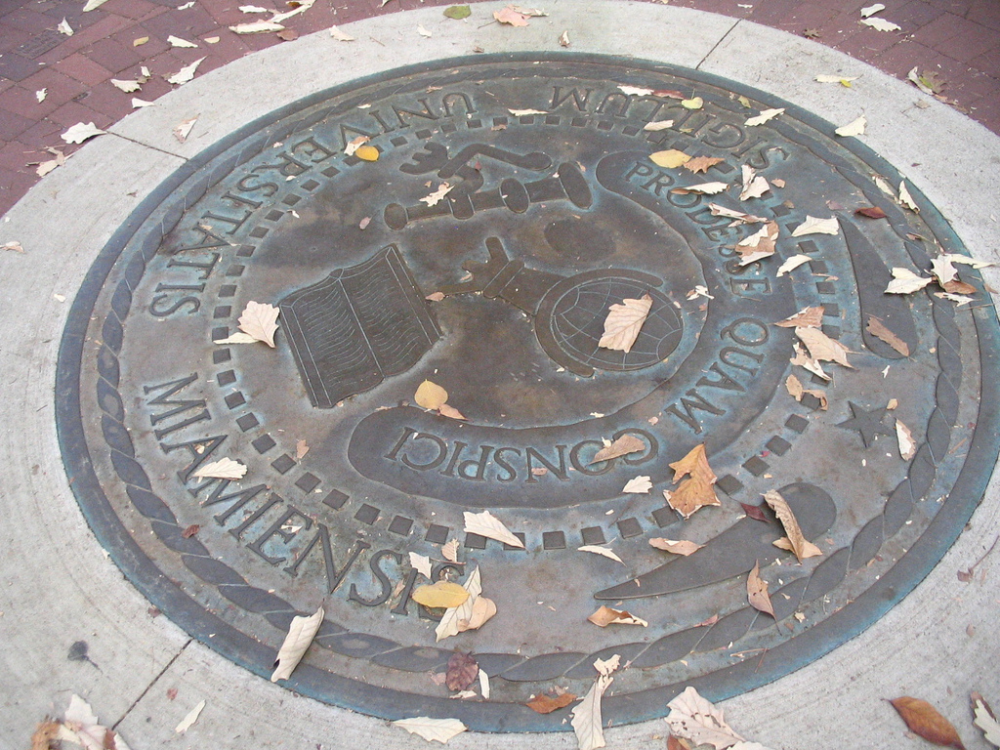
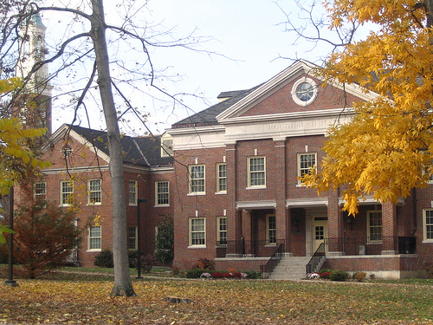
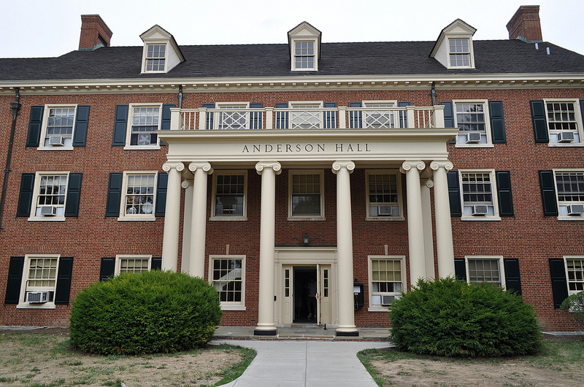
The Context:
Notes:
JENNIFER
Introduction – About MU
Established 1809
Public university with main campus in Oxford, OH and 3 smaller regional campuses in Hamilton, Middletown, and West Chester.
In 2012 the university had a total undergraduate FTE of 21,000 students and total grad enrollment of 3,700 students.
Focuses primarily on undergrad liberal education offering bachelor’s degrees in over 100 areas, master’s degrees in more than 50 areas, and several doctoral degrees.
Faculty positions are primarily tenure-track but adjunct and clinical/lecturer positions have been rising in number in recent years.

Slide 3
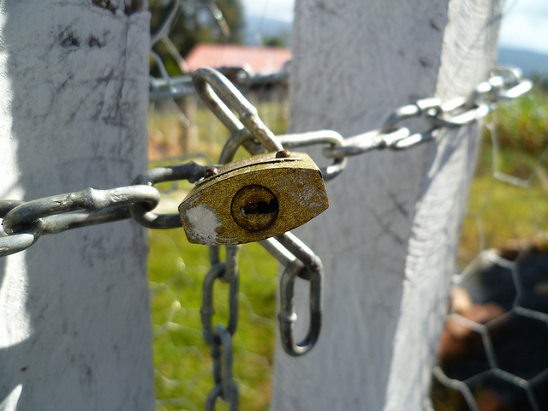

The Challenge:
Notes:
JENNIFER
The Challenge
While MU has a large and active body of faculty performing research and publishing, the university community is conservative and has been slow to recognize changes in scholarly communication.
Our goal was to increase conversation about open access on campus and to eventually create an open access policy for the entire campus.

Slide 4
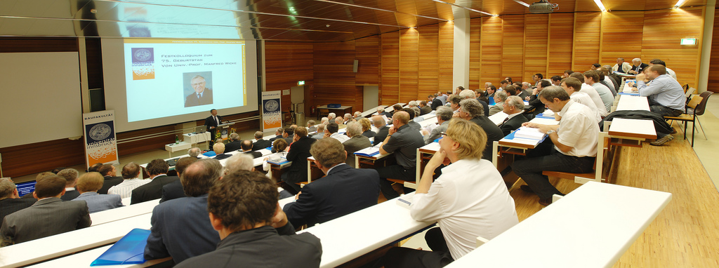
Previous Efforts
Presentations to:
  History Department
  Psychology Department
  College of Arts & Sciences Department Chairs
Notes:
JENNIFER
Previous Efforts
library formed a Scholarly Communication working group in 2009 both to support the formation and maintenance of the library’s institutional repository (called the Scholarly Commons) as well as to educate librarians, faculty, and the university community at large on current issues in scholarly communication.
members of the working group initially prepared presentations on open access, scholarly communication, and journal costs to present to individual departments around campus.
faculty were clearly interested in the issues at hand, but presentations had the unfortunate effect of generating hostility about subscription costs and open access rather than starting a dialogue amongst concerned parties.
open access resolution drafted and presented to the Council of Academic Deans (COAD) in 2010 but was not widely accepted and ultimately not implemented.
working group created a LibGuide for open access and copyright, but it was not widely utilized by faculty or students.
Some of the group’s most successful efforts were in offering copyright seminars for faculty, increasing faculty participation in the institutional repository, and establishing a stronger scholarly communication presence on campus through social media and the celebration of Open Access week on campus.
these successes helped to overcome some faculty skepticism, but group struggled with a way to educate researchers on campus in a focused and deliberate manner.
At end of 2011, group discussed idea of using a Faculty Learning Community (FLC) to educate a finite group of university community members on issues in scholarly communication.
The FLC was an appealing idea for several reasons.
university community has high participation rate in FLCs both because they are important additions to tenure-seeking faculty resumes and because FLC offers each participating member a professional development stipend to be used on educational materials.
scholarly communication issues affect so many portions of research lifecycle—an FLC could accommodate multiple stakeholders in process
With support from library administration, three librarians volunteered as potential co-facilitators for the FLC, and moved forward in preparing a description and proposal for an FLC on scholarly communication for the 2012/2013 school year.

Slide 5
What is an FLC?
“A faculty learning community is a group of trans-disciplinary faculty, graduate students and professional staff group of size 6-15 or more (8 to 12 is the recommended size) engaging in an active, collaborative, yearlong program with a curriculum about enhancing teaching and learning and with frequent seminars and activities that provide learning, development, transdisciplinarity, the scholarship of teaching and learning, and community building.”
http://www.units.miamioh.edu/flc/whatis.php
Notes:
JENNIFER
What is an FLC?
Center for the Enhancement of Learning, Teaching, and University Assessment (CELTUA)
FLCs are sponsored by Miami University's Center for Learning, Teaching, and University Assessment.
CELTUA is a community that serves a number of purposes within Miami University, including supporting both long-term and short-term Faculty Learning Communities (FLCs) and workshops/seminars.
also offer grants and awards to support innovative teaching and help the university’s programs to assess their effectiveness as educators.
CELTUA organizes and hosts annual Lilly Conference on College Teaching and also publishes several journals on teaching and learning
FLCs in General
A faculty learning community (FLC) is a group of trans-disciplinary faculty, graduate students and professional staff group of size 6-15 or more (8 to 12 is the recommended size) engaging in an active, collaborative, yearlong program with a curriculum about enhancing teaching and learning and with frequent seminars and activities that provide learning, development, transdisciplinarity, the scholarship of teaching and learning, and community building.
purpose of the FLC is to provide a structured environment for members to meet together and explore some of the teaching and professional development issues they encounter as faculty, staff, or as graduate students
an FLC may select a focus course or project to try out innovations, assess resulting student learning, and prepare a course or project mini-portfolio to show the results; engage in triweekly seminars and some retreats; work with student associates; and present project results to the campus and at national conferences.
Miami University has been running FLCs since the 1970s.
Prior to the FLC for Scholarly Communication, an FLC on Information Literacy existed from 2004 until 2012, helping more than 110 faculty, librarians, and staff members work together to enhance information literacy on campus. Each year a new group identified student struggles with information literacy, discussed them with students, and together devised methods to address those struggles.
In 2012, the facilitator retired from Information Literacy FLC after eight successful years.

Slide 6
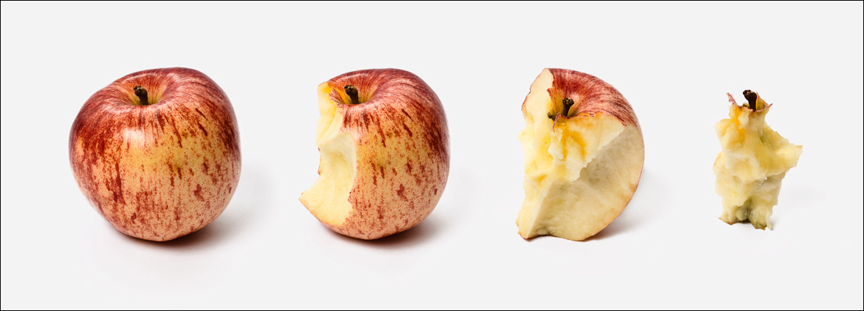
The Process: Timeline
Notes:
JENNIFER
Process of creating an FLC - Preparation, Set-Up
2012/2013 Timeline
January 2012: began prepping description and proposal for 2012 FLC
February 24, 2012: FLC proposal accepted by CELTUA
March 1, 2012: call for applications sent out
April 16, 2012: deadline for application submission (16 applications total)
May 1, 2012: decisions on applicants made and invitations sent out (12 total members and 3 co-facilitators)
September 11, 2012: first FLC meeting (2012)
The Scholarly Communication FLC
original description and proposed activities 2012/2013
Description: This Faculty Learning Community will focus on the process of communication itself: how scholars find information, create knowledge, and communicate among themselves, with students, and beyond the academy with other audiences. Members will participate in a public event sharing the results of the FLC with the Miami Community.
Amount: Each participant has available up to $500 to support his or her efforts, for example, purchase of hardware or software, travel to conferences, etc
Eligibility: Full-time and part-time faculty, administrative staff, graduate assistants, librarians
Selection: The FLC's facilitator will choose the FLC members based on answers on the application form.
Submission: Please send an electronic copy of your application to CELTUA and one original application with your signature page via campus mail to CELTUA.
Due Date: Applications due April 16, 2012.
Purpose and Description - The term "scholarly communication" is frequently used as shorthand for peer-reviewed publishing, traditionally the primary way a discipline advances. In this learning community, the focus of attention is on the process of communication itself: how scholars find information, create knowledge, and communicate among themselves, with students, and beyond the academy with other audiences. New digital capabilities (including electronic publishing, social media, institutional repositories, and copyright legislation) are profoundly impacting traditional scholarly communication. This shifting landscape affects researchers, instructors, students, publishers, scholars, and librarians dramatically. While some characterize the situation as a crisis, we would prefer to address these changes thoughtfully and in a reflective, measured fashion. Using Peter Suber's foundational readings as a starting point, we plan to explore the intersection of the Internet, scholarly communication, research, teaching, learning, and the sharing of knowledge.

Slide 7
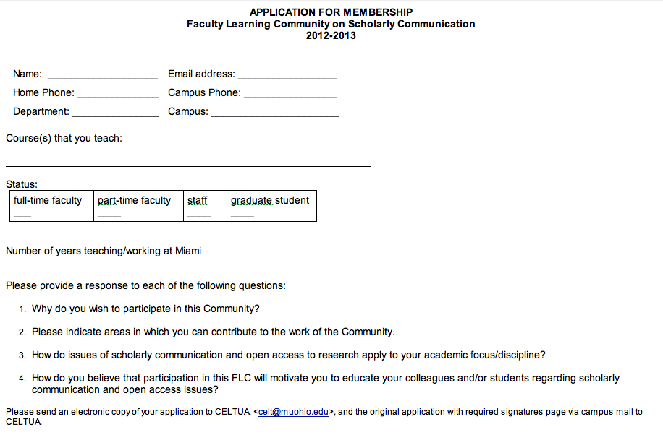
The Process: Applications
Notes:
JENNIFER
See slide

Slide 8

The Process: Member Selection
Notes:
JENNIFER
Choosing Members
scholarly communication FLC received 16 applications from faculty (both full and part time, as well as faculty from both the main and regional campuses), administrative staff (primarily from Information Technology), and graduate students.
Co-facilitators chose members based on answers to the application questions, their research interests, and their university status (faculty, administrative staff, grad student)
co-facilitators looking for applicants who demonstrated genuine interest in objectives of the FLC in relation to their role in the university community.
Thoughtful answers to questions on application were ranked highly as it was felt that this would lead to the most committed FLC members.
also important to have an equitable distribution across subject areas, since scholarly communication issues are significantly different for STEM researchers than they are for humanities scholars.
also an interest in having a mix of members from the university community--the hope was to have faculty, staff, and graduate student perspectives in our final membership.
co-facilitators selected 12 applicants for membership in the FLC, including 8 tenured or tenure-track faculty, 2 administrative staff (both from Information Technology), and 2 graduate students.
Research disciplines among the faculty and graduate students included psychology, women’s studies, music, art/architecture, sociology, ecology, and zoology.

Slide 9
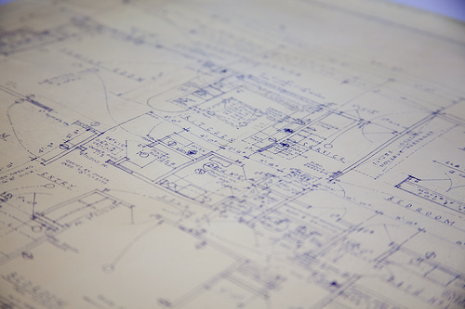
Initial Objectives
Notes:
JENNIFER
Original objectives/goals of 2012/2013 FLC
Activities - Planned activities included
Seminar style meetings five to six times per semester for approximately 1.5 hours
Panel presentation during Open Access Week (October)
Conferences: FLC members to attend and potentially present at Lilly Conference in Oxford (November) and two to three members to attend and potentially present at the Scholarly Publishing and Academic Resources Coalition (SPARC) Open Access Meeting (March).
CELTUA seminar: FLC members to plan and present a CELTUA workshop on a scholarly communication topic of interest to the Miami community.

Slide 10

The Nuts & Bolts
Notes:
JEN:
nitty gritty, day to day details of how we planned and ran the FLC
Acknowledge Eric Resnis
ran the most successful, longest running FLC on campus
phasing out the information literacy FLC
agreed to act as our administrator/mentor

Slide 11
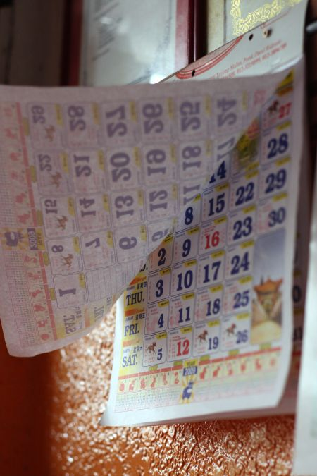
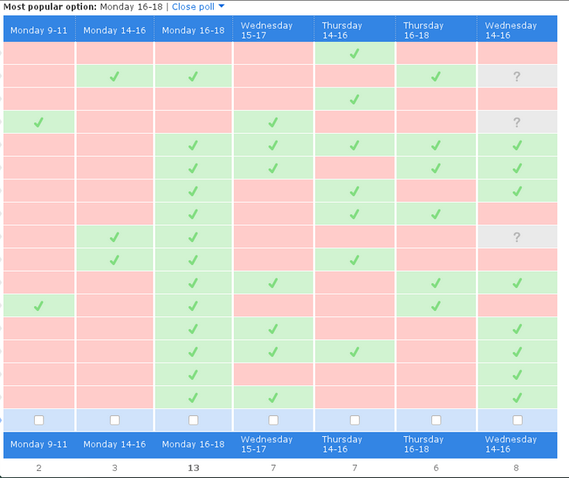
Scheduling
Notes:
JEN:
figure out schedule first
CELTUA suggests 5-6 meetings per semester, each lasting 1-1.5 hours.
challenge getting 14 people scheduled to meet at same time
looked at the course list and time blocks for each of the participants narrows down options
Doodle poll

Slide 12

Meetings
Notes:
JEN:
Meetings took place in the library
rooms w/moveable furniture allowed flexibility
forming groups
setting up for a discussion
viewing a web seminar or panel discussion
Rooms were wired w/monitors and screens for projecting and viewing and with electronic whiteboards.
Center for Digital Scholarship opened in the Spring
meetings moved there
good way to promote Center

Slide 13
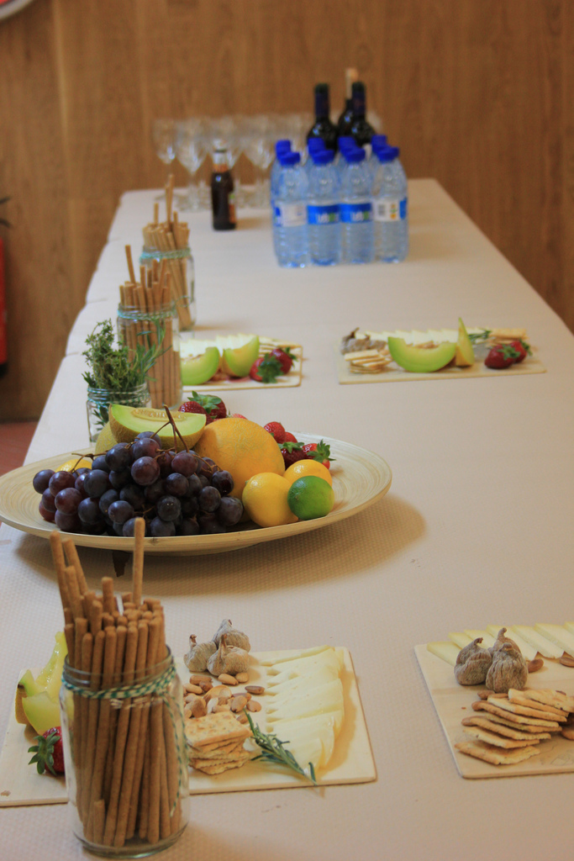
Meetings
Notes:
JEN:
food at every meeting - small food budget
important when meetings took place during lunch
mid-morning meeings in Spring - snacks were lighter
Food options - university catering expensive.
co-facilitators took turns picking up food Starbucks, Panera, food co-op, Kroger
Eric’s did the bulk of the work.

Slide 14
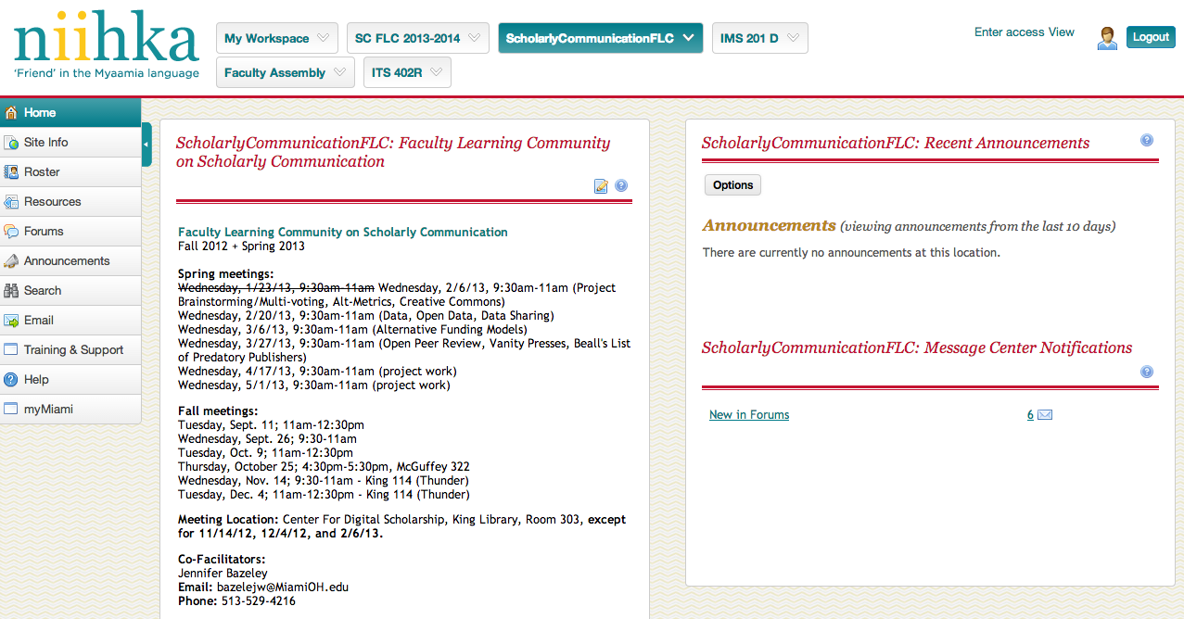
Meeting and Content Organization
Notes:
JEN:
CMS is instance of Sakai, branded Niihka.
Added participants to a site we created
organize meetings, make announcements, post readings, create forums. Email tool
Can add others w/peripheral interest in FLC
kept the content organized in one place.

Slide 15
Meeting Topics
Open Access
Open Data, Data Sharing (panel discussion)
Open Peer Review
Predatory Publishers, Vanity Presses
Alternative Funding Models (Kickstarter)
Altmetrics
Author Rights
Creative Commons
Copyright
Misconceptions about Open Access
Open Access Week special programming
Notes:
JEN:
general sense of the topics to cover
meet two weeks prior to each meeting
posted readings one week prior to give participants ample time
send an email when the readings were posted

Slide 16
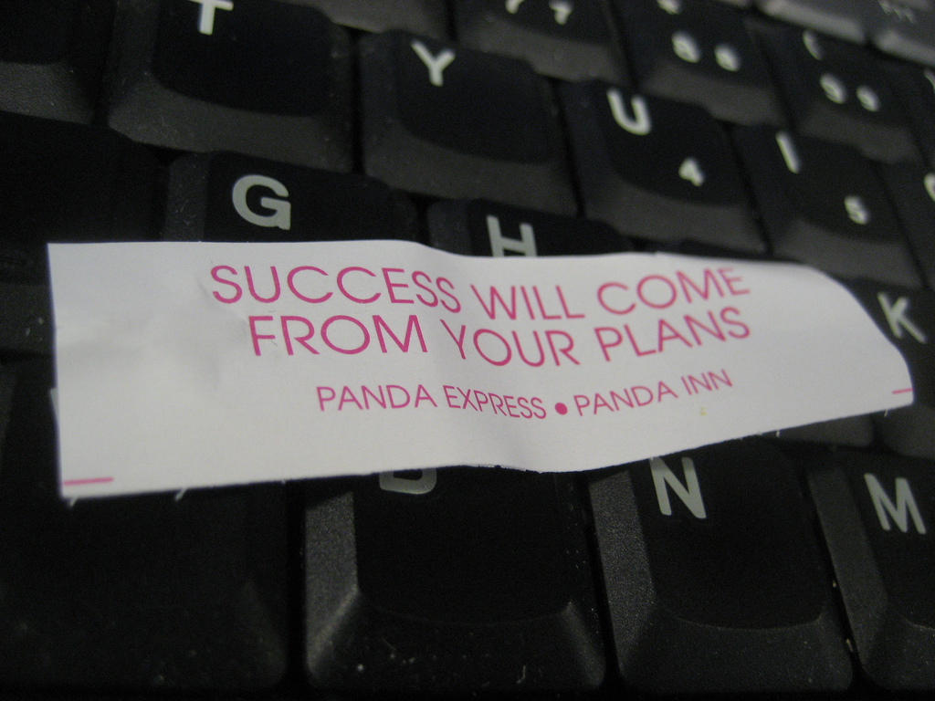
Most Successful Topics
Notes:
JEN:
always had participation and discussion
some meetings stood out more than others

Slide 17
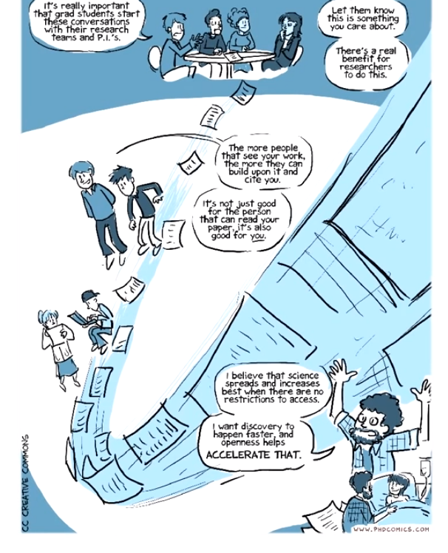
Successful
Topics:
PhD Comics Video
“Open Access Explained”
http://youtu.be/L5rVH1KGBCY
Notes:
JEN
Nick Shockey, Jonathan Eisen, and PhD Comics
“Open Access Explained,” a 10-minute video on YouTube.
released for Open Access Week 2012
Combination of anecdotal style and narrated by a scientist made it understandable AND authoritative.
one of the most successful tools at getting members to relate to problems with toll journals and the traditional system. Members suggested that we show it earlier. in the year.
Caveat: doesn’t spend time on institutional repositories.

Slide 18
Publisher Revenue & Profit
Successful Topics: Journal Costs
Year | Total Revenue | Total Profit
2002 | $2,097,511,500.00 | $694,851,300.00
2003 | $2,236,805,700.00 | $756,399,900.00
2004 | $2,207,651,100.00 | $745,062,000.00
2005 | $2,325,889,200.00 | $727,245,300.00
2006 | $2,463,563,700.00 | $753,160,500.00
2007 | $2,440,887,900.00 | $772,596,900.00
2008 | $2,753,490,000.00 | $919,989,600.00
2009 | $3,215,104,500.00 | $1,122,452,100.00
2010 | $3,281,512,200.00 | $1,172,662,800.00
2011 | $3,333,342,600.00 | $1,243,929,600.00
Notes:
JEN:
created a homework assignment – members select three journals in their field and find the institutional subscription price for them.
Jennifer is expert - part of her job. Created a ppt presentation
OhioLINK, “big deals,” actual subscription price for selected journals
revenue and profits for major publishers like Springer, Wiley, Taylor & Francis, etc.
participants were shocked at the prices, but they also found the system very interesting
how do publishers spend these profits – do they roll them back into the system?
call to action
crystallized their understanding of how they provide free labor that they give to publishers who lease it back to us.
transparency is important and faculty really do care about costs.

Slide 19
Successful
Topics:
Author Rights
ACRL copyright transfer exercise:
http://www.scholcomm.acrl.ala.org/node/32
Notes:
JEN:
discussion of copyright in a way that was relevant to faculty
exercise directly from the ACRL Scholarly Communication Roadshow and the ACRL Scholarly Communication Toolkit
Each member brings in a publishing contract that they’ve signed
break into groups
examines contracts for language retaining or giving away rights.
Discuss in small groups and then discuss as a whole
Also provided publishing contracts from three different publishers – JAMA, Wiley, BioMed Central – that vary from very closed to very open
eye opening for participants – most hadn’t ever bothered to read the publication agreements they had signed
good way to introduce institutional repository
One of our members later shared an email exchange she had had with a publisher.

Slide 20


Successful
Topics: Altmetrics
Notes:
JEN:
readings and discussion of altmetrics and alternative ways to get your research out in the world
demo of ImpactStory that we had “pre-loaded” with one of the members’ works.
discussed PlumX
several members got trial account set up on Plum X.
discussion of “what is impact?”
impact their work might have when they share it through “non traditional” channels like Mendeley, blogs, Facebook and Twitter.
good discussion of promotion and tenure and the differences in P&T among the various disciplines.

Slide 21

Successful
Topics:
Open Peer
Review
Notes:
JEN:
Open Peer review topic surprised us
weren’t expecting it to lead to such a thoughtful and thought provoking conversation
first time they had heard of open peer review or had thought critically about the peer review process
was just something they DID or had done to them
generated discussion of how peer review system works for them, which led to a discussion about privilege in the academy.

Slide 22
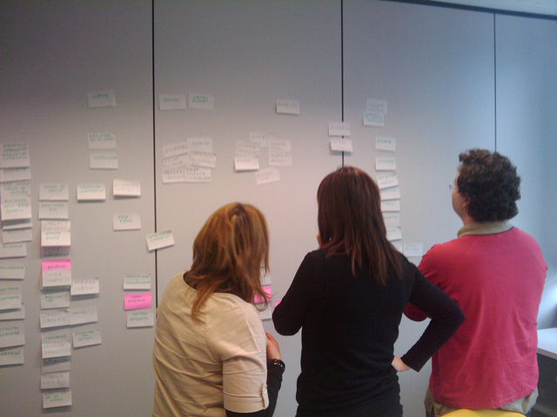
Successful
Topics: Card Sorting
Notes:
JEN:
related to a project
rounds of multi-voting
web site for the entire university – students, faculty, administrators, librarians – that would act as a resource for scholarly communication and open access issues
brainstormed
what they would expect to find on a website like this
where they would look for it
what it would be named
where it would be linked
important to get input from the people who would actually be using the system to see how they would arrange the information
identified topics on index cards + blank index cards in case groups thought of new topics
sorted into an meaningful categories and hierarchies
fun, interactive, and they commented that they had never done it before.

Slide 23

Feedback & Outcomes
Notes:
JENNIFER
Outcomes
Several months into fall semester, co-facilitators realized that accomplishing all goals in single school year would be unrealistic.
The learning curve for group members in the fall was slower than expected.
Of initial FLC goals, seminar style meetings were the most successfully accomplished activity, followed by the presentation by William Gunn during Open Access week.
While some FLC members did attend Lilly Conference, the group did not have enough time to prepare any presentations for the conference that year.
SPARC Open Access Meeting attendance was postponed to 2014, as this conference is held every other year.
CELTUA workshop goal was postponed to fall 2013 semester. Took place on Wednesday of open access week 2013 with 4 panel members and 1 moderator.
FLC decided as a group that final project would be to develop the structure and content for a dynamic website on scholarly communication issues, tailored specifically to faculty and graduate students.
Due to time constraints during school year, co-facilitators decided that creation and implementation of website would occur in winter 2013, following the conclusion of the FLC.
Members of library’s Scholarly Communications working group would be responsible for that implementation.
Feedback (FLC Members)
FLC members provided anecdotal feedback to co-facilitators throughout 2012/2013 school year and submitted written reflections on their experience to the co-facilitators at the last meeting of the group.
CELTUA formally collected feedback through a written evaluation conducted after final FLC meeting in May 2013.
Overall, member responses were enthusiastic and positive. There were several topics that the majority of members identified as crucial:
Learning what open access and scholarly communication mean, and what they encompass.
Learning about copyright and author’s rights for journal articles, and how to negotiate/amend those rights with publishers.
Learning about predatory publishing practices, how to identify them, and how to respond to them.
Learning about publication system outside of the writing, submission, and editorial processes.
Learning about “serials crisis”--the institutional costs of commercial and scholarly publications.
Learning about impact of open access materials for researchers in developing countries.
Several aspects of FLC group experience were specifically identified as notable
Interacting with faculty from across disciplines and learning how scholarly communication issues differ among subject areas.
Discussions created a significant rise in member confidence in discussing scholarly communication issues with colleagues and students.
FLC co-facilitators were organized and used suggestions of the group members to shape the direction of the group. Topics and associated readings were relevant, thoughtfully selected, and discussed in a moderated manner.
There were also several things that members wished the FLC had done better
Better integration of “outside experts” into panels or presentations on scholarly communication issues.
More emphasis throughout both semesters on the final project (as opposed to emphasizing the project in the second semester).
The addition of a discussion about open educational resources
What Co-Facilitators Learned
In many cases, what co-facilitators thought were most interesting topics/readings were not the same as what group members found most interesting (e.g., the PhD Comics video)
Be adaptable with programming--although we selected topics in advance, we had numerous requests from FLC members who wanted to discuss specific things outside of our pre-selected topics. Accommodating requests kept members engaged and made the experience better for all.
Members, especially faculty, really enjoy sharing their own experiences with the topics discussed (communications from predatory publishers, attempts at negotiating author’s rights), and this in turn fosters collegial discussion.
Having grad students in the group forced faculty and co-facilitators to think about publishing and scholarly communication from a different perspective (looking forward at the next generation of researchers/teachers).
Creating awareness through education of faculty can mitigate conflict. Earlier hostility encountered with faculty in regard to discussing open access was not seen in the FLC, in part because we were able to approach them as colleagues and to focus in-depth on the topics.
library needs to do a more thorough job in promoting the university’s institutional repository and disseminating information about scholarly communication issues. This might be accomplished by a better training and awareness program for the university’s librarians who are liaisons with specific departments.

Slide 24
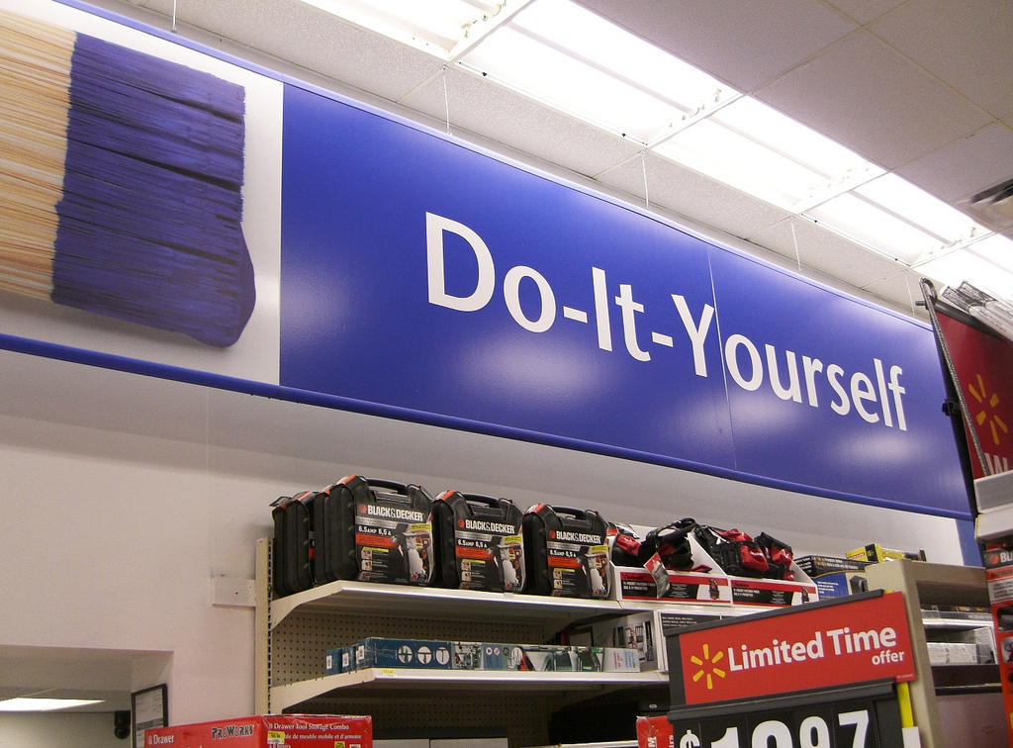
Setting up your own FLC: DIY
Notes:
JEN:
resources and literature about FLCs
a few of the practical considerations.

Slide 25

How To DIY: funding
Notes:
JEN:
CELTUA and the University Libraries shared cost
most used for professional development funds for participants
$250-$500 per person per year. 14 participants @ $500
conference travel or registration, a piece of technology that would enhance their job
$7000 – by far the biggest expense
not necessary to spend $500 a head
funds help attract faculty and let them know that their participation has value.

Slide 26
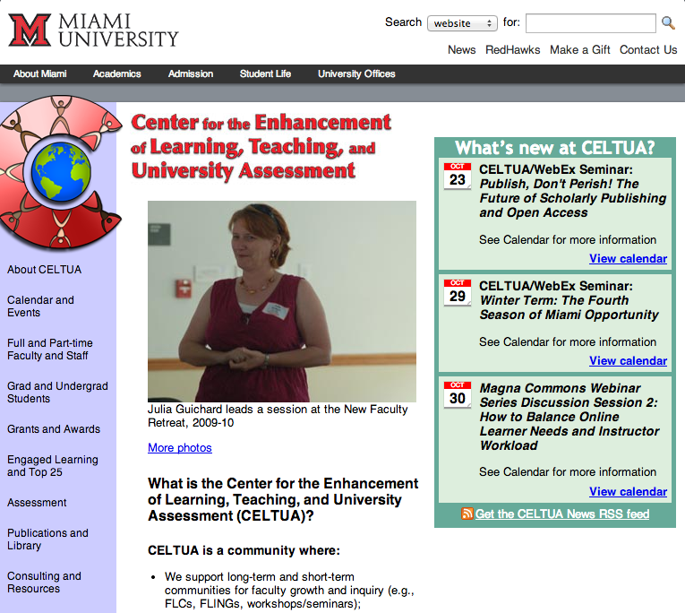
How To DIY: partners
Miami’s CELTUA might be your ...
Center for Teaching & Learning
Center for Advancement of Teaching
Center for Teaching Innovation and Excellence
Faculty Professional Development Center
Notes:
JEN:
Miami has CELTUA and the Libraries for funding
you probably have something similar, although it is likely called something else

Slide 27
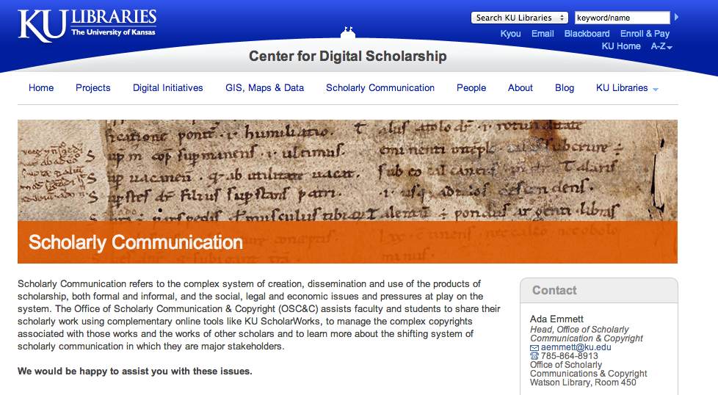
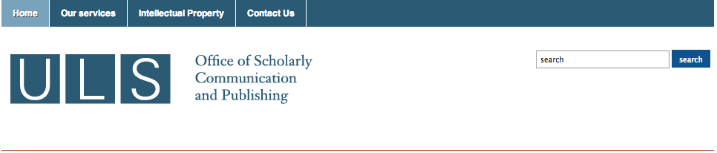
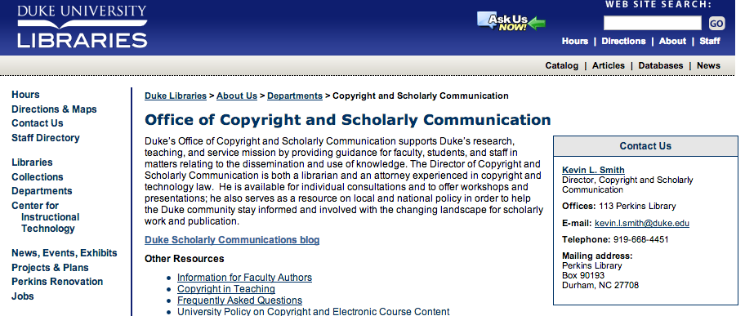

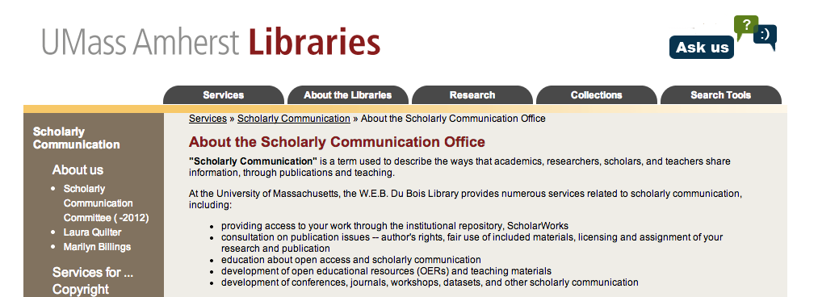
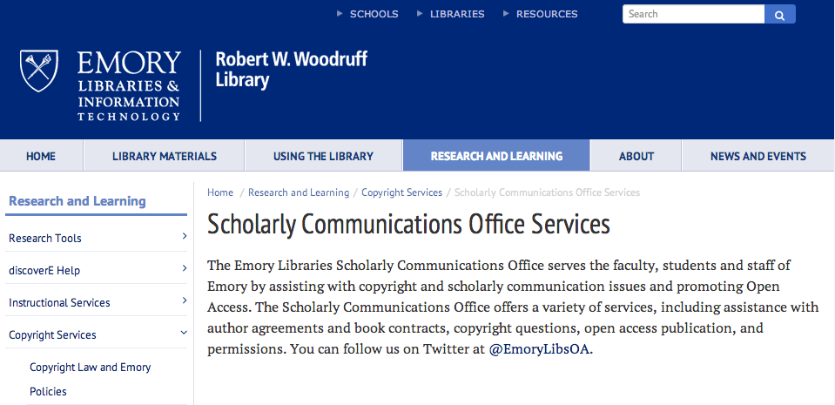
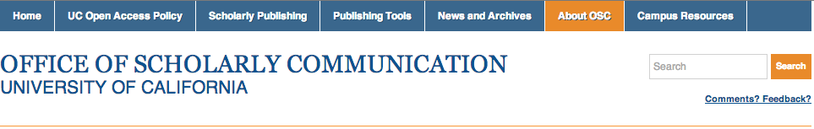
How To DIY: partners
Notes:
JEN:
school’s office for scholarly communication
may be a case of “partnering with yourself” but may have a different budget line
support from
provost’s office
university’s research and grants office
grants themselves.

Slide 28
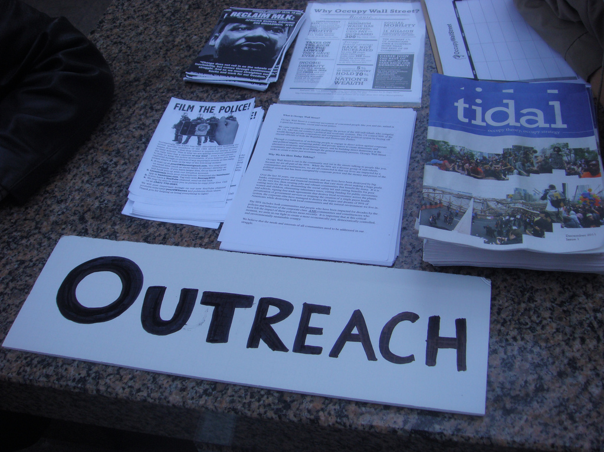
How To DIY: outreach
Notes:
JEN:
advertising, marketing, outreach, and promotion
CELTUA announces on website and through their listserv - well-known structure, w/people who want to participate in any FLC every year
still had to do a fair amount of outreach
developed a “pitch” email that liaison librarians could send to their faculty, & asked the liaisons to help with recruitment.
developed an email list of faculty who had already shown an interest in open access or scholarly communication
questions about copyright or data management plans
people who had already created a profile or uploaded their work to our institutional repository
sent out individual, targeted emails to every single one of these people.
generated a lot of interest

Slide 29

Notes:
JEN:
“most successful way we’ve had to reach our community regarding open access and scholarly communication”
Reaching 14 people may not sound like it’s making an impact,
those 14 people involved w/ faculty meetings, p&t meetings, and who talk to colleagues every single day.
Information spread naturally and organically
has made an impact on our campus.

Slide 30

Thank you! Questions?
Notes:
JEN:
contact us!
contact information is on the last slide
will upload to Slideshare and to our institutional repository.

Slide 31
Photo Credits
“Town Meeting on Minority Participation in Mathematics”
by Mathematical Association of America
http://farm8.staticflickr.com/7291/9522144785_e7f0c04104.jpg
Used under a CC BY-ND 2.0 license
"Miami University Seal" by ColorblindRain,
http://farm1.staticflickr.com/43/86556587_bda0aaef5c.jpg
Used under a CC BY-NC 2.0 license
"DSC_6515" by Laskafamilypictures
http://farm9.staticflickr.com/8428/7801628736_c9ea98a24b.jpg
Used under a CC BY-NC-SA 2.0 license
"Sesquicentennial Chapel" by ColorblindRain,
http://farm1.staticflickr.com/2/3658757_206a3afed6.jpg
Used under a CC BY-NC 2.0 license
"Sundial and MacCracken Hall" by ColorblindRain
http://farm1.staticflickr.com/3/3658748_392a95b13d.jpg
Used under a CC BY-NC 2.0 license

Slide 32
Photo Credits
"Upham Hall" by Billy V
http://farm1.staticflickr.com/4/4595775_005e4e5b4c.jpg
Used under a CC BY-NC-SA 2.0 license
"Roudebush Hall" by ColorblindRain
http://farm1.staticflickr.com/38/86556265_9806b080d0.jpg
Used under a CC BY-NC 2.0 license
"King Library" by ColorblindRain
http://farm1.staticflickr.com/36/86556538_b951f9d875.jpg
Used under a CC BY-NC 2.0 license
"Open Access" by maolibrarian
http://farm6.staticflickr.com/5025/5618343640_6f39d68168.jpg
Used under a CC BY-NC-SA 2.0 license
"Lecture Hall" by uniinnsbruck
http://farm3.staticflickr.com/2558/3723227064_24e9ef9dea.jpg
Used under a CC BY-NC 2.0 license

Slide 33
Photo Credits
"Deciding Which Door to Choose" 2 by hang_in_there
http://farm8.staticflickr.com/7034/6460660699_f4fdac066d.jpg
Used under a CC BY-2.0 license
"Timeline: Minutes" by szb78
http://farm4.staticflickr.com/3553/3349572686_9c49539415.jpg
Used under a CC BY-NC-ND 2.0 license
"Blueprint by Will Scullin
http://farm3.staticflickr.com/2661/3770015991_9314ce3861.jpg
Used under a CC BY 2.0
"Bolts" by Adrian Midgley
http://farm6.staticflickr.com/5140/5443384362_8b89aaa52e.jpg
Used under a CC BY-NC-ND 2.0 license
"calendar days fly by" by boo_licious
http://farm3.staticflickr.com/2568/3823087332_45ddd8219d.jpg
Used under a CC BY-NC 2.0 license
“

Slide 34
Photo Credits
"meetings" by Amanda Schutz
http://farm1.staticflickr.com/149/405891143_4c99751233.jpg
Used under a CC BY-NC 2.0 license
"#foodlab: Catering" by Medialab Prado
http://farm9.staticflickr.com/8394/8640085860_d286139e69.jpg
Used under a CC BY-SA 2.0 license
"Success" by Jeff Hester
http://farm3.staticflickr.com/2088/2434283985_a0063bfda5.jpg
Used under a CC BY-NC-SA 2.0 license
"Open Access Explained" image by Nick Shockey and Jonathan Eisen
http://youtu.be/L5rVH1KGBCY
Used under a CC BY license
"Peer Review Monster" by Gideon Burton
http://farm4.staticflickr.com/3112/3157622458_b19d039158.jpg
Used under a CC BY-SA 2.0 license

Slide 35
Photo Credits
"Card Sorting" by Francisco Tosete
http://farm7.staticflickr.com/6174/6168967242_89e5caebdd.jpg
Used under a CC BY-NC-SA 2.0 license
"Feedback checklist" by AJC1
http://farm8.staticflickr.com/7454/9568156463_86087625dd.jpg
Used under a CC BY-SA 2.0 license
"DIY / Wal-Mart" by Toban B.
http://farm3.staticflickr.com/2633/3794847189_1ac3d78f9b.jpg
Used under a CC BY-NC 2.0 license
"Funding" by HowardLake
http://farm5.staticflickr.com/4104/4986288875_12a50c06c7.jpg
Used under a CC BY-SA 2.0 license
"Outreach Table at Reopened Zuccotti Park" by Jagz Mario,
http://farm8.staticflickr.com/7025/6679826241_98739a9bb5.jpg
Used under a CC BY-SA 2.0 license

Slide 36
Photo Credits
"Amplify Truth" by Paul Downey
http://www.flickr.com/photos/psd/2902476635/
Used under a CC BY 2.0 license
"Questions" by Oberazzi,
http://farm1.staticflickr.com/134/318947873_12028f1b66.jpg
Used under a CC BY-NC-SA 2.0 license

Slide 37
Et Cetera
This work was created by Jennifer Bazeley and Jen Waller for the Academic Library Association of Ohio (ALAO) 39th Annual Conference held at the University Center at Kent State University at Stark in North Canton, Ohio on October 25, 2013
This work is licenced under a Creative Commons Attribution – Share Alike 3.0 Unported (CC BY-SA 3.0) license. For more information about this license, please see:
http://creativecommons.org/licenses/by-sa/3.0/deed.en_US
You can reach Jennifer Bazeley at bazelejw@miamioh.edu
You can reach Jen Waller at jenwaller@miamioh.edu or @jenniferwaller on Twitter
Notes:
Jennifer Bazeley: bazelejw@miamioh.edu
Jen Waller: jenwaller@miamioh.edu or @jenniferwaller on Twitter

