Slide 1
Rock, paper, scissors, COUNTER, SUSHI:
Making sense of usage
Jennifer Bazeley
Head, Collection Access & Acquisitions
Miami University Libraries
ALAO CMIG Workshop
June 9, 2014

Slide 2
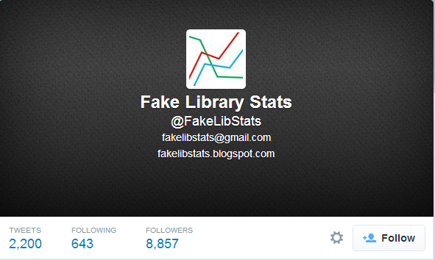

The truth of the matter
https://twitter.com/FakeLibStats/status/464074593049649153
Notes:
https://twitter.com/FakeLibStats/status/464074593049649153
May 7, 2014, 9:09 am

Slide 3
The approach
Select
Obtain
Compile
Store
Analyze - Visualize
Disseminate – Share

Slide 4
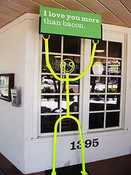
Select - Understand the standards
SUSHI & COUNTER
https://www.flickr.com/photos/crobj/14269377082/
Notes:
SUSHI
The SUSHI protocol provides instructions to automate the collection of usage statistics reports from compliant vendors, which you’d otherwise manually download from a vendor website or receive via email. If you have an electronic resource management (ERM) or subscribe to usage statistics software, using SUSHI generally just requires entering SUSHI configurations for each of your vendors. Not every vendor supports SUSHI—there is a list online at the NISO/SUSHI site that will tell you which vendors are SUSHI-compliant.
COUNTER Version 4
COUNTER consists of standard and optional reports—for a vendor to be COUNTER-compliant, they must offer all of the standard reports. I won’t talk about every report type, as you can read that information online, but I do want to mention some of the improvements.
What is better about v.4?
Expanded list of definitions – including gold OA and access denied categories--so that you know exactly what is being reported on
Requirement for DOIs to be included in usage reports – data mapping
Requirement for usage of Gold OA articles to be reported separately
Requirement to provide journal report 5 (year of pub/journal)
DB reports modified: session counts dropped; must report record views and result clicks – helps with issues created by federated search services that were inflating usage numbers
New report Multimedia Report 1 for audio, video, image resources
Optional reports for usage on mobile devices

Slide 5
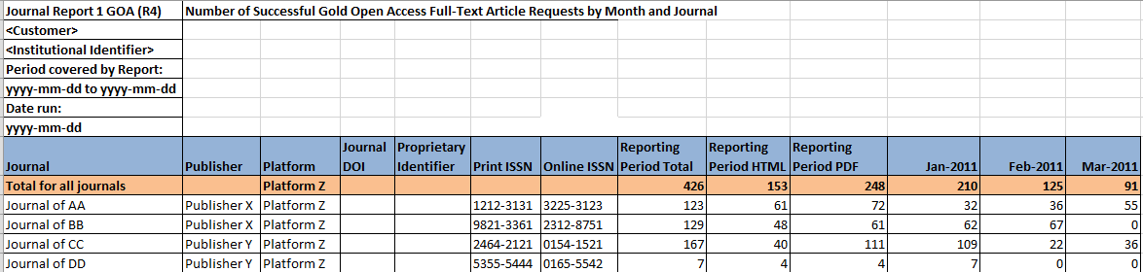
COUNTER JR1 GOA
Notes:
JR1 GOA - Number of successful gold open access full-text article requests by month and journal

Slide 6
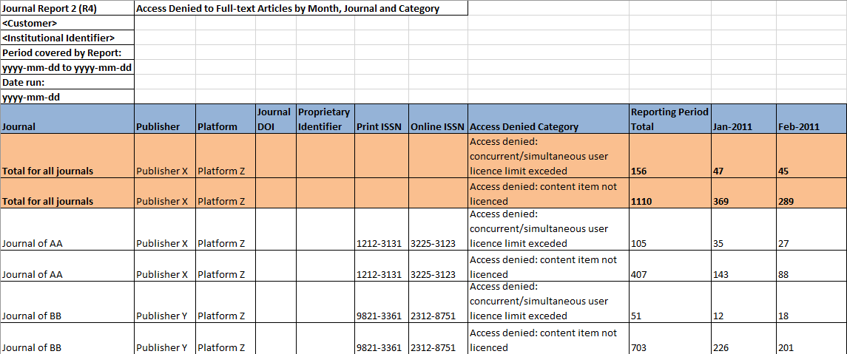
COUNTER JR2
Notes:
JR2 - Access denied to full-text articles by month, journal and category

Slide 7
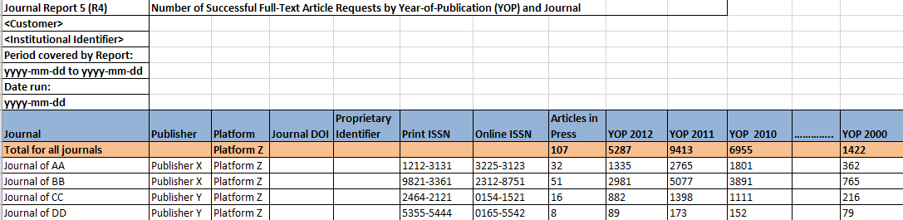
COUNTER JR5
Notes:
JR5 - Number of successful full-text article requests by year of publication and journal

Slide 8
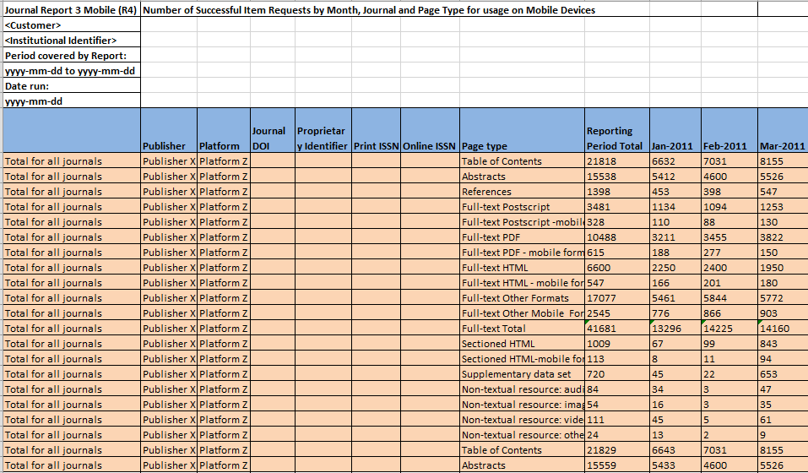
JR3 - Mobile
Notes:
JR3 Mobile

Slide 9
Select
Which usage is important?
  E-books, e-journals, databases (COUNTER & non-COUNTER reports)
  PDA
  Link resolver & A to Z
  Discovery service
  Book and journal circulation numbers (checkouts, internal use, renewals)

Slide 10
Caveats: there’s always a “but”
Vendor/publisher discrepancies
Technology fails
Garbage in, garbage out
Notes:
“Garbage in, gospel out: twelve reasons why librarians should not accept cost per download figures at face value.” The Serials Librarian, 63 no. 2 (2012): 192-212.

Slide 11
Obtain
Electronic
  Publisher, platform, vendor, consortia websites
  Self-service, automated e-mails, gentle prodding of vendor
Print
  Your friendly ILS
  Review files, statistics, web management reports

Slide 12
Compile
Usage statistics software
Excel

Slide 13
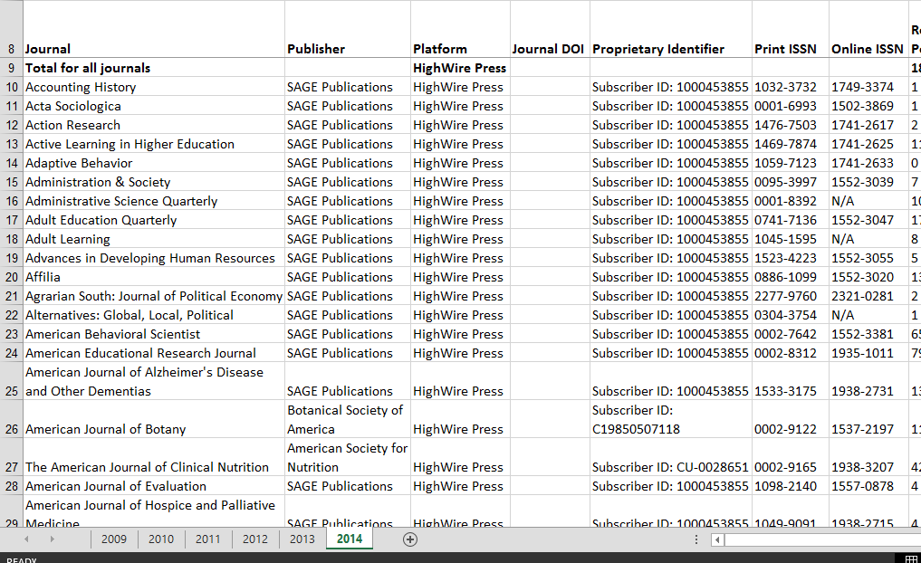
Compile

Slide 14
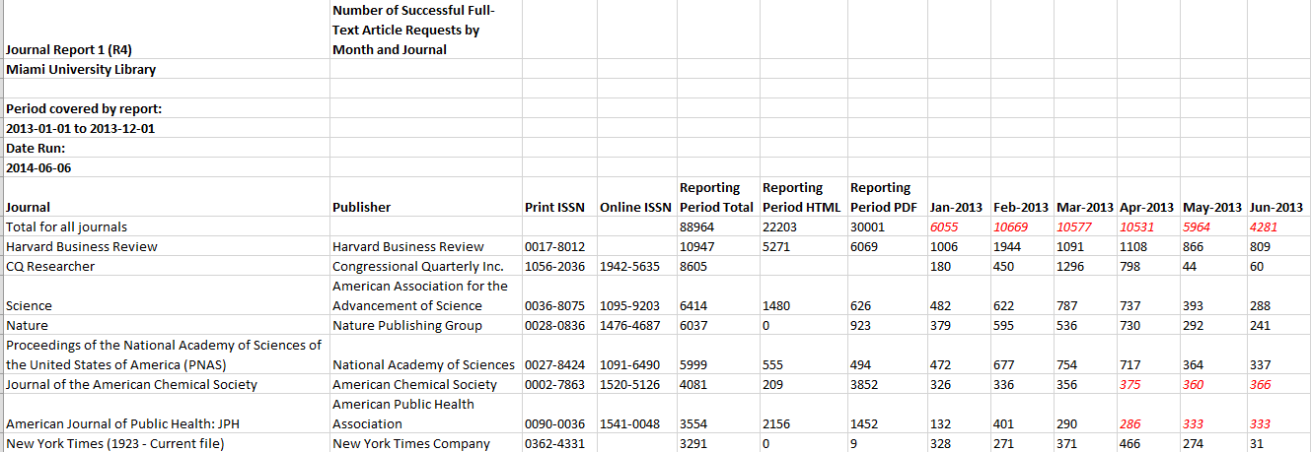
Compile

Slide 15
Store
Someplace in addition to your hard drive
  Library or departmental server
  Dropbox
  Google Drive
  Usage statistics software

Slide 16
Analyze
Combine/compare usage with other data
Benchmark against peer/aspirational institutions
Apply existing principles (e.g., Pareto)
Patterns over time, across platforms, across locations
Predict/extrapolate

Slide 17
Visualize
Charts & graphs
Pivot tables
Word clouds
Infographics

Slide 18
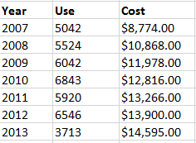
Analyze

Slide 19
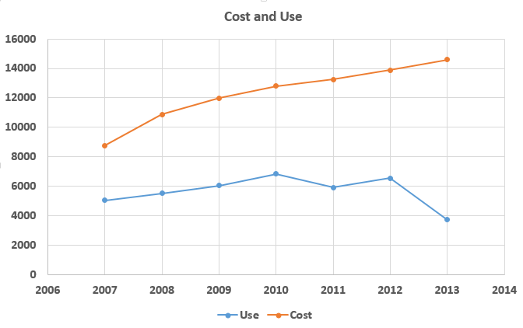
Visualize

Slide 20
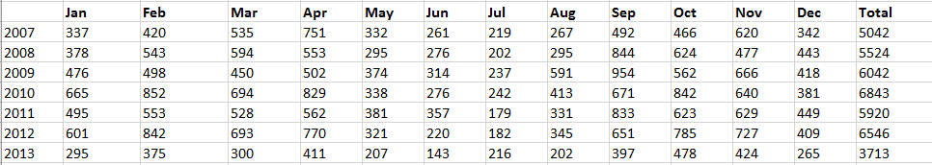
Analyze

Slide 21
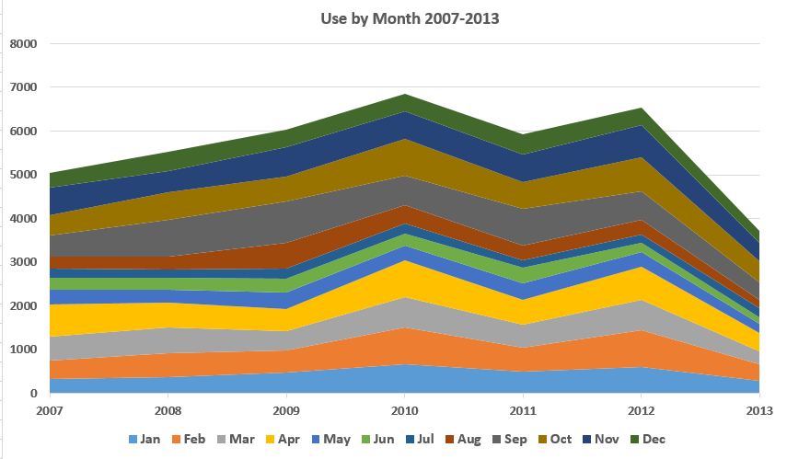
Visualize

Slide 22
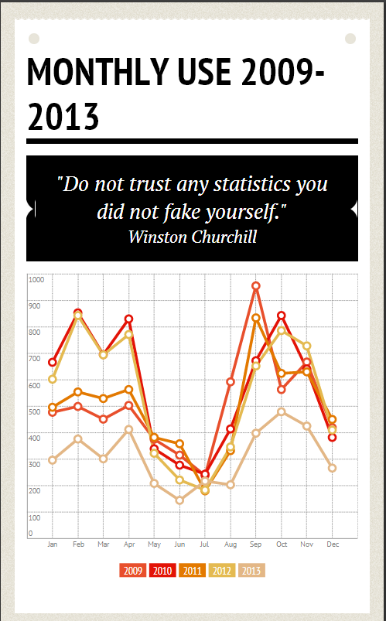
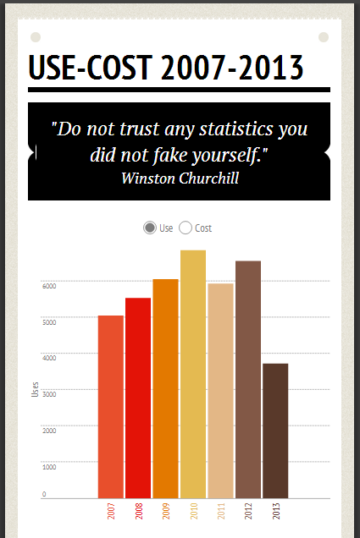
Visualize
Notes:
http://infogr.am/

Slide 23
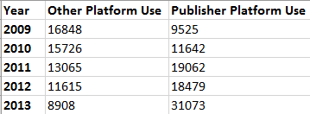
Analyze

Slide 24
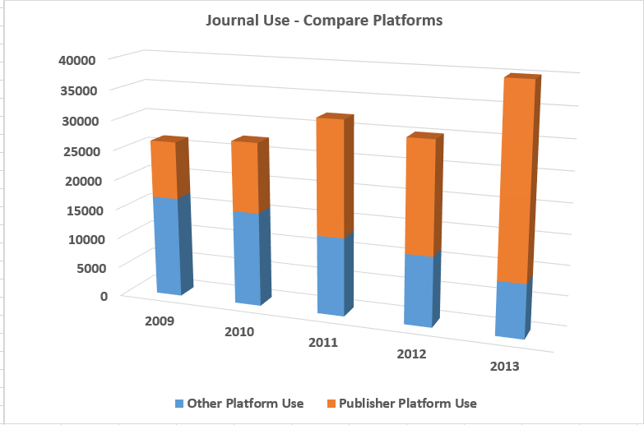
Visualize

Slide 25
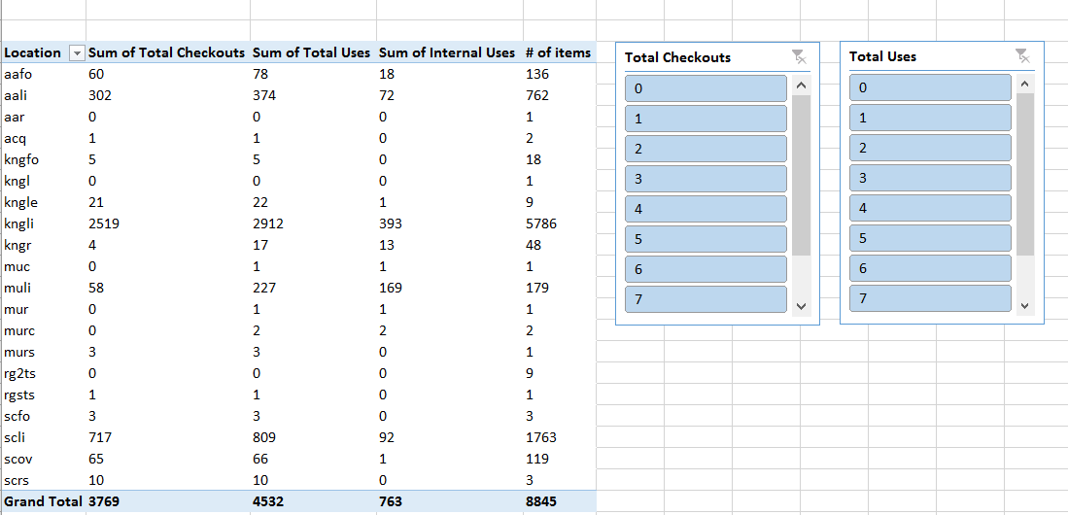
Analyze

Slide 26
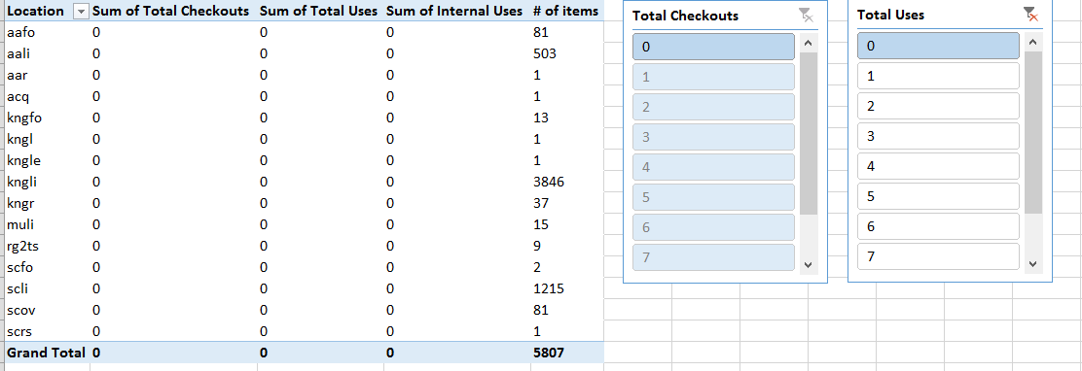
Analyze

Slide 27
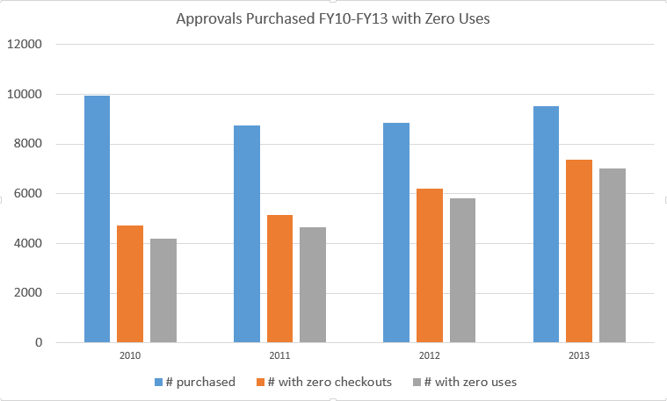
Visualize

Slide 28
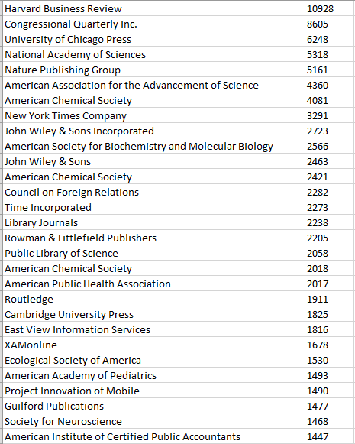
Analyze

Slide 29

Visualize
Notes:
Wordle

Slide 30
Disseminate - Share
Google Drive
LibGuides
EBSCOnet

Slide 31
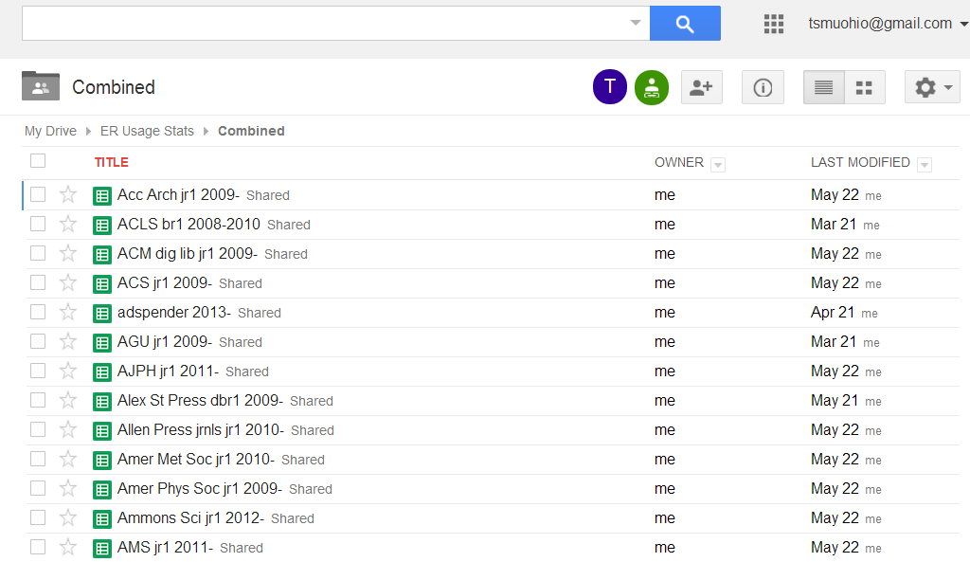
Disseminate – Share

Slide 32
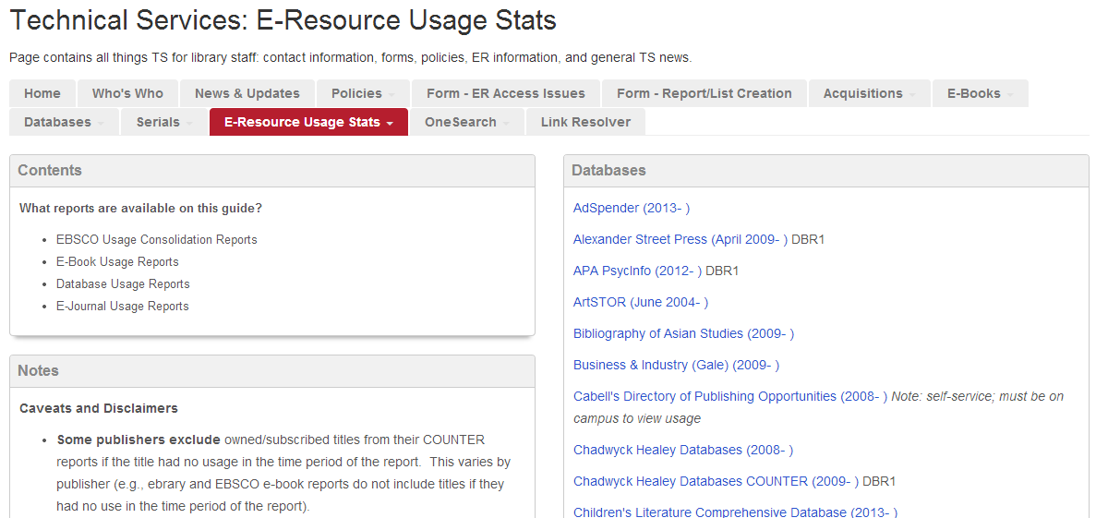
Disseminate – Share

Slide 33
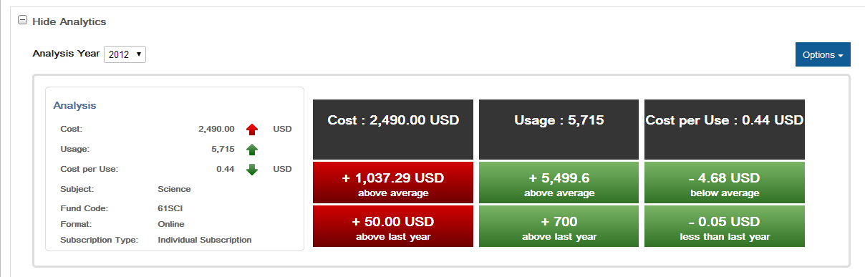
Disseminate – Share

Slide 34
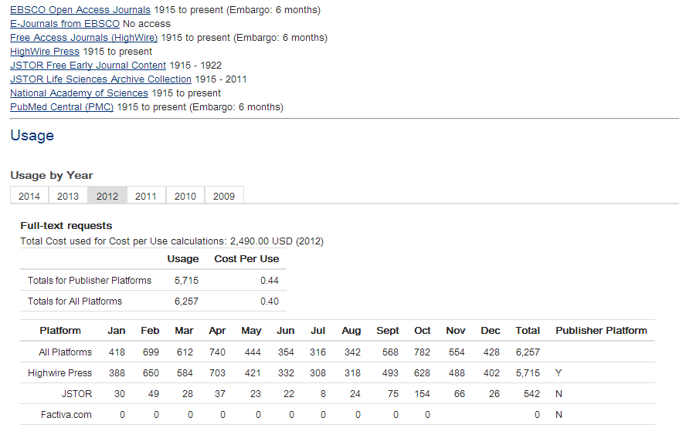
Disseminate – Share

Slide 35
Useful Resources
Bucknell, Terry.
  “Garbage in, gospel out: twelve reasons why librarians should not accept cost per download figures at face value.” The Serials Librarian, 63 no. 2 (2012): 192-212.
Tufte, Edward R.
  Envisioning Information. Cheshire, Conn.: Graphics Press, 1990.
COUNTER v. 4
  http://www.projectcounter.org/r4/COPR4.pdf
  http://www.projectcounter.org/r4/APPF.xls
SUSHI
  http://www.niso.org/workrooms/sushi/librarians/

Slide 36
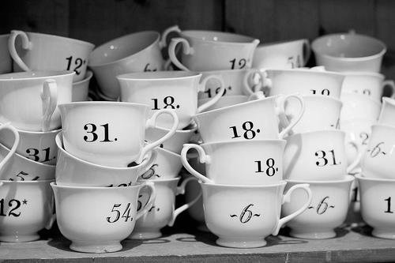
Questions?
bazelejw@miamioh.edu
https://www.flickr.com/photos/crobj/5558548657

