Slide 1
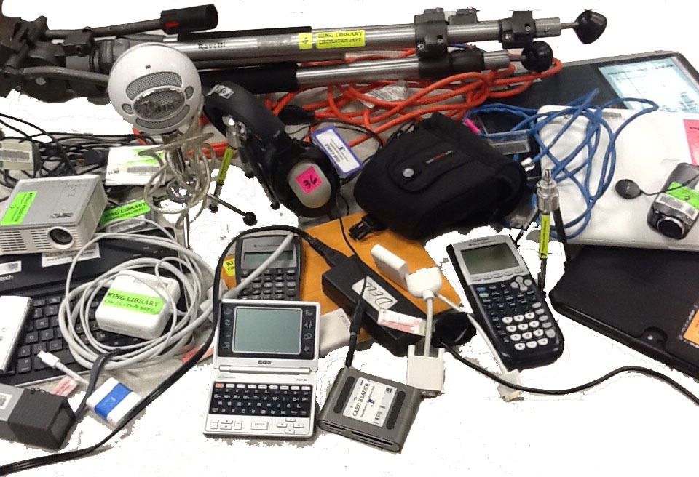
Creating and Supporting a Borrowable Collection of Portable Digital Technology
Rob Withers
Miami University Libraries

Slide 2
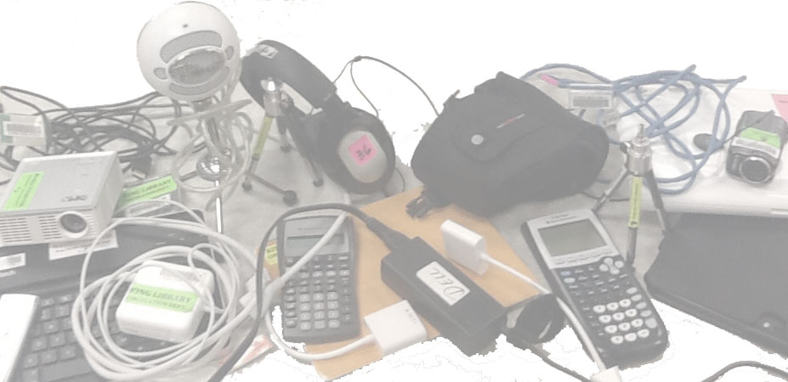
Outline
II. Exercises:
Participant backgrounds
Exercise: Brainstorming Challenges
Exercise: Brainstorming Solutions
Brainstorming a collection & delivery model

Slide 3
Outline
I. Overview of Miami University:
Institutional stats
Service points
Available equipment
Usage patterns

Slide 4
Miami University: Background
Small town, residential campus
Selective public institution
15,081 Undergraduates
2,476 Graduates

Slide 5
Service Point Background
24/7 Operations during academic year
347,309 checkins / checkouts per year
4,000 informational transactions per year
8 FTE staff + 6.5 FTE student employees

Slide 6
Equipment: Laptop & Tablets
Windows Laptop (33)
Macintosh Laptop (13)
iPads (31)
Nexus Tablets (6)
iPad keyboard covers (10)
Power cords (46 Mac, 47 Dell, 13 HP)

Slide 7
Equipment: Cameras & Recorders
Digital Video Cameras (76, of 6 types)
Digital Still Cameras (8)
Digital Audio Recorders (28, of 3 types)
Microphones (16)
Tripods (16, of 2 types)
Tripod dollies
Steadycam + weights

Slide 8
Equipment: Miscellaneous
Headphones (76)
Calculators (14 Graphing, 27 Financial)
Projectors (23, of 2 types)
Computer mice (4)
Foreign language translators (10)
Electrical extension cords (2)
Portable Lectern w/microphone (1)

Slide 9
Usage: Central Service Point

Slide 10
Usage: Central Service Point+Branches

Slide 11
Challenges:
How will we pay for it?
Will it be used?
How will it be supported?
What do YOU envision for YOUR environment … ?

Slide 12
Possible Solutions
Thinking of YOUR environment, how would you deal with:
Budgeting
Wear & Tear
Privacy Concerns
Troubleshooting
What else … ?

Slide 13
Planning Exercise
In YOUR environment:
What types/quantities of equipment?
What types of services

Slide 14
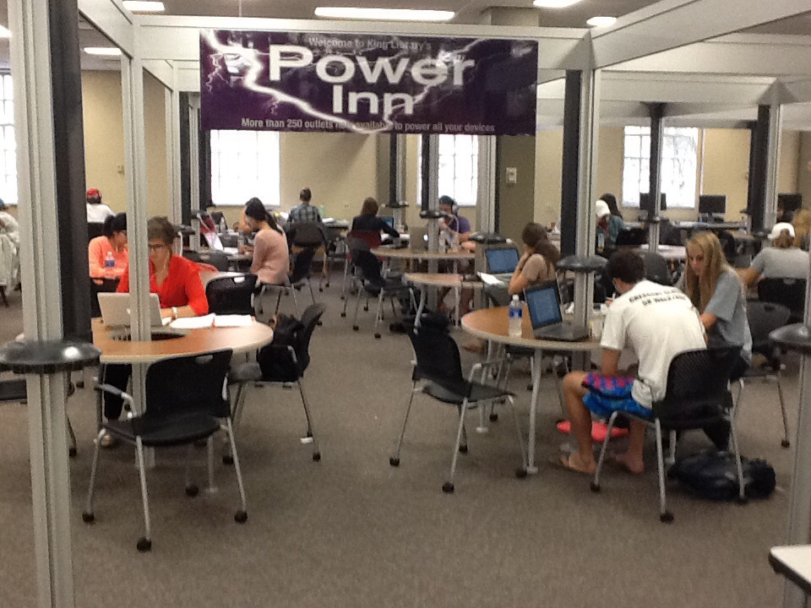
Challenges:

Slide 15
Further Information
Rob Withers
Access Services Librarian
witherre@miamioh.edu

