Slide 1
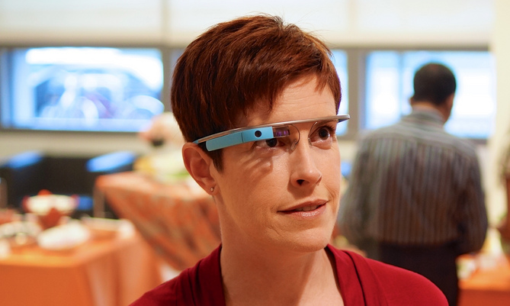


Using Google Glass
to Teach Privacy
(and sharing)
Jen Waller
Miami University Libraries
Notes:
Introduction (Glasshole)
Thank you
How Glass works, my thoughts about how it works, how I’m using it to teach students about privacy

Slide 2
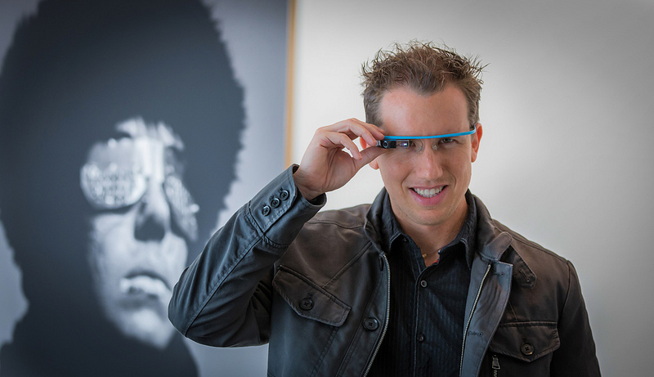
Notes:
Glass Explorer
8000 people using and beta test Google’s latest consumer technology
interested in how people perceive new technology
interested in library services and education methods using new technology
selection process

Slide 3
#ifIhadGlass
Notes:
hashtag “if I had Glass”
Explorers chosen from this pool
not aware of the “contest” or “drawing”
started seeing tweets from friends, colleague

Slide 4
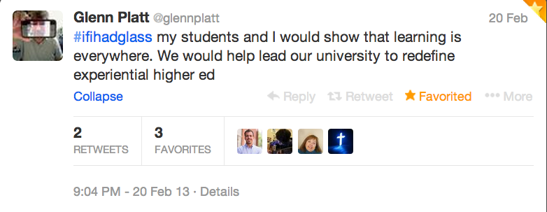
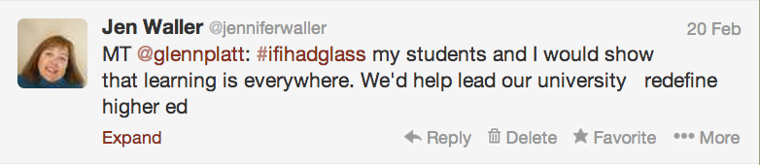
Notes:
Glenn Platt’s tweet summed up my feelings
MT instead of RT
not even a very good modified retweet!

Slide 5
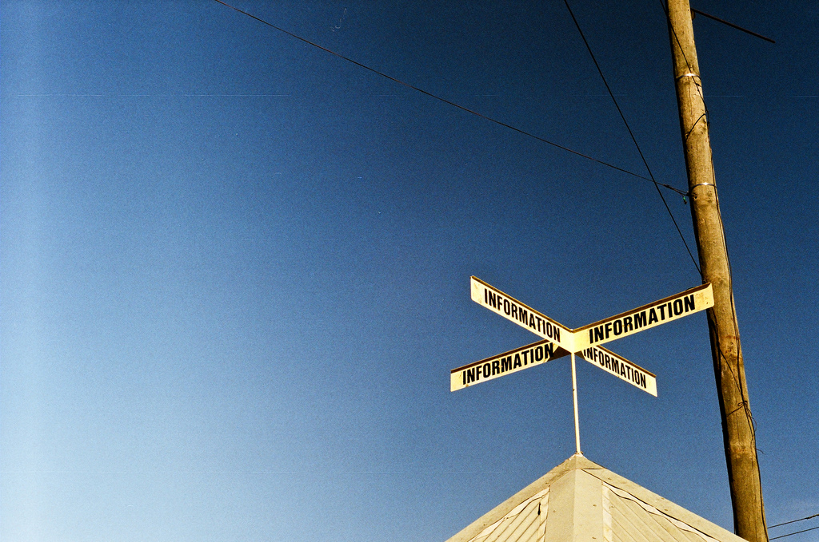
Notes:
Google SHOULD be choosing librarians to be Glass Explorers.
Librarians work to connect people with information every single day, and Glass is an information delivery tool.
supporter and early user of Google products
Gmail since it required an invitation
wide and diverse set of friends and social media contacts
selection process wasn’t entirely random.

Slide 6
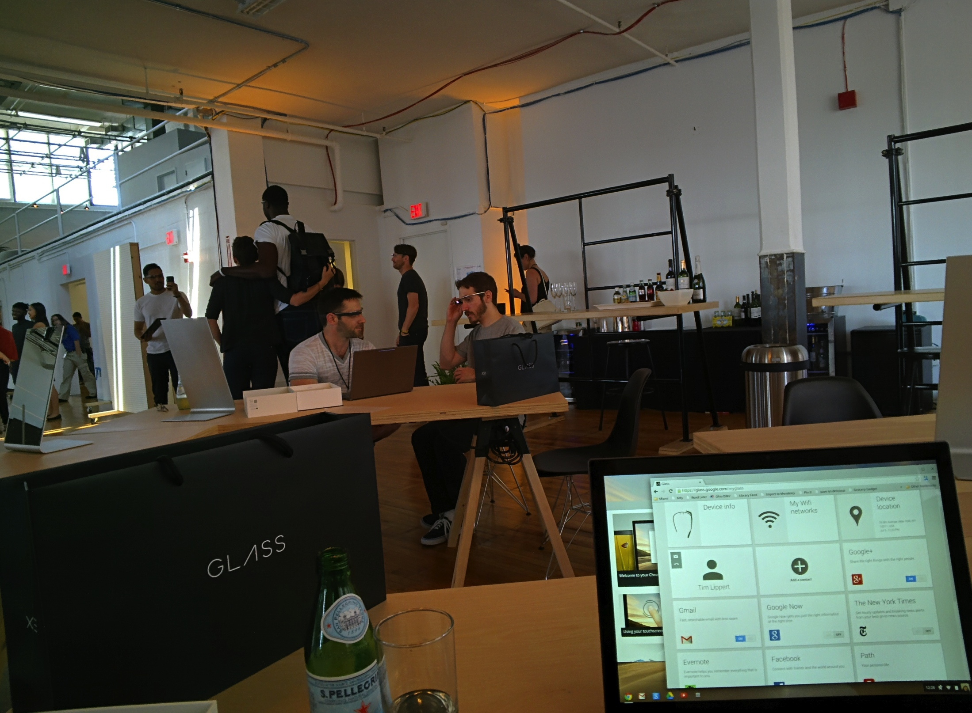
Notes:
$1500 - Dean covered through an innovation grant
travel to either New York, Los Angeles, or San Francisco
new form factor - careful about how roll out.
45-minutes to 2+ hours with “Glass Guide” who fit and adjusted the Glass, who showed them how it works, and who answered questions.
First photo
quality isn’t so terrible - Glass has the ability to take decent photos and videos.
warehouse/loft space - easy to move, flexible furniture, which reminded me of how libraries are using furniture.
associated web site for Glass Explorers
tall person in background

Slide 7
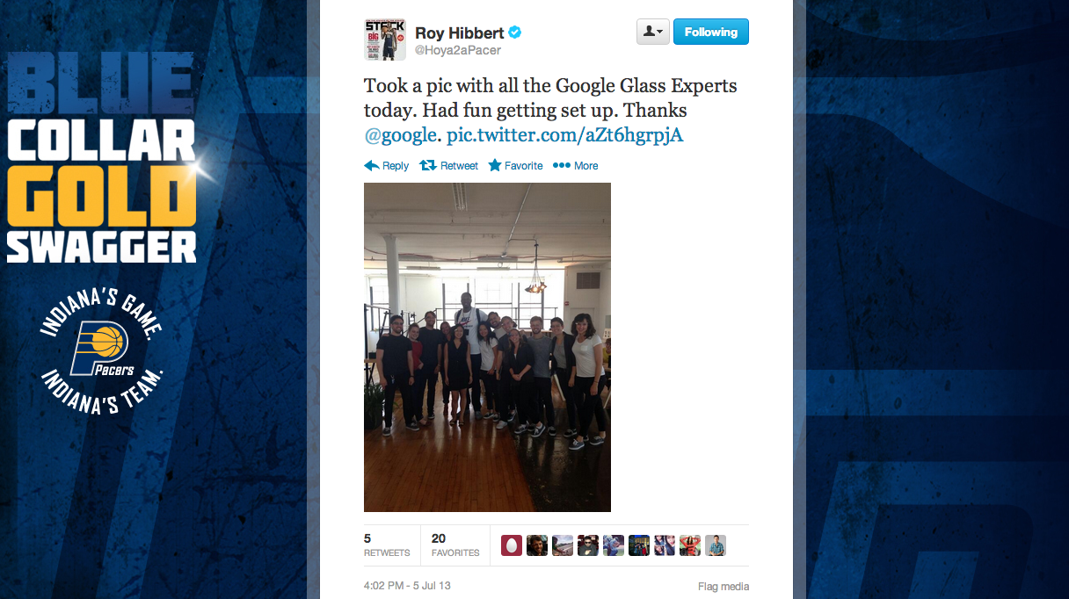
Notes:
Roy Hibbert, from the Indiana Pacers, was getting his Glass fitted at the same time I was.

Slide 8
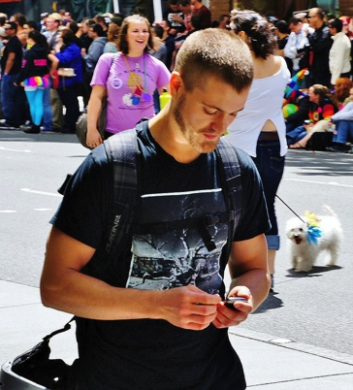
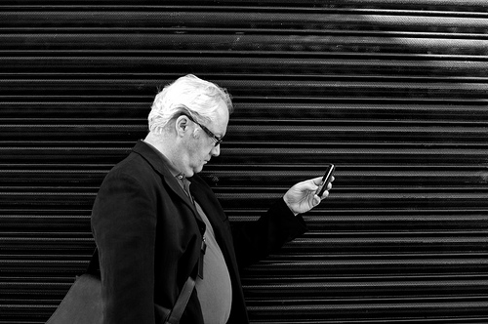
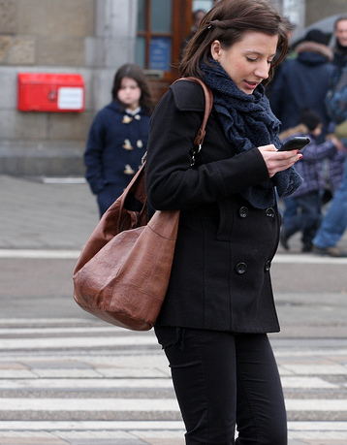
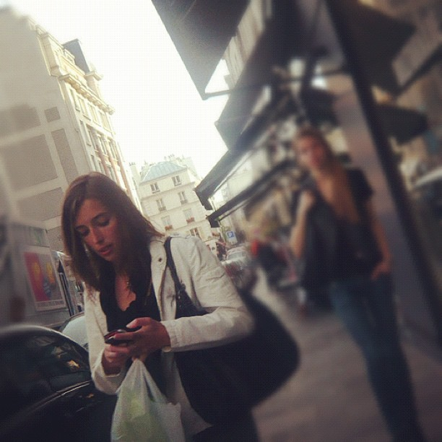
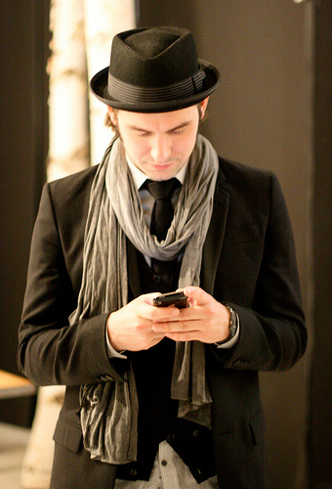
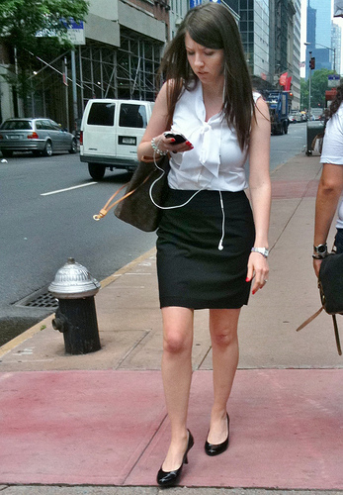
Notes:
Google’s inspiration
head down texting
“hands free” is going to become increasingly important. Just think about how many times you reach into your pocket or your purse to grab your cell phone. usability issue Google is working to solve

Slide 9
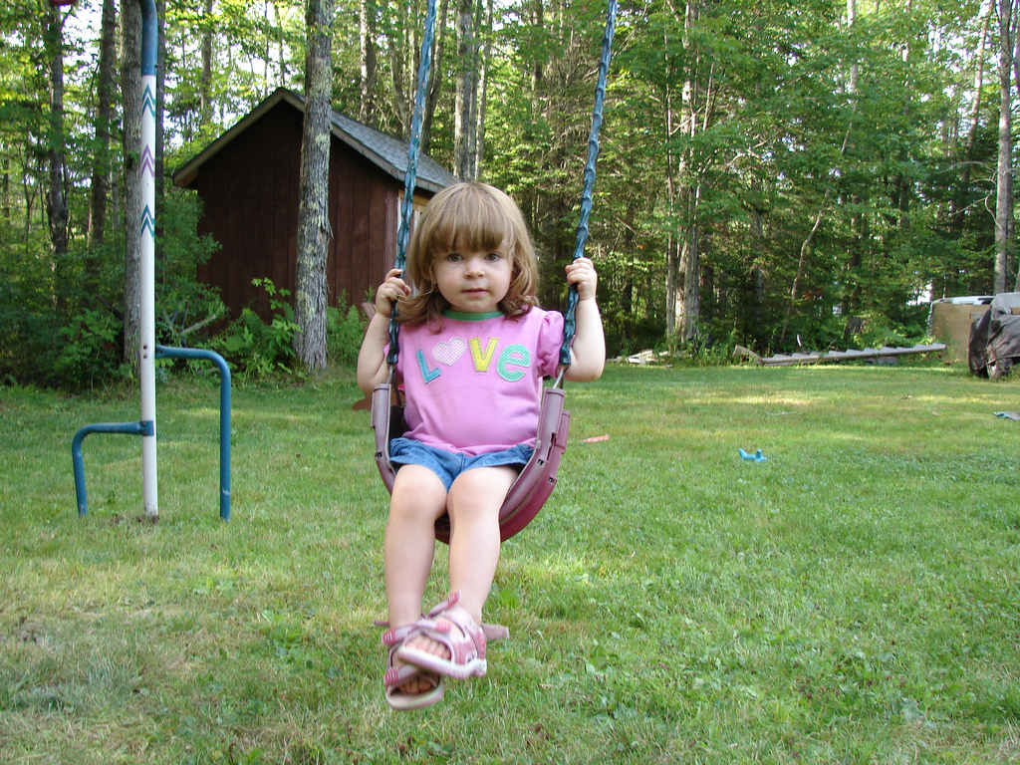
Notes:
hands free story
pushing his daughter on a swing at the playground while simultaneously shooting a video or – even better – having a video chat with his mother
keep these “human” aspects in mind when we’re using and evaluating new technology.

Slide 10
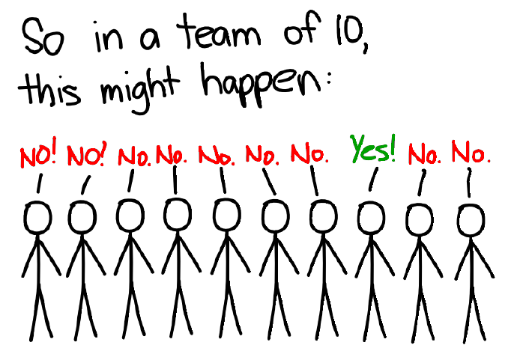
Notes:
not a futurist, a technologist, or even an early adopter exactly.
saw many uses for Glass in the work I do at Miami
and one of those uses was teaching students about privacy.

Slide 11
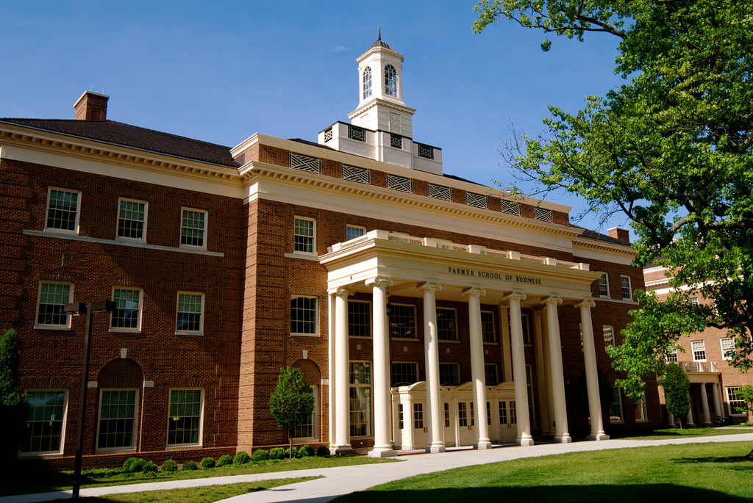
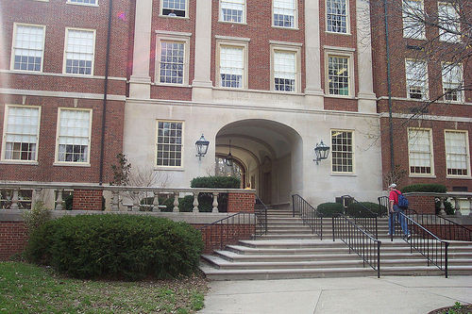
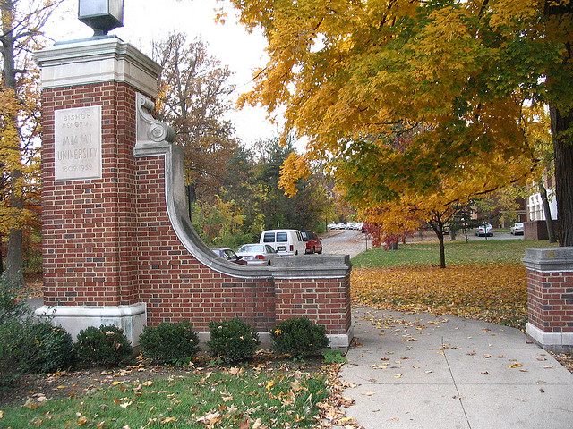
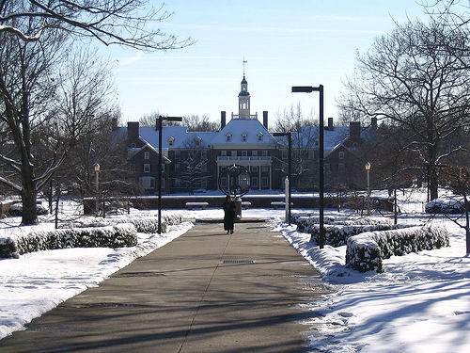
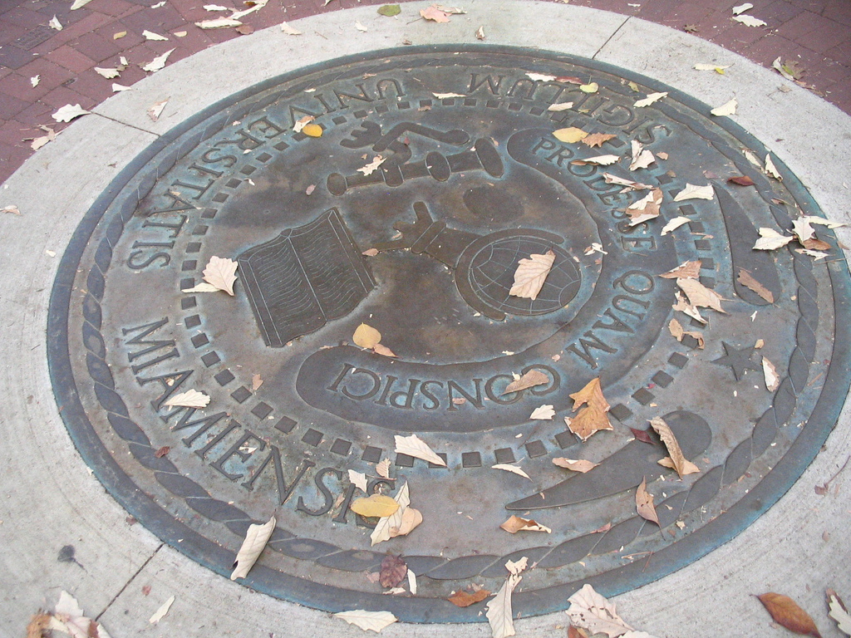
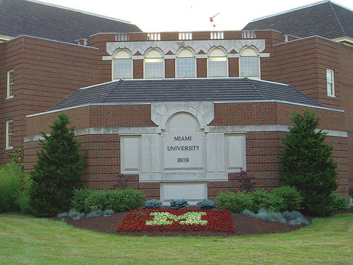
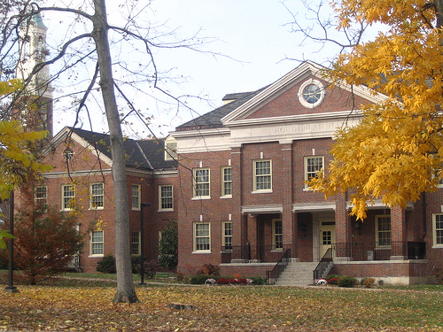
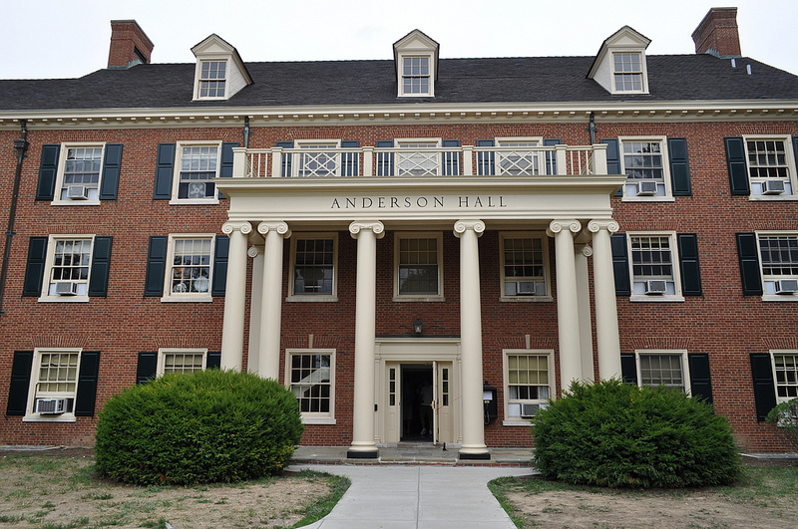
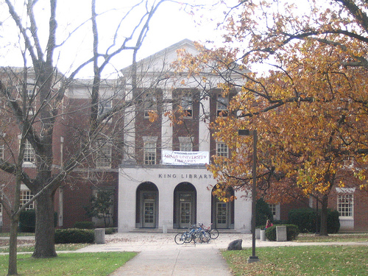
Notes:
Context: Miami University established in 1809
public university
main campus in Oxford, Ohio
three smaller regional campuses in Hamilton, Middletown, and West Chester, Ohio.
2012 FTE 21,000 undergrads; 3700 grad students.
focus on undergraduate liberal education
bachelors degrees in over 100 areas, masters degrees in more than 50 areas, and several doctoral degrees.

Slide 12
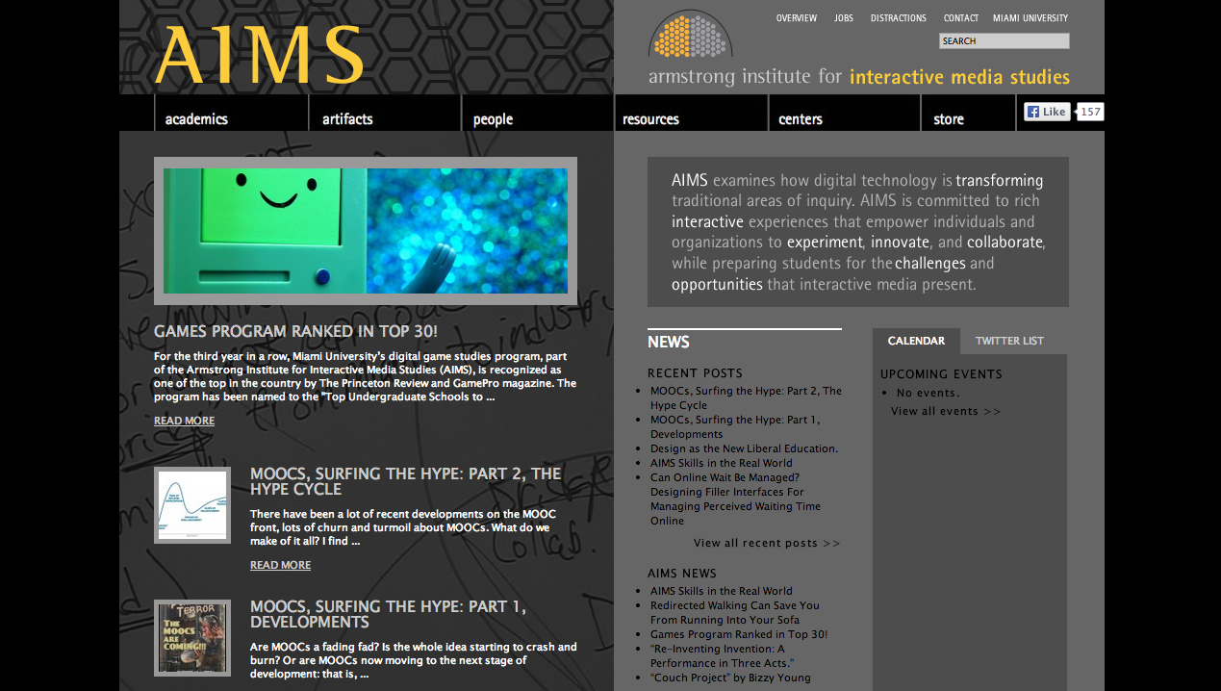
“ AIMS examines how digital technology is transforming traditional areas of inquiry. AIMS is committed to rich interactive experiences that empower individuals and organizations to experiment, innovate, and collaborate, while preparing students for the challenges and opportunities that interactive media present.”
http://aims.muohio.edu/
Notes:
AIMS, the Armstrong Institute for Interactive Media Studies
interdisciplinary program that examines how digital technology is transforming traditional areas of inquiry
affiliate instructor , IMS 201, “Information in the Digital Age,” semester-long course for undergrads
explores what it means to be information literate in today’s digital world.
includes all aspects of the information lifecycle, including ethical and legal issues
foundation course for the IMS thematic sequence and IMS minor.
requirement for those doing an IMS major.
person I retweeted to get the Google Glass = Glenn Platt ,Director of the AIMS program

Slide 13
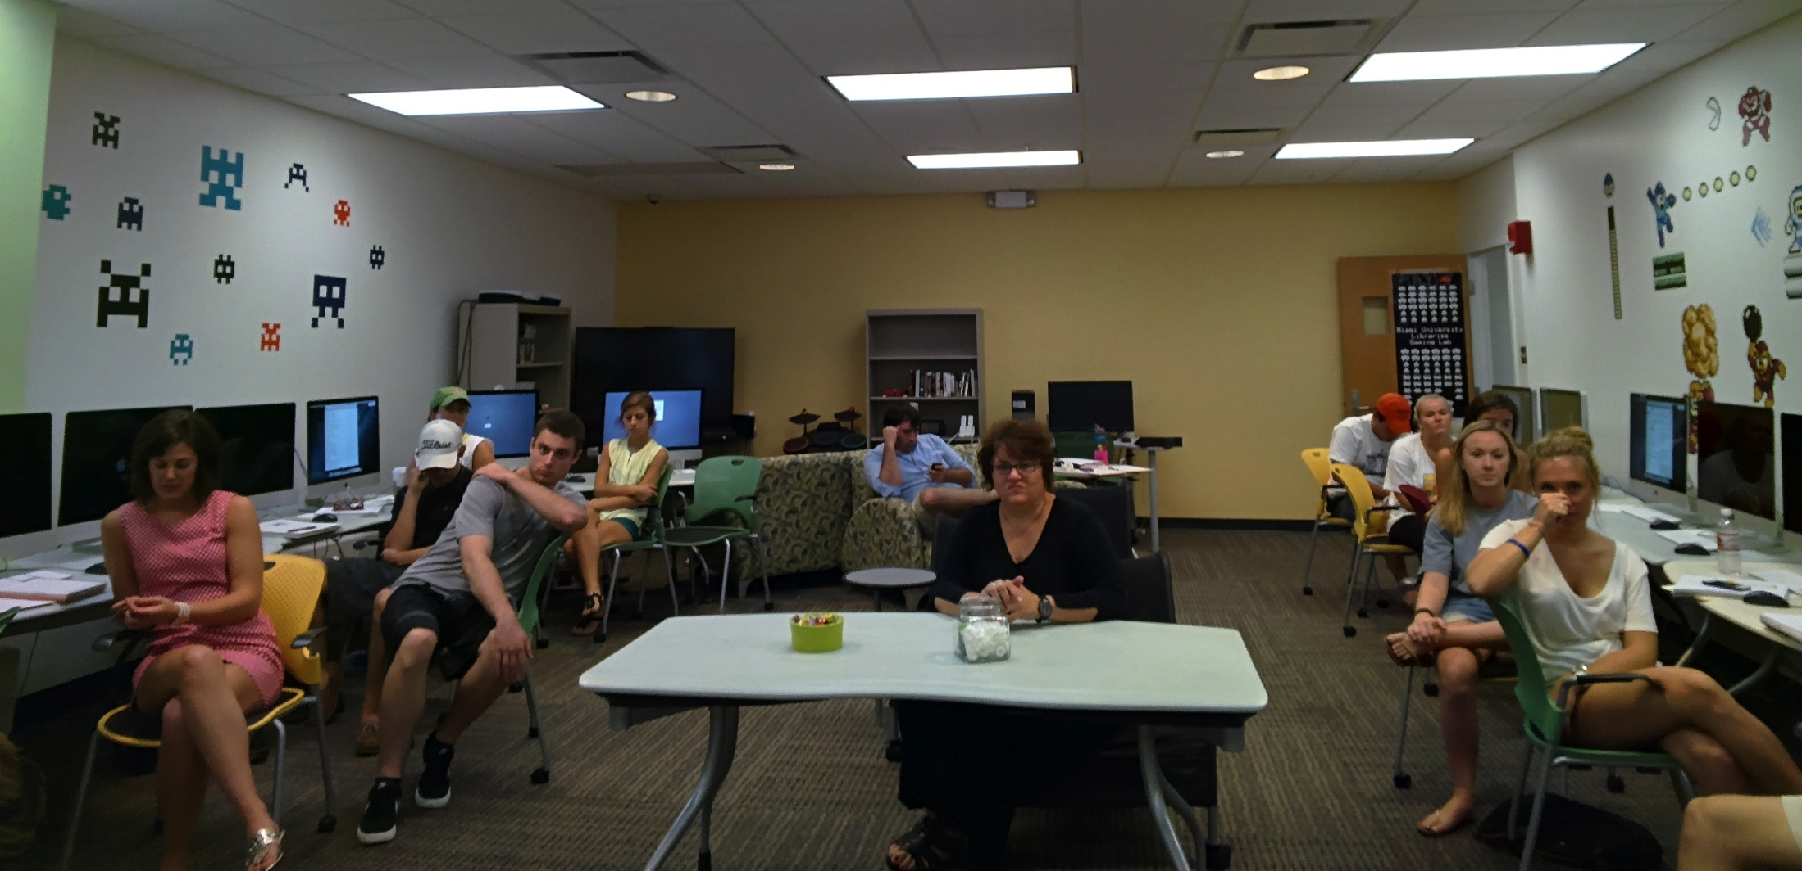
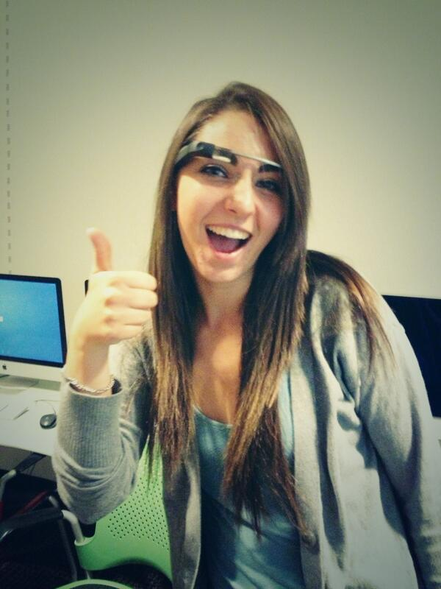
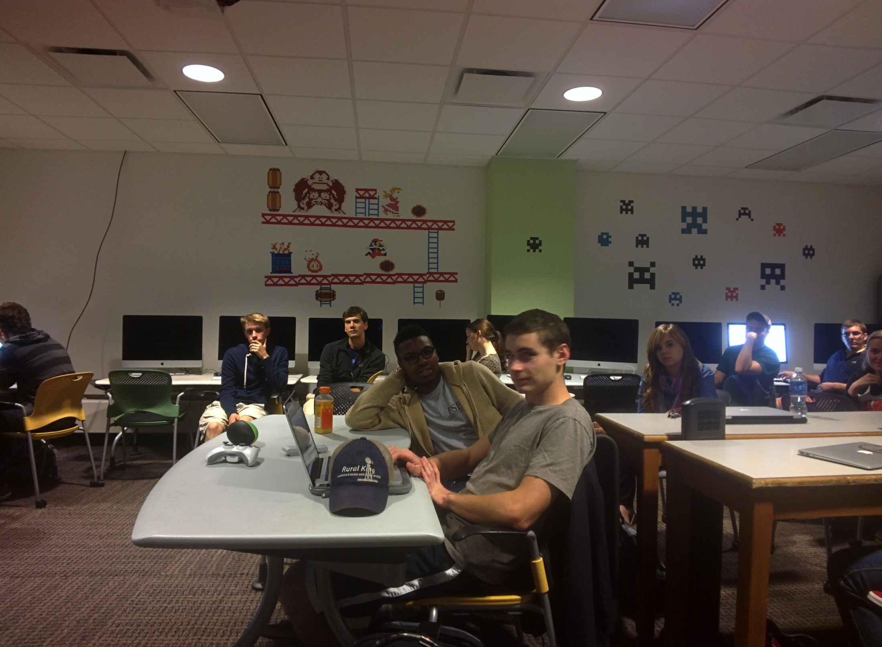
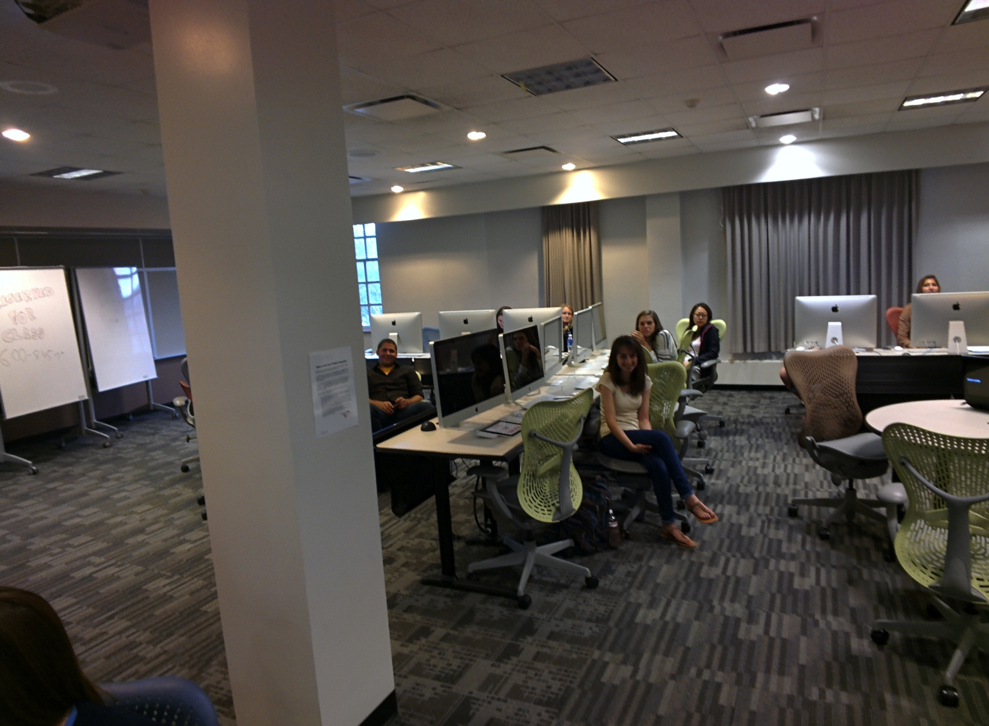
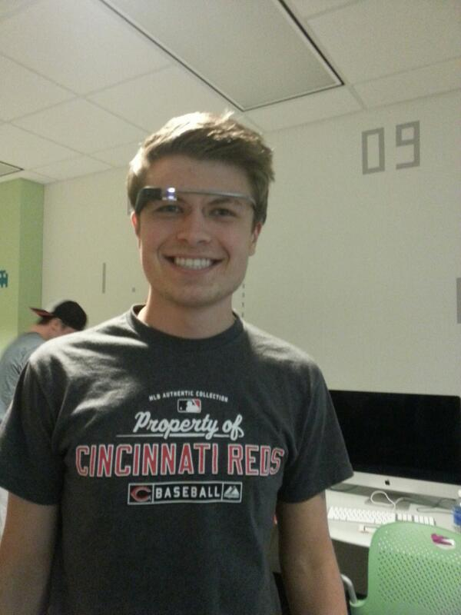
Notes:
not scheduled to teach
allowed me time to visit other instructors’ IMS classes
55-minutes - 2+ hours on privacy, sharing, Glass

Slide 14
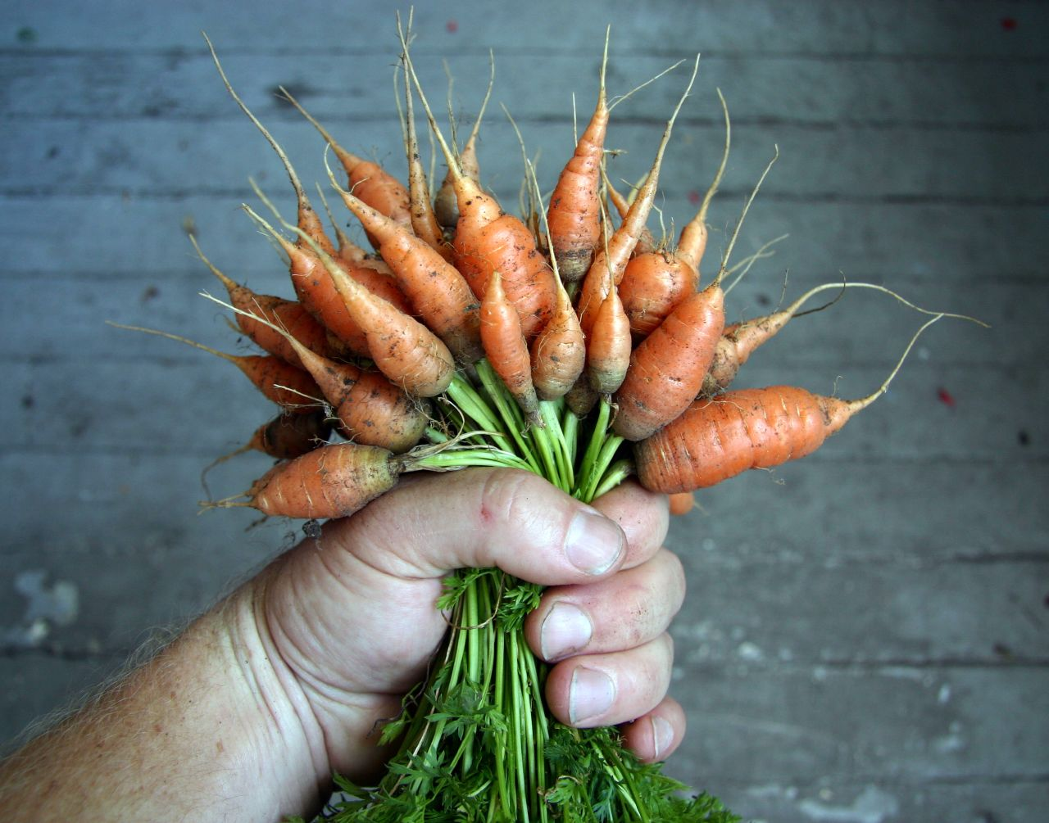
Notes:
Glass = carrot or hook that got these students excited
eager to try out the technology, learn how I got it, how it worked, and think up creative uses for it.
privacy discussions weren’t the stick
participation, discussion and interaction in every class

Slide 15
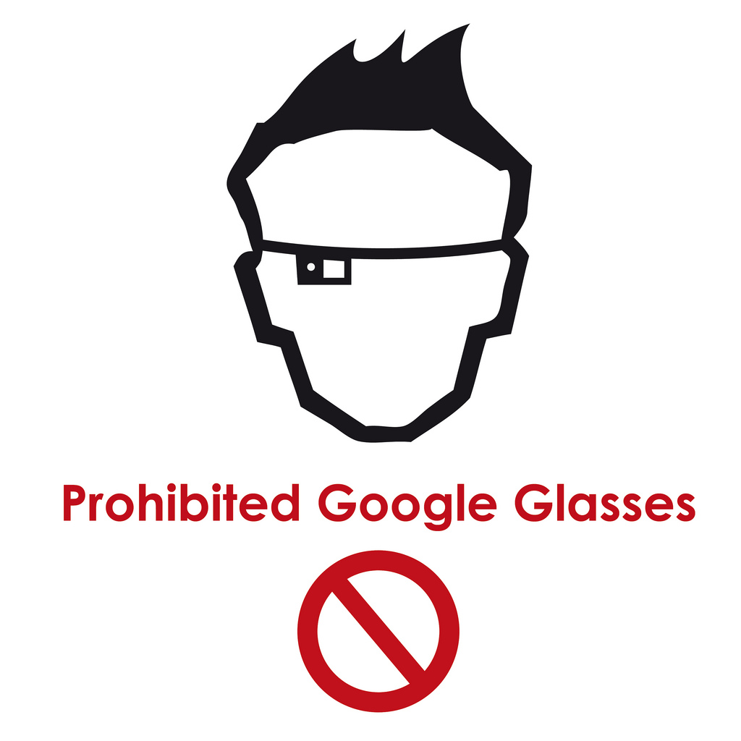
Notes:
most reported privacy concerns people taking photos without your knowledge or consent
students need to think critically about this reaction
mirrors “what if” knee jerk reactions about new technology
Glass isn’t the problem here.
People can already take pictures of you without your knowledge. They can use a cell phone when you’re in a public place.

Slide 16
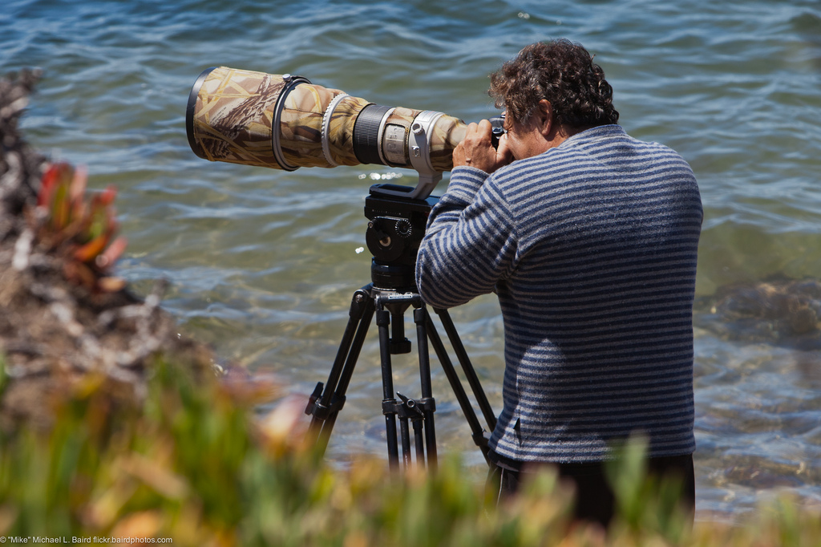
Notes:
not about technology at all
telephoto lens when you’re in a private place
fear of photography via Glass is not really about the photography, and it’s not really about the Glass
Instead, three things that it’s really about:

Slide 17

1) instantaneous dissemination
Notes:
Instantaneous dissemination

Slide 18
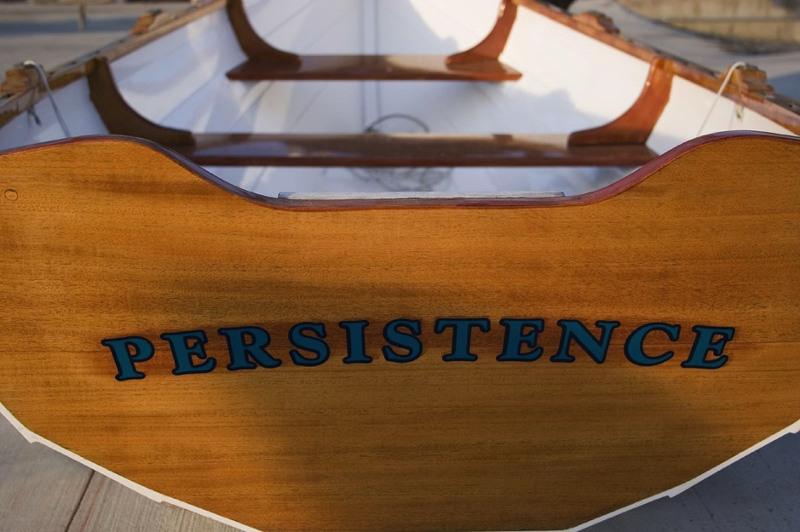
2) persistence of data
Notes:
persistence of online data.

Slide 19
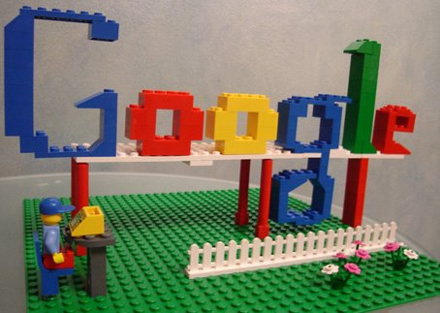
3) ease of search
Notes:
ease of search

Slide 20
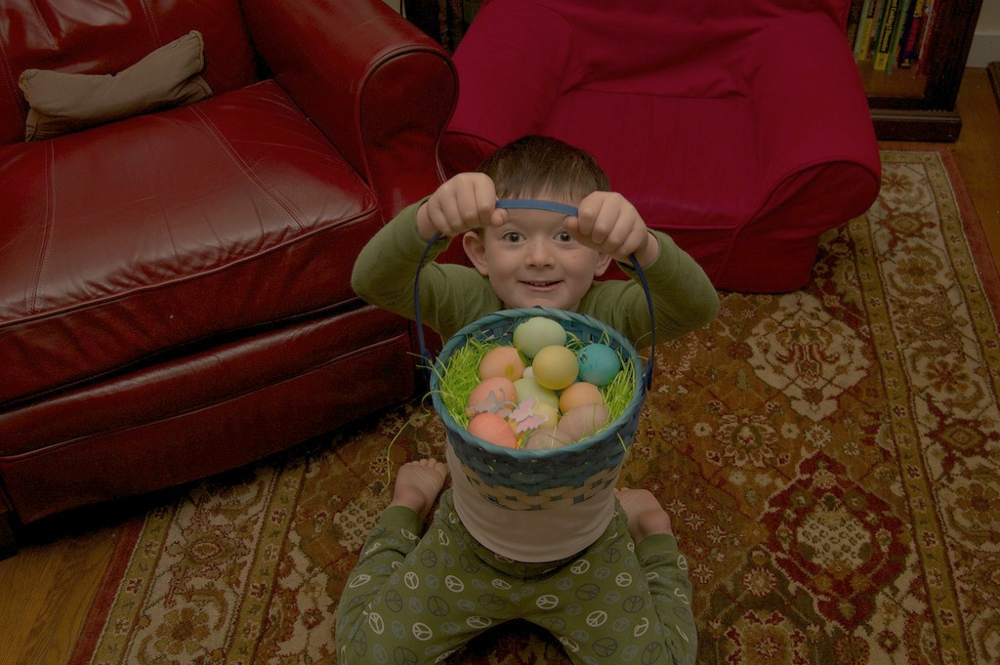
Notes:
objections - I don’t like putting all my eggs in one basket
scatter my online and computing experience and spread my digital life around
Glass wants you to put all your eggs in Google’s basket.
discuss reliance on Google

Slide 21
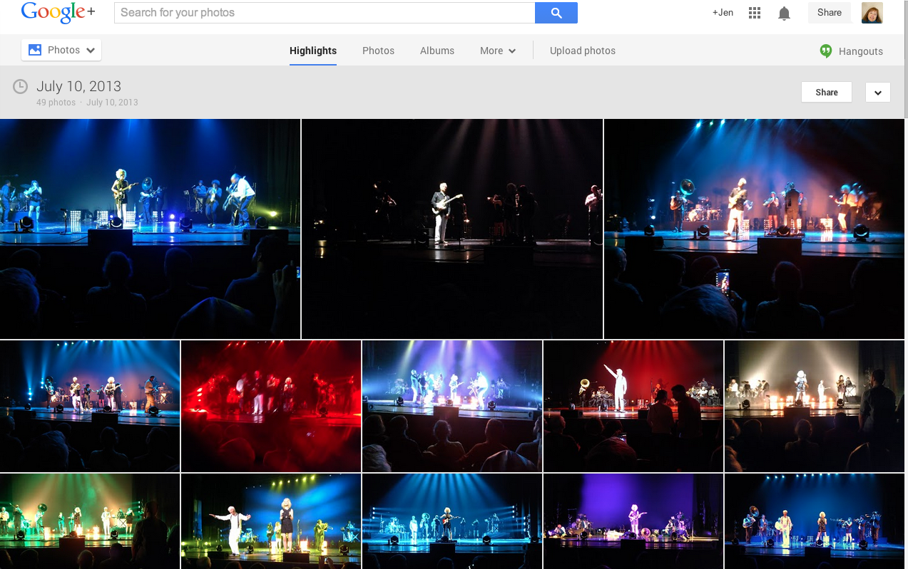
Notes:
Glass prioritizes Google’s tools and services.
Google+ account
Glass automatically uploads your photos and videos to your Google+ account.

Slide 22
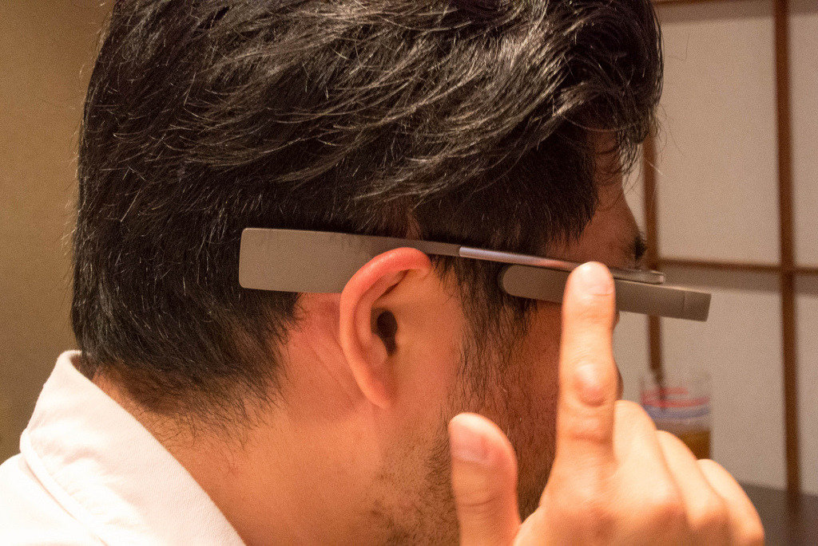
Notes:
touchpad, swipe forward and backward
swipe down to go back to the Glass Welcome screen
tap to select something
easy to get these gestures mixed up
muscle memory that makes people want to tap the touchpad - easy to take a picture and accidentally tap it, which selects it and tap again, which uploads it. Glass is tied to my personal Google account, which means my personal email and my personal G+ page. One wrong tap, and I could be sharing the wrong thing

Slide 23
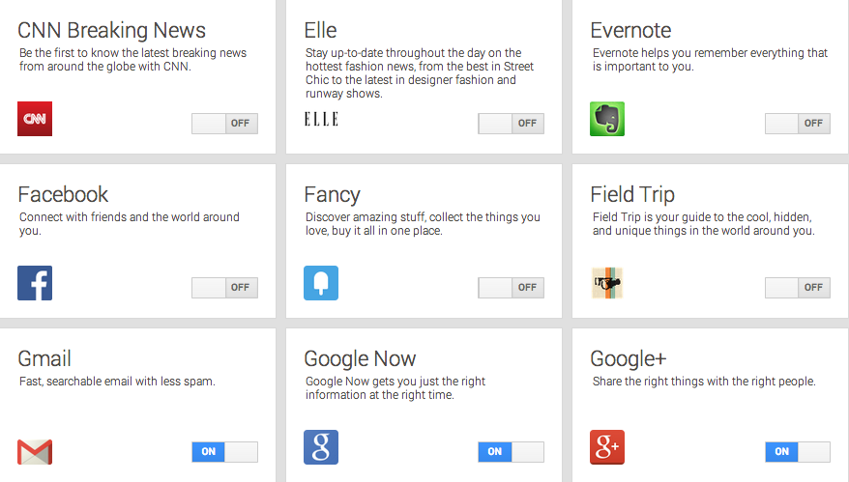
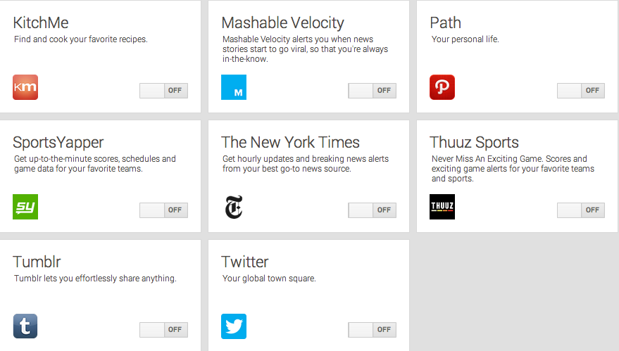
Notes:
Glass apps - “Glassware.”

Slide 24
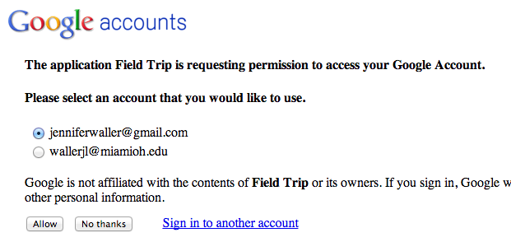
Notes:
adding apps to Glass
conversation about privacy with students
Wall Street Journal “What they Know”
Students vaguely aware that this happens when browsing the web online. But they were largely unaware this practice exists with mobile apps, much less with Glass apps.

Slide 25
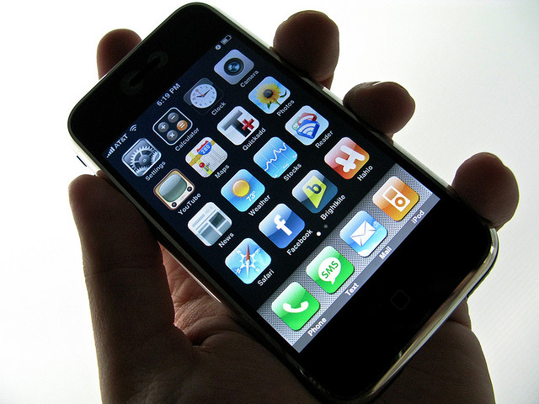
55%
31%
28%
make their privacy policy available in the
app store (prior to download)
make their privacy policy available within the app (after download)
don’t have a privacy policy at all
Source: http://www.insidemobileapps.com/2013/08/21/mef-study-analyzes-privacy-policies-in-most-popular-ios-android-apps/
Notes:
discussion about privacy policies, both on websites but especially on mobile apps.
no specific to Glass, but Glass is the hook
more difficult to get students interested in privacy policies when you’re holding mobile phone in your hand and waving it in front of them. The mobile phone is technology they’re all familiar with and take for granted

Slide 26

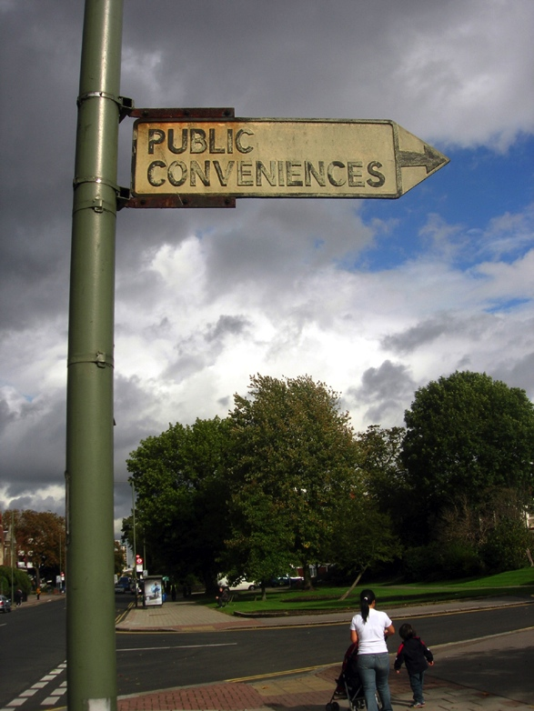
Notes:
discussion of privacy policies allowed us to talk about our decisions to trade privacy for convenience
we don’t read them, but we know they’re there. We want the product, the service, the tool
knowingly sign up for the service and provide our information, even though we might not be aware of how that information will be used.
remind students and let them really consider just how much we live our lives online and just how much information we willingly put out there: social media, flight reservations, shopping + product reviews, prescription drugs, bank statements, medical records, location data, taxes.

Slide 27
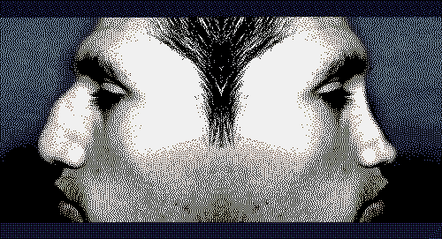
Notes:
don’t understand the long term consequences of all this information about us being “out there”
grooming our “online persona,” and this is particularly true of the juniors and seniors in these IMS classes - beginning to look for jobs, so they are aware of how they need to appear to future employers.
We choose our images and words to create a portrait of ourselves online. We want to control our images.
But what is going on behind the scenes? Students were very concerned to think about the persona that is also being created by others on the other side of their screens. This is the persona we can’t see or control, yet it is making judgments about us.

Slide 28
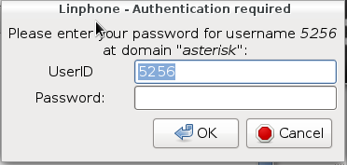
Notes:
Glass has difficulty connecting to a closed network
using Glass on campus on an open network instead of the closed network.

Slide 29


Notes:
other connection issues as well
well on an Android phone
“My Glass” app generates a QR code
No “My Glass” app for iOS

Slide 30
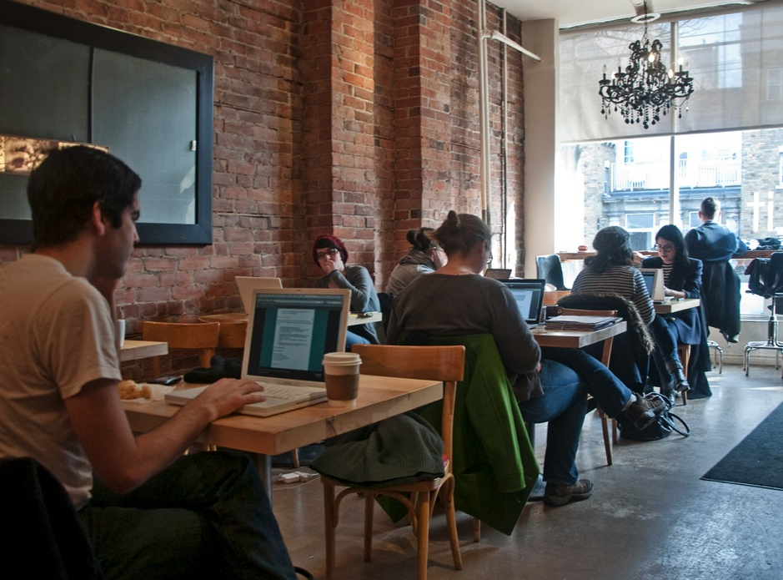
Notes:
Must connect w/laptop.

Slide 31
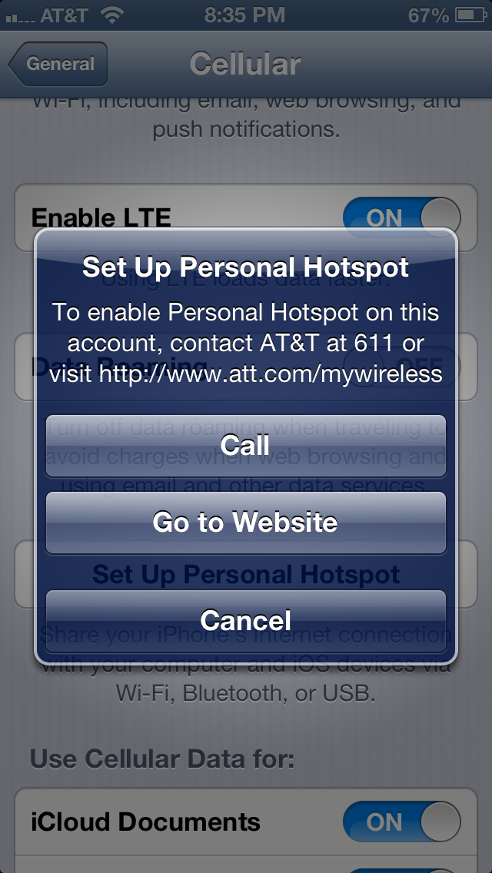
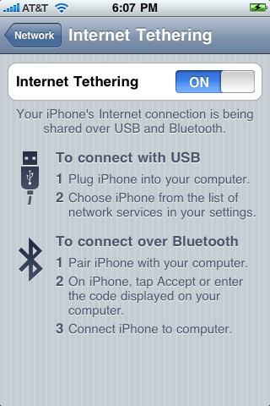
Notes:
connect Glass to my iPhone by tethering it
unlimited data – grandfathered in – so tethering won’t work

Slide 32
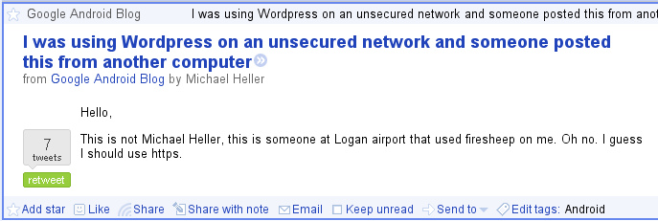
Notes:
connection issues that Google
open wifi not secure
Firesheep, secure http, and how to use Miami’s VPN. Students were unaware of these things and didn’t even know they were issues of concern.

Slide 33
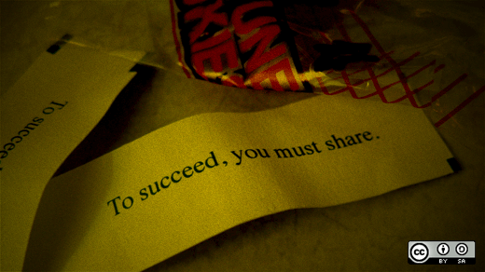
Notes:
classes weren’t scary and full of doom and gloom...
work involves thinking about privacy, but I think about sharing at least as much – if not more
promote OA on campus as one of my primary responsibilities.
Many of the ways Glass is used doesn’t really lend itself to sharing - singular, personal experience similar to how you don’t share your mobile phone. important for students to understand the value of sharing and what they can gain by contributing vs. consuming.
1/3 of the class time discussing privacy, 1/3 talking about sharing and 1/3 about Glass

Slide 34


Notes:
Questions/share

Slide 35
Photo Credits
"Google Glass and Future Health 25822" © tedeytan
http://www.flickr.com/photos/22526649@N03/9082188786/
Used under a CC BY-SA 2.0 license
"Privacy" © g4ll4is
http://www.flickr.com/photos/g4ll4is/8521624548/
Used under a CC BY-SA 2.0 license
"Google Glass" © Stuck in Customs
http://www.flickr.com/photos/stuckincustoms/7350510542/
Used under a CC BY-NC-SA 2.0 license
"Information overload" © wasabicube
http://www.flickr.com/photos/wasabicube/4588137886/"
Used under a CC BY-NC-ND 2.0 license
"First Google Glass Photo" © Jen Waller
Some rights reserved
License: CC BY-SA 2.0 license
"Texting - (Day 4 of Holiday 2011)" © Matthew Kenwrick
http://www.flickr.com/photos/58847482@N03/5597906430/
Used under a CC BY-ND 2.0 license
"Texting While Walking" © sea turtle
http://www.flickr.com/photos/sea-turtle/7647691828/
Used under a CC BY-NC-ND 2.0 license
"texting" © opacity
http://www.flickr.com/photos/opacity/4107198594/
Used under a CC BY-NC-ND 2.0 license
"Texting while walking #paris" © pieceoplastic
http://www.flickr.com/photos/pieceoplastic/8293895852/
Used under a CC BY-NC 2.0 license
"Texting while walking" © JuhaOnTheRoad
http://www.flickr.com/photos/12810816@N08/7424015658/
Used under a CC BY-NC-SA 2.0 license
"texting" © meanmachine_ie
http://www.flickr.com/photos/mean-machine/6078011142/
Used under a CC BY-NC-ND 2.0 license
"8-13-11 Swingset (2)" © jenpilot
"http://www.flickr.com/photos/jenpilot/6679829793
Used under a CC BY-NC-ND 2.0 license
"Untitled" © Emilio Quintana
http://www.flickr.com/photos/eq/4343110105/
Used under a CC BY-NC-SA 2.0 license
"Untitled" © muohace_dc
http://www.flickr.com/photos/cmstaley/5894539400/
Used under a CC BY 2.0 license

Slide 36
Photo Credits
"Upham Hall" © Billy V
http://www.flickr.com/photos/billyv/4595775/
Used under a CC BY-NC-SA 2.0 license
"Bishop Memorial" © ColorblindRain
http://www.flickr.com/photos/bmcirillo/86556103/
Used under a CC BY-NC 2.0 license
"Sundial and MacCracken Hall" © ColorblindRain
http://www.flickr.com/photos/bmcirillo/3658748/
Used under a CC BY-NC 2.0 license
"Miami University Seal" © ColorblindRain,
http://www.flickr.com/photos/bmcirillo/86556587/
Used under a CC BY-NC 2.0 license
"MU-MarcumCenter-Campus01" © David@UNT
http://www.flickr.com/photos/rosenkavalier/20831049/
Used under a CC BY-NC-SA license
"Roudebush Hall" © ColorblindRain
http://www.flickr.com/photos/bmcirillo/86556265/
Used under a CC BY-NC 2.0 license
"DSC_6515" © Laskafamilypictures
http://www.flickr.com/photos/laska_family_pictures/7801628736/
Used under a CC BY-NC-SA 2.0 license
"King Library" © ColorblindRain
http://www.flickr.com/photos/bmcirillo/86556538/
Used under a CC BY-NC 2.0 license
"Glass in IMS 1_Lisa27" © Jen Waller
Some rights reserved
License: CC BY-SA 2.0
"Glass in IMS2_ThumbsUp" © Jen Waller
Some rights reserved
License: CC BY-SA 2.0
"Glass in IMS3_27Guys" © Jen Waller
Some rights reserved
License: CC BY-SA 2.0
"Glass in IMS4_CincReds" © Jen Waller
Some rights reserved
License: CC BY-SA 2.0
"Glass in IMS5_Kamm" © Jen Waller
Some rights reserved
License: CC BY-SA 2.0
"Carrots" © alon salant
http://www.flickr.com/photos/alon/614857760/
Used under a CC BY-NC-ND 2.0 license

Slide 37
Photo Credits
"Prohibited Google Glass" © cabreraluengo.com
http://www.flickr.com/photos/cabreraluengocom/8553476261/
Used under a CC BY-NC-SA 2.0 license
"Photographer with 600mm Lens. Morro Bay Scene 2011-06-29”
© mikebaird
http://www.flickr.com/photos/mikebaird/5885850217/
Used under a CC BY 2.0 license
"Entering Hyperspace" © Éole
http://www.flickr.com/photos/eole/380316678/
Used under a CC BY-NC-SA 2.0 license
"Persistence" © StevenErat
http://www.flickr.com/photos/stevenerat/156905030/
Used under a CC BY-NC-SA 2.0 license
"google_logo" © keso
http://www.flickr.com/photos/keso/108805307/
Used under a CC BY-NC-ND 2.0 license
"Jack has all his eggs in one basket!" © laughograms
http://www.flickr.com/photos/jackjack/5658307403/
Used under a CC BY-NC-ND 2.0 license
"DSC_0686.jpg © kwmr
http://www.flickr.com/photos/kwmr/8902308585/
Used under a CC BY-SA 2.0 license
"iPhone" © sparktography
http://www.flickr.com/photos/sparktography/2485147794/
Used under a CC BY-NC 2.0 license
"privacy" © Alan Cleaver
http://www.flickr.com/photos/alancleaver/4105726930/
Used under a CC BY 2.0 license
"Public Conveniences" © malias
http://www.flickr.com/photos/malias/261406666/
Used under a CC BY 2.0 license
"Reputation-Job" © mushon
http://www.flickr.com/photos/mushon/296437369/
Used under a CC BY-NC-SA 2.0 license
"SIP Authentication" © Luis M. Gallardo D.
http://www.flickr.com/photos/lgallardo/8119881851/
Used under a CC BY-NC-ND 2.0 license
"FREE WIRELESS INTERNET" © Leo Reynolds
http://www.flickr.com/photos/lwr/4578947548/
Used under a CC BY-NC-SA 2.0 license
"T-Mobile G1 Google Android" © netzkobold
http://www.flickr.com/photos/netzkobold/2987275926/
Used under a CC BY-NC-SA 2.0 license

Slide 38
Photo Credits
"Classroom? - DSC 6190 ep" © Eric.Parker
http://www.flickr.com/photos/ericparker/5488484187/
Used under a CC BY-NC 2.0 license
"iPhone tethering" © seanbonner
http://www.flickr.com/photos/seanbonner/3636651317/
Used under a CC BY-NC-SA 2.0 license
"Firesheep" © rolfkleef
http://www.flickr.com/photos/rolfkleef/6885602021/
Used under a CC BY-SA 2.0 license
"Fortune cookie says: To succeed, you must share." © opensourceway
http://www.flickr.com/photos/opensourceway/4812651268/
Used under a CC BY-SA 2.9 license
"Nazarene General Assembly 2013" © SimpleSkye
http://www.flickr.com/photos/simpleskye/9190409373/
Used under a CC BY 2.0 license
"Share By Night" © SHAREconference
http://www.flickr.com/photos/shareconference/5599787188/
Used under a CC BY-NC-SA license

Slide 39
Et Cetera
This work was created by Jen Waller for the Indiana Online Users Group (IOLUG) 2013 Fall Conference, Digital Libraries: Live Spaces, Learning Places, held at Indiana Wesleyan University North Education Center in Indianapolis, IN on November 1, 2013
This work is licensed under a Creative Commons Attribution–Non Commercial-Share Alike 3.0 Unported (CC BY-NC-SA 3.0) license. For more information about this license, please see:
http://creativecommons.org/licenses/by-nc-sa/3.0/deed.en_US
You can reach Jen Waller at jenwaller@miamioh.edu or @jenniferwaller on Twitter
Notes:
Jen Waller: jenwaller@miamioh.edu or @jenniferwaller on Twitter

