Slide 1

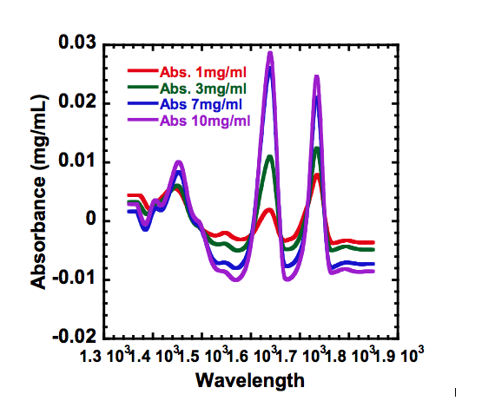
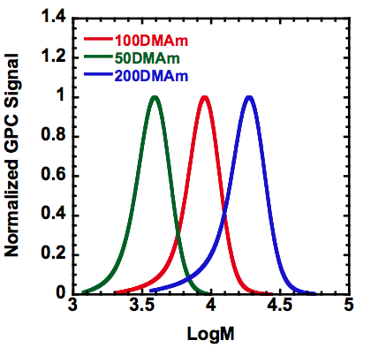
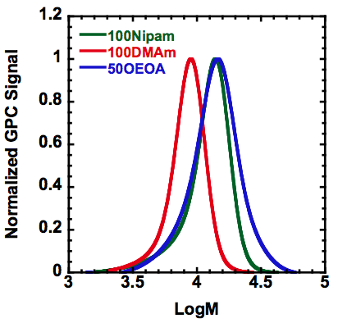
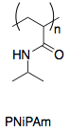
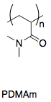

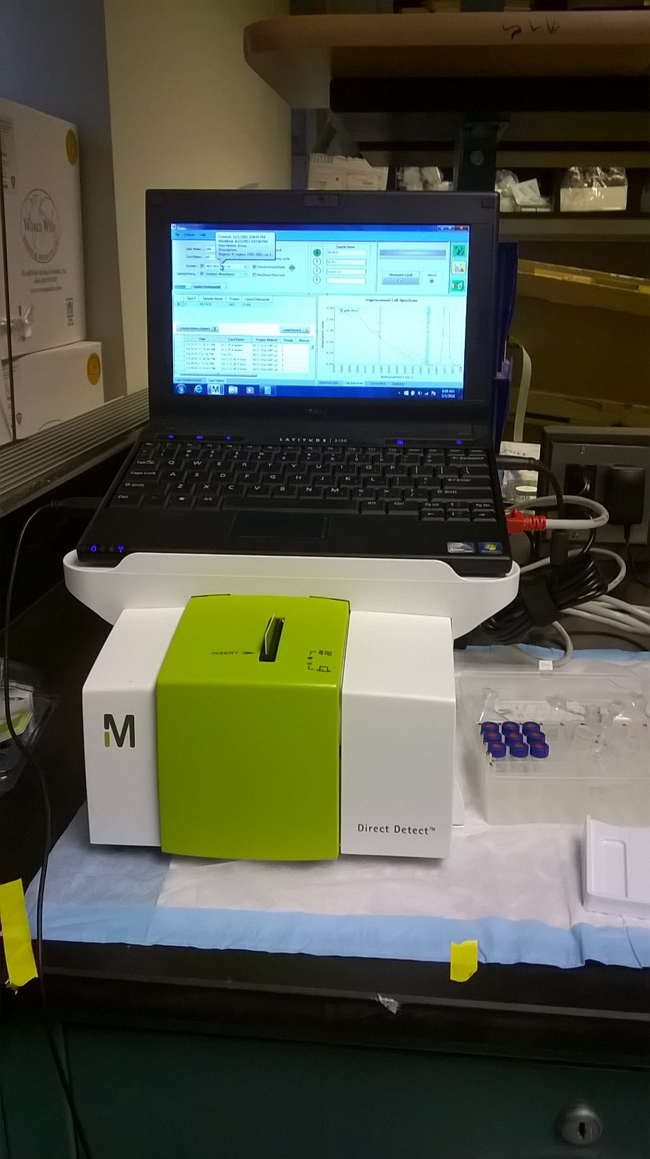
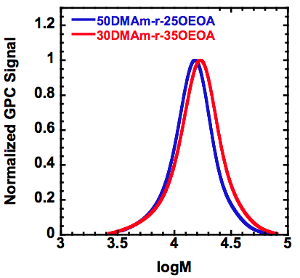
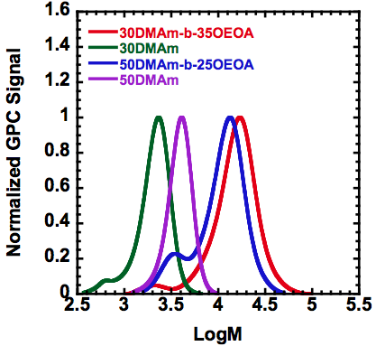
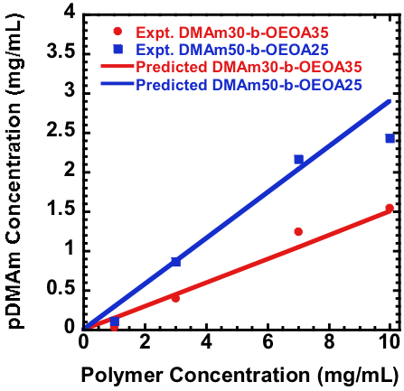
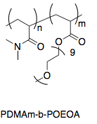
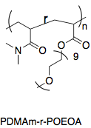
ANALYSIS OF POLYMERS THROUGH DIRECT DETECT Spectroscopy
Samantha Sloaneª, Dominik Konkolewiczª, Saadyah Averick^{b}
ª Department of Chemistry and Biochemistry, Miami University, Oxford, Ohio 45056
^{b} Laboratory for Biomolecular Medicine, Allegheny Health Network Research Institute, Pittsburgh, PA 15212
INTRODUCTION
Methodology
RESULTS CONT.
50DMAm-b-25OEOA
RESULTS
Polymers are very large molecules that are made up of repeating units of a monomer. This makes it challenging to determine the concentrations of polymers. However, a DirectDetect Spectrometer was found to be able to determine the concentrations much more efficiently. This device works similarily to an IR Spectrometer in it’s power and accuracy. Its method is to measure the amide bonds in protein chains, where the polymers are attached to. It is predicted that the DD spectrometer will only be able to measure the concentrations of 2 out of 3 of the polymers made because one does not contain amide bonds, as seen in figure 1.
Results showed that all polymers were reacted to at least 95% completion through NMR Spectroscopy.
 | Theor. Concen. | Exp. Concen.
200DMAm | 7 | 5.6
 | 3 | 2.5
 | 1 | 0.65
50DMAm | 7 | 6.1
 | 3 | 2.9
 | 1 | 0.56
100Nipam | 7 | 5.0
 | 3 | 2.8
 | 1 | 0.90
100OEOA | 7 | 0
 | 3 | 0
 | 1 | 0
100DMAm | 7 | 6.9
 | 3 | 2.9
 | 1 | 0.92
Graph 1: GPC Results of varying MW DMAm polymers
Graph 2: GPC Results of Nipam, DMAm, and OEOA polymers
Graph 5: Direct Detect Raw Data of polymer 50DMAm-b-25OEOA
Table 2: Concentrations of Homopolymers
Polymer | DMAm | OEOA | Weight Ratio DMAm/(OEOA+DMAm)
30DMAm-b-35OEOA | 30 | 35 | 0.15
50DMAm-b-25OEOA | 50 | 25 | 0.29
30DMAm-r-35OEOA | 30 | 35 | 0.15
50DMAm-r-25OEOA | 50 | 25 | 0.29
Figure 2: Direct Detect Spectrometer Device
Graph 3: GPC Results of two random polymers with different ratios
Graph 4: GPC Results of two block polymers with different ratios compared to the primary polymer
Figure 1: Monomer and Polymer Structures
Graph 6: Polymers 30DMAm-b-35OEOA and 50DMAm-b-25OEOA Concentration on DD
(Compared to Theoretical Concentration)
METHODOLOGY
Polymer | Theoretical OEOA/DMAmª | Ratios of DMAm/ OEOA^{b} | Units of DMAmª | Units of OEOA^{a,b}
30DMAm-b-35OEOA | 1.16 | 1.2±0.1 | 30.0±0.2 | 35±3
50DMAm-b-25OEOA | 0.50 | 0.56±0.03 | 50.0±0.3 | 28±2
30DMAm-r-35OEOA | 1.16 | 1.3±0.1 | 30.0±0.2 | 38±4
50DMAm-r-25OEOA | 0.50 | 0.6±0.1 | 50.0±0.3 | 30±5
Table 3: Estimated Molecular Weight Ratios
CONCLUSIONS
A total of 12 polymers were made. They were each made using a chain transferring agent, a monomer, a radical initiator, and a solvent. The chain transferring agent used was PAETC and the radical initiator used was AIBN. The solvent was ethanol. There were three different monomers used, DiMethyl acrylamide (DMAm), N-Isopropylacrylamide (Nipam), and Oligo(ethylene oxide) methyl ether acrylate (OEOA). Each solution was then deoxygenated and stirred to completion overnight. The polymer was then precipitated into hexane to eliminate the excess ethanol. Each polymer was then run on NMR to confirm reaction completion and to confirm ratios of each monomer, for the random and block copolymers. The polymers were then run on GPC to determine total molecular weight and average molecular weight and to compare the polymers with different degrees of polymerization. The DirectDetect Spectrometer was also run on each polymer.
Each polymer was made to at least 95% conversion. The OEOA polymers were not able to be seen in the IR of the DD spectrometer because of their lack of amide bonds, as seen in table 2. However, homopolymers of both DMAm and Nipam absorbed with concentrations similar to the expected concentration. For the combination polymers, the block polymers showed a ratio from NMR comparable to the theortical ratio of OEOA/DMAm. The random copolymers also showed the correct trend, with some dicrepancy between the expected and measured ratio, shown in table 3 and graph 6. The random polymers will continue to be analyzed and run again through DirectDetect Spectroscopy.
REFERENCES AND ACKNOWLEDGEMENTS
Dr. Dominik Konkolewicz and Dr. Saadyah Averick for startup funds.
Dr. Saadyah Averick for usage of DD Spectrometer and help with analyzing results.
Miami University Chapter of the American Chemical Society
Miami University Department of Chemistry and Biochemistry for use of NMR and materials
Table 1: NMR Spectra Results
a: from stoichiometry, b: from NMR

