Slide 1

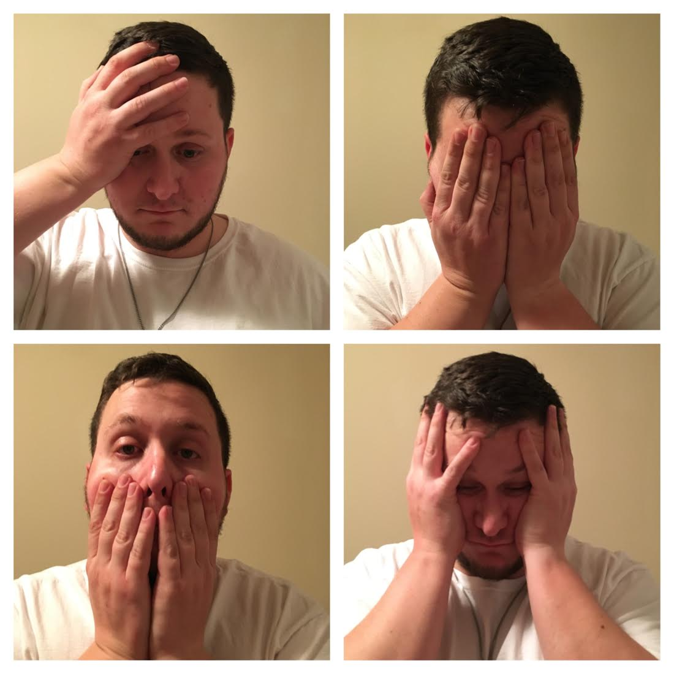
Feelings of Premarital Sexual Guilt based on Religious Views or Practices
Suzanne Simpson (Miami University, Family Studies & Social Work)
SAMPLE
Figure of respondents by Gender
RESULTS
Age 18+.
97 Respondents.
The mean age was: 24 years old.
85.6% of respondents were women.
13.4% of respondents were men.
1% of respondents were transgender.
4.1% of respondents identified as Jewish.
52.6% of respondents identified as Christian (Protestant).
17.5% of respondents identified as Catholic.
25.8% of respondents identified as Other.
I recruited my sample by using social media and by handing out flyers
There is no association between religiosity/spirituality and personally knowing someone who felt guilty after participating in premarital sexual behavior because of their religious views or practices, r=.211, p=.078.
According to the respondents, in general, people feel guilty after participating in premarital sexual behavior.
RESEARCH QUESTIONS
Bivariate Correlation Test Statistic
Do people feel guilty after participating in premarital sexual behavior because of religious views or practices?
Does a higher religiosity score (6-10), correlate with knowing someone specifically who has felt guilty after participating in premarital sexual behavior?
 | How religious/spiritual would you say you are on a scale of 1-10? With 1 being not at all religious/spiritual, and 10 being the most religious/spiritual.
In general, do you think people feel guilty about participating in premarital sex, because of their religion? | .064
Do you know anyone, including yourself, who has ever felt guilty after participating in premarital sexual behavior? | .080
It seems you indicated that you do know someone, possibly including yourself, who has ever felt guilty after participating in premarital sexual behavior. Do you think that person felt guilty because of their/your religious views or practices? | .211
MEASURES
Age – Self-defined.
Gender – Self-defined: Male, Female, Transgender, Other.
Religion – Self-defined: Judaism, Christianity (Protestant), Catholicism, Other.
Sexual Guilt – In general, do the respondents think people feel guilty after participating in premarital sexual behavior because of their religion? 1=Yes, 0=No.
Sexual Guilt – Do the respondents know someone specifically, including possibly themselves, that has ever felt guilty after participating in premarital sexual behavior? 1=Yes, 0=No.
Sexual Guilt – If the respondents do know someone specifically, who has felt guilty, did that person feel guilty because of their religious views? 1=Yes, 0=No.
DISCUSSION
77.32% of the respondents reported that they did think in general people felt guilty after participating in premarital sexual behavior because of their religion.
Over half of the respondents reported that they know someone, personally, including possibly themselves, that felt guilty after participating in premarital sexual behavior.
Most respondents reported that of the people they know, the they think they felt guilty specifically because of their religion.
That guilty feelings that come from participating in premarital sexual behavior, might not always be a bad thing. Sometimes trying to avoid that feeling could lead people to make better decisions.
**p<.01

