Slide 1
Managing E-Resource Usage Stats
Jennifer Bazeley
Miami University Libraries

Slide 2
“Oh, people can come up with statistics to prove anything, Kent. 14% of people know that.”
-Homer Simpson
Notes:
This is one of my favorite statistics-related quotes is from Homer Simpson: “Oh, people can come up with statistics to prove anything, Kent. 14% of people know that.” While I quote Homer Simpson with tongue in cheek, in essence he’s correct.
Statistics can tell a wide variety of stories, sometimes even conflicting stories, depending upon lots of variables, including issues like the quality of your raw data, the amount of data you’ve gathered, the audience for your statistics, and the methods and tools you use to manage your data.
What I hope to do today is to clarify some of the issues we’ve encountered in managing our usage statistics and perhaps offer you some new ideas or tools to address those challenges.

Slide 3
Challenges
Quantity
Quality
Standards
Audience
Notes:
While the specific challenges of managing e-resource usage statistics vary from institution to institution, I think for everyone, the greatest overarching challenge is the labor and time involved in the process. No matter what tool, system, or software you use, or how many staff you have, the task of gathering and compiling this data simply requires a lot of time.
For me, the challenges on this slide are what makes the whole process so labor intensive, and I’ll briefly address each of these. After that, I’ll talk more in depth about the tools we’re using to manage usage stats at Miami University and how those tools address the challenges. While your institution may have different collection and staffing situations, I hope that I can still provide you with a new idea or two.

Slide 4
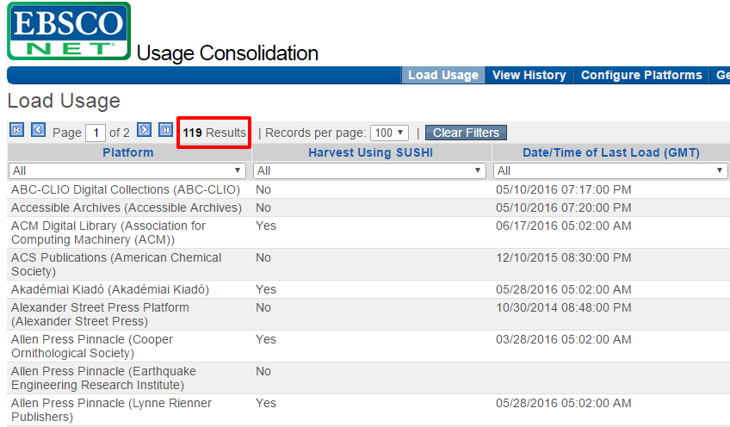
Challenge: Quantity
Notes:
The challenges associated with quantity are familiar to many of us. The number of available e-books, e-journals, and electronic audiovisual resources has exploded over the last 15 years. Even the smallest institutions are managing numerous e-resource platforms every year and large institutions may be managing hundreds of platforms. Miami is a medium-sized university, and we gather stats for about 120 different platforms that are a combination of locally and consortially purchased e-resources. The challenges in managing usage data for this many platforms arise from a variety of things. Each vendor’s platform is a little different and harvesting usage reports varies from vendor to vendor. Some vendors report on every title on their platform, even if you don’t subscribe, which makes for large and unwieldy report files. Some reports can only be generated via e-mails while others can only be generated and downloaded online. Reports come in several different formats and some vendors give you a choice of formats while others offer only one format. To be useful, usage reports must be stored somewhere—on a server or in the cloud, and those reports need to be accessible to multiple people.
With this quantity and variety come the challenges of staffing—who oversees all of this work and who performs the tedious tasks of gathering, compiling, or uploading an institution’s usage reports? At Miami, usage statistics are managed in technical services—I oversee the platforms, procedures, and processes, and I have one classified staff member and one librarian in the department who spend a few hours a week gathering and compiling our reports.
Local resources: 912 print subs, 149 print + online subs, 805 online only subs, 10,000+ e-books
Consortial resources: 231,898 e-books, 29,731 e-journals, 128,468 AV e-resources

Slide 5
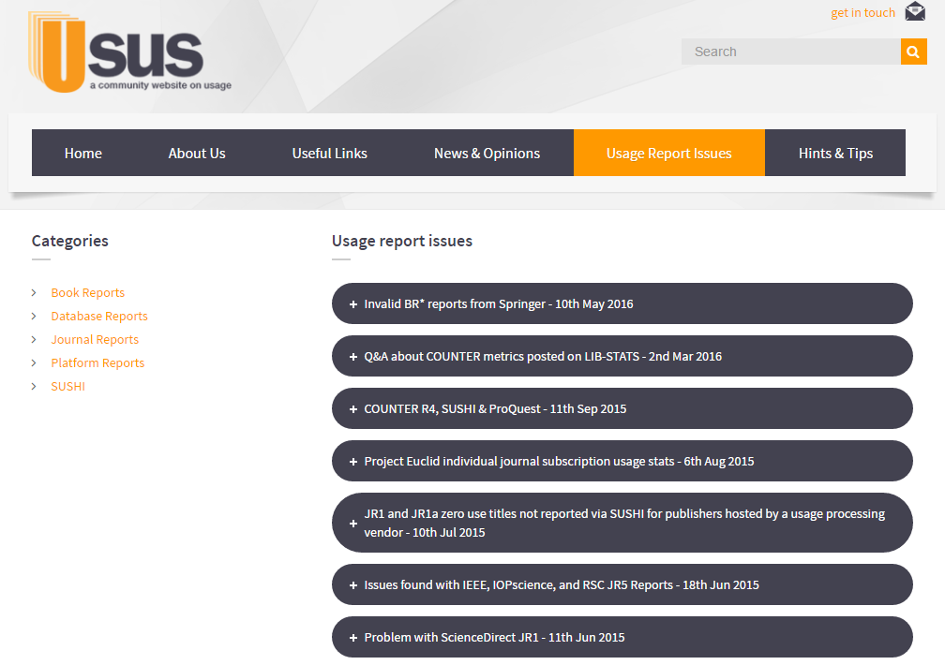
Challenge: Quality
Notes:
Compared to quality issues even 5 years ago, usage reporting has greatly improved. However, there are still challenges. Oliver mentioned Usus as a resource, and one of the things Usus does is track usage report problems, which is what you see on this slide. While usage reporting has gotten more consistent over the years, there are still issues that require us to update or completely refresh our usage reports. Technology is fickle: Publishers report usage data problems on their end somewhat regularly—servers fail or become inaccessible, a platform change causes data to be lost, etc. Sometimes vendors are able to go back and correct the problems, but sometimes the data is just gone.
Additionally, there are still some vendors (who will remain nameless) that don’t offer usage reports at all, which can be a huge problem for us when trying to justify the expense of an e-resource.

Slide 6
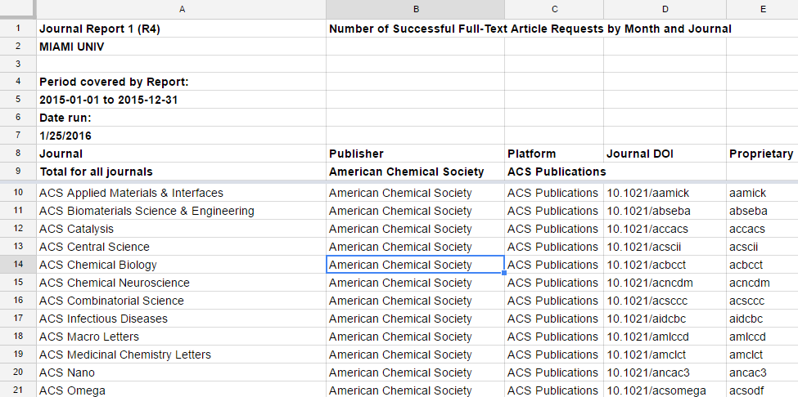
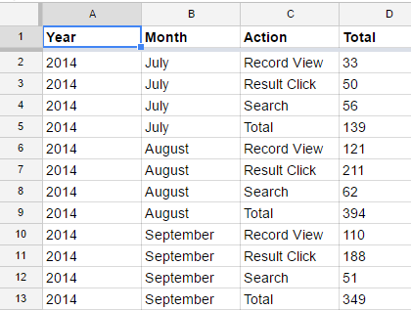
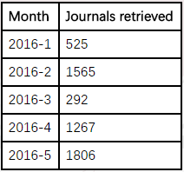
Challenge: Standards
Notes:
Our current industry standards in COUNTER and SUSHI lead to two different challenges. The first is that some vendors provide standardized COUNTER reports while others provide non-COUNTER reports. These reports are difficult to compare and lead to librarian confusion—all three reports on this slide are journal usage statistics but look drastically different from one another. I’m used to looking at them and knowing how to interpret them because I look at them every month. But a library selector or bibliographer who looks at these once a year for a serials review may not remember what each of these reports really indicates.
The second challenge is standards compliance. While many vendors who claim standards compliance are completely compliant with COUNTER and SUSHI standards, there are some who are not. This can be very frustrating when working with those reports in any sort of consolidation tool or software. The vendor claims to be compliant, but when you attempt to compare their report with another vendor’s or load it into a consolidation tool, the process fails due to the lack of compliance. This means additional staff time spent in manipulating these reports to make them usable. Oliver has addressed some of this challenge through the creation of Compliance Testing and Data Analysis Templates for COUNTER Reports, which allows us to more efficiently fix compliance problems.

Slide 7
Challenge: Audience
Librarians/Staff
Administration
Patrons
Notes:
One of the biggest challenges with usage reports, whether they are COUNTER compliant or not, is that they’re not that intelligible to anyone who doesn’t look at them on a regular basis, which is almost everyone. I’m frequently asked for e-resource usage information to justify expenditures, make subscription decisions, or provide material for things like the library’s annual report. While raw usage reports are necessary to calculate things like cost per use, they are not helpful when talking to administrators or creating public-facing reports. At Miami, we provide access to our raw usage reports to our librarian liaisons and we also provide cost per use data to them for our local subscriptions. This gives librarians who are comfortable with raw reports the option to combine them with other types of data, such as subject areas, fund codes, or impact factors. For administrators and patrons (in the format of library reports like our annual report), I identify interesting usage patterns or trends and create a visualization.
While many of the commercially available usage software choices available are able to provide clean and consolidated usage reports along with some graphing and visualization capabilities, the interfaces of these products are not always easily learned by librarian staff who don’t work with them on a regular basis.

Slide 8
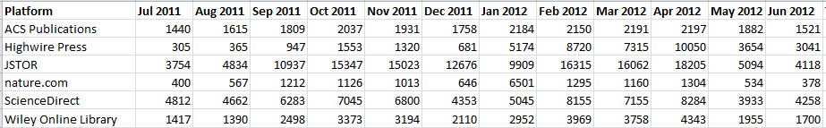
Use of Journal Platforms by Month (FY12)
Notes:
Raw Data: Platforms with Highest Use FY12
Made in Excel
This is an example of the raw data I compiled detailing journal usage across our most popular platforms during fiscal year 2012. While I love an Excel spreadsheet, this is not a particularly accessible way to present data. Numbers can be impressive but it’s almost impossible to identify any trends or tell any stories from this format, other than noting that some months look impressively high.

Slide 9
Use of Journal Platforms by Month (FY12)
Notes:
In order to tell a story and make the data accessible at a glance, I used Excel to turn it into this graph.
Not only does this graph make it clear which platforms were the most used in FY12 (JSTOR, by a lot), but we can also easily identify trends across platforms and over time. Unsurprisingly, usage is lowest in the summer months, which is indicative of the fact that we have few summer classes at Miami and that many faculty are on hiatus. Peak months are the same across most platforms and generally occur in Sept-Oct and Apr-May, which fits in with what we know—these are the busiest months of the fall and spring semester for most undergrads—a time when many midterm projects are due and when the libraries are physically at their busiest. However, an interesting outlier is the month of January—during this month, the Nature platform hits its highest usage and the JSTOR platform hits it’s lowest usage. This fits in with what we know about Miami’s campus in January—there are very few students around but many faculty remain on campus over the winter break to work on their research. This indicates that the primary users of our Nature titles are faculty and the primary users of JSTOR are our undergraduates. If I hadn’t combined all of these platforms into the same graph, I might not have made these observations.

Slide 10
Tools
Free/Low Cost
  Excel
  Google Drive / Spreadsheets
  LibGuides
Commercial
  Ebsco Usage Consolidation
  EBSCOnet
Notes:
At Miami, we are currently using two different tools to manage usage statistics. This sounds time-consuming but each method serves a different need.
When I began working at Miami in 2009, no one had ever compiled usage statistics for our e-resources and for many of our vendors, e-access hadn’t even been set up correctly. After fixing access issues, I realized there was a need for usage statistics to aid in decision making processes—librarians were asking for usage and downloading reports and emailing it to individuals quickly became inefficient. We did not have money in our budget to purchase usage software, and I needed a self-service system that was easy to update and would allow librarians to access our usage reports as they needed them. To accomplish that, I started by using the free or low cost tools that were available to us at the time. Those tools were Excel, Google Drive, and LibGuides.

Slide 11
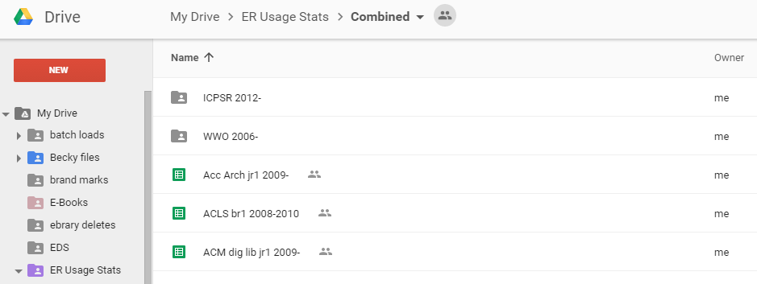
Google Drive
Notes:
We use Google Drive both to manage our usage stats reports and to share them with others. Google Drive helps us to address both the quantity and audience challenges. Google Drive currently allows for 15 GB of storage, which more than meets our quantity needs, and Google spreadsheets are already familiar to almost all of our staff.
I started the process by gathering whatever usage stats were available for our existing subscriptions, and where possible, saving them as Excel files on my hard drive. In order to manage and share them with staff in our library, we uploaded them to a shared Google Drive account that we had created for our tech services department. We currently have about 5 years worth of usage data stored there, in about 211 separate files. To date, we have not run out of room in our Google Drive, which currently has 15 GB of storage (we’ve used about 1 GB thus far). Staff who update our usage reports monthly have access to this Drive account and simply copy and paste the updated statistics into the relevant Google spreadsheet. One of the great features of Google Drive, is that it allows us to search within all of the spreadsheets and folders in our drive account. This can be really helpful in locating specific titles or ISSNs when we’re uncertain which report they might be contained in.
In addition to managing our reports here, Drive also allows us to share view-only versions of the spreadsheets with all library staff. We do not provide full access to our Google Drive account to all staff and librarians because that would allow everyone to edit reports, which is dangerous. By providing a link to a view-only spreadsheet, librarians can view the spreadsheet, sort or filter it without making changes to the original file, and download it into Excel on their computer if they want to manipulate the file further.
As an added benefit, Miami University moved from using Microsoft Outlook to using Google Apps for Education 3 years ago. This makes sharing Google Drive documents with individual staff members even easier, because everyone in the institution is using Google Drive.

Slide 12
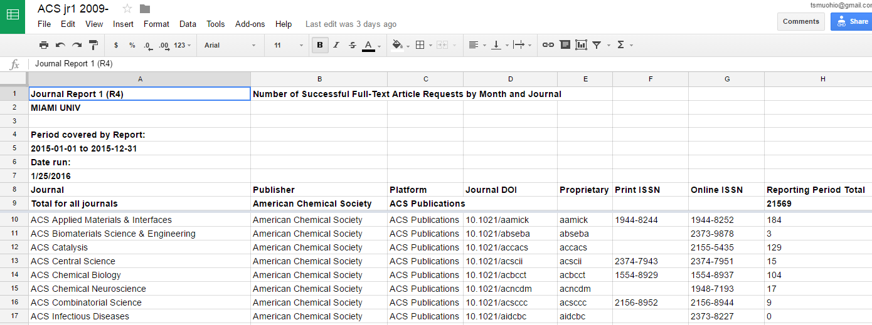
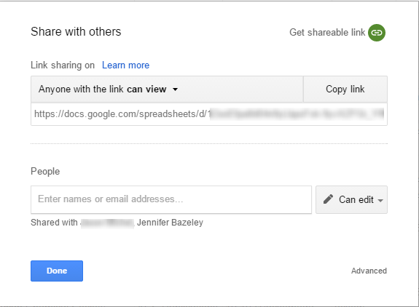
Google Docs – Share
Notes:
Google spreadsheets now have much of the same functionality as Excel, so we are able to easily format reports to make them more readable. The “share with others” functionality that you see here is incredibly easy to activate, and can provide a link to share or the ability to share editing capabilities with specific users. For the few staff in tech services who maintain these reports, we shared editing privileges, but for all staff, we just provide the shared view-only link.

Slide 13
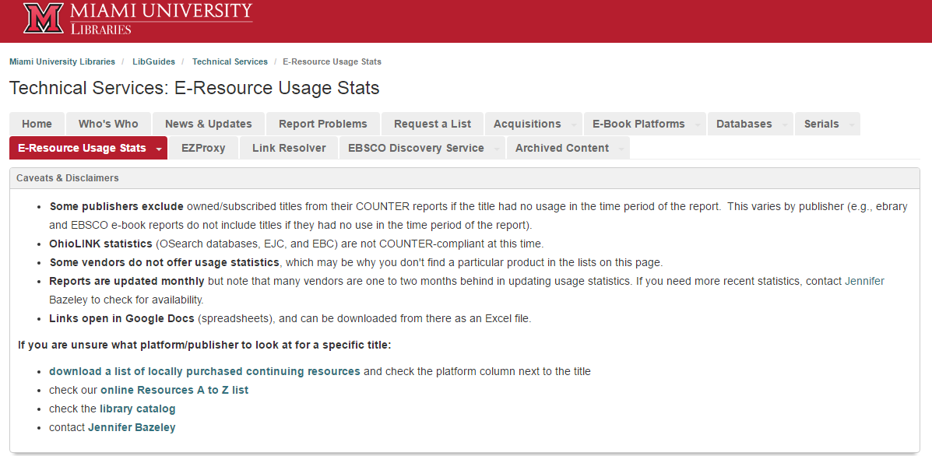
LibGuides
Notes:
The way that we share links to each of our usage reports is through an internal LibGuide. We have maintained a tech services LibGuide for internal staff communications for about 5 years now. It was the logical place to put our usage stats to make them available to all staff.
The LibGuide helps us to address all of our challenges. LibGuides can accommodate as many links as you require and we can add any and all information about reporting nuances and existing standards that we feel is necessary. At this point, all of our staff are intimately familiar with the LibGuides interface, as we’ve been using it for close to 7 years.
We have a dedicated page for e-resource usage stats where we provide links to the reports but also general information about usage reporting and the COUNTER standard. We include this additional information to try and reduce the number of questions tech services staff get about this page, and to make these reports as self-service as possible.
In this slide, you’re looking at the top of the guide, where we provide caveats, disclaimers, and other info that librarians tend to forget--for example, the fact that some publishers exclude titles from usage reports if they have no usage in a given time period. This is something that’s easy to forget if you only look at these reports once a year.
I also include a link here to a list of our current local subscriptions that tells users which vendor’s report to look at for a particular title—as you’ll see in the next few slides, reports are organized by format and then by vendor or platform, and it can often be hard to identify the platform a journal resides on.

Slide 14
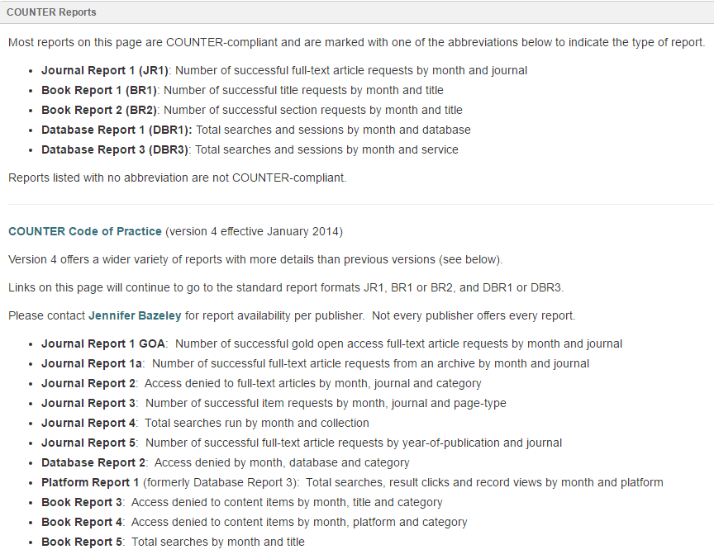
LibGuides
Notes:
This is the middle of our usage stats guide, where I’ve listed information about COUNTER-compliance and the COUNTER standard. Again, this information is here in an effort to make the reports on this page as self-service as possible, and to cut down on questions to tech services staff.

Slide 15
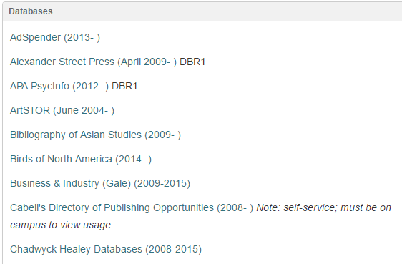
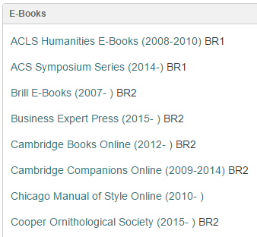
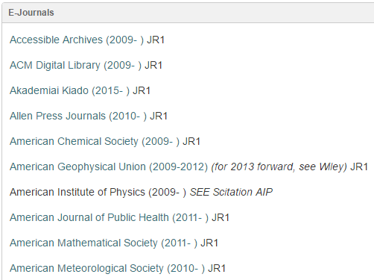
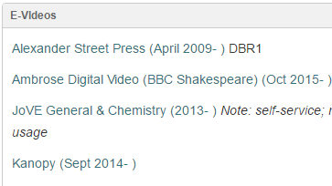
LibGuides
Notes:
At the bottom of the guide, we have five boxes, one for each format of materials including e-books, e-journals, databases, and e-videos, as well as a box with links to consolidated reports that we create in our EBSCO usage software, which will show up on a different slide.
Within each format box, reports are listed and linked alphabetically by vendor or platform, include the start year of the usage stats, and the type of COUNTER report, if a report is COUNTER compliant. If no COUNTER report type is listed, then that indicates a report is not COUNTER compliant.
Setting this up was initially labor intensive, but once it’s set up, it’s actually quite easy to maintain. The only changes that are required in these boxes are when a platform needs to be added due to new subscriptions or a platform change. When a platform changes, for example when the American Geophysical Union journals moved to the Wiley platform, we close out the date range next to that link and direct the user to the current vendor’s report with a note.

Slide 16
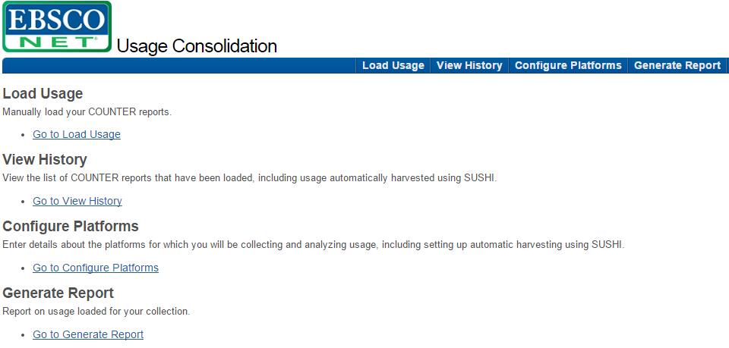
EBSCO Usage Consolidation
Notes:
In addition to our Google Drive and LibGuide, we are now also using EBSCO’s Usage Consolidation software. In 2012, I was able to beta test Ebsco’s Usage Consolidation software and as a result, I was able to make a case to our library administration for subscribing to this product, which we have had ever since.
Usage Consolidation fills some gaps in managing our usage statistics that our Google Drive/LibGuides solution could not, primarily the automating of the harvesting process via the SUSHI protocol, and the ability to easily combine multiple COUNTER-compliant reports across vendors.
Like all of the commercial usage software out there, this tool addresses some challenges but compounds others. It addresses the quantity problem by creating greater efficiencies through the use of SUSHI to harvest many of our monthly stats automatically. Additionally, UC makes the process of combining COUNTER reports across vendors incredibly easy.
Where this tool (and most others) are problematic, are in dealing with quality issues. For vendors that are truly COUNTER compliant, reports are easily uploaded and for vendors that are truly SUSHI compliant, those reports don’t even require manual upload. For vendors that claim to be COUNTER compliant but are actually not producing COUNTER compliant reports, more work is created for staff because they have to edit reports manually before the software can successfully ingest them. Oliver’s tool for transforming reports into COUNTER compliant reports goes a long way towards addressing this issue, but is not currently integrated into the UC software, so is still a separate step.
And like any tool that integrates such a large amount of metadata, post-ingestion clean-up is still required for many reports. Titles and ISSNs change and the software’s knowledgebase may not update at the same time as a vendor’s reports, forcing staff to take extra time to manually match ingested titles.
I also want to note that we do not give access to this interface to all of our staff, only those who maintain and update our usage stats. This tool addresses our audience needs through the generation of compiled reports and to some extent through its integration with EBSCOnet, which I’ll talk about shortly.

Slide 17
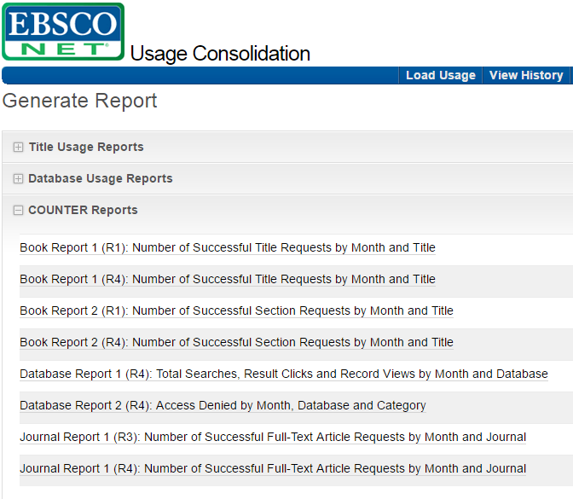
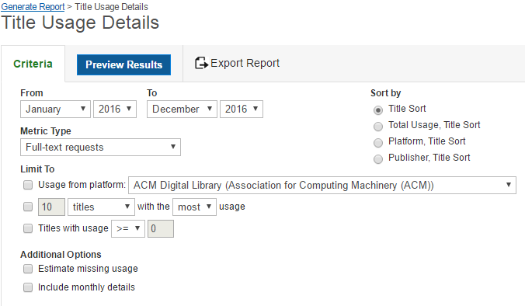
EBSCO Usage Consolidation - Reports
Notes:
One of the best features of this tool is the ability to produce reports across platforms that can be limited, sorted, and augmented in a variety of ways. Criteria for reports include date ranges of month and year, metric type (full text requests versus PDF full text requests among others), limiting to specific platforms, limiting to titles with or without usage, and the option to have the software estimate missing usage based on previous usage. This last option is interesting and the resulting report shows estimated usage in red. This can be useful for some of the large aggregator reports, where usage reports may not be consistent across titles and months.

Slide 18
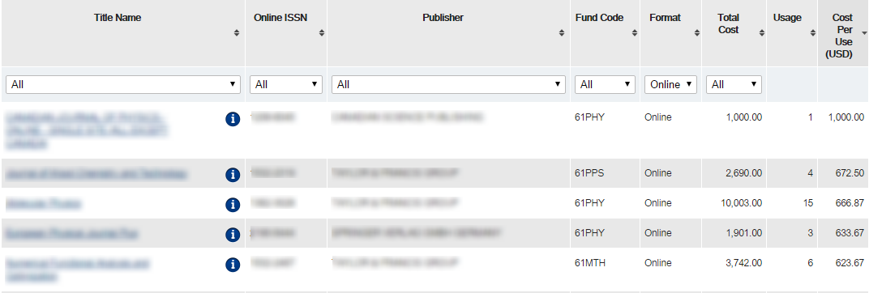
EBSCOnet
Notes:
One of the other great features of UC is that if you use Ebsco as your subscription manager, the data you load into UC is integrated with your subscription data in Ebsconet. This is reflected in 3 different places—in the browse display of your orders, in individual subscription records, and in the analysis reports offered in Ebsconet. If Ebsconet detects usage has been loaded for a title and you have a subscription, it calculates cost per use automatically and displays it both in the browse display and in the individual subscription records.
This screenshot is the browse display for our current subscription orders. For each title, total cost, usage, and cost per use is displayed and you can sort your list by any of these fields. This is an incredibly easy way to see highest and lowest cost per use for any given year of subscriptions.
The only downside to this integration is that material not ordered through Ebsco can’t be added to the interface, so if you purchase e-resources through a consortia or from other vendors, it won’t integrate into this platform. Perhaps this is a future enhancement?
We have Ebsconet accounts for tech services staff and for subject librarians who are comfortable with it, where they can look at analytics information on a title by title basis.

Slide 19
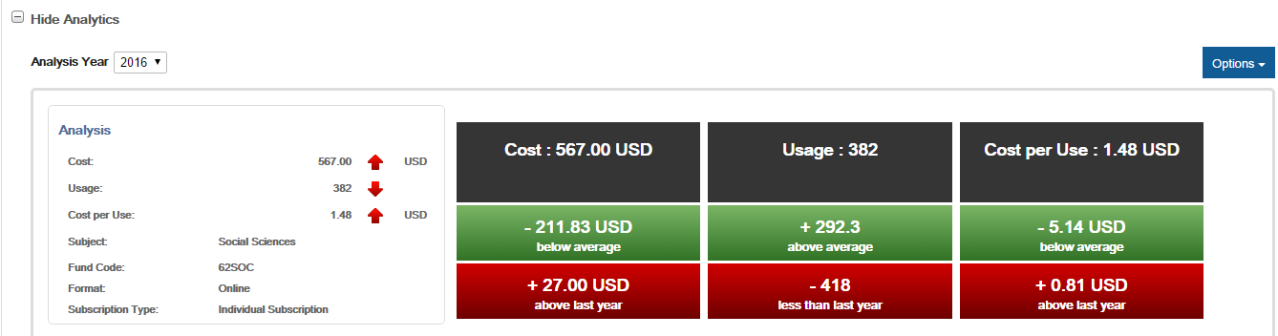
EBSCOnet
Notes:
If usage was loaded for a title in UC, Ebsconet will calculate and display details of cost and usage in the Analysis tab of the individual order. This is what the top part of the analysis display looks like. Without having to run a new search, I can see whether the price of this journal has gone up or down and whether usage has gone up or down since the previous year. Additionally, Ebsco generates the red and green blocks you see on the right side, which indicate how this title compares to the average and how it compares to last year’s numbers. In this example, the cost of the journal has gone up and usage has gone down, which means my cost per use has gone up. While the CPU is still reasonable at $1.48, it’s helpful to be able to see the changes all on one screen.

Slide 20
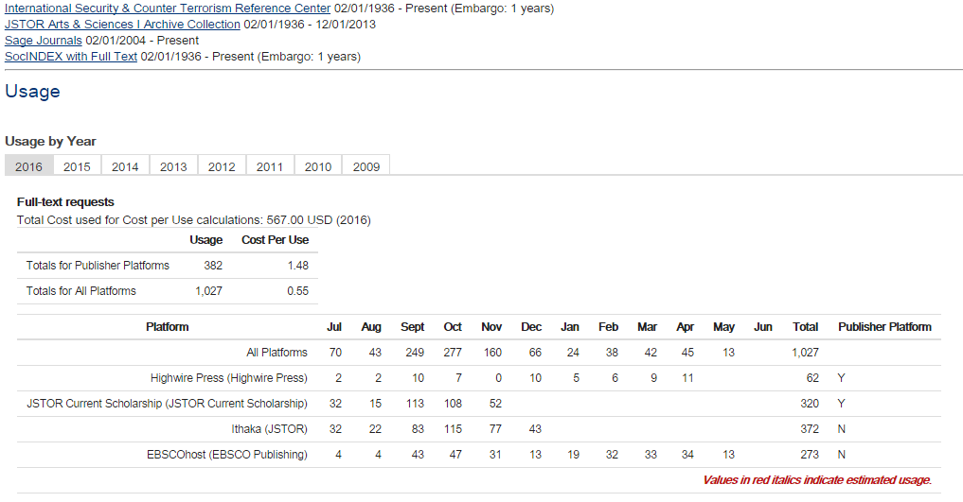
EBSCOnet
Notes:
This is the bottom half of the analysis display we looked at on the previous slide, where you can view all of your holdings for this title (taken from our Full Text Finder holdings), as well as aggregated usage for the title on all platforms. If you’ve loaded multiple years of usage data into UC , you can toggle between the years and view usage totals for publisher platforms as well as all platforms. Cost per use info is calculated using both the publisher platforms and the total for all platforms.

Slide 21
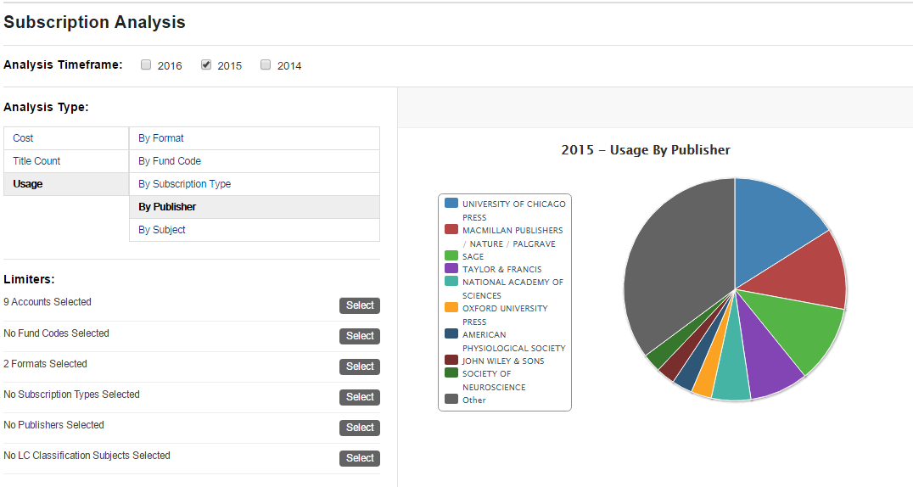
EBSCOnet
Notes:
This is the final place in Ebsconet where usage consolidation data is reflected. This is the Analysis Reports section of the software. It gives you the ability to look at your subscription information combined with usage over the last three years. In this example, I’ve chosen fiscal year 2015. The pie chart shows usage by publisher and I selected a format limiter of online and print+online subscriptions only, since print usage is not reflected in this software. Ebsconet generates the pie chart and also gives you the option at the bottom of the screen to view all of the data used to create the pie chart. That data can be exported into Excel so that you can manipulate it outside of the software.

Slide 22
“Do not trust any statistics you did not fake yourself.”
-Winston Churchill
Notes:
Based on everything that’s been said today, it’s clear that managing usage stats is still a challenge (we wouldn’t be here talking about it if it wasn’t). It helps to think about how much the standards and tools have improved over the years. Not only has the COUNTER standard been fine-tuned with every new version, but the number and quality of tools available to us manage these reports have risen significantly.
In my opinion, this is work worth doing, as long as we’re aware of the challenges, limitations, and variables within the ecosystem.
Do not trust any statistics you did not fake yourself.
Winston Churchill

Slide 23
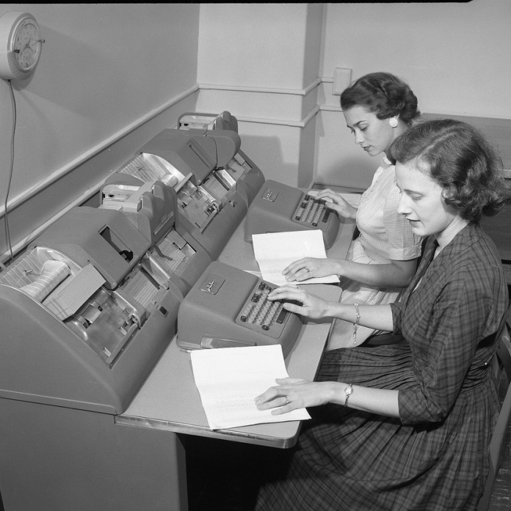
Jennifer Bazeley
Interim Head, Technical Services
bazelejw@miamioh.edu
http://www.flickr.com/photos/cushinglibrary/3876088472/in/photostream
Notes:
Questions

