Slide 1


Transfer Today:
Updates on the Transfer Code of Practice
Jennifer Bazeley & Elizabeth Winter
May 20, 2016
Notes:
Jennifer Bazeley and I are both members of the Transfer Code of Practice standing committee. We’re here today to talk about the Transfer Code of Practice, which is a NISO recommended practice, and to give some updates on Transfer.

Slide 2
What is Transfer?
A voluntary code of practice for journal publishers containing best practices for transferring and receiving journals.
Governed by a standing committee of librarians, publishers & other intermediaries
More than 60 endorsing publishers
Notes:
What is Transfer?
A voluntary code of practice for journal publishers containing guidelines for key steps to take when transferring and receiving journals.
Transfer is governed by a standing committee which currently includes 9 publishers, 5 librarians and 7 intermediaries. The group is led by two co-chairs, one who is a publisher (Alison Mitchell of Springer Nature) and one who is a librarian (myself), and meets every two months.
To date, the Transfer code of practice has more than 60 endorsing publishers, including CUP, Elsevier, NPG, OUP, Springer, T&F, Wiley.

Slide 3
Why is Transfer Important?
Unpleasant Surprises
“Where’s the journal content I paid for?”
Notes:
The Code helps publishers to ensure that journal content remains accessible by librarians and readers when there is a transfer between parties, and ensures that the transfer process occurs with minimum disruption. Publishers who register as Transfer-compliant are asked to endorse the Code, and to abide by its principles wherever it is commercially reasonable to do so.
This minimizes those unpleasant surprises when journal content doesn’t appear where it is expected to.

Slide 4
Problems for Librarians
Significance of problems caused
*ICOLC/Transfer survey, May 2011
164 respondents
65% North America, 14% Europe, 14.5% Asia-Pacific
Notes:
*ICOLC/Transfer survey, May 2011
164 respondents
65% North America, 14% Europe, 14.5% Asia-Pacific
91.4% of librarians surveyed* feel that the transfer of journals between publishers causes them “very” or “fairly” significant problems
Almost 50% of respondents spend a lot of time amending serials management systems and internal records as the result of a transfer
Problems for publishers, too:
Publishers were surveyed* in their roles as both ‘Transferring’ and ‘Receiving’ Publishers
The area where the highest percentage of Transferring Publishers had often experienced problems was in the transfer of subscriber information. Over 70% of respondents sometimes or often had problems in this area
Many Transferring Publishers did not know whether there had been communication with a large number of third-party organisations, including A&I services and link resolver companies
The areas where the highest percentage of Receiving Publishers had often experienced problems were the receipt of subscriber information and content files
55% of Receiving publishers grace online access to existing subscribers for one month or more
60% of respondents did not have a central coordinator responsible for overseeing the transfer of journal publishing arrangements

Slide 5
Problems for Librarians
Subscription information:
Most significant problem areas =
Access to current content
Time spent on amending records
*ICOLC/Transfer survey, May 2011
164 respondents
65% North America, 14% Europe, 14.5% Asia-Pacific
Notes:
The area where the highest percentage of respondents said they have often experienced problems was “subscription information” (delays in data being transferred to the new publishers, intermediaries not being informed)
When asked to list the two most significant transfer issues that cause them problems, librarians mainly cited access to current content and the time required to amend their systems.
Access to archives/backfiles, big deals, and pricing were also cited

Slide 6
Problems for Publishers
June 2011 TRANSFER survey of publishers*
Subscription information: Over 70% ‘often’ or ‘sometimes’ had problems as transferring publishers in this area.
Subscription information was also the most problematic area for publishers receiving journals, where 80% ‘often’ or ‘sometimes’ had problems.
*In both ‘transferring’ and ‘receiving’ roles. 151 respondents:
34 commercial, 16 society, 8 non-profit, 7 university press
Notes:
We followed-up the May 2011 survey of librarians with one that June aimed at publishers.
We had 151 respondents, and where they indicated the nature of their business, the majority were commercial publishers (as opposed to self-publishing societies, not-for-profits, or university presses).
The area where the highest percentage of transferring publishers had often experienced problems was with subscription information
and over 70% ‘often’ or ‘sometimes’ had problems in this area.
Subscription information was also the most problematic area for publishers receiving journals.
and 80% ‘often’ or ‘sometimes’ had problems.

Slide 7
Problems for Publishers
June 2011 TRANSFER survey of publishers*
60% had no central coordinator
Many unsure of communications to key third-parties
*In both ‘transferring’ and ‘receiving’ roles. 151 respondents:
34 commercial, 16 society, 8 non-profit, 7 university press
Notes:
60% of responding publishers did not have a central coordinator responsible for overseeing the transfer of journal publishing arrangements.
And, perhaps related to this, many (around half) of the transferring publishers did not know whether there has been communication with third-party organisations – including abstracting and indexing services, link resolver companies, and CrossRef (regarding Digital Object Identifiers).

Slide 8
Brief history of Transfer
2006: Established in 2006 as a UKSG working group
2007: Version 1.0 of the Code released
2008: Version 2.0 of the Code released
2010: Publisher/Librarian Co-Chairs: Alison Mitchell (Springer Nature) and Elizabeth Winter (Georgia Tech)
Early 2015: Became a NISO Recommended Practice
2015: Version 3.0 of the Code released under NISO
Notes:
Organized by Nancy Buckley then of Blackwell, Transfer began as a working group set up by UKSG in 2006 to investigate & recommend a standard for journal transfers and was driven by stakeholders in the publishing and library worlds.
The first version of the Code was released in 2007 in response to issues identified by the scholarly communications community when journal titles change platform providers or owners.
Version 2.0 of the Code released in 2008. The UKSG continued to host the project with Ed Pentz from CrossRef chairing the group.
In 2010 the group decided to implement publisher and librarian co-chair model to keep things moving, so Alison Mitchell and I agreed to take over as co-chairs. In 2014 Ed and Todd Carpenter of NISO began having some conversations about whether it might make sense for Transfer to become a NISO Recommended Practice. This move was approved by the appropriate NISO parties and formalized in 2015, which is also when Version 3.0 of the Code of Practice was released.
The Transfer working group then became a NISO Standing Committee and is as I mentioned is comprised of individuals from the publishing, agent, and library fields.

Slide 9
What does Transfer do and provide?
Transfer Code of Practice (v. 3)
  http://goo.gl/JiSQHf
Educational & Support Activities – presentations and publications
  http://www.niso.org/workrooms/transfer/papers_pres/
Transfer Alerting Service – over 600 registrants
  http://etas.jusp.mimas.ac.uk/
Notes:
At the core of Transfer is a voluntary Code containing best practice guidelines for both transferring and receiving publishers. It is detailed
There is an on-going, if informal, programme of ‘education’ and presentation to help different constituencies in the library supply chain better understand each other’s problems
Transfer Standing Committee members also provide education to help each of the stakeholders in this supply chain better understand each others’ challenges and priorities. Members of the Transfer standing committee regularly give conference presentations and write articles to promote the use and understanding of the Transfer code and services.
One of our most important accomplishments is the TAS, the Transfer Alerting Service, for communicating details of transitioning journals to over 600 registered recipients. Jennifer will talk more about this in a moment.

Slide 10
Highlights of the Transfer
Recommended Practice
For the Transferring Publisher and the Receiving Publisher:
Access to the title: Includes ensuring continued access to customers where the Transferring Publisher has granted perpetual access rights
Digital content files — current (born digital) and archive (digitized from print), if available: Covers transfer of digital files
Subscription lists: Covers early transfer of the subscription lists and an outline of subscriber data types
Notes:
Elizabeth

Slide 11
Highlights of the Transfer
Recommended Practice
For the Transferring Publisher and the Receiving Publisher:
Journal URL: Covers transfer of journal-related domain name(s) and provision of a link or redirect to the new journal home page Communication: Covers communication to customers (including electronic table of contents alert recipients) and relevant intermediaries
DOI name ownership: Covers changes to Digital Object Identifier (DOI) name ownership

Slide 12
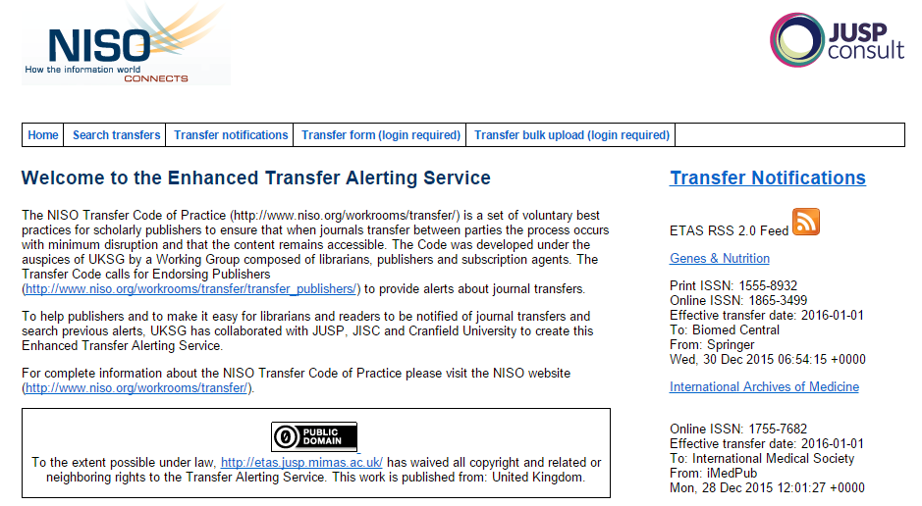
Transfer Alerting Service (TAS)
http://etas.jusp.mimas.ac.uk/
Notes:
Thanks Elizabeth. I’m going to talk about the transfer alerting service, which we refer to as TAS. The URL for TAS is on this slide if you would like to take a look at the site yourself. I’ll be addressing what TAS provides, how to access the information that resides in the TAS database, and some potential workflows for using TAS notifications in your daily work.
The transfer alerting service is a database of journal transfer information created by publishers and vendors who submit journal transfer information for titles they are responsible for. The database currently includes information about approximately 1,000 transfers made between 2009 and the present. Transfer compliant publishers submit basic metadata about transferring journals to the TAS database. Submissions can be done through this site on a title by title basis or through a bulk upload process. This metadata is stored in the TAS database and can be accessed in three ways--through the online database, via an RSS feed, or via an email listserv. The TAS home page displayed on this slide will provide you with links for browsing and searching the database as well as a link to the RSS feed. The link to the TAS listserv is not on this page, but is on NISO’s Transfer home page, and I’ll talk about that in more detail later.

Slide 13
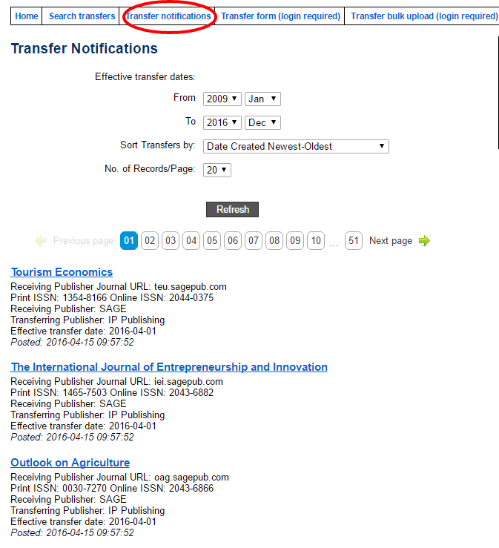
Database Browse
Notes:
The first and most direct method of accessing transfer notifications is to browse or search the TAS database online.
In order to browse submitted TAS entries in the database, click the “Transfer Notifications” link, circled in red on this slide. Browsing TAS allows you to see all submitted transfers. Viewing options include the ability to limit the date range of transfers, and to sort transfers by date created, by effective transfer date, or alphabetically by title. The browse results screen displays brief entries. Clicking on the title link for each entry takes you to the more detailed entry for the submission.

Slide 14
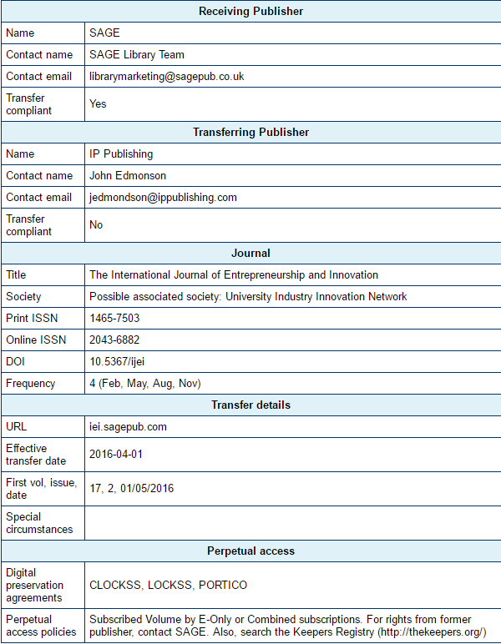
DatabaseEntry
Notes:
This is a typical TAS database record. A typical record for a transferred journal has 5 sections of information.
As you can see, contact information for both the receiving and transferring publishers are provided. These contacts are useful when there are transfer questions that can’t be answered by the information in this database. Entries also indicate whether or not the publishers are Transfer-compliant.
Journal information provided includes journal title, the name of the society or publisher of the title, print and online ISSNs, DOIs when available, and the journal’s frequency.
The transfer details section should include the new URL for the title, the effective date of the transfer, and the first volume or issue affected by the transfer. This section also provides a space for publishers to note any special circumstances associated with the transfer. Finally, the perpetual access section should indicate which digital preservation agreements (such as LOCKSS or Portico) the title is covered under as well as the publisher’s perpetual access policies. This section often includes a link to the Keepers Registry, which is an initiative hosted at the University of Edinburgh that monitors archiving arrangements for electronic journals.
It’s important to remember when looking at these entries that this information is submitted to the database by publishers and vendors without mediation. The information for any given journal transfer may include more or fewer details than what you see in the example I’ve provided here.

Slide 15
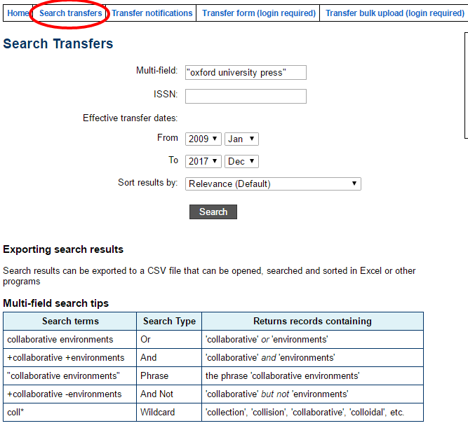
Database Search
Notes:
The TAS database is also searchable. Clicking on the “Search Transfers” link (circled in red) takes you to the database search page. Here you can search by title, publisher, or ISSN. Transfer dates can be narrowed by month and year, and you can elect to sort results by relevance (which is the default), by effective transfer date, or alphabetically by title. The search box can accommodate Boolean searching with and, or, and not, as well as phrase searching using quotation marks around a phrase. Wildcard searches are also possible by using an asterisk in place of a letter or letters in a word. Search examples are provided on the site, as you can see.
As an example, I performed a phrase search for “oxford university press”.

Slide 16
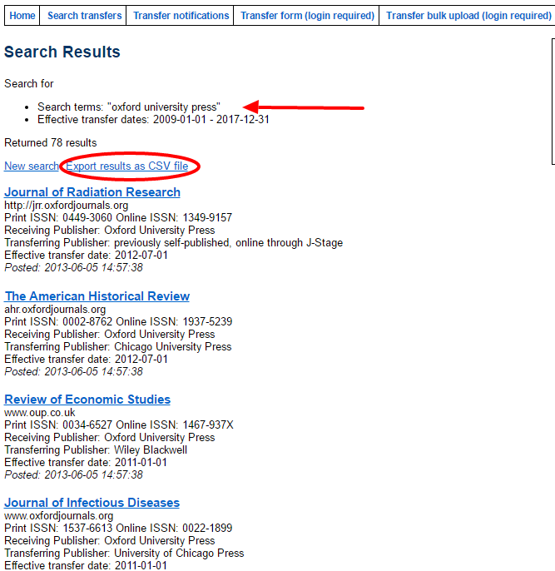
Database Search
Notes:
The database search results list displays the brief entries for each title with “oxford university press” as the receiving or transferring publisher. Like the browse display, I can click on an individual title to view a full entry. Search results also offer an added functionality--from this screen, I can export my search results as a csv file and open it in Excel.

Slide 17
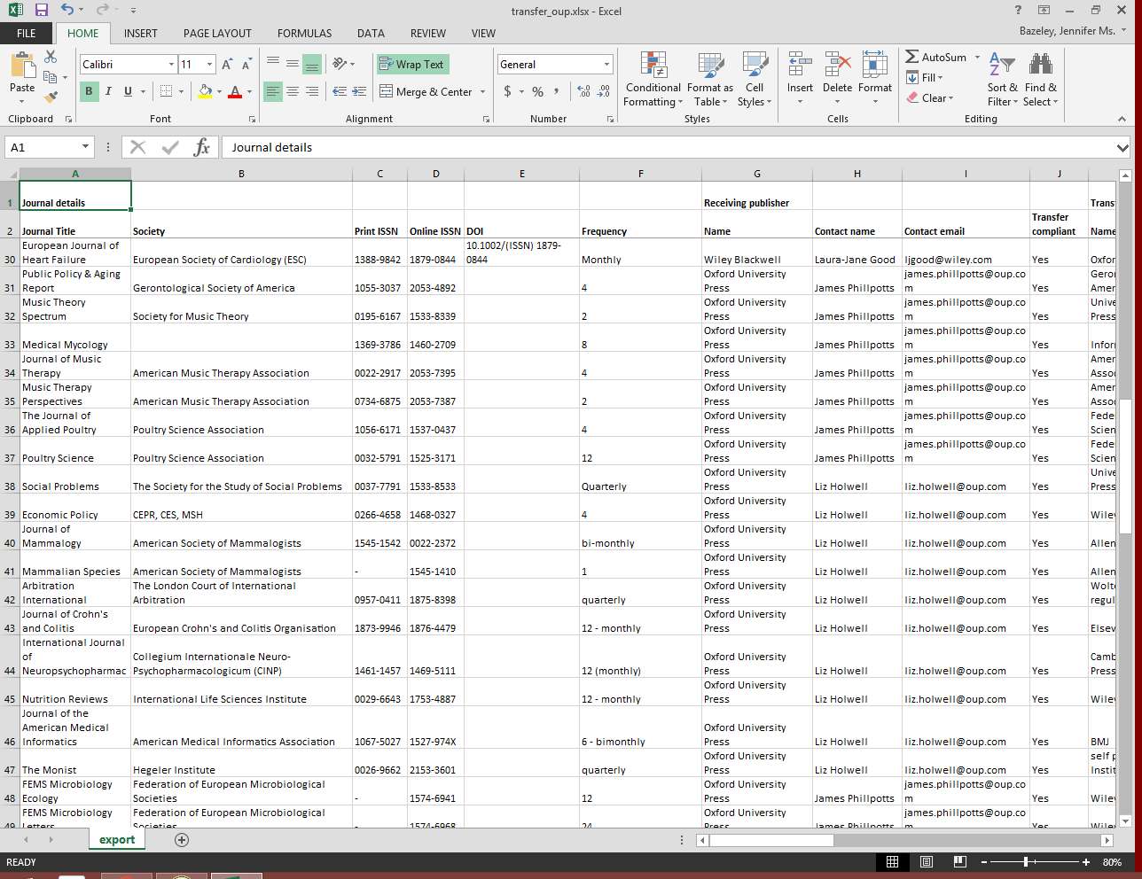
Export
to CSV
Notes:
The export feature allows you to download a csv file and create a spreadsheet with all the detailed information from the Transfer entries. This allows you to work on multiple transfers at once rather than on a title by title basis through listserv emails or RSS feeds, which I’m going to talk about shortly.

Slide 18
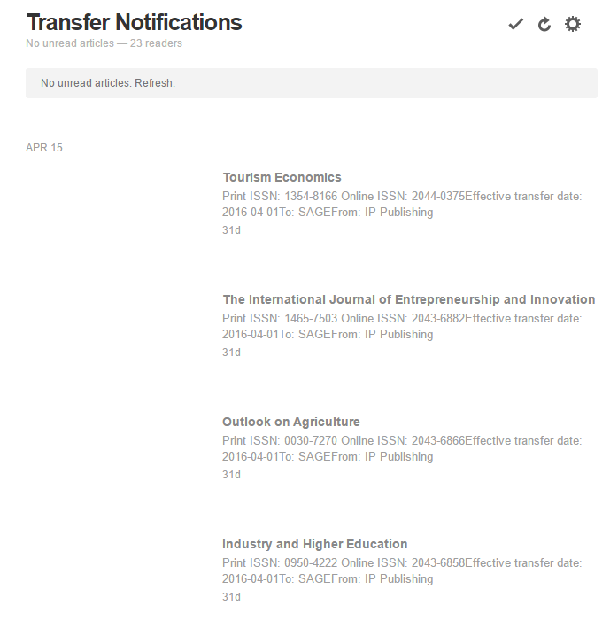
RSS Browse
Notes:
The second method of accessing TAS notifications is via an RSS feed. By using the TAS RSS feed, users who prefer not to browse or search the database manually can have TAS notifications delivered to the feed reader of their choice. This slide illustrates an example of what Transfer notifications look like when they arrive in my Feedly feed reader. Feedly is a free RSS reader (with some premium paid options also available). I like it because I can sign into it via Google, and Miami is a Google apps school. This means that my Feedly account is accessible with my university unique ID and password, which is convenient for me.
In most RSS feed readers, you can save, highlight, or bookmark entries that are important to you. So if I subscribed to any of these titles, I would mark them as “saved” in my Feedly account, so that I could easily identify them later.

Slide 19
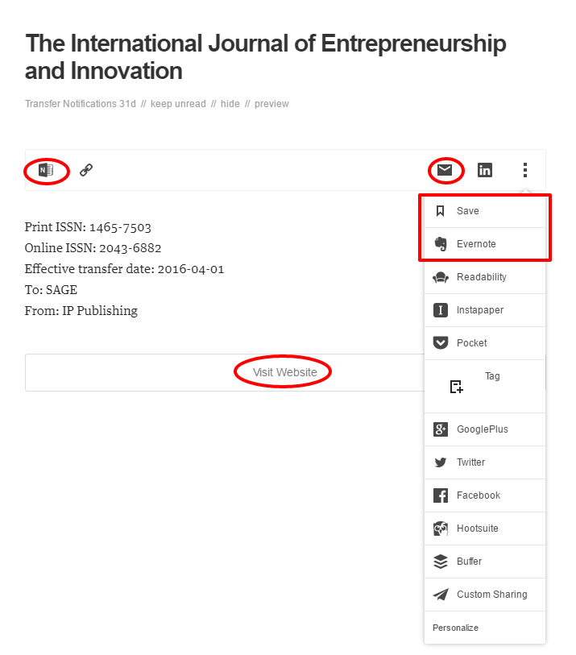
RSS Entry
Notes:
The RSS entries differ from the TAS database entries we looked at earlier in that clicking on the title doesn’t provide the same detailed view that it does in the TAS database. Instead, the feed reader provides a link to the TAS database site, which is in the center of the slide, circled in red. However, the feed reader does offer you additional options and tools that are not present in the TAS database. If you use tools like Microsoft OneNote or EverNote (also noted with red), you can populate this entry to those tools directly, via links that you can customize to appear either in the top left of the entry or in the dropdown menu on the right. You can also email this entry to yourself, which would allow you to adopt a workflow through your email’s inbox.

Slide 20
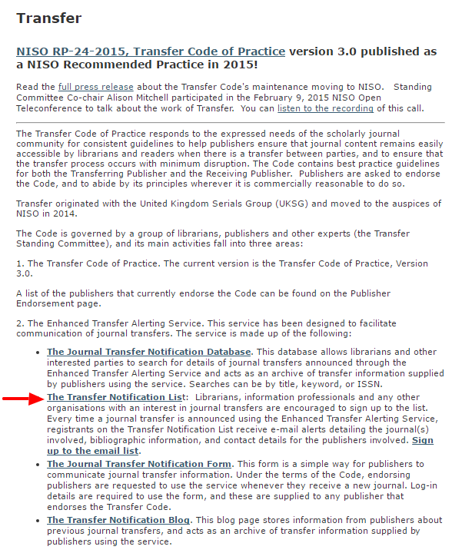
Transfer
Listserv
Notes:
The third method for accessing transfer notifications is through the Transfer listserv. This is probably the most popular method of accessing notifications because it allows you to receive TAS notifications directly in your email inbox. The listserv alerting service has more than 600 registered recipients, mostly librarians. The simplest way to get to the notification listserv site is to Google Transfer and NISO. The first search result should be the Transfer homepage, which you see on this slide. The link you see with the red arrow appears in the middle of the page and will take you to the listserv site where you can subscribe.
Personally, I like the listserv emails the best because I find that much of my e-resource workflow revolves around my email, and I use a combination of email tools and task manager tools to manage my journal transfers.
If you prefer to get notifications in your inbox, you can sign up for the Transfer listserv and you’ll receive an email like this each time a publisher submits a transfer to the database, or you can elect to receive a “digest” version of the listserv emails. It includes the same information as the RSS feeds and the TAS database entries that I showed you earlier.

Slide 21
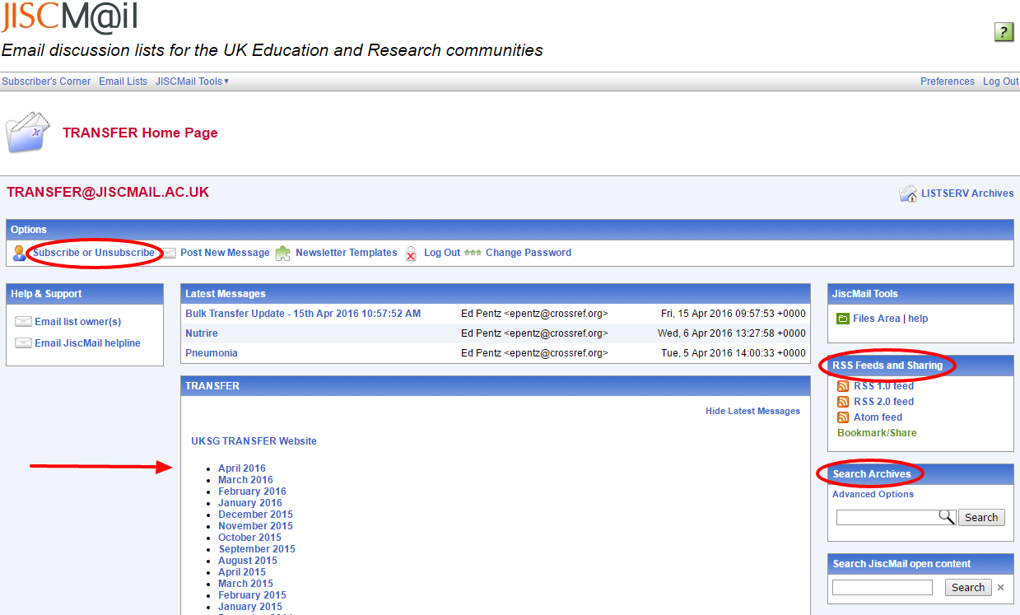
Listserv
Functions
Notes:
Once you are subscribed to the listserv and you log in here, you can access all of the listserv functions you are probably already familiar with.
Here you can change your subscription settings, browse the Transfer notification archives by month, access the RSS Feeds, and search the archives for specific titles or publishers.

Slide 22
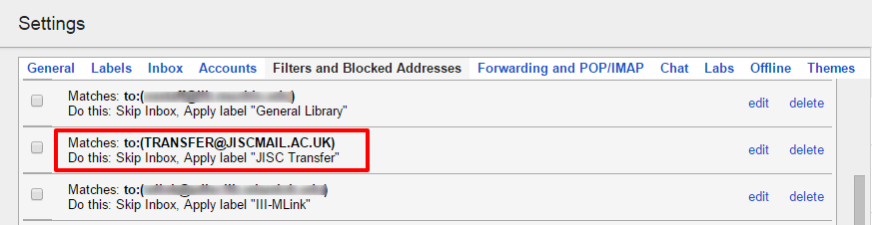
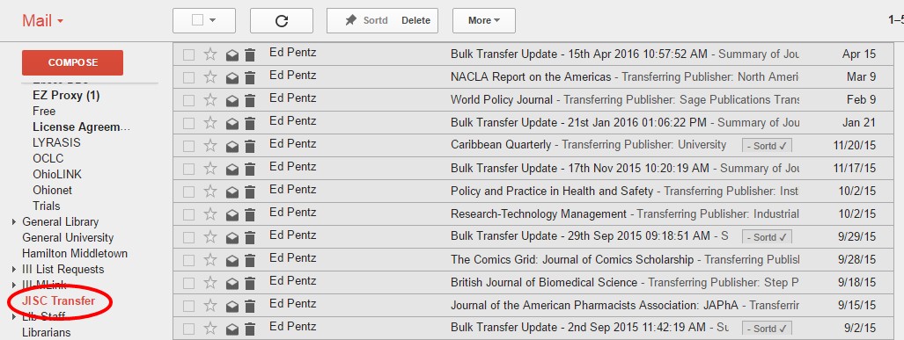
Listserv
Workflow
Notes:
As I mentioned earlier, the listserv emails are my preferred method of accessing Transfer notifications. I route the Transfer listserv emails into a Transfer-specific folder in my inbox. To do this, I set up a filter in gmail that pushes Transfer messages out of my primary inbox and into my Transfer folder. This allows me to look at them when I have time instead of letting them languish in my inbox for months. If a notification is for a title we don’t subscribe to, I simply delete the email. If we do subscribe, I push the notification into my workflow.

Slide 23
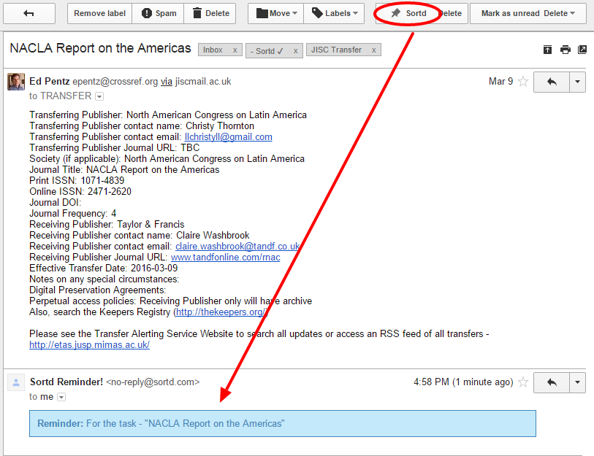
E-Mail
Workflow
Notes:
This is what an email notification looks like. It provides the same detailed entry as the TAS database entries. This slide illustrates how I manage Transfer notifications for titles I subscribe to. I use a free tool called Sortd that integrates with Gmail. Using this tool, I am able to add these emails to my Sortd “to do” list as well as set up a reminder that arrives in my inbox on the day of my choice. The email on the top is the original Transfer notification email and the email on the bottom is the Sortd reminder that arrived in my inbox on the date I selected.
At this point in the workflow, you could also set up a filter to push these task reminders to a colleague or colleagues with whom you might be sharing this work.

Slide 24
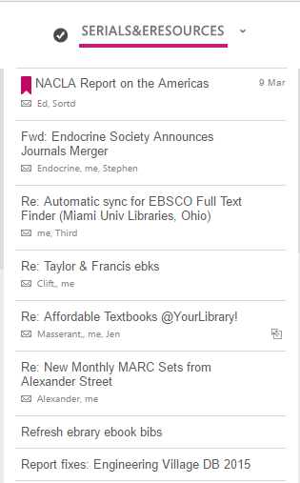
E-Mail
Workflow
Notes:
The final part of my workflow is to regularly check my Sortd Serials & E-Resources to do list, which you can see here includes a Transfer email entry notification at the top. Because I set a reminder date of March 9 on this particular email, it popped back into my inbox on March 9 so that I could address the transfer as part of my day to day workflow. Once the transfer is complete and I’ve updated all of my records, I mark this as complete in my Sortd to do list.
Most other task managers offer similar functionality, so if you’re using a different tool, look for email and reminder functionality.
Now that we’ve talked more in depth about the Transfer alerting service, we’re going to switch gears slightly. Elizabeth is going to discuss feedback from our users that resulted from our most recent Transfer user survey.

Slide 25
2016 TAS Survey
Early 2016
Distributed on
    TAS Listserv
    TAS Database Web Site
    NISO Transfer site
112 respondents
    93.4% library
    5.66% publisher
    0.94% library systems vendor
Notes:
Goals were to see how well the TAS was being used and received, and what we can do to improve it going forward.

Slide 26
TAS Survey Results
94% satisfied with the formats offered by the alerting service (.csv, email, RSS feed, etc.)
93.5% ‘satisfied’ or ‘very satisfied’ with the content of the alerts

Slide 27
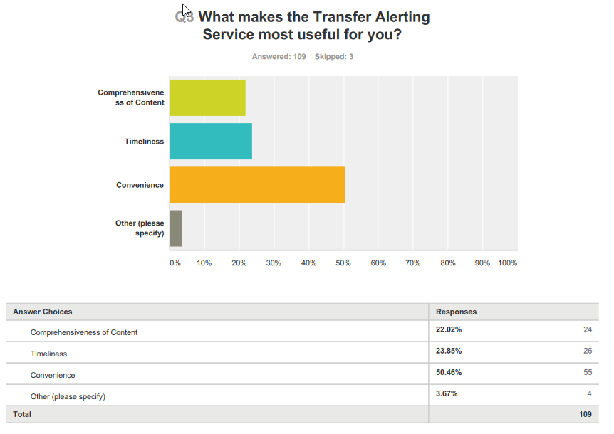
TAS Survey
Results

Slide 28
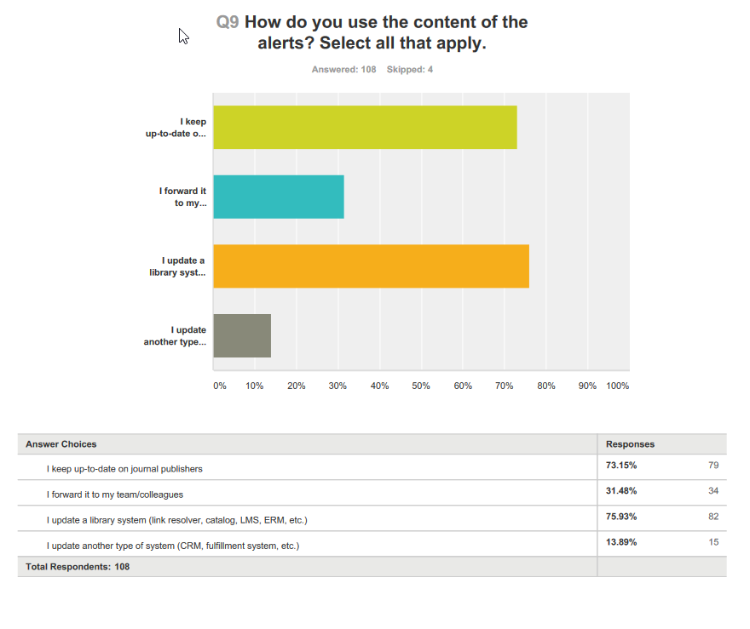
TAS Survey
Results

Slide 29
TAS Survey Results…Notable Comments
How did you keep track of transferring journals before using the TAS?
  I relied on publishers or subscription agents to tell me.
  Visiting each publisher's page. Subscribing to publishers' emails.
  I didn't.
  Print notebook - VERY inefficient!
  With great difficulty!
  Randomly.
  Badly.
Notes:
Elizabeth

Slide 30
TAS Survey Results…Notable Comments
Is there anything else that would make the service more valuable for you? Is there any functionality you think should be added?
    Maybe an API
    Might work well as a Twitter feed
    → More publishers notifying their journal transfers
    → I just wish that more folks adhered to the TRANSFER guidelines/Code of Practice... they're so valuable & useful <sigh>.

Slide 31
What’s Next for Transfer?
2016 priority goals:
  Goal 1: Future development of the TAS
  Goal 2: Outreach, education and training
  Goal 3: Evolution of the Recommended Practice
Other areas of focus:
  Marketing Transfer
  Encouraging publisher endorsement
  New logo soon, we hope

Slide 32
Links
Transfer at NISO (NISO RP-24-2015)
  http://www.niso.org/workrooms/transfer/
Transfer Notifications
  http://www.niso.org/workrooms/transfer/notifications/
Transfer - Participating Publishers
  http://www.niso.org/workrooms/transfer/transfer_publishers/
Notes:
Here are a few links to Transfer materials that you may find useful:
The first link goes to the NISO Transfer home page. This can also be found easily by Googling NISO and Transfer.
The second link will direct you to information about the three types of Transfer notifications I discussed today.
The final link provides a list of the publishers who currently endorse the Transfer code of practice. If you come across a publisher who is on the list but does not appear to be complying with the Transfer code, please contact the Transfer standing committee and we will investigate. We also encourage you to mention Transfer to publishers or vendors that you may have contact with who are not yet Transfer compliant.

Slide 33
Articles
Bannerman, Ian, Nancy Buckley, and Jennifer McMillan. 2008. "Project Transfer: A Publisher's Perspective." Serials Librarian 55, no. 3: 411-418.
Beals, Nancy and Paul Harwood. 2012. "Project Transfer: Findings from the Surveys of Publishers and Librarians Undertaken in 2011." Serials Librarian 63, no. 2:213-228.
Hutchens, Chad. 2011. "Journal Title Transfers: The Process, the Complexities, the Problems, and What the Transfer and KBART Working Groups are Doing to Address Them." Serials Librarian 61, no. 3-4: 389-395.
Mitchell, Alison, and Elizabeth L. Winter. 2012. “Project Transfer comes of age?” Learned Publishing 25, no. 2: 87-92.
Phillpotts, James, Devenport, Tim, and Alison Mitchell. 2015. “Evolution of the Transfer Code of Practice.” Learned Publishing 28, no. 1: 75-79.
(Also, thanks to Alison Mitchell and James Phillpotts for some of this presentation content!)
Notes:
As Elizabeth mentioned earlier, the Transfer standing committee works hard to educate our librarian and publisher users through presentations and publications. If you’re interested in further details on the history of Transfer as well as the surveys we’ve done on the project, please take a look at the articles on this slide.

Slide 34
Q&A
Notes:
We have time now for questions. We received a lot of feedback from registrants in advance of today’s webinar, and we tried to address some of the questions we saw in that feedback with our presentation. If you have other questions for us, please type them into the Q&A box in the webinar window.

Slide 35
Contacts
Elizabeth Winter
elizabeth.winter@library.gatech.edu
Jennifer Bazeley
bazelejw@miamioh.edu
Notes:
Thank you for taking the time to attend the webinar and learn more about Transfer. If you’re a librarian, we encourage you to try the transfer alerting service through any of the methods we discussed today. Please also feel free to contact myself or Elizabeth with any questions.
If you’re a publisher interested in becoming Transfer-compliant, please feel free to contact one of us for further information on becoming compliant.
Thank you.

