Slide 1


Code of Practice
Jennifer Bazeley
Coordinator, collection access & acquisitions
Miami university libraries (Oh)
ER&L 2017
Notes:
I’m Jennifer Bazeley, one of the librarian members of the Transfer Code of Practice standing committee. I’m here today to talk briefly about the Transfer Code of Practice, which is a NISO recommended practice.

Slide 2
What is Transfer?
A voluntary code for journal publishers containing best practices for transferring and receiving journals.
Governed by a standing committee of librarians, publishers & other intermediaries
Notes:
What is Transfer?
A voluntary code for journal publishers containing best practices for transferring and receiving journals. The code helps publishers to ensure that journal content remains accessible by librarians and readers when there is a transfer between parties, and ensures that the transfer process occurs with minimum disruption. Publishers who register as Transfer-compliant are asked to endorse the Code, and to abide by its principles wherever it is commercially reasonable to do so.
Best practices in the code include:
formalized roles/responsibilities for transferring and receiving publishers
timelines for transfer actions and communications
suggestions for transferring digital content and subscriber lists, guidance on handling identifiers and URLs
use of the Transfer alerting service
advice on existing licensing terms and preservation agreements
Currently working under version 3.0, finalized 2014/2015. Key changes to Version 3.0:
Introduction of new subsections dealing with content published ‘ahead of paginated issue’ as well as new content and data types to keep up with market practices, including online editorial systems, content in production and publisher-supplied usage data.
Best practices for dealing with the details of institutions receiving the journal via deeply discounted or ‘big deal’ collections and readers who have gratis access to journal content.
Changes related to journal URLs included guidelines for transitional URL links or redirects as well as preferred practice regarding HTTP301 permanent redirects.
Updates were also made to advise on communication to journals’ e-alert registrants, likely audiences for communications from receiving publishers (publishers to whom journals are transferring) and a new subsection highlighting the existence of the Transfer Alerting Service (TAS) – an ‘the Transfer Code of Practice became a NISO Recommended Practice’--an important benefit provided by Transfer.
Transfer began as a working group set up by UKSG in 2006 to investigate & recommend a standard for journal transfers and was driven by stakeholders in the publishing and library worlds. From 2007-2014, Transfer was a UKSG initiative, but in 2014, Transfer moved under NISO’s umbrella as a recommended practice.
Transfer is governed by a standing committee which currently includes 9 publishers, 5 librarians and 7 intermediaries. The group is led by two co-chairs, one who is a publisher and one who is a librarian, and meets once every two months.
To date, the Transfer code of practice has more than 60 endorsing publishers, including CUP, Elsevier, NPG, OUP, Springer, T&F, Wiley.

Slide 3
Why is it important?
Journals change publishers frequently
Lack of communication during transfers = disruptions in supply chain
Loss of library subscription access
Notes:
As I’m sure most of you know, journals change publishers regularly through acquisitions and divestments, among both commercial and society publishers.
A lack of communication during the transfer process can cause disruptions in every aspect of the supply chain. Journal transfers affect all the systems we work with, including Discovery products, A to Z software & link resolvers, our Subscription vendors, and more.
This disruption can ultimately result in loss of library subscription access and angry patrons. Many of us are familiar with these disruptions, which usually occur at the beginning of the calendar year, when many transfers take place.
The recommendations in Transfer’s code of practice attempt to minimize these disruptions and provide a useful framework for encouraging a degree of self regulation on the part of publishers.
Transfer also allows for an ongoing, informal program of education to help each of the stakeholders in this supply chain better understand each others’ challenges and priorities.

Slide 4
What does Transfer offer?
Transfer Code of Practice (v. 3)
  http://goo.gl/JiSQHf
Educational & Support Activities
  http://www.niso.org/workrooms/transfer/papers_pres/
Enhanced Transfer Alerting Service
  http://etas.jusp.mimas.ac.uk/
Notes:
Transfer is more than just a standard. For publishers, the Transfer code of practice can provide a useful framework for encouraging consistent internal transfer procedures.
Transfer also allows for an ongoing, informal program of education to help each of the stakeholders in this supply chain better understand each others’ challenges and priorities. Members of the Transfer standing committee regularly give conference presentations and write articles to promote the use and understanding of the Transfer code and services.
The Enhanced Transfer Alerting Service, used by both publishers and librarians, eases the disruption of journal transfers by aggregating and disseminating transfer information via one source.
What’s next for Transfer?
Future development of the TAS, including an application programming interface (API), which has been developed and is currently being tested.
Also working on future funding for TAS.
Working on development of Transfer website to provide more clarity for each stakeholder group.
Standing committee currently looking at code evolution; future considerations include issues related to deferred revenue when journals transfer, as well as issues that arise when titles go open access.

Slide 5
Read About Transfer
Winter, E., (2016). Transfer: progress and prospects. Insights. 29(3), p.280–286.
DOI: http://doi.org/10.1629/uksg.324
Notes:
Transfer committee co-chair Elizabeth Winter recently wrote a great overview article about Transfer published in the UK journal “Insights” and is freely available to read online.
The Transfer Code of Practice is a Recommended Practice of the National Information Standards Organization (NISO). It seeks to address the issues that can arise when journals change publishers, and its administration is governed by NISO’s Transfer Standing Committee. This article will discuss Transfer’s progress and prospects, with topics including the initiative’s history, elements of the Recommended Practice, the initiative’s move from UKSG to NISO, recent developments, and benefits to libraries, publishers and scholarly societies. Finally, we will discuss what is next for Transfer.

Slide 6
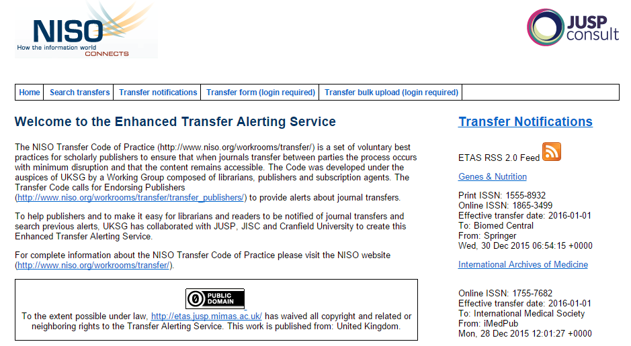
Enhanced Transfer Alerting Service
Notes:
The enhanced transfer alerting service (which we refer to as ETAS) is, at its core, a database.
Transfer compliant publishers submit basic metadata about transferring journals to the Enhanced Transfer Alerting Service. Submissions can be done title by title or through a bulk upload process. This metadata is stored in a searchable database and also disseminated via an e-mail listserv or RSS feed.
This slide shows a screenshot of the ETAS home page.
If you’re a publisher, the ETAS site allows you to submit transfers via a form or through bulk upload
If you’re a librarian, the ETAS site allows librarians to search or browse journal transfers, to subscribe to the ETAS RSS feed or e-mail listserv

Slide 7
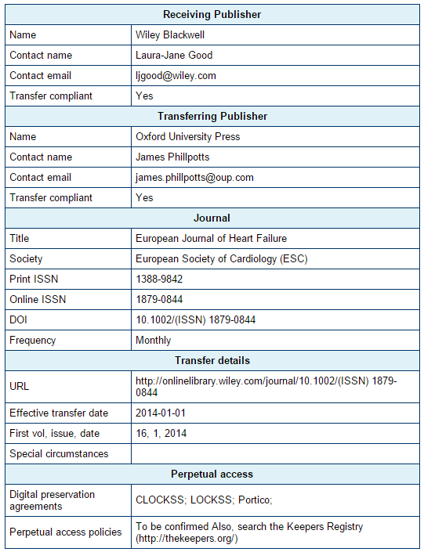
Notes:
This is a typical ETAS entry for a journal title that transferred from Oxford University Press to Wiley.
Typical entries include the following information:
Contact information for receiving and transferring publisher and info on Transfer compliance.
Journal title info, including unique identifiers like ISSN and/or DOI
Transfer details including the new URL of the title, the effective date of the transfer, and first volume
Also includes details about perpetual access, including digital preservation agreements in services like LOCKSS and Portico

Slide 8
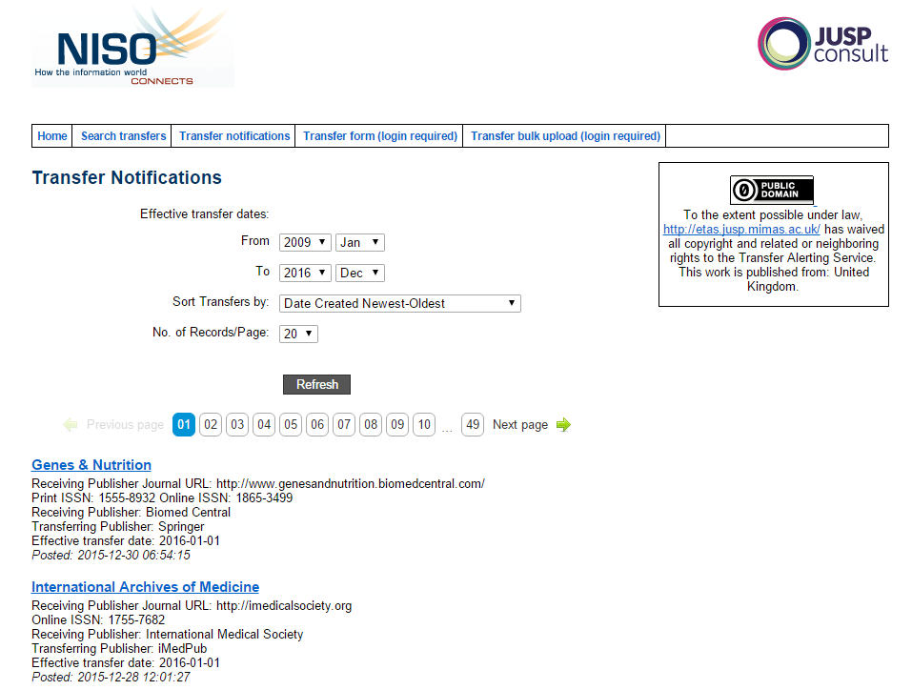
Notes:
Submitted ETAS entries can be viewed online.
Browsing ETAS allows you to see the most recent transfers made.
ETAS online can also be searched by keyword (journal title) or ISSN, and searches can be limited by the effective transfer date.
The database current includes transfers made between 2009 and the present.

Slide 9
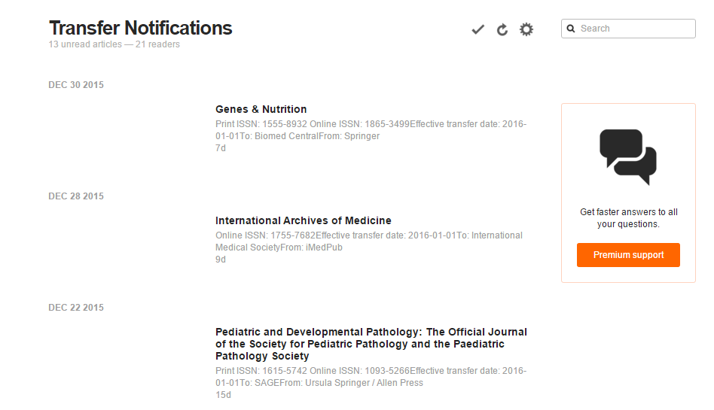
Notes:
ETAS also offers an RSS feed.
By using the ETAS RSS feed, users who prefer not to search the database can have ETAS notifications delivered to the feed reader of their choice.
Above is an example of what Transfer notifications look like when they arrive in my Feedly account. While the RSS feed reader display provides less detailed information than the ETAS database entry, it does provide a link back to the ETAS entry.

Slide 10
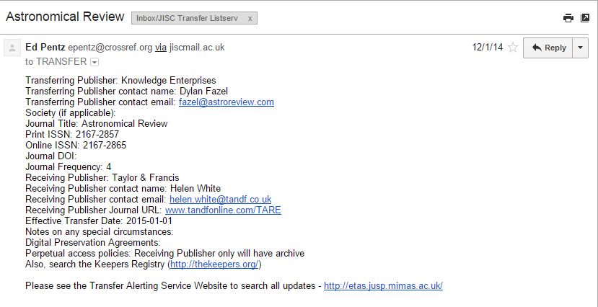
Notes:
ETAS notifications can also be received by joining the ETAS listserv. The listserv alerting service has more than 600 registered recipients, mostly librarians.
If you prefer to get notifications in your inbox, which is my preference, you can sign up for the Transfer listserv and you’ll receive an email like this each time a publisher submits a transfer to the database. It includes the same information as the RSS feeds and the ETAS database entries.
I route my Transfer listserv emails into a specific folder in my email inbox and check them regularly to see if there are any titles we subscribe to. If a subscribed title is to be transferred, I can then add the email to my task or to do list online.

Slide 11
Links
Transfer at NISO (NISO RP-24-2015)
  http://www.niso.org/workrooms/transfer/
Transfer Notifications
  http://www.niso.org/workrooms/transfer/notifications/
Transfer-Endorsing Publishers
  http://www.niso.org/workrooms/transfer/transfer_publishers/
Notes:
Here are a few links to Transfer materials that you may find useful:
The first link goes to the general NISO Transfer page.
The second link will direct you to information about the types of Transfer notifications I discussed today.
The final link provides a list of the publishers who currently endorse the Transfer code of practice.

Slide 12
Contacts
Jennifer Bazeley
bazelejw@miamioh.edu
Standing Committee Co-Chairs
James Phillpotts
james.phillpotts@oup.com
Elizabeth Winter
elizabeth.winter@library.gatech.edu
Notes:
If you’re a librarian, I encourage you to try the enhanced transfer alerting service and contact me with any questions. Please contact Transfer committee members if there are particular publishers you would like to see become compliant. Consider including language in your license agreements for full-text journals, requiring publishers to agree to adhere to the Code guidelines in transfer situations.
If you’re a publisher and already Transfer compliant, please familiarize yourself with the guidelines and coordinate with colleagues in transfer situations. If you’re interested in becoming Transfer-compliant, please feel free to contact one of our standing committee co-chairs for further information.
If you’re a society looking to move your content to a different publishing platform or arrangement, please consider selecting a provider who is already Transfer compliant.

