Slide 1
SYNTHESIS OF π-EXTENDED TETRAPHENYLPORPHYRINS
By: Frank Wang
Student Mentor: Abdulah Bilal Altundas
Faculty Mentor: Hong Wang

Slide 2
Preview
Introduction
Works and Results
Conclusions
Acknowledgement
Questions
Reference

Slide 3
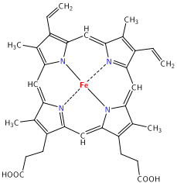
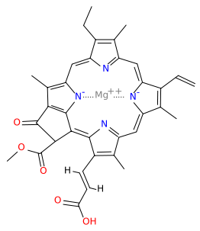
Introduction
Simple Porphyrins
  Porphine
  Hemoglobin
  Chlorophyll
Porphine
Hemoglobin b group (subunit)
Chlorophyll c1
http://creationwiki.org/pool/images/e/ef/Heme.png
https://en.wikipedia.org/wiki/Chlorophyll#/media/File:Chlorophyll_c1.svg

Slide 4
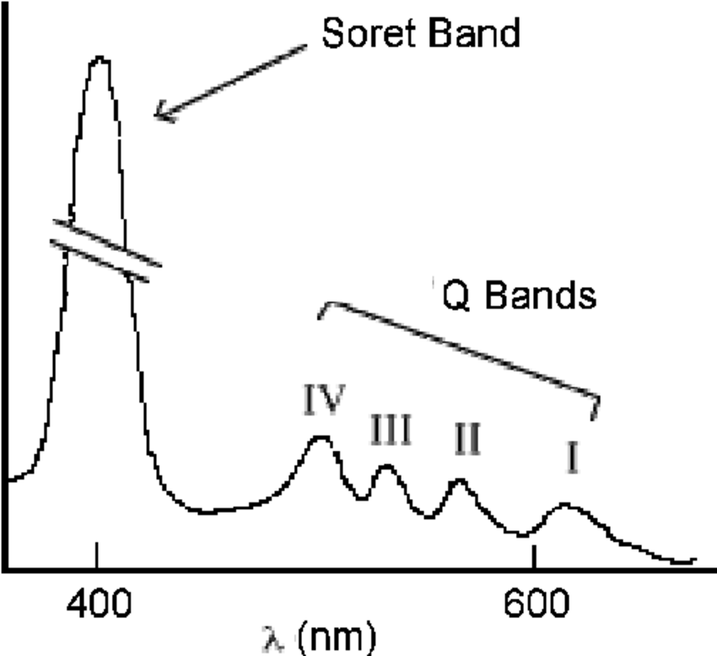
Introduction
Absorption of light spectrum
  B-band (Soret Band): Ultraviolet to purple (390 to 425 nm)
  Q-bands: Different numbers of bands for different porphyrins
  Substitution leads to shift of absorption bands
https://www.researchgate.net/figure/24426479_fig2_Figure-2-Typical-UV-Visible-absorption-spectrum-of-a-porphyrin

Slide 5
Introduction
π-Extended Porphyrins
  Red shift (excited spectra)
  Broadening (excited spectra)
Applications
  Photodynamic therapy
  Organic light emitting diodes
  Dye-sensitized solar cells

Slide 6
Introduction
Benzo Tetraphenyl porphyrin (TPP) Derivatives

Slide 7
Bromo TPP

Slide 8
Isopropyl porphyrin (IPP) and TPP

Slide 9
Work and Result
Synthesis of IPP and TPP
Bromination of TPP
IPP related reactions (Metalation and Nitration)

Slide 10
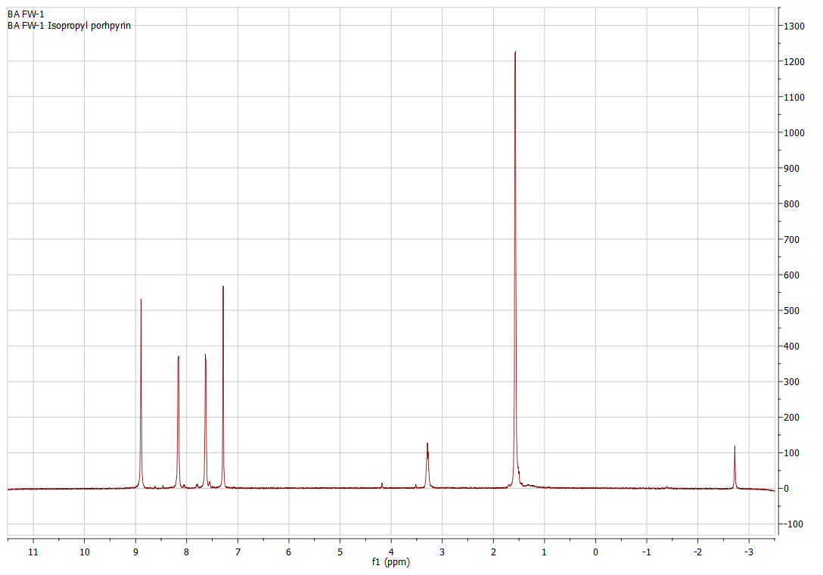
Synthesis of IPP
Yield: ~45g
% Yield: 20~30%

Slide 11
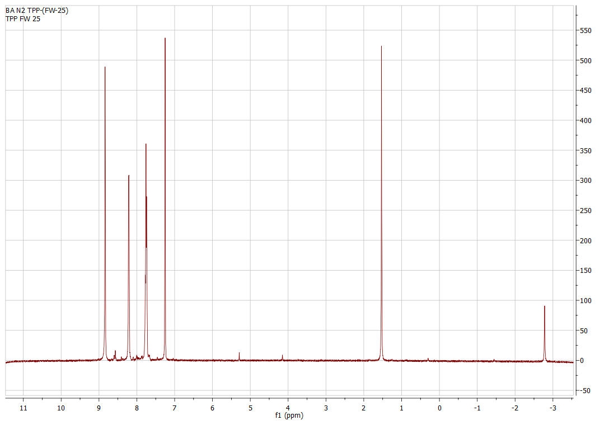
Synthesis of TPP
Yield: ~4.5g
% Yield: ~30%

Slide 12
Bromination of TPP (Dibromo)
Bacterochlorin
Chlorin
% Yield: 55%

Slide 13
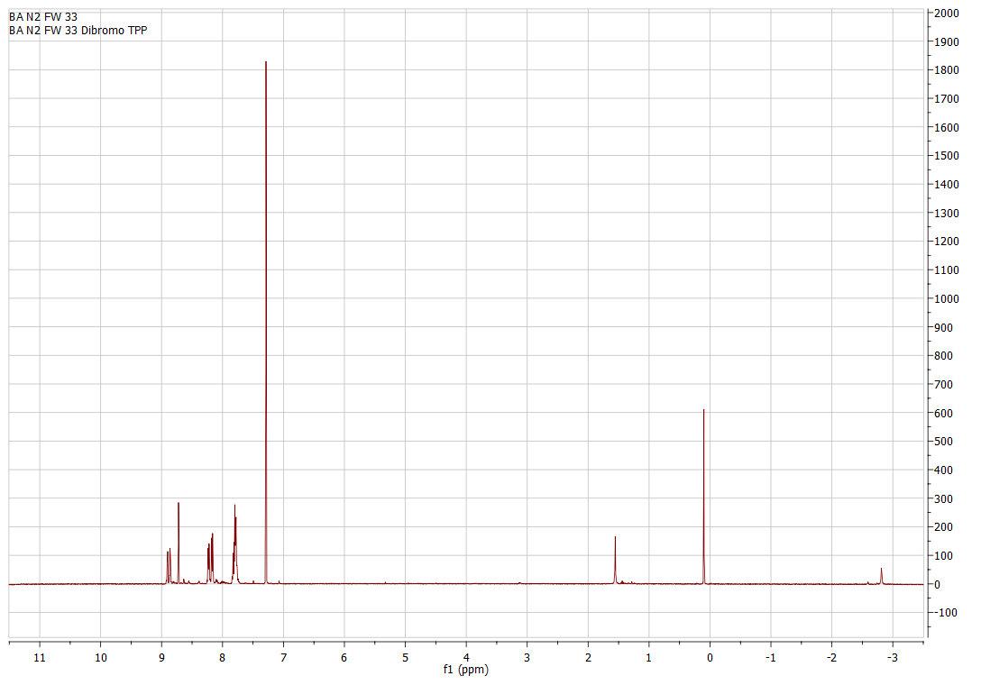
% Yield: 71%
% Yield: 81%

Slide 14
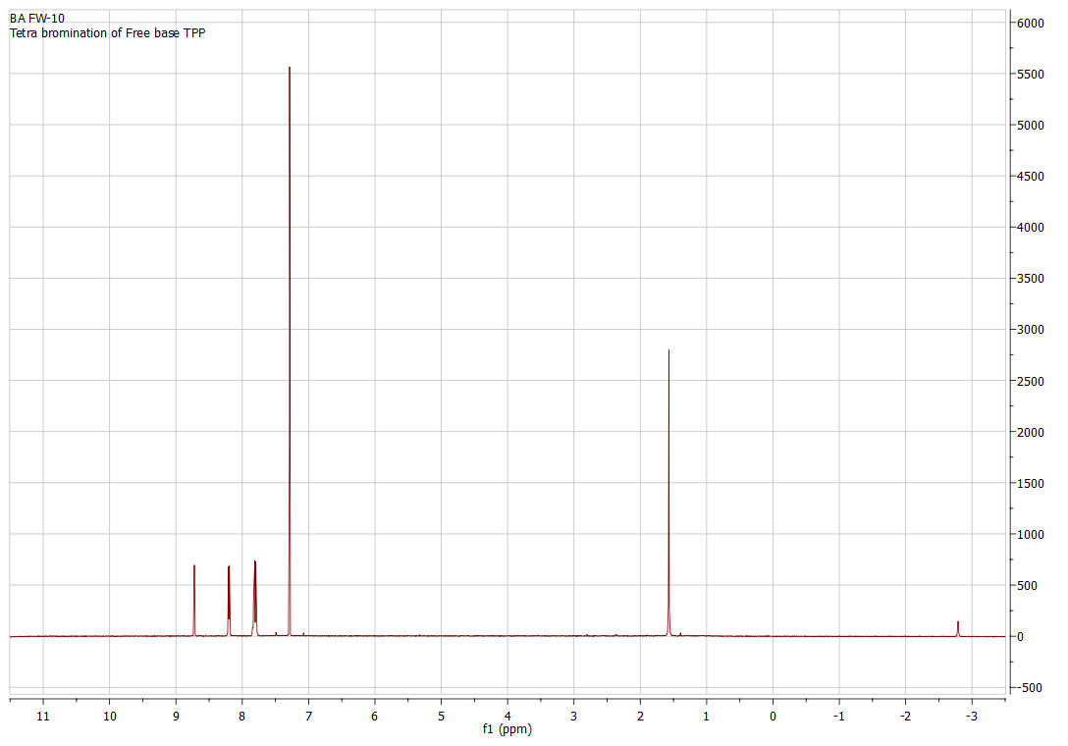
Bromination of TPP (Tetrabromo)
% Yield: 60~79%

Slide 15
IPP related reactions (Metalation)

Slide 16
IPP related reactions (Metalation)
% Yield: 56%

Slide 17
IPP related reaction (Nitration)
% Yield: 11%

Slide 18
Conclusions
Synthesis of IPP
  Recrystallize the product with Chloroform instead of Dichloromethane (DCM)
  Wash the mixture with more DCM
Synthesis of TPP
  Don’t let the reaction go too long
  Don’t let the solution be too concentrated

Slide 19
Conclusions
Nitration of Copper inserted IPP
    May need more Copper nitrate (2.5~3.5 Eq.)
Synthesis of TPP dibromide
  Less steps (Reduction, Oxidation, Bromination) than previous method (Metalation, Nitration, Bromination, Denitration, Dementalation)

Slide 20
Acknowledgement
First of all, I would like to thank my faculty mentor, Dr. Hong Wang, for accepting me into her group and providing me with the invaluable opportunity to participate in the exciting and interesting research.
I also would like to thank my student mentor, Bilal Altundas, for teaching and guiding me in the workspace. His help is crucial and selfless.
I would like to thank all the members in the group, Dr. Chamini Karunaratne, Dr. Raja Gabadage Jinadasa, graduate student Yi Hu, Siddhartha, Kumar, Jennifer Reeves, Benjaming Schmitz, for their unbelievable help and support. My current experience and achievement won’t be like this without them.
Last but not least, I would like to thank the support from Chemistry & Biochemistry department and Miami University that providing me with the Hughes/Miami Internship Program for Summer 2016

Slide 21
Questions

Slide 22
Reference
Jiang, Lin, James T. Engle, Laura Sirk, C. Scott Hartley, Christopher J. Ziegler, and Hong Wang. "Triphenylene-Fused Porphyrins." Organic Letters 13, no. 12 (2011): 3020-023. doi:10.1021/ol200853g.
Altundas, Abdullah "Synthesis of XZH-5 Derivatives as Inhibitors of Signal Transducer and Activator of Transcription 3 (STAT3) and Synthesis of π-Extended Tetraphenylporphyrins ." Electronic Thesis or Dissertation. Miami University, 2016. https://etd.ohiolink.edu/
http://faculty.elmira.edu/cstilts/organic/Porphyrin%20Synthesis.pdf
http://www.spq.pt/magazines/RPQ/318/article/1511/pdf
https://www.researchgate.net/figure/24426479_fig2_Figure-2-Typical-UV-Visible-absorption-spectrum-of-a-porphyrin

