Slide 1
A Powerful Partnership
Incorporating TRiO Student Support Services into the Library’s Space to Impact Student Success
Carrie Girton, Krista McDonald, and Jamie Viars, Miami University Hamilton

Slide 2
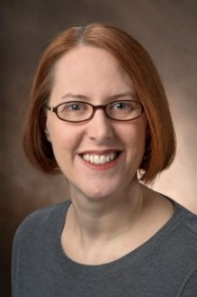
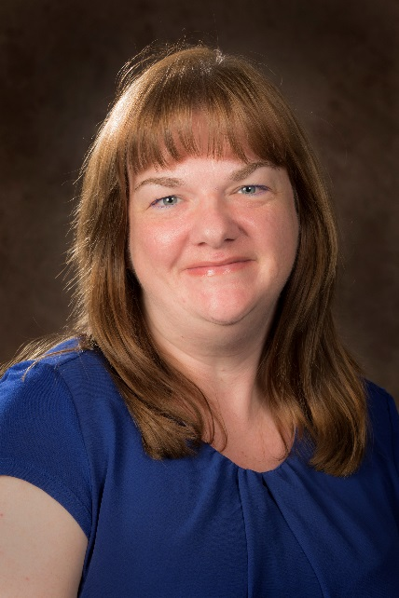
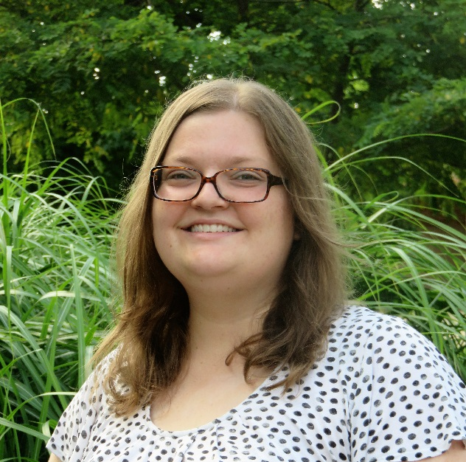
Introductions
Krista McDonald, Library Director, Miami University Hamilton
Carrie Girton, Public Services Librarian, Miami University Hamilton
Jamie Viars, TRiO Student Support Services (SSS) Academic Coach, Miami University Hamilton

Slide 3
Our Campus
35-40% of students at our regional campuses receive Pell grants
32% of Hamilton students self-reported as first-generation in 2016
5% of Hamilton students register with the Office of Student Disability Services
Notes:
K
Define TRiO SSS grant program:
Funded by US Dept of Ed
Goal is to increase retention and grad rates
Eligibility criteria are LOW INCOME, 1ST GEN, and STUDENTS w/DISABILITIES
*Note that self-report happens on admission application to University
Also discuss basic student demographics – many nontrads, and vets, greater racial diversity than Oxford, etc.

Slide 4
TRiO Timeline
2015 – Miami Regionals applied for a
5-year, $1.1 million grant
- Grant awarded
- Needed to determine best location on campus
– Program began Sept. 1
Notes:
K
Winter awarded, program start in Sept. leaving little time for finding a “home” and setting it up
Both the grant author and I felt that Library and TRiO were perfect partnership because students who are eligible for this program are the students who most need to be in the library in order to achieve academic success.
While there were a couple of other viable options on our campus, thi

Slide 5
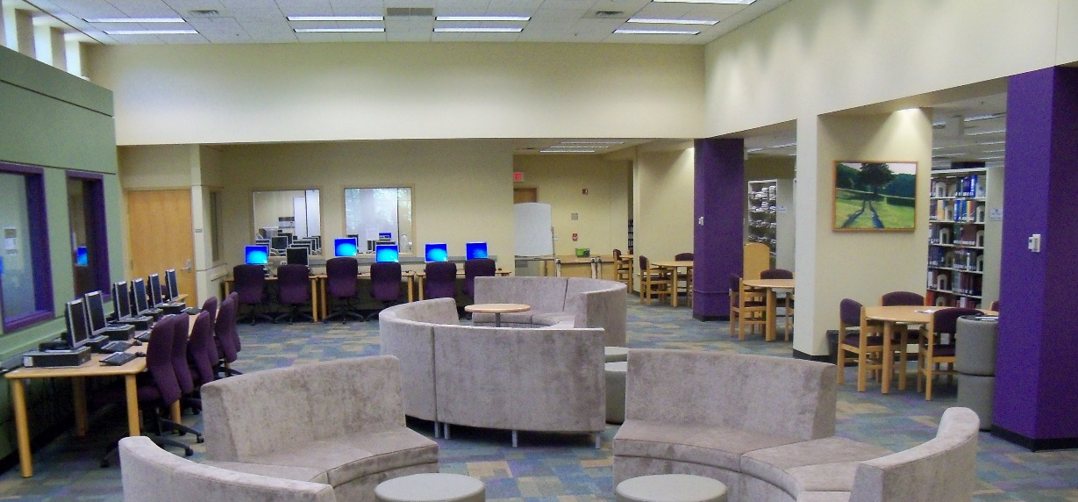
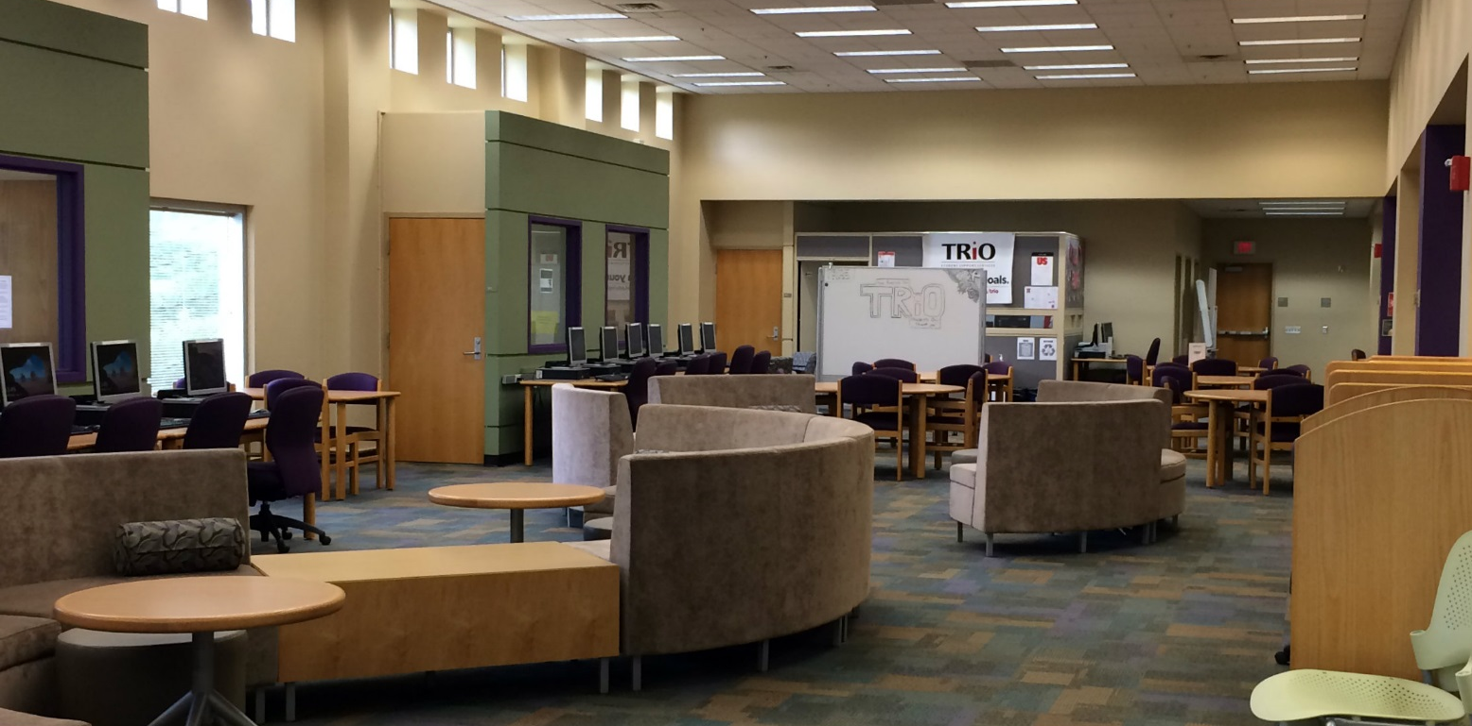
Incorporating TRiO SSS
After
Before
Notes:
K

Slide 6
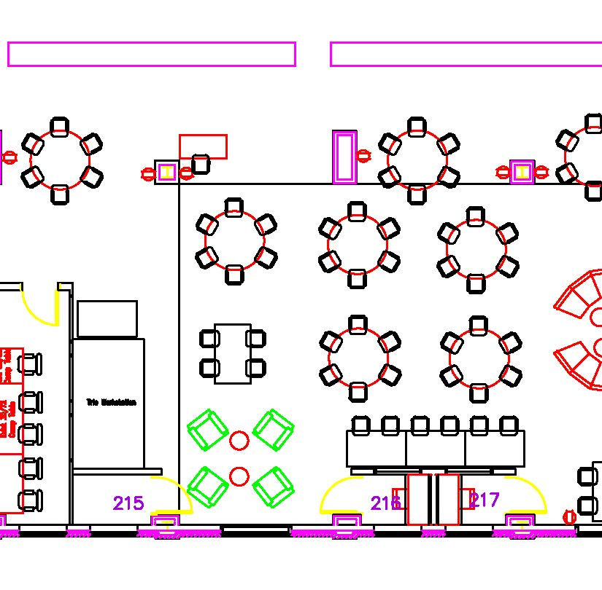
Incorporating TRiO SSS
Notes:
K

Slide 7
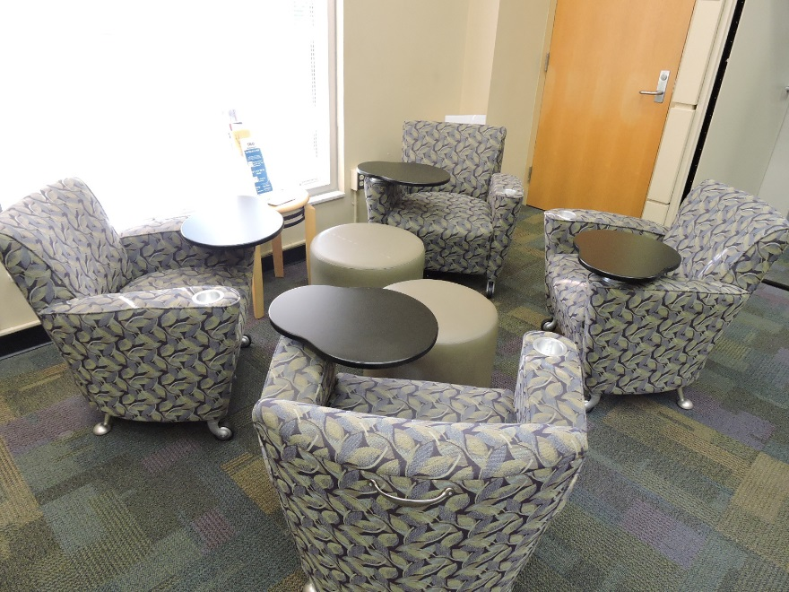
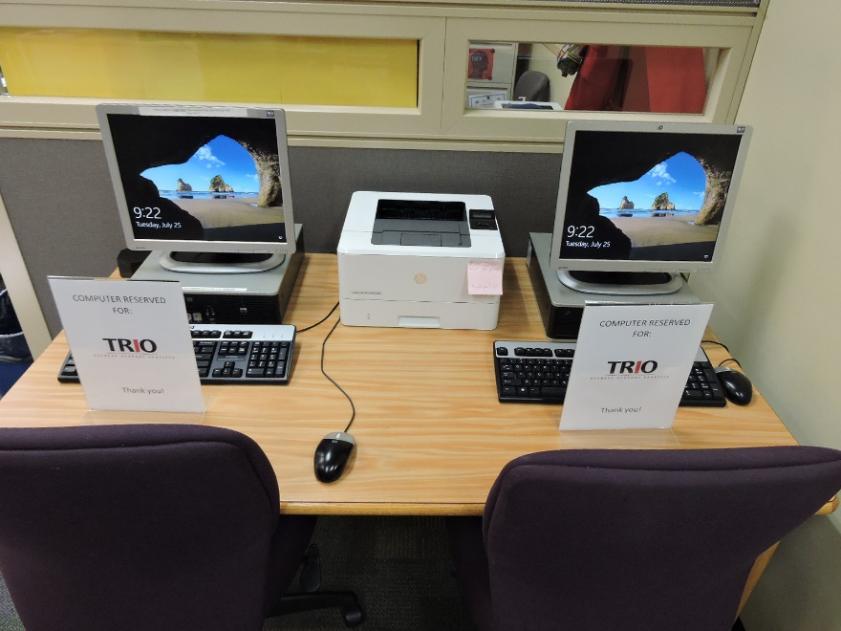
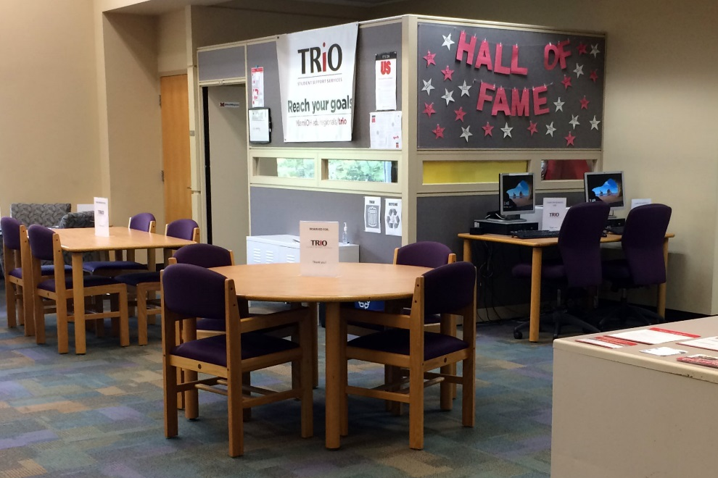
Incorporating TRiO SSS
Notes:
K
Grant funds could not be used to make changes to existing space, purchase furniture, etc.
Donation of items:
Library—tablet arm chairs, footstools, study tables and chairs, computers
Other campus departments—printer, desk, cubicle, office furniture in cubicle

Slide 8
Student Perspectives
[Video clip of TRiO student interview has been removed because of research participant consent.]

Slide 9
Student Perspectives
“I think there is great benefit of having TRiO in the library because most students typically come to the library to complete school work between classes or to use the computer for research or online assignments...these services also provide students with snacks, pens, paper, and other organizing materials that are very useful while completing work in the library.”
Notes:
C
Brad

Slide 10
Student Perspectives
“I think it would be a bad idea to move TRiO to another location . . . because the library is the biggest resource on campus to help students with class assignments. TRiO’s main goal is to assist the students and keep them on task, so the library and TRiO really complement each other.”
Notes:
C
Brad

Slide 11
Student Perspectives
[Video clip of TRiO student interview has been removed because of research participant consent.]

Slide 12
Student Perspectives
“. . . being located in the library is convenient and I love that we have our own space. I feel that helps us succeed even more [in] our studies . . . I like that TRiO has access to the librarians when we are in the library, because I need help on the computers a lot. . . I like the idea of all of us TRiO students together; it builds our confidence and helps us have a sense of belonging here on campus.”
Notes:
C
Susan

Slide 13
Student Perspectives
“The only reason it would be problematic [to have TRiO somewhere other than the library] is not having access to the librarians right there for us.”
Notes:
C
Susan

Slide 14
Student Perspectives
[Video clip of TRiO student interview has been removed because of research participant consent.]

Slide 15
Student Perspectives
Academic focus of the library environment
Access to computers and technology
Access to librarians and library services
Conveniently located
Sense of community
Notes:
C
Susan

Slide 16
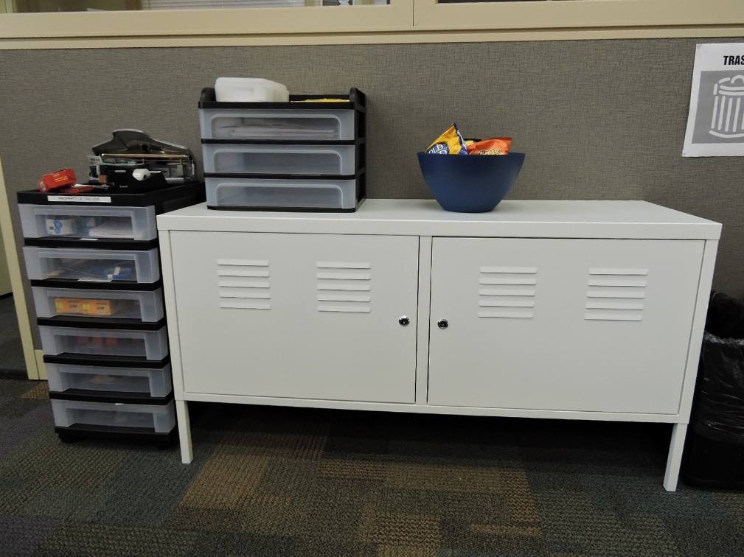
What We’ve Learned
Partnership facilitates ease of access to needed resources
  Computers
  Tutors
  Library staff
  Internet
  Free printing
Notes:
C
Computers includes library computers, chrome books available through TRiO, and laptops available through library

Slide 17
What We’ve Learned
There are some needs that aren’t being met or could be met in better ways
  Privacy of conversations with TRiO Coach is a huge concern.
  TRiO space needs to be more defined.
  Expand the space available to the TRiO program.
Notes:
C

Slide 18
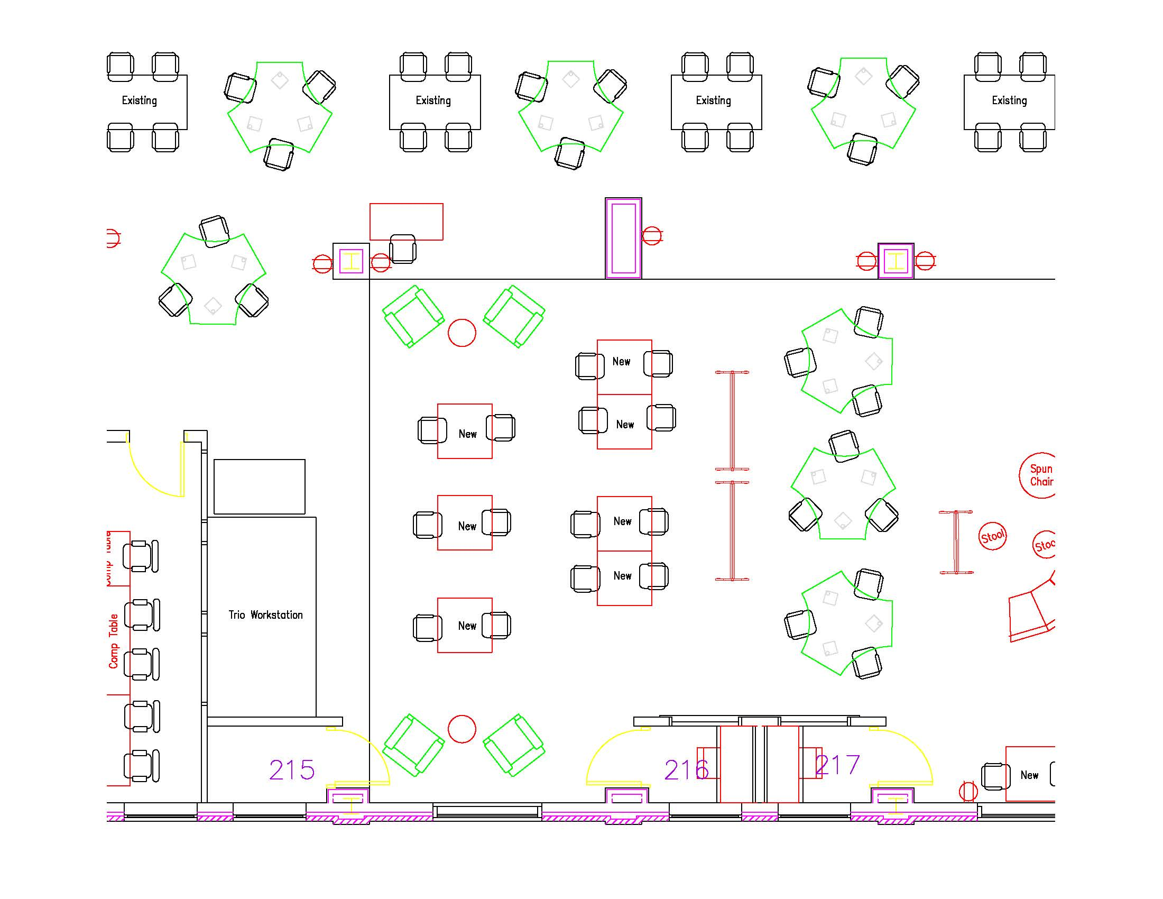
Thinking Ahead
Notes:
K
Library redesign/upgrade in Summer 2017 and Winter 2018

Slide 19
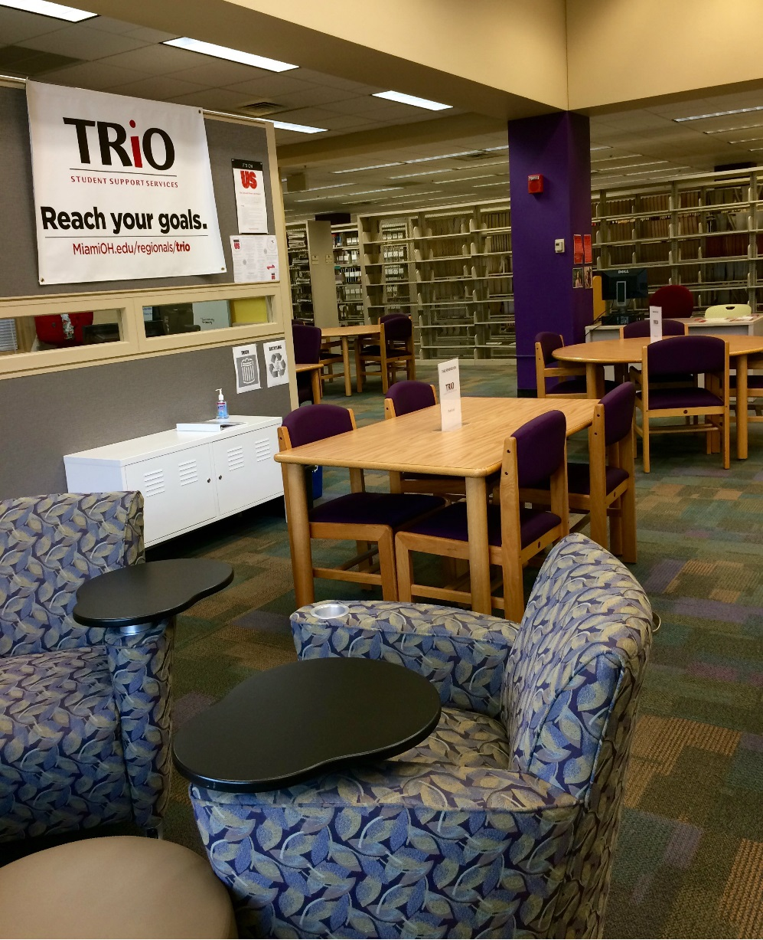
Thinking Ahead
Shifting collection and computers to allow for more TRiO space.
Notes:
K
Library redesign/upgrade in Summer 2017 and Winter 2018

Slide 20
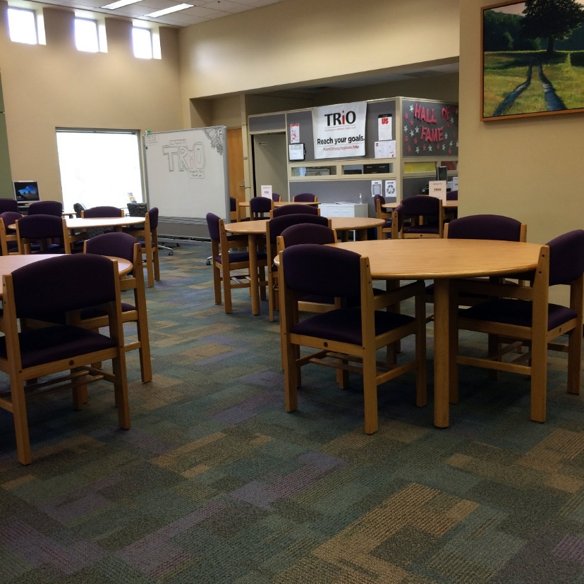
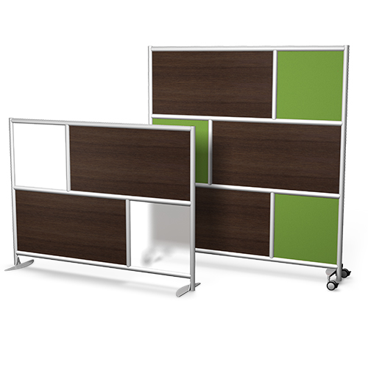
Thinking Ahead
Urban Walls to better demarcate TRiO space
Notes:
K

Slide 21
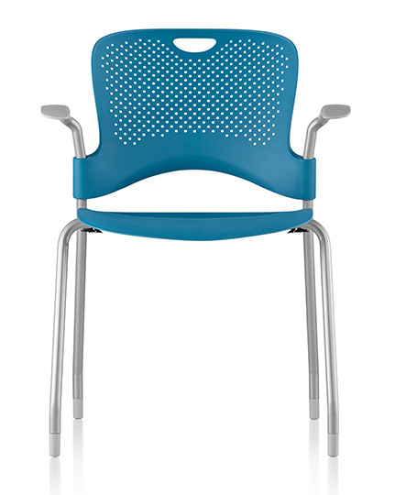

Thinking Ahead
New tables
and chairs
that are
more
configurable.
Notes:
K

Slide 22
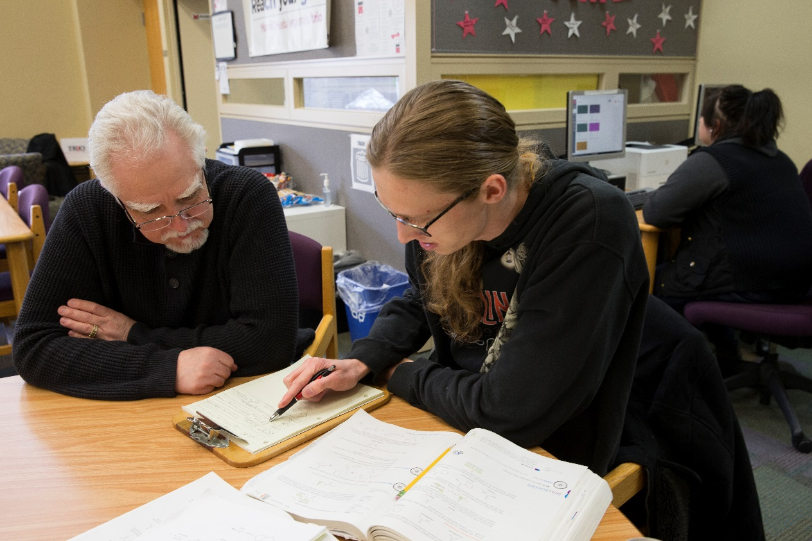
Thinking Ahead
Working with university interior designer to implement sound
proofing for
the TRiO
Coach’s
office.
Miami University Communications and Marketing Photo By Jeff Sabo Copyright 2017
Notes:
K
Grant funds cannot be used for renovations or furniture.

Slide 23
Questions???
Carrie Girton: girtonc@miamioh.edu
Krista McDonald: mcdonak@miamioh.edu
Jamie Viars: viarsje@miamioh.edu

