Slide 1
Copyright Boot Camp
Miami University Libraries Copyright Conference
September 20, 2017

Slide 2
​
Carla Myers
Assistant Librarian & Coordinator of Scholarly Communications
Miami University Libraries (Ohio) myersc2@miamioh.edu

Slide 3
Please Note:
The information provided in this presentation should not be construed as legal advice. If you have a legal question you should speak with an attorney.

Slide 4
Overview
Copyright Basics
Copyright Exemptions
Putting it all Together

Slide 5
Copyright Basics

Slide 6
Origins of U.S. Copyright Law
Article 1 Section 8 of the U.S. Constitution and represents the founding fathers effort "To promote the progress of science and useful arts, by securing for limited times to authors and inventors the exclusive right to their respective writings and discoveries."

Slide 7
The Law
Copyright is codified in title 17 of the U. S. Code
Definitions
Scope
Rights & Limitations
Exceptions
http://www.copyright.gov/title17/

Slide 8
Securing Copyright
Copyright protection subsists in “in original works of authorship” (not copied) which are “fixed in any tangible medium of expression.”
17 U.S.C. § 102

Slide 9
Originality
“Original, as the term is used in copyright, means only that the work was independently created by the author (as opposed to copied from other works), and that it possesses at least some minimal degree of creativity.”
-Justice O’Connor, Fiest v. Rural
https://www.youtube.com/watch?v=oOlDewpCfZQ

Slide 10
Fixation
A work is “fixed” in a tangible medium of expression when its embodiment in a copy or phonorecord…is sufficiently permanent or stable to permit it to be perceived, reproduced, or otherwise communicated for a period of more than transitory duration.”
17 U.S.C. § 101

Slide 11
This means…
We all own thousands of copyrights.
Much of what we encounter in our daily lives is protected by copyright.
Copyright notice (e.g. © 2017 by Carla Myers) is no longer required!

Slide 12
Registering with the Copyright Office
Registration and the inclusion of a copyright notice is no longer necessary, but does have some benefits
Documents your ownership in the copyright of the work
Allows you to recover statutory damages if suing someone for copyright infringement.
http://www.copyright.gov/eco/

Slide 13
What is Copyrightable?
Literary works (fiction/nonfiction, poetry, textbooks, reference works, directories, catalogs, advertising copy, compilations of information, computer programs and databases)
Musical works (this generally refers to music scores & accompanying words)
Dramatic works (plays, film, radio, and television scripts)
Pantomimes and choreography

Slide 14
What is Copyrightable?
Pictorial, graphic, and sculptural works (art)
Motion pictures and other audiovisual works (film, television show, videogame, etc.)
Sound recording (performances of musical works, audio recordings of literary works)
Architectural works (just the designs, not the building its self!)

Slide 15
What is Not Copyrightable?
Ideas—no one can copyright an idea, however your expression of an idea may be protectable.
Making ideas freely available for anyone to pursue “promotes the progress of…useful arts”

Slide 16
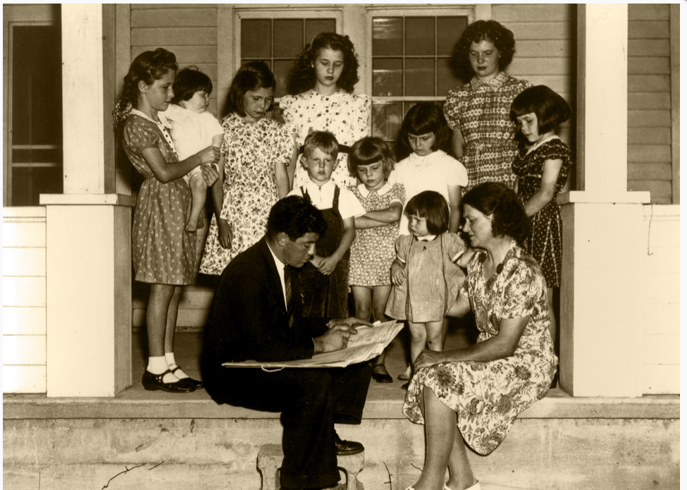
What is Not Copyrightable?
Facts-No one may claim originality as to facts. This is because facts do not owe their origin to an act of authorship. The distinction is one between creation and discovery. The first person to find and report a fact has not created it, they have merely discovered its existence. –Fiest v. Rural

Slide 17
What is Not Copyrightable?
Works in the public domain, which include…
Works whose copyright has expired
Works created by the U.S. Government

Slide 18
What is Not Copyrightable?
Works that are not fixed in a tangible medium of expression do not have copyright protection.
Names, phrases, slogans, titles, symbols (though these could be protected under trademark).
Mere variation of typographic ornamentation, lettering, or coloring.
Simple listings, e.g. table of contents, recipe ingredients (think facts!)
Procedures, methods, processes (though these could be protected under patent or trade secret law).
Works consisting of common facts, e.g. calendar, height/weight chart, ruler.

Slide 19
Exceptions!

Slide 20
Copyright & Facts
You could have copyright for your writings about facts
  Textbook
  Nonfiction
  Scholarly article
  Additions to factual lists such as recopies
Could secure copyright for your arrangement of facts/data
  Section of facts and data used in an annotated bibliography
  Arrangement and layout of a pie chart or graph

Slide 21
Copyright in new Expressions of or Components added to Public Domain Works
Illustrations
Footnotes
Introductions

Slide 22
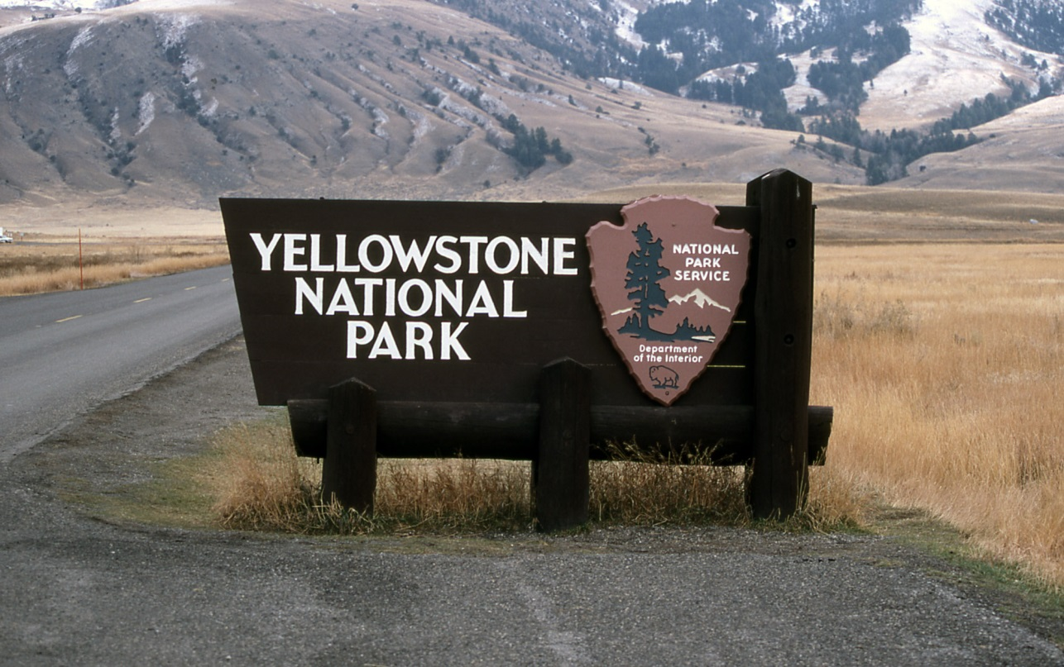
Works Created by Employees of the U.S. Government Could have Copyrightable Components
Photo Credit: nps.gov

Slide 23

Copyright in Graphic Design
Bringing shapes, lettering, and coloring together in a way that is protectable.
Not Protectable
Protectable!

Slide 24
Copyright Ownership

Slide 25
The Rightsholder is…
Generally, the person who creates the work.
Joint Authorship-When two or more authors work together to create a work the copyright is shared between them.
Authors must decide to work collaboratively
Each author must contribute significantly to the copyrightable expression to the work
“Merged into inseparable or interdependent parts of a unitary whole”

Slide 26
Works Made for Hire
Works created by the employee in the scope of their employment
  Generally, the copyright will rest with the employer
Works created by independent contractors
  Even with commissioned works, the parties must agree in writing ahead of time who will hold the rights to the work

Slide 27
Duration of Copyright

Slide 28
How Long Does Copyright Last?
Works created after Jan. 1, 1978 are protected for the life of the author plus 70 years
Join authorship-life of last surviving author +70 years
Works for Hire-95 years from publication or 120 years from creation, whichever is shorter
For older works, it depends…

Slide 29
Works Created Before 1923
Works published before 1923 are in the public domain. Use them anyway you like!
Republish, make a movie or play, add commentary
Original work is still not protected, but your expression of it is
Always, always give proper attribution!

Slide 30
In Limbo
Works published between 1923-1978
It depends!
  Inclusion of copyright notice?
  Was it registered?
  Was the copyright renewed?
If in doubt, treat as a protected work
http://librarycopyright.net/resources/digitalslider/

Slide 31
Authors Rights

Slide 32
Authors Rights
Owner of a protected work is provided with certain right….
The right to reproduce (copy) the work
The right to distribute the work (share/publish/sell)

Slide 33
Derivative Works
Reconstructing an original work to express it in a different way, e.g. Eragon, by Christopher Paolini
Translations
Graphic novel
Film
Merchandising

Slide 34
Public Display
To “display” a work means to show a copy of it, either directly or by means of a film, slide, TV image, or any other device or process.
In the case of motion picture or visual work, to show individual images nonsequentially
Examples of Public Displays
Showing images in the classroom
Including a film still as part of a movie review posted to a website

Slide 35
Public Performance
To “perform” a work means to recite, render, play, dance, or act it, either directly or by means of any device or process
In the case of a motion picture or other audiovisual works, to show its images in sequence or to make accompanying sounds audible.
Examples of Public Performances
Acting out a play
Hosting a film screening
Musical performance
Story time!

Slide 36
Copyright Infringement

Slide 37
Common Misconceptions
If it’s on the internet I can use it however I want.
If it’s a library/personal/not-for-profit use I can use anything I want, however I want, right?
So long as I give credit to the person who created the work I don’t have to worry about copyright infringement.
I’ll never get caught!

Slide 38
Infringement
Copyright infringement occurs when we take advantage of one of the rights granted to creators under the law without their authorization.
Reproduce works
Make derivatives
Distribute copies
Perform the work publicly
Display the work publicly
In the case of sound recordings, to perform the copyrighted work publicly by means of a digital audio transmission.

Slide 39
Summary

Slide 40
Basics Recap
It’s very easy to secure copyright
Many different types of works are protected
Work have copyright protection for a long time
It’s easy to infringe!

Slide 41
Yikes!
Fortunately there are exceptions written into the law that allow us to reuse the works of others in certain situations

Slide 42
Exemptions!

Slide 43
Legal Exceptions
Many exceptions to copyright, with a few specific to education and libraries
Fair use
Library copying
First sale doctrine
Face-to-face teaching
Displays and performances for distance learning (TEACH Act)
Special formats for those with disabilities
Digital Millennium Copyright Act

Slide 44
Fair Use
17 U.S.C. § 107

Slide 45
17 U.S.C. § 107
In determining whether the use made of a work in a particular case is a fair use the factor to be considered shall include—
the purpose and character of the use, including whether such use is of a commercial nature or is for nonprofit educational purposes;
the nature of the copyrighted work;
the amount and substantiality of the portion used in relations to the copyright work as a whole; and
the effect of the use upon the potential market for or value of the copyrighted work

Slide 46
Factor 1: Purpose & Character of the Use
Nonprofit educational use is heavily favored over a commercial use
Assigned material vs. being used more for entertainment

Slide 47
Transformative Use
Have you turned it the original into something new by adding new expression or meaning?
Judge Pierre Leval provides a wonderful definition of “transformative use” in his article Toward a Fair Use Standard, which can be found here: http://docs.law.gwu.edu/facweb/claw/levalfrustd.htm. He states that a transformative use…
    “must employ the quoted matter in a different manner or for a different purpose from the original. A quotation of copyrighted material that merely repackages or republishes the original is unlikely to pass the test; in Justice Story's words, it would merely "supersede the objects" of the original. If, on the other hand, the secondary use adds value to the original--if the quoted matter is used as raw material, transformed in the creation of new information, new aesthetics, new insights and understandings-- this is the very type of activity that the fair use doctrine intends to protect for the enrichment of society.”

Slide 48
Examples of Transformative Use-Music
Musical Mash-up
Glee--The Way You Look Tonight / You're Never Fully Dressed Without A Smile (Glee Cast Version)

Slide 49
Examples of Classroom Transformative Use
Using a popular movie to teach a subject, e.g. using clips from World War Z to discuss disaster response.

Slide 50
Factor 2: The Nature of the Work
Explores the characteristics of the work being used
Fiction vs. nonfiction
Published vs. unpublished
Consumable?
Notes:
Salinger?

Slide 51
Factor 3: The Amount & Substantiality of the Portion Used
Looks at quantity and quality
“There are no absolute rules as to how much of a copyrighted work may be copied and still be considered a fair use”
-Maxtone-Graham v. Burchael

Slide 52
Supreme Court Ruling
  News reporting, but unfair commercial use due to intent to supplant “first publication”
  Informative work
  Small amount, but the heart of the work and…
  Serious market erosion

Slide 53
Best Advice Regarding the “Amount” Used
Consider the amount needed to serve the purpose of the use in relation to the work being used. This is a judgment call, and one you must be prepared to justify should your use of the work ever come into question!
  If straight copying or quoting, less is better
  If transformative, can usually justify more!

Slide 54
Beware of the Guidelines!
Classroom Photocopying Guidelines (1976)
  Use must be “spontaneous”
  Brevity…
    Can use 1 chapter or 10% of a work
    No more than 250 words from a poem
    Only 1 chart, picture or diagram from a work
  Must seek permission for subsequent use
Off-Air Recording of Broadcast Programming for Educational Purposes (1981)
Carry no force of law and provide no safe harbor against infringement!

Slide 55
Factor 4: Effect on the Market
Is your use resulting in lost revenue for the rightsholder?
Occurs when use replaces sale of the work
This factor often carries a lot of weight, especially when looking at commercial uses
Can weigh in favor if use is transformative (parody, mash-up)
Consider that your use could actually help the market for the item! (comment, critique)

Slide 56
But it’s so confusing!
Congress deliberately created fair use to flexible so that it could apply to many different situations. Unfortunately though, this can lead to uncertainty regarding its application.

Slide 57
Fair Use Tools

Slide 58
Using Fair Use Tools
These decisions are very subjective and need to be made by the person utilizing the protected work
Only work if you are completely honest!
Keep a copy
  Record of fair use decision
  Can be used as a legal document

Slide 59
Fair Use Tools
Ken Crews’ Fair Use Checklist: http://copyright.columbia.edu/copyright/fair-use/fair-use-checklist/
ALA Fair Use Evaluator: http://librarycopyright.net/fairuse/
Thinking Through Fair Use (U of Minnesota)
http://www.lib.umn.edu/copyright/fairthoughts

Slide 60
Library Copying for Research & Preservation
17 U.S.C. § 108

Slide 61
What it Allows
Section 108 allows libraries to make copies of protected works for the purpose of
Private study
Preservation
InterLibrary Loan (ILL)
A few requirements:
Library must be open to the public
Copies are not made for commercial purposes
Library does not engage in bulk distribution of copies
Each copy includes a copyright notice

Slide 62
17 U.S.C. § 108 Making Copies for Private Study

Slide 63
Types of Works that can be Copied
Literary works, including magazines, journals, newspapers, and books
Illustrations, pictures, charts, and graphs that accompany literary works
Those audiovisual works that deal with the news

Slide 64
Types of Works that cannot be Copied
Musical compositions/scores
Most art
Most audiovisual works, including movies

Slide 65
Making Copies for Private Study
The copy becomes the property of the user
You have no reason to suspect that the patron will be using the copy for any other purpose besides private study
Your library displays a copyright warning where requests are submitted (online or on paper) and on the work being provided to the patron
After a reasonable investigation the library can conclude that a copy cannot be obtained at a reasonable price (when requesting a substantial portion of the item or a full copy)

Slide 66
17 U.S.C. § 108 Making Copies for Preservation

Slide 67
Types of Works that Can be Copied
Any type of material including art, audiovisual works, and musical scores
“Any such copy or phonorecord that is reproduced in digital format is not otherwise distributed in that format and is not made available to the public in that format outside the premises of the library or archives.”

Slide 68
Making copies for Preservation-Unpublished Works
The item being reproduced is currently part of the collection of their collection
The copy is for…
  Preservation (it is, or is on the verge of falling apart)
  Security (you don’t want a patron handling the original)
  Deposit in another library or archive who has an interest in the item

Slide 69
Making Copies for Preservation-Published Works
It is being used to replace a damaged, deteriorating, lost, or stolen copy
If the work is in a format that has become obsolete which, under the law, means that the technology needed to play or perform the work is no longer manufactured or is not readily available for purchase
They conclude that, after performing a reasonable investigation, an unused replacement copy cannot be obtained at a reasonable price

Slide 70
17 U.S.C. § 108 Making Copies for Interlibrary Loan

Slide 71
Making Copies for Interlibrary Loan
When you’re lending: the rules are the same as for private study
When you’re borrowing: make sure that your practices are not substituting for a subscription to a periodical or purchase of a work
CONTU Guidelines, or ‘Rule of 5:’ Up to 5 copies from the most recent 5 years of a journal title-another guideline, not law!

Slide 72
17 U.S.C. § 108
Copying Equipment

Slide 73
Copying Equipment
Placing a notice regarding copyright on duplication equipment, including printers, photocopiers, scanners, and media duplication equipment can help release your institution from liability.

Slide 74
17 U.S.C. § 109
First Sale Doctrine

Slide 75
First Sale Doctrine
Notwithstanding the provisions of section 106 (3), the owner of a particular copy or phonorecord lawfully made under this title, or any person authorized by such owner, is entitled, without the authority of the copyright owner, to sell or otherwise dispose of the possession of that copy or phonorecord.

Slide 76
Essentially
When you own a copyrighted work that is “lawfully made under this title” you can lend, sell, or dispose of it without having to obtain permission from (or pay a fee to) the rightsholder.
This provision allows….
Libraries to lend items
Folks to sell copyrighted item at garage sales, on eBay
You to donate copyrighted items
Remember that owning a copy of a work is not the same as owning the copyright in it!
You can sign-away this right via a license

Slide 77
17 U.S.C. § 110(1)
Face-to-Face Instruction

Slide 78
Face-to-Face Teaching
Notwithstanding the provisions of § 106 the following are not infringements of copyright: performance or display of a work by instructors or pupils in the course of face-to-face teaching activities of a nonprofit educational institution, in a classroom or similar place devoted to instruction, unless, in the case of a motion picture or other audiovisual work, the performance, or the display of individual images, is given by means of a copy that was not lawfully made under this title, and that the person responsible for the performance knew or had reason to believe was not lawfully made.

Slide 79
Breaking it Down
The performance or display of a work
By instructors or pupils
In the course of face-to-face teaching activities
Of a nonprofit educational institution
In a classroom or similar place devoted to instruction
Are not infringements of copyright

Slide 80
Breaking it Down
Unless!
In the case of a motion picture or other audiovisual work
The performance of the work, (e.g. “playing it”)
Or the display of individual images
Is given by means of a copy that was not lawfully made under this title (U.S. Copyright Law, Title 17 United States Code) and that the person responsible for the performance knew or had reason to believe was not lawfully made.

Slide 81
What Does ‘Lawfully Acquired’ Mean Here?
A copy you have purchased
A copy owned by the library or borrowed through a legitimate library lending service such as another Prospector or Interlibrary Loan
A copy the you have borrowed from a colleague
A copy you have acquired lawfully for your own personal research (conference materials, etc.)

Slide 82
Recommendations
Work with faculty to acquire items for the library’s collection
Help them understand options for requesting works through consortia/ILL

Slide 83
17 U.S.C. § 110(2)
Online Instruction

Slide 84
The TEACH Act
The Technology, Education and Copyright Harmonization Act, or TEACH Act was passed by Congress in 2002 to address copyright issues in distance education

Slide 85
What the TEACH Act Allows
Full performance of any nondramatic music or literary work, e.g. reading of stories, poetry, or text. Performance of musical works
Reasonable and limited portions* of all other works, including audiovisual works (e.g. films, television shows, videogames).
Displays of works in any amount comparable to that which is displayed in the course of a live classroom session”

Slide 86
What the TEACH Act Does Not Allow
Digitization of works produced or marketed primarily for online education
Works that are made from a copy that was not lawfully acquired –OR—that the transmitter knew or had reason to believe was not lawfully made and acquired

Slide 87
TEACH Act Compliance
Nonprofit educational institution
At an institutional level, copyright policies, notifications, and educational programming must be in place to help establish the appropriate use of protected works in an educational setting
Technological measures must be put into place by system administrators to limit access to only those students enrolled in a course (CMS)
Must find ways to prevent students from retaining works “for longer than the class session” and to limit the “unauthorized further dissemination” of copyright works outside the class learning environment

Slide 88
Recommendations
Only digitize as much as needed to teach a work (clips), though full work may be justifiable!
Stream all audio and media files
Use CMS to limit access
Work with school administrators to provide some type of copyright education

Slide 89
17 U.S.C. § 121
Special Formats for Those with Disabilities

Slide 90
For Patrons With Disabilities
Allows libraries to make copies of previously published, nondramatic literary works in specialized formats (e.g. Braille copy for the blind, an audio recording for the hearing impaired, or digital text for those with visual impairment) for use by those with other disabilities.
-and-
Allows the transmission of the performance of a nondramatic literary or musical work or display to those whose disabilities prevent their attendance in classrooms, when the performance or display is part of the instructional activities of the university.

Slide 91
So Long As…
Materials are reproduced or distributed only in a specialized format exclusively for use by persons with disabilities
Copies bear a notice that any further reproduction or distribution in a format other than a specialized format is an infringement
You include a copyright notice identifying the copyright owner and the date of the original publication

Slide 92
17 U.S.C. § 1201
Digital Millennium Copyright Act

Slide 93
DMCA
“Anticircumvention” law
Prohibits circumvention of technological measures which protect access to copyrighted works
Can include circumventing..
  Encryption on a CD or DVD
  Password protection on a website
  Technology “locking” a device
Also prohibits creation, sharing, and use to products and programs which allow circumvention*

Slide 94
Good News
Only applies to unauthorized use, so if you are circumventing under the auspices of fair use or any other exception the DMCA does not apply.*
  Chamberlain, Inc. V. Skylink Technologies
AIME v. UCLA
  Had legal access to the work in question
  Technology used (Video Furnace) has uses beyond circumventing technological protections.

Slide 95
More Good News
Exceptions written into the law
New exceptions considered by the Registrar of Copyrights and the Librarian of Congress every 3 years
Need an exception…pursue it!

Slide 96
Copyright & Your Library

Slide 97
Copyright & Libraries
Librarians can’t escape it!
Circulating items
InterLibrary Loan (borrowing and lending)
Course reserve services
Duplication equipment
License agreements for electronic resources
Archives
Preservation
Online access
Patrons with disabilities

Slide 98
Your Role
Be aware of library copyright issues
Understand how the law applies to libraries
Understand which laws may apply to the situation at hand
Have sound copyright policies to guide your use

Slide 99
Library Copyright Policies

Slide 100
Copyright Policies
Having intuitional copyright policies can provide guidance for staff when using copyrighted works
Should be written in plain language so that it’s easily understandable
Work with your institution’s attorney
Update often!

Slide 101
Have Policies for..
Library copying for preservation and private study
InterlibraryLoan
Use of orphan works-those works for which the rightsholder cannot be identified
Licensing materials
Digitization projects
Accepting archival donations

Slide 102
Copyright Policies for Making Copies for Preservation & Private Study
Reproduction by Libraries and Archives (17 U.S.C § 108)
Fair Use (17 U.S.C § 107)

Slide 103
Copyright Policies for Interlibrary Loan
First Sale Doctrine
Rule of 5 vs. 17 U.S.C § 108
Make sure you are not signing away your ability to lend through ILL in your license agreements!

Slide 104
Copyright Policies for Orphan Works
Works for which the rightsholder cannot be identified
Look to legal exceptions to make use of work
No pending legislation regarding orphan works

Slide 105
Copyright Policies for Licensing Materials
It is critically important that you negotiate license agreements, especially for electronic works.
Negotiate, negotiate, negotiate!
License will trump rights afforded under the law!
Read, negotiate, track.

Slide 106
Copyright Policies for Library Digitization Projects
You may need to write a new policy for each project!

Slide 107
Copyright Policies for Donor Agreements for Archives
Donations of rare/unique/historical items to your archives can be very exciting
Does the person donating the items also own the copyright?
If not, who does?
If so, are they willing to transfer it to you?

Slide 108
Copyright & Accessibility
Making alternate copies of works for patrons who have disabilities
Fair Use
110(8)
Section 121

Slide 109
Other Library Copyright Issues

Slide 110
Film Screenings
Any film screening where the public is invited is considered a public performance. As such, you must…
  Purchase the film with public performance rights.
  Obtain a license for the screening.
Are you charging a fee?
  Monetary fee vs. food or clothing donation
  You cannot skip getting a public performance license simply because you are not charging an entrance fee!

Slide 111
Story Time
This can also be considered a public performance
Consider fair use!
Are there kits with puppets, recordings with sound effects, coloring pages, etc. that can be purchased?

Slide 112
3D Printers
Objects created using a 3D printer could infringe on copyright, patent, and trademark law.
Have a policy in place to help guide the use of your 3D printer.
Warning Notice for 3D Printers
http://www.ala.org/offices/sites/ala.org.offices/files/content/3D%20Printer%20Warning%20Notice%20for%20Libraries_TLEDITED.pdf

Slide 113
Answering Copyright Questions

Slide 114
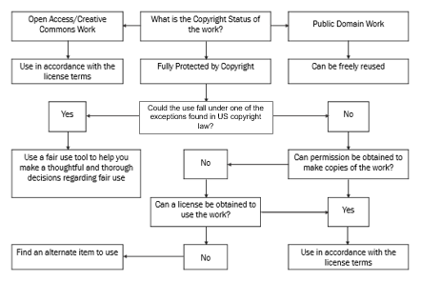

Slide 115
Recommendations
Be careful to provide information rather than legal advice!
Have quality resources (print, online) available that you can refer patrons/staff to.
Have policies in place that dictate the use of library equipment.

Slide 116
Putting it all Together

Slide 117
Why is this all important?
Having a basic knowledge of the law will help you better understand your rights and responsibilities in using protected works
It is especially important in academia where we come are constantly having to deal with protected works as part of our regular job duties

Slide 118
We’ve Got it Good
There are many exceptions written into the law which allow us to use protected works for educational purposes
Your part is to understand your rights and responsibilities under the law

Slide 119
Questions?
This work is licensed under a Creative Commons Attribution-NonCommercial 4.0 International License.

