Slide 1
Copyright Basics
6 Things EVERY LIBRARIAN SHOULD Know

Slide 2
Carla Myers
Assistant Librarian
Coordinator of Scholarly Communications
Miami University Libraries
513-529-3935
myersc2@miamioh.edu

Slide 3
The information provided in this presentation should not be taken as legal advice. If you have a legal question you should consult your institution’s legal counsel.

Slide 4
#1-Securing Copyright
Copyright protection is instantly granted when an original, eligible work is fixed in a tangible medium of expression (17 U.S.C. § 102).

Slide 5
#2-Copyright Lasts a Long Time
Life of the author +70 years
For an anonymous work, works prepared under a pseudonym, or a work made for hire, the copyright endures for a term of 95 years from the year of its first publication or a term of 120 years from the year of its creation, whichever expires first.

Slide 6
#3-Copyright Infringement
Copyright infringement occurs when we take advantage of one of the rights granted under the law without the consent of the rightsholder.
  Making copies of works
  Sharing copies of works with others
  Making alternate versions
  Showing a work publically
  Performing a work publically

Slide 7
#4-Common Misconceptions
In an educational/nonprofit setting, I don’t have to worry about copyright.
I can reuse 10% or one chapter from a book, and that’s ok.
So long as money is not being made, there’s no need to worry about copyright infringement.
It’s ok to use something one time, but you must seek permission for subsequent use.
I’ll never get caught!

Slide 8
#5-Reusing Works
You own the copyright, or
The work is in the public domain or has no copyright protection, or
The item you are using is a Creative Commons or Open Access work, or
The use is a “Fair Use” as defined under 17 U.S.C. § 107 or the use falls under one of the other copyright exemptions, or
You obtain permission to use the work from the rightsholder,
You obtain a license to use the work.

Slide 9
Legal Exceptions
Many exceptions to copyright, with a few specific to education and libraries
Fair Use
Library Copying
First Sale Doctrine
Face-to-face teaching
Displays and performances for distance learning (TEACH Act)
Special formats for those with disabilities
Digital Millennium Copyright Act

Slide 10
#6-Reasons to Consider Copyright
It’s the law
Modeling the behavior we expect from our users
It’s can be a bit confusing, but only at first

Slide 11
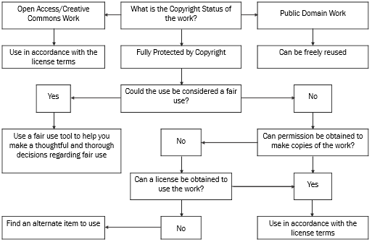
Copyright Decision Tree

Slide 12
Q&A!
What are the common copyright scenarios you encounter on the job?
What copyright questions are patrons asking?
This work is licensed under a Creative Commons Attribution-NonCommercial 4.0 International License.

