Slide 1
Outreach & Programming
Carla Myers
Guelph, ON
December 14
Notes:
“Outreach & Programming" by [presenter names], Association for College and Research Libraries is licensed under CC BY-NC-SA 4.0

Slide 2

Getting Started:
Developing
an Outreach Program
“Audience” by Unsplash is in the Public Domain, CC0
Notes:
Jenny
Who is your audience?
Brainstorming session:
Presenter: As a group, brainstorm the potential audience(s) that you/your organization may target through Scholarly Communication outreach/programming.

Slide 3
Questions to Ask
1. Who is your audience?
Campus community-Faculty, students, staff, university administration, alumni
Community community-who lives nearby?
Professional Community-colleagues from around the world
2. What are their needs?
What services and resources might they be looking for?
3. What can you offer?
What skills, knowledge, and resources do you have or can you tap into?

Slide 4
Activity!

Slide 5
Who is Your Audience?
As a group, brainstorm the potential audience(s) that you/your organization may target through Scholarly Communication outreach/programming.

Slide 6
Examples!

Slide 7

North Carolina State University
Raleigh, North Carolina
Approximate Enrollment: 34,000, 24,000 of which are undergraduates

Slide 8
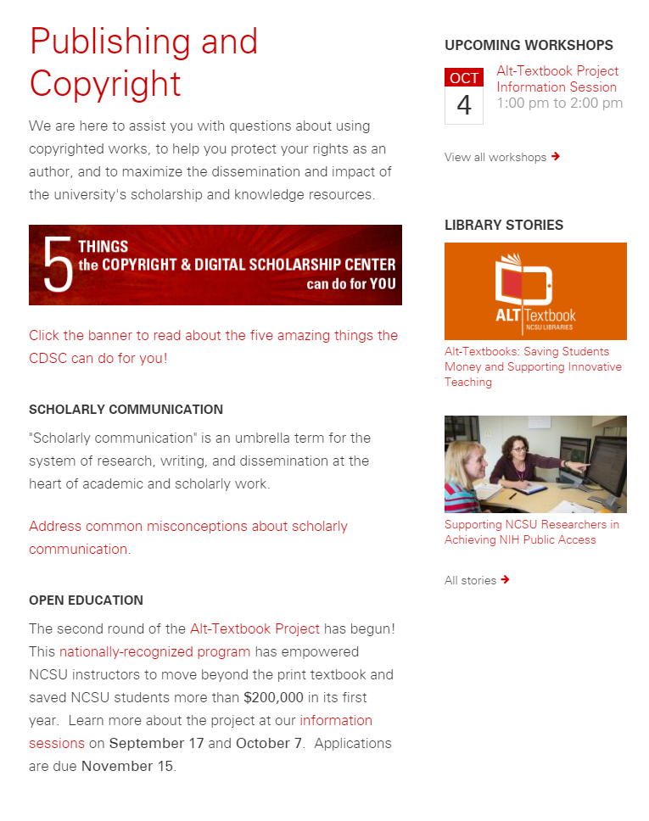
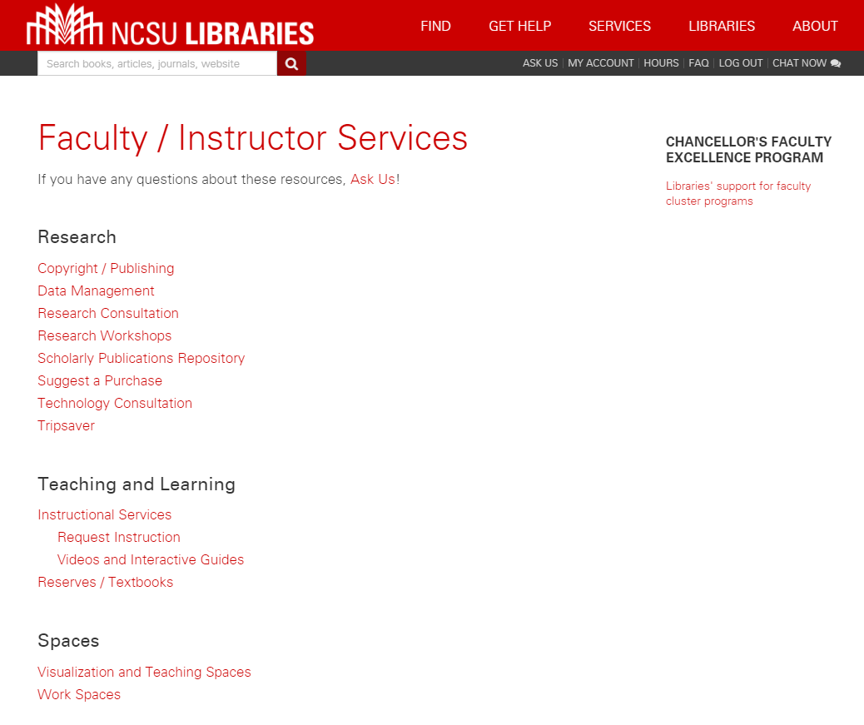
Faculty & Instructor Outreach
Notes:
Outreach programs can be based on raising awareness of services. Also, becomes opportunity to learn what else faculty need, where new services and outreach can fill in gaps.
Screencap credit:
https://www.lib.ncsu.edu/faculty
https://www.lib.ncsu.edu/stories

Slide 9
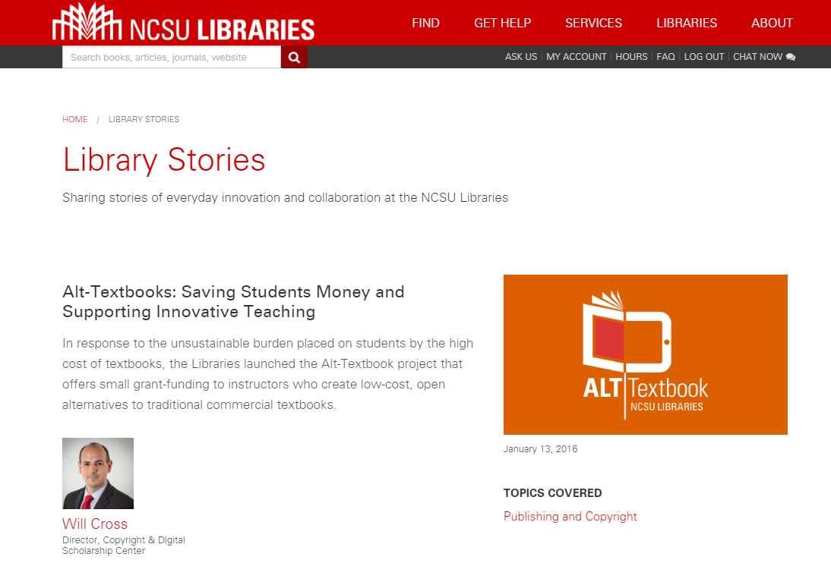
Telling Stories
Notes:
Will

Slide 10

North Carolina State University
Forest Grove, Oregon
Approximate Enrollment: 3,500, 1,700 of which are undergraduates
Notes:
In addition to offering library support for scholarly communication, including a resources for authors page with information about

Slide 11
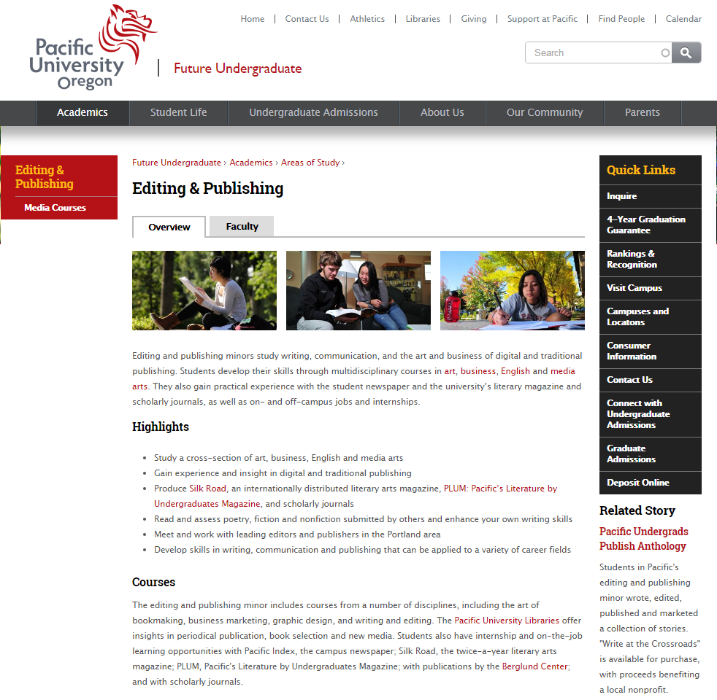
Student Outreach
Editing and Publishing Minor
Students take part in editing and publishing several undergraduate journals including PLUM: Pacific’s Literature by Undergraduates Magazine and Silk Road.
Also and Introduction to Scholarly Journal Publishing course
Other journals to get involved with as well
Notes:
http://www.pacificu.edu/future-undergraduates/academics/areas-study/editing-publishing

Slide 12
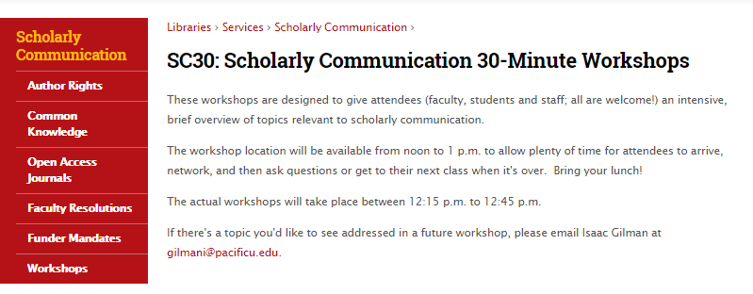
Anyone Outreach: 30 Minute Workshops
A quick and easy
LOW COST!
High impact way to start
Brown bag lunches
Bribe attendees with
baked goods
Have a presentation
planned, a series of questions for discussion, or just ask attendees to bring their questions and concerns.
All you need is a little bit of your time and a room in the library.
Notes:
Screencap credit:
http://www.pacificu.edu/libraries/services/scholarly-communication/workshops

Slide 13

Grand Valley State University
Allendale, Michigan
Approximate Enrollment: 25,000, 22,000 of which are undergraduates
Notes:
Institutional repository is Scholarworks@GVSU
Author recognition is a yearly list of new publications, creative works, and research from faculty and staff at GVSU, alongside a recognition ceremony

Slide 14
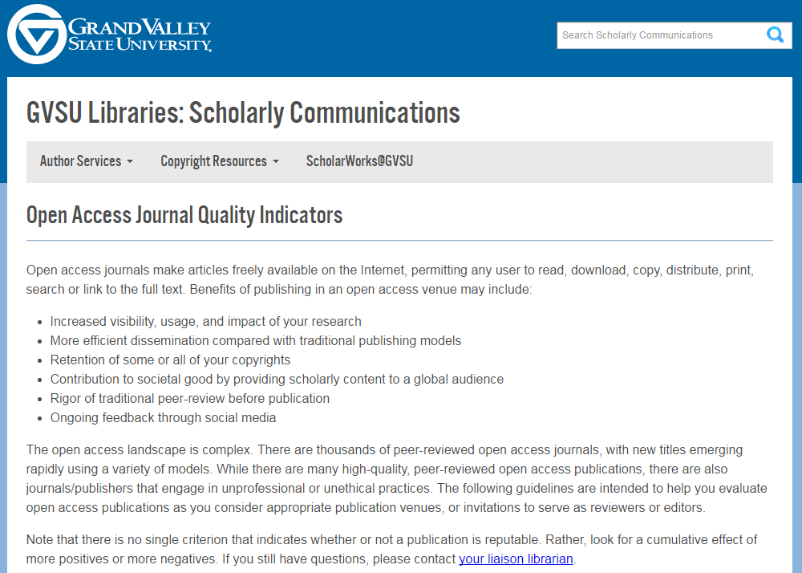
Faculty Outreach: Journal Quality Indicators
Providing information about OA publishing.
GVSU isn’t endorsing or blacklisting a particular journal or journals, but offering information and support (through their liaison librarian program) in determining if a journal is appropriate to publish in.
Notes:
Screencap credit:
http://www.gvsu.edu/library/sc/open-access-journal-quality-indicators-5.htm

Slide 15
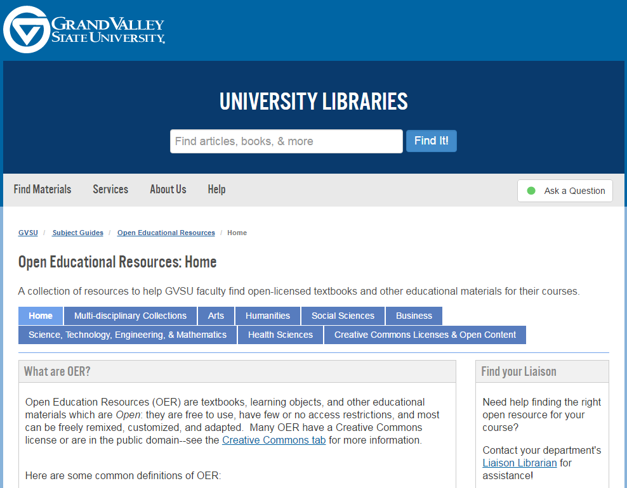
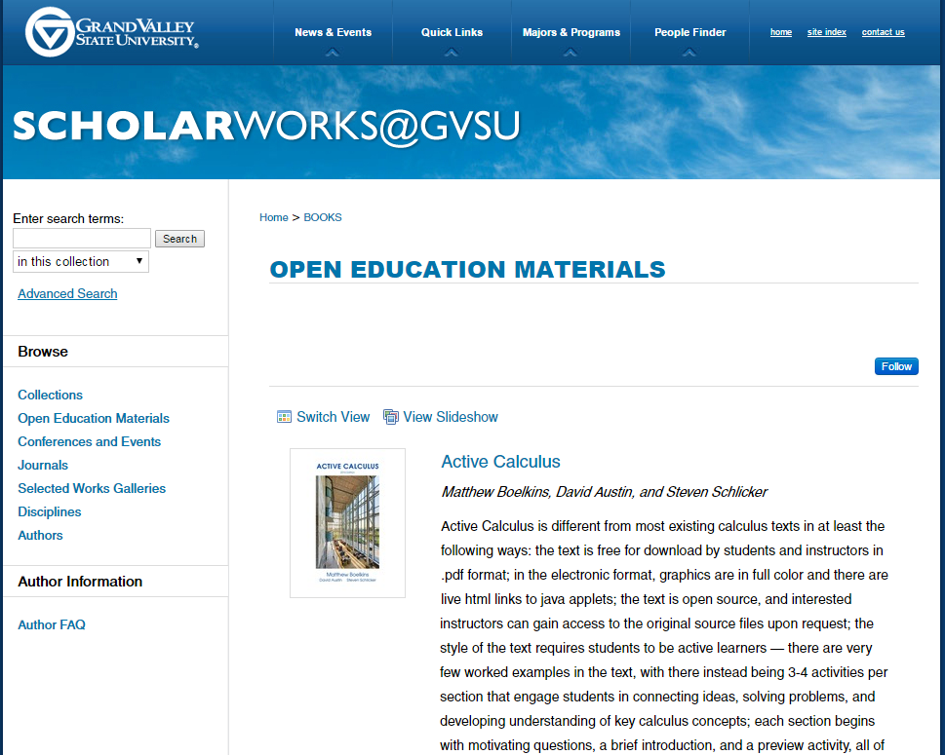
Open Educational Resource (OER) Publishing and Support
Publish OER through the Institutional Repository
provide a LibGuide specifically for finding open education resources.
Notes:
Screencap credit:
http://scholarworks.gvsu.edu/books/
http://libguides.gvsu.edu/c.php?g=275750&p=1838305

Slide 16

University of Alberta
Edmonton, Alberta
Approximate Enrollment: 38,000
Notes:
Jenny - Total enrollment ~ 39,000

Slide 17
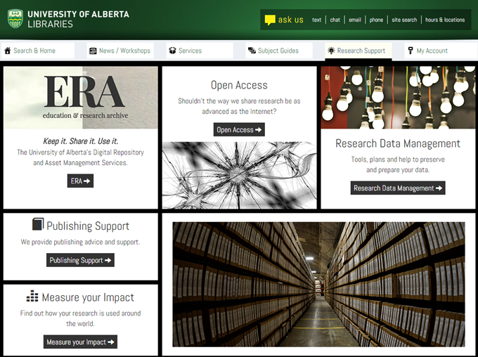

Slide 18
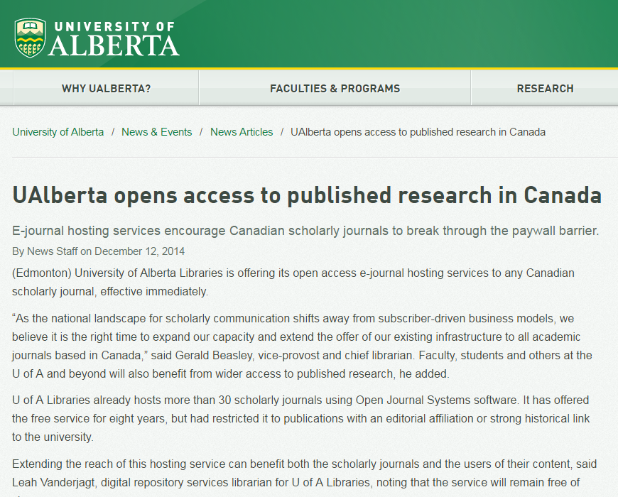
Scholarly Society Outreach
University of Alberta makes use of current infrastructure to expand their outreach. By offering to host open access journals for scholarly societies in Canada, U of A is utilizing the current platform they have in place to open up research from behind paywalls.
Notes:
https://www.ualberta.ca/news-and-events/newsarticles/2014/december/ualberta-opens-access-to-published-research-in-Canada

Slide 19

Linfield College
McMinnville, Oregon
Approximate Enrollment: 2,500, 1,700 of which are undergraduates.
Notes:
Anali - Student population ~2,500, with 1,700 undergrads
Linfield College is a small institution with an institutional repository, with an IR emphasis on student works and showcasing items from their Archives and Special Collections.
http://digitalcommons.linfield.edu/

Slide 20
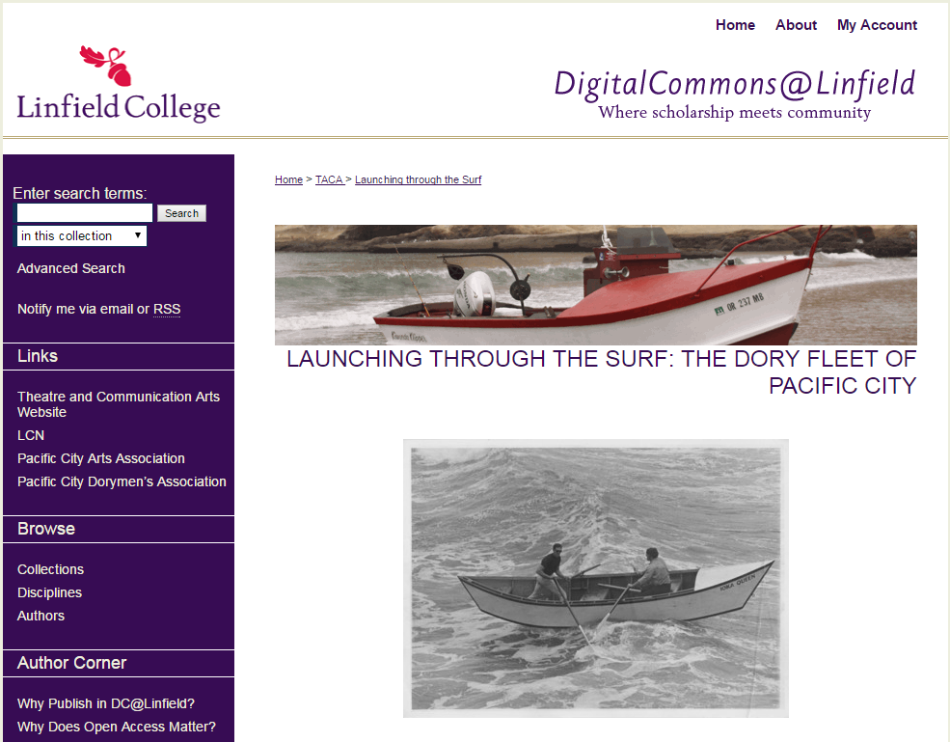
Community Outreach
The Linfield College Department of Theatre and Communication Arts, the Jereld R. Nicholson Library, the Linfield Center for the Northwest, the Pacific City Arts Association, and the Pacific City Dorymen's Association have joined forces to engage in this collaborative college and community venture.
The project involves collecting oral histories from individuals associated with the Pacific City Dory Fleet.
Original multimedia theatrical script and production, digital archives, scholarly papers and poster sessions, a traveling exhibit, and a visual art exhibit.
Notes:
Screencap credit:
http://digitalcommons.linfield.edu/dory/

Slide 21

Furman
Greenville, South Carolina
Approximate Enrollment: 3,000, all of which are undergraduates.
Notes:
Anali - Furman University – Student population of 3,000
Scholarly Communications is an umbrella term that encompasses several services in the Furman University Libraries including the institutional repository, open access initiatives, open educational resources (OERs), and digital liberal arts. These services are managed by Andrea Wright (Science and Outreach Librarian) in the Outreach Services Division, as well as Christy Allen (Assistant Director for Discovery Services) and Kathie Sloan (Digital Projects Specialist) in the Discovery Services Division.

Slide 22

Outreach Everywhere!
Notes:
Screencap credit:
http://libguides.furman.edu/scholarly-communications
OER Review Program - participants
Attend an OER consultation with a librarian in which they will learn more about OERs and identify appropriate OER(s) for review.
Complete a review form (provided) for each OER identified in the consultation.
Provide feedback on the program through an online survey.
Then receive a $250 stipend. In addition, this program will provide guidance on OER identification and evaluation, common obstacles to OER adoption. Participants are only asked to carefully evaluate OERs as potential pedagogical tools for their classrooms; adoption is not required.

Slide 23
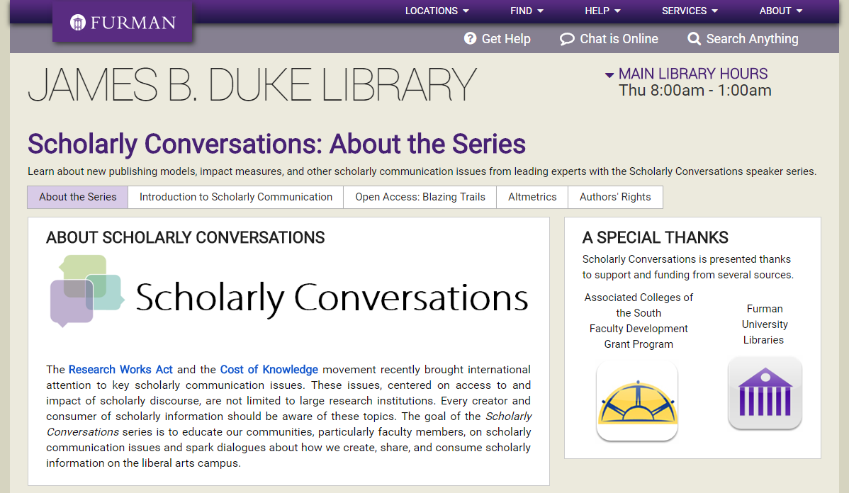
Professional Outreach
Notes:
Utilized a faculty development grant for funding to bring speakers to campus, with simultaneous live stream on Adobe Connect for three of the four.
“provide meaningful education related to scholarly communication issues facing [the] academic community” (Wright 2013)
For more information about the program, see:
Wright, A.M., (2013). Starting Scholarly Conversations: A Scholarly Communication Outreach Program. Journal of Librarianship and Scholarly Communication. 2(1), p.eP1096. DOI: http://doi.org/10.7710/2162-3309.1096
http://jlsc-pub.org/articles/abstract/10.7710/2162-3309.1096/
Screencap credit:
http://libguides.furman.edu/scholarlyconversations

Slide 24

Furman
McMinnville, Oregon
Approximate Enrollment: 50,000, 35,000 of which are undergraduates.

Slide 25
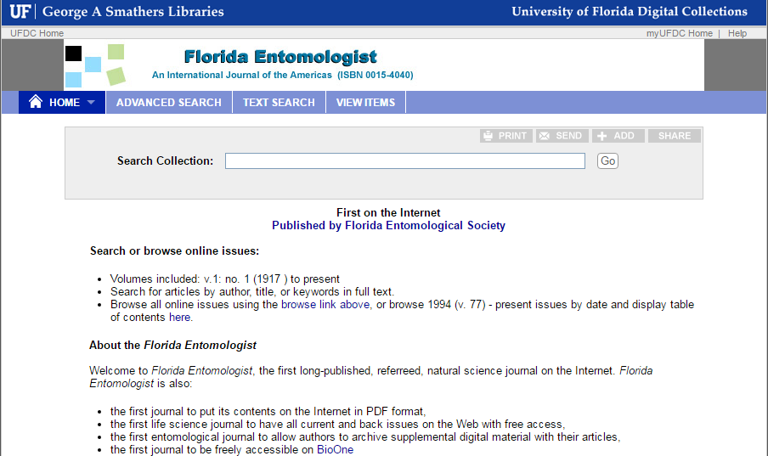
Awesome Outreach
Notes:
Jenny - Scholarly Society Journal from the Florida Entomological Society, available from v.1 n.1 (1917) to present
“the first long-published, referreed, natural science journal on the Internet. Florida Entomologist is also:
the first journal to put its contents on the Internet in PDF format,
the first life science journal to have all current and back issues on the Web with free access,
the first entomological journal to allow authors to archive supplemental digital material with their articles,
the first journal to be freely accessible on BioOne”

Slide 26
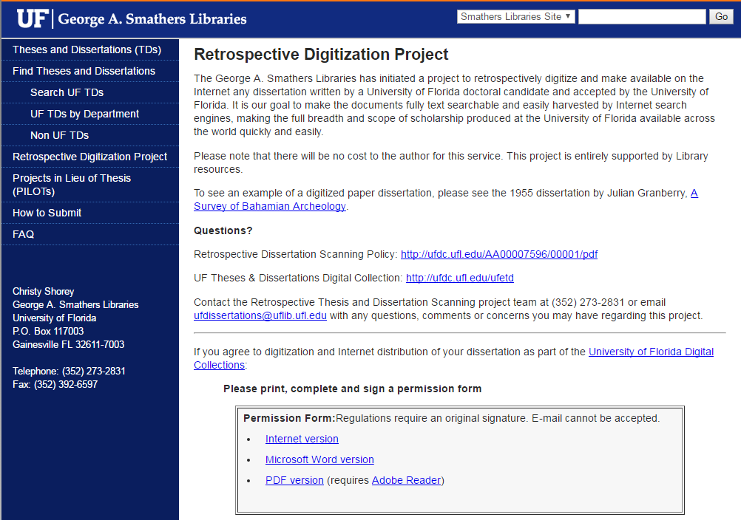
Graduate Student Outreach
Notes:
Project to retrospectively digitize any dissertation written by a U of FL doctoral candidate. No cost to author, all supported by Library
- Alumni outreach!
Screencap credit:
http://cms.uflib.ufl.edu/etd/rds.aspx

Slide 27

Building the Infrastructure for a Successful Program
"Hong Kong" by tpsdave is in the Public Domain, CC0

Slide 28
Programs don’t grow on trees
They require
Money
Time
Space
Planning
Followup
Look into grant opportunities available at your institution
Faculty development grants
Student development grants
Notes:
Furman used university faculty development grants to support the Scholarly Conversation series; Western Washington University Office of Sponsored Research offers faculty mini grants that can be use, among other things, to support open access publishing fees
Student technology fees have been used to support Open Education Resource funding at Kansas State University and Western Washington University

Slide 29
We Are a Community!
Talk to colleagues
Talk to us!
Chat with neighbors and presenters at conferences
Search the web and reach out to those institutions doing interesting things

Slide 30
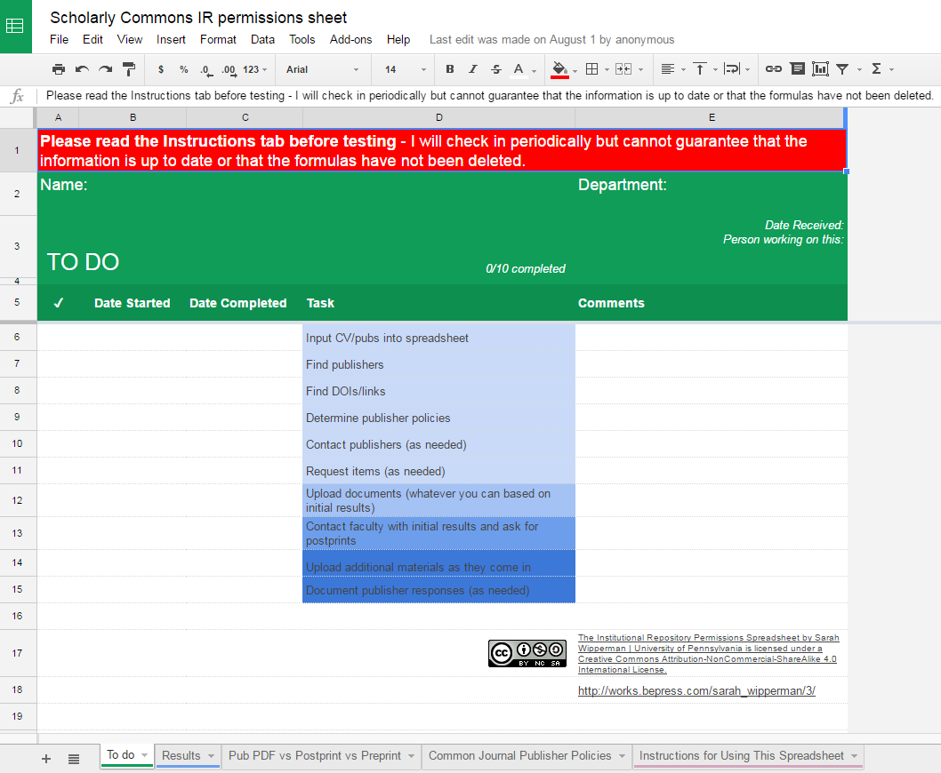
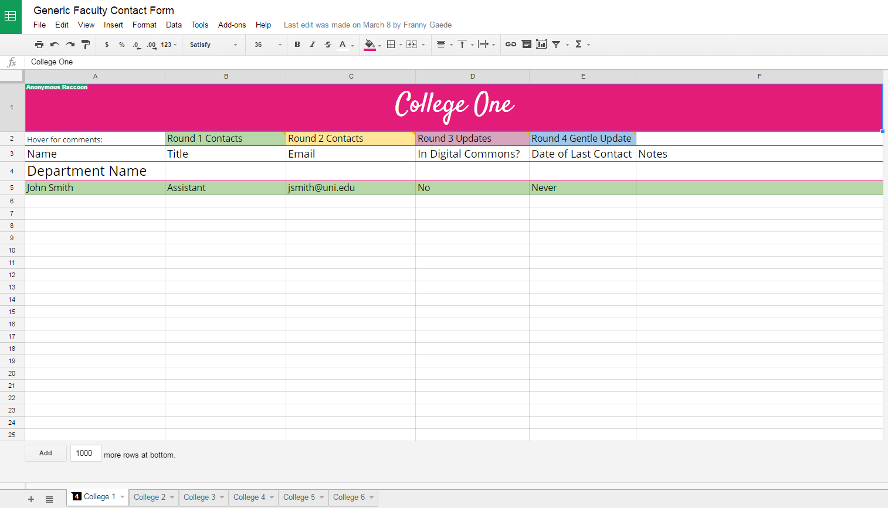
Other Resources
Notes:
The library community is awash with colleagues willing to share what has and hasn’t worked for them. This includes documents to help support scholarly communications work:
Scholarly Communications IR permissions sheet by Sarah Wipperman: https://docs.google.com/spreadsheets/d/1uEujtJlldjNG2_cK03OGc_wz37Ex0JF8RtAgyOV72N0/edit?usp=sharing
Generic Faculty Contact Form by Franny Gaede:
https://docs.google.com/spreadsheets/d/1EDdwGzEqP2YMRhTXoB5_EcgLS0IF51NoSfJxqN-az9M/edit?usp=sharing

Slide 31
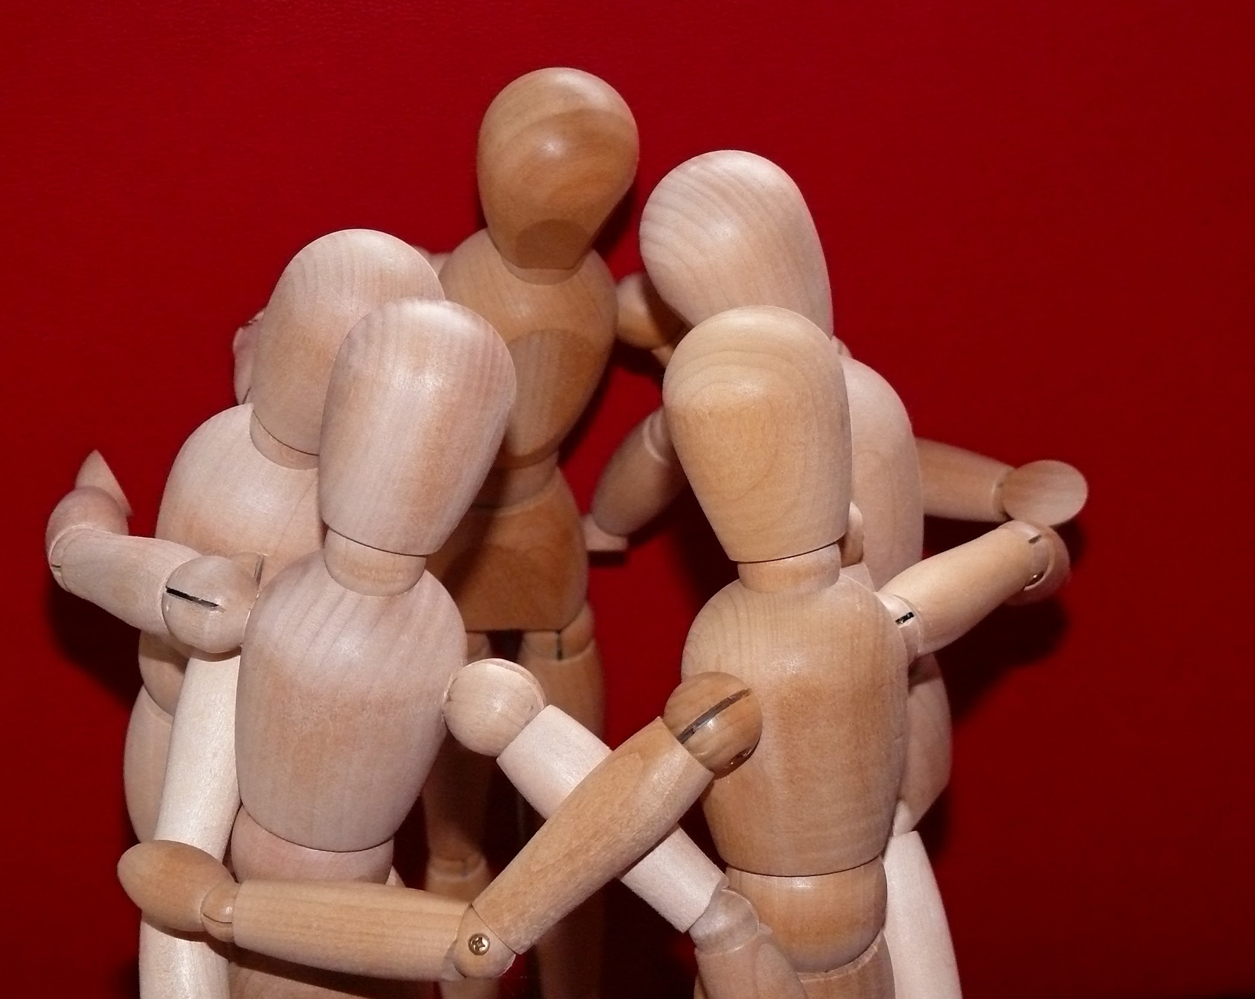
Other Allies!
Subject Librarians
Office of Research
Provost office
Graduate school
Faculty champions
Student government
Campus IT/instructional designers
Alumni association
Friends of the Library
Campus or library communications and marketing group
"Articulated male" by Buecherwurm_65 is in the Public Domain, CC0

Slide 32
TIPS AND TRICKS

Slide 33

Tell your story
Story telling image
"typing" by Sebastien Wiertz is licensed under CC BY 2.0
Notes:
What does scholarly communication mean to you? To your institution or your library? It is often said that an institutional repository is the story of an institution’s research, creativity, and scholarship. If your institution/library has one – are you talking about it, about what is in it? Are you tweeting about it? Posting to facebook?
Are you telling your story?
And if you don’t have an IR, your library can still use social media to tell the story of your institution’s work.

Slide 34
Things to Keep in Mind
Seek support from your administrators and colleagues
Start small
Focus on campus needs
Talk to others who are doing similar programs
Stay current
Accept that failure is part of every scholarly communications program. Be flexible, be honest in the good and bad, and be prepared to try again!

Slide 35

So much depends on word of mouth
"Project 365 #169" by Pete is in the Public Domain, CC0
Notes:
Make sure your subject librarians have the elevator speech ready to go. Make sure information about your program – even if it is something small that you’re just getting started on, is readily available
(or https://www.flickr.com/photos/dbasanta/14235065526/)

Slide 36
Activity!

Slide 37
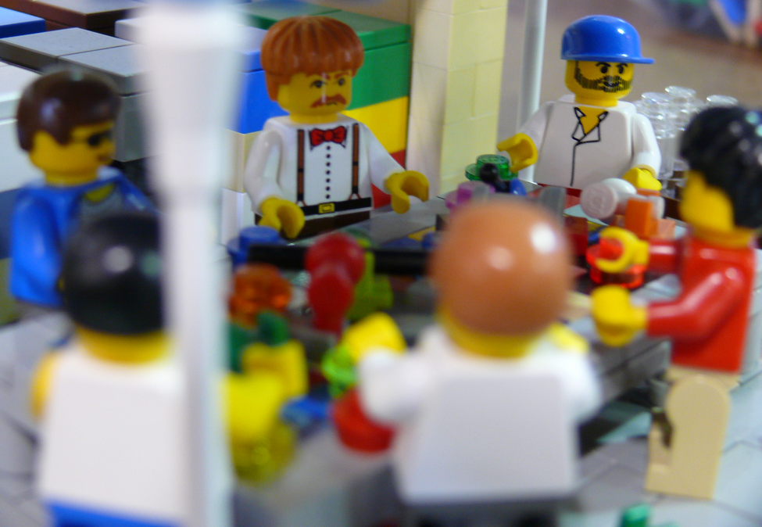
Who is your audience?
Using the audiences you identified in he earlier activity, select one target audience and brainstorm potential programming/outreach from their perspective.
"Uncle Dan's Gift 6 - BayLUG 10th Anniv Meeting" by Bill Ward is licensed under CC BY 2.0
Notes:
Jenny - Stakeholder exercise:
Using the audiences and stakeholders from the earlier activity, select one target stakeholder and brainstorm potential programming/outreach from their perspective. What do they care about? What are they most interested in as researchers/scholars/university administration? What are potential ways to tailor programming/outreach to target these stakeholders?

Slide 38
Planning
What do they care about?
What outreach/programming might they most interested in?
What resources do your have to help meet these needs?
  Time
  Money
  Colleagues
  Spaces

Slide 39

"Question Mark Pile" by qimono is in the Public Domain, CC0

