Slide 1
An Introduction to the Creative Commons

Slide 2
Welcome!
Heather Crozier
Electronic Resources Librarian
Heterick Memorial Library
Ohio Northern University
h-crozier@onu.edu
Carla Myers
Coordinator of Scholarly Communications
Miami University Libraries
myersc2@miamioh.edu

Slide 3
Overview
Copyright Basics
CC Licenses
Using CC Licensed Works
Using CC Licenses for Your Works

Slide 4
Copyright basics

Slide 5
Securing Copyright
Copyright protection subsists in “in original works of authorship” (not copied) which are “fixed in any tangible medium of expression” (can be perceived by eye, or with the assistance of some type of machine, e.g. computer, CD player, DVD player, etc.).

Slide 6
This Means…
We all own thousands of copyrights.
Much of what we encounter in our daily lives is protected by copyright.
Includes physical works and those we find online
Copyright notice (e.g. © 2017 by Carla Myers) is no longer required!
Registration is also not required

Slide 7
Works Eligible for Copyright Protection
Literary works (fiction/nonfiction, poetry, textbooks, reference works, directories, catalogs, advertising copy, compilations of information, computer programs and databases)
Musical works (this generally refers to music scores & accompanying words)
Dramatic works (plays, film, radio, and television scripts)
Pantomimes and choreography
Pictorial, graphic, and sculptural works (art)
Motion pictures and other audiovisual works (film, television show, videogame, etc.)
Sound recording (performances of musical works, audio recordings of literary works)
Architectural works (just the designs & models, not the building its self!)

Slide 8
What is Not Copyrightable?
Ideas
Facts
Works not fixed
Names, phrases, slogans, titles, symbols (though these could be protected under trademark).
Simple listings, e.g. table of contents, recipe ingredients (think facts!)
Procedures, methods, processes (though these could be protected under patent or trade secret law).
Works consisting of common facts, e.g. calendar, height/weight chart, ruler.

Slide 9
Who Owns the Copyright in a Work?
Generally, the person who creates the work.
Joint Authorship-When two or more authors work together to create a work the copyright is shared between them.
Works Made for Hire

Slide 10
Authors’ Rights
Owner of a protected work is provided with certain right….
The right to reproduce (copy) the work
The right to distribute the work (share/publish/sell)
The right to create derivative works
The right to publicly perform or display a work

Slide 11
How Long Does Copyright Last?
Works created after Jan. 1, 1978 are protected for the life of the author plus 70 years
Join authorship-life of last surviving author +70 years
Works for Hire-95 years from publication or 120 years from creation, whichever is shorter

Slide 12
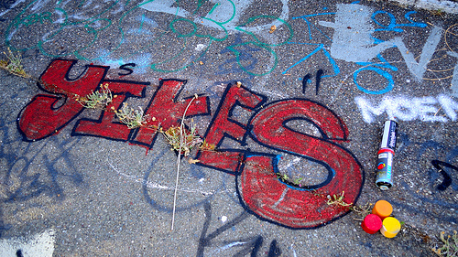
YIKES!
Copyright is Kind of Scary
Image credit: "Yikes!" (CC BY-NC-ND 2.0) by Indiecent Exposure-Blockton Photography

Slide 13
Copyright Infringement
Copyright infringement occurs when we take advantage of one or more of the rights granted to rightsholders under US copyright law without their permission:
  Copying works
  Distributing works
  Making derivatives
  Making a public performance or display of a work

Slide 14
Copyright Exceptions
There are exceptions in US copyright law that may cover certain uses:
  Fair Use (Section 107)
  Face-to-Face Classroom Exception (Section 110(1))
  Library Exception (Section 108)
Useful, but come with some uncertainty

Slide 15
Reuse of Third Party Works
Many rightsholders are eager to share their works with others
  Just enjoy creation
  Looking to share knowledge
  Looking for notoriety (fame/tenure)
How can we communicate this with others?
  Rely on users knowledge of exceptions
  Licensing!

Slide 16
The Creative Commons

Slide 17
About the CC
Founded in 2001 by Lawrence Lessig, Hal Abelson, and Eric Eldred with the support of Center for the Public Domain.
Released their first set of licenses in 2002.
Licenses provide rightsholders with a simple, standardized way to grant copyright permissions to their creative work.
Today its estimated that there are more than 1 billion works licensed under the various Creative Commons licenses.
https://creativecommons.org/

Slide 18
Attribution (BY)
This license lets others distribute, remix, tweak, and build upon your work, even commercially, as long as they credit you for the original creation. This is the most accommodating of licenses offered. Recommended for maximum dissemination and use of licensed materials.
https://creativecommons.org/licenses/

Slide 19
Sharealike(SA)
This license lets others remix, tweak, and build upon your work even for commercial purposes, as long as they credit you and license their new creations under the identical terms.
https://creativecommons.org/licenses/

Slide 20
NoDerivatives (ND)
This license allows for redistribution, commercial and non-commercial, as long as it is passed along unchanged and in whole, with credit to you.
https://creativecommons.org/licenses/

Slide 21
NonCommercial (NC)
This license lets others remix, tweak, and build upon your work non-commercially, and although their new works must also acknowledge you and be non-commercial, they don’t have to license their derivative works on the same terms.
https://creativecommons.org/licenses/

Slide 22
Mix and Match!
All licenses require attribution (CC-BY)
CC-BY-SA
CC-BY-ND
CC-BY-NC
CC-BY-NC-SA
CC-BY-NC-ND

Slide 23
No Rights Reserved (CC0)
Enables scientists, educators, artists and other creators and owners of copyright- or database-protected content to waive those interests in their works and thereby place them as completely as possible in the public domain, so that others may freely build upon, enhance and reuse the works for any purposes without restriction under copyright or database law.
https://creativecommons.org/share-your-work/public-domain/cc0/

Slide 24
Legal Code
By exercising the Licensed Rights (defined below), You accept and agree to be bound by the terms and conditions of this Creative Commons Attribution 4.0 International Public License ("Public License"). To the extent this Public License may be interpreted as a contract, You are granted the Licensed Rights in consideration of Your acceptance of these terms and conditions, and the Licensor grants You such rights in consideration of benefits the Licensor receives from making the Licensed Material available under these terms and conditions…..
Notes:
Created by lawyers
Lots of legalese
Hand out copies of the CC-BY legal code: https://creativecommons.org/licenses/by/4.0/legalcode

Slide 25
License Deed
You are free to:
Share — copy and redistribute the material in any medium or format
Adapt — remix, transform, and build upon the material for any purpose, even commercially.
This license is acceptable for Free Cultural Works. The licensor cannot revoke these freedoms as long as you follow the license terms.
Under the following terms:
Attribution — You must give appropriate credit, provide a link to the license, and indicate if changes were made. You may do so in any reasonable manner, but not in any way that suggests the licensor endorses you or your use.
No additional restrictions — You may not apply legal terms or technological measures that legally restrict others from doing anything the license permits.
Notices:
You do not have to comply with the license for elements of the material in the public domain or where your use is permitted by an applicable exception or limitation.
No warranties are given. The license may not give you all of the permissions necessary for your intended use. For example, other rights such as publicity, privacy, or moral rights may limit how you use the material.
Notes:
A plain English, simplified version of the legal code…

Slide 26
CC Advantages
More options for the content creator
Increased opportunities for collaboration and innovation
Clear rights for reuse
  No need to seek permission

Slide 27
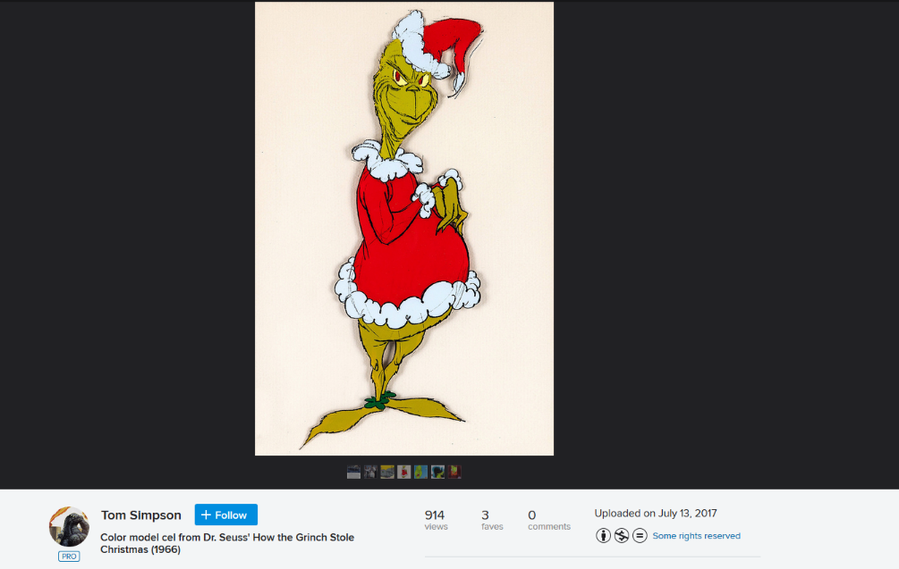
CC Disadvantages
Works may be posted with a CC license that are not attached by the rightsholder

Slide 28
Using CC Licensed Works
Putting CC Licenses to Work

Slide 29
Step #1—Explore Your Situation
What is your situation?
  Noncommercial
  Commercial
What do you want to do?
  Simply reuse the work (e.g. quote, illustrate)
  Change the work, or create an alternate version (build upon, translate, graphic novel, audio recording, video recording)
What are you willing to do?
  ShareAlike?

Slide 30
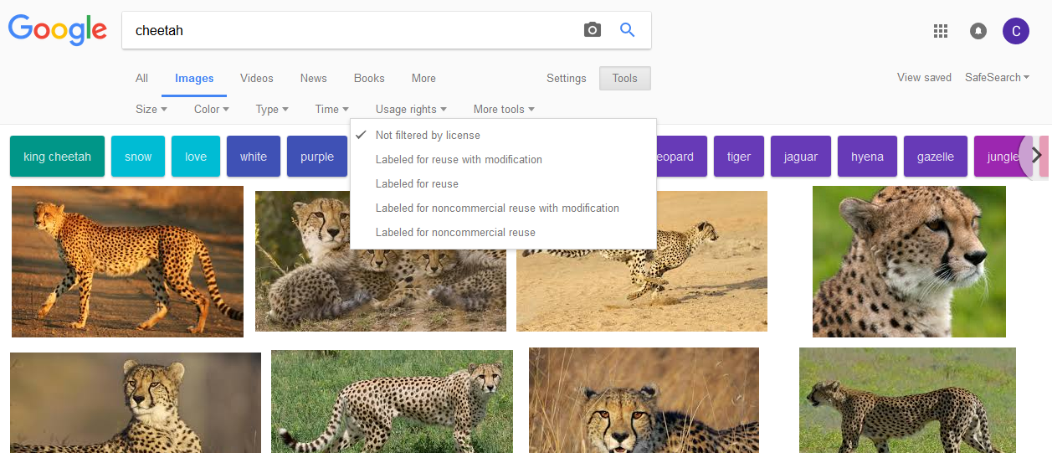
Step #2—Searching for Appropriate CC Works to Reuse
Search the Commons: https://search.creativecommons.org/
Google Image Search

Slide 31
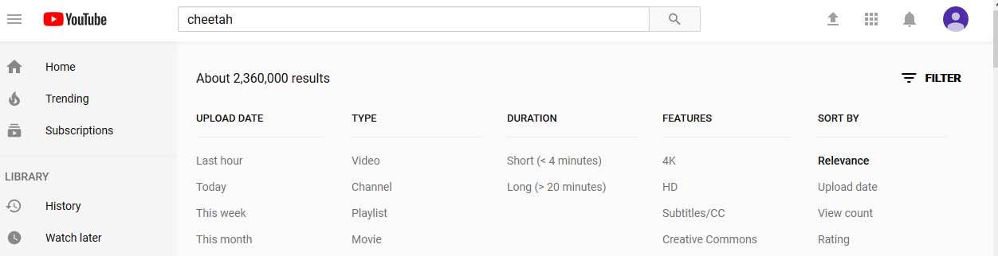
Step #2—Searching for Appropriate CC Works to Reuse
YouTube

Slide 32
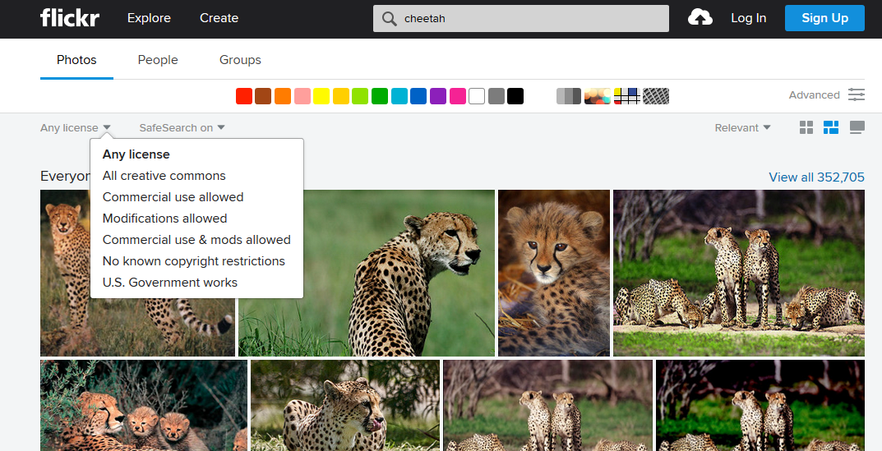
Step #2—Searching for Appropriate CC Works to Reuse
Flickr

Slide 33
Practice!
Perform a CC search based off the scenario presented to you…

Slide 34
Licensing Your Works
Putting CC Licenses to Work

Slide 35
Sharing Your Work with Others
Are you comfortable with others reusing your work?
How do you want to be attributed? (BY)
Commercial or Noncommercial (NC)
Are derivatives ok? (ND)
Should others share too? (SA)

Slide 36
Get Help
CC “Choose a License” tool can help you work through these decisions and identify the license that might be a good fit for you
https://creativecommons.org/choose/

Slide 37
Practice!
Select a CC license based off the scenario presented to you…

Slide 38

Considerations
Can go from strict (CC-BY-NC-ND) to more open (CC-BY), but not vice versa.
Provide clear attribution info.
In the case of NC and/or ND licenses, make contact info available so people can follow-up with you if they are interested in these uses.

Slide 39
Violations
If you find someone using a work of your in a way that falls outside the scope of your CC license…
  Reach out to them to explain the situation
  Be nice and assume the best!
In worst case scenarios
  CC licenses have been held-up as valid contracts in court

Slide 40
Questions?
This work is licensed under a Creative Commons Attribution-NonCommercial 4.0 International License.

