Slide 1
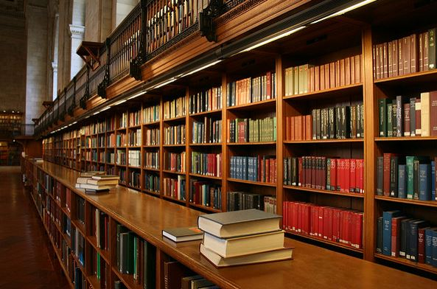
CAN’T YOU JUST SAY YES?
Answering Copyright Questions About Fair Use for Faculty Colleagues

Slide 2

Carla Myers
Coordinator of Scholarly Communications
Miami University Libraries myersc2@miamioh.edu

Slide 3
My aim in giving this presentation…
Provide a general introduction to the law
Present some considerations regarding how you and/or your institution may be able to help faculty with fair use questions
Identify a few methods for consulting with faculty on fair use
Help you identify resources and tools that can help you learn more about the law and aid you (or faculty) in making fair use determinations

Slide 4
A (Very) Basic Introduction to U.S. Copyright Law

Slide 5
Securing Copyright
Copyright protection subsists in “in original works of authorship” that are “fixed in any tangible medium of expression” (17 U.S.C. § 102(a)).
Copyright notice (e.g. © 2018 by Carla Myers) is not required for protection
Registration is also not required

Slide 6
What is Copyrightable?
Literary works-fiction/nonfiction, poetry, textbooks, reference works, directories, catalogs, advertising copy, compilations of information, computer programs and databases
Musical works-this generally refers to music scores & accompanying words
Dramatic works-plays, film, radio, and television scripts
Pantomimes and choreography
Pictorial, graphic, and sculptural works-art
Motion pictures and other audiovisual works-film, television show, videogame, etc.
Sound recordings-performances of musical works, audio recordings of literary works
Architectural works-just the designs, not the building its self!

Slide 7
The Rightsholder is…
Generally, the person who creates the work.
A “joint work” is a work prepared by two or more authors with the intention that their contributions be merged into inseparable or interdependent parts of a unitary whole (17 USC § 101).
According to 17 USC § 101, work made for hire is…
  (1) a work prepared by an employee within the scope of his or her employment; or
  (2) a work specially ordered or commissioned…

Slide 8
How Long Does it Last?
Works created by a single author are protected for the life of the author plus 70 years
Join authorship-life of last surviving author +70 years
Works for Hire-95 years from publication or 120 years from creation, whichever expires first.
17 U.S. Code § 302

Slide 9
Authors Rights
Owner of a protected work is provided with certain rights, including but not limited to….
The right to reproduce (copy) the work
The right to distribute the work (publish/sell)
The right to make derivative works (translations, audio version of a book, etc.)
The right to display (show) the work publically
The right to perform (recite, act, play) the work publicly
17 U.S. Code § 106
Learn More: Copyright Basics (Circular 1), published by the US Copyright Office: https://www.copyright.gov/circs/circ01.pdf
  Provides and overview of the basics of US copyright law, including works eligible for copyright protection, the rights of copyright owners, the duration of copyright, and registration with the U.S. Copyright Office.

Slide 10
Infringement
Copyright infringement occurs when we take advantage of one of the rights granted to creators under the law without their authorization.
Making copies of works;
Distributing copies of works
Making derivative works;
Making public performances or displays of works
In the case of sound recordings, to perform the copyrighted work publicly by means of a digital audio transmission.

Slide 11
Fair Use
17 U.S.C. § 107

Slide 12
Fair Use (17 U.S.C. § 107)
Notwithstanding the provisions of sections 106 and 106A, the fair use of a copyrighted work, including such use by reproduction in copies or phonorecords or by any other means specified by that section, for purposes such as criticism, comment, news reporting, teaching (including multiple copies for classroom use), scholarship, or research, is not an infringement of copyright. In determining whether the use made of a work in any particular case is a fair use the factors to be considered shall include—
  (1) the purpose and character of the use, including whether such use is of a commercial nature or is for nonprofit educational purposes;
  (2) the nature of the copyrighted work;
  (3) the amount and substantiality of the portion used in relation to the copyrighted work as a whole; and
  (4) the effect of the use upon the potential market for or value of the copyrighted work.
The fact that a work is unpublished shall not itself bar a finding of fair use if such finding is made upon consideration of all the above factors.

Slide 13
Purpose of the Use
Teaching/Research/Scholarship
Criticism/commentary
Nonprofit institution
Commercial use
Transformative
  Have you turned the original into something new by adding new expression or meaning?
  Learn More: Pierre N. Leval, Toward a Fair Use Standard, Harvard Law Review, Vol. 103, No. 5 (Mar., 1990), pp. 1105-1136

Slide 14
The Nature of the Work
Explores the characteristics of the work being used…
Nonfiction/factual
Fiction/creative
Published or unpublished

Slide 15
The Amount & Substantiality of the Portion Used
“The amount and substantiality of the portion used in relation to the copyrighted work as a whole” -17 USC § 107
There are no absolute rules as to how much of a copyrighted work may be copied and still be considered a fair use.
-Maxtone-Graham v. Burtchaell
Think quantity and quality
Consider the amount needed to serve the purpose of the use in relation to the work being used.
This is a judgment call, and one you must be prepared to justify should your use of the work ever come into question!

Slide 16
Effect on the Market
Is your use resulting in lost revenue for the rightsholder?
Could your use replace sale of the work?
Could your use help the market for the item, e.g. comment, critique, parody?

Slide 17
It’s so Confusing!
Patrons want straight ‘yes’ or ‘no’ answer
Deliberately created to be vague, which is good!
Each application of fair use must be examined on a case-by-case basis

Slide 18
Answering Fair Use Questions

Slide 19
What Types of Consultations Will You Provide?
What types of services is your institution prepared to offer?
  What are your institution’s values and mission?
  Risk management
What are you comfortable with?
Options for answering fair use questions
  Referral to information
  Referral to someone else
  Consultations

Slide 20
Referral to Information
Directing patrons to information about the law so they can draw their own conclusions
Referral to QUALITY information!
  There is lots and lots of bad information out there about the law
Directing faculty to tools that can help them in making a fair use determination

Slide 21
Referral to Someone Else
Do you have a copyright librarian on staff?
Do you have a designated copyright guru?
Can someone in the Office of General Counsel provide assistance?
How can the faculty member get ahold of them?
What services do they provide?

Slide 22
Consultations
Help the patron in making a fair use determination, or
Answering their question

Slide 23
Step 1—Talk to me!
Get as much useful information as you can about the situation
What work are they looking to reuse?
How are they looking to reuse it?
Are you sure that’s everything?

Slide 24
What work are you looking to reuse?
Is it protected by copyright?
Is it an Open Access (OA), Creative Commons (CC) work, or is it controlled by some other type of license?
Who owns the copyright?
How much of the work are you looking to reuse?

Slide 25
How are you looking to reuse the work?
Face-to-face teaching
Online education
Copying
Distribution
Linking
Publication
Personal use
Posting to a public website

Slide 26
Can you think of anything else I should know?
Can you spot any holes in the information?
Is there anything they might not have thought of?
Does anything sound suspicious?

Slide 27
Pause
Is fair use even a consideration for their situation?
Is fair use the best exception to use in this situation?
If no, provide information about “other options.”
If yes, proceed to Step 2!

Slide 28
Step 2—Working Through the Four Factors of Fair Use
Purpose
Nature of the work
Amount being used
Affect on the market

Slide 29
Fair Use Tools

Slide 30
Using Fair Use Tools
Only work if user is completely honest!
Keep a copy
  Record of fair use decision
  Can be used as a legal document

Slide 31
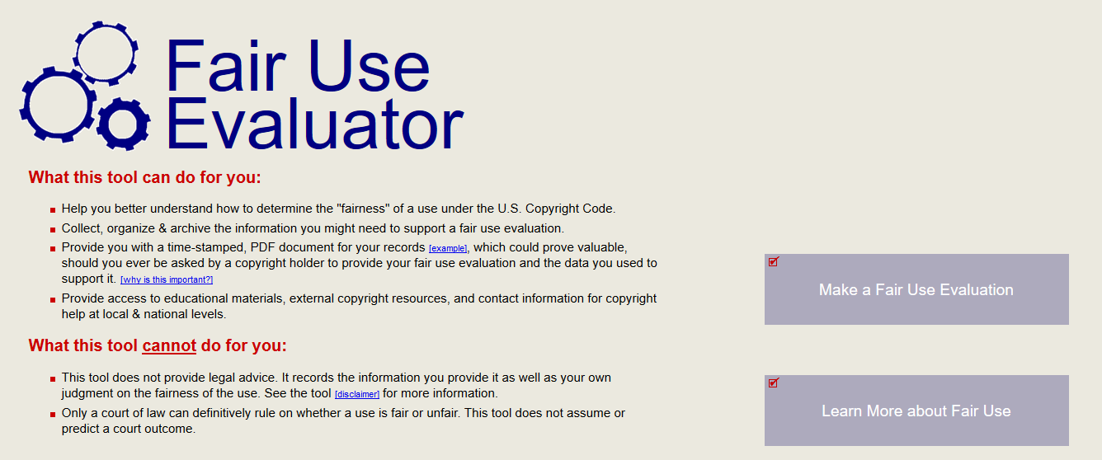
ALA Fair Use Evaluator
http://librarycopyright.net/resources/fairuse/
http://librarycopyright.net/resources/fairuse/

Slide 32
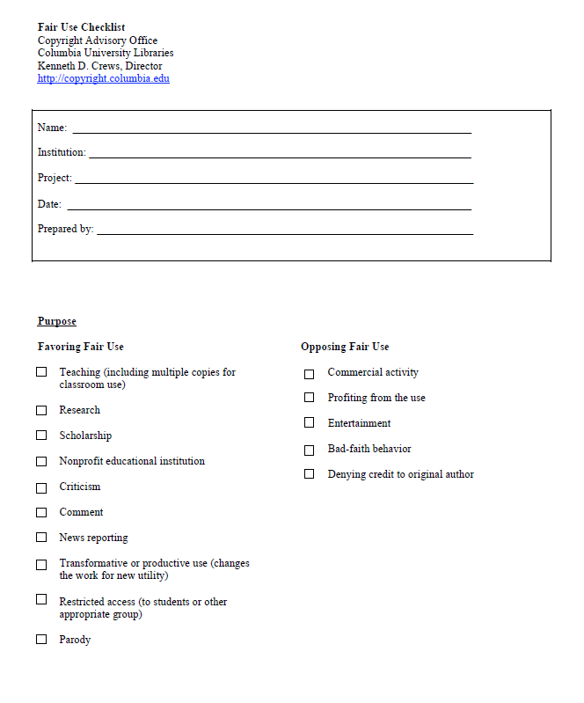
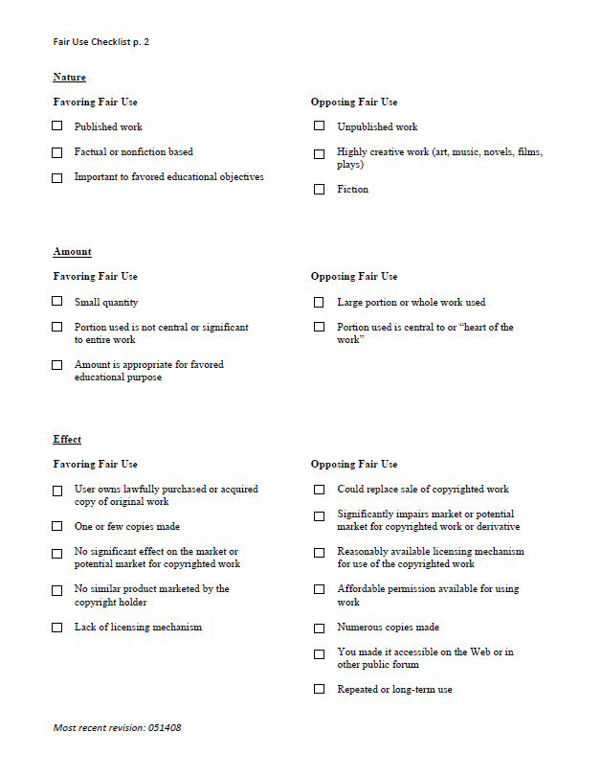
Kenneth D. Crews’ Fair Use Checklist
https://copyright.columbia.edu/content/dam/copyright/Precedent%20Docs/fairusechecklist.pdf

Slide 33
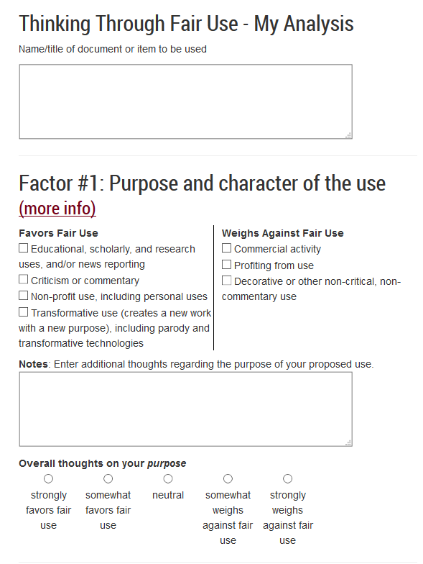
Think Through Fair Use
http://www.lib.umn.edu/copyright/fairthoughts
Tip: Think of checklist tools as a list of things to consider and a way to help you work-through/balance the factors, not an exercise in checking and counting boxes.

Slide 34
It’s Not Easy!
Patrons want straight answers…yes or no
“No” is sometimes easy. Yes is sometimes easy
The final answer is subjective to each situation
Low-risk scenarios vs. high risk scenarios
Legal precedent
Accepted/general library practices
  Learn More: Code of Best Practices in Fair Use for Academic and Research Libraries: Developed in partnership with librarians, this document provides easy-to-understand and reasonable approaches to the application of fair use in academic libraries.
  http://www.arl.org/storage/documents/publications/code-of-best-practices-fair-use.pdf

Slide 35
Avoid Providing Legal Advice
Providing information vs. interpreting the law
If it’s a tricky question, who will make the final call?
If legal advice is needed, who can you direct the patron to?
Be aware of your institution’s copyright policies
Learn More: University of South Carolina School of Law, Legal Research Training for Non-Lawyers: http://guides.law.sc.edu/c.php?g=315482&p=2714899

Slide 36
Getting Through the Consultation
Ask lots of questions
Make the patron feel comfortable in sharing information
Determine if one of the tools may be helpful and, if so, which one
Some people will get upset with the result of the consultation
  What other options can you offer them?
  Be prepared to handle the occasional REALLY angry person

Slide 37
Common Misconceptions That Often Pose Challenges
If it’s on the internet, I can use it however I want.
If it’s an educational use I can use anything I want, however I want, right?
I provided a citation to the original work, so it’s not copyright infringement.
If it’s a commercial use I can’t even consider fair use.
Arbitrary limits. Factor #3 states “(3) the amount and substantiality of the portion used in relation to the copyrighted work as a whole,” not:
  10% or 1 chapter from a work, 30 seconds from a song, 3 minutes from a film
  Spontaneous use, it’s fair use only 1 semester
  They hold no force of law and provide no safe harbor against claims of infringement
  Learn More: Kenneth D. Crews, The Law of Fair Use and the Illusion of Fair-Use Guidelines (October 1, 2001). Ohio State Law Journal, Vol. 62. www.arl.org/storage/documents/publications/fair-use-code-crews.pdf

Slide 38
Other Options

Slide 39
Other Exceptions
108
110(1)
110(2)
121
https://www.copyright.gov/title17/92chap1.html

Slide 40
Using Public Domain Works
Works created by employees of the US Federal Government acting within the scope of their job responsibilities
Works whose copyright has expired
  Works published prior to January 1, 1923
Digital Copyright Slider: http://librarycopyright.net/resources/digitalslider/index.html

Slide 41
Using Creative Commons Works
Allows rightsholders to license their works for reuse
CC-BY
CC-BY-SA
CC-BY-ND
CC-BY-NC
CC-BY-NC-SA
CC-BY-NC-ND
https://creativecommons.org/

Slide 42
Using Open Access Works
Scholarship made freely available online and licensed for reuse.
Learn more: https://sparcopen.org/open-access/
Directory of Open Access Journals (DOAJ): https://doaj.org/

Slide 43
Seeking Permission
Contact the rightsholder!
Request their permission to use the work
Detailed info on who, what, and how
Good resource: Columbia Copyright Advisory Office
https://copyright.columbia.edu/basics/permissions-and-licensing.html

Slide 44
Licensing
License rights for various uses, including copies, posting online, commercial republication, etc.
Copyright Clearance Center: http://www.copyright.com/
Swank: https://www.swank.com/

Slide 45
Putting It All Together

Slide 46
Remember our Mission!
Don’t blatantly ignore the law, but also don’t let the fear of being sued keep you from taking advantage of the exceptions found in the law.
Thoughtful, “good faith” applications of the law can go a long way.
  The court shall remit statutory damages in any case where an infringer believed and had reasonable grounds for believing that his or her use of the copyrighted work was a fair use under section 107, if the infringer was: (i) an employee or agent of a nonprofit educational institution, library, or archives acting within the scope of his or her employment who, or such institution, library, or archives itself, which infringed by reproducing the work in copies or phonorecords -17 U.S. Code § 504(c)(2)
A checklist (and a sound copyright policy!) can help demonstrate good faith applications of fair use.

Slide 47
Recommendations
Educate yourself on copyright and fair use
Work with colleagues/administrators/institutional attorneys to develop a game plan for answering copyright questions/providing copyright services
Offer copyright education for your patrons
  Classes or workshops
  Website

Slide 48
Scenarios

Slide 49
Questions I’ve been asked…
How many pages from this book can I copy and share with my students?
For my online class I want to assign one article and one chapter from a book. Is that ok?
  Content Management System (CMS) or personal webpage
  Consider linking
  What do the library’s license agreements allow?
  Fair Use
I found this chart in an article. Can I include it in a book/article I’m writing?
  Fair use can be considered, but does the publisher have any specific rules?
I’m creating a digital museum that includes 3D scans of statues/objects/artifacts as well files that can be used to print them from a 3D printer.

Slide 50
Educational Tools and Resources

Slide 51
Learn More—Fair Use
Code of Best Practices
Codes on many different fair use topics!
http://cmsimpact.org/codes-of-best-practices/
Fair Use Week
http://fairuseweek.org/
An annual celebration of the important doctrines of fair use and fair dealing.
Stanford Copyright and Fair Use Center
https://fairuse.stanford.edu/
A website that includes primary case law, statutes, regulations, information about newly filed copyright lawsuits, pending legislation, copyright office news, recent publications as well as blog and twitter feeds from practicing attorneys and law professors.

Slide 52
Learn More--Copyright
CopyrightX
http://copyx.org/
Copyright for Educators and Librarians
https://www.coursera.org/learn/copyright-for-education
Copyright for Multimedia
https://www.coursera.org/learn/copyright-for-multimedia
Copyright Law for Librarians and Educators: Creative Strategies and Practical Solutions
https://www.alastore.ala.org/content/copyright-law-librarians-and-educators-creative-strategies-and-practical-solutions-fourth
Kraemer Copyright Conference
https://www.uccs.edu/copyright/kraemerconference.html
The Journal of Copyright in Education and Librarianship
https://www.jcel-pub.org/

Slide 53
Learn More—Fair Use Court Cases
US Copyright Office Fair Use Index
https://www.copyright.gov/fair-use/
The Fair Use Index tracks a variety of judicial decisions to help both lawyers and non-lawyers better understand the types of uses courts have previously determined to be fair—or not fair.
Georgia State Lawsuit
Provides information and resources on the Georgia State Lawsuit and its application of fair use in providing course reserve services.
http://libguides.law.gsu.edu/gsucopyrightcase

Slide 54
Tools
A Framework for Analyzing any U.S. Copyright Problem, developed by Smith, Kevin L. Smith and Lisa Macklin
A great tool for working through copyright questions and issues.
http://hdl.handle.net/1808/22723
The Copyright Advisory Network (CAN)
http://librarycopyright.net/
Provides copyright tools and resources and includes a forum where you can ask questions that will be answered by members of ALA’s Copyright Education Committee.
http://librarycopyright.net/resources/

Slide 55
Stay Current
CopyTalk Webinars
http://www.ala.org/advocacy/pp/pub/copytalk
Monthly webinars on various copyright topics
Copyright Chat Podcast
https://www.library.illinois.edu/scp/copyright-overview/chat-podcast/
A podcast dedicated to discussing important copyright matters.
Scholarly Communications @ Duke
https://blogs.library.duke.edu/scholcomm/
A blog about copyright and publication issues
IO: In the Open
http://intheopen.net/
A blog exploring libraries, scholarship, and publishing
The Taper
http://thetaper.library.virginia.edu/
A blog exploring copyright information and policy

Slide 56
Carla Myers
Coordinator of Scholarly Communications
Miami University Libraries myersc2@miamioh.edu
This presentation is licensed under a Creative Commons Attribution-NonCommercial 4.0 International License.
Image "Library books” © 2007 timetrax23 and made available under a Attribution-ShareAlike 2.0 Generic license.

