Slide 1

Be a Force For
Affordable Learning!

Slide 2
Presented by:
Carla Myers
Coordinator of Scholarly Communications
King Library
Miami University
Oxford
myersc2@miamioh.edu
513-529-3935
John J. Burke, MSLS
Library Director
Gardner-Harvey Library
Miami University Middletown
burkejj@miamioh.edu
513-727-3293
Carrie Girton
Public Services Librarian
Rentschler Library
Miami University Hamilton
girtonc@miamioh.edu
513-785-3180

Slide 3
Affordable Learning

Slide 4

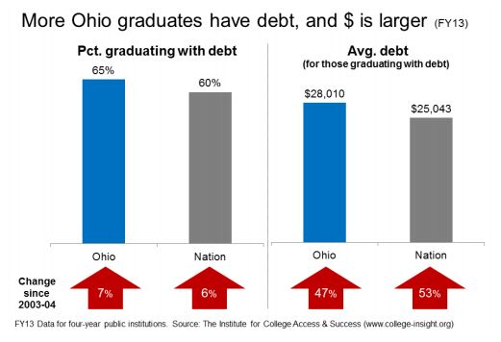
Ohio Department of Higher Education
Text placeholder
-“Action Steps to Reduce College Costs” by the Ohio Task Force on Affordability and Efficiency in Higher Education, Oct. 1, 2015.

Slide 5
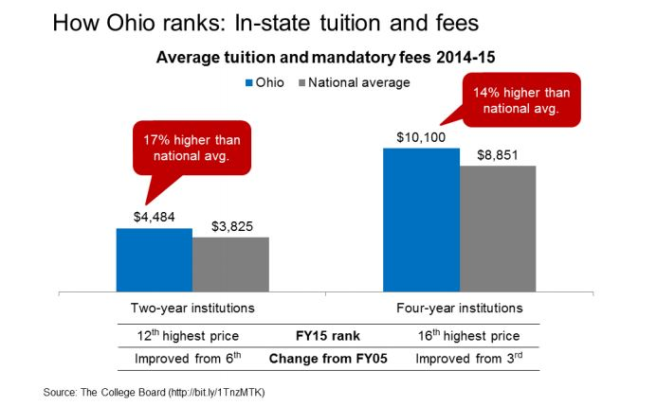
Ohio Department of Higher Education
-“Action Steps to Reduce College Costs” by the Ohio Task Force on Affordability and Efficiency in Higher Education, Oct. 1, 2015.

Slide 6

Recommendations from Ohio Department of Higher Education
-“Progress Report: An evaluation of how institutions responded to ‘Action Steps to Reduce College Costs’” by the Ohio Task Force on Affordability and Efficiency in Higher Education, Feb. 7, 2017.

Slide 7
Textbook Affordability Stats
Students were asked to select ways in which textbook costs impacted their learning (they could choose more than one from the list)...
47% of students take fewer courses because of textbook costs
45% don’t register for a particular course due to the cost of a textbook
26% dropped a course because they could not afford the course text
20% withdrew from a course because they could not afford the course text
37% stated that they earned a poor grade in a course
because they cannot afford the book
19% stated that they failed a course because they
cannot afford the book
-2016 Florida Virtual Campus Student TExtbook & Course Materials Survey

Slide 8
Student Solutions
Students were asked to select the different ways in which they “deal” with the high costs of textbooks (they could choose more than one from the list)...
66% don’t purchase the required book
34% admitted to downloading course materials from an unauthorized website
23% choose to share a copy of the book with classmates
10% stated that they take advantage of a reserve copy provided by the library
-2016 Florida Virtual Campus Student Textbook & Course Materials Survey

Slide 9
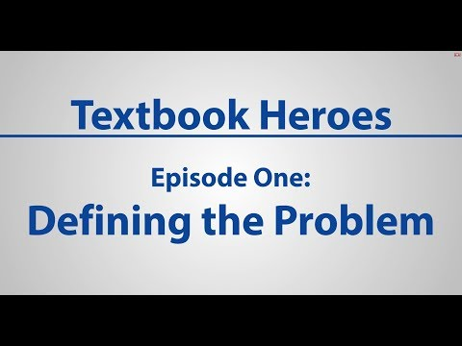
https://youtu.be/UAFodc-Egc8

Slide 10
Open Educational Resources
(OER)

Slide 11

What if there were free textbooks?
Written by experts
Peer-reviewed
Easy for students to access
Easy to link in Canvas (parts or whole)
Licensed for anyone to use, share, and change

Slide 12
OER: the answer?
Online resources (can also be printed)
Public domain or open-licensed (Creative Commons)
Reuse, remix, revise, redistribute, retain
Not just textbooks
  videos, images, sound recordings
  course modules and full courses
  assignments, study guides, exams, quizzes
  course readings and lesson plans

Slide 13
OER: how are open texts made?
Individual authors (self-motivated, hired)
Groups of volunteers
Make your own from open materials
Peer reviewed?
Ongoing maintenance and updating?

Slide 14
OER: how are open texts funded?
Foundations and non-profit organizations
Collaborative projects/institutional memberships
Institutional support - authors, hosting resources
Conversion - free text, charge for printing/extras

Slide 15
OER: effective?

Slide 16
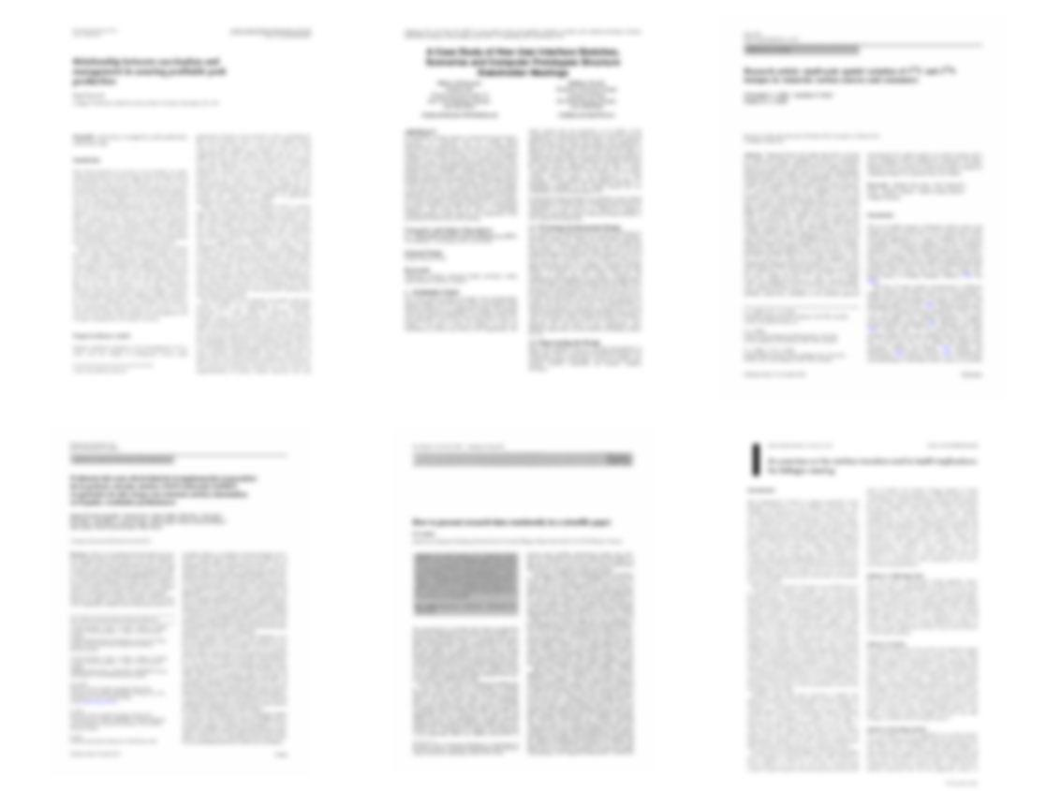
13 Peer Reviewed Studies of Efficacy
http://openedgroup.org/
Notes:
Across 13 academic studies that attempted to measure results pertaining to student learning (higher ed: 15784 treatment, 99,692 control, k12: 1805 treatment 2439 control) none showed results in which students who utilized OER performed worse than their peers who used traditional textbooks.
Allen, G., Guzman-Alvarez, A., Molinaro, M., Larsen, D. (2015). Assessing the Impact and Efficacy of the Open-Access ChemWiki Textbook Project. Educause Learning Initiative Brief, January 2015. See also this newsletter. Bowen, W. G., Chingos, M. M., Lack, K. A., & Nygren, T. I. (2012). Interactive Learning Online at Public Universities: Evidence from Randomized Trials. Ithaka S+R. Bowen, W. G., Chingos, M. M., Lack, K. A., & Nygren, T. I. (2014). Interactive Learning Online at Public Universities: Evidence from a Six‐Campus Randomized Trial. Journal of Policy Analysis and Management, 33(1), 94-111. Feldstein, A., Martin, M., Hudson, A., Warren, K., Hilton, J., & Wiley, D. (2012). Open textbooks and increased student access and outcomes. European Journal of Open, Distance and E-Learning. Retrieved from http://www.eurodl.org/index.php?p=archives&year=2012&halfyear=2&article=533. Gil, P., Candelas, F., Jara, C., Garcia, G., Torres, F (2013). Web-based OERs in Computer Networks. International Journal of Engineering Education, 29(6), 1537-1550. (OA preprint) Hilton, J., Gaudet, D., Clark, P., Robinson, J., & Wiley, D. (2013). The adoption of open educational resources by one community college math department. The International Review of Research in Open and Distance Learning, 14(4), 37–50. Hilton, J., & Laman, C. (2012). One college’s use of an open psychology textbook. Open Learning: The Journal of Open and Distance Learning, 27(3), 201–217. Retrieved from http://www.tandfonline.com/doi/abs/10.1080/02680513.2012.716657. (Open Repository Preprint). Lovett, M., Meyer, O., & Thille, C. (2008). The open learning initiative: Measuring the effectiveness of the OLI statistics course in accelerating student learning. Journal of Interactive Media in Education, 2008 (1). Pawlyshyn, Braddlee, Casper and Miller (2013). Adopting OER: A Case Study of Cross-Institutional Collaboration and Innovation. Educause Review. Robinson, T.J. (2015). Open Textbooks: The Effects of Open Educational Resource Adoption on Measures of Post-secondary Student Success (Doctoral dissertation). Robinson T. J., Fischer, L., Wiley, D. A., & Hilton, J. (2014). The impact of open textbooks on secondary science learning outcomes. Educational Researcher, 43(7): 341-351. Wiley, D., Hilton, J. Ellington, S., and Hall, T. (2012). “A preliminary examination of the cost savings and learning impacts of using open textbooks in middle and high school science classes.” International Review of Research in Open and Distance Learning. 13 (3), pp. 261-276.
This also includes Fischer et al (2015), Wiley et al. (EPAA) (2016), and Hilton et al. (IRRODL) (in press)

Slide 17

119,720 Students
http://openedgroup.org/
Notes:
Across 13 academic studies that attempted to measure results pertaining to student learning (higher ed: 15784 treatment, 99,692 control, k12: 1805 treatment 2439 control) none showed results in which students who utilized OER performed worse than their peers who used traditional textbooks.
Allen, G., Guzman-Alvarez, A., Molinaro, M., Larsen, D. (2015). Assessing the Impact and Efficacy of the Open-Access ChemWiki Textbook Project. Educause Learning Initiative Brief, January 2015. See also this newsletter. Bowen, W. G., Chingos, M. M., Lack, K. A., & Nygren, T. I. (2012). Interactive Learning Online at Public Universities: Evidence from Randomized Trials. Ithaka S+R. Bowen, W. G., Chingos, M. M., Lack, K. A., & Nygren, T. I. (2014). Interactive Learning Online at Public Universities: Evidence from a Six‐Campus Randomized Trial. Journal of Policy Analysis and Management, 33(1), 94-111. Feldstein, A., Martin, M., Hudson, A., Warren, K., Hilton, J., & Wiley, D. (2012). Open textbooks and increased student access and outcomes. European Journal of Open, Distance and E-Learning. Retrieved from http://www.eurodl.org/index.php?p=archives&year=2012&halfyear=2&article=533. Gil, P., Candelas, F., Jara, C., Garcia, G., Torres, F (2013). Web-based OERs in Computer Networks. International Journal of Engineering Education, 29(6), 1537-1550. (OA preprint) Hilton, J., Gaudet, D., Clark, P., Robinson, J., & Wiley, D. (2013). The adoption of open educational resources by one community college math department. The International Review of Research in Open and Distance Learning, 14(4), 37–50. Hilton, J., & Laman, C. (2012). One college’s use of an open psychology textbook. Open Learning: The Journal of Open and Distance Learning, 27(3), 201–217. Retrieved from http://www.tandfonline.com/doi/abs/10.1080/02680513.2012.716657. (Open Repository Preprint). Lovett, M., Meyer, O., & Thille, C. (2008). The open learning initiative: Measuring the effectiveness of the OLI statistics course in accelerating student learning. Journal of Interactive Media in Education, 2008 (1). Pawlyshyn, Braddlee, Casper and Miller (2013). Adopting OER: A Case Study of Cross-Institutional Collaboration and Innovation. Educause Review. Robinson, T.J. (2015). Open Textbooks: The Effects of Open Educational Resource Adoption on Measures of Post-secondary Student Success (Doctoral dissertation). Robinson T. J., Fischer, L., Wiley, D. A., & Hilton, J. (2014). The impact of open textbooks on secondary science learning outcomes. Educational Researcher, 43(7): 341-351. Wiley, D., Hilton, J. Ellington, S., and Hall, T. (2012). “A preliminary examination of the cost savings and learning impacts of using open textbooks in middle and high school science classes.” International Review of Research in Open and Distance Learning. 13 (3), pp. 261-276.
This also includes Fischer et al (2015), Wiley et al. (EPAA) (2016), and Hilton et al. (IRRODL) (in press)

Slide 18
95% Same or Better Outcomes
http://openedgroup.org/
Notes:
Across 13 academic studies that attempted to measure results pertaining to student learning (higher ed: 15784 treatment, 99,692 control, k12: 1805 treatment 2439 control) none showed results in which students who utilized OER performed worse than their peers who used traditional textbooks.
Allen, G., Guzman-Alvarez, A., Molinaro, M., Larsen, D. (2015). Assessing the Impact and Efficacy of the Open-Access ChemWiki Textbook Project. Educause Learning Initiative Brief, January 2015. See also this newsletter. Bowen, W. G., Chingos, M. M., Lack, K. A., & Nygren, T. I. (2012). Interactive Learning Online at Public Universities: Evidence from Randomized Trials. Ithaka S+R. Bowen, W. G., Chingos, M. M., Lack, K. A., & Nygren, T. I. (2014). Interactive Learning Online at Public Universities: Evidence from a Six‐Campus Randomized Trial. Journal of Policy Analysis and Management, 33(1), 94-111. Feldstein, A., Martin, M., Hudson, A., Warren, K., Hilton, J., & Wiley, D. (2012). Open textbooks and increased student access and outcomes. European Journal of Open, Distance and E-Learning. Retrieved from http://www.eurodl.org/index.php?p=archives&year=2012&halfyear=2&article=533. Gil, P., Candelas, F., Jara, C., Garcia, G., Torres, F (2013). Web-based OERs in Computer Networks. International Journal of Engineering Education, 29(6), 1537-1550. (OA preprint) Hilton, J., Gaudet, D., Clark, P., Robinson, J., & Wiley, D. (2013). The adoption of open educational resources by one community college math department. The International Review of Research in Open and Distance Learning, 14(4), 37–50. Hilton, J., & Laman, C. (2012). One college’s use of an open psychology textbook. Open Learning: The Journal of Open and Distance Learning, 27(3), 201–217. Retrieved from http://www.tandfonline.com/doi/abs/10.1080/02680513.2012.716657. (Open Repository Preprint). Lovett, M., Meyer, O., & Thille, C. (2008). The open learning initiative: Measuring the effectiveness of the OLI statistics course in accelerating student learning. Journal of Interactive Media in Education, 2008 (1). Pawlyshyn, Braddlee, Casper and Miller (2013). Adopting OER: A Case Study of Cross-Institutional Collaboration and Innovation. Educause Review. Robinson, T.J. (2015). Open Textbooks: The Effects of Open Educational Resource Adoption on Measures of Post-secondary Student Success (Doctoral dissertation). Robinson T. J., Fischer, L., Wiley, D. A., & Hilton, J. (2014). The impact of open textbooks on secondary science learning outcomes. Educational Researcher, 43(7): 341-351. Wiley, D., Hilton, J. Ellington, S., and Hall, T. (2012). “A preliminary examination of the cost savings and learning impacts of using open textbooks in middle and high school science classes.” International Review of Research in Open and Distance Learning. 13 (3), pp. 261-276.
This also includes Fischer et al (2015), Wiley et al. (EPAA) (2016), and Hilton et al. (IRRODL) (in press)

Slide 19
OER: use, knowledge, and barriers
Babson Survey Research Group (2017)
2700 faculty surveyed in 2016/17
9% have adopted OER in their courses
16.5% of high enrollment courses have OpenStax texts
30% of faculty are very aware or aware of OER
19% of faculty are very aware of Creative Commons
47% - “not enough resources for my subject”
50% - “too hard to find what I need”

Slide 20
OER: where to find them
Open Textbook Library
OpenStax
OER Commons
MERLOT (federated search)
OhioLINK A-Z Affordable Learning Course Materials
Mason OER Metafinder

Slide 21
Let’s examine some
open textbooks!

Slide 22
Consider . . .
Similarities/differences with traditional textbooks?
Would I recommend to a colleague?
Would I use this textbook in my course?
What would make this textbook better?

Slide 23
Miami University OER/AL
Grant Programs

Slide 24
OER-Explore
2 hour workshop, usually held in the fall and spring of each year
Learn more about OER and AL initiatives and resources
Provide an online review of an OER
$200 stipend

Slide 25
OER-Adapt & Adopt
3 semester-3 year commitment
Replace your current commercial textbook with an OER
If needed, adopt the resource to your specific needs
$1000 in professional development funds granted for the completion of each phase of the grant
Phase 1, analyze student learning with commercial text
Phase 2, Introduce use of OER and analyze student learning
Phase 3, plan for long-term use and continue to
analyze learning

Slide 26

OER-Create
Launching in 2018
Award of funds for the creation of an OER to be used for course instruction

Slide 27
Affordability Initiative - Course Pack Consultation Service
For faculty using readings-based course packs
Reading list will be analyzed to determine what works can be made accessible to students freely under US copyright law
$200 stipend for going through the consultation service

Slide 28
Affordability Initiative - Alternative Textbook Program
Replacing a commercial textbook with works that can be made freely available to students under US copyright law
May also include replacing current course materials with alternative, low-cost options
Grant funding: TBD

Slide 29

Learn More
MU OER/AL Grant Webpage
http://miamioh.edu/academic-affairs/teaching/open-educ-res/index.html

Slide 30
Questions?

