Slide 1
Beyond the Stacks to Partner for Success
Libraries and TRiO Programs
Carrie Girton | Julie McDaniel | Krista McDonald

Slide 2
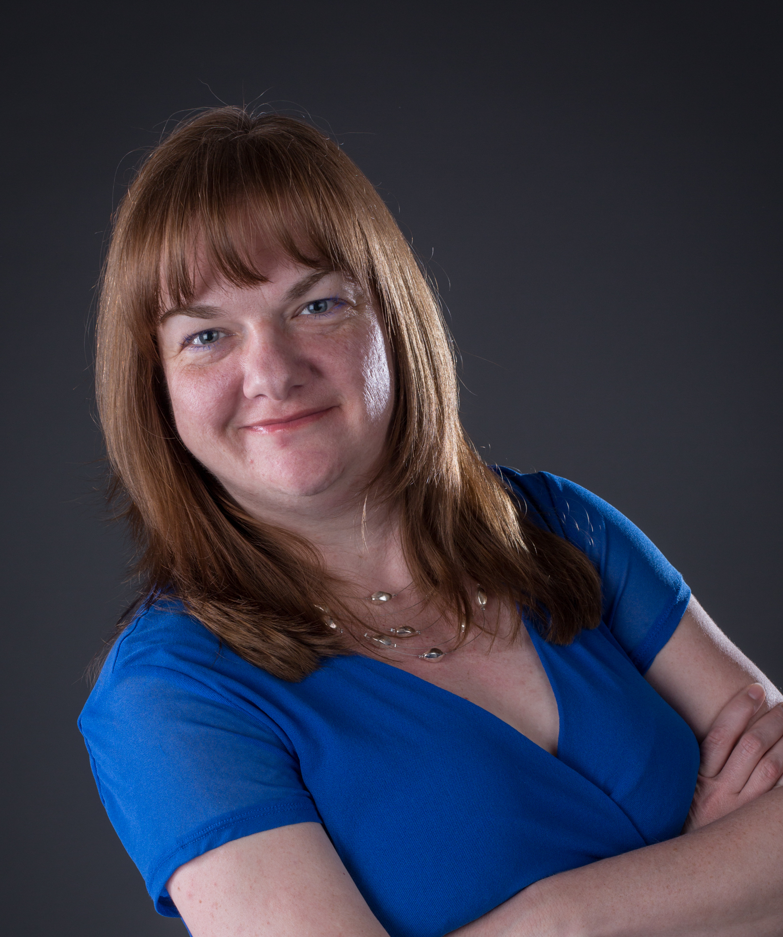
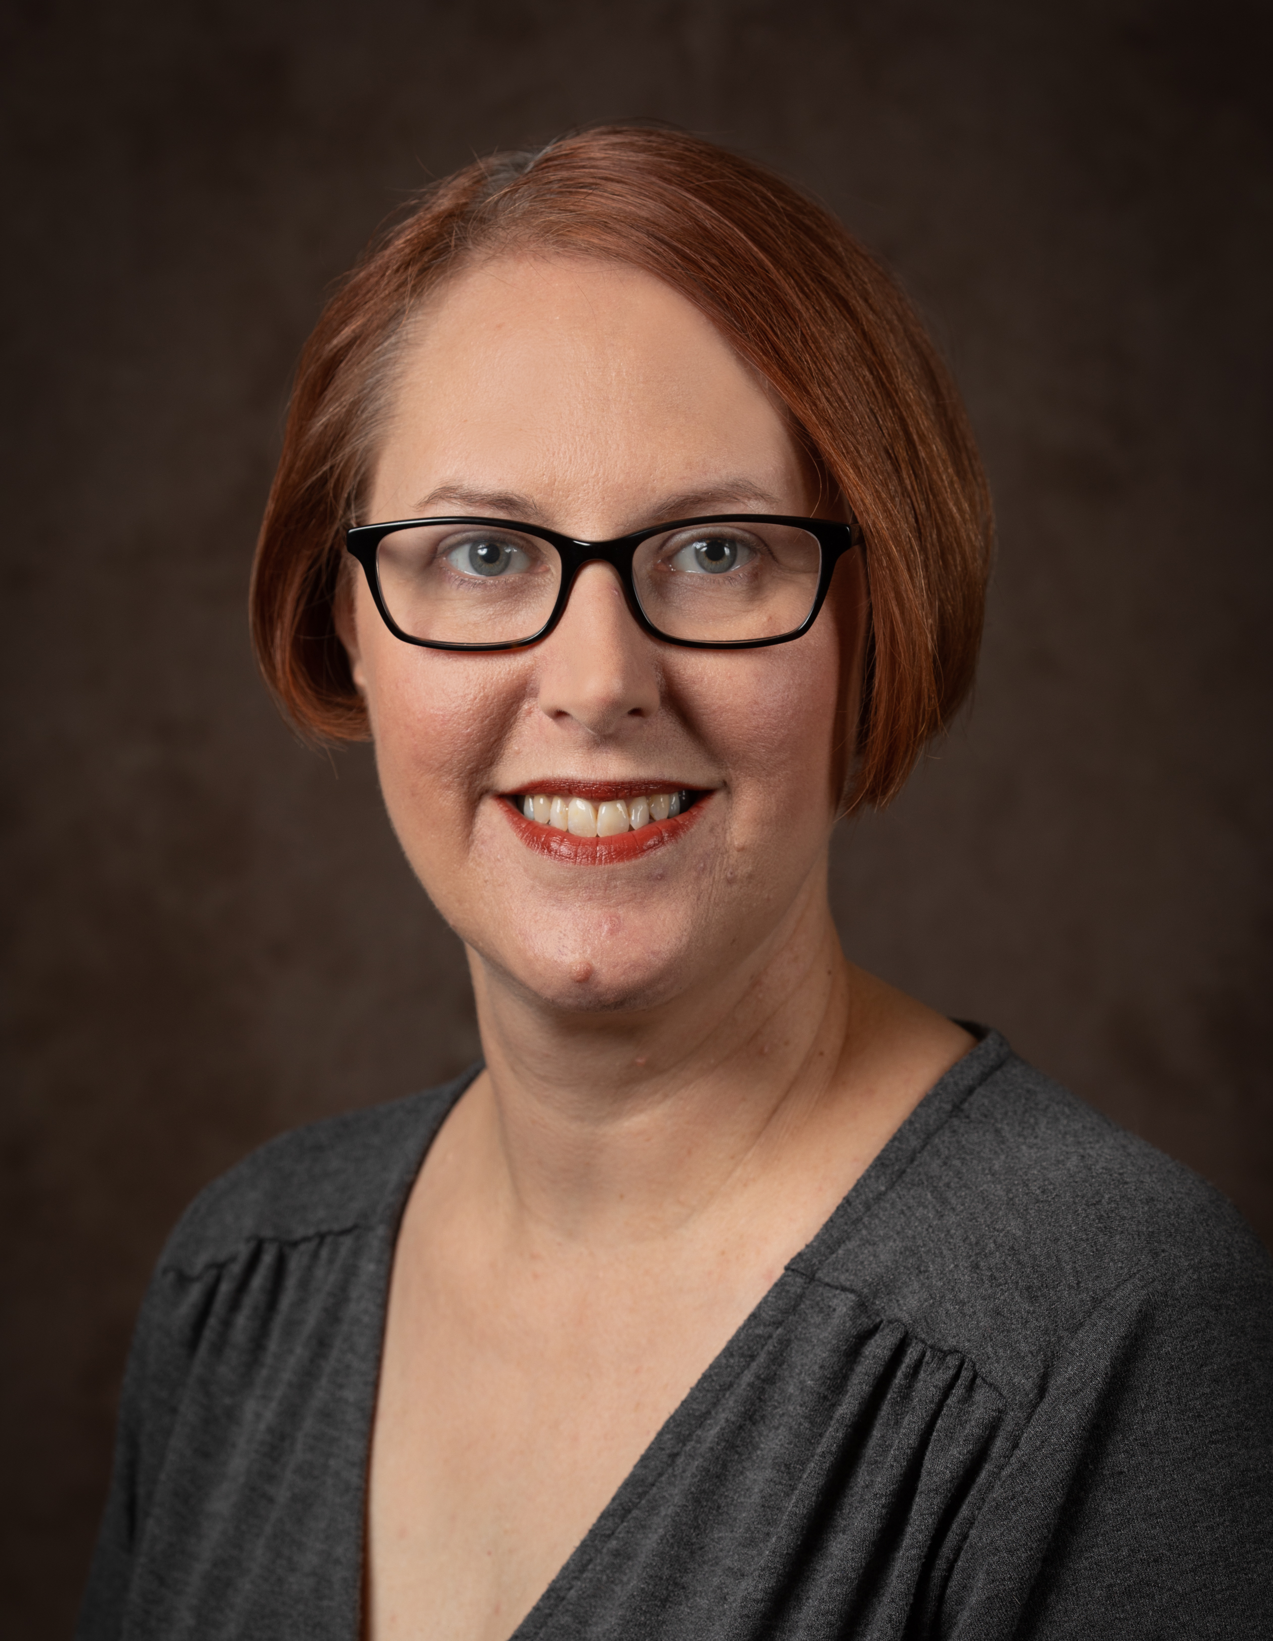
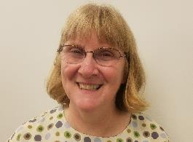
Introductions
Carrie Girton, Public Services Librarian, Miami University Hamilton
Julie McDaniel, Student Success Librarian, Sinclair College
Krista McDonald, Library Director, Miami University Hamilton
Notes:
Julie:
Any librarians? Any TRiO staff? Is there TRiO on your campus?

Slide 3
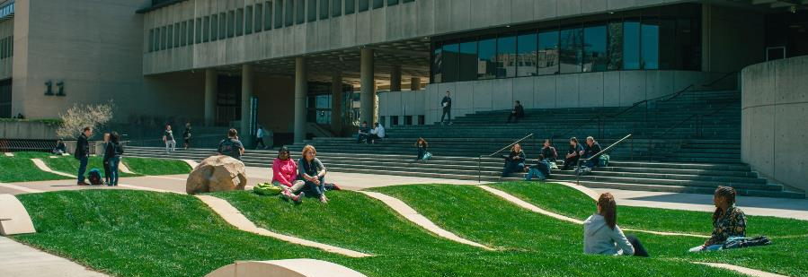

Slide 4
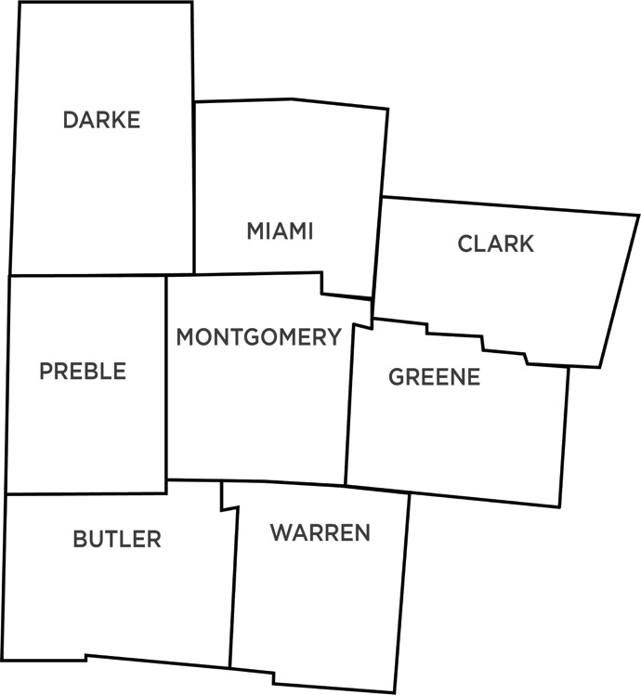
Sinclair Service Area
Notes:
This year, we awarded 5800 degrees and certificates. We have around 20,000 students working on over 240 degrees and certificates. That student count includes more than 5000 CCP students.
Sinclair receives funding through property tax levies in Montgomery County allowing it to offer the lowest cost tuition in the state to Montgomery County residents (2971).

Slide 5

Student Success Librarian
Scheuler, S. A. (2015). Retention and Student Success: An Action Plan for Academic Librarians. Library Leadership & Management, 30(2), 1-5.
Notes:
New position at Sinclair; New model of library service. Historically librarians are assigned to academic departments and a group of faculty. They work within the constraints of the curriculum for their assigned subject areas. The Student Success model looks at students in everything outside of the classroom – tutoring; student clubs; advising; financial aid; organizations. And the librarian is assigned to work with staff who are not part of academic units – tutors, advisors, student development staff, admin assistants; club advisors.
Following Scheuler model
Meeting departments, started with Student Affairs who recommended I meet with TRiO director, who also was new to SCC

Slide 6
TRiO at Sinclair
First generation, low-income, or documented disability
Funded for 165 students
2/3 of students are in good academic standing
One stop for all student services
Notes:
Shareka tutors for STEM; Debbie tutors for Social Science and English Language Arts. Each student can have only 1/hour/week/class of tutoring. But they can use SSS and Tutoring Center to get 2 hours/week
Larry and Cynthia full time counselors.
SSS provides wholistic assistance to their 165 admitted students. They provide financial aid, counseling, tutoring, FAFSA, admissions, career help, etc. from one office. Provides one stop for their students.
More prepared than any other dept I met – had a list of things they needed. Had talked to her staff to ask.

Slide 7



Initial TRiO concerns
Notes:
Fin lit – campus wide committee; Game of Life; library collection updated; workshop series aimed at TRiO students
Connected TyAnn with Paul for ESL students

Slide 8
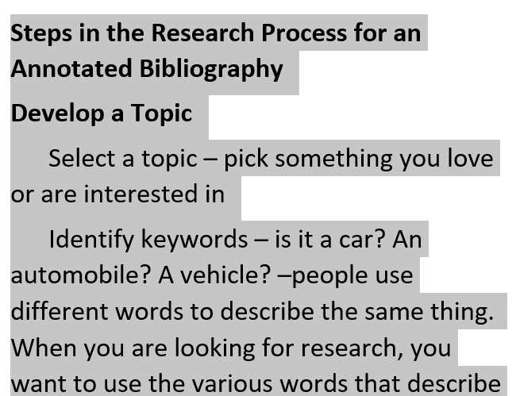
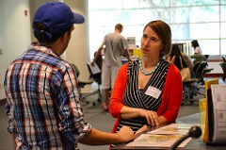
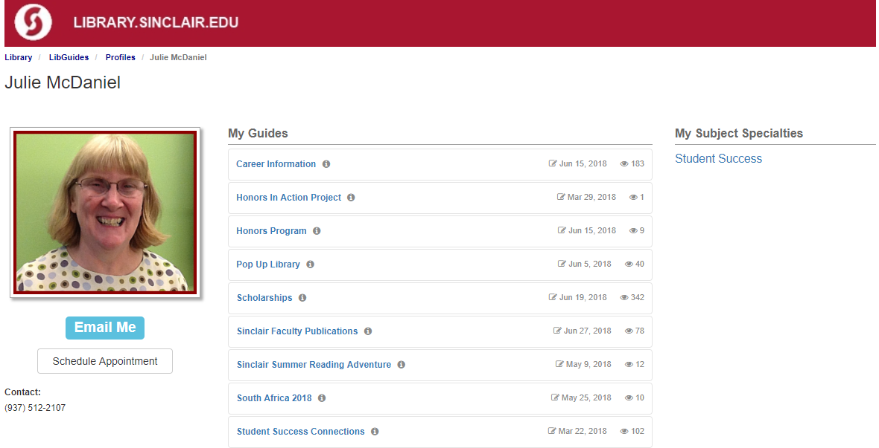
Library & TRiO
Notes:
Refer students to me
Appointments on LibGuides
Step-by-step Research Guide
Librarian on Location

Slide 9
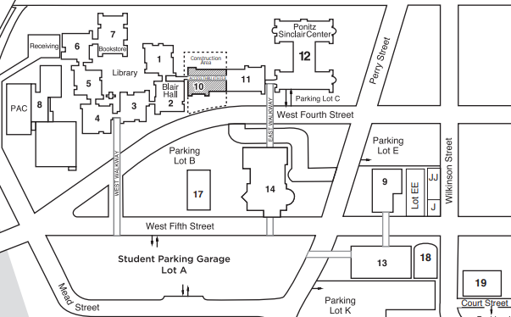
TRiO to Library…..
Notes:
Map doesn’t do this justice – this is at least one city block in distance. And 6 flights of stairs. Because of changing levels of buildings and where elevators do and don’t go, it requires 3 different elevators.

Slide 10

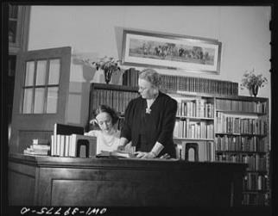
Librarian on Location
One hour/week
Student Success and Reference
AY 2017-2018 – 23 visits
Helped 57 students
Notes:
Historically, librarians needed to stay in their libraries with their card catalogs and reference books. With the advent of modern technology and the disappearance of card catalogs and print reference collections, librarians can move beyond the library walls.
57 students helped in TRiO; 23 in library during same time
Referrals to other departments – either student didn’t know that might be where he/she needed to be or knew the department but not where it was;
Works cited and bibliography help; conversations with students considering applying for TRiO to talk about services and opportunities; snow rollers, Jeff Bezos and logistics, career research, study skills, legally changing your name; health benefits of soy; scholarships; research about social class; art history research; explained plotter to staff; explained OhioLINK and other library services
Now see more TRiO students in the library

Slide 11

Library & TRiO
Notes:
Ripple effect – Julie on subcommittee talking about an new mentoring program designed to pair employees with students. Needed a test group of students and Julie was able to suggest TRiO
LOL started in three other departments – Int Ed; AAMI; CASI (Center for Applied Social Issues)
Also things Julie did for other areas of benefit to TRiO – LG for time management and test taking; Mental Health First Aid Training for their staff
When TRIO moved to SEP, TyAnn told her new boss about us and that led to Julie meeting with Chris and being invited to Summer Bridge with SEP students

Slide 12
Comments from TRiO
We expect students to leave their comfort zones and enter the “foreign land” that is higher education. As staff, we need to try new things and help the students who make us feel uncomfortable. The Library is doing that with the Librarian on Location service.

Slide 13
Comments from TRiO
“You’ve been bringing the library to us and making it more accessible. We appreciate the attempt to help students develop trusting relationships with staff and the library in particular.”

Slide 14
Credits
Plagairism wordart http://savannahstate.libguides.com/plagiarism
ESL graphic: https://classroom-assessment-theory-into-practice.wikispaces.com/ are licensed under a Creative Commons Attribution Share-Alike 3.0 License
Piggy bank image: https://www.seniorplanning.org/
Librarian talking with student: Washington University Libraries

Slide 15
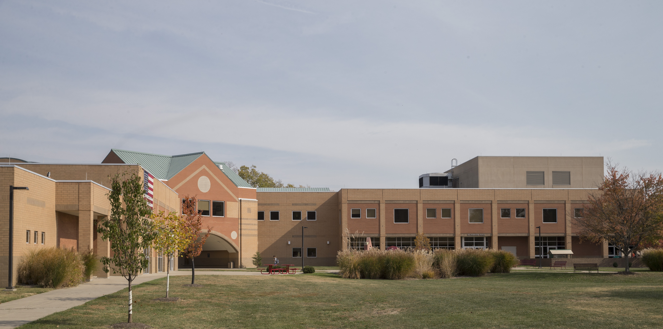

Slide 16
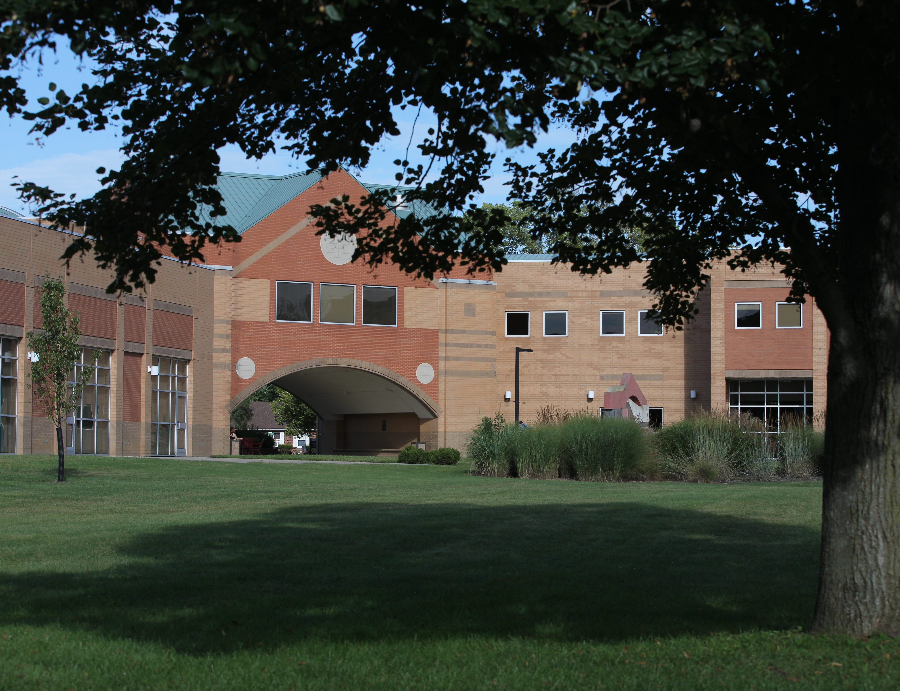
Our Campus
35-40% of students at our regional campuses receive Pell grants
32% of Hamilton students self-reported as first-generation in 2016
5% of Hamilton students register with the Office of Disability Services
Notes:
Carrie:
*Note that self-report happens on admission application to University
Also discuss basic student demographics – many nontrads, and vets, greater racial diversity than Oxford, etc.

Slide 17
TRiO Timeline
2015 – Miami Regionals applied for a five-year, $1.1 million grant
Grant awarded
Needed to determine the best location on campus
Program began September 1
Notes:
Carrie:
Winter awarded, program start in Sept. leaving little time for finding a “home” and setting it up
Both the grant author and library director felt that Library and TRiO were perfect partnership because students who are eligible for this program are the students who most need to be in the library in order to achieve academic success.
While there were a couple of other viable options on our campus, this was the place that was the best fit.

Slide 18
Incorporating TRiO: Phase I
Mostly rearranging some furniture
Constructed a cubicle office for the TRiO coach
Relocated a group of PCs to accommodate the office
Created a comfortable seating area to facilitate student conversation and bonding
Notes:
Krista:

Slide 19
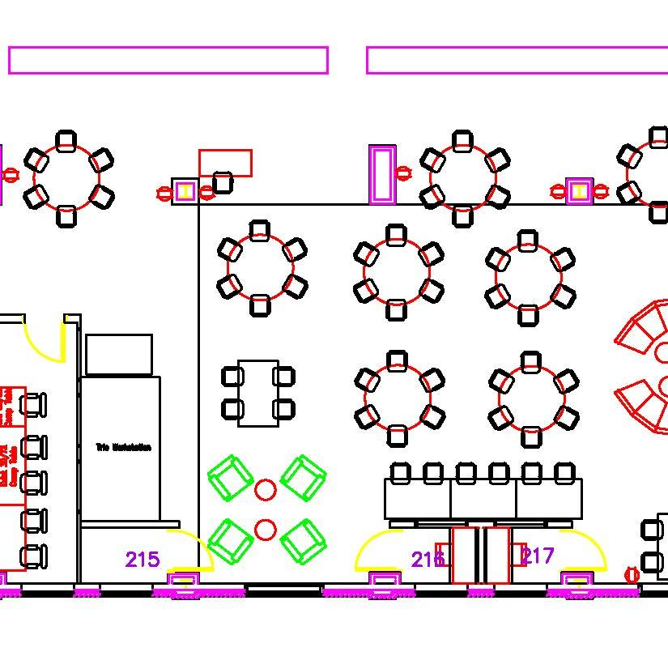
Incorporating TRiO: Phase I

Slide 20
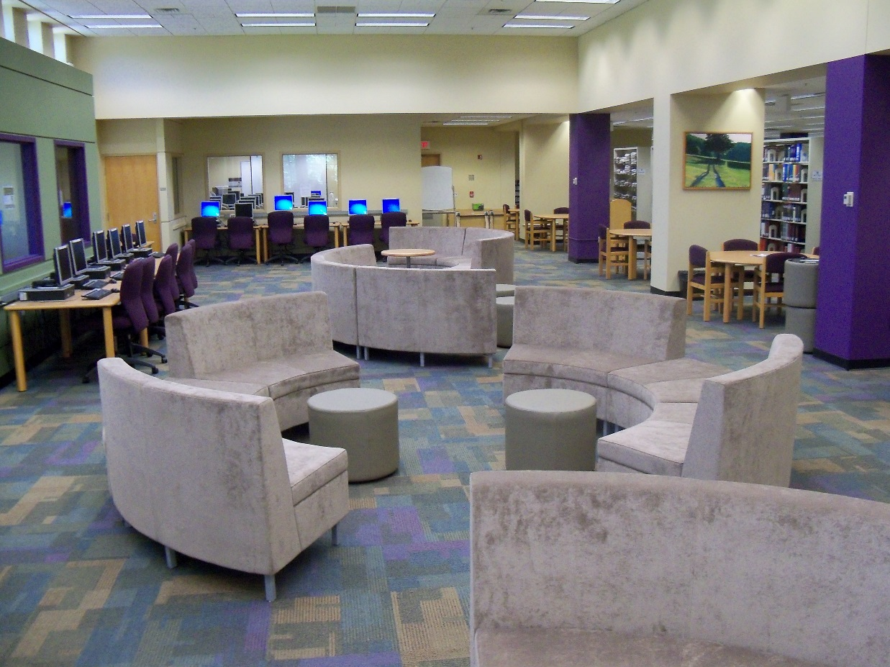
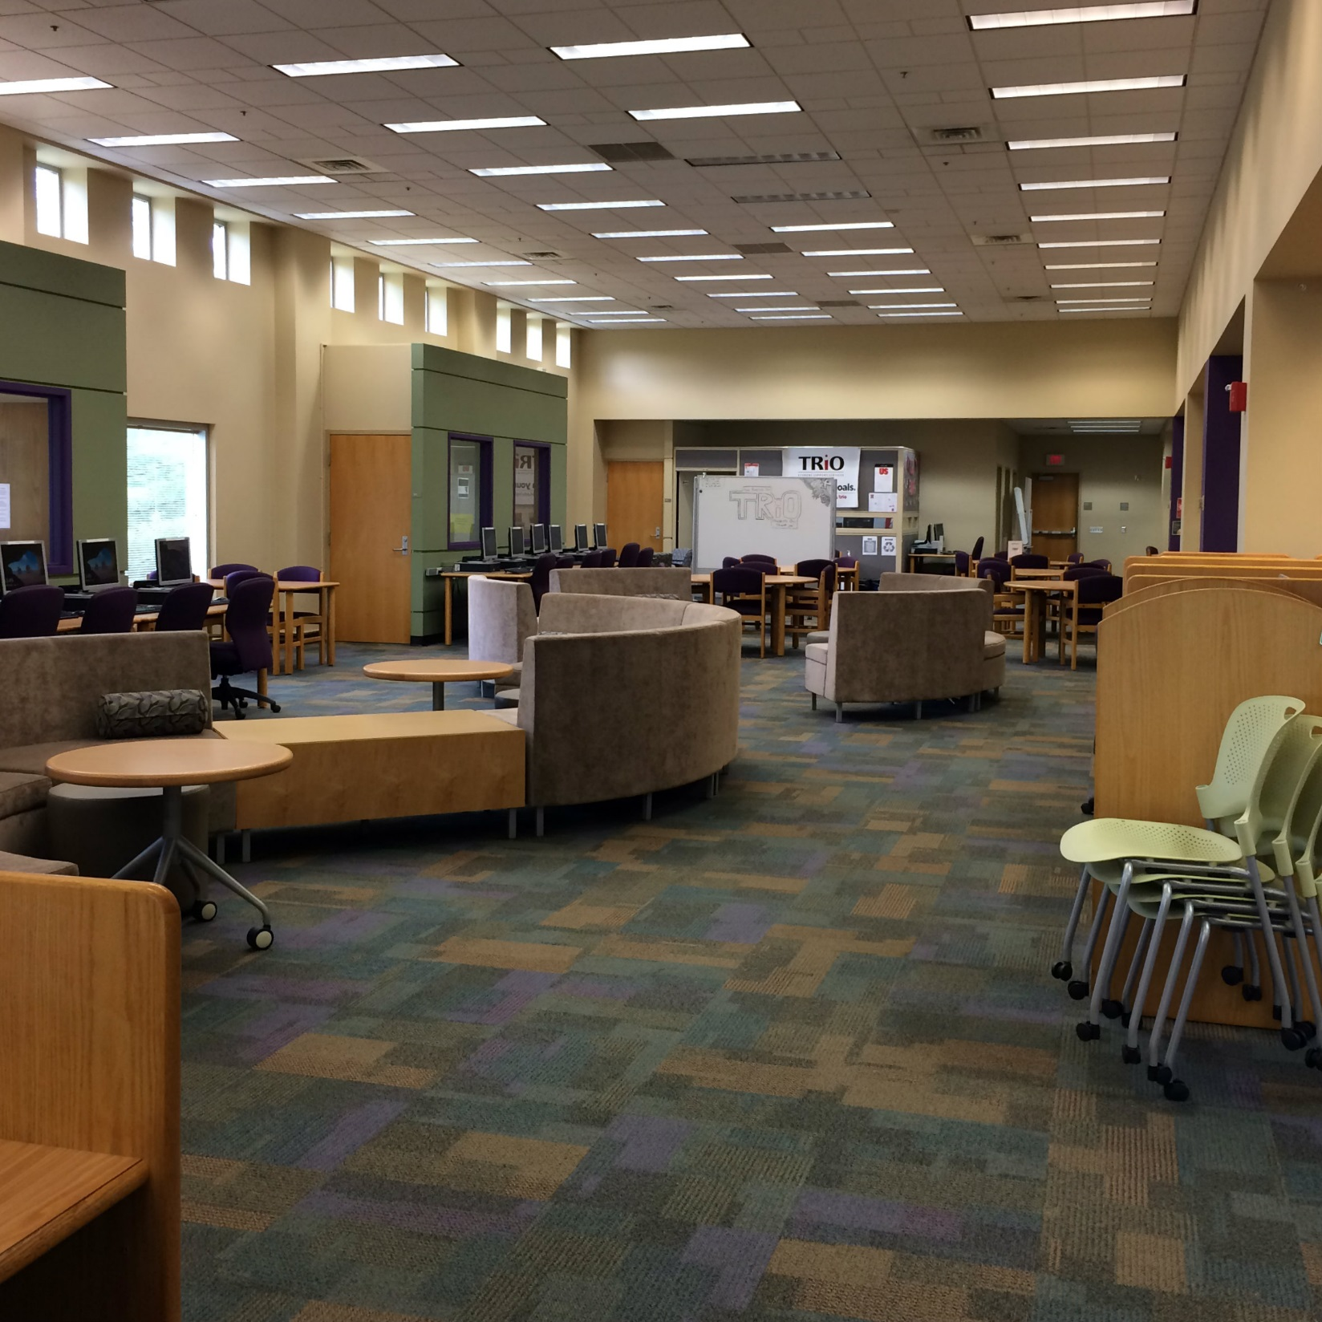
Incorporating TRiO: Phase I
After
Before
Notes:
Krista:
One of the reasons this was a good fit is that there were minimal construction updates needed.

Slide 21
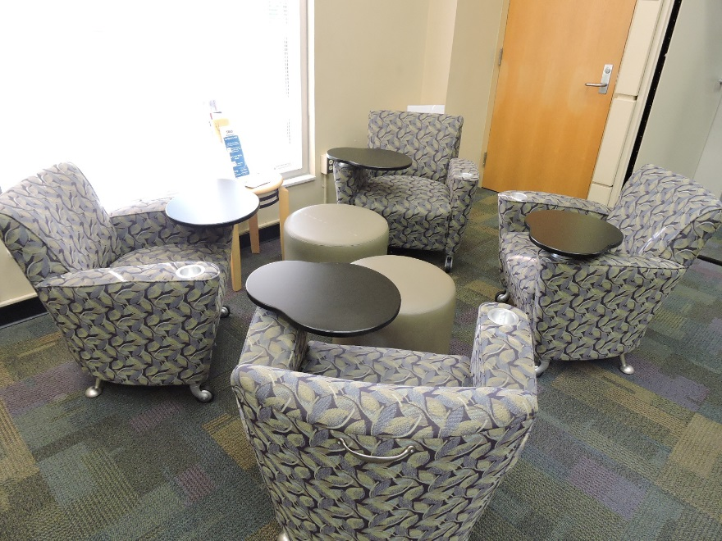
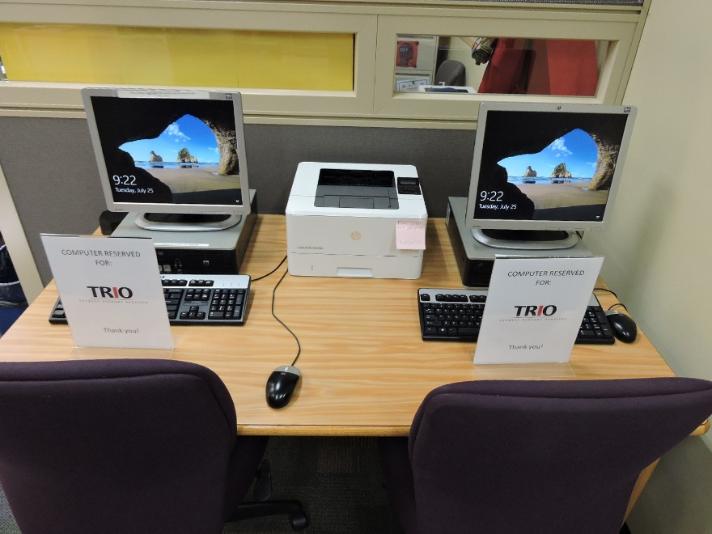
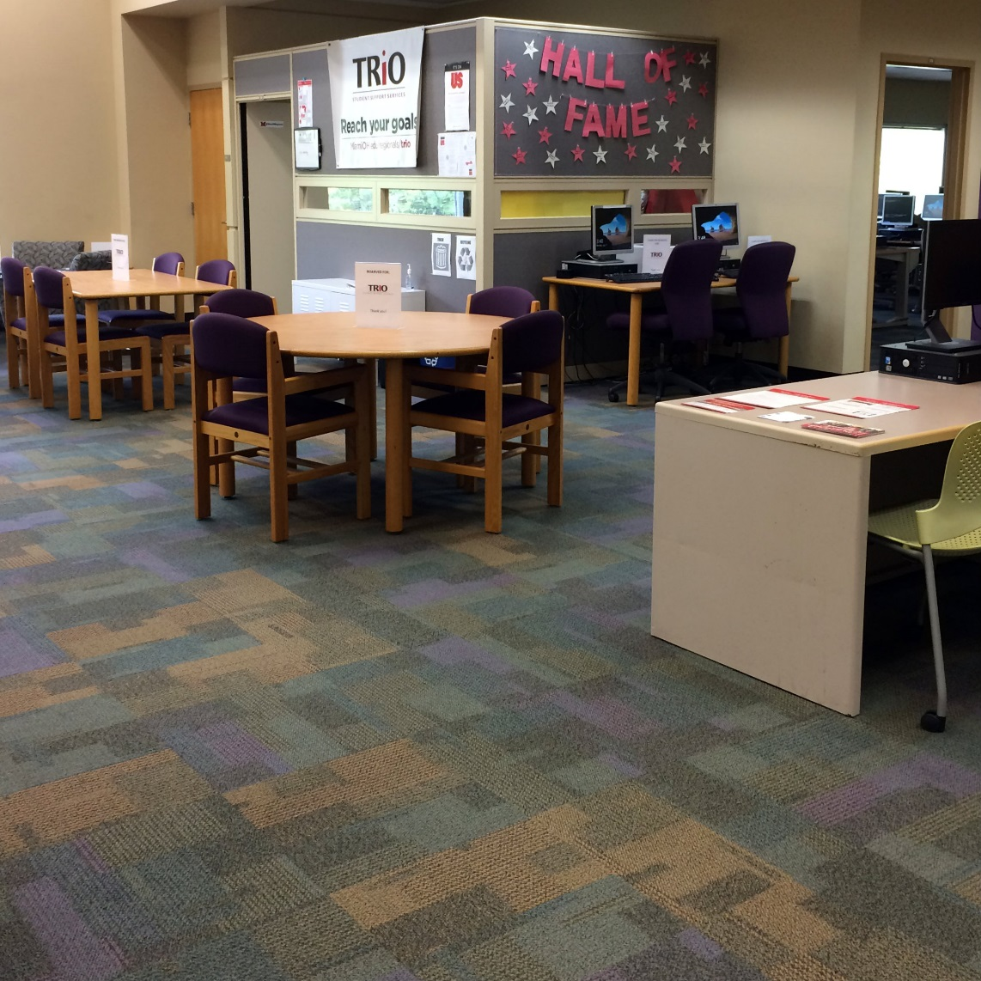
Incorporating TRiO: Phase I
Notes:
K
Grant funds could not be used to make changes to existing space, purchase furniture, etc.
Donation of items:
Library—tablet arm chairs, footstools, study tables and chairs, computers
Other campus departments—printer, desk, cubicle, office furniture in cubicle

Slide 22
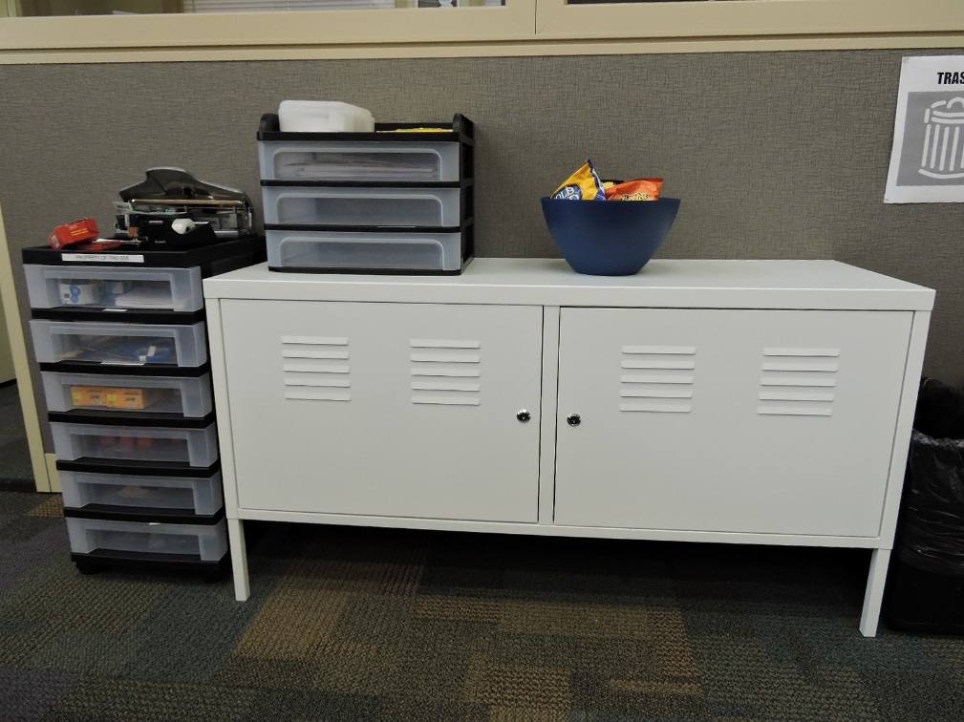
What We Learned: Phase I
Partnership facilitated ease of access to needed resources
  Computers
  Tutors
  Library staff
  Internet
  Free printing
Notes:
Carrie:
Computers includes library computers, chrome books available through TRiO, and laptops available through library

Slide 23
What We Learned: Phase I
There were some needs that were not being met or that could have been met in better ways.
  Privacy of conversations with the TRiO Coach was a concern
  TRiO space needed to be more defined
  Needed to expand the space available to the TRiO program
Notes:
Carrie:

Slide 24
Incorporating TRiO: Phase II
Shifted collection and computers to allow for more TRiO space.
Added Urban Walls to better demarcate the TRiO space.
Selected new tables and chairs that could easily be reconfigured based on student needs.
Notes:
Krista
The library was planning a major renovation of the space, so the interior designer and I met with the TRiO coordinator and coach to discuss how we could further accommodate them and their students as part of this process.

Slide 25
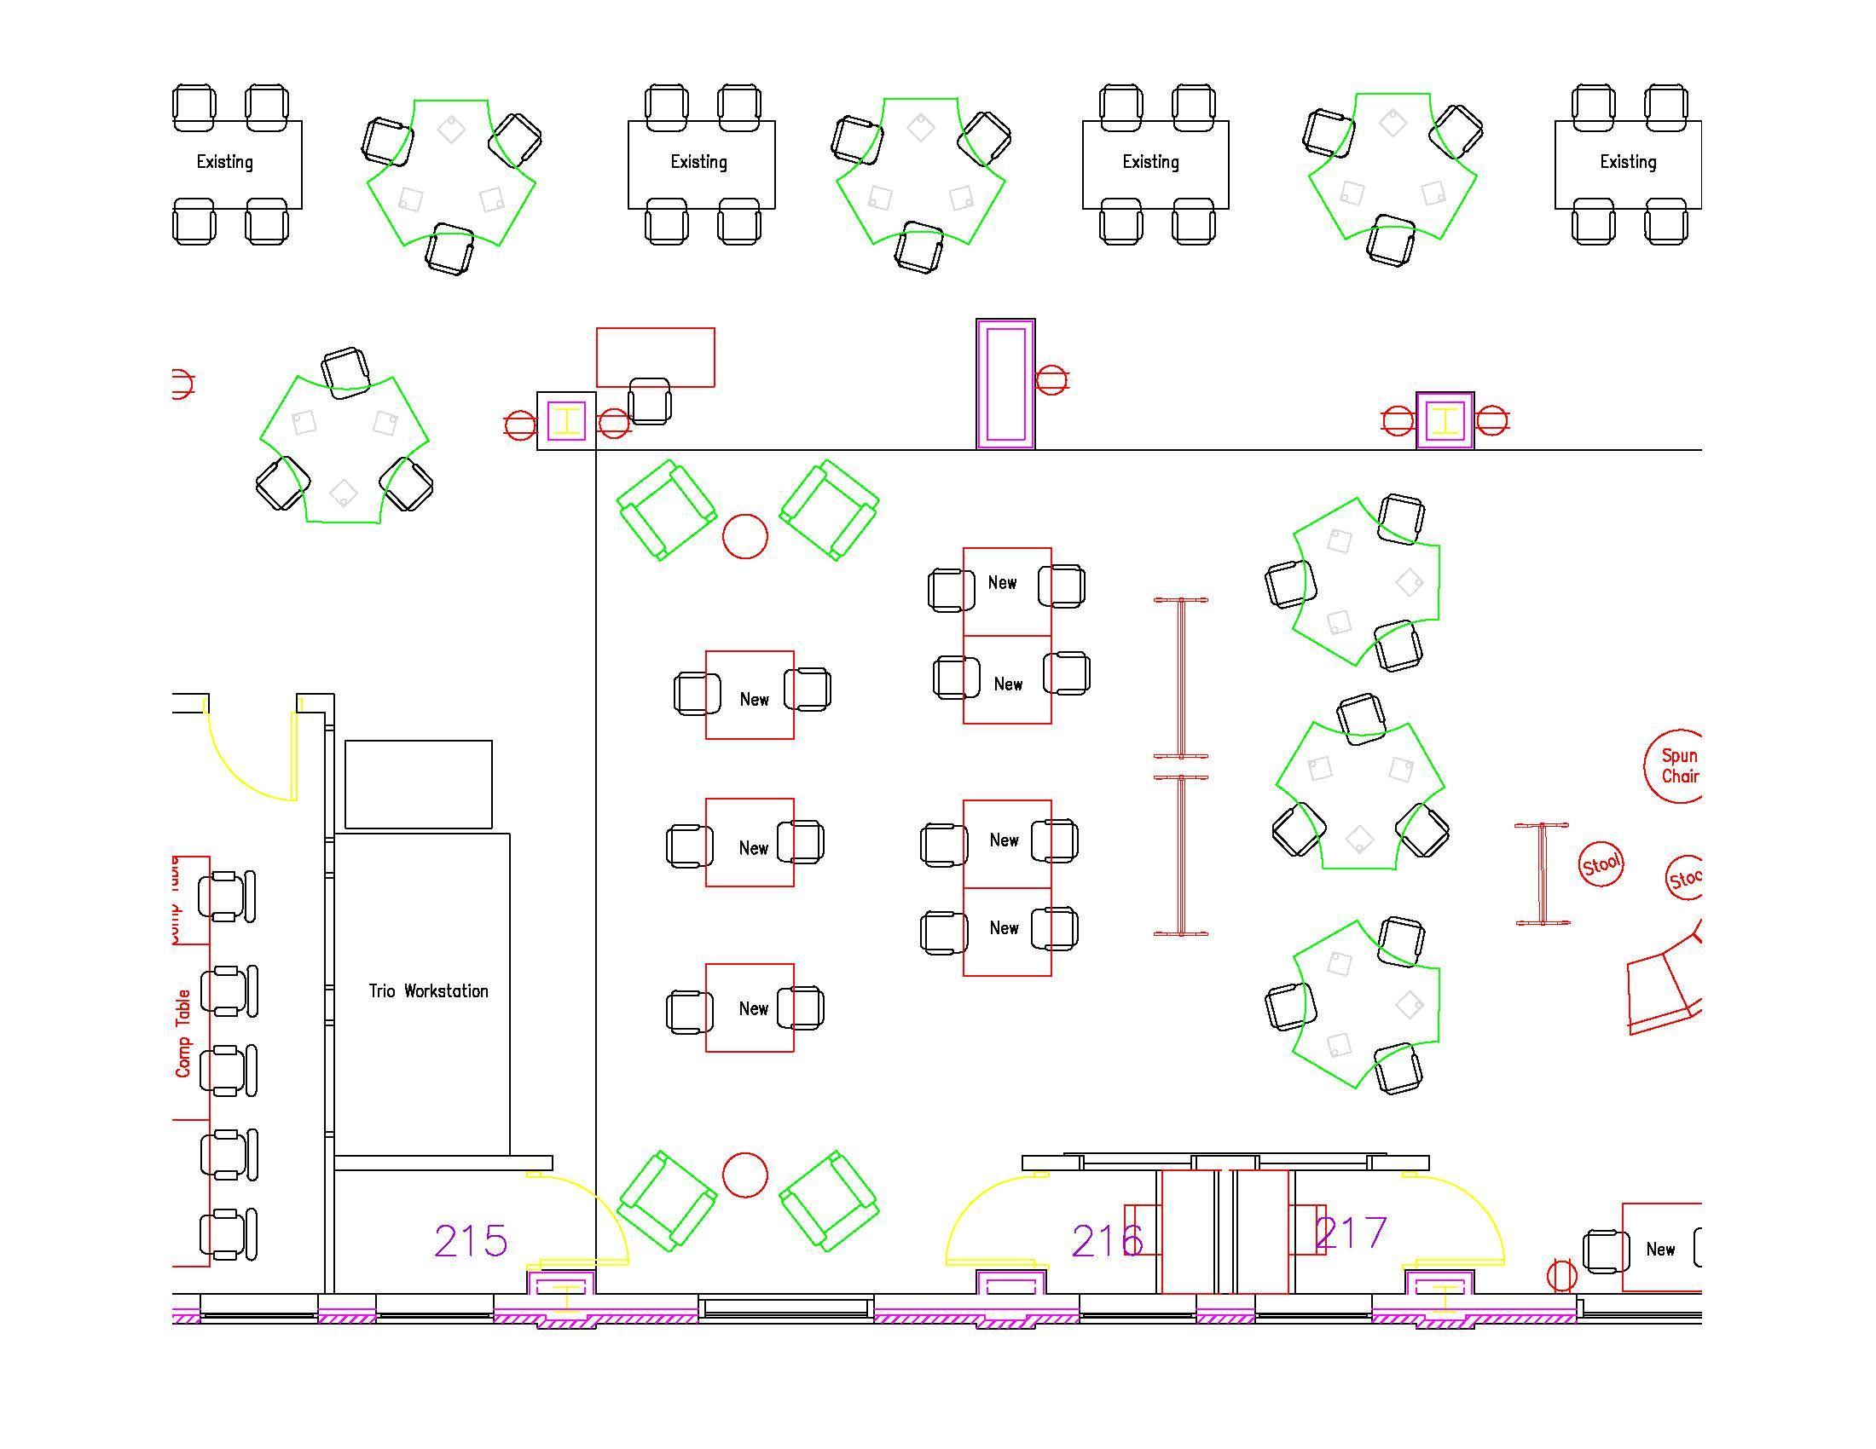
Incorporating TRiO: Phase II
Notes:
Krista
Library redesign/upgrade in Summer 2017 and Winter 2018

Slide 26
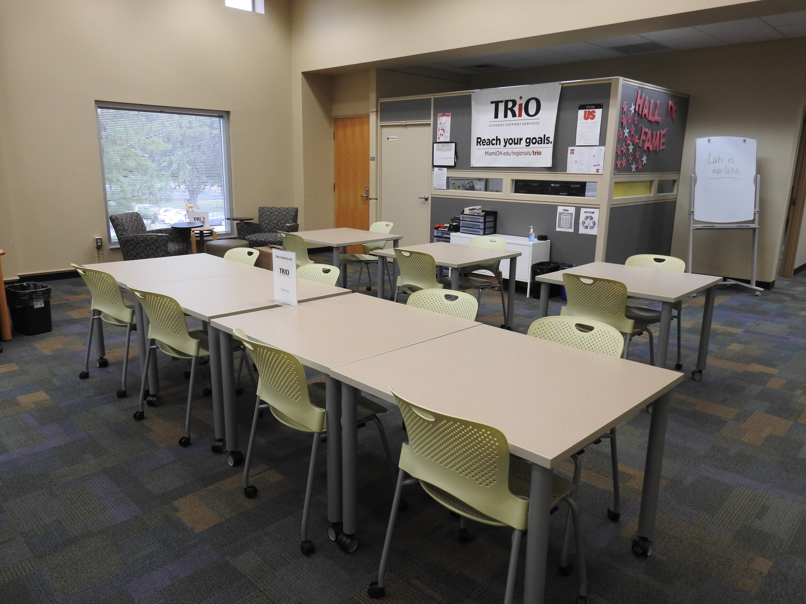
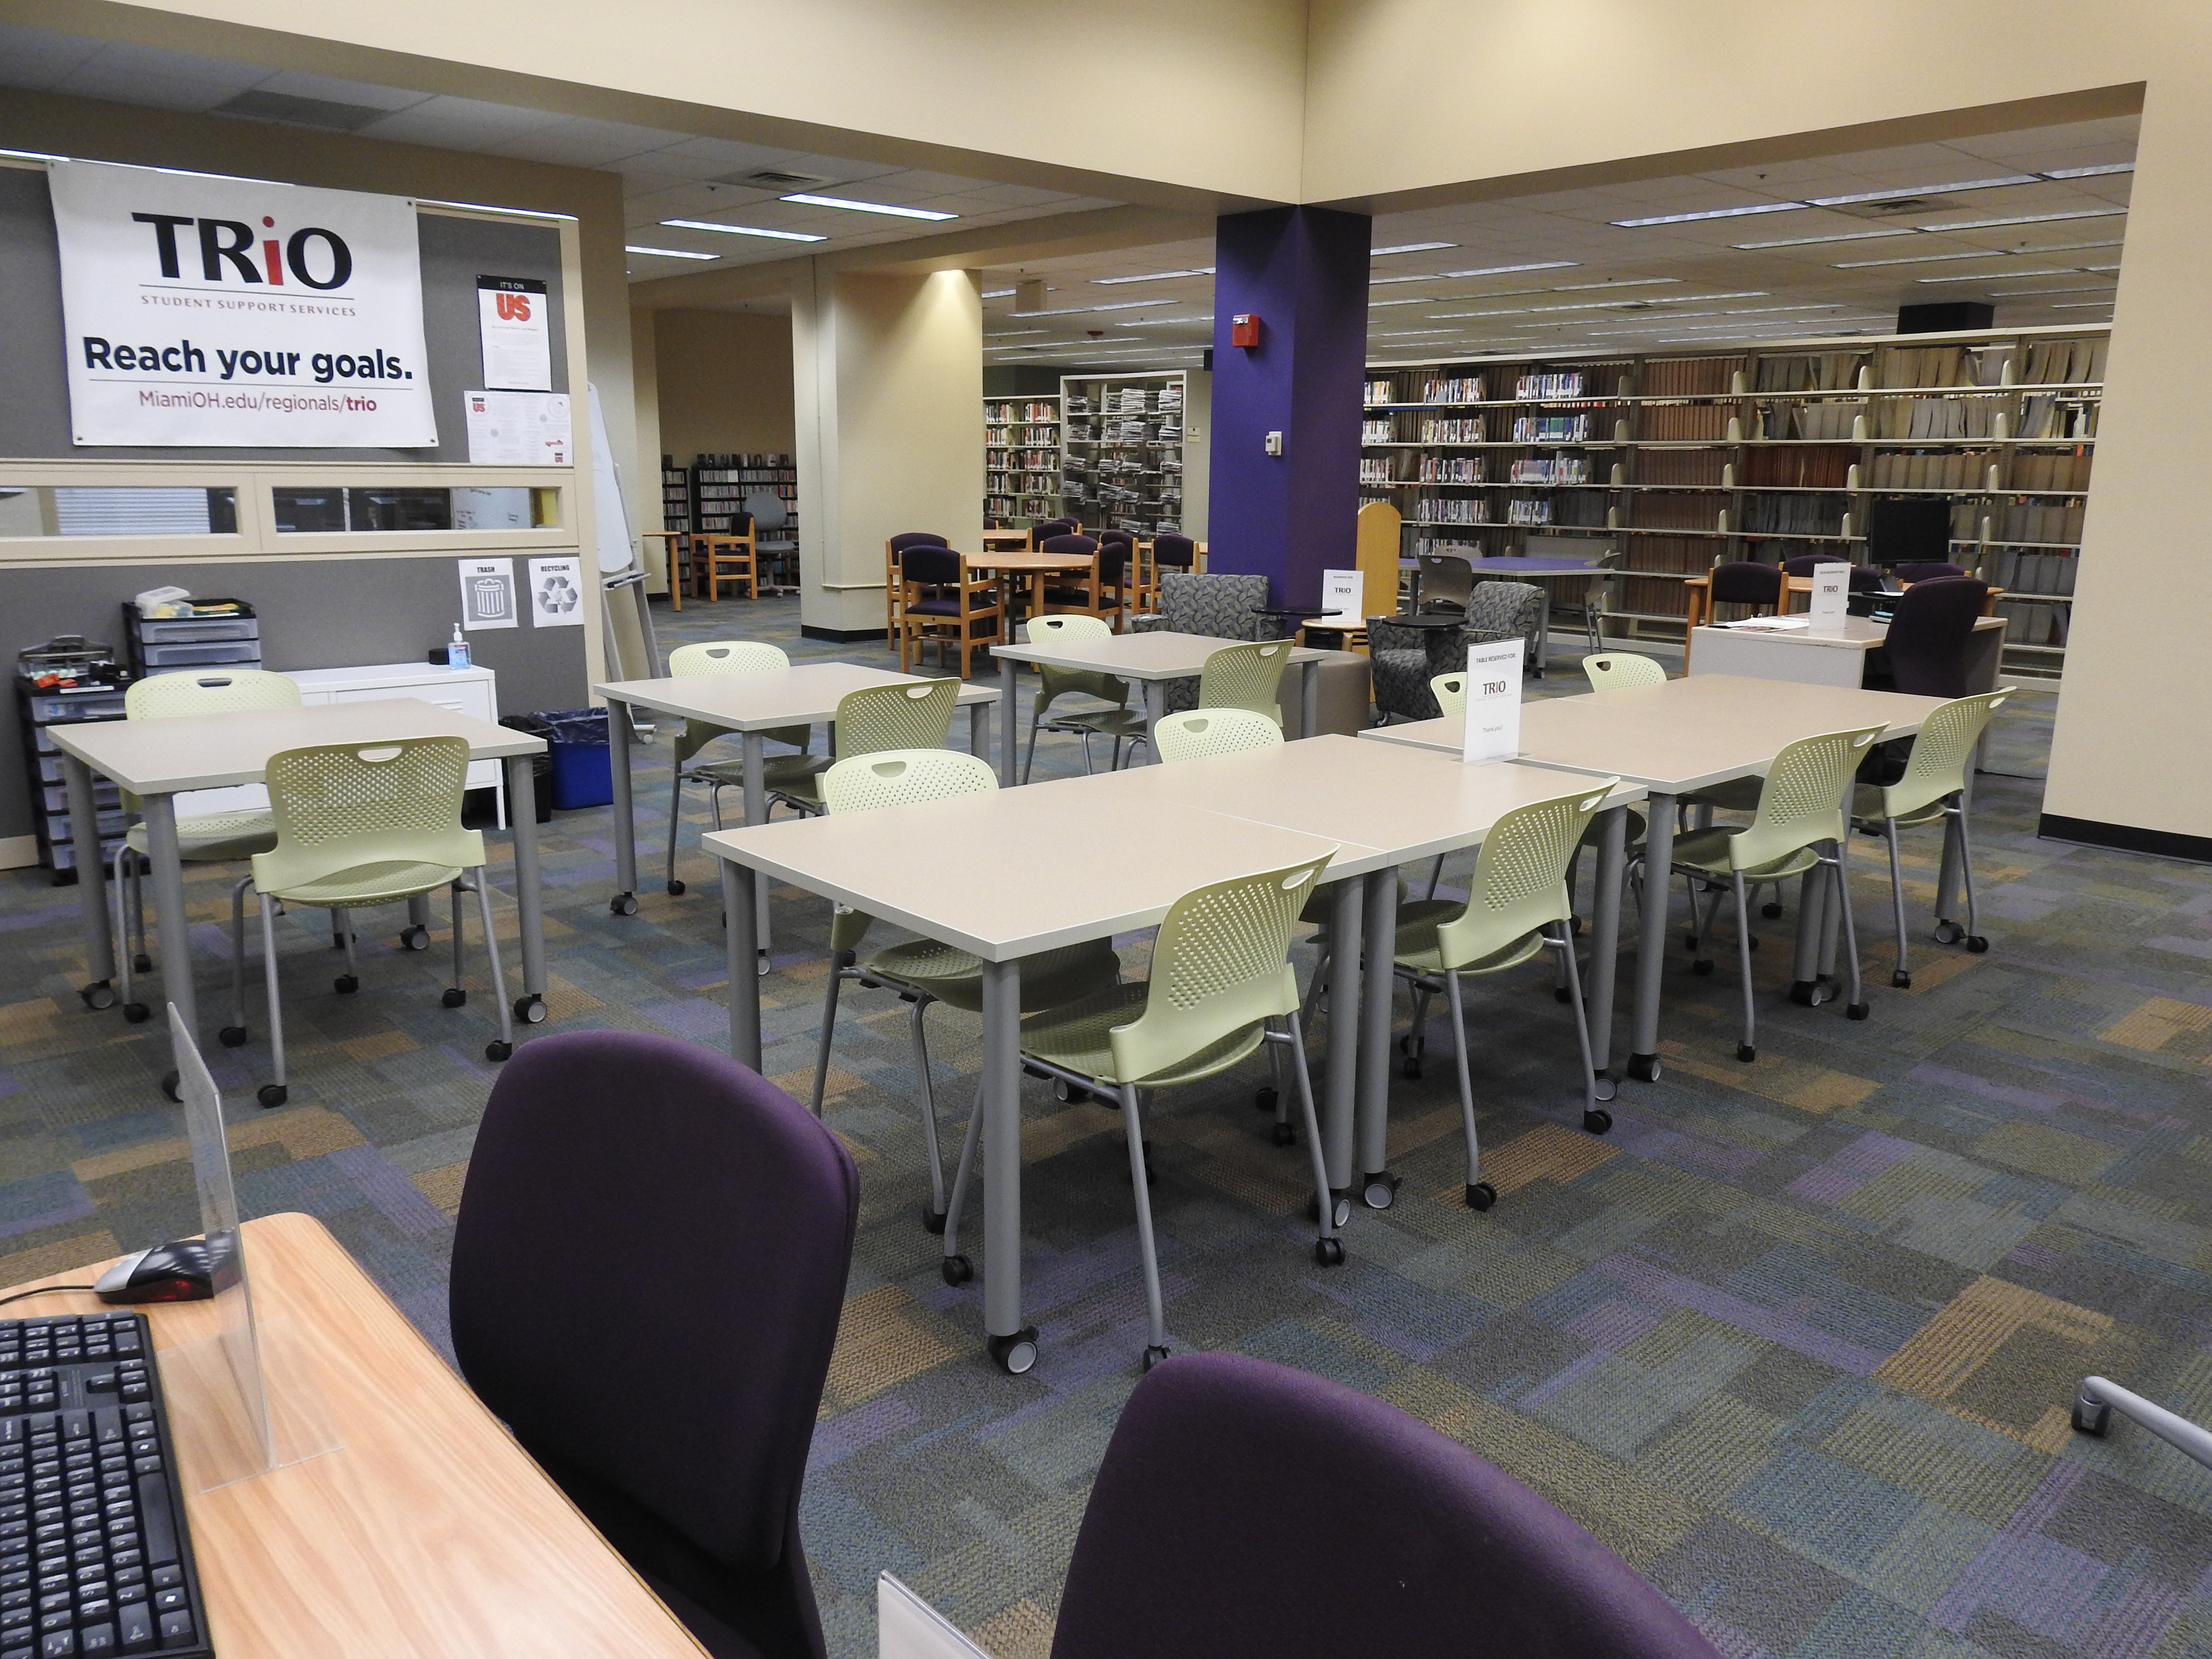
Incorporating TRiO: Phase II
Notes:
Krista:
Library redesign/upgrade in Summer 2017 and Winter 2018

Slide 27
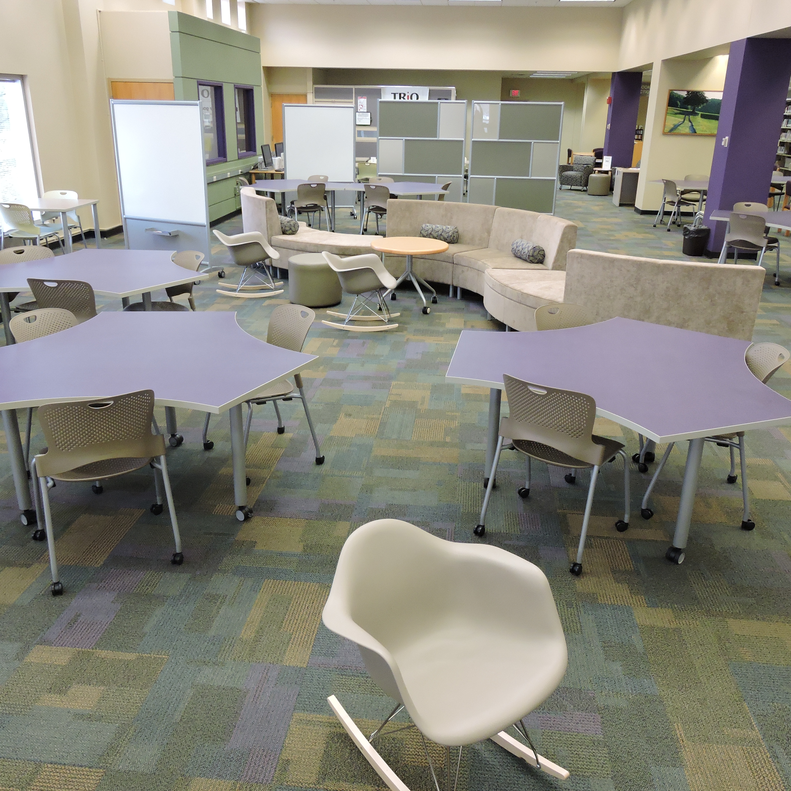
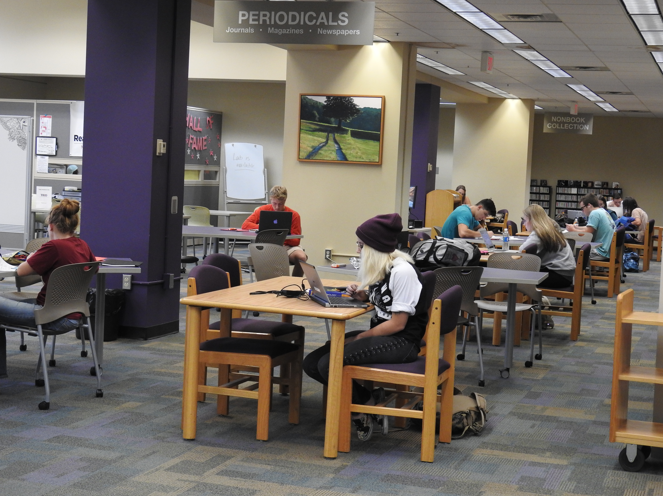
Incorporating TRiO: Phase II
Notes:
Krista

Slide 28
What We Learned: Phase II
Furniture outside the TRiO area was reconfigured frequently, but that happened less often in the TRiO space.
There were some student concerns voiced that being in the TRiO space identified them as having a disability.
Although several students regularly used the TRiO space, more students used the adjacent, non-labeled seating.
Relocating printing and PCs from the TRiO office helped, but private conversations could still be heard outside the office.
Notes:
Carrie

Slide 29
Thinking Ahead
Serving as “Personal Librarian” for the TRiO students.
Holding reference hours in the new TRiO location.
Reconfiguring the library (again).
Now hosting the student athletes’ study tables in the library.
Notes:
Split: Carrie 1st 2 and Krista 2nd 2

Slide 30
Questions?
Carrie Girton: girtonc@miamioh.edu
Julie McDaniel: julie.mcdaniel@sinclair.edu
Krista McDonald: mcdonak@miamioh.edu

