Slide 1
Open Access & Institutional Repositories
Carla Myers
University of Illinois at Urbana–Champaign
May 4, 2018

Slide 2
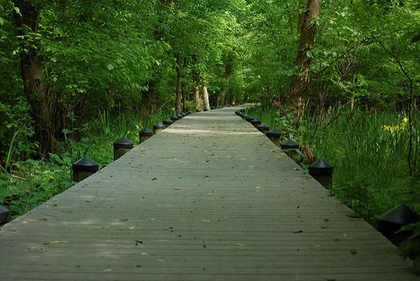
Where you are?
clio1789, Path, CC BY-NC-ND 2.0
Notes:
Ask participants how their institutions are engaging with institutional repositories.

Slide 3
Open Access
Getting on the Same Page

Slide 4
What OA is…
Free, immediate, online availability of scholarship.
Flexible licensing to help promote use and reuse.
What OA is not…
Not forsaking peer review
Not forsaking editorial processes or quality
Notes:
"Why can't I read this article?"
Traditionally, access to scholarly literature has been available only to institutions or people with subscriptions to the publishing journal. These subscriptions are not just expensive, but also increasingly out of reach even for the largest research universities. Largely, the demand for online literature has not changed this result: If your institution has a subscription to the journal in print, then you may also have access to electronic versions of the articles. But if you don't have a subscription (or have subscription access through an institution), online access is often available only behind a "paywall"--that is, if you are willing to pay money to read the particular article.
How does Open Access change things?
Eliminating barriers to readership enables everyone to have access to the research they need. A world without scholarship paywalls also advances knowledge, promotes progress, and maximizes research impact and return on investment.
OA is at its most effective in serving these goals where the scholarship is also made available with the fewest possible restrictions on reuse, thereby facilitating broad dissemination, constructive engagement, and broader educational possibilities. In other words: OA scholarship that is not merely "available online" for free to read, but also free from a rights perspective to use freely and build upon.

Slide 5
Terminology
Pre-Prints
Post-Prints
Publisher’s Version
Notes:
Review the terms with participants so they have the context for the OA color discussion and so they can help patrons/faculty/colleagues understand them.
Pre-Prints – The author's copy of article as it was submitted to the publisher, or the manuscript before its gone through editorial review and/or peer review.
Post-Prints – The author's copy of article after it has been reviewed and revised, but before the publisher has formatted it for publication.
Publisher’s Version – The version of the article that has been formatted (layout) and appears as the version of record within the publication (print and/or online).

Slide 6
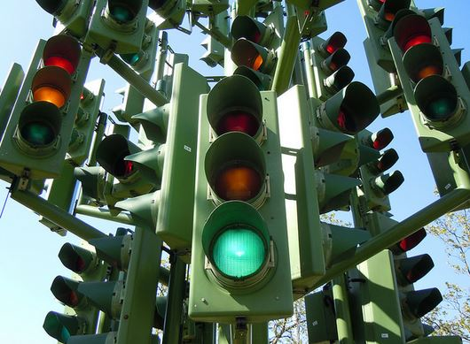
Pick a Color!
Green
Gold
Yellow
Red
White
Black
Kevan, Traffic Light Tree, CC BY 2.0
Notes:
Green allows the archiving of the post-print version
Gold allows sharing of final, published version (can be APC-based or Non-APC-based)
Yellow - refers to publishers whose policies allow archiving of pre-print
Red (red as in “stop”) as it encourages libraries to stop paying for subscriptions as well as article processing charges and directing funds to support OA publishing instead.
White - refers to publishers whose policies do not formally support archiving any version
Black…pirate OA (think Sci-Hub)
Most frequently, you’ll hear about green and gold OA. For the OA purpose of IRs, they rely on Green OA

Slide 7
Institutional Repositories

Slide 8
What is an IR?
Used as a mechanism for making scholarly works freely accessible on the web.
-ACRL
Digital collections capturing and preserving the intellectual output of a single university or a multiple institution community of colleges and universities
-SPARC
A set of services that a university offers to the members of its community for the management and dissemination of digital materials created by the institution and its community members.
-Clifford Lynch
Promote free and unrestricted access to the research output of the institution.
-The Sheridan Libraries Johns Hopkins University
Notes:
There is no one agreed upon definition of IR’s. Here are some a few though….

Slide 9
Everyone Can Agree
Digital
Accessible
Scholarly
Services to a group
Community
Notes:
Almost all of the definitions of IR have these five things in common.

Slide 10
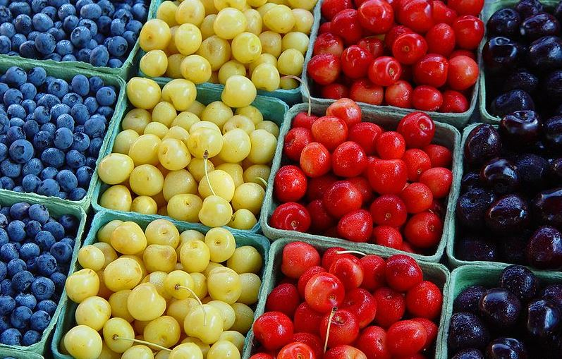
Variety!
Faculty and student generated content
Institutional content
Special collections
Data repositories
Disciplinary
Government
Social?!
Bluberries and different kinds of cherries, David Jakes from Naperville, CC BY 2.0
Notes:
IR can take on many shares and forms, the best are tailored to the needs of those they serve.
Government, e.g PubMed, ERIC (Education Resources Information Center)
Social, e,g ResearchGate, Academia.edu

Slide 11
Why IR?
It is a tool used to accomplish strategic goals - it should NOT be the goal in itself
Should have a purpose, plan, and partners in mind
Notes:
One of the biggest mistakes you can make is to have and IR just because you think you should or because everyone else is getting one. They involve a serious investment of time, and if you’re interested in having one think about what purpose it can serve for your institution and users.

Slide 12
Considerations
How does it tie into the strategic goals/scholarly communications plan of your institution/library?
Are you prepared to make the financial, staffing, and technological commitment to launch and maintain an IR?
Opportunities for partnership?
Notes:
Think through these very carefully and seriously, and have honest conversations with others about them.
How does it tie into the strategic goals/scholarly communications plan of your institution/library?
Are you prepared and able to make the commitment?
Financial
Staffing
Technology and tech. sport
Opportunities for partnership?
Your own IR vs. consortia IR

Slide 13
Who Should be Part of the Discussion?
Library staff
University/Institutional partners
Scholars
Community
Notes:
Talking with these groups can help you gain valuable perspective. It can also be a way to get various stakeholders engaged and excited about the project early-on.

Slide 14

Who Else?
Robert Scoble, Audience listens at Startup School, CC BY 2.0
Notes:
Activity: ask participants to spend a few minutes thinking about potential partners at their institution and beyond
Library administration, librarians, metadata, cataloging, discovery services, web/usability services
University administration
Disability services
Disability services
Research office/sponsored projects
University marketing
Faculty, researchers
Community organizations
Local archives

Slide 15
Launching
Funding
Where will it live?
Platform
Workflows
Copyright
Notes:
Funding
Technology
Staffing
Promotions
Where will it live?
Dept.
Website
Platform
Homegrown
Commercial
Homegrown
Host?
What will your copyright policy be?
Institutional OA policy
Deposit agreements
Balancing your goals with publication agreements
Providing education on negotiating publication agreements
Providing education on publishing on OA journals
Funder deposit agreements

Slide 16
Now That You Have One

Slide 17
Internal Considerations
IR Staff
Subject librarians
Library administration
Notes:
Subject librarians - key talking points for them to take to their faculty, help them be confident in responding to questions about policies & how to deposit. Be as clear as possible!
IR Staff - how are things working for them?
Library admin - needs to be kept in the loop about positive impact metrics

Slide 18
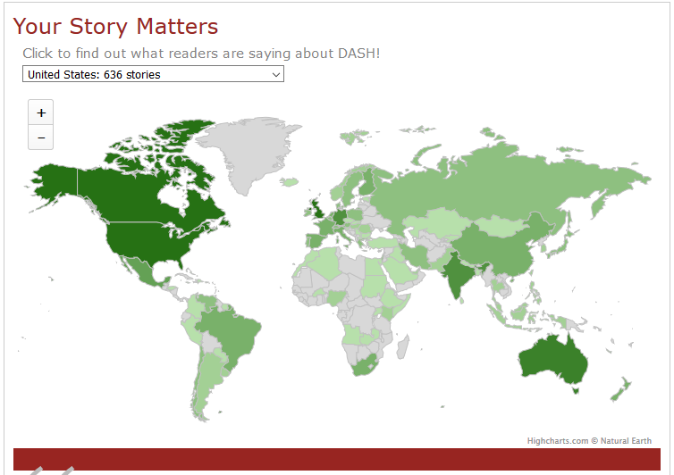
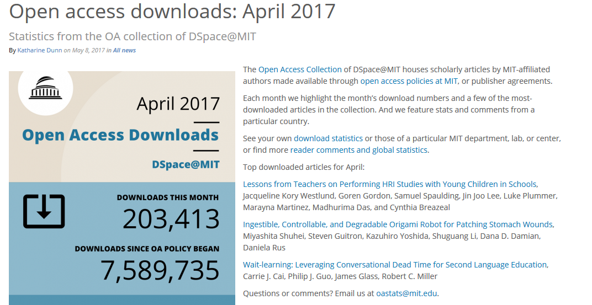
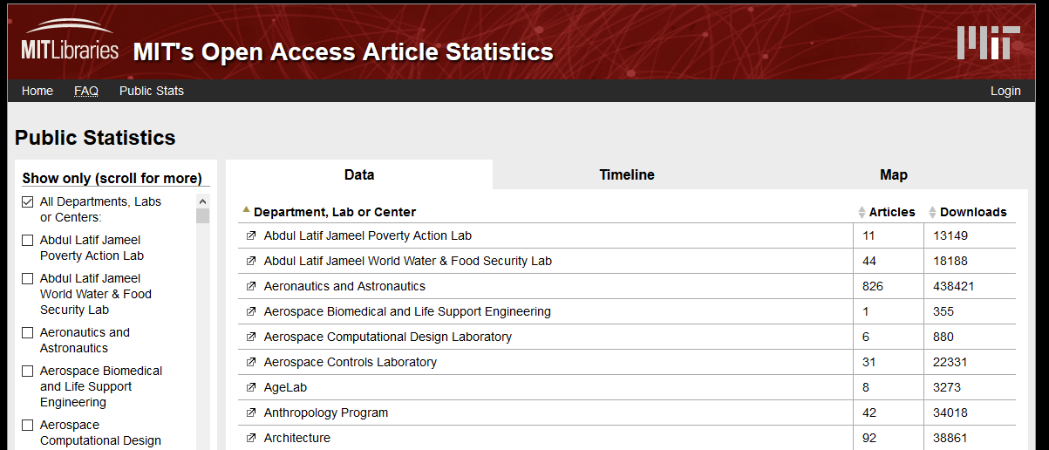
Demonstrating Impact
https://dash.harvard.edu/stories/
http://libraries.mit.edu/news/access-downloads-april/25118/
http://oastats.mit.edu/public.php

Slide 19
Recruiting Content
Identifying and engaging with your target audience
Big sell to administrators, small sell to individuals
OA/IR champions
Notes:
Marketing & Engagement
Who is your intended audience, and what are they interested in?
Passion for OA?
Tenure track
Preservation and documentation of a scholarly records
Making your institution look good
Identify what motivates each person you speak with/work with and explain how your product and services can help them meet their goal.
Find a friend!
Identify some faculty champions to set an example
Graduate office to partner on ETDs?

Slide 20
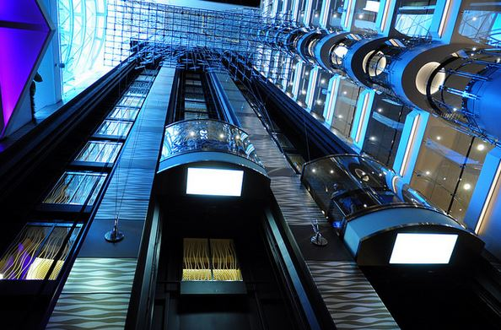
Activity!
Develop and “Elevator Pitch” describing a/your repository
Notes:
Introduce the activity and then click on to the next side to to provide some things for participants to think about.

Slide 21
Planning Your Elevator Speech
Who is your audience? What is their role related to IRs?
What are their concerns/challenges, opportunities?
What would you like to partner with them on?
Write out your elevator pitch - less than a minute.

Slide 22
Questions You’ll Be Asked

Slide 23
FAQs
Why have an IR when I can put my stuff in Academic.edu or ResearchGate?
I’m on the tenure track. How does this impact me?
What about peer review?
If it’s free it can’t be any good.
I don’t have time for this.
Notes:
Sites such as ResearchGate and Academia may make content widely available, but do not (and cannot) ensure long-term preservation.
Similarly, federal repositories such as PubMed Central are subject to the whims of governmental policy and budgeting - their purpose is to ensure the availability of federally-funded research, not all research in general.

Slide 24
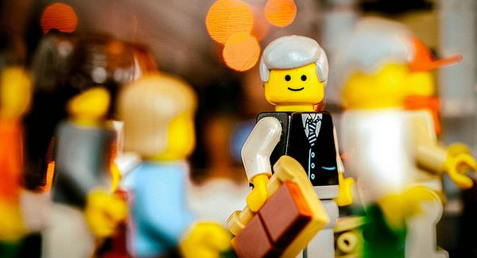
Activity!
What questions might your persona ask?
Sonny Abesamis, Mr Lego Goes To Work, CC BY 2.0

Slide 25
Be Prepared

Slide 26
A Few Pieces of Advice…
Sometimes it takes a while to get things up-and-running
You will meet skeptics!
You’ll also meet a lot of people excited about your IR.
Stay engaged
Be flexible
Scholarly communications is an emerging field, IR may need to be as well.

Slide 27
What Can You Do?
Education
Work-wise, what are you able to do?
Notes:
Education
About your IR
About copyright
About negotiating publication agreements
Work-wise, what are you able to do?
Help folks upload works
Upload works for them
Review publication agreements

Slide 28
What’s Your Forte?
Each person has their own area of specialized knowledge.
What is your specialty?
Who do you know who has specialized knowledge that can be put to use?

Slide 29
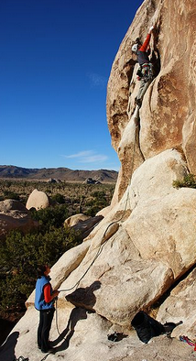
Activity
Who is belying you?
Joshua Tree National Park: Climbers on Lazy Day on South Horror Roc, Jarek Tuszyński, CC-BY-SA-3.0

Slide 30
Closing Thoughts
There is no one right way to implement a repository.
IRs open the door for conversations about author rights, copyright, sharing work, ethics in research and publishing, student/faculty collaboration

Slide 31
Recommendations
Have a plan
Have conversations
Be flexible

Slide 32
Tools & Resources
Scholarly Publishing and Academic Resources Coalition (SPARC): https://sparcopen.org/
OpenDoar: http://www.opendoar.org/
ROARMap: https://roarmap.eprints.org/
SHERPA/RoMEO: http://www.sherpa.ac.uk/romeo/index.php
SHERPA/JULIET: http://v2.sherpa.ac.uk/juliet/
SHERPA/FACT: http://www.sherpa.ac.uk/fact/
Open Repositories: http://www.or2018.net/

