Slide 1
Copyright and Open Educational Resources
Creation, Licensing, and Use

Slide 2
Today We’ll Discuss
Copyright Basics
Copyright Considerations in Creating OER
Licensing Considerations for OER
Reuse Rights when Engaging with OER

Slide 3
My aim in giving this presentation
Introduce you to copyright and licensing considerations associated with the creation and use of OER
Help you feel more confident in addressing these issues at your institution
Point you to resources that can help you find the answers you need

Slide 4
Copyright Basics

Slide 5
Securing Copyright
Copyright protection subsists, in accordance with this title, in original works of authorship fixed in any tangible medium of expression, now known or later developed, from which they can be perceived, reproduced, or otherwise communicated, either directly or with the aid of a machine or device.
-17 United States Code (USC) § 102(a)

Slide 6
Works Eligible for Copyright Protection
Literary works;
Musical works, including any accompanying words;
Dramatic works, including any accompanying music;
Pantomimes and choreographic works;
Pictorial, graphic, and sculptural works;
Motion pictures and other audiovisual works;
Sound recordings; and
Architectural works.
-17 USC § 102(a)

Slide 7
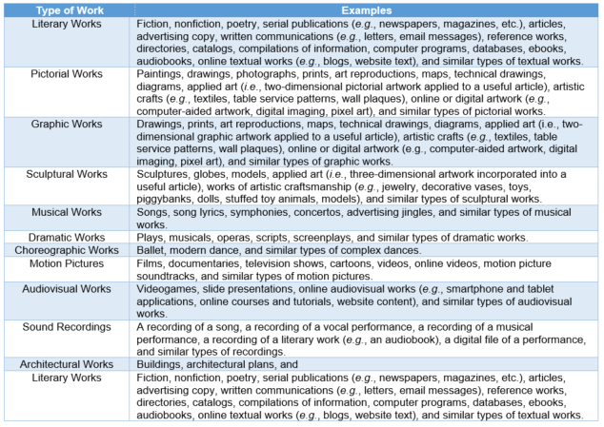
-U.S. Copyright Office, Compendium of U.S. Copyright Office Practices § 503.1(B) (3d ed. 2017).

Slide 8
You Can’t Copyright…
In no case does copyright protection for an original work of authorship extend to any idea, procedure, process, system, method of operation, concept, principle, or discovery, regardless of the form in which it is described, explained, illustrated, or embodied in such work.
-17 USC § 102(b)
Recommended resource: USCO Circular 33, Works Not Protected by Copyright, https://www.copyright.gov/circs/.

Slide 9
Who is the Rightsholder?
Copyright in a work protected under this title vests initially in the author . . . of the work.
-17 USC § 201(a)

Slide 10
Who is the Rightsholder?
Copyright in a work protected under this title vests initially in the . . . authors of the work. The authors of a joint work are coowners of copyright in the work.
-17 USC § 201(a)
They must plan to work together to create the copyrightable work;
The authors must each contribute significant, copyrightable content to the work; and
They must have the intention that their individual contributions will be merged together to form the final, whole work.
(see definition in § 101)

Slide 11
Who is the Rightsholder?
Works Made for Hire.—In the case of a work made for hire, the employer or other person for whom the work was prepared is considered the author for purposes of this title, and, unless the parties have expressly agreed otherwise in a written instrument signed by them, owns all of the rights comprised in the copyright.
-17 USC § 201(b)
Recommended resource: USCO Circular 30, Works Made for Hire, https://www.copyright.gov/circs/.

Slide 12
A Work Can be Considered a WMFH When
a work prepared by an employee within the scope of his or her employment; or
a work specially ordered or commissioned for use as a contribution to a collective work, e.g.,
  As a part of a motion picture or other audiovisual work,
  as a translation,
  as a supplementary work*,
  as a compilation,
  as an instructional text**,
  as a test,
  as answer material for a test,
  or as an atlas,
  If the parties expressly agree in a written instrument signed by them that the work shall be considered a work made for hire.
  *For the purpose of the foregoing sentence, a “supplementary work” is a work prepared for publication as a secondary adjunct to a work by another author for the purpose of introducing, concluding, illustrating, explaining, revising, commenting upon, or assisting in the use of the other work, such as forewords, afterwords, pictorial illustrations, maps, charts, tables, editorial notes, musical arrangements, answer material for tests, bibliographies, appendixes, and indexes
  ** An “instructional text” is a literary, pictorial, or graphic work prepared for publication and with the purpose of use in systematic instructional activities.
-17 USC § 101

Slide 13
Compilation Copyright
A “compilation” is a work formed by the collection and assembling of preexisting materials or of data that are selected, coordinated, or arranged in such a way that the resulting work as a whole constitutes an original work of authorship. The term “compilation” includes collective works.
-17 USC § 101
A “collective work” is a work, such as a periodical issue, anthology, or encyclopedia, in which a number of contributions, constituting separate and independent works in themselves, are assembled into a collective whole.
-17 USC § 101
The copyright in a compilation or derivative work extends only to the material contributed by the author of such work, as distinguished from the preexisting material employed in the work, and does not imply any exclusive right in the preexisting material. The copyright in such work is independent of, and does not affect or enlarge the scope, duration, ownership, or subsistence of, any copyright protection in the preexisting material.
-17 USC § 103(b)

Slide 14
Who is the Rightsholder?
Contributions to Collective Works.—Copyright in each separate contribution to a collective work is distinct from copyright in the collective work as a whole, and vests initially in the author of the contribution. In the absence of an express transfer of the copyright or of any rights under it, the owner of copyright in the collective work is presumed to have acquired only the privilege of reproducing and distributing the contribution as part of that particular collective work, any revision of that collective work, and any later collective work in the same series.
-17 USC § 201(c)
Recommended resource: USCO Circular FL 104, Contribution to Collective Work, https://www.copyright.gov/circs/.

Slide 15
Rights Granted Under the Law
The owner of copyright under this title has the exclusive rights to do and to authorize any of the following:
to reproduce the copyrighted work in copies or phonorecords;
to prepare derivative works based upon the copyrighted work;
to distribute copies or phonorecords of the copyrighted work to the public by sale or other transfer of ownership, or by rental, lease, or lending;
in the case of literary, musical, dramatic, and choreographic works, pantomimes, and motion pictures and other audiovisual works, to perform the copyrighted work publicly;
in the case of literary, musical, dramatic, and choreographic works, pantomimes, and pictorial, graphic, or sculptural works, including the individual images of a motion picture or other audiovisual work, to display the copyrighted work publicly; and
in the case of sound recordings, to perform the copyrighted work publicly by means of a digital audio transmission.”
-17 USC § 106

Slide 16
Duration of Copyright
Single authors – life of the author +70 years
Joint authors – life of the last surviving author +70 years
Anonymous Works, Pseudonymous Works, and Works Made for Hire—95 years from the year of its first publication, or 120 years from the year of its creation, whichever expires first.
-17 USC § 302(a-c)

Slide 17
Copyright Basics, In Summary
It’s easy to secure
It protects many types of works
The rightsholder will often be the author(s), but not always
Lots of rights are granted under the law
Copyright lasts for a long time

Slide 18
Copyright & OER Creation

Slide 19
Securing Copyright in the OER
It’s easy
Will cover many types of works published as OER
literary works;
musical works, including any accompanying words;
dramatic works, including any accompanying music;
pantomimes and choreographic works;
pictorial, graphic, and sculptural works;
motion pictures and other audiovisual works;
sound recordings; and
architectural works.

Slide 20
Authorship of OER
May be created by one author
Could qualify as a joint work
Compilation copyright situations?
Could be a work made for hire situation
Licensing and copyright transfer considerations associated with all of these that should be addressed ahead of time (more about this later)!
Notes:
Who the rightsholder is will be important when it comes to adding a license to the work (more on that later)
Think about this up front, especially when it comes to works of joint authorship and works made for hire
These situations require preplanning
Helps avoid confusion and hurt feelings down the road
Same for work made for hire situations!

Slide 21
Creating ALL Materials vs. Using 3rd Part Works
Pros
  Allows for more creative control as part of the OER development process
  Helps ensure that all works perfectly align with the scope and intent of the OER
  Helps cut down on copyright and licensing issues
Cons
  It can be time consuming
  To create some works, you may need specialized software
  In some situations it can be impractical

Slide 22
Reusing Third-Party Works in OER
The work is a public domain work
The work is licensed for reuse
The use could be considered a fair use
Permission is obtained to include the work in the OER
A license is obtained to include the work in the OER

Slide 23
1. Using Public Domain Works
Works without copyright protection
  Copyright has expired
  No copyrightable content
  US government works
  Work was placed in the public domain by the rightsholder

Slide 24
1(a) Expired Copyrights
Works published prior to 1923 (soon to be 1924?) are in the public domain under US copyright law
Works published between Jan. 1, 1923- Dec. 31, 1977—it depends
Unpublished works—it depends
Recommended resource: Peter Hirtle’s Copyright Term and the Public Domain in the United States Charts: https://copyright.cornell.edu/publicdomain

Slide 25
1(b) No Copyrightable Content
Works consisting entirely of facts
Multiplication tables
Conversation tables (e.g. teaspoon/tablespoon/cups to ounces)
Basic calendar
White pages
Tip:
Small amounts of creativity can change things, e.g. the selection and arrangement of facts
Copyrightable components added to these works (e.g. pictures or graphics added to a calendar) will be protectable from the facts
Read this: Feist v Rural, 499 U.S. 340 (1991), https://www.law.cornell.edu/copyright/cases/499_US_340.htm

Slide 26
1(c) US Government Works
Copyright protection under this title is not available for any work of the United States Government, but the United States Government is not precluded from receiving and holding copyrights transferred to it by assignment, bequest, or otherwise.
-17 USC § 201(a)
Tips:
There could be a combination of public domain and copyrightable works, so check.
“Open” governmental works created under grants are not the same as public domain works.

Slide 27
1(d) Item Placed in the Public Domain
People can choose not to enforce their rights
People can attach a license to the work indicating its “public domain” status, e.g. CC-0 license (more about this option soon).

Slide 28
2. The Work is Licensed for Reuse
This can include:
CC Works
OA Works

Slide 29
2(a) Creative Commons Works
Founded in 2001 by Lawrence Lessig, Hal Abelson, and Eric Eldred with the support of Center for the Public Domain.
Released their first set of licenses in 2002.
Licenses provide rightsholders with a simple, standardized way to grant copyright permissions to their creative work.
If not a forfeiture of rights or a transfer of rights to the CC. Rather, it is setting “rules” for reuse
https://creativecommons.org/

Slide 30

Logo | License | License Info
 | Attribution (BY) | This license lets others distribute, remix, tweak, and build upon your work, even commercially, as long as they credit you for the original creation. This is the most accommodating of licenses offered. Recommended for maximum dissemination and use of licensed materials.
 | Sharealike (SA) | This license lets others remix, tweak, and build upon your work even for commercial purposes, as long as they credit you and license their new creations under the identical terms.
 | NoDerivatives (ND) | This license allows for redistribution, commercial and non-commercial, as long as it is passed along unchanged and in whole, with credit to you.
 | NonCommercial (NC) | This license lets others remix, tweak, and build upon your work non-commercially, and although their new works must also acknowledge you and be non-commercial, they don’t have to license their derivative works on the same terms.
 | CC-BY-NC-SA | This license lets others remix, tweak, and build upon your work non-commercially, as long as they credit you and license their new creations under the identical terms.
 | CC-BY-NC-ND | This license lets others remix, tweak, and build upon your work non-commercially, as long as they credit you and license their new creations under the identical terms.
 | CC0 | Enables scientists, educators, artists and other creators and owners of copyright-or database-protected content to waive those interests in their works and thereby place them as completely as possible in the public domain, so that others may freely build upon, enhance and reuse the works for any purposes without restriction under copyright or database law.

Slide 31
CC Advantages
Clear rights for reuse
  No need to seek permission if use falls within the scope of the license
Limited liability if you follow the license terms
Help save time and money in creation of the OER
Help promote other creators

Slide 32
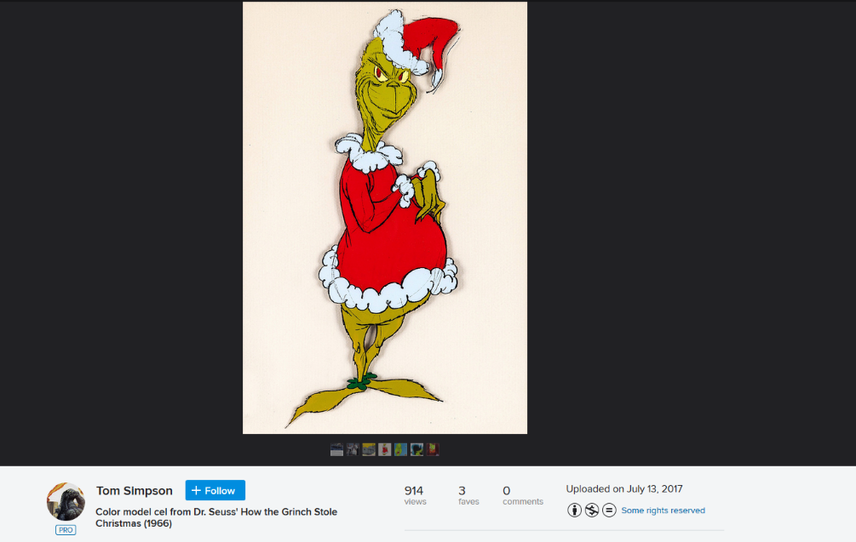
CC Disadvantages
Works may be posted with a CC license that are not attached by the rightsholder
Tips:
Think of it as an info assessment!
Follow the breadcrumbs
Does this seem logical?
What other work have they done?
Print/save a copy for your records

Slide 33
2(b) Open Access Works
Open access (OA) literature is digital, online, free of charge, and free of most copyright and licensing restrictions.
-Peter Suber, Open Access, MIT Press, 2012
Frequently articles, books, book chapters, data sets, tools, resources, PowerPoints
Frequently licensed under CC licenses
Sometimes have their own license
Look on work and/or to publisher for more info

Slide 34
3. The Use Could be Considered a Fair Use
Notwithstanding the provisions of sections 106 and 106A, the fair use of a copyrighted work, including such use by reproduction in copies or phonorecords or by any other means specified by that section, for purposes such as criticism, comment, news reporting, teaching (including multiple copies for classroom use), scholarship, or research, is not an infringement of copyright. In determining whether the use made of a work in any particular case is a fair use the factors to be considered shall include—
(1) the purpose and character of the use, including whether such use is of a commercial nature or is for nonprofit educational purposes;
(2) the nature of the copyrighted work;
(3) the amount and substantiality of the portion used in relation to the copyrighted work as a whole; and
(4) the effect of the use upon the potential market for or value of the copyrighted work.
The fact that a work is unpublished shall not itself bar a finding of fair use if such finding is made upon consideration of all the above factors.
-17 USC § 107

Slide 35
What Fair Use Is
Exception to the rights outlined in Section 106 of US copyright law
Helps promote teaching, research, scholarship, etc.
Also helps support free speech and expression

Slide 36
What Fair Use Isn’t
Word or chapter counts
Percentages
A set number of photographs
A certain few seconds from a song
A few minutes from a videorecording
Recommended resource: Kenneth D. Crews, The Law of Fair Use and the Illusion of Fair-Use Guidelines (October 1, 2001). Ohio State Law Journal, Vol. 62, www.arl.org/storage/documents/publications/fair-use-code-crews.pdf.

Slide 37
Look to the Law!
Fair use statute
Court cases
Recommended resource: USCO Fair Use Index, https://www.copyright.gov/fair-use/index.html. The goal of the Index is to make the principles and application of fair use more accessible and understandable to the public by presenting a searchable database of court opinions, including by category and type of use (e.g., music, internet/digitization, parody).

Slide 38
Code of Best Practices in Fair Use for Open Courseware
OCW materials often, where possible, integrate third-party materials. Incorporating such material frequently presents significant challenges. Under certain circumstances, those producing OCW will be required to secure permission from copyright owners and “clear the rights” in order to proceed with the intended use. The process of securing permissions or licenses from copyright owners is rarely an easy, inexpensive, certain, or straightforward enterprise. Fortunately, there are instances under U.S. copyright law where rights clearance is not necessary. Fair use is one such instance. Fair use is the right to use copyrighted material without permission or payment under some circumstances—especially when the cultural or social benefits of the use are predominant. It is a general right that may apply even in situations where the law provides no specific authorization for the use in question. This is a guide to current best practices for the use of copyright material in OCW, drawing on the actual activities of educators and educational staff who prepare courses for distribution.
http://cmsimpact.org/code/code-best-practices-fair-use-opencourseware/

Slide 39
Using the Code
Open Courseware (OCW) is a form of OER
Rooted in community practice
Does not hold the force of law, but a good indicator of how other librarians and educators are applying fair use to these situations
Addresses:
  Incidental uses
  Critique and analysis
  Illustration
  Demonstration or explanation
  Assigned and supplementary works

Slide 40
Other Codes
http://cmsimpact.org/codes-of-best-practices/
For academic and research libraries
Orphan works
Not targeted to OER creation, but relevant and helpful

Slide 41
4. Permission is Obtained to Include the Work in the OER
Ask! The worse thing they can say is “no”
You’ll be surprised how many say yes!
Permissions process
  Identify the rightsholder
  Outline the who, what, where, when, and how’s of the request in email or a letter
  Send and wait
Recommended resource: Columbia Copyright Advisory Services, Asking for Permission, https://copyright.columbia.edu/basics/permissions-and-licensing.html.
Recommended resource: USCO Circular 16A, How to Obtain Permission, https://www.copyright.gov/circs/.

Slide 42
5. A License is Obtained to Include the Work in the OER
A license is “permission [granted] to commit some act that would otherwise be unlawful”
–Black’s Law Dictionary, 2009, p. 1002
Generally,
Rights to reuse a certain work, in a certain way, for a certain period of time.
Usually involves the payment of a fee for the use
Obtained from the rightsholder and/or their representative, e.g. the publisher

Slide 43
Special Consideration-Orphan Works
Works where the rightsholder cannot be identified or reached
Will likely have to rely on fair use
Consideration: how does the orphan work status support applications of fair use?
Recommended Resource: Digitizing Orphan Works: Legal Strategies to Reduce Risks for Open Access to Copyrighted Orphan Works, by Dave Hansen, https://dash.harvard.edu/handle/1/27840430.

Slide 44
Copyright & OER Creation, in Summary
Will be made-up of many copyrighted works
Internal decision to create them all or include works (copyrighted or not) created by others
Reuse options include:
  The work is a public domain work
  The work is licensed for reuse
  The use could be considered a fair use
  Permission is obtained to include the work in the OER
  A license is obtained to include the work in the OER

Slide 45
OER Licensing Considerations - PREPUBLICATION

Slide 46
The Big License!
“5 R’s” of Open Access, as identified by David Wiley
Retain - the right to make, own, and control copies of the content (e.g., download, duplicate, store, and manage)
Reuse - the right to use the content in a wide range of ways (e.g., in a class, in a study group, on a website, in a video)
Revise - the right to adapt, adjust, modify, or alter the content itself (e.g., translate the content into another language)
Remix - the right to combine the original or revised content with other material to create something new (e.g., incorporate the content into a mashup)
Redistribute - the right to share copies of the original content, your revisions, or your remixes with others (e.g., give a copy of the content to a friend)
http://opencontent.org/definition/

Slide 47
CC Licenses and the 5R’s
License | Retain | Reuse | Revise | Remix | Redistribute
CC-BY | ✓ | ✓ | ✓ | ✓ | ✓
CC-SA | ✓ | ✓ | ✓ | ✓ | ✓*
CC-ND | ✓ | ✓ |  |  | ✓
CC-NC | ✓ | It Depends | ✓ | ✓ | It Depends
CC-BY-NC-SA | ✓ | It Depends | ✓ | ✓ | It Depends
CC-BY-NC-ND | ✓ | It Depends |  |  | It Depends
CC0 | ✓ | ✓ | ✓ | ✓ | ✓

Slide 48
Choosing a License
5R’s are important
Rightsholder’s wishes are important too
Have this discussion and agree on terms before work even begins!
  Individual author considerations
  Joint work agreement
  Compilation and work made for hire contracts
Funder, institutional, or publishing service “open” requirements
  Get grant funding? Check to see if it requires you use a certain license.
  Have an institutional OA policy? See if it comes into play here.
  Library/institutional publishing service? Check to see if it requires you use a certain license.

Slide 49
Little Licenses
Licenses attached to photos, graphs, charts, CC works, OA works, etc. included in the OER
When working directly with others
  Having this discussion with each person who many have contributed to the work, e.g. taken a photograph, created a chart or graph, written a case study to include in a book
  Not required for nonexclusive licenses, but best to get something in writing.
Ensuring licenses are attached to individual works in the OER, including CC licenses

Slide 50
License Placement for Individual Works
On each work (e.g. individually licensed works)
Only on the third-party works? e.g.
    NASA occasionally uses copyrighted material by permission on its website. Those images will be marked copyright with the name of the copyright holder. NASA's use does not convey any rights to others to use the same material. Those wishing to use copyrighted material must contact the copyright holder directly.
  NASA Media Usage Guidelines
  https://www.nasa.gov/multimedia/guidelines/index.html

Slide 51
License Placement the OER Itself
On the OER itself
  On the webpage/website it’s posted to
  On the title page
  On each chapter
  On every page?
Avoiding confusion with other licenses on each page

Slide 52
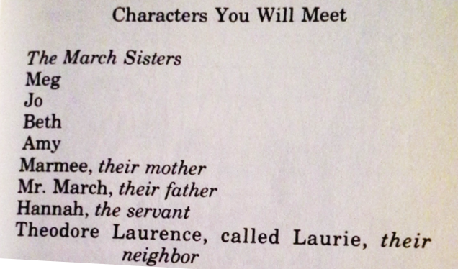
OER Copyright Info Page?
Webpage or page-page
Copyright notice
Licenses you will meet
Photo credit: Great Illustrated Classics, Little Women, © 1989

Slide 53
OER Licensing Summary
Decide early what the “big” license will be, keeping an eye open for influencing factors
Keep good track of the “little” licenses, and make sure all works in the OER are tagged accordingly
Decide how best to communicate the “big” license to users

Slide 54
Using OER

Slide 55
OER Challenges
Acceptance
Finding
Updating

Slide 56
Copyright & Licensing Issues are Tricky Too!
Equating “open” with no copyright
Licensed works (CC licensing and others)
Reuse under fair use

Slide 57
CC Licenses
What each means
  Some are clear, some are not
  May only be clear if user is familiar with them
Understanding that exceptions and limitations can still be considered if the use falls outside the scope of a CC license

Slide 58
License-Licenses
Used with permission
Helping users understand their options under the terms of the license

Slide 59
Reused Under Fair Use
My fair use is not your fair use
  A fair use decision was made regarding its inclusion in the OER
  Another fair use decision will need to be made regarding your use

Slide 60
Answering Copyright Questions Related to OER Creation & Use

Slide 61
What’s a Librarian to do?
Run and hide
  Appealing but, ethically, not an option
Think of it as any other tricky/difficult reference interaction
  Pause
  Take a deep breath
  Look for info
  Sometimes the answer is “I’ll have to get back to you”
  Sometimes the answer is “will an alternate resource work?”

Slide 62
What services will you offer?
Decision among library staff and administrators when it comes to copyright and OER creation
  Full service, including permissions assistance and helping to direct the author license phase?
  Consultants on tricky issues?
  Providing information
OER Use
  Info on the way about copyright and licenses
  Answer reference-type questions
  Full service consultations

Slide 63
Pause
What options are available here?
  The work is a public domain work
  The work is licensed for reuse
  The use could be considered a fair use
  Permission is obtained to include the work in the OER
  A license is obtained to include the work in the OER
  Recommended resource: A Framework for Analyzing any U.S. Copyright Problem, by Kevin Smith and Lisa Macklin, https://www.k-state.edu/copyright/docs/CopyrightFramework.pdf.

Slide 64
Take a Deep Breath
Organize your thoughts
Things may be a bit technical! What is the best way to convey this information to the patron based off their familiarity with these issues? What tools and resources may you and the patron find helpful?

Slide 65
Where can I find info to answer this question?
Creation
  Can you talk to the person who created the item?
  Can you find a license attached to the work?
  Fair use tools and resources
  How do we get the permissions ball rolling
  We may need a license here….
Use
  What do you know about the license
  Where can you send them for more info?
  Communicating info about fair use, permissions, etc.

Slide 66
“I will have to get back to you”
Don’t be hesitant to say this!
Get contact info, follow-up, offer additional information and resources
Options!

Slide 67
Would an alternate resource work?
Another option
Look to CC, OA, and public domain works works
Notes:
Medical book OA example. Questionable book online example

Slide 68
Common Misconceptions That Often Pose Challenges
If it’s on the internet, I can use it however I want.
If it’s an educational use I can use anything I want, however I want, right?
I provided a citation to the original work, so it’s not copyright infringement.

Slide 69
Answering Questions, In Summary
It’s always scary at first
Bad info can be scarier!
Use basic reference/service procedures as a guide
Offer options
Don’t take it personally if they don’t like your options

Slide 70
Presentation Takeaways

Slide 71
Copyright & OER Creation and Use
Goes together like cheese and crackers
Those creating and using OER should be cognizant of these issues
Don’t have to be attorneys or copyright experts as a little understanding of the basics of both can go a long way
Seek out that quality info, and don’t be afraid to ask questions

Slide 72
Because we are all in this together…
​Carla Myers
Assistant Librarian & Coordinator of Scholarly Communications
Miami University Libraries
This work is licensed under a Creative Commons Attribution-NonCommercial 4.0 International License.

Slide 73
Tools & Resources

Slide 74
Learn More About Copyright
CopyrightX
http://copyx.org/
Copyright for Educators and Librarians
https://www.coursera.org/learn/copyright-for-education
Copyright for Multimedia
https://www.coursera.org/learn/copyright-for-multimedia
Copyright Law for Librarians and Educators: Creative Strategies and Practical Solutions
https://www.alastore.ala.org/content/copyright-law-librarians-and-educators-creative-strategies-and-practical-solutions-fourth

Slide 75
Tools and Resources
A Framework for Analyzing any U.S. Copyright Problem, developed by Smith, Kevin L. Smith and Lisa Macklin
A great tool for working through copyright questions and issues.
http://hdl.handle.net/1808/22723
The Copyright Advisory Network (CAN)
Provides copyright tools and resources and includes a forum where you can ask questions that will be answered by members of ALA’s Copyright Education Committee.
http://librarycopyright.net/

Slide 76
Stay Current
CopyTalk Webinars
http://www.ala.org/advocacy/pp/pub/copytalk
Monthly webinars on various copyright topics
Copyright Chat Podcast
https://www.library.illinois.edu/scp/copyright-overview/chat-podcast/
A podcast dedicated to discussing important copyright matters.
Scholarly Communications @ Duke
https://blogs.library.duke.edu/scholcomm/
A blog about copyright and publication issues
IO: In the Open
http://intheopen.net/
A blog exploring libraries, scholarship, and publishing
The Taper
http://thetaper.library.virginia.edu/
A blog exploring copyright information and policy

Slide 77
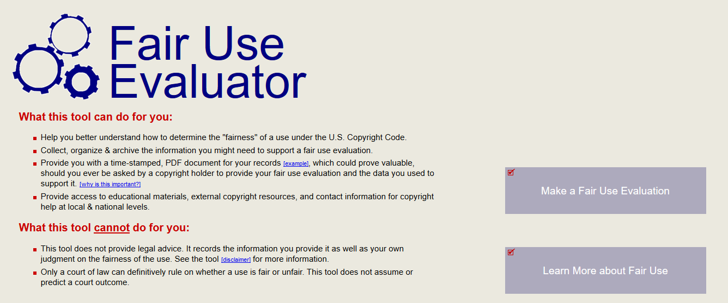
ALA Fair Use Evaluator
http://librarycopyright.net/resources/fairuse/
http://librarycopyright.net/resources/fairuse/

Slide 78
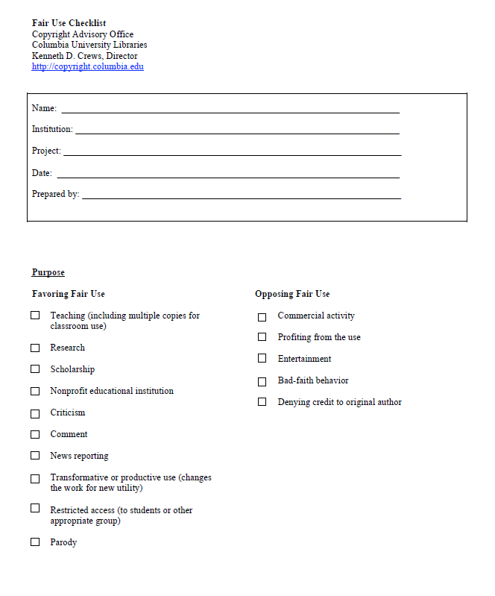
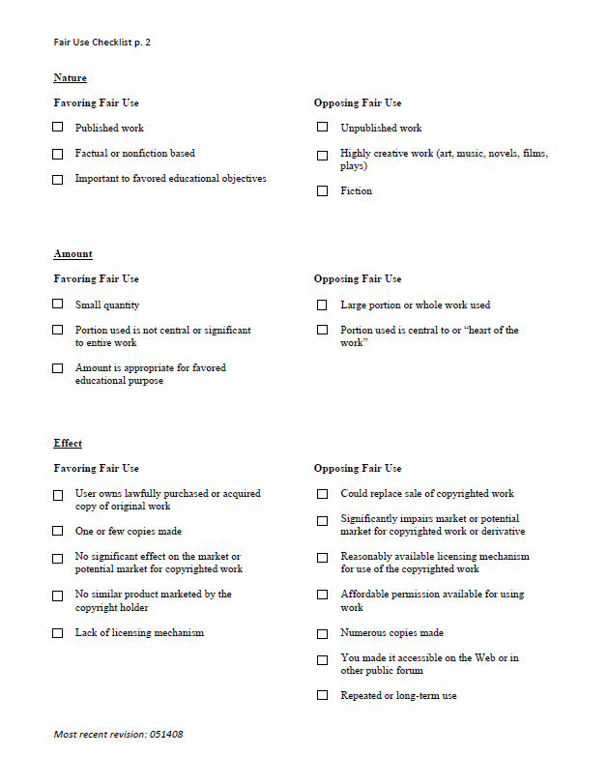
Kenneth D. Crews’ Fair Use Checklist
https://copyright.columbia.edu/content/dam/copyright/Precedent%20Docs/fairusechecklist.pdf

Slide 79
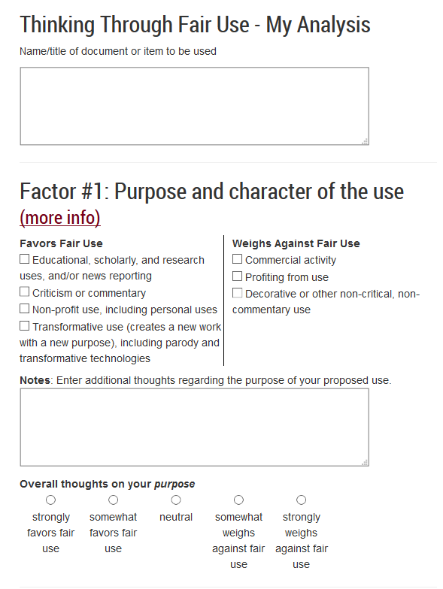
Think Through Fair Use
http://www.lib.umn.edu/copyright/fairthoughts
Tip: Think of checklist tools as a list of things to consider and a way to help you work-through/balance the factors, not an exercise in checking and counting boxes.

