Slide 1
Fair Use
An Overview for Librarians & Educators

Slide 2
​
Carla Myers
Assistant Librarian & Coordinator of Scholarly Communications
Miami University Libraries myersc2@miamioh.edu

Slide 3
Overview
Quick copyright basics review
Fair use
Court cases
Tools and resources
Putting it all together

Slide 4
Quick Basics Overview

Slide 5
Securing Copyright
Copyright protection subsists in “in original works of authorship” (not copied) which are “fixed in any tangible medium of expression.” (17 U.S.C. § 102)
Registration and the inclusion of a copyright notice is no longer necessary, but does have some benefits

Slide 6
Copyrightable Works Include
Literary works (fiction/nonfiction, poetry, textbooks, reference works, directories, catalogs, advertising copy, compilations of information, computer programs and databases)
Musical works (this generally refers to music scores & accompanying words)
Dramatic works (plays, film, radio, and television scripts)
Pantomimes and choreography
Pictorial, graphic, and sculptural works (art)
Motion pictures and other audiovisual works (film, television show, videogame, etc.)
Sound recording (performances of musical works, audio recordings of literary works)
Architectural works (just the designs, not the building its self!)

Slide 7
Copyrightable Works Do Not Include
Ideas
Facts
Procedures, methods, and processes
Works in the public domain

Slide 8
Copyright Ownership
Generally the person who creates the work is the rightsholder
With works of “joint authorship,” all of those who contributed copyrightable content to the work will be considered rightsholders
In “works made for hire” situations, copyright may vest with the employer
For contracted works, it depends

Slide 9
How Long Does Copyright Last?
Works created after Jan. 1, 1978 are protected for the life of the author plus 70 years
Join authorship-life of last surviving author +70 years
Works for Hire-95 years from publication or 120 years from creation, whichever is shorter

Slide 10
Authors Rights
Owner of a protected work is provided with certain right….
The right to reproduce (copy) the work
The right to distribute the work (share/publish/sell)
The right to create derivatives
The right to public performances and displays of the work

Slide 11
Infringement
Copyright infringement occurs when we take advantage of one of the rights granted to creators under the law without their authorization.
Reproduce works
Make derivatives
Distribute copies
Perform the work publicly
Display the work publicly
In the case of sound recordings, to perform the copyrighted work publicly by means of a digital audio transmission.

Slide 12
Fair Use

Slide 13
Legal Exceptions
Allow us to use copyrighted works in ways that would otherwise be considered copyright infringement.
Fair use
Library copying
First sale doctrine
Face-to-face teaching
Displays and performances for distance learning (TEACH Act)
Special formats for those with disabilities
Digital Millennium Copyright Act

Slide 14
17 U.S.C. § 107
Notwithstanding the provisions of sections 106 and 106A, the fair use of a copyrighted work, including such use by reproduction in copies or phonorecords or by any other means specified by that section, for purposes such as criticism, comment, news reporting, teaching (including multiple copies for classroom use), scholarship, or research, is not an infringement of copyright. In determining whether the use made of a work in any particular case is a fair use the factors to be considered shall include—
(1) the purpose and character of the use, including whether such use is of a commercial nature or is for nonprofit educational purposes;
(2) the nature of the copyrighted work;
(3) the amount and substantiality of the portion used in relation to the copyrighted work as a whole; and
(4) the effect of the use upon the potential market for or value of the copyrighted work.
The fact that a work is unpublished shall not itself bar a finding of fair use if such finding is made upon consideration of all the above factors.

Slide 15
Fair Use Line-by-Line
Notwithstanding the provisions of sections 106 and 106A
the fair use of a copyrighted work
including such use by reproduction in copies or phonorecords or by any other means specified by that section
for purposes such as criticism, comment, news reporting, teaching (including multiple copies for classroom use), scholarship, or research
is not an infringement of copyright

Slide 16
Fair Use Line-by-Line
In determining whether the use made of a work in any particular case is a fair use the factors to be considered shall include—
the purpose and character of the use, including whether such use is of a commercial nature or is for nonprofit educational purposes;
the nature of the copyrighted work;
the amount and substantiality of the portion used in relation to the copyrighted work as a whole; and
the effect of the use upon the potential market for or value of the copyrighted work.
The fact that a work is unpublished shall not itself bar a finding of fair use if such finding is made upon consideration of all the above factors.

Slide 17
The Four Factors of Fair Use

Slide 18
Say You Wish To…
Provide criticism or commentary on a work
Are reporting the news
Are looking to make and distribute copies of works as part of teaching
Are performing scholarship or research
Preserve/safeguard a work
Make derivatives of a work

Slide 19
Factor 1: Purpose & Character of the Use
Teaching/Research/Scholarship
Criticism/commentary
Nonprofit institution
Commercial use

Slide 20
Transformative Use
Have you turned the original into something new by adding new expression or meaning?
    “If…the secondary use adds value to the original--if the quoted matter is used as raw material, transformed in the creation of new information, new aesthetics, new insights and understandings-- this is the very type of activity that the fair use doctrine intends to protect for the enrichment of society.”
    -Pierre N. Leval
    Toward a Fair Use Standard, Harvard Law Review, Vol. 103, No. 5 (Mar., 1990), pp. 1105-1136

Slide 21
Transformative Use
A transformative use…
  “[F]ocuses on whether the new work merely supersedes the objects of the original creation, or whether and to what extent it is ‘transformative,’ altering the original with new expression, meaning, or message. The more transformative the new work, the less will be the significance of other factors, like commercialism, that may weigh against a finding of fair use.”
  -Justice David H. Souter
  Campbell v. Acuff-Rose Music (92-1292), 510 U.S. 569 (1994).

Slide 22
Examples of Transformative Use
Parody
Musical Mash-up
Entertainment to scholarship/news reporting

Slide 23
Factor 2: The Nature of the Work
Explores the characteristics of the work being used…
Nonfiction/factual
Fiction/creative
Published or unpublished
Notes:
Salinger?

Slide 24
Factor 3: The Amount & Substantiality of the Portion Used
“The amount and substantiality of the portion used in relation to the copyrighted work as a whole” -17 USC § 107
There are no absolute rules as to how much of a copyrighted work may be copied and still be considered a fair use.
-Maxtone-Graham v. Burtchaell
Think quantity and quality
Consider the amount needed to serve the purpose of the use in relation to the work being used.
This is a judgment call, and one you must be prepared to justify should your use of the work ever come into question!

Slide 25
Beware of the Guidelines!
Classroom Photocopying Guidelines (1976)
  Use must be “spontaneous”
  Brevity…
    Can use 1 chapter or 10% of a work
    No more than 250 words from a poem
    Only 1 chart, picture or diagram from a work
  Must seek permission for subsequent use
Off-Air Recording of Broadcast Programming for Educational Purposes (1981)
Carry no force of law and provide no safe harbor against infringement!

Slide 26
Factor 4: Effect on the Market
Is your use resulting in lost revenue for the rightsholder?
Could your use replace sale of the work?
Could your use help the market for the item, e.g. comment, critique, parody?
This factor can carry a lot of weight, especially when looking at commercial uses.

Slide 27
It’s so confusing!
Congress deliberately created fair use to flexible so that it could apply to many different situations.
Unfortunately though, this can lead to uncertainty regarding its application.

Slide 28
Fair Use in the Courts

Slide 29
Campbell V. Acuff Rose
Acuff-Rose Music was an American music publishing firm formed in 1942 by Roy Acuff and Fred Rose in Nashville
They own the copyright in the song “Oh, Pretty Woman” written by Roy Orbison and William Dees
https://www.youtube.com/watch?v=WdmS9wCHhSU
The manager for the rap group, 2 Live Crew reached out to Acuff-Rose asking for a license to use the tune of Orbison’s song and the first line in a parody composed by the band composed "Pretty Woman." They also offered to provide creative credit to Acuff-Rose, Roy Orbison, and William Dees for the original.
https://www.youtube.com/watch?v=65GQ70Rf_8Y&list=RD65GQ70Rf_8Y
Acuff-Rose denied the license.
2 Live Crew went ahead and released their song anyway and has been making a tidy profit off it.
Acuff-Rose have decided to sue the band and it’s recording label, Luke Skyywalker Records for copyright infringement.

Slide 30
Round 1: The District Court
Purpose--2 Live Crew's version was obviously a parody, which "quickly degenerates into a play on words, substituting predictable lyrics with shocking ones" to show "how bland and banal the Orbison song" is; that 2 Live Crew
Nature of the Work—Creative Song
The Amount Used—2 Live Crew has taken no more than was necessary to "conjure up" the original in order to parody it
Effect on the Market—It’s "extremely unlikely that 2 Live Crew's song could adversely affect the market for the original.“
Ruling: It’s a Fair Use!

Slide 31
Round 2: The Appellate Court
Purpose—Commercial, and "every commercial use . . . is presumptively . . . Unfair.“
Nature of the Work—Creative song
The Amount Used—They took the “heart” of the original work and made it the “heart” of the new work.
The Effect on the Market—What about the market for a derivative work?
Ruling: It is not a Fair Use.

Slide 32
Round 3: The US Supreme Court
Purpose—Transformative…taking the original work and turning it into something new.
Nature of the Original—Yes…it’s a creative, original song, however “Parodies almost invariably copy publicly known, expressive works.”
The Amount Used—”The parody must be able to "conjure up" at least enough of that original to make the object of its critical wit recognizable.”
The Effect on the Market—It is unlikely “that creators of imaginative works will license critical reviews or lampoons of their own productions removes such uses from the very notion of a potential licensing market” and there is “no evidence that a potential rap market was harmed in any way by 2 Live Crew's parody, rap version.”
Ruling: Fair use!

Slide 33
Harper & Row v. The Nation
Harper and Row contracted with Gerald Ford to publish his memoirs.
Harper & Row negotiated a prepublication agreement with Time Magazine for the right to excerpt 7,500 words from Ford's account, with an emphasis on his decision to pardon Richard Nixon.
Before Time released its article, the magazine The Nation Magazine got their hands on a copy of the book and published approximately 300 words from it in a story outlining why Ford pardoned Nixon.
Time magazine cancelled their contract and refused to pay the last installment of the agreed upon amount.
Harper & Row sued The Nation, alleging copyright infringement.

Slide 34
Round 1: The District Court
The purpose--Though The Nation billed their article as "hot news" it contained no new facts and was "published…for profit.”
The Nature of the Work—Factual to an extent, but “a soon-to-be-published” work.
The Amount—It was a small amount, however it was the “heart of the work.”
The Effect on the Market—“The totality of these facts and memoranda collected, together with Ford's reflections, that made them of value to The Nation, [and] this . . . totality . . . is protected by the copyright laws."
The Ruling: Not a Fair Use

Slide 35
Round 2: The Appellate Court
The Purpose—the purpose of the article was "news reporting“ on a significant, important topic.
The Nature of the Work—factual.
The Amount--300 words in a 2,250-word article published in The Nation.
The Effect on the Market. Minimal.
The Ruling: Fair Use

Slide 36
Round 3—The US Supreme Court
Purpose--The Nation was definitely out to scoop the right of first publication.
The Nature of the Work—Somewhat factual, but also expressive. The Nation could have stuck to the facts, but they did not.
The Amount--Although the "amount" was small, it was the "heart of the work".
The Effect on the Market—There was actual hard, Time's cancellation of their publishing contract.
The Ruling: Not a Fair Use

Slide 37
Fair Use Tools

Slide 38
Using Fair Use Tools
These decisions are very subjective and need to be made by the person utilizing the protected work
Only work if you are completely honest!
Keep a copy
  Record of fair use decision
  Can be used as a legal document

Slide 39
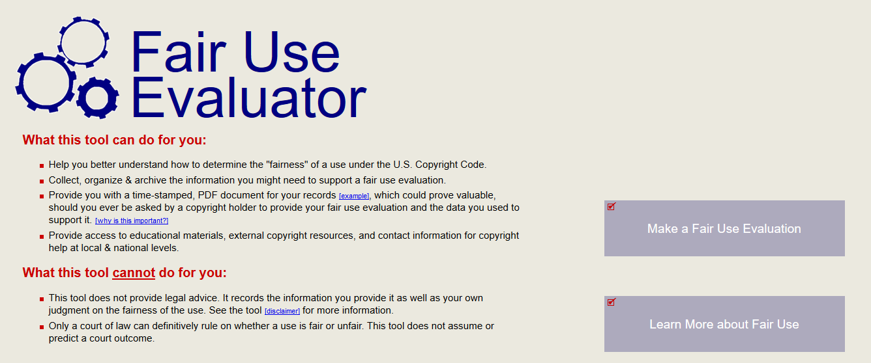
ALA Fair Use Evaluator
http://librarycopyright.net/resources/fairuse/
http://librarycopyright.net/resources/fairuse/

Slide 40
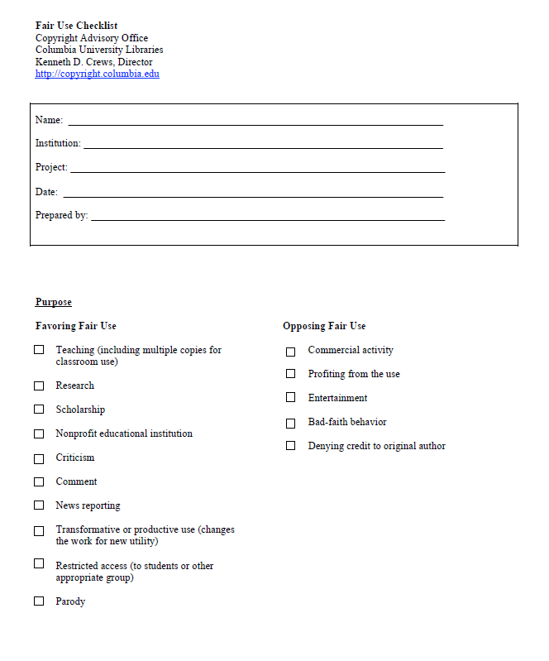
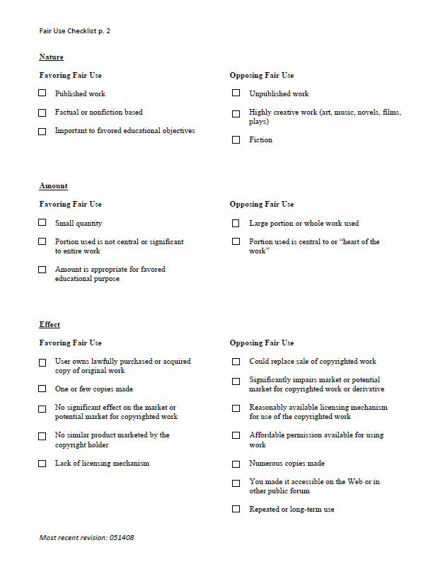
Kenneth D. Crews’ Fair Use Checklist
https://copyright.columbia.edu/content/dam/copyright/Precedent%20Docs/fairusechecklist.pdf

Slide 41
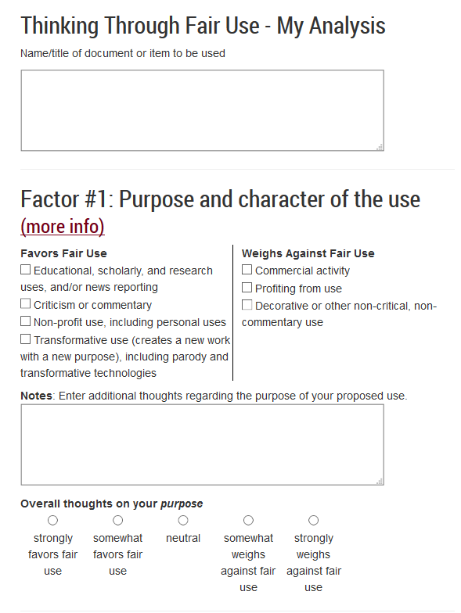
Think Through Fair Use
http://www.lib.umn.edu/copyright/fairthoughts
Tip: Think of checklist tools as a list of things to consider and a way to help you work-through/balance the factors, not an exercise in checking and counting boxes.

Slide 42
Putting it all Together

Slide 43
Remember our Mission!
Look for balance between the rights of creators and the rights of users.
Use the tools for help in thinking through the law.
Who has the final decision making authority, and who can help in making final determinations?
  Copyright librarians
  Copyright guru?
  Legal counsel?

Slide 44
17 U.S. Code § 504(c)(2)
Thoughtful, “good faith” applications of the law can go a long way.
  The court shall remit statutory damages in any case where an infringer believed and had reasonable grounds for believing that his or her use of the copyrighted work was a fair use under section 107, if the infringer was: (i) an employee or agent of a nonprofit educational institution, library, or archives acting within the scope of his or her employment who, or such institution, library, or archives itself, which infringed by reproducing the work in copies or phonorecords

Slide 45
Working Through the Four Factors
It’s not a fair use…that’s ok! There are other options you can consider, including utilizing other exceptions, getting permission, etc.

Slide 46
Helping Patrons with Fair Use Questions
Referral to information
Referral to someone else, e.g. a copyright librarian
Providing problem-solving consultations
Hosting workshops on fair use
Having tools and resources readily available for them to use.

Slide 47
Recommendations
Educate yourself on copyright and fair use
Follow case law
  US Copyright Office Fair Use Index
    https://www.copyright.gov/fair-use/
    The Fair Use Index tracks a variety of judicial decisions to help both lawyers and non-lawyers better understand the types of uses courts have previously determined to be fair—or not fair.
  Georgia State Lawsuit
    Provides information and resources on the Georgia State Lawsuit and its application of fair use in providing course reserve services.
    http://libguides.law.gsu.edu/gsucopyrightcase

Slide 48
Learn More
Code of Best Practices
  http://cmsimpact.org/codes-of-best-practices/
Fair Use Week, An annual celebration of the important doctrines of fair use and fair dealing:
  http://fairuseweek.org/
Stanford Copyright and Fair Use Center:
  https://fairuse.stanford.edu/
  A website that includes primary case law, statutes, regulations, information about newly filed copyright lawsuits, pending legislation, copyright office news, recent publications as well as blog and twitter feeds from practicing attorneys and law professors.

Slide 49
Questions?
Questions?
This work is licensed under a Creative Commons Attribution-NonCommercial 4.0 International License.

