Slide 1
Section 108
Reproduction by Libraries and Archives

Slide 2
​
Carla Myers
Assistant Librarian & Coordinator of Scholarly Communications
Miami University Libraries (Ohio) myersc2@miamioh.edu

Slide 3
Overview
Exploring Section 108
Putting it all Together

Slide 4
17 USC § 108
Limitations on Exclusive Rights: Reproduction by Libraries and Archives

Slide 5
17 USC 108
Addresses the:
Making of copies of works for preservation purposes
Making of copies of works for private study and Interlibrary Loan
Liability in regards to reproduction equipment
Uses in the last 20 years of any term of copyright of a published work

Slide 6
Qualifying Institutions
Under 17 USC § 108(a), qualifying institutions are libraries and archives, whose collections are:
Open to the public, or
Available to affiliated researchers and other persons doing research in a specialized field.

Slide 7
“Rules”
Under 17 USC § 108(a), libraries and archives may make copies of works so long as…
The reproduction and/or distribution of copyrighted works are made without any purpose of direct or indirect commercial advantage; and
Works they reproduce/distribute under 108 must include a notice of copyright…either the one that was originally found on the work or one they add that states that the work may be protected by copyright.

Slide 8
“Rules,” Continued
Under 17 USC § 108(g)(1), libraries and archives may make isolated and unrelated reproductions or distributions of a single copy of the same material on separate occasions, but this does not extend to…
Related or concerted reproduction or distribution of multiple copies of the same material made on one occasion or over a period of time for aggregate use by one or more individuals or for separate use by the individual members of a group

Slide 9
Preservation Copies

Slide 10
Preservation Copies – Unpublished Works
Under 17 USC § 108(b) up to three copies of any type of unpublished work may be made for:
  Preservation purposes (it is, or is on the verge of falling apart);
  Security purposes (you don’t want a patron handling the original); or
  Deposit in another library or archive who has an interest in the item

Slide 11
Preservation Copies – Unpublished Works (cont.)
So long as….
The work being reproduced is currently in the collections of the library or archives making the copy; and
Any work reproduced in digital format is not otherwise distributed in that format and is not made available to the public in that format outside the premises of the library or archives.

Slide 12
Preservation Copies - Published Works
Under 17 USC § 108(c) up to three copies or phonorecords of any type of published work may be made if the original is:
Damaged
Deteriorating
Lost, or stolen
If the work is in a format that has become obsolete which, under the law, means that the technology needed to play or perform the work is no longer manufactured or is no longer reasonably available in the commercial marketplace

Slide 13
Preservation Copies - Published Works (Cont.)
So long as…
The library or archives has, after a reasonable effort, determined that an unused replacement cannot be obtained at a fair price; and
Any work that is reproduced in digital format is not made available to the public in that format outside the premises of the library or archives.
Notes:
VHS example

Slide 14
Discuss with Legal Counsel
How will you define “premises”?
What types of materials do you consider to be “obsolete” under the definition provided in the law?
How will you interpret “three copies”?

Slide 15
Making Copies for Private Study

Slide 16
Types of Works that Can be Copied for Private Study
Literary works, including magazines, journals, newspapers, and books
Illustrations, pictures, charts, and graphs that are part of these literary works
Those audiovisual works that deal with the news
Notes:
See 17 USC 108(i)

Slide 17
Types of Works that Cannot be Copied for Private Study
Musical works/compositions (scores)
Pictorial, graphic or sculptural works
Most audiovisual works, including movies
Notes:
See 17 USC 108(i)

Slide 18
Private Study Copies – Limited Portions
Under § 108(d) a library or archives may reproduce and distribute works:
For their own users
Or fill a request from another library or archives a library or archives (Interlibrary Loan)
Of…
  no more than one article; or
  one other contribution to a copyrighted collection (e.g. an edited volume) or periodical issue; or
  a small part of any other copyrighted work

Slide 19
Private Study Copies – Limited Portions (cont.)
So long as…
The copy becomes the property of the user; and
The library or archives has had no notice that the copy would be used for any purpose other than private study, scholarship, or research; and
The library or archives displays prominently, at the place where orders are accepted, and includes on its order form, a warning of copyright in accordance with requirements that the Register of Copyrights shall prescribe by regulation.
Notes:
(d) The rights of reproduction and distribution under this section apply to a copy, made from the collection of a library or archives where the user makes his or her request or from that of another library or archives,

Slide 20
And, when it Comes to ILL
The library or archives receiving such copies are not requesting works in such quantities that would substitute for a subscription or purchase of such work (17 USC § 108(g)(2)).

Slide 21
Private Study Copies – Substantial Portion/Entire Copy
Under § 108(e), when a patron of a library or archive requests:
An entire work; or
A substantial part of a work
Or an ILL request is received for a copy of
An entire work; or
A substantial part of a work

Slide 22
Private Study Copies – Substantial Portion/Entire Copy (cont.)
The library or archives must determine on the basis of a reasonable investigation, that a copy of the work cannot be obtained at a fair price
The copy or phonorecord becomes the property of the user

Slide 23
Private Study Copies – Substantial Portion/Entire Copy (cont.)
The library or archives has had no notice that the copy would be used for any purpose other than private study, scholarship, or research; and
The library or archives displays prominently, at the place where orders are accepted, and includes on its order form, a warning of copyright in accordance with requirements that the Register of Copyrights shall prescribe by regulation.

Slide 24
Regulated Warning
See Code of Federal Regulations, Title 37, Volume 1, Section 201.14:
  The copyright law of the United States (title 17, United States Code) governs the making of photocopies or other reproductions of copyrighted material.
  Under certain conditions specified in the law, libraries and archives are authorized to furnish a photocopy or other reproduction. One of these specific conditions is that the photocopy or reproduction is not to be “used for any purpose other than private study, scholarship, or research.” If a user makes a request for, or later uses, a photocopy or reproduction for purposes in excess of “fair use,” that user may be liable for copyright infringement.
  This institution reserves the right to refuse to accept a copying order if, in its judgment, fulfillment of the order would involve violation of copyright law.

Slide 25
Discuss With Legal Counsel
What do you consider to be a “substantial” part of a work?
What will you consider to be a “reasonable investigation”
The use of the “Rule of 5”
Notes:
Commission on New Technological Uses of Copyrighted Works ("CONTU") negotiated guidelines that described what amounts of copying would substitute for a subscription to or purchase of such work. Up to 5 articles from the last 5 years of a journal.

Slide 26
Note!
Lending an original copy vs. making a copy of a work for a patron or to send through ILL
Lending of the original copy will most likely be controlled by the first sale doctrine found in Section 109 of US copyright law
If you are making a copy of the original work for the patron or to send through ILL, then Section 108 may come into play.

Slide 27
Reproduction Equipment

Slide 28
Reproduction Equipment
Under § 108(f)
The library/archives will not be liable for copyright infringement for the unsupervised use of reproduction equipment located on its premises so long as that equipment displays a notice that the making of a copy may be subject to the copyright law
Notes:
No prescriptive warning here, but a variation on “The copyright law of the United States (title 17, United States Code) governs the making of photocopies or other reproductions of copyrighted material.” from the regulated warning is often used.

Slide 29
Uses in the Last 20 Years of Copyright Protection

Slide 30
A Free Pass?
Under § 108(h), during the last 20 years of any term of copyright of a published work, a library or archives, including a nonprofit educational institution that functions as such, may:
Reproduce, distribute, display, or perform
In facsimile or digital form
A copy of such work, or portions thereof
For purposes of preservation, scholarship, or research
Notes:
NOTE: The exemption provided in this subsection does not apply to any subsequent uses by users other than such library or archives.

Slide 31
So Long As…
The library or archives has first determined, on the basis of a reasonable investigation, that none of the following conditions apply:
The work is subject to normal commercial exploitation;
A copy or phonorecord of the work can be obtained at a reasonable price; or
The copyright owner or its agent provides notice pursuant to regulations promulgated by the Register of Copyrights that either of the conditions set forth in subparagraphs (A) and (B) applies.

Slide 32
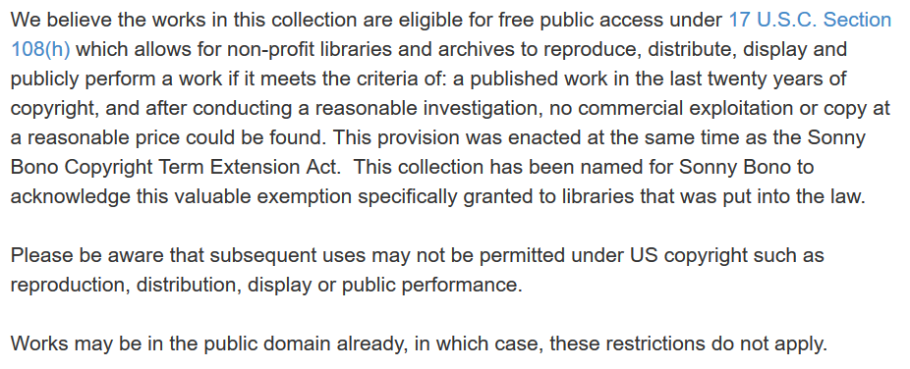
Sunny Bono Memorial Collection
Archive.org project: https://archive.org/details/last20

Slide 33
Discuss With Legal Counsel
Might you take advantage of 108(h)?
What will you consider to be a “reasonable price”?

Slide 34
Putting It All Together

Slide 35
108 Super Powers!
This limitation on the exclusive rights allows libraries and archived to do a lot.
Not an if/than situation in regards to the application of fair use
  “Nothing in this section in any way affects the right of fair use as provided by section 107 (17 USC 108(f)(4)).”

Slide 36
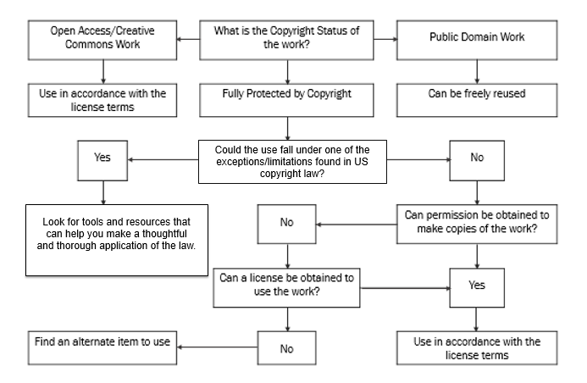

Slide 37
Questions?
Questions?
This work is licensed under a Creative Commons Attribution-NonCommercial 4.0 International License.

