Slide 1
Coping with Copyright Questions at Your Institution

Slide 2
Can I ask you a question?
Patron copyright questions
Copyright questions from coworkers
Copyright questions from colleagues

Slide 3
Prepping for Copyright Questions
Learn the basics of US copyright law.
Identify quality, trusted sources you can consult when working through copyright questions.
Develop a game plan for answering those questions.
Develop a plan for documenting your work.

Slide 4
17 U.S.C. § 110(1)
Learning the Basics of the Law

Slide 5
Copyright Basics for Librarians
How copyright is secured
What copyright protects
What is not protected by copyright
Who is considered to be the rightsholder of the work
Rights granted under US copyright law
Duration of copyright
Public domain
Exceptions, including:
  Fair Use (Section 107)
  Library Exemption (Section 108)
  First Sale (Section 109)
  Face-to-Face exemption and the TEACH Act (Sections 110(1) & 110(2))
  Reproductions for those with Disabilities (Section 121)

Slide 6
Tips & Tricks
Bookmark the law on your computer: https://www.copyright.gov/title17/
Pursue every opportunity you have to learn about the law, even if it’s a repeat of the basics.

Slide 7
17 U.S.C. § 110(1)
Identifying Quality, Trusted Sources

Slide 8
The Law
Law itself: https://www.copyright.gov/title17/
US Copyright Office Compendium: https://www.copyright.gov/comp3/
US Copyright Office Circulars: https://www.copyright.gov/circs/

Slide 9
Notable Authors & Organizations
Notable authors: Kenneth D. Crews, Dwayne Butler, Kevin Smith, Brandon Butler, Carrie Russell, Donna Ferullo, Tom Lipinski
Reputable Organizations: American Library Association, The Association of College & Research Libraries, the Music Library Association, Ohio State University Copyright Office, Brigham Young University Copyright Office
Reputable publishers: NOLO, the American Bar Association, the American Library Association,
This list is far from exhaustive!

Slide 10
Educational Opportunities
ALA CopyTalk Webinars: http://www.ala.org/advocacy/pp/pub/copytalk
CopyrightX: http://copyx.org/
Copyright for Educators & Librarians: https://www.coursera.org/learn/copyright-for-education
Copyright for Multimedia: https://www.coursera.org/learn/copyright-for-multimedia
Kraemer Copyright Conference: https://www.uccs.edu/copyright/kraemerconference
Miami University Libraries Copyright Conference: https://copyrightconference.lib.miamioh.edu/
This list is far from exhaustive!

Slide 11
Tools
Copyright Genie: http://librarycopyright.net/resources/genie/index.php
Fair Use Evaluator: http://librarycopyright.net/resources/fairuse/index.php
Public Domain Slider: http://librarycopyright.net/resources/digitalslider/index.html
Section 108 Spinner: http://librarycopyright.net/resources/spinner/index.html
Exceptions for Educators: http://librarycopyright.net/resources/exemptions/index.php
Peter Hirtle’s Public Domain Chart: https://copyright.cornell.edu/publicdomain
This list is far from exhaustive!

Slide 12
Be Wary Of…
Classroom Photocopying Guidelines
“Classroom Rights” for videos
Those using scare tactics
Ask yourself…
  Are they citing the law itself?
  Are they advancing their own agenda?
Read several sources on a topic, then check what they are saying against the law.
Recognize and embrace that you may know more than the some authors, vendors, or colleagues

Slide 13
17 U.S.C. § 110(1)
Developing Your Game Plan

Slide 14
1. What is the scope of your responsibilities?
Who will you be answering questions for?
  Coworkers
  Patrons
  Others at your institution?
What types of questions will you answer?
How much of your time will be devoted to providing these services?

Slide 15
2. What types of questions will you answer, and how will you answer them?
Answer any question?
Answer questions only about library tools and resources?
Will you be directing them to information only?
Will you be providing them with an informed opinion?

Slide 16
3. What tools and resources are available to you?
What’s in your library’s collection?
Can you order items for your collection?
Who else at your institution may be knowledgeable about copyright?
What role can your institution’s legal counsel play?

Slide 17
4. Framework for answering any copyright question.
Based on the “A Framework for Analyzing any U.S. Copyright Problem developed by Kevin Smith & Lisa Macklin: https://www.k-state.edu/copyright/docs/CopyrightFramework.pdf
Step-by-Step methods for working through copyright questions.

Slide 18
Framework Question #1 - What is the Copyright Status of the Work?
Is the work in the public domain?
  If yes, the work can be used however one wishes.
Is the work protected by copyright?
  Proceed to Question #2
Are you uncertain of the status of the work
  Proceed to Question #2

Slide 19
Framework Question #2 - Is the use of the work controlled by a license?
Is the work self-authored, but controlled by a publication agreement, a funder agreements, or perhaps even a “work made for hire situation”
Is the work a Creative Commons work?
Is it a work under license as part of the library’s collection?
Would the use of the work fall under a campus/institutional license, e.g. BMI/ASCAP license for musical performances or an umbrella (MPLC) license for movie screenings?
Is access to the work controlled by an End User License Agreement (EULA) that the person asking the question may have entered into (e.g. a Netflix subscription, their iTunes account).
  If yes to any of these, use the work in accordance with it’s license terms.
  If no, proceed to Question #3.

Slide 20
Framework Question #3 – Can the use of the work fall under one of the exceptions found in US copyright law?
Could the use fall under:
  Fair Use (Section 107)
  Library Exemption (Section 108)
  First Sale (Section 109)
  Face-to-Face exemption and the TEACH Act (Sections 110(1) & 110(2))
  Reproductions for those with Disabilities (Section 121)
  Or any other exception found in the law

Slide 21
Framework Question #4 – Can permission be obtained to use the work?
Determine:
  Who is the rightsholder
  How they can be contacted
Reach out to them (preferably in writing):
  Explain the intended use
  How long you wish to use the item
  Who will have access to it
  How people will be able to access it
Will you help with permission requests, or refer them to resources so they can craft their own letter?

Slide 22
Framework Question #5 – Can a license be obtained to use the work?
License for the reuse of print works: http://www.copyright.com/
License for musical performances:
  BMI: https://www.bmi.com/
  ASCAP: https://www.ascap.com/
License for movies & TV shows:
  SWANK: https://www.swank.com/
  MPLC (umbrella licenses): http://www.mplc.com/

Slide 23
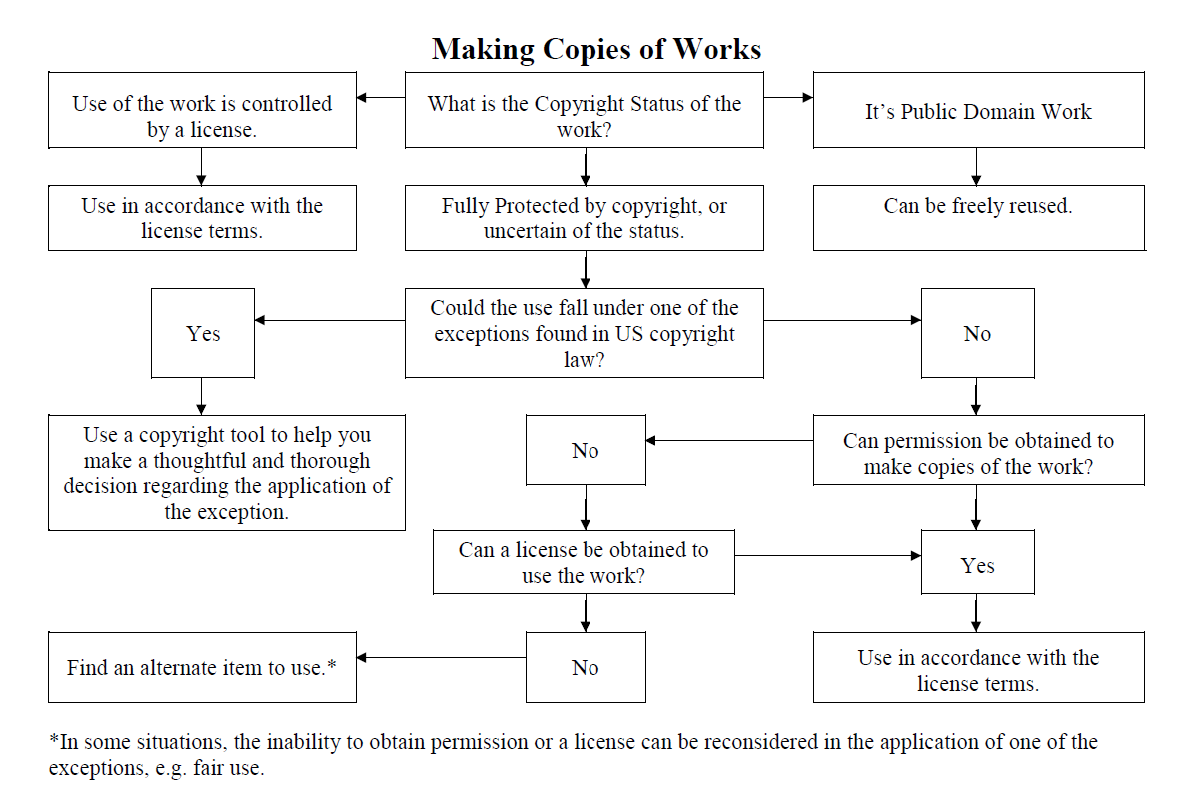

Slide 24
17 U.S.C. § 110(1)
Documenting Your Work

Slide 25
Why document your work?
As a record of the interaction
Documentation of what was discussed, and what you recommended
Just in case, e.g. 504(c)(2)?!

Slide 26
Documentation Methods
Reference statistics
Your own tracking methods
Email follow-up
Institutional policies and best practices

Slide 27
Hints & Tips

Slide 28
Avoid Providing Legal Advice
Providing information vs. interpreting the law
If it’s a tricky question, who will make the final call?
If legal advice is needed, who can you direct the patron to?
Be aware of your institution’s copyright policies
Learn More: University of South Carolina School of Law, Legal Research Training for Non-Lawyers: http://guides.law.sc.edu/c.php?g=315482&p=2714899

Slide 29
Getting Through the Consultation
Ask lots of questions
Make the patron feel comfortable in sharing information
Make sure they are sharing all pertinent information
Work through the framework together
Some people will get upset with the result of the consultation
  What other options can you offer them?
  Be prepared to handle the occasional REALLY angry person

Slide 30
Common Misconceptions That Often Pose Challenges
If it’s on the internet, I can use it however I want.
If it’s an educational use I can use anything I want, however I want, right?
I provided a citation to the original work, so it’s not copyright infringement.
I’ll never get caught.

Slide 31
Putting it all Together

Slide 32
It’s Not Easy!
Patrons want straight answers…yes or no
“No” is sometimes easy. Yes is sometimes easy
The final answer is subjective to each situation
  Low-risk scenarios vs. high risk scenarios
  Legal precedent
What’s the ethical thing to do?

Slide 33
Don’t Get Discouraged!
Work through the framework
Consult the law
Utilize tools and reputable resources
Phone a friend

Slide 34
Remember our Mission!
Don’t blatantly ignore the law, but also don’t let the fear of being sued keep you from taking advantage of the exceptions found in the law.
Thoughtful, “good faith” applications of the law can go a long way.

Slide 35
Scenarios!

Slide 36
Common Copyright Questions
Can I make a copy of this?
What is the copyright status of the work?
Is the use of the work controlled by a license?
Can the use of the work fall under one of the exceptions found in US copyright law?
Can permission be obtained for the use of the work?
Can a license be obtained to use the work?

Slide 37
Common Copyright Questions
Can I use this in my report/project?
What is the copyright status of the work?
Is the use of the work controlled by a license?
Can the use of the work fall under one of the exceptions found in US copyright law?
Can permission be obtained for the use of the work?
Can a license be obtained to use the work?

Slide 38
Common Copyright Questions
Can I use this in my classroom?
What is the copyright status of the work?
Is the use of the work controlled by a license?
Can the use of the work fall under one of the exceptions found in US copyright law?
Can permission be obtained for the use of the work?
Can a license be obtained to use the work?

Slide 39
Common Copyright Questions
Can I share this with my students online?
What is the copyright status of the work?
Is the use of the work controlled by a license?
Can the use of the work fall under one of the exceptions found in US copyright law?
Can permission be obtained for the use of the work?
Can a license be obtained to use the work?

Slide 40
Common Copyright Questions
Can I use this in my article/book chapter?
What is the copyright status of the work?
Is the use of the work controlled by a license?
Can the use of the work fall under one of the exceptions found in US copyright law?
Can permission be obtained for the use of the work?
Can a license be obtained to use the work?

Slide 41
Your Scenarios!
What is the copyright status of the work?
Is the use of the work controlled by a license?
Can the use of the work fall under one of the exceptions found in US copyright law?
Can permission be obtained for the use of the work?
Can a license be obtained to use the work?

Slide 42
Carla Myers
Assistant Librarian & Coordinator of Scholarly Communications
Miami University Libraries
513-529-3935
myersc2@miamioh.edu
This work is licensed under a Creative Commons Attribution-NonCommercial 4.0 International License.

