Slide 1
Do you Haiku? Running an Effective Haiku Contest in Your Library
KLA/KSMA Joint Conference
Sept. 30th 2011, Louisville, KY
Mark Shores
Miami University Hamilton

Slide 2
Why a Haiku Contest?
Outreach tool
National Poetry Month (April)
Tie-in with collections

Slide 3
The basics..
Two contests…….April 2010, January 2011
Submissions taken electronically and in print
Structure! Must use 5-7-5 syllable lines

Slide 4
The basics 2
Only one submission per person
Marketing through social media
Judging by librarians and ENG faculty
Prizes!

Slide 5
What worked
Shortening the contest
The structure
Write your own haikus to help promote
Web-based form

Slide 6
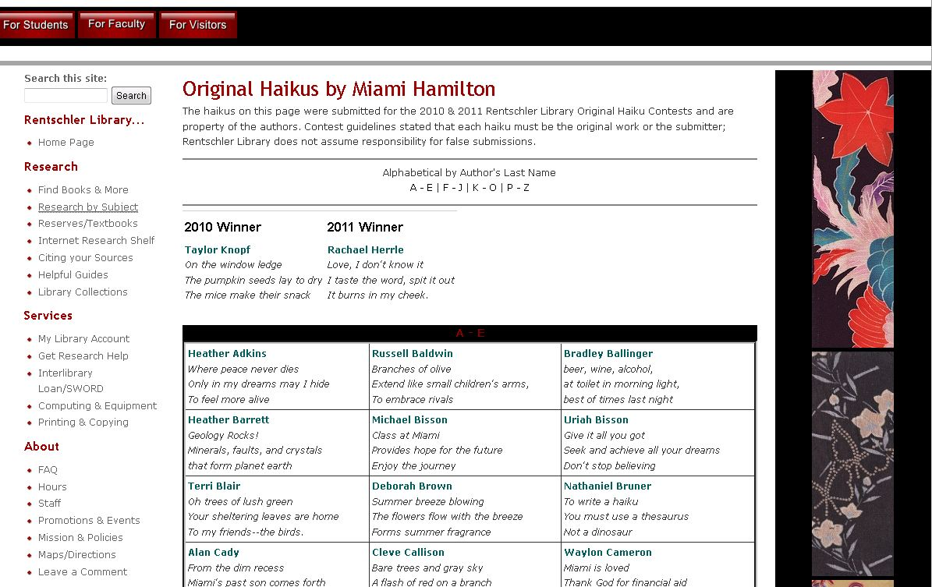
List of all haiku submissions

Slide 7
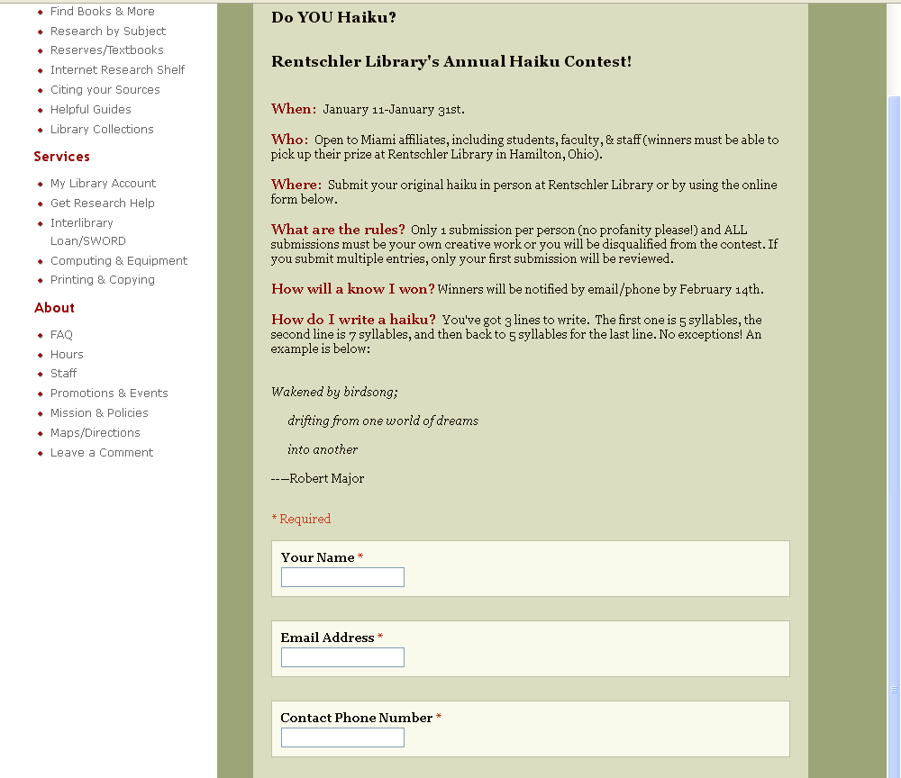
2011 Contest – web form

Slide 8
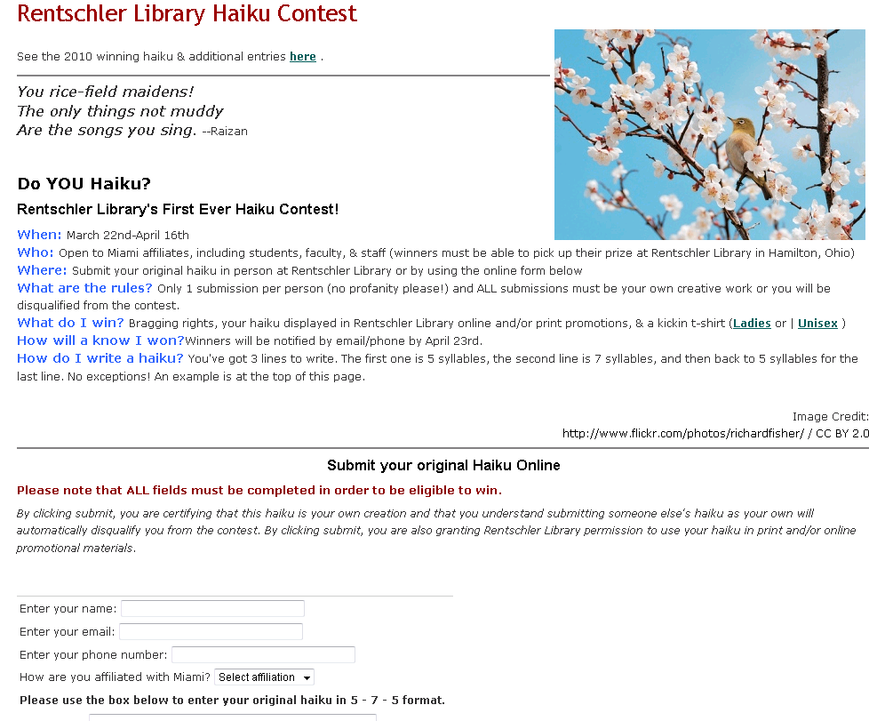
2010 contest & description

