Slide 1
Creating Order from Chaos and Fostering Collaboration:
Documentation, Cross-training, and Continuous Operations in Multi-service Point Libraries

Slide 2
Presenters
Alea Henle, Head of Access & Borrow Department, Miami University
Rob Withers, Access Services Coordinator, Miami University
Eric Weaver, Technology Librarian, Charleston County Public Library

Slide 3
Documentation helps . . .
Ensure continuity of knowledge and practices in times of change
Help compare/contrast practices to facilitate standardization
Identify opportunities to adopt/adapt practices from one site to another

Slide 4
Before Reorganization
Access Services
King Library Circulation
Document Delivery
Branch Libraries
B.E.S.T. Library
Art & Architecture Library
Music Library
Technical Services
Acquisitions
Cataloging
Discovery
E-Resources & Serials
Notes:
ALEA

Slide 5
After Reorganization (aka Now)
Acquisitions
King Library
B.E.S.T. Library
Branch Facilitators
Art & Architecture Library
Access & Borrow
Music Library
Cataloging
Discovery
Document Delivery
E-Resources & Serials
Notes:
ALEA

Slide 6

Different Practices
Notes:
ALEA
For example -- closing procedures -- 2 libraries have PA systems (different kinds), 2 don’t, so the phrase “announce closing” has a very different meaning depending on whether it’s an automated, pre-recorded announcement building-wide; non-automated and non-pre-recorded building-wide announcement; or requires staff to walk around warning people (or use a bullhorn)

Slide 7

Notes:
ALEA
There are good, solid reasons for promoting standardization of certain practices across service points. These include (but are not limited to):
Staffing levels necessitate increasing the number of staff who regularly work at more than one site--it’s not fair to them (and will burn them out faster) if everything changes at every site
Different practices with respect to materials/services offered at multiple service points can confuse patrons - such as different technology checkout periods, one site allowing certain items to go out of the building while other sites require on-premises use only

Slide 8

Notes:
ALEA
Different service points (libraries) have different customer bases and resources.
We want to embrace/maintain what makes them unique -- but at the same time . . .

Slide 9

Notes:
ALEA
How do we promote standardization while also supporting site individuality?

Slide 10

Notes:
ALEA
One tactic -- promoting transparency through documentation. [in this case: creation of a shared wiki]. This serves multiple purposes -- it allows for information gathering (what are we doing?), comparison (hmm, you’re doing it a little bit differently or a lot), and either affirmation of different practices (ah, that’s why you do X differently, that makes sense) or identification of areas to standardize (huh, these could cause confusion, we’d better pick one practice)

Slide 11
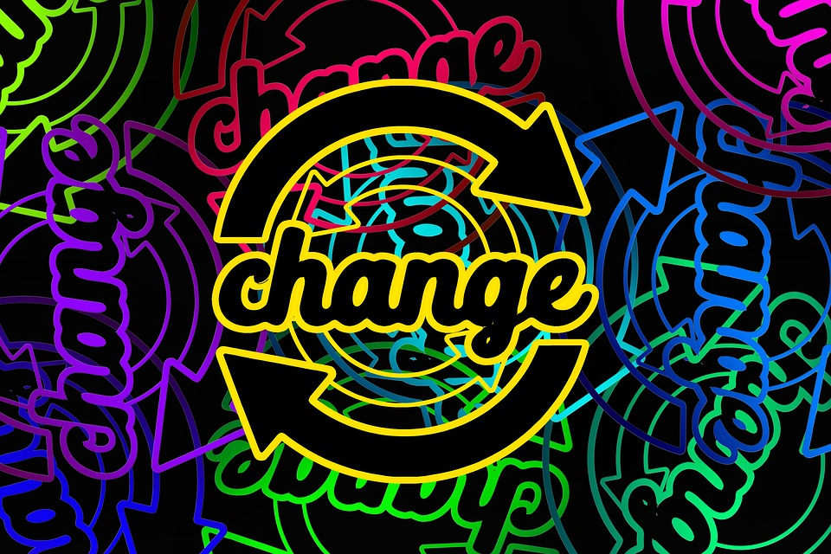
Notes:
ALEA
Documentation can also be key in a time of high personnel change

Slide 12

Identifying the Right Tool (aka “Selecting a Platform”)
Notes:
Why a wiki? -- image to represent weighing options & decision to go that way

Slide 13
Notes:
Why particular wiki software easier to explain -- but then comes core questions of layout (how is it going to be used, what’s important to include/not), integration w/ or use of existing software, encouraging compliance, and the nitty-gritty of actually entering the info

Slide 14
Populating the wiki
Incorporating (or dismantling) pre-existing documentation
Discussion, debate, compromise
External documentation
Writing procedures
  Task falls to those with primary responsibility
  Priority to those without backups
Notes:
Each site had their own practices and their own ways of disseminating that information to staff, including physical binders of procedures. Creating new uniform standards necessitated interpolating or getting rid of the old records. (Print gets out of date quickly, gets lost, tied to a physical space)
Lots of discussion / debate (student employee attendance expectations, dress code)
Consider linking to external documentation (policies from parent institution, user guides for software, etc.); no need to reinvent
Tasks should be documented by those who do it; boots-on-the-ground perspective essential for “how tos”; more buy-in when you help create
Consider revising to maintain a consistent voice
Document the tasks done by the fewest number of individuals first

Slide 15
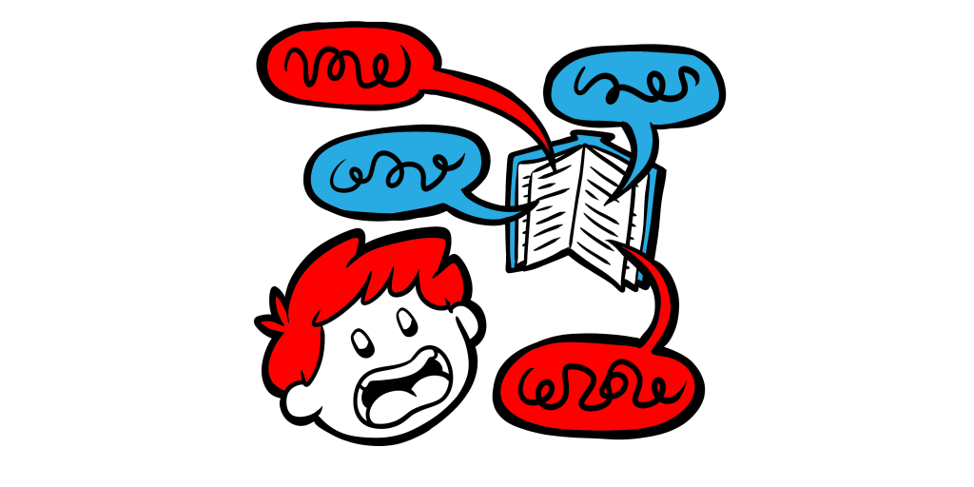
The dangers of too much detail
Notes:
Tempting to document every possible eventuality in great detail, but users get lost. Built for scanning, not reading, and for practical use, not a legal document. Need to focus in on essentials and likely scenarios with perhaps links to additional pages. Important to find balance so as to account for multiple possibilities without overwhelming. Examples: what to do in facility emergencies (need quick answers); how to process on-the-fly records for reserves (need detail, step by step, but recording every possible scenario would be too dense)

Slide 16

Editing and ongoing maintenance
Notes:
Compiling a set of documentation isn’t worthwhile unless it undergoes review, expands to include new processes, and undergoes periodic backups. These small investments of time can reap huge dividends.

Slide 17
Benefits
Standardization of procedures
Ability to seamlessly move staff to different locations
Ability to train and update staff outside business hours

