Slide 1
An Inclusive and Creative Service for Experiential Learning
Lori Chapin
Sarah Nagle
Elias Tzoc
Miami University Libraries

Slide 2
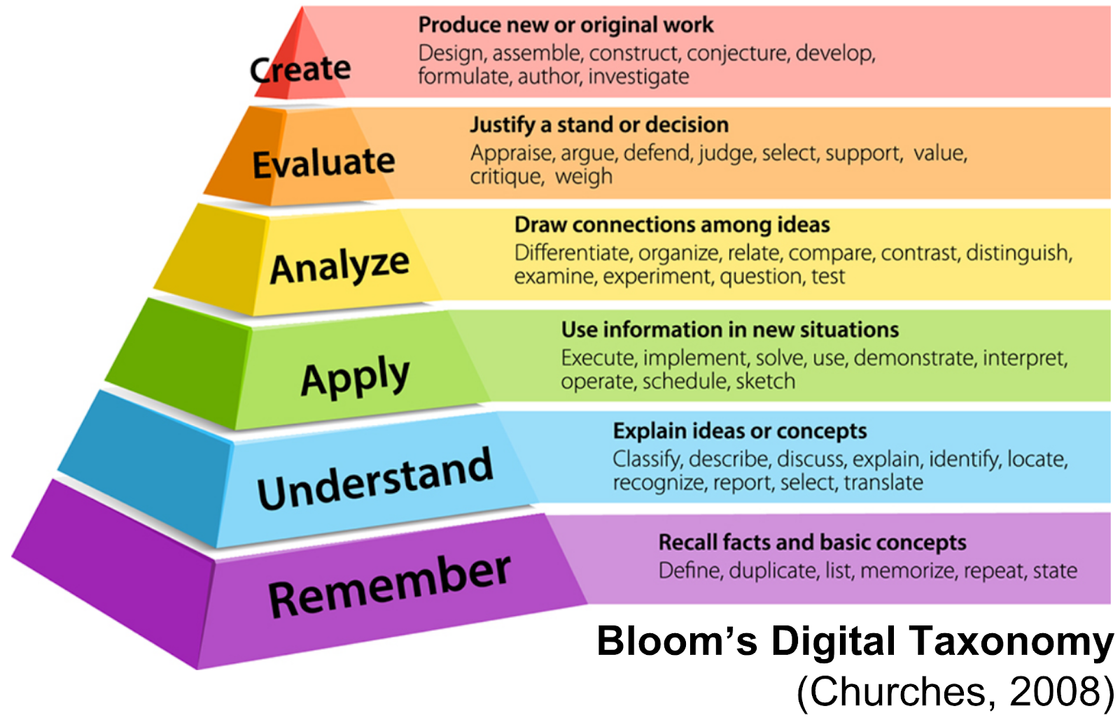
Background on innovation/experiential
learning in higher education
The transformation of learning
Reflective to active
Memorizing to making/creating
Individual to collective and multidisciplinary

Slide 3
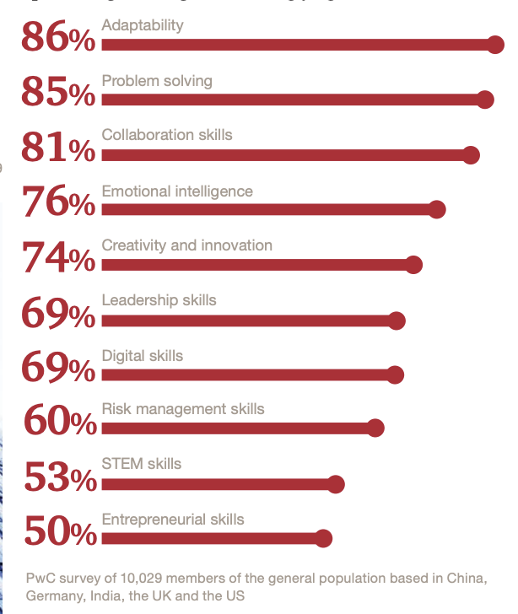
Background on innovation/experiential
learning in higher education
New/future workforce skills
Learning new things & new ways
of thinking
Focus on digital competencies
Harnessing the power of human skills

Slide 4

Background on innovation/experiential
learning in higher education
Emerging roles in academic libraries
Entry-level to emerging services/spaces
Seamless and inclusive library experience
Use of predictive analytics
… custom experiences

Slide 5
The Makerspace @ King
C+I Mission:
We enhance scholarly work by anticipating the resources, technologies, spaces and expertise that drive groundbreaking research, creative forms of expression, innovative tools for teaching, and new mediums for sharing our community’s scholarly achievements.
Notes:
C+I department was founded in 2017
Outreach librarian 2018
Makerspace 1.0-pop ups, dissection tables
Buy in by administration, staff fleshed out 2019

Slide 6
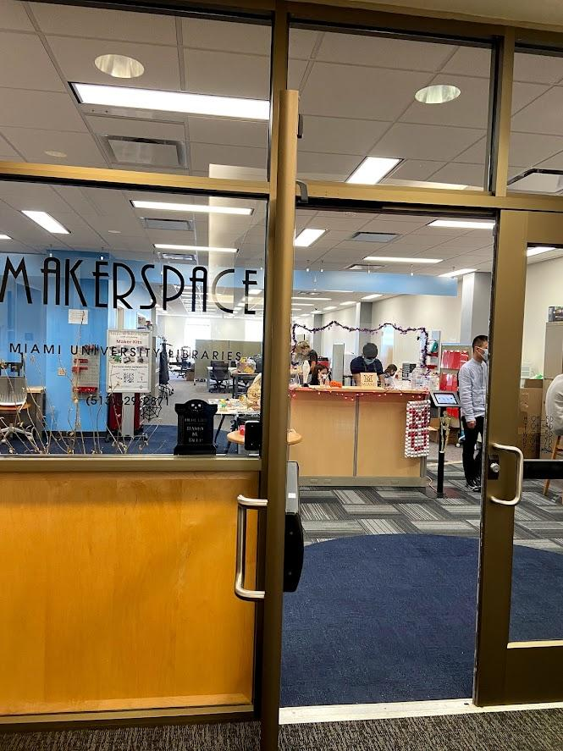
Makerspace Mission and Guiding Principles
The Makerspace is designed to give students the skills and experience in design, prototyping and fabrication, the lab provides access to hardware and software that students can use to turn a concept into a reality.
Guiding Principles:
Low-barrier of entry
Inclusivity
Transdisciplinary collaboration
“Liminal space”

Slide 7
COVID and Reopening
Closing in 2020
Make Alongs
Maker Kits
Eventual opening by appointment
Reopening in 2021
New machines
10 new student workers
300% increase in bookings from pre-COVID!
Notes:
Make Alongs-zoom meet ups with crafts from materials you could find at home or pick up a kit for
Maker Kits-sewing, silhouettes, button makers, Lego Mindstorms, arduinos, 1st-Audio video
Eventual opening by appointment, traffic was there, but limited by university allowances

Slide 8
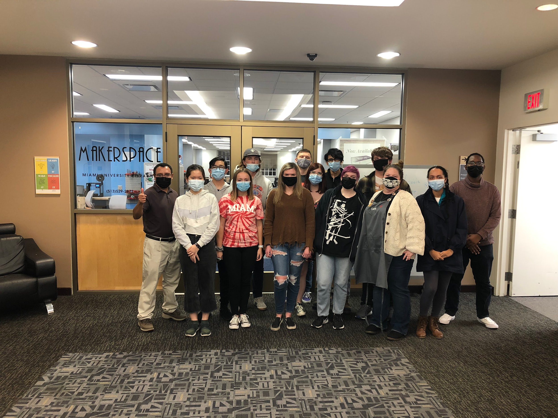
Hiring with Purpose
Bringing DEI principles to the student hiring process
Building to a staff of 14 at start of the academic year
Training with a visual component
C+I Makerspace Student Staff 2021
Notes:
After limited allowances of student employees, a need to add to roster
Importance of allowing students to see themselves represented in our staff
Outreach to Hub, ~15 groups
Partnered with LSAMP (Louis Stokes Alliance for Minority Participation) and met with additional hires
Brought on 10 new staff members in a staggered fashion, in part to HR response
This allowed for more hands on training opportunities, and led to students training each other
Example of Annie teaching in Vietnamese

Slide 9
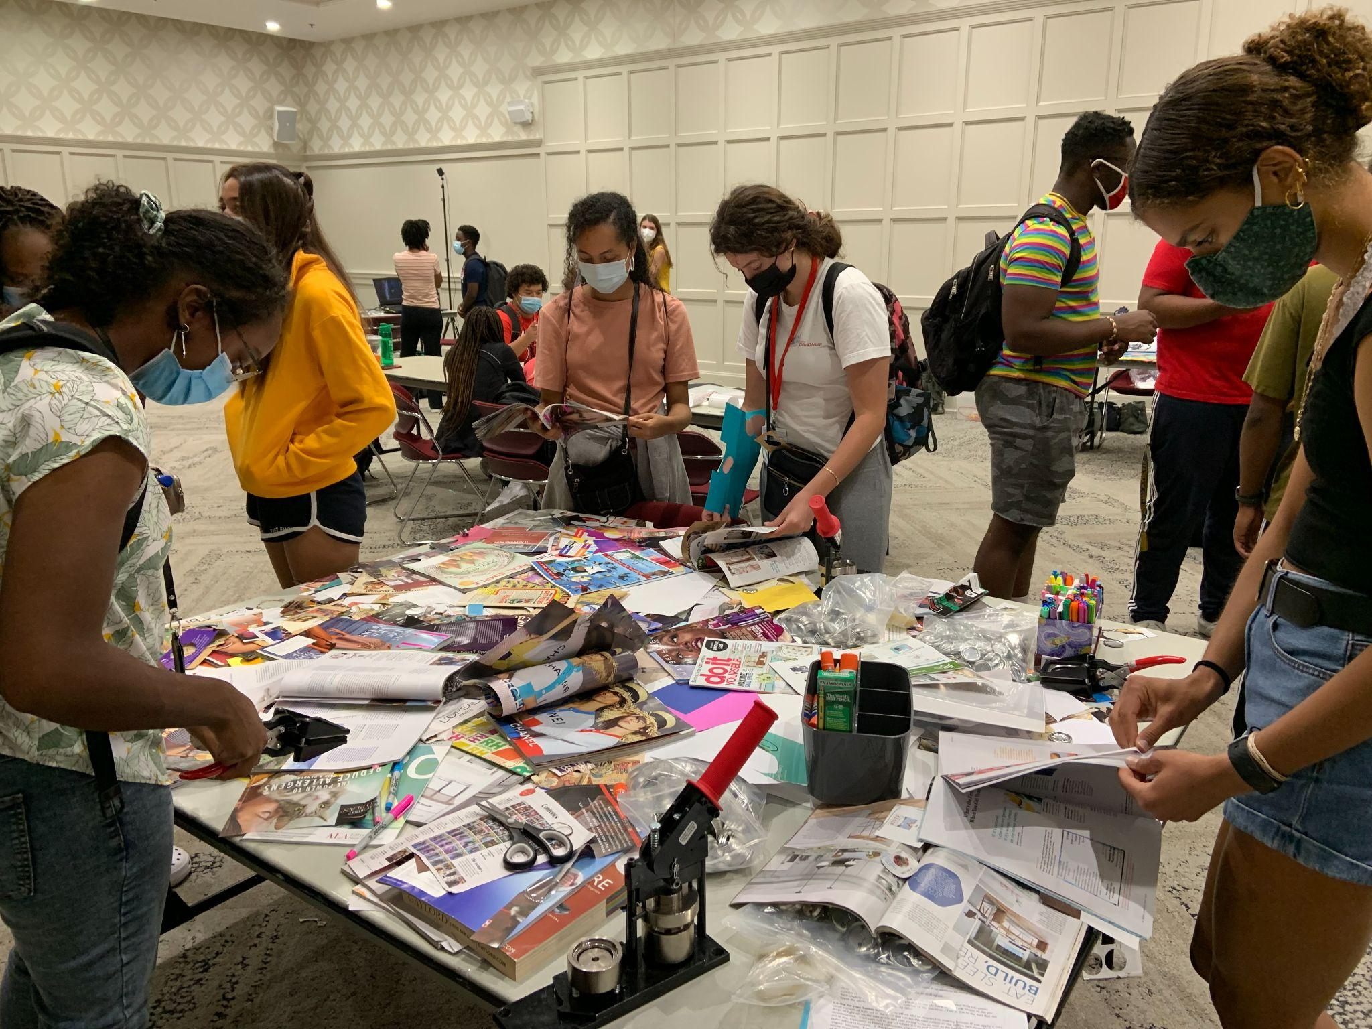
Campus Partnerships
Increase reach
Bring in diverse students
Build relationships with staff across university
Can lead to unexpected places
LSAMP/Makerspace Event, September 2021

Slide 10

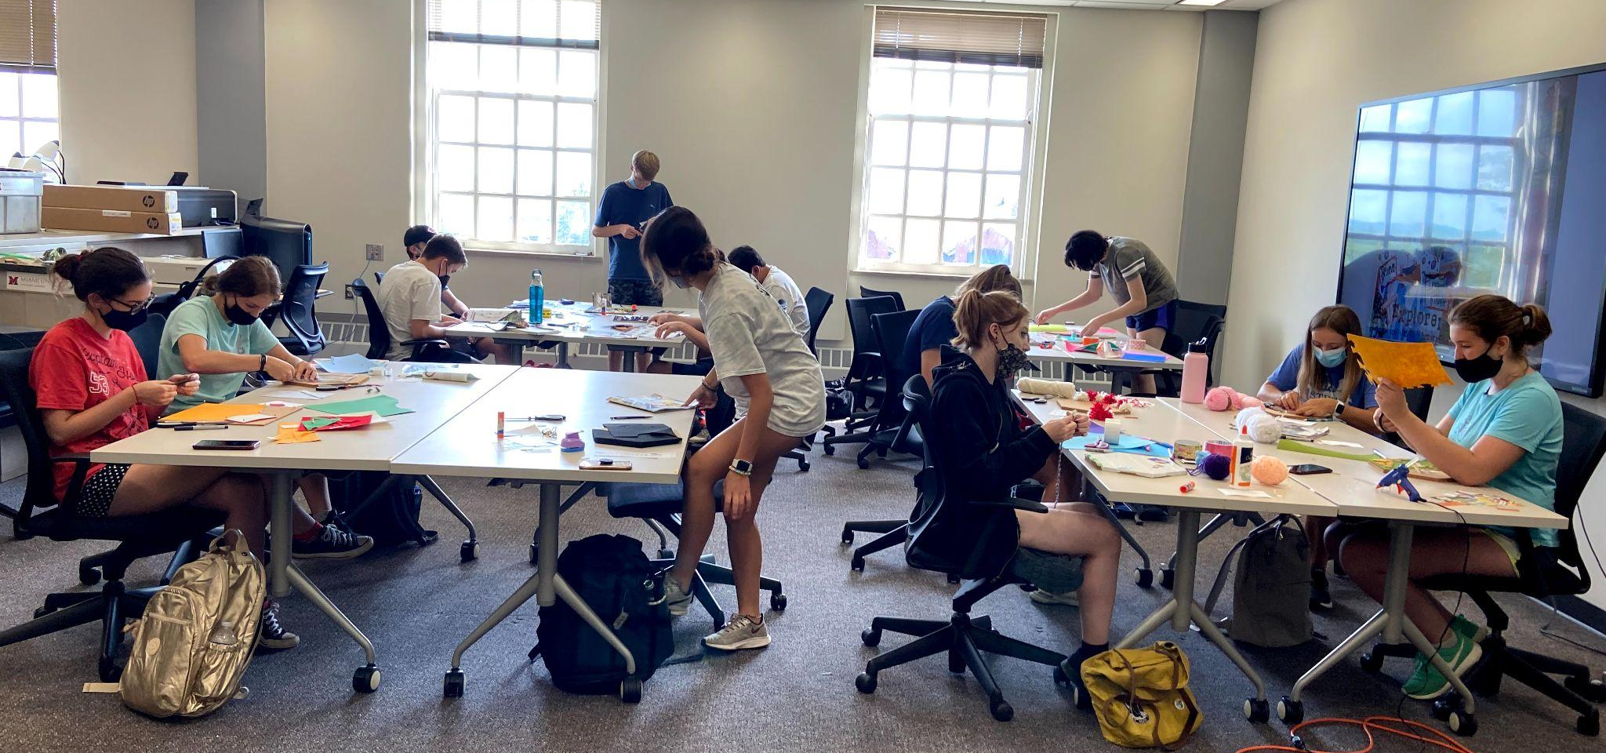
Curriculum Integrations/Maker literacy
Beyond just STEM courses
Build deeper meaning
Reach new students

Slide 11
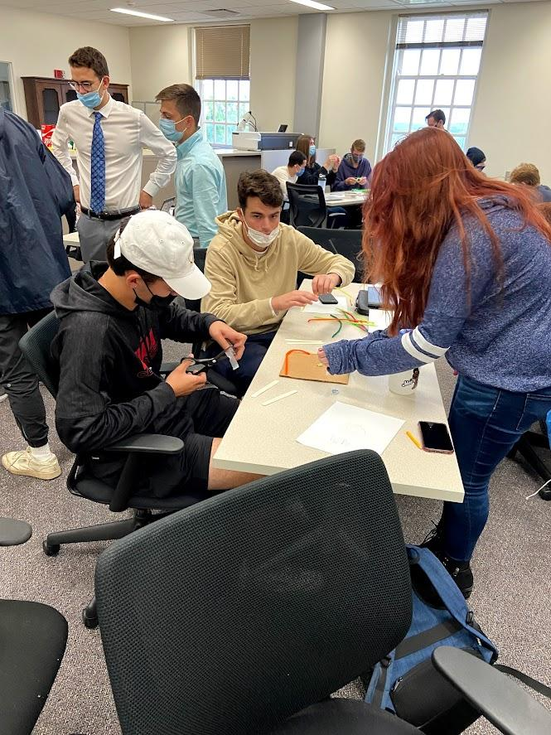
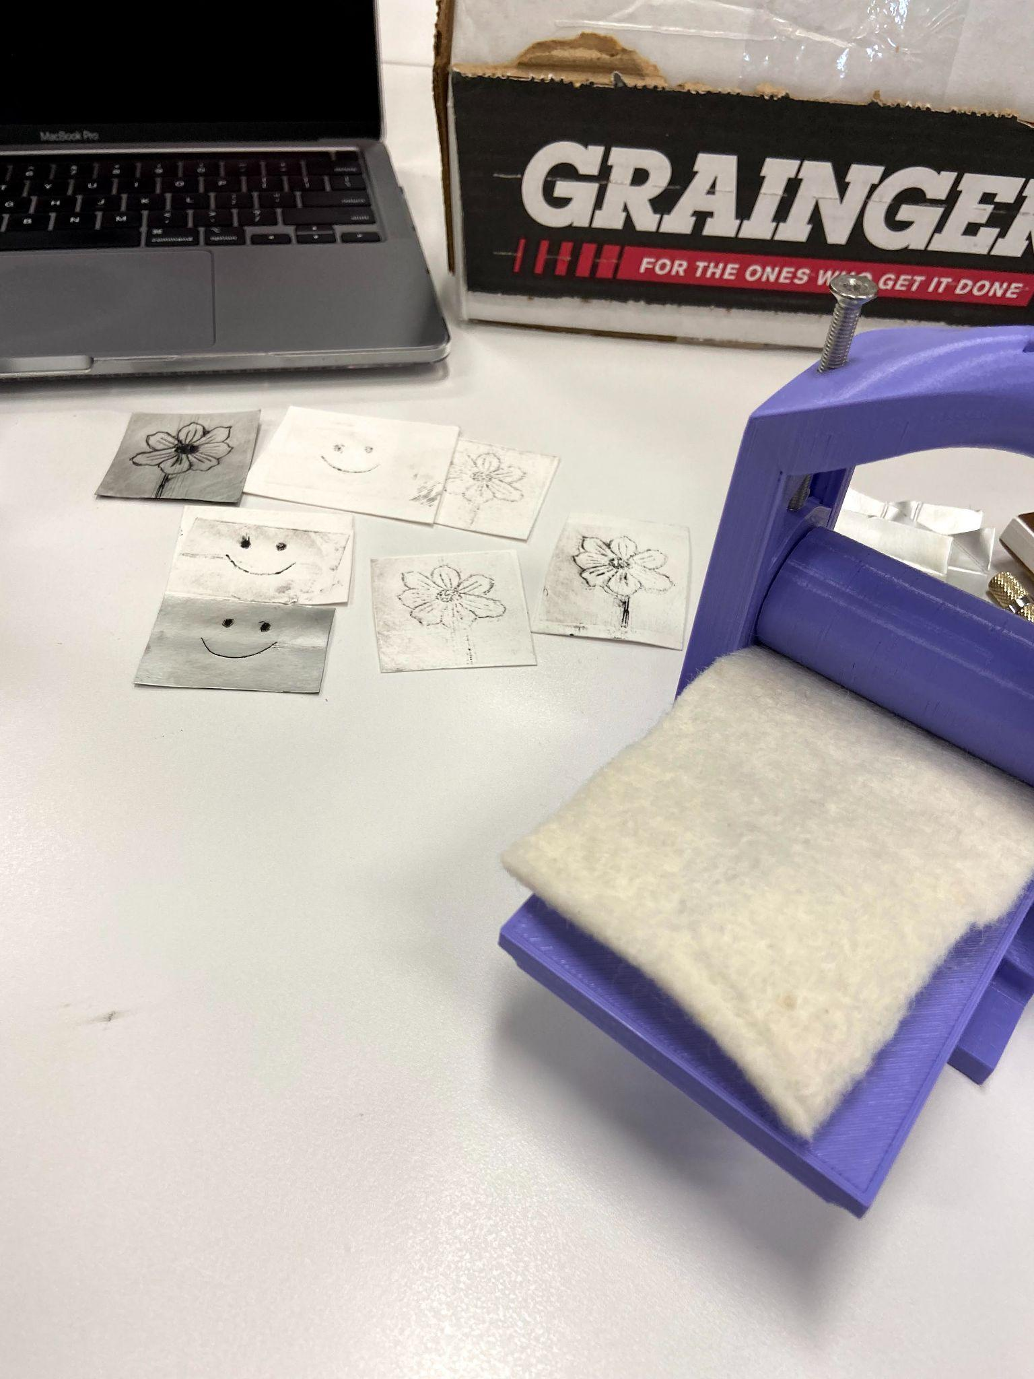
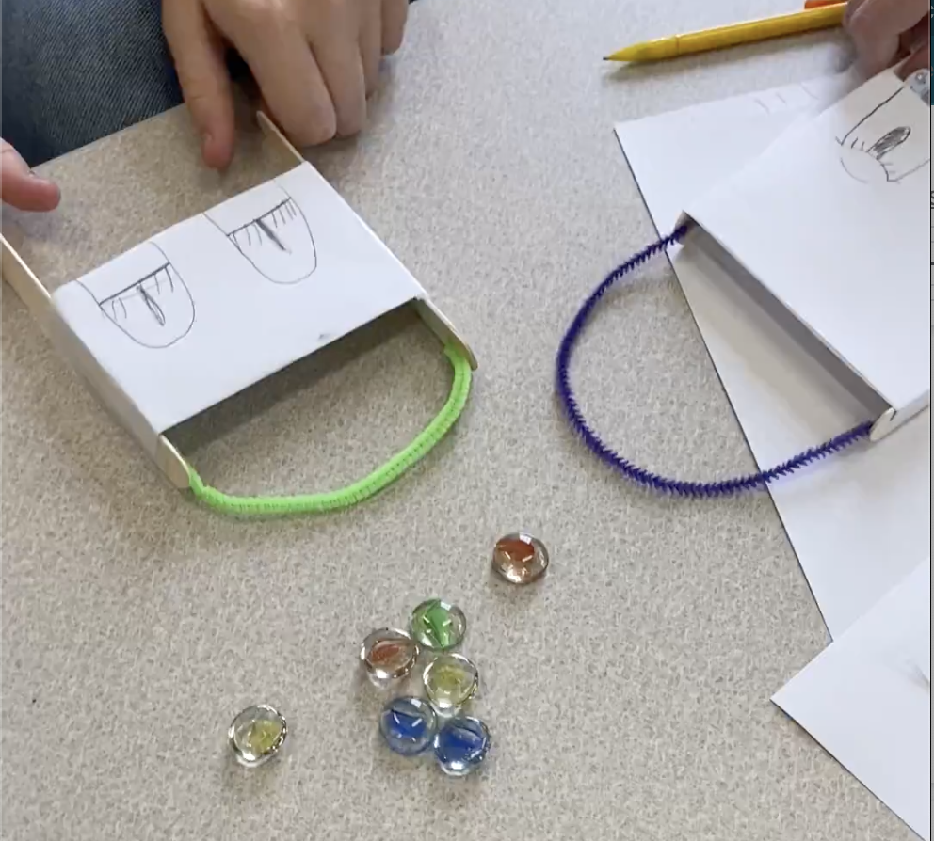

Curriculum Integration Examples
SPN 450/550 - Short Forms of the Mexican Revolution
ENG 313 - Technical Writing

Slide 12
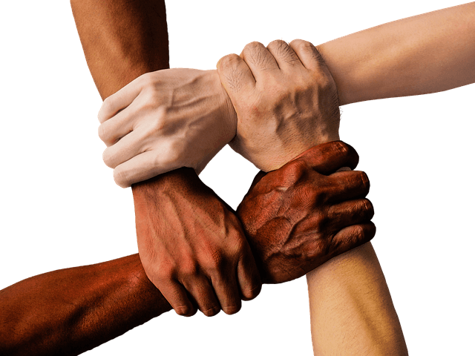
Leadership & innovation
What’s important and what we can realistically/efficiently do
Support and advocacy from leadership
Lessons from COVID-19 times
Strategic Planning and institutional priorities
Integration with teaching and learning plans

Slide 13
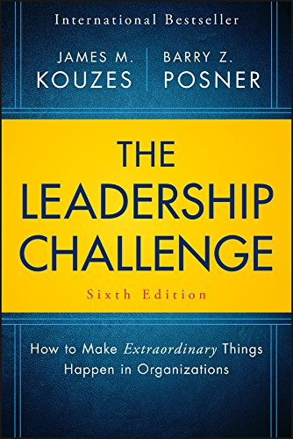
Leadership & innovation
Collaboration promotes a shared vision & maximizes outcomes
Campus partnerships and engagement
Intentional and collaborative partnerships
Collective outreach and engagement initiatives
Corporate partnerships
Model the Way; Inspire a Shared Vision; Challenge the Process; Enable Others to Act; and Encourage the Heart.

Slide 14

Leadership & innovation
Meeting today's needs without compromising tomorrow's ones
Prep for sustainability plans
Re-allocation of budget lines
Ongoing assessment of services
Connections with alumni and donors

Slide 15


Slide 16
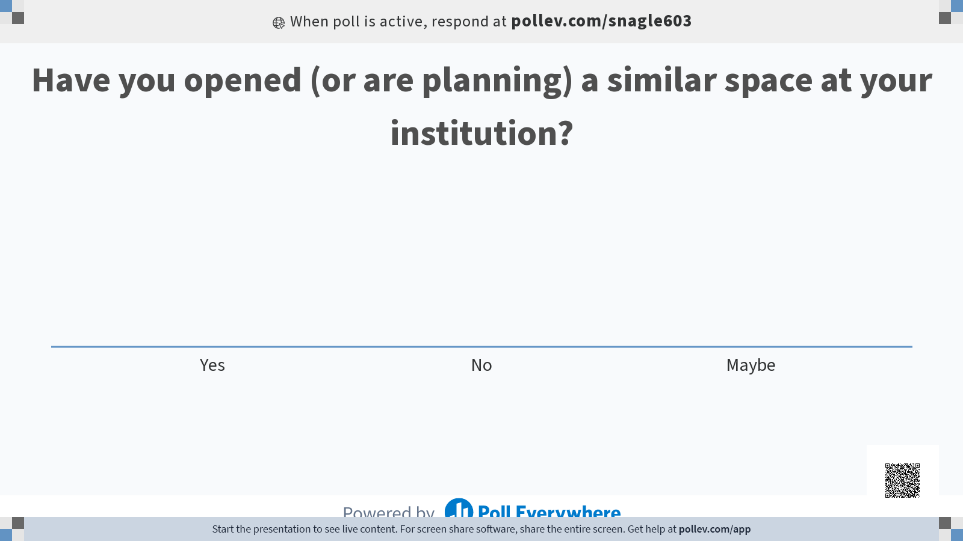

Slide 17
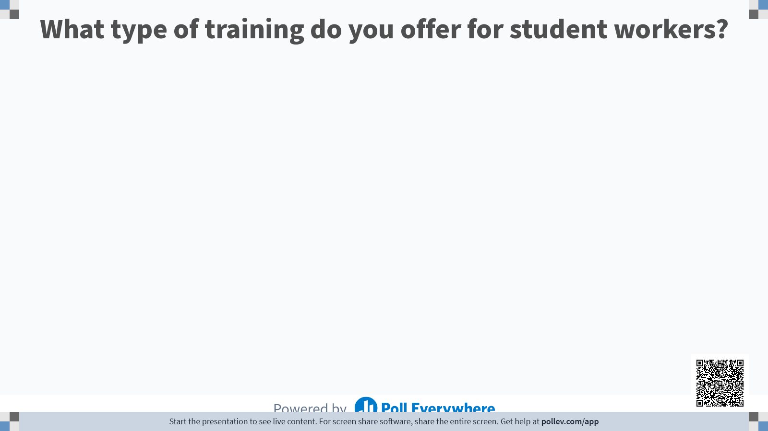

Slide 18
