Slide 1
Building Library Communities through Makerspace Engagement
Internet Librarian 2021
Sarah Nagle
Creation and Innovation Services Librarian
Miami University (Ohio)

Slide 2

What we’ll cover today
Why Build Community?
Events
01
02
Curriculum Integrations
03
04
Partnerships

Slide 3
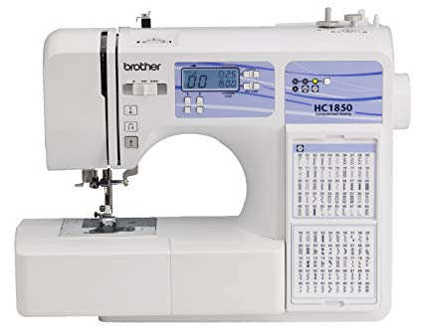
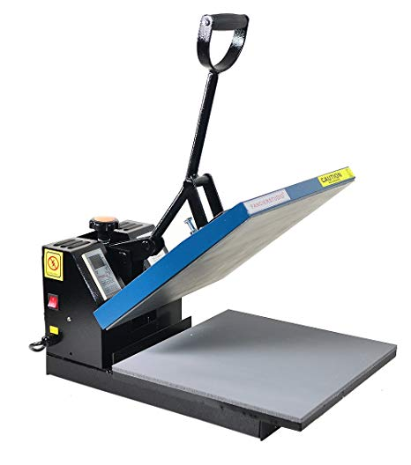
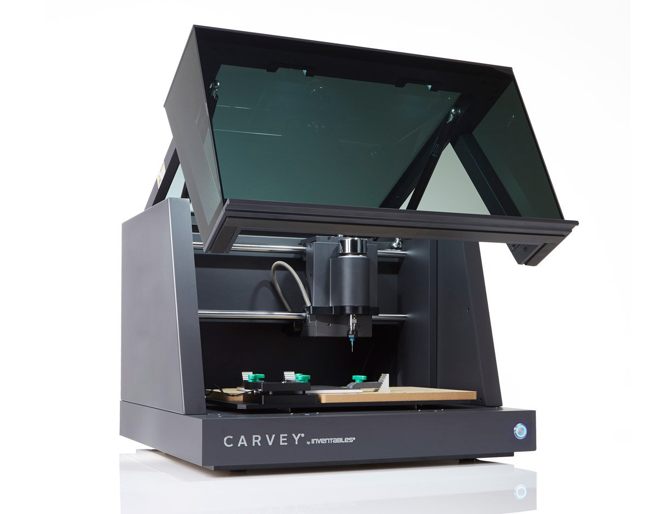
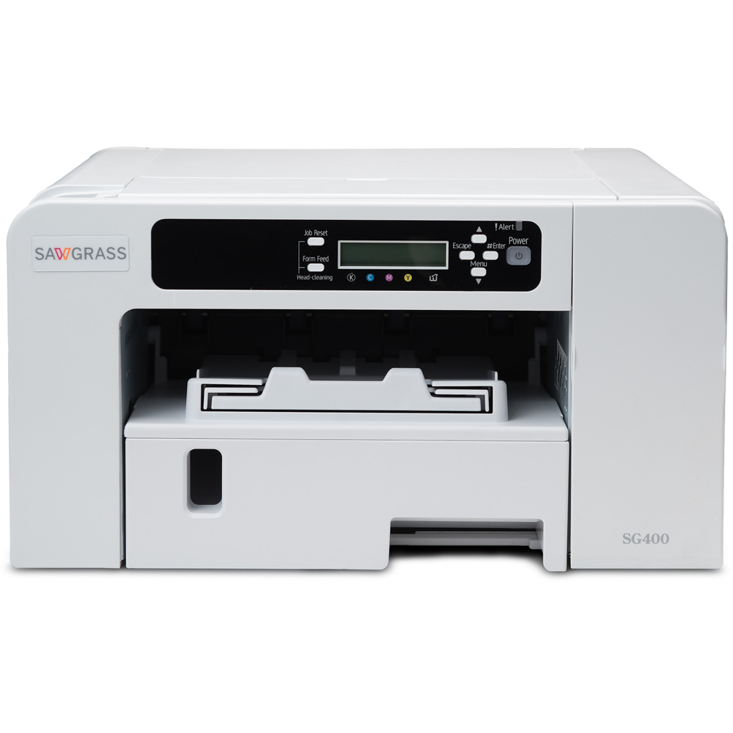
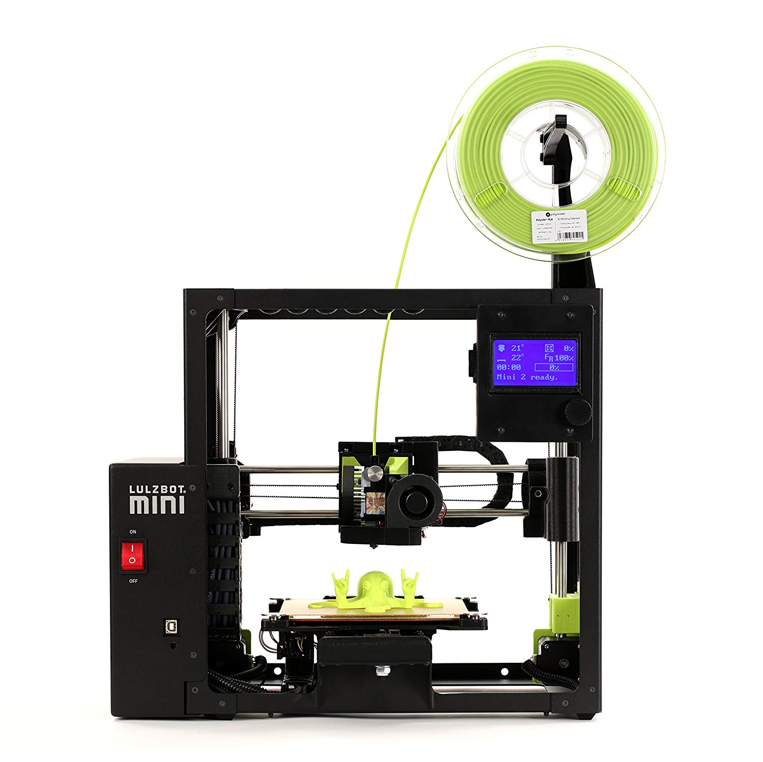
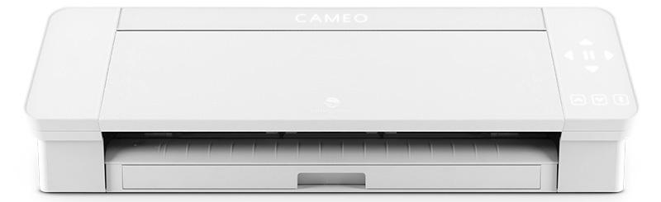
The Makerspace @ King Library
A hands-on, highly collaborative, and experiential learning space located on the third floor of King Library.
Equipment:
Glowforge Plus Laser Cutter
Lulzbot Mini 2 3D Printers
Carvey CNC Machines
Brother Sewing/Embroidery Machines
Heat Press
Silhouette Cameo 4 Plus Electronic Cutting Machine
Sawgrass Sublimation Printer

Slide 4
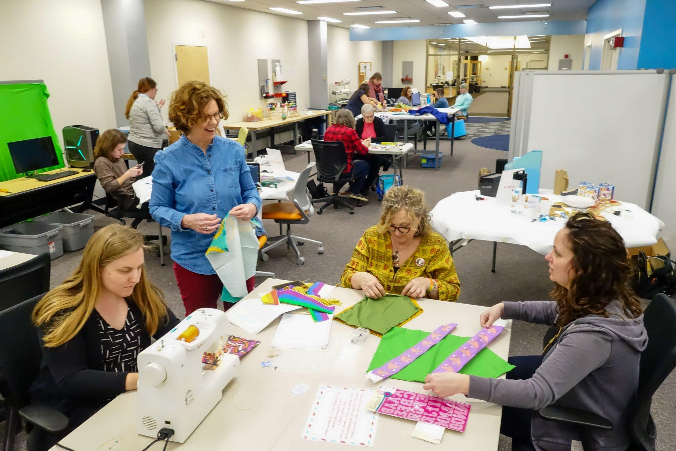
Makerspaces aren’t just spaces
People connectors
Community gathering spots
Transdisciplinary incubators

Slide 5
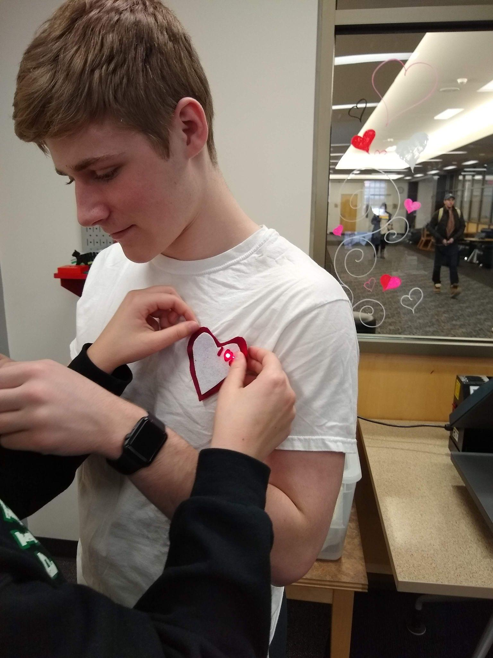
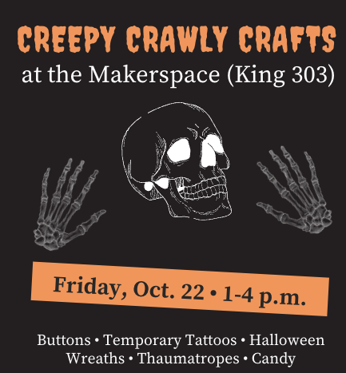
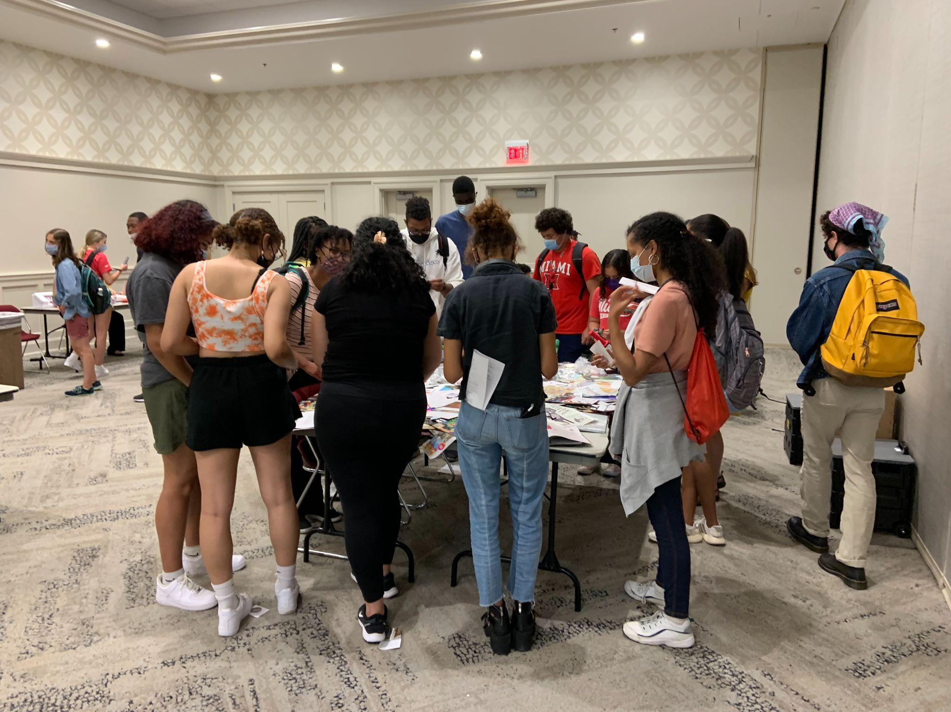
Makerspace Events

Slide 6
Building Community
Through Events
Low-barrier Activites
Open-Ended
Targeted Marketing
Mix of low-tech and high-tech
Allows for more creativity!
Make sure you’re reaching everyone

Slide 7
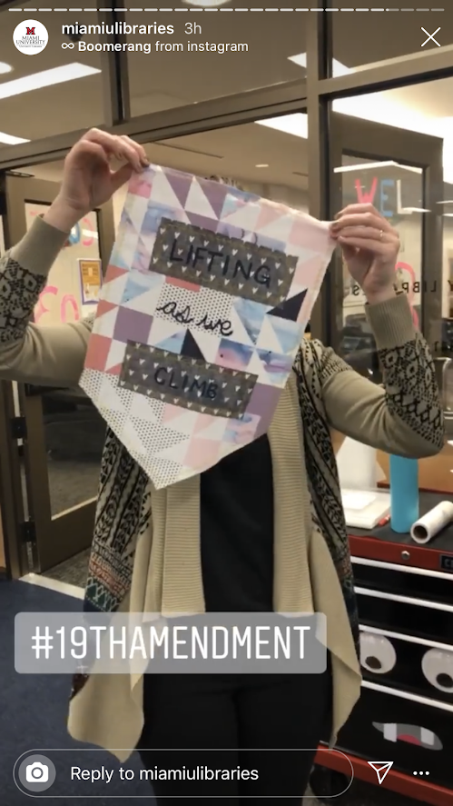

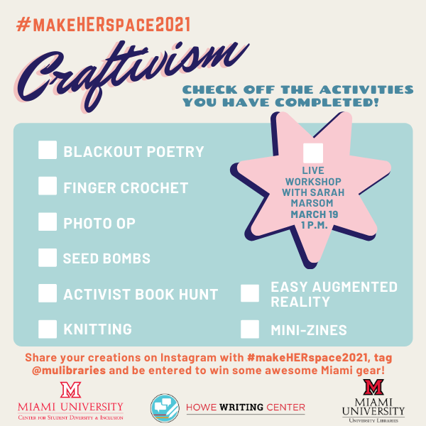
MakeHERspace

Slide 8
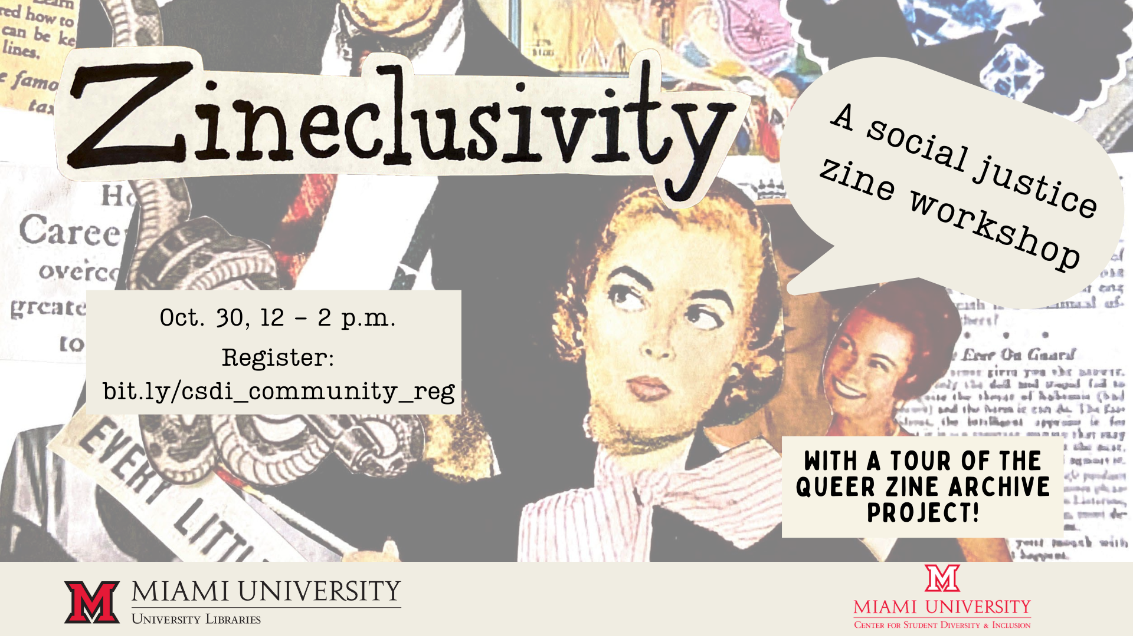
Zineclusivity

Slide 9
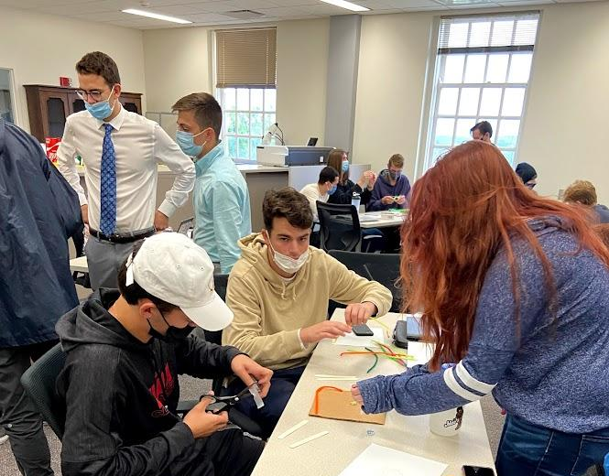
Curriculum Integrations

Slide 10
Building Community Through Curriculum Integrations
Reach a wide range of courses
Help students connect the Makerspace to their studies.
Reach more students
Not just STEM!

Slide 11
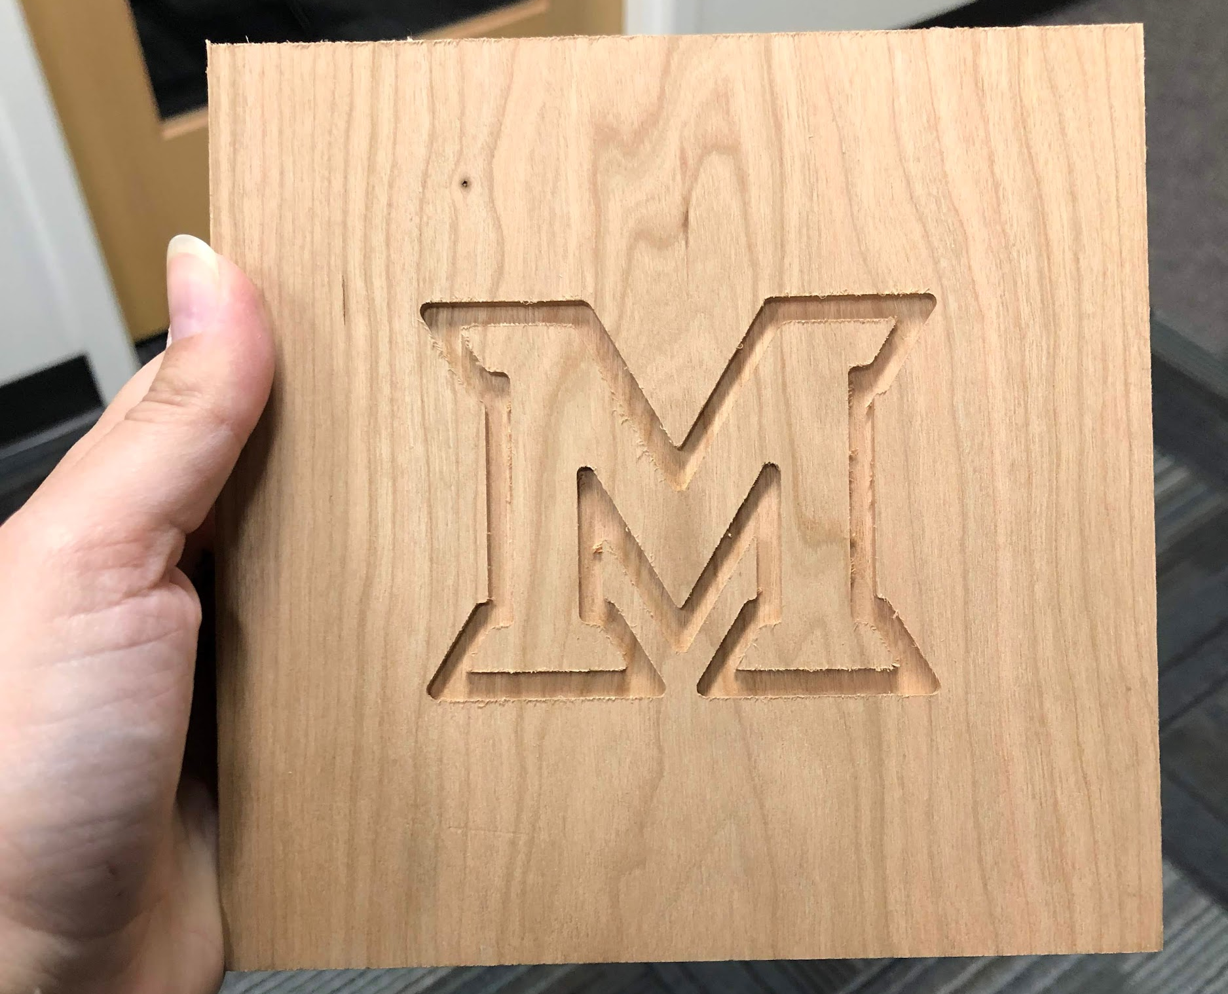

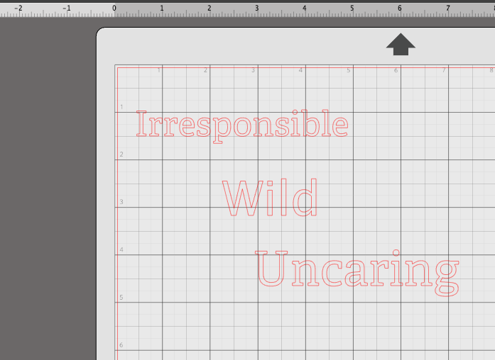
Course Examples
University Studies - Identity Assignment
Who I Am Not
Who I Am

Slide 12
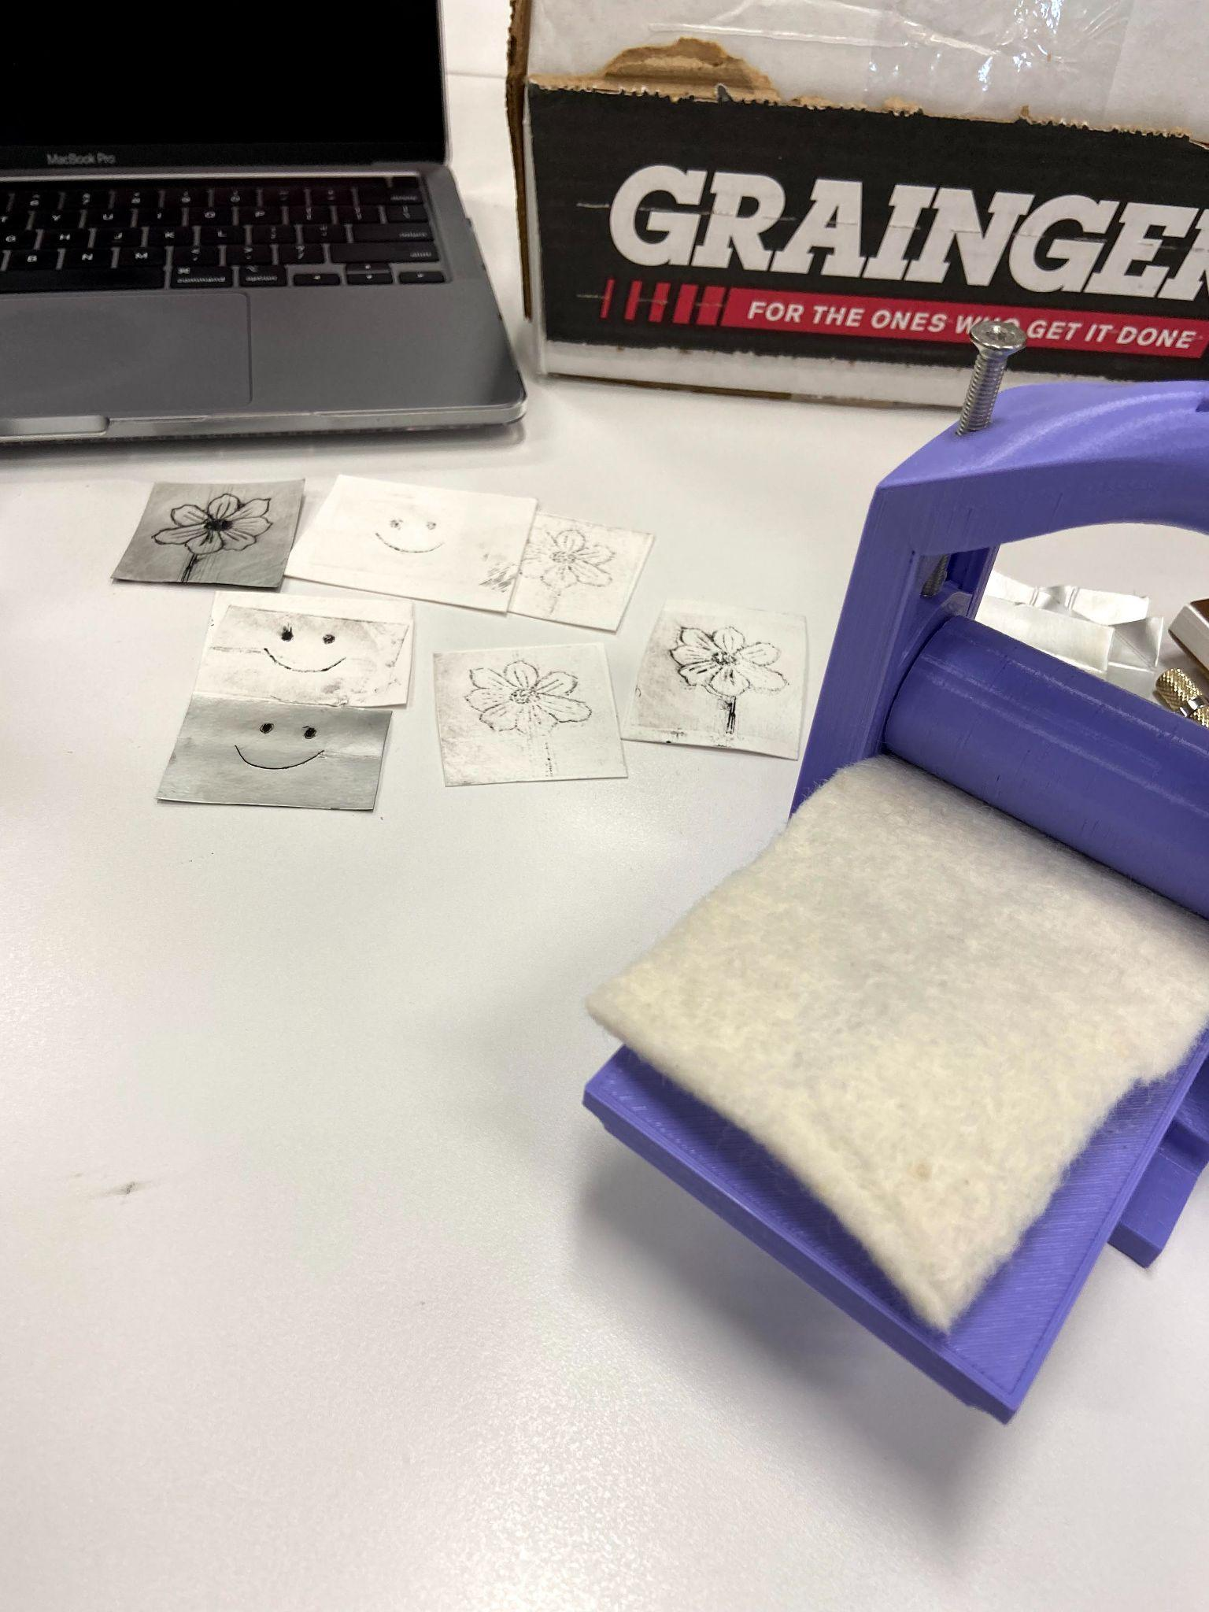
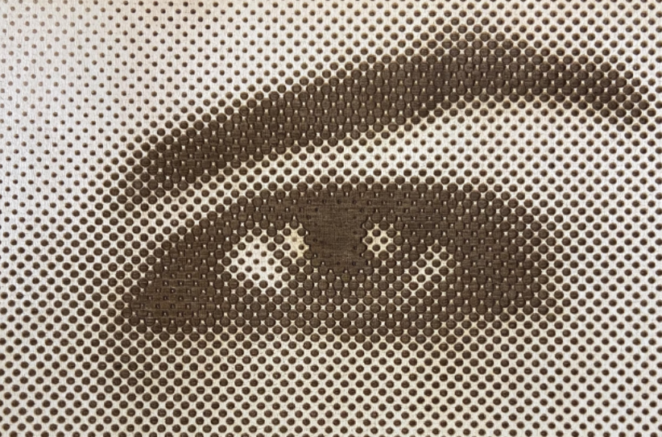
Course Examples
SPN 450/550 - Short Forms of the Mexican Revolution
Print & photography technology of the Mexican Revolution
3D printed printing presses
3D printed block prints
Laser-cut halftone images

Slide 13
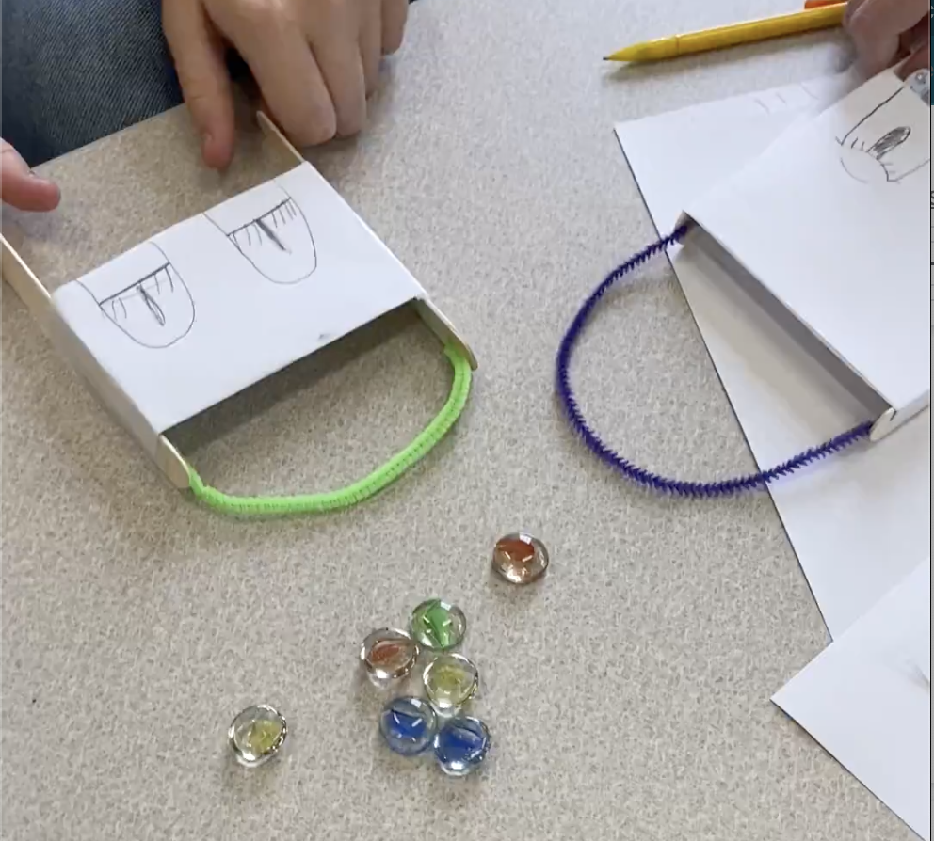
Course Examples
ENG 313 - Technical Writing
Students research an industry, create a prototype
Learn about why makerspaces are great for prototyping
Rapid prototyping lesson - tabletop games
Brainstorm using Makerspace for their prototypes

Slide 14
Building Community
Through Partnerships
Increase Usage
Leads to unexpected places
Build Relationships w/ Staff Throughout University

Slide 15
Thanks!
Questions?
pricesb@miamioh.edu
Twitter: @SarahNagle10
Pre-order my book, co-edited with Elias Tzoc:
https://bit.ly/nagle_tzoc_book

