Slide 1
Maker Literacy & the ACRL Framework
ALAO Conference 2021
Sarah Nagle
Creation & Innovation Services Librarian
Miami University

Slide 2
01
Current State of Makerspaces in Academic Libraries
02
Maker-Centered Learning Background
03
Maker Literacy & Metaliteracy
04
Maker Literacy & Liminality

Slide 3
Academic Libraries & Makerspaces
GROWING POPULARITY
LONG-TERM
SUSTAINABILITY

Slide 4
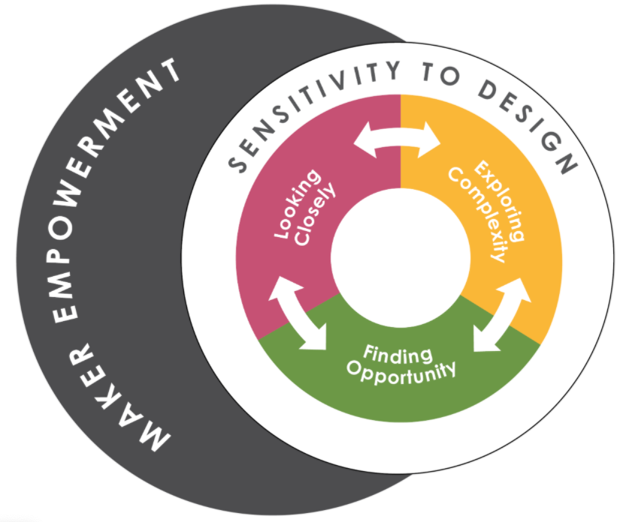
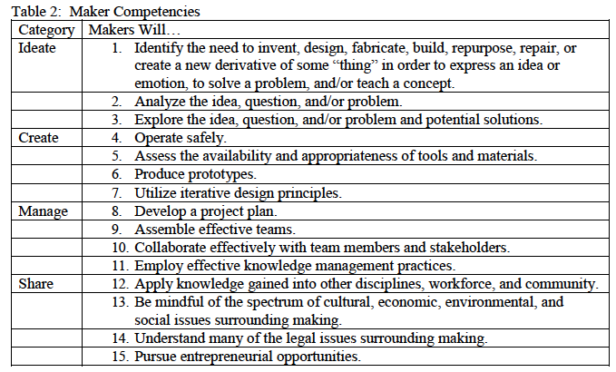
Maker-centered learning
Agency by Design (K-12)
Maker Literacies Project (Higher Ed)
Agency by Design. (n.d.) The Framework for Maker-Centered Learning. http://www.agencybydesign.org/explore-the-framework
Boardman, B. S., & Wallace, M. K., & Chivers, M. (2019, July 28). A Makerspace Project for New Transfer Students. Paper presented at the 2019 First Year Engineering Experience Conference, Pennsylvania, PA. Retrieved from https://peer.asee.org/33697

Slide 5
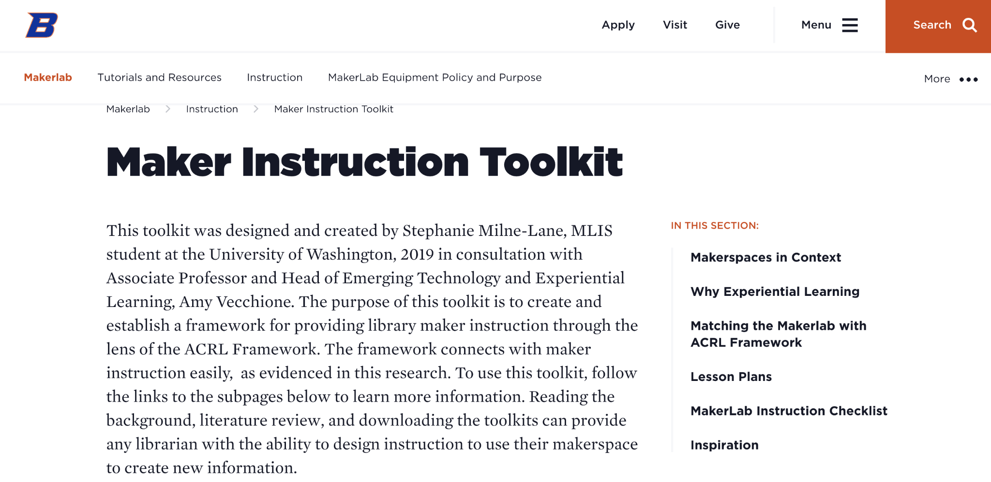
Maker Instruction Toolkit
Stephanie Milne-Lane and Amy Vecchione
Milne-Lane, Stephanie and Amy Vecchione. “Maker Instruction Toolkit.” Accessed May 20, 2021. https://www.boisestate.edu/library-makerlab/makerlab-instruction/maker-instruction-toolkit/.

Slide 6

Metaliteracy
Thomas Mackey and Trudi Jacobson
An overarching framework for emerging literacies.
Mindset > skill acquisition
Empowerment
Creation over consumption
Civic mindedness
Metacognition
Metaliteracy.org

Slide 7
Maker Literacy & Metaliteracy
Shift from Consumer to Creator
2018 Metaliteracy Goals and Learning Objectives; Goal 3, “Produce and share information in collaborative and participatory environments.”
  “See oneself as a producer as well as consumer of information.”
  “Participate conscientiously and ethically in collaborative environments.”
Maker movement ethos of “create don’t consume”
Jacobson et al. “2018 metaliteracy goals and learning objectives,” Metaliteracy, 2018, https://metaliteracy.org/learning-objectives/2018-metaliteracy-goals-and-learning-objectives/

Slide 8
Maker Literacy & Metaliteracy
Student Empowerment
2018 Metaliterate Learning Goals - empowerment leads to scholarly inquiry
Wallis & Battista, “The Politics of Information”.
Maker learning and empowerment
Jacobson, Trudi, Tom Mackey, and Kelsey O’Brien, “Metaliterate Learner Roles,” 2018, https://metaliteracy.org/ml-in-practice/metaliterate-learner-roles/
Lauren Wallis and Andrew Battista, “The Politics of Information: Students as Creators in a Metaliteracy Context,” in Metaliteracy in Practice, ed. Trudi Jacobson and Thomas Mackey (Chicago: American Library Association (ALA)/Neal-Schuman Publishers, Inc., 2016), 23-46.

Slide 9
Maker Literacy & Metaliteracy
Civic-mindedness
Metaliterate Learning Characteristics - tendency for metaliterate students to be civic-minded.
The Maker Movement gives back to communities and society!
  Project e-Nable
  Maker COVID PPE efforts
Mackey, Tom, “Empowering Metaliterate Learners for the Post-Truth World,” in Metaliterate Learning for the Post Truth World, ed. Tom Mackey and Trudi Jacobson, New York: American Library Association (ALA)/Neal-Schuman Publishers, Inc., 2019, 1-32.
“About Us,” Enabling the Future Website, Enabling the Future. Accessed May 20, 2021. http://enablingthefuture.org/about/.
Lucia Corsini, Valeria Dammicco, Lin Bowker-Lonnecker, and Robbie Blythe, "The Maker movement and its impact in the fight against COVID-19," (working paper, Centre for Technology Management working paper series, 2020), https://aspace.repository.cam.ac.uk/handle/1810/313163

Slide 10
Maker Literacy & Metaliteracy
Metacognition
“Awareness or understanding of one’s own thought processes.”
Students “thinking about their own thinking”.
Maker Literacies Project - journaling activity
Memorable Making Experience
Wallace et al., “Maker Competencies and the Undergraduate Curriculum” (Paper presented at the 2018 International Symposium on Academic Makerspaces, Stanford, CA, August 3-5, 2018), http://hdl.handle.net/10106/27518
Edward P. Clapp et al., Maker-Centered Learning: Empowering Young People to Shape Their Worlds (San Francisco: Josey-Bass, 2017).

Slide 11
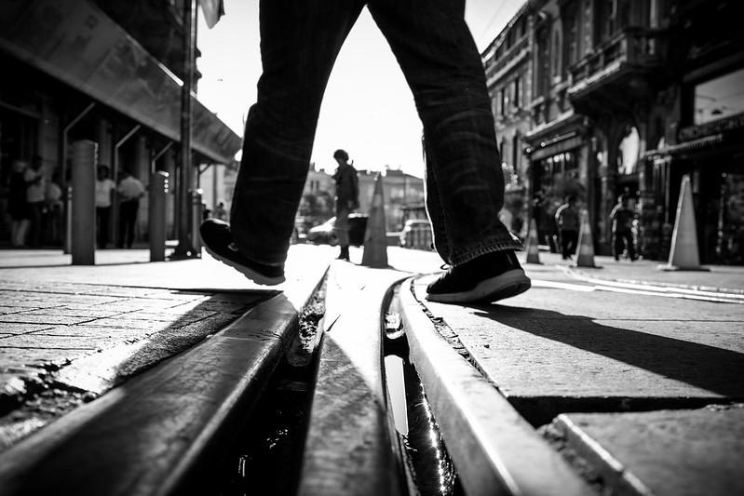
Liminality
And Maker Learning
Gennep (1908)
Turner (1960s)
Meyer and Land - Threshold concepts
Kim Skjoldager-Nielsen and Joshua Edelman, “Liminality,” Ecumenica 7, no. 1-2 (2014): 33-40.
Jan H.F. Meyer and Ray Land, “Threshold Concepts and Troublesome Knowledge (2): Epistemological Considerations and a Conceptual Framework for Teaching and Learning,” Higher Education 49, no. 3 (April, 2005): 377.
Image credit: Tuncay on Flickr, https://www.flickr.com/photos/tuncaycoskun/29287713956

Slide 12

Liminality
Barbara Fister
““...the place where we are between understandings. It’s the borderland we’re passing through as we move from a familiar place to an unknown place. It’s where we are unsettled, where we might turn back because it’s just too uncomfortable—or where we might feel exhilarated by the challenge.”
Fister, Barbara, “The Liminal Library: Making Our Libraries Sites of Transformative Learning,” (Paper presented at the LILAC Conference, April 13, 2015), 4, https://barbarafister.com/LiminalLibrary.pdf.

Slide 13
Maker Literacy and Liminality
Open ended
Tinkering
Failure as learning
Maker
Mindset

Slide 14
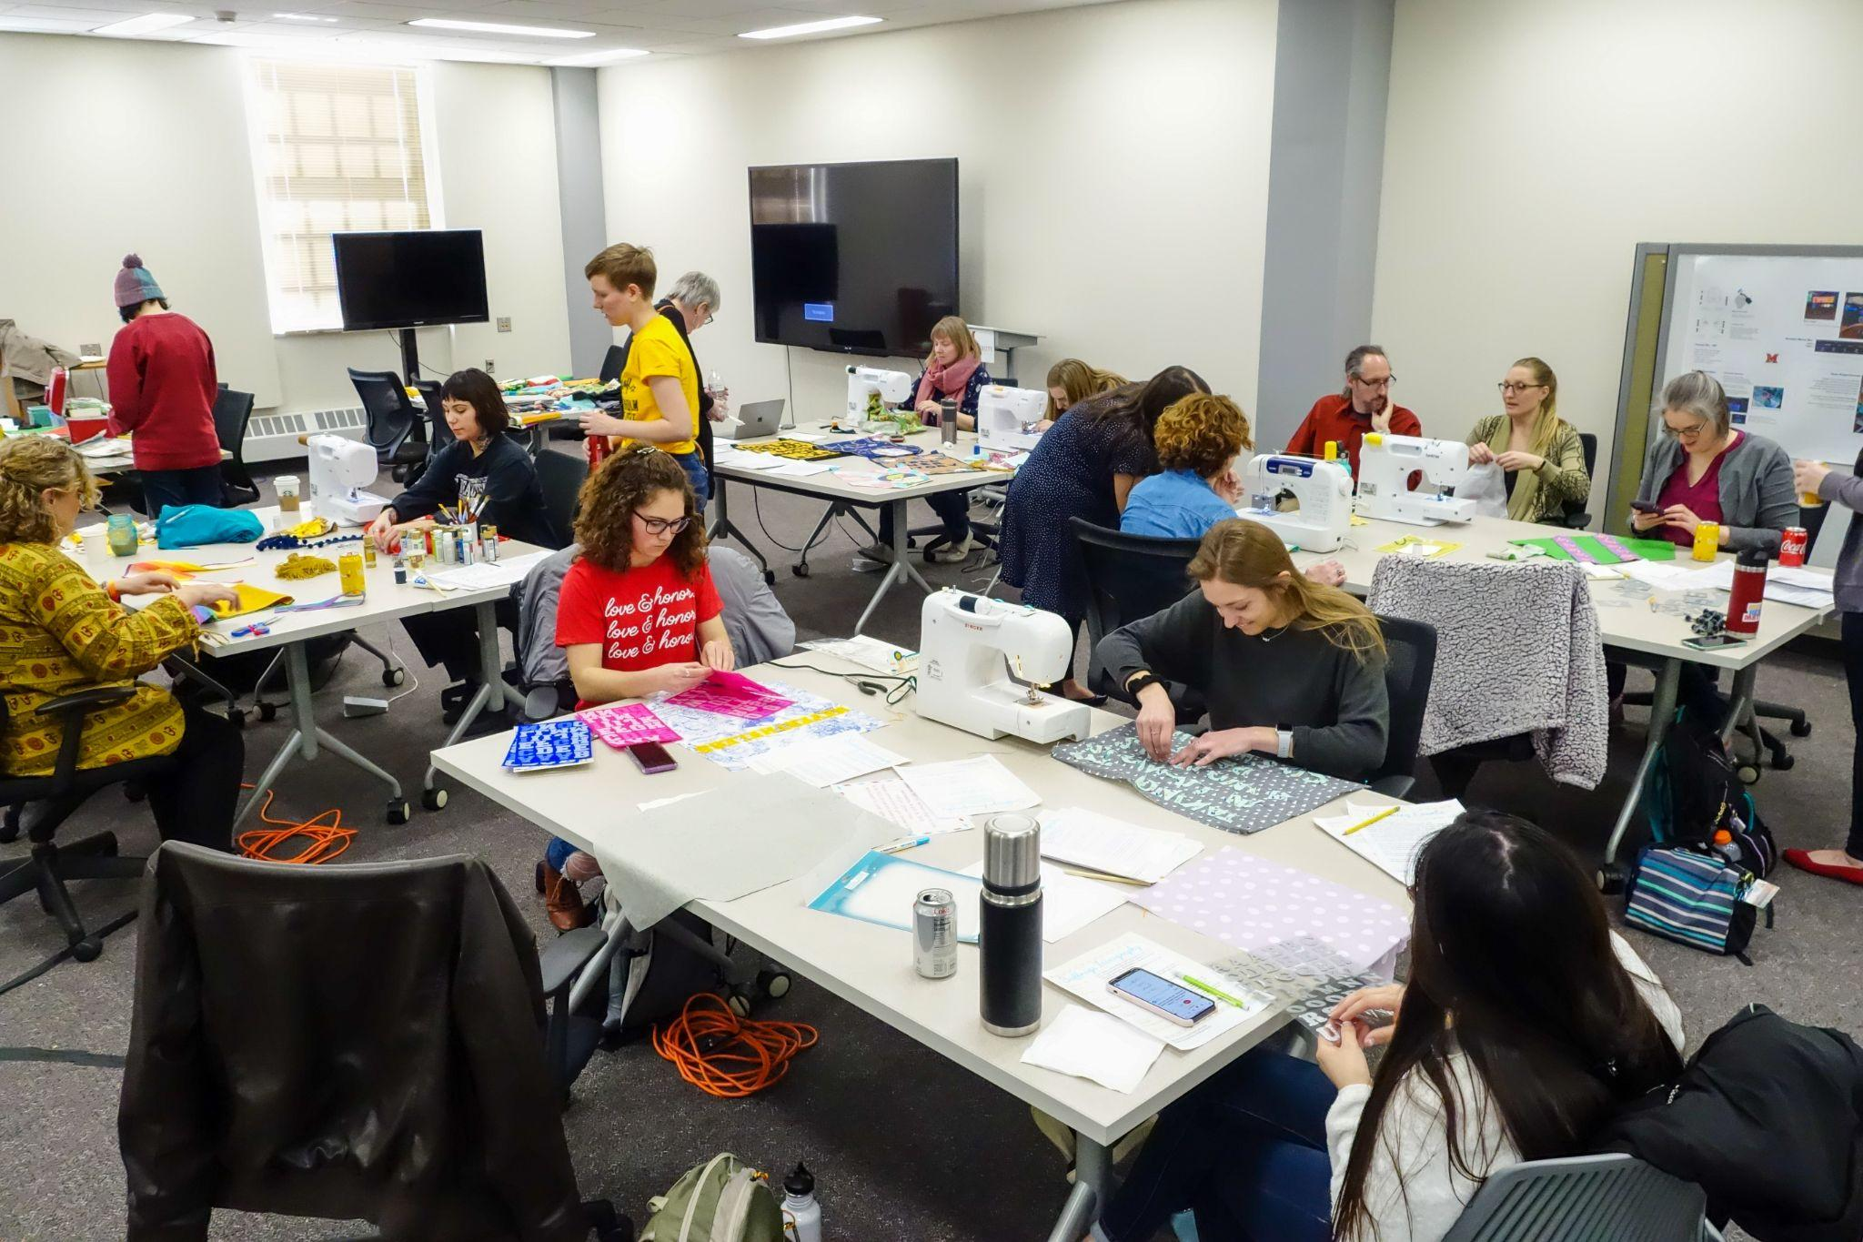
Makerspaces as Liminal Space
Miller et al. - Curtin Library Makerspace (Australia)
The space itself is outside of structured curriculum
A different way for students to learn and grow

Slide 15
Conclusion and Next Steps
Keep sharing the benefits of maker literacy, especially as it relates to information literacy
Revising my learning outcomes.
Building on maker literacy theory

Slide 16
THANKS!
Questions?
pricesb@miamioh.edu
Twitter: @SarahNagle10

