Slide 1
A Series of Fortunate Events
Planning Great Maker Events
NOMCON 2021
Sarah Nagle
Miami University
Twitter: @SarahNagle10
Email: pricesb@miamioh.edu

Slide 2
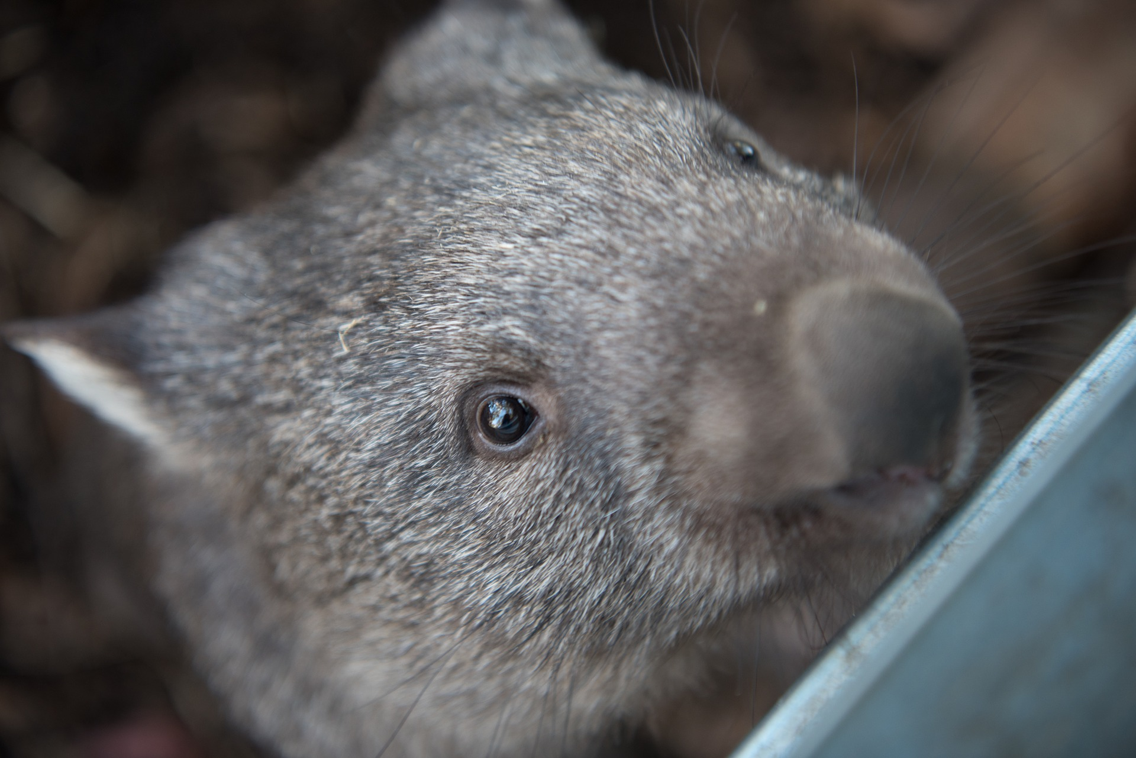
Share in chat:
Location/Makerspace
Favorite animal

Slide 3
What We’ll Cover Today
Why Events?
Examples of My Events
Best Practices
Tips and Lessons Learned
Sharing Your Events

Slide 4
Why Events?
Get people in the doors!
Build an inclusive environment
Enrich learning and creativity in your space

Slide 5
Types of Maker Events
Maker Fests (or Faires)
Social/Networking Events
Project-Based Workshops
Take & Make
Training Sessions/Classes
Open Houses
Hack-a-thons
Virtual Events

Slide 6
Some Event Examples

Slide 7
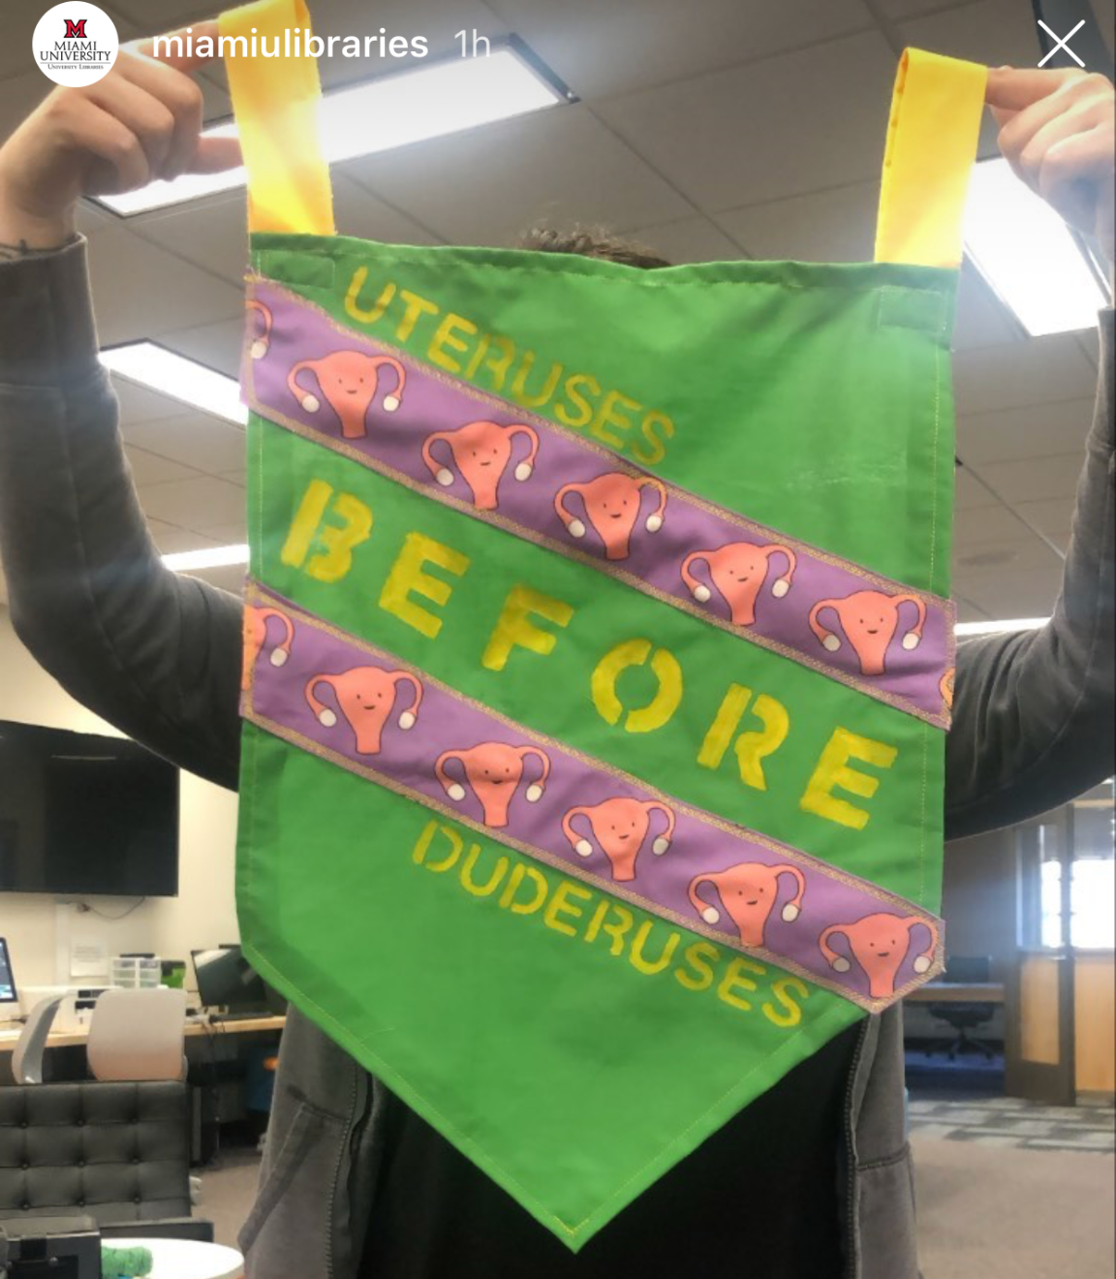
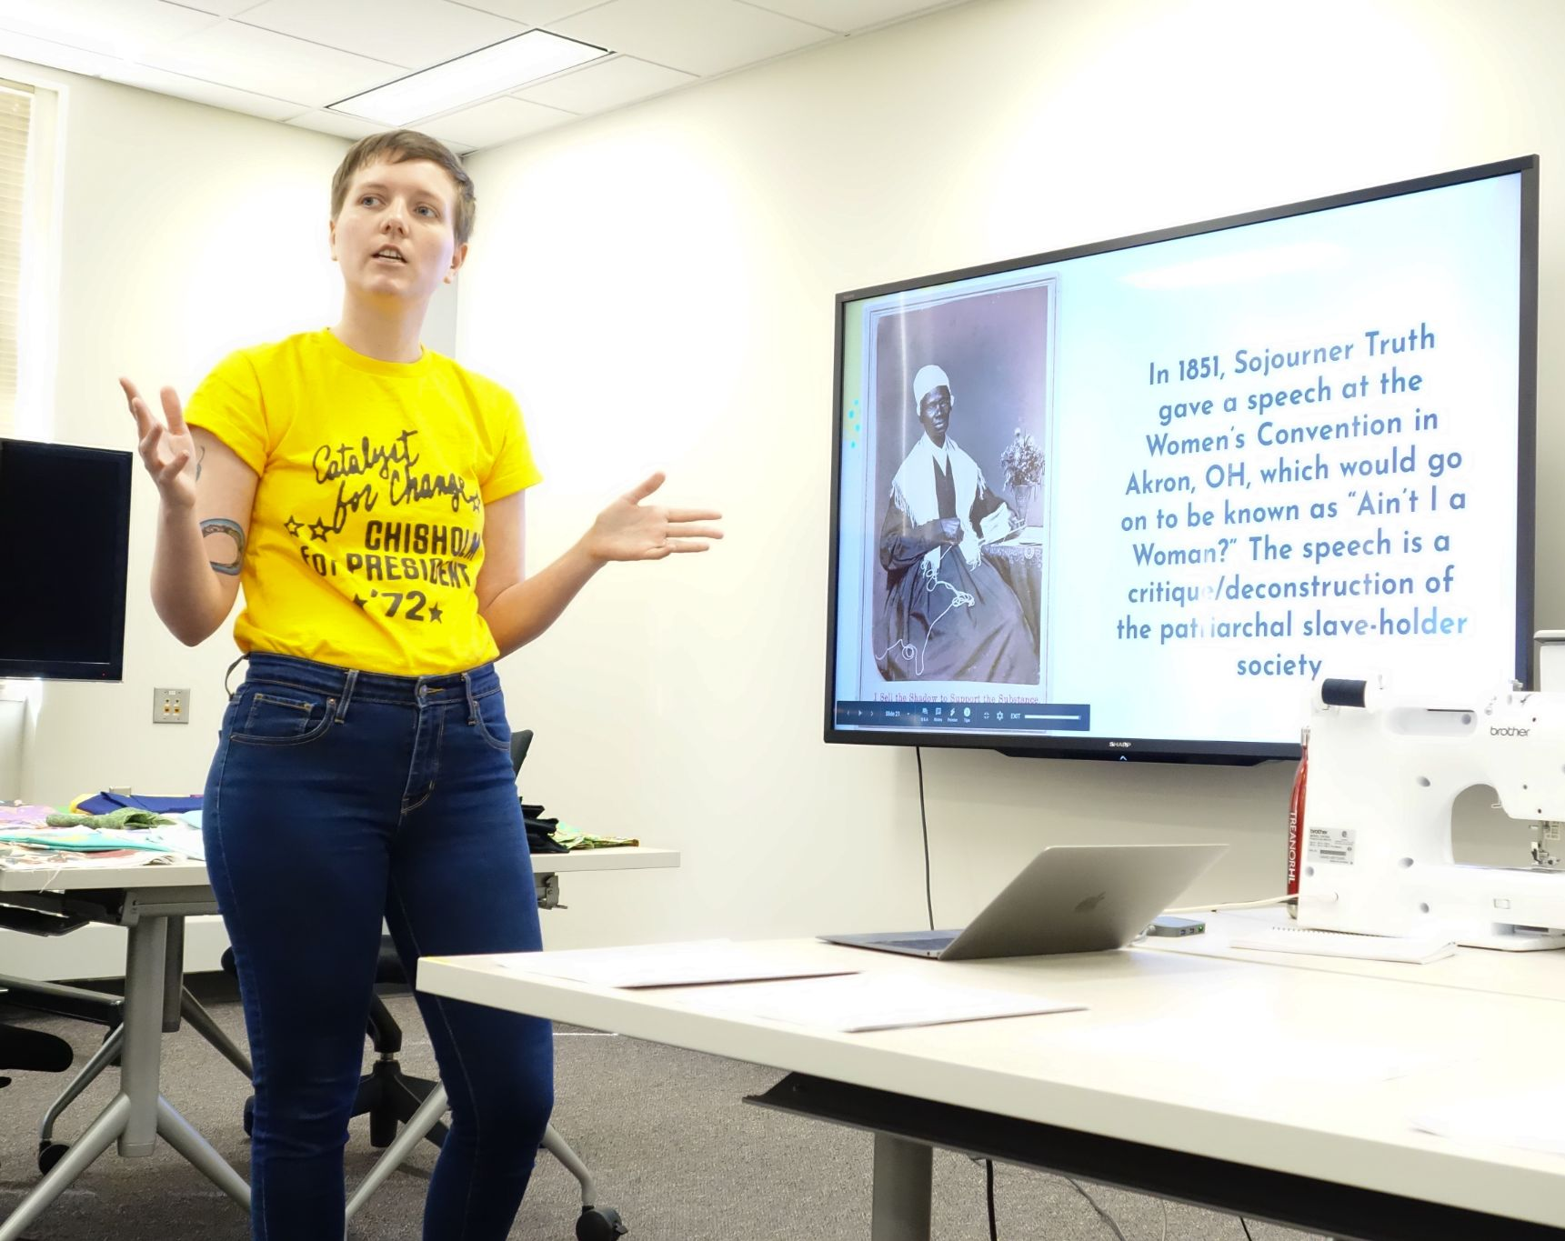
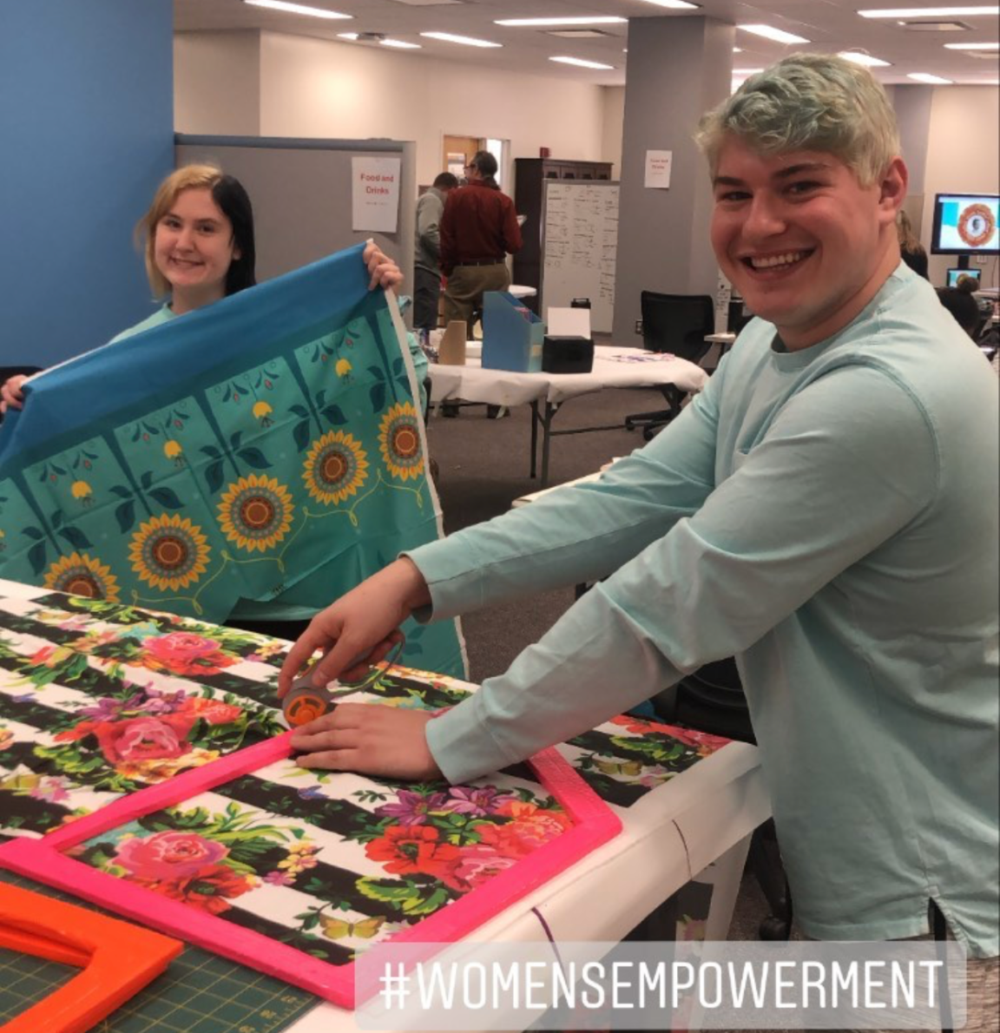
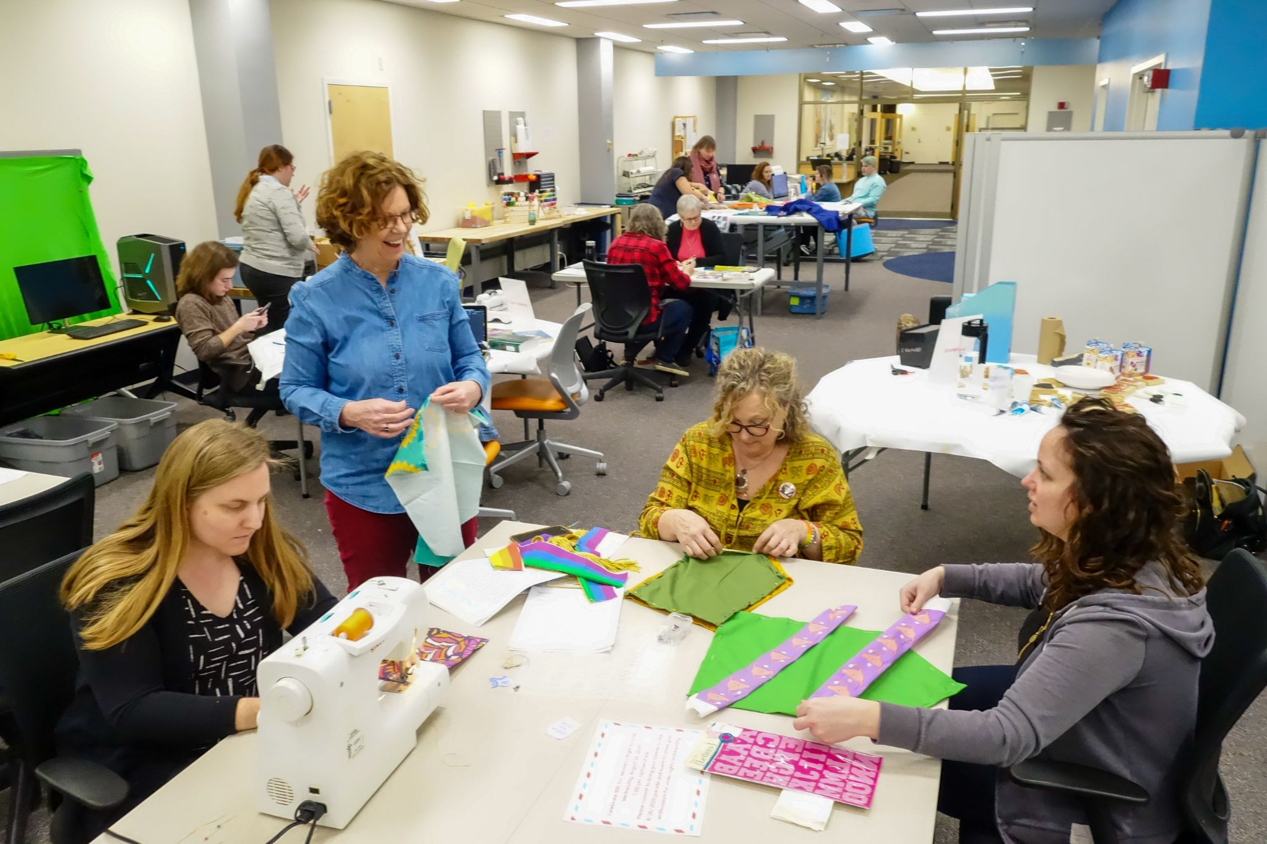
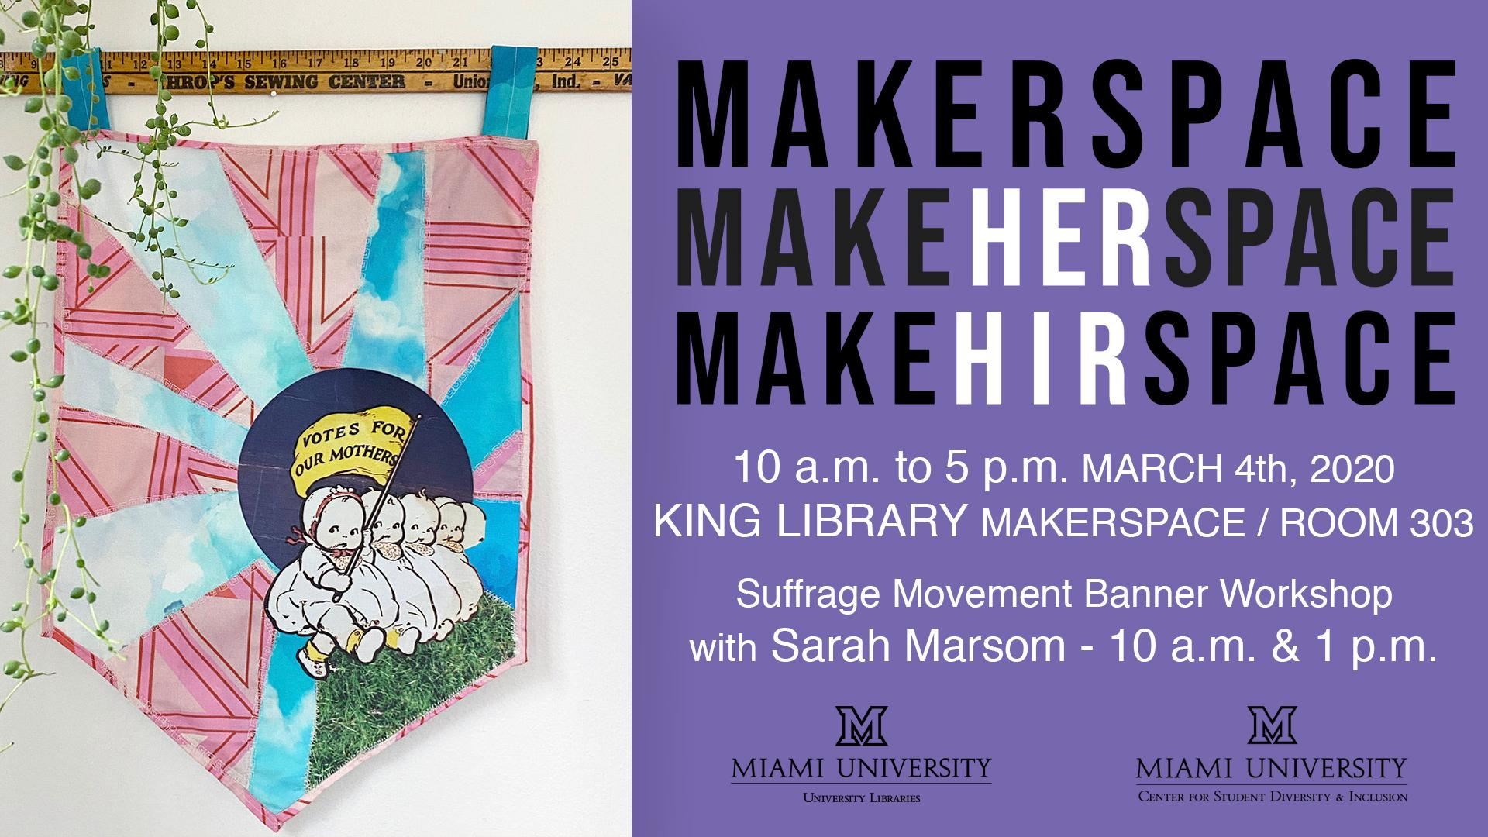
Images courtesy of Miami University Libraries, Oxford, OH

Slide 8
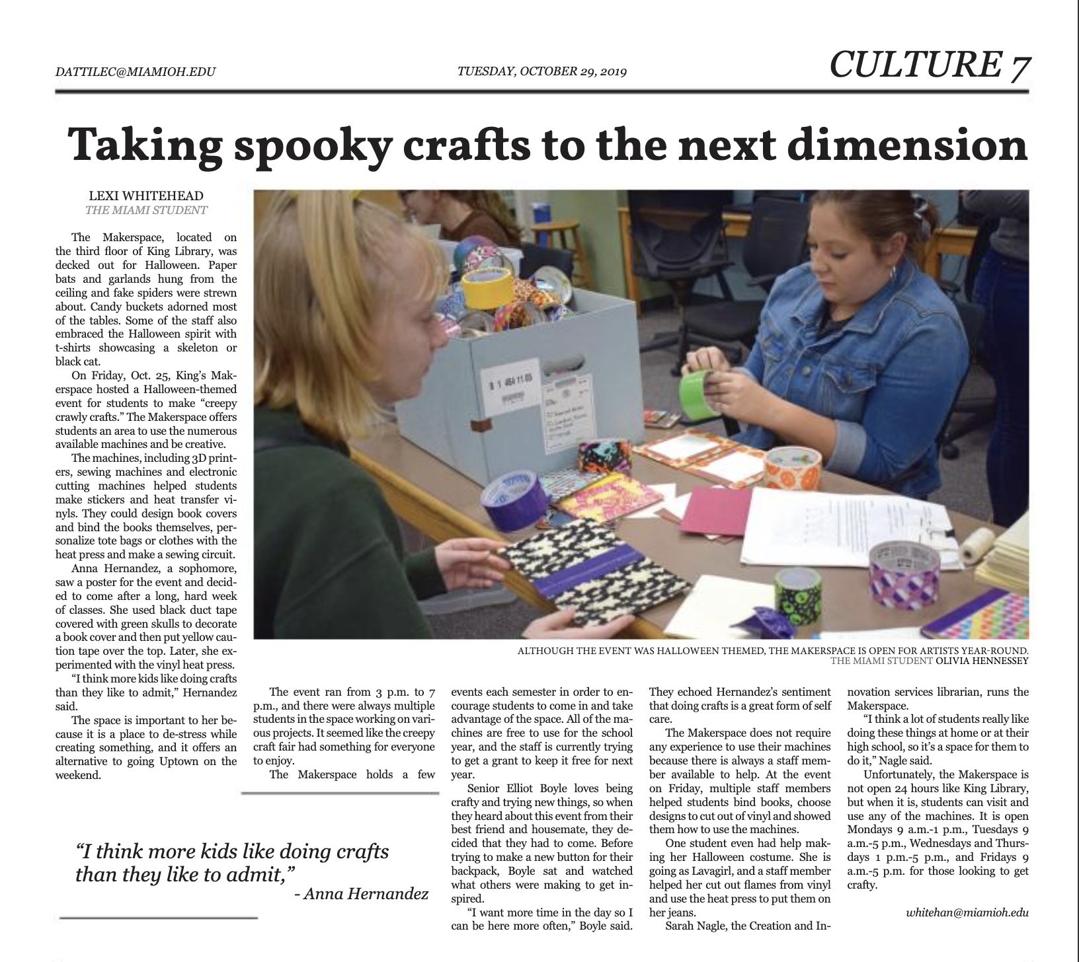
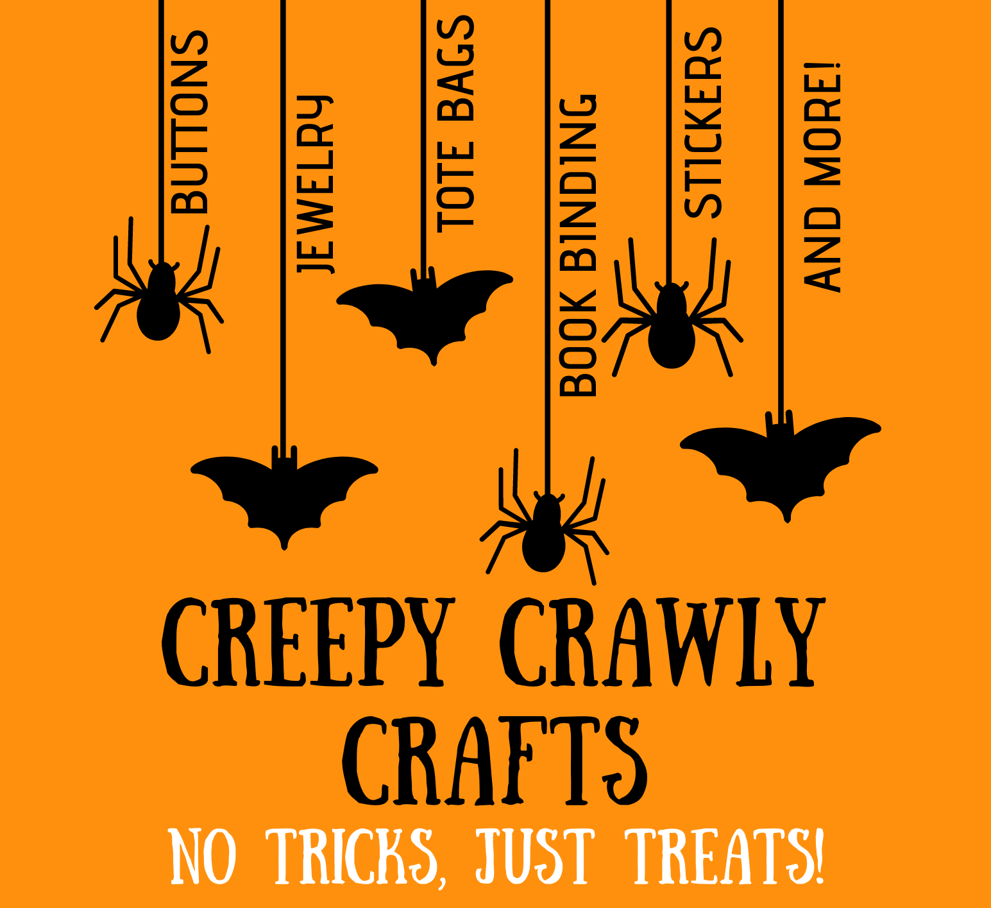
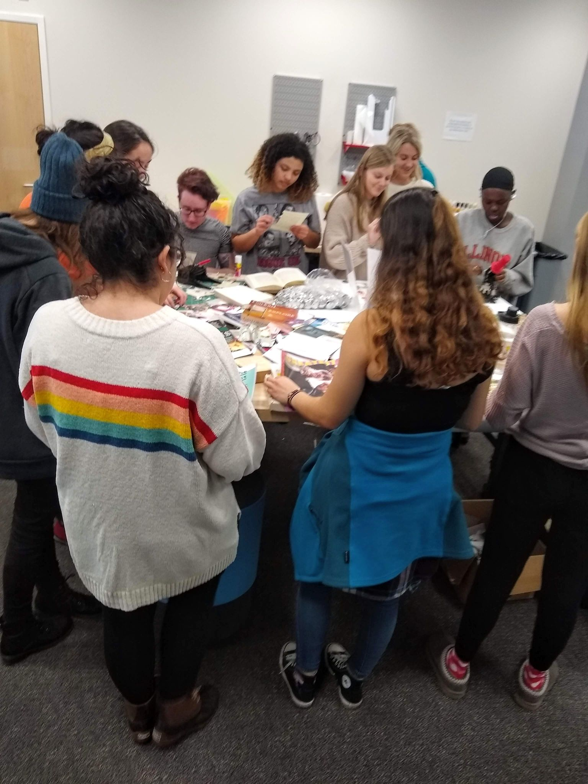
Image courtesy of Miami University Libraries, Oxford, OH
News Clipping from The Miami Student, October 29, 2019.

Slide 9
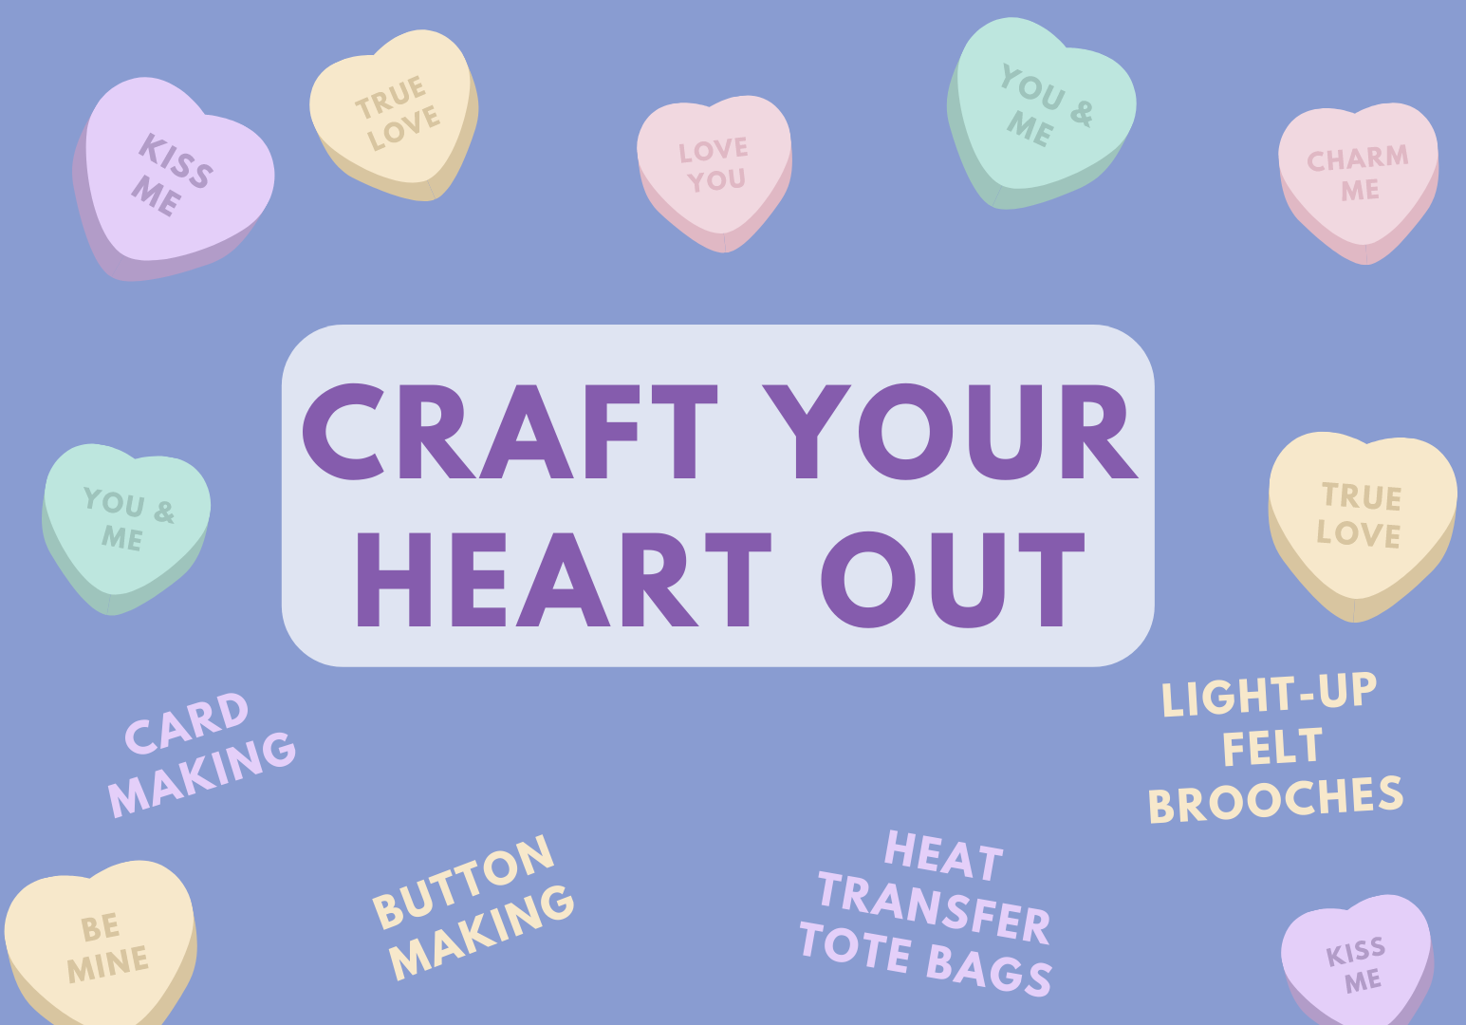
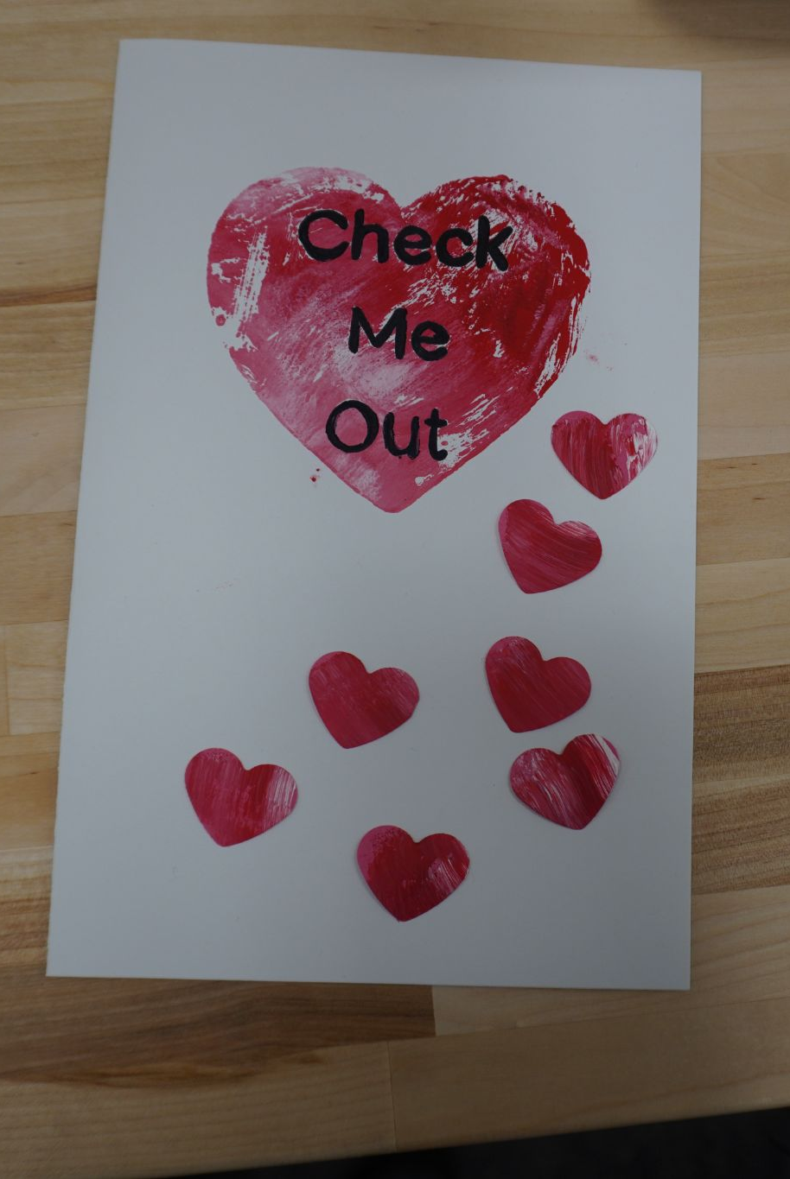
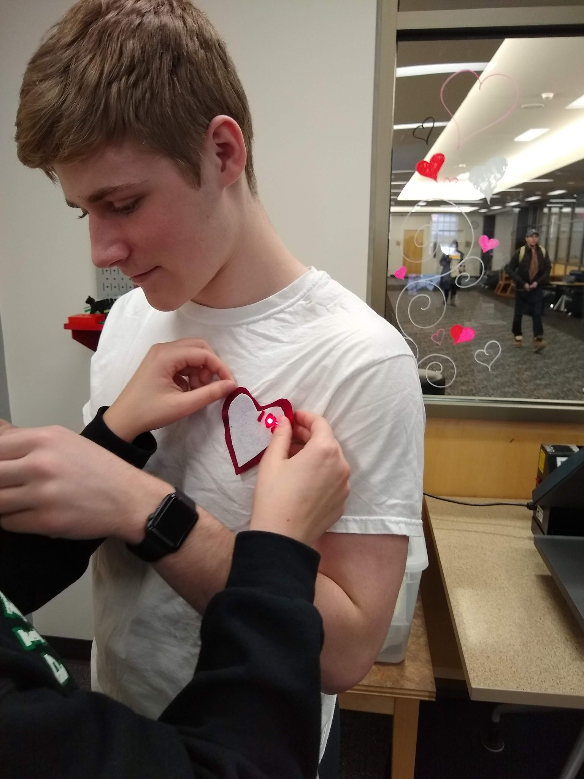
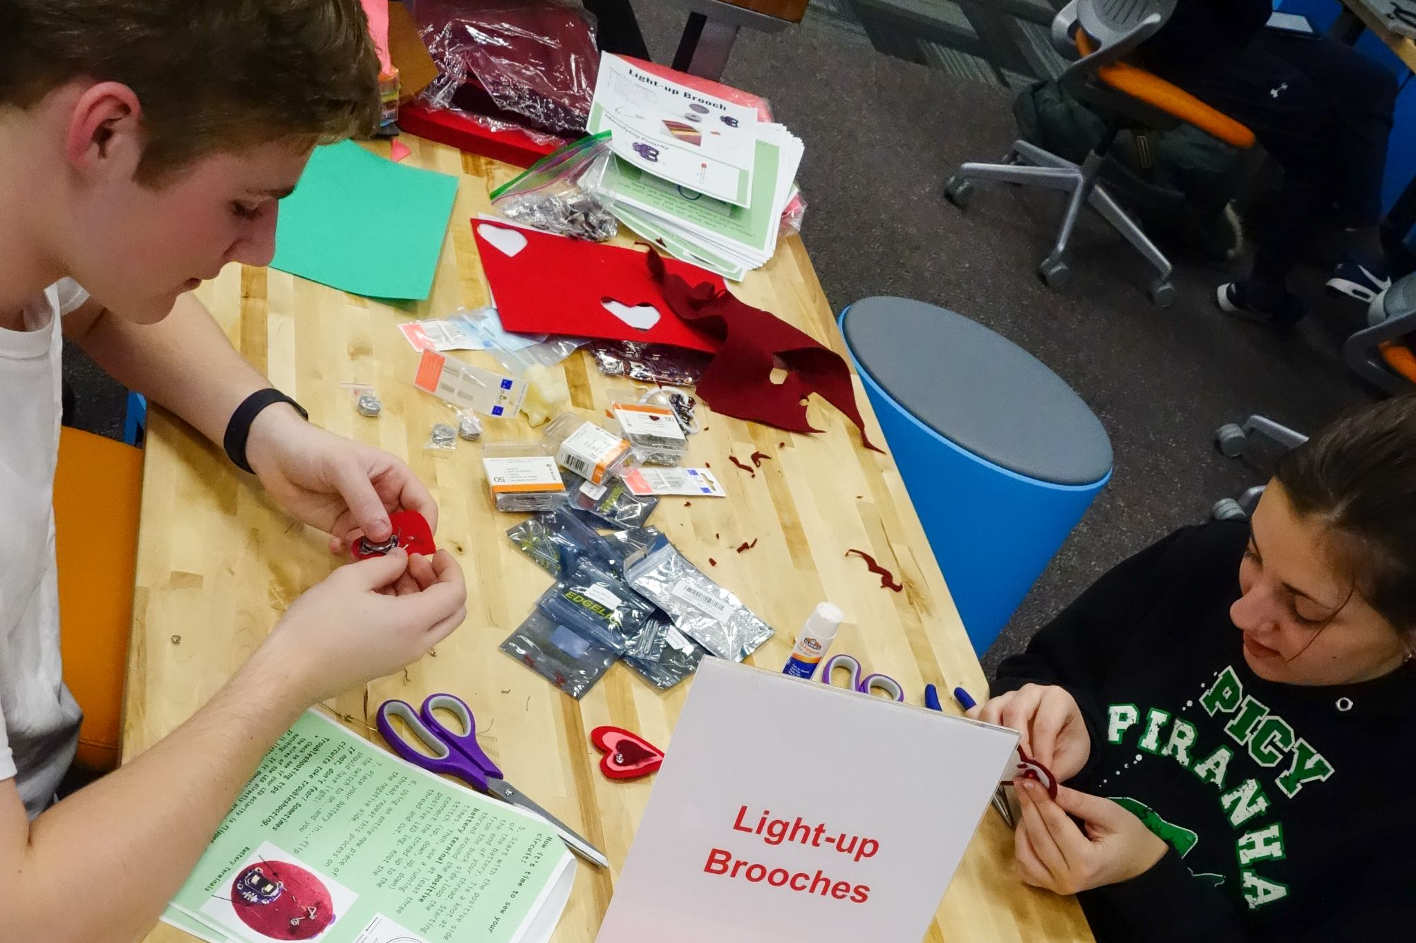
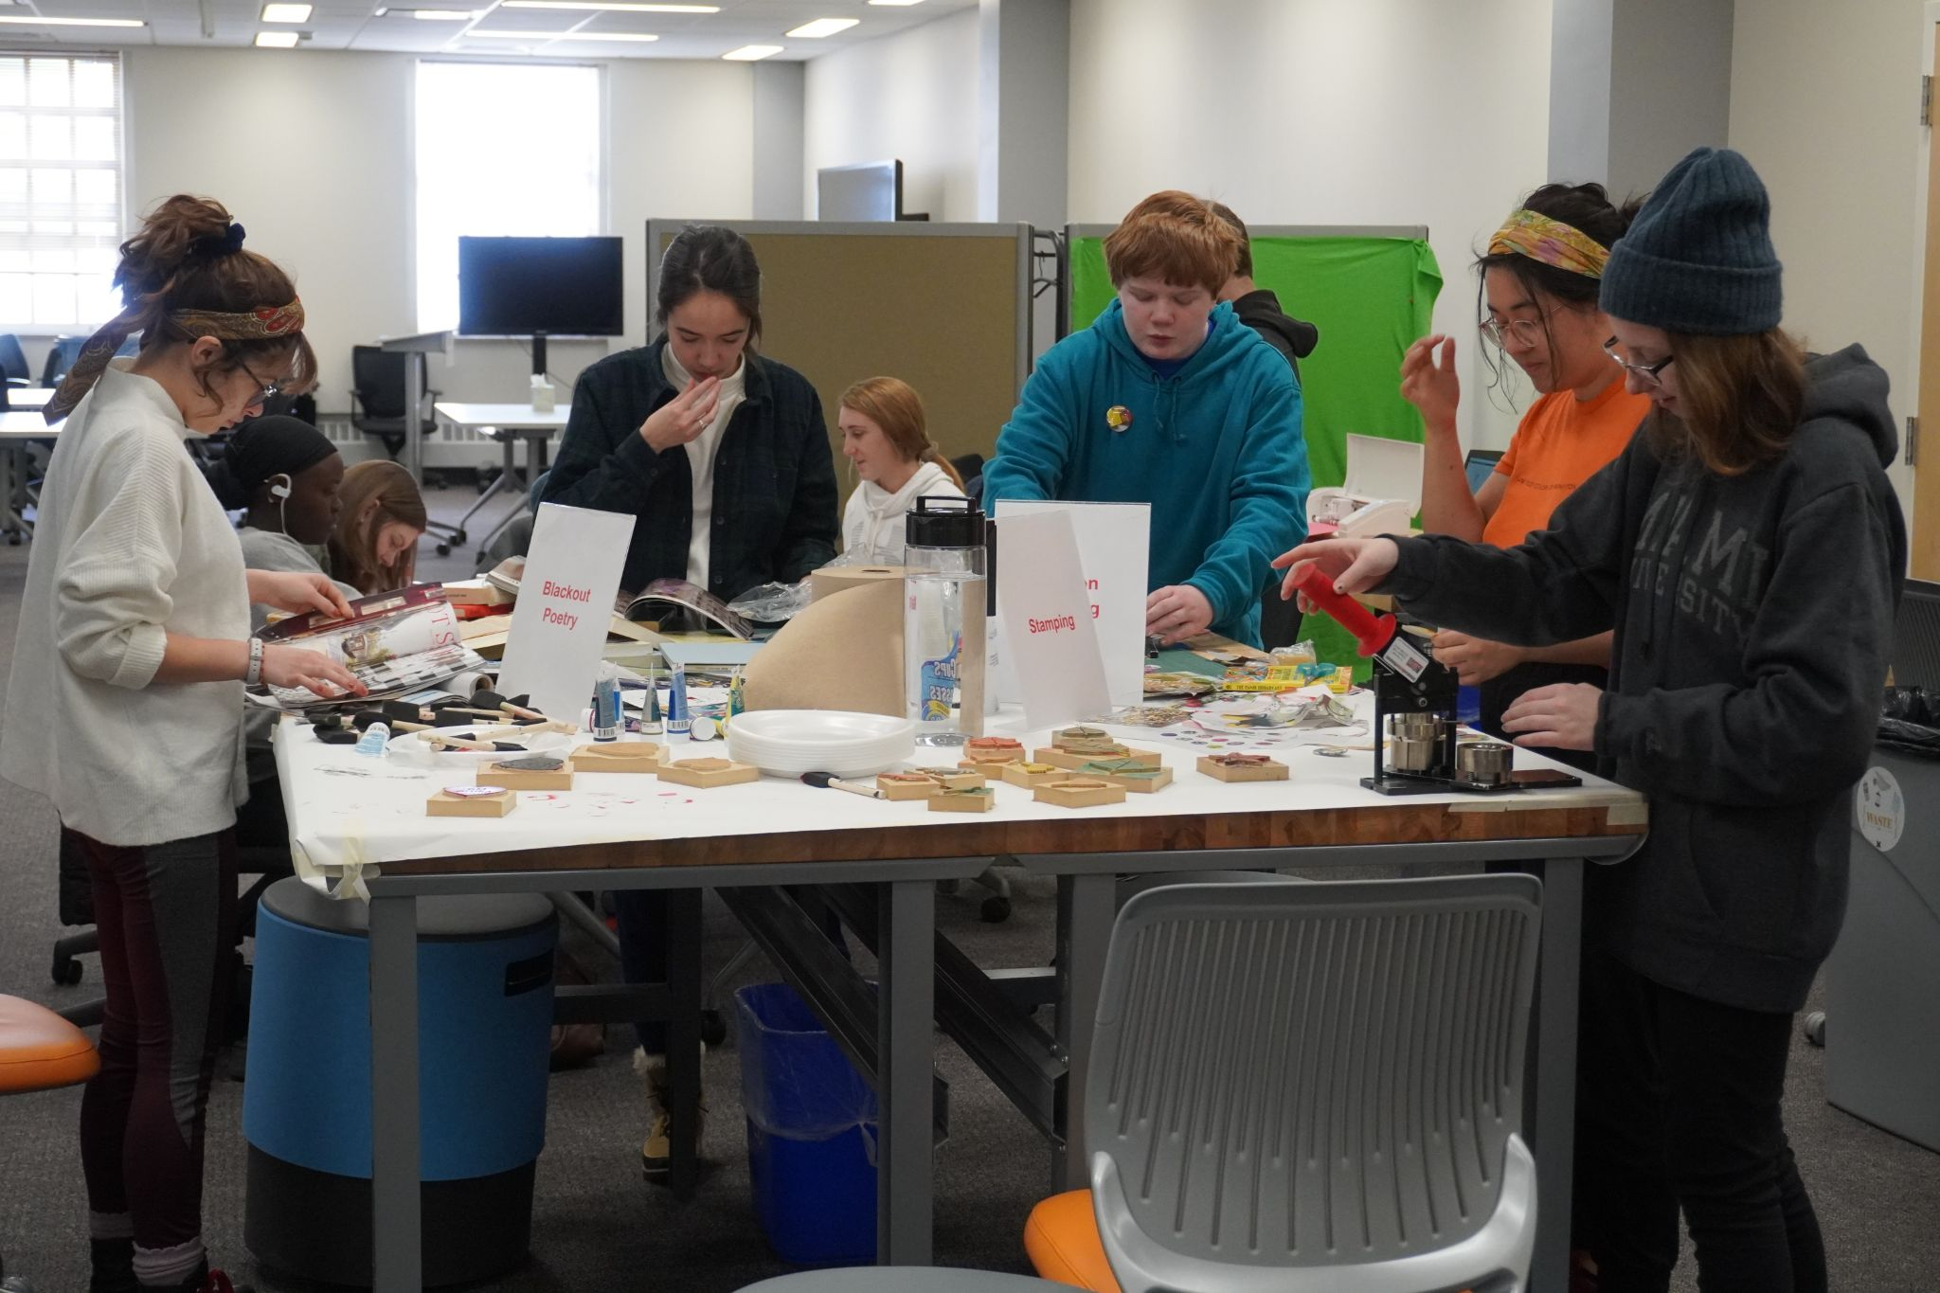
Images courtesy of Miami University Libraries, Oxford, OH

Slide 10
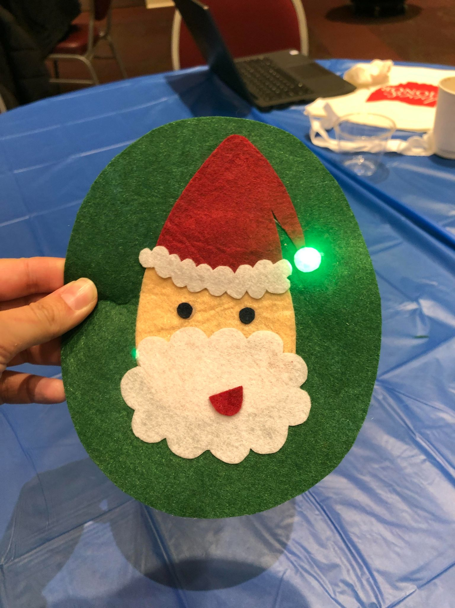
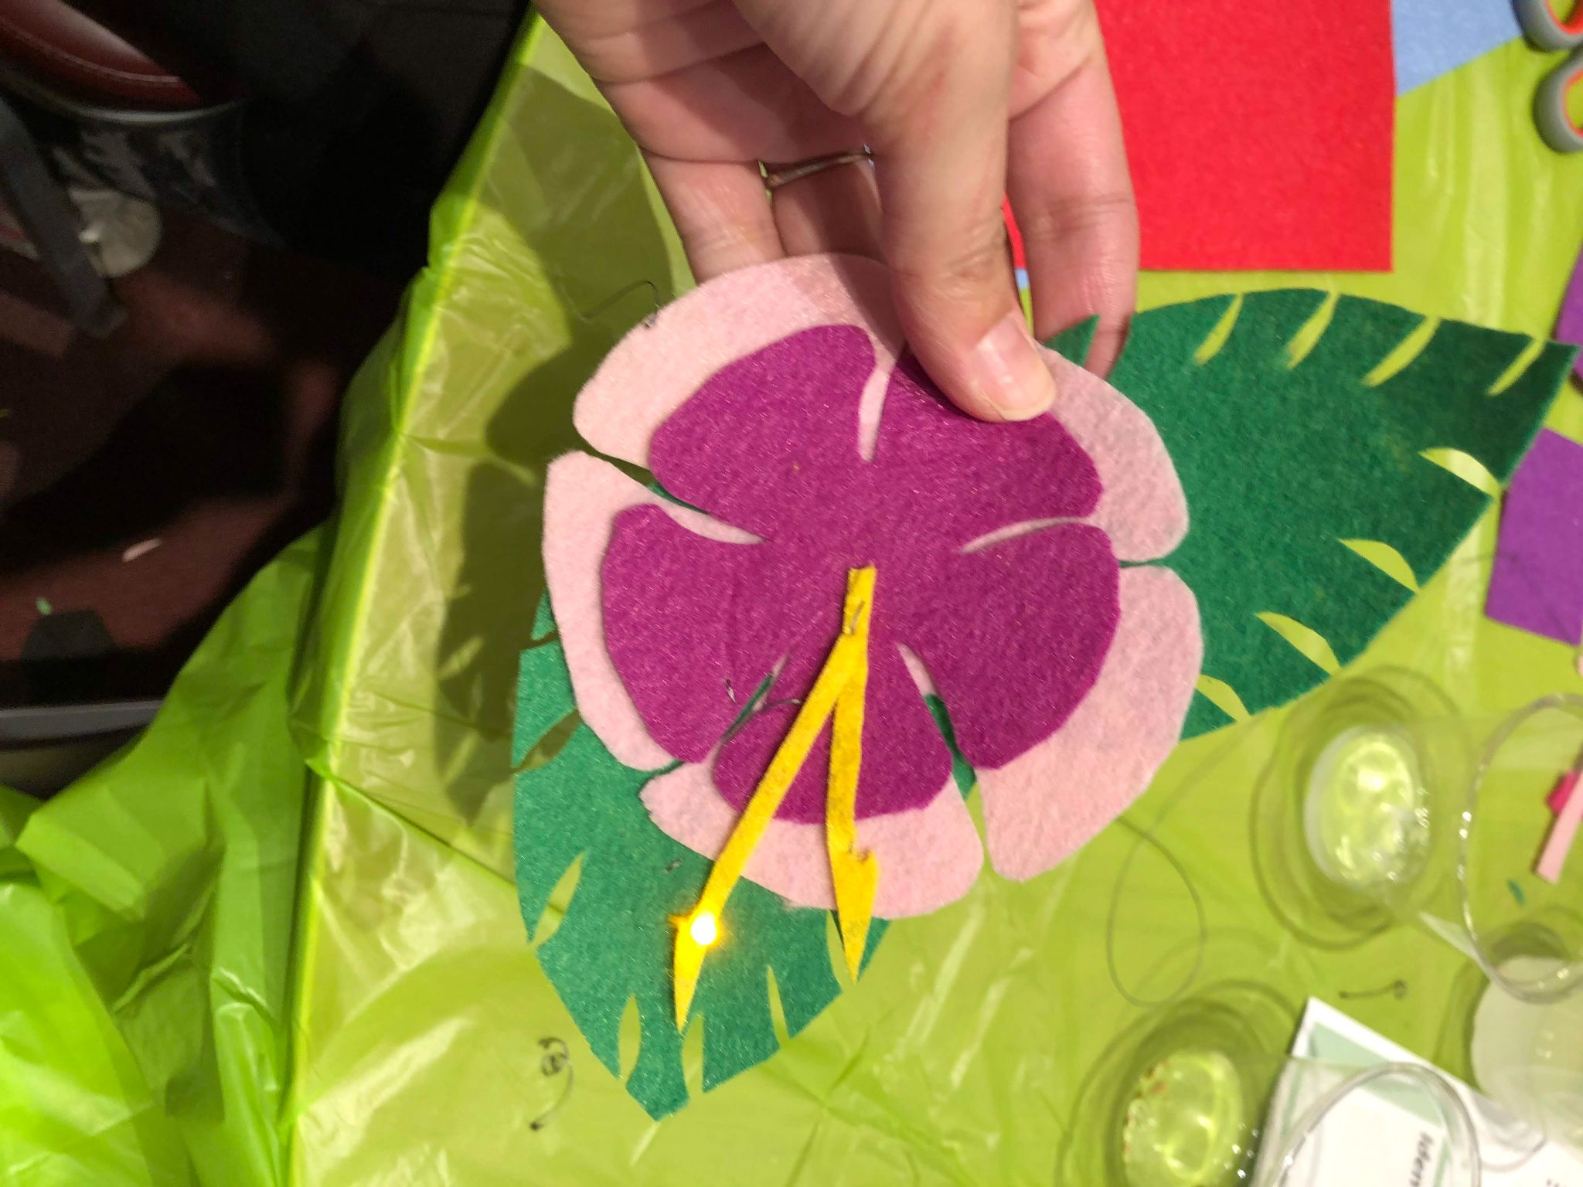
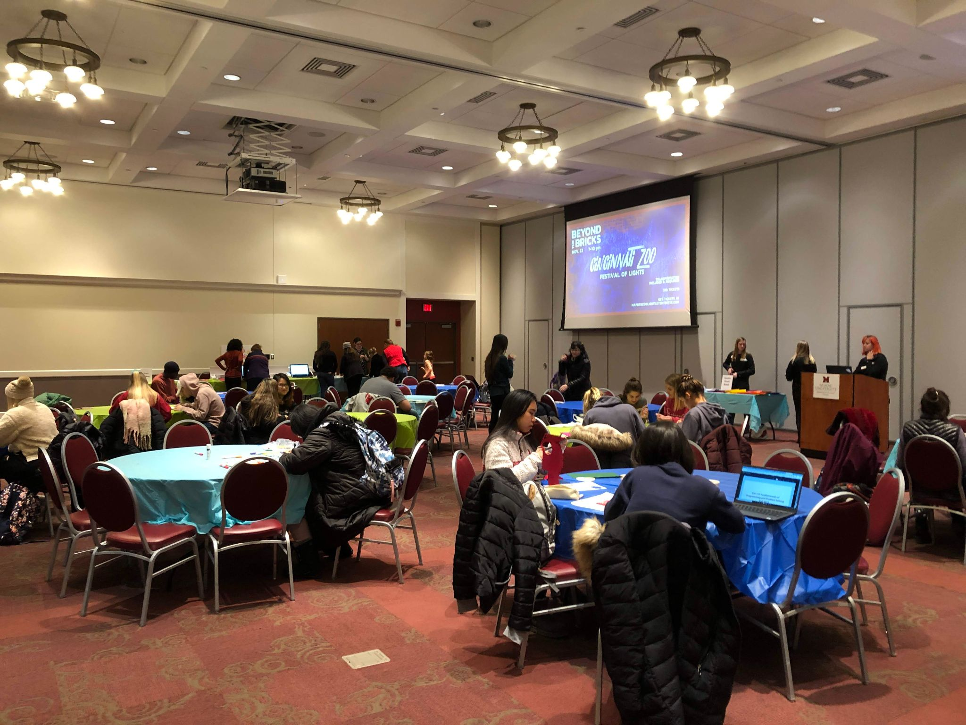
Late-night Makerspace
Images courtesy of Miami University Libraries, Oxford, OH
News Clipping from The Miami Student, October 29, 2019.

Slide 11
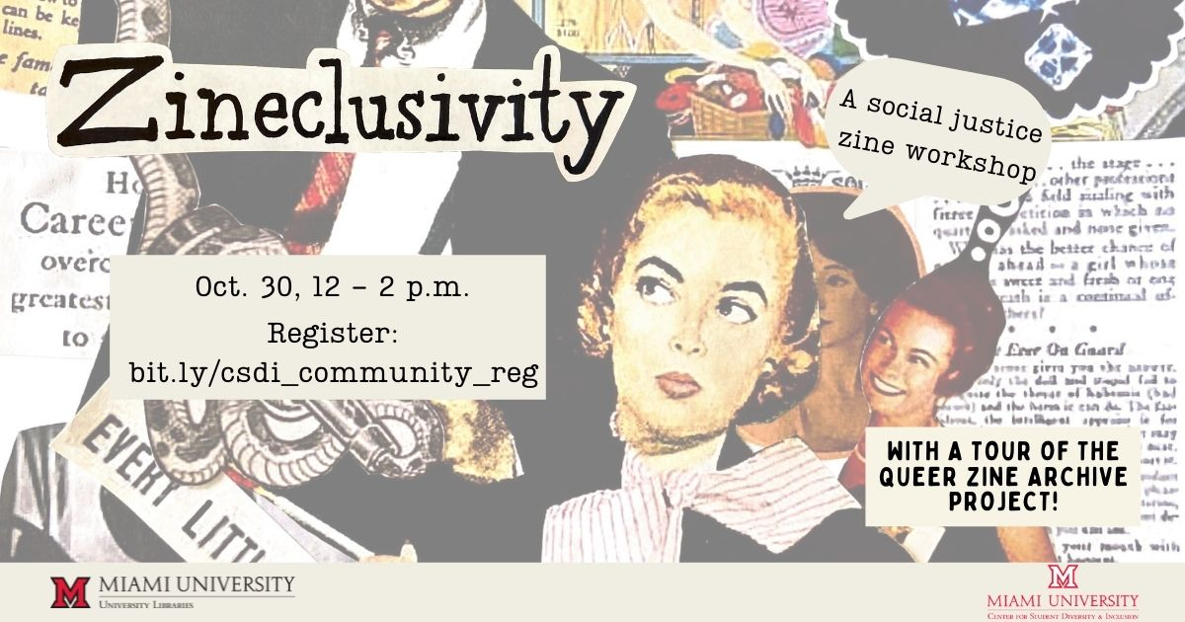

Slide 12
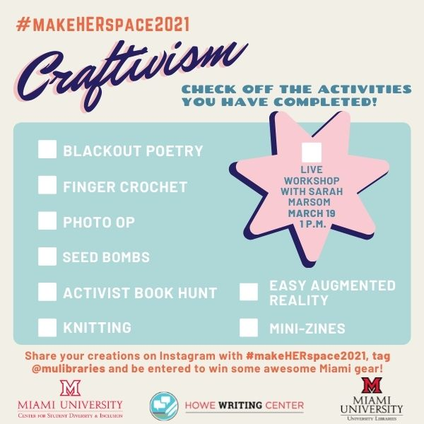
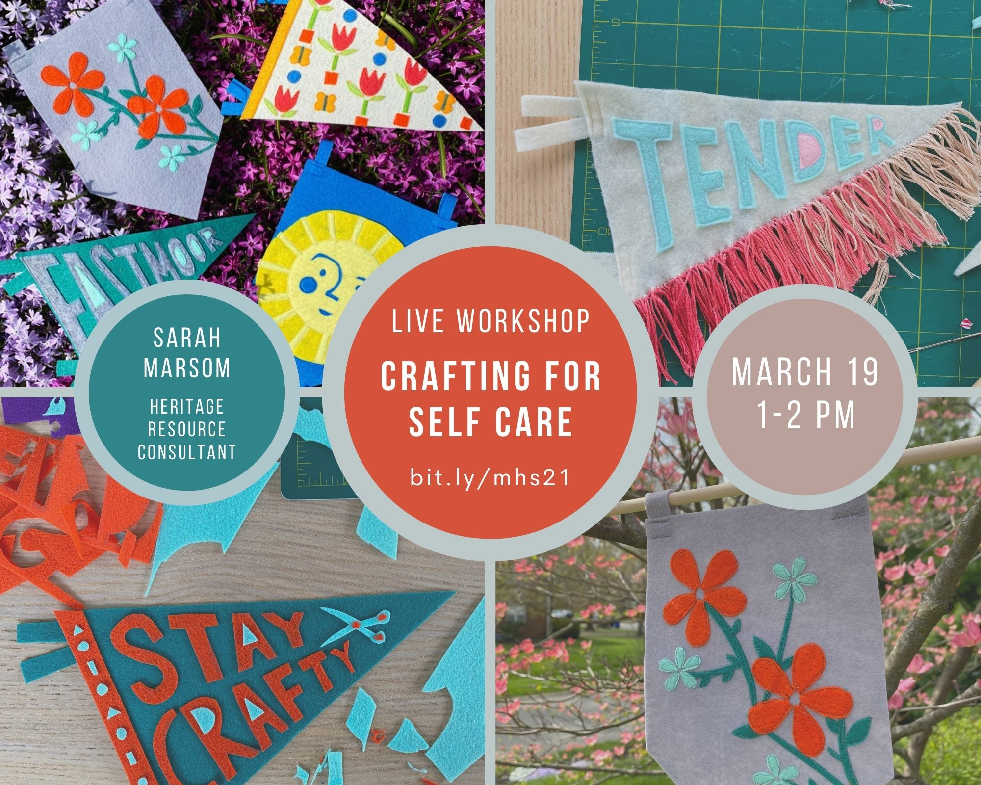

Slide 13
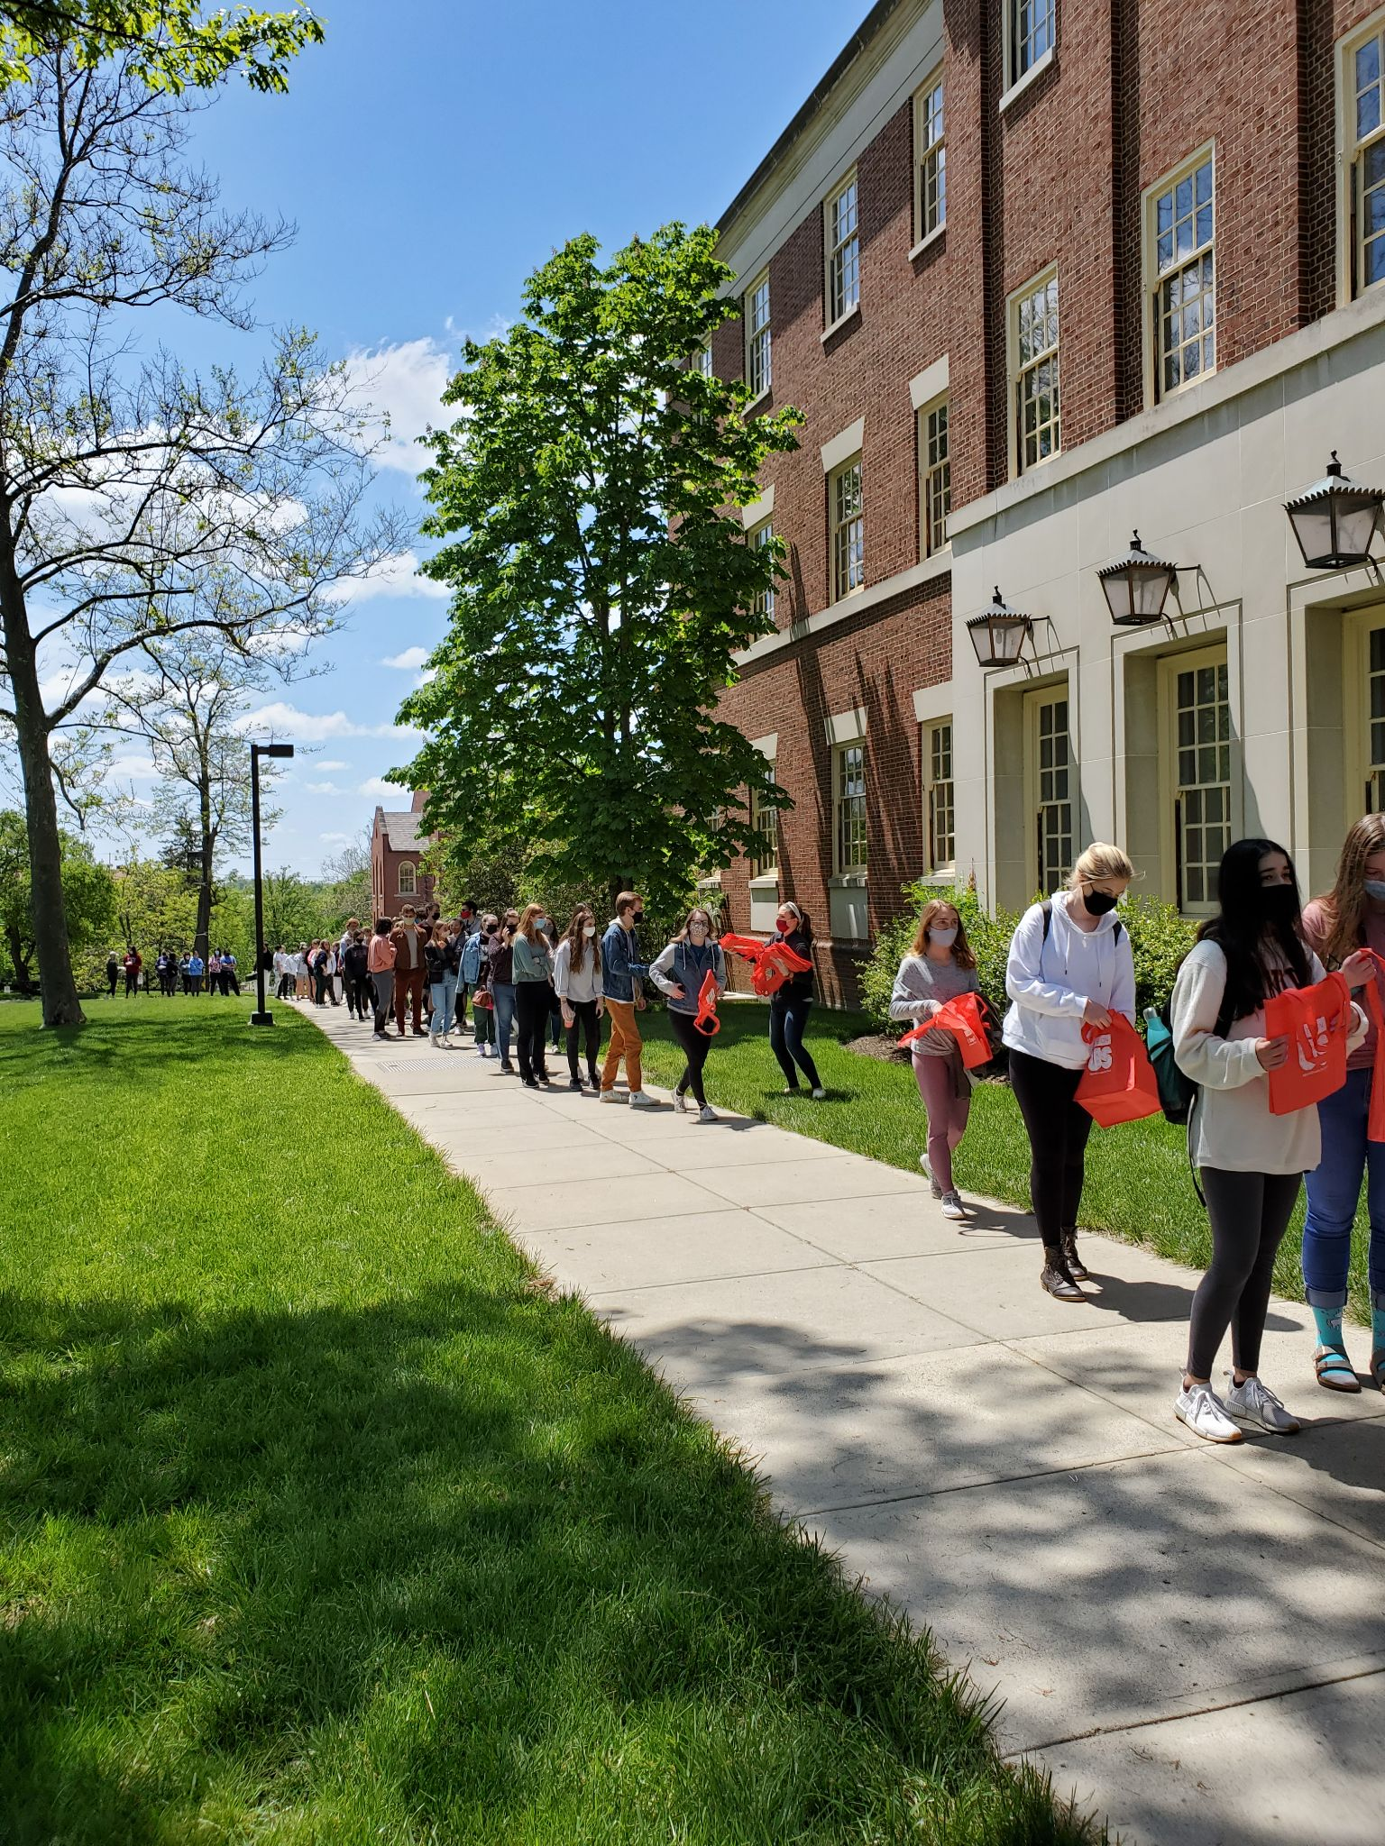
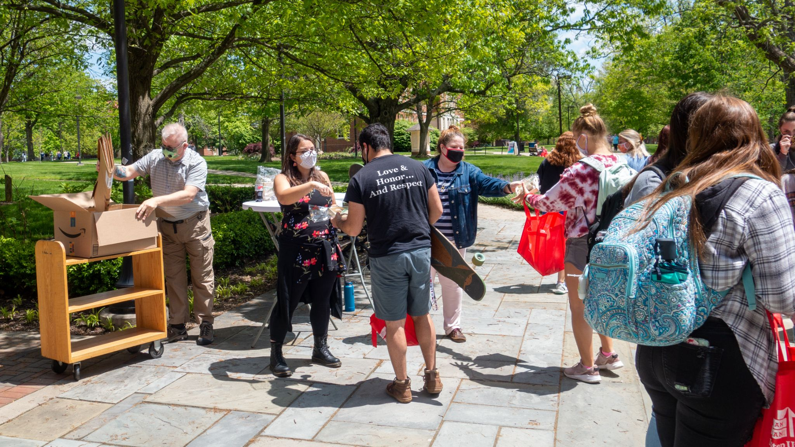
Take and Make:
Zen Gardens
https://drive.google.com/file/d/1Bg1OQnLs15IkyucrNXkMT6TdhoycenwW/view?usp=sharing
Images and videocourtesy of Miami University Libraries, Oxford, OH

Slide 14
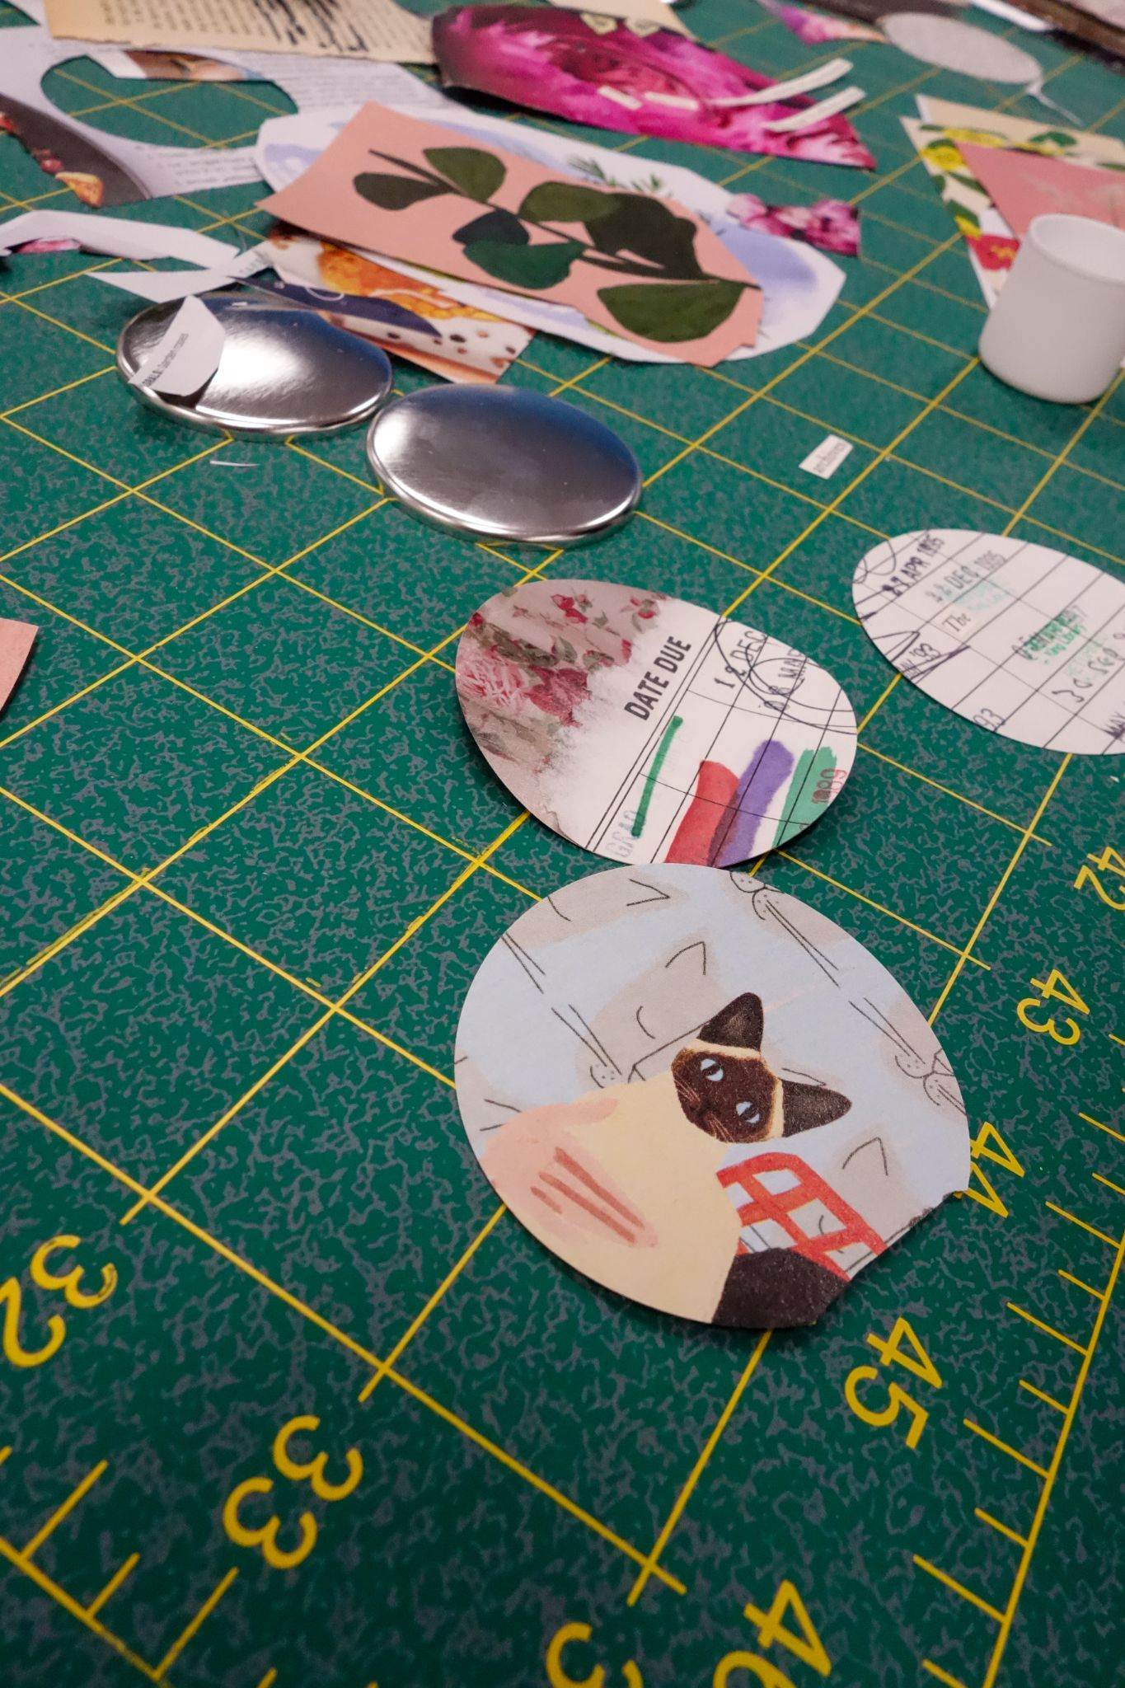
Best Practices
Develop an event planning plan
Know Your Community
Planning Timeline
Promotion Catered to Your Community

Slide 15
Budgeting for Events
Keep a Master Spreadsheet
Be Flexible
Organization is key!
Partners to Supplement Costs
With materials, activities, tools.
You truly can work with what you’ve got!
Partnering is a win-win for you and your partners!

Slide 16
Assessing Events
Testimonials
Surveys
Helps to show decision-makers the impact your events are having!
How did you hear about this event?
What did you like the most?
What suggestions do you have?
What events would you like to see in the future?
General Comments
Pictures
Can be very impactful to show the success of an event.

Slide 17
Final Tips/Lessons Learned
Flops happen!
Partnerships are key
Activities that allow for failure/tinkering/flexibility
Outreach pays off!

Slide 18
Share Back
Before you share, let us know your name, location, and type of library/makerspace
Biggest event successes? - What make them a success?
Biggest failures?
Any tips/tricks/lessons learned?
Anything else you’d like to share?

Slide 19
THANKS!
Do you have any questions?
pricesb@miamioh.edu
@SarahNagle10

Slide 20
Bibliography
Buechley, L. (2014, June 10). Thinking About Making. EYEO Festival, Minneapolis, MN. https://vimeo.com/110616469
Duncan, Suzette. 3 “Ways the Maker Movement Can Be More Inclusive of Women and People of Color—EdSurge News.” (2016, May 23). EdSurge. https://www.edsurge.com/news/2016-05-23-three-ways-the-maker-movement-can-be-more-inclusive-to-women-and-people-of-color
Land, E. (2017). “How to write a program planning guide.” York County Public Library. https://www.vla.org/assets/Conference_Session_Docs_Slideshows/2017_VLAPAF/howtowriteaprogramplanningguide.pdf
Queer Zine Archive Project. https://www.qzap.org/v9/index.php

Slide 21
Bibliography (cont’d)
Stark Masters, A. (2018, April). “How Making and Maker Spaces Have Contributed to Diversity & Inclusion in Engineering: A [non-traditional] Literature Review.” 2018 CoNECD - The Collaborative Network for Engineering and Computing Diversity Conference, Crystal City, Virginia. https://peer.asee.org/how-making-and-maker-spaces-have-contributed-to-diversity-and-inclusion-in-engineering-a-non-traditional-literature-review.pdf
Vecchione, A., Brown, D., Brasier, G., & Delaney, A. (2017). Encouraging a Diverse Maker Culture. In E. Kroski (Ed.). The Makerspace Librarian’s Sourcebook (pp. 51–71). Chicago: American Library Association.

