Slide 1

“The Forms of Things Unknown:”
Insights from a Librarian-designed Shakespeare Course
Mark Dahlquist, Humanities and Social Sciences Librarian
Rachel Makarowski, Special Collections Librarian
Sarah Nagle, Creation and Innovation Services Librarian
Andrew Revelle, Instructional Technologies Librarian
LibLearnX
28 January, 2023

Slide 2
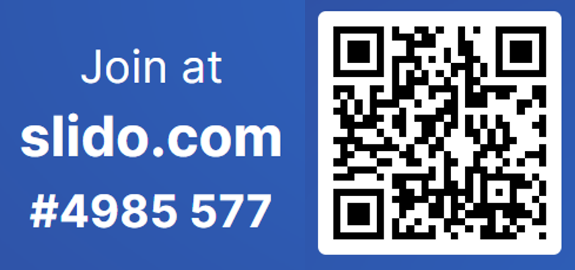
Questions: Intro
What’s your favorite creative activity?
What are some of the ways your library supports creativity?

Slide 3
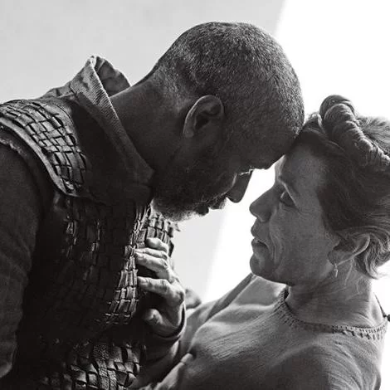

English/Film Studies 221: Shakespeare & Film
“Study of selected plays of Shakespeare that have been filmed. Students read plays and view one or more versions of each play.”
  A testbed for supporting student creativity across makerspace, special collections and liaison library units.
  Support for multimodal and non-traditional student projects
Macbeth (dir. Joel Coen, 2021)
Omkara (dir. Vishal Bhardwaj, 2006)

Slide 4

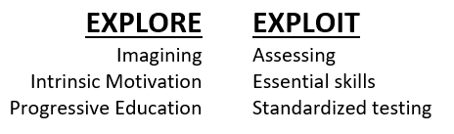
Information Creativity & the Explore-Exploit Dilemma
“Information creativity involves the experience of encountering, employing, transforming, or making informational objects for artistic, exploratory, or communicative purposes when creative originality or production is of primary concern”
Mark Dahlquist, “Towards a Framework for Information Creativity” (2023)
Alison Gopnik, “Childhood as a Solution to Explore–Exploit Tensions” (2020)

Slide 5
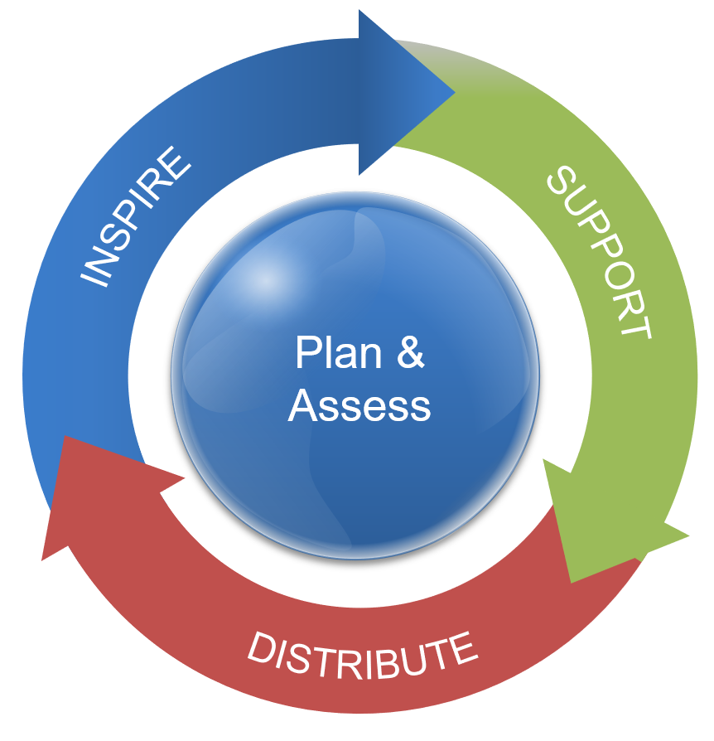
Information Creativity: Inspire Support Distribute
Inspire: e.g. Exhibits, Displays, Programming
Support: e.g. Instruction, Makerspaces, Studios
Distribute: Collections, Preservation, Social Media
Mark Dahlquist, “Towards a Framework for Information Creativity” (2023)

Slide 6
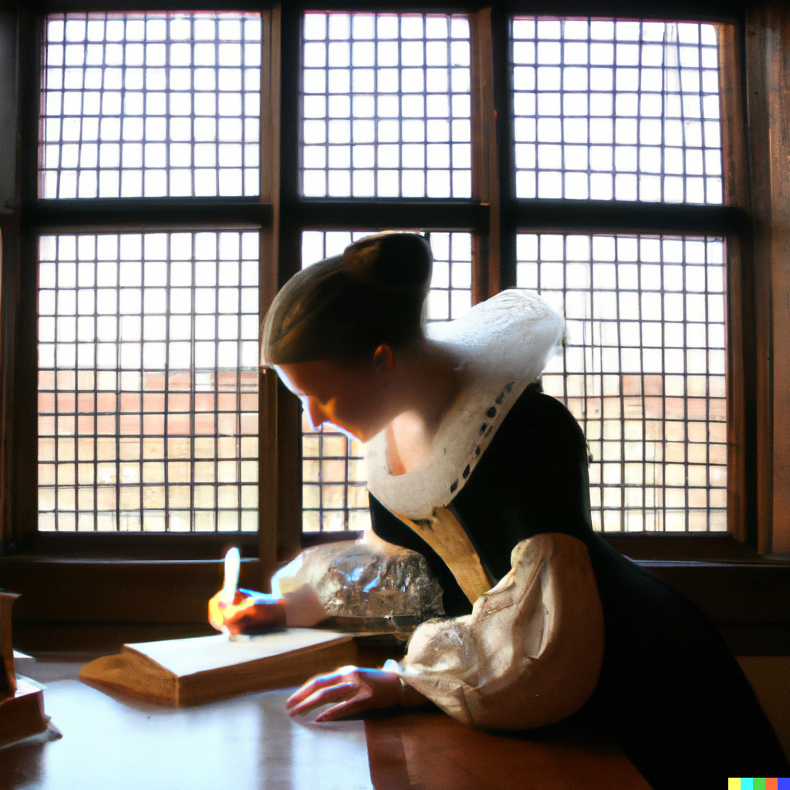
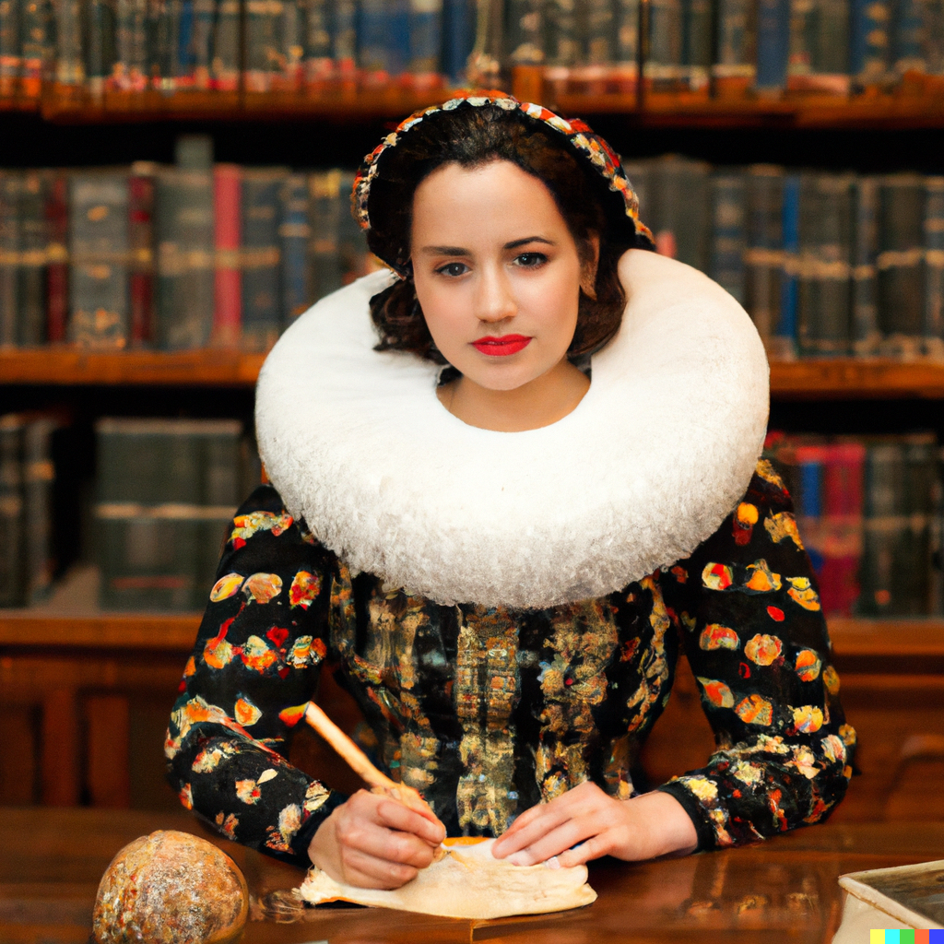
Creativity and Libraries
“What is the state of mind that is most propitious to the act of creation?”
Virginia Woolf, A Room of One’s Own (1929)

Slide 7
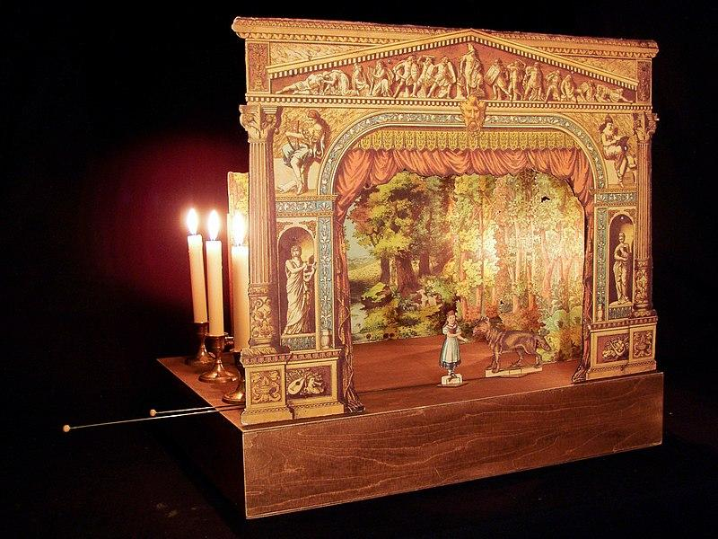
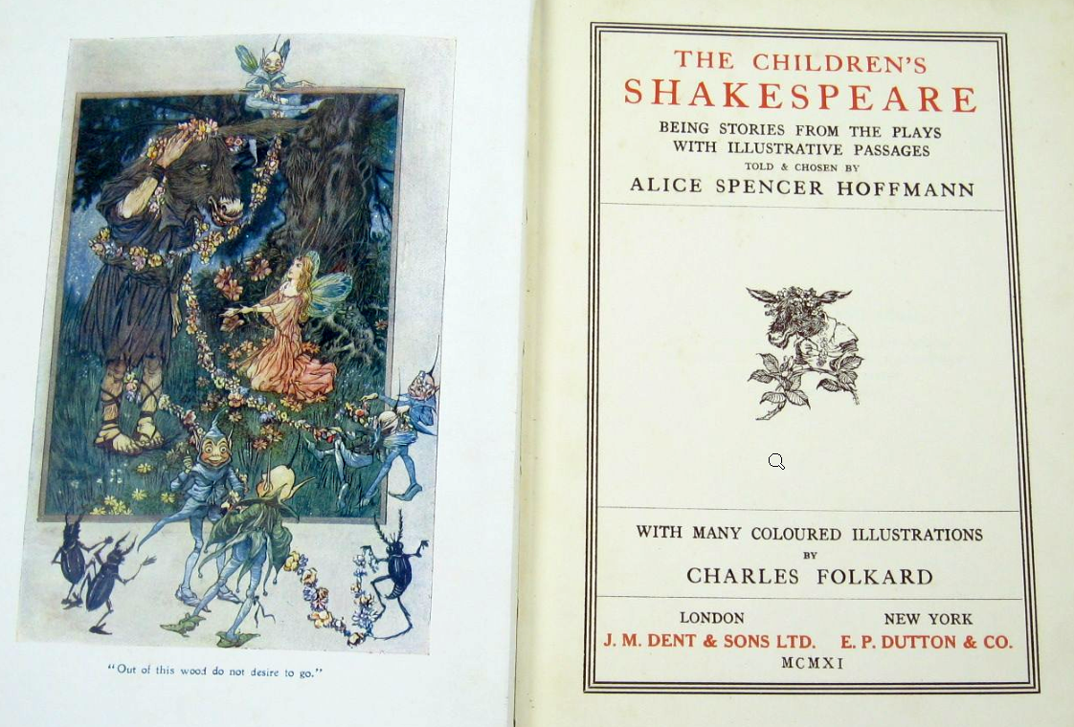
Special Collections
How can special collection inspire creativity, including for non-traditional maker projects, in addition to providing traditional resources for bibliographic and cultural history?
Approach to ENG/FST 221
  Past interpretations including art and creative responses

Slide 8
Special Collections
How can special collection inspire creativity, including for non-traditional maker projects, in addition to providing traditional resources for bibliographic and cultural history?
Approach to ENG/FST 221
  Past interpretations including art and creative responses
  Evolution of technologies

Slide 9
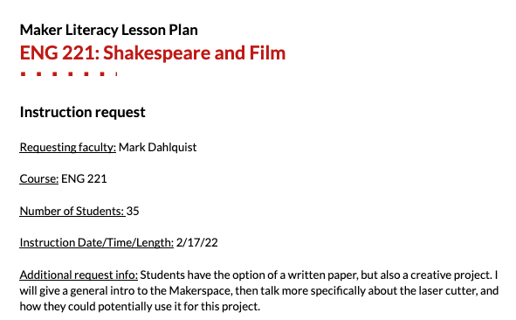
Makerspace
How can Makerspaces support academic courses such as ENG/FST 221?
Supporting academic courses
Instructors as partners
No “one size fits all”
Lesson planning template
Student learning outcomes

Slide 10
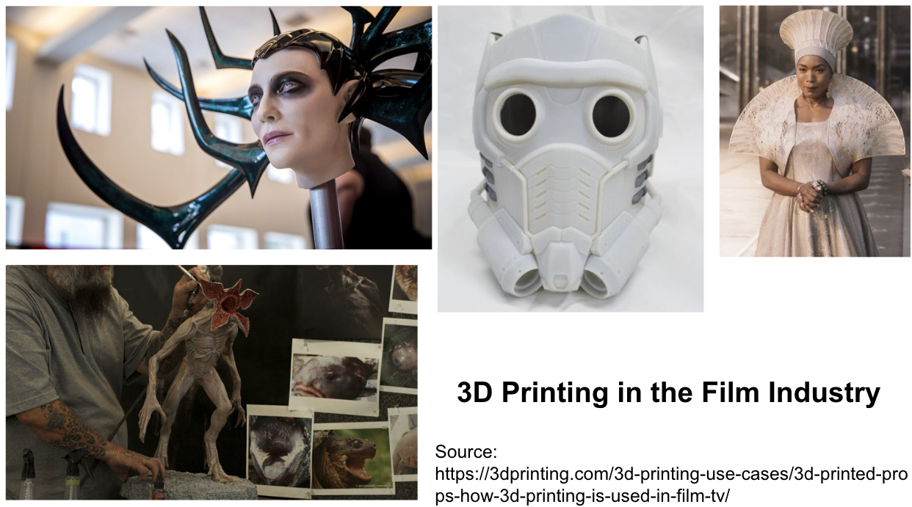
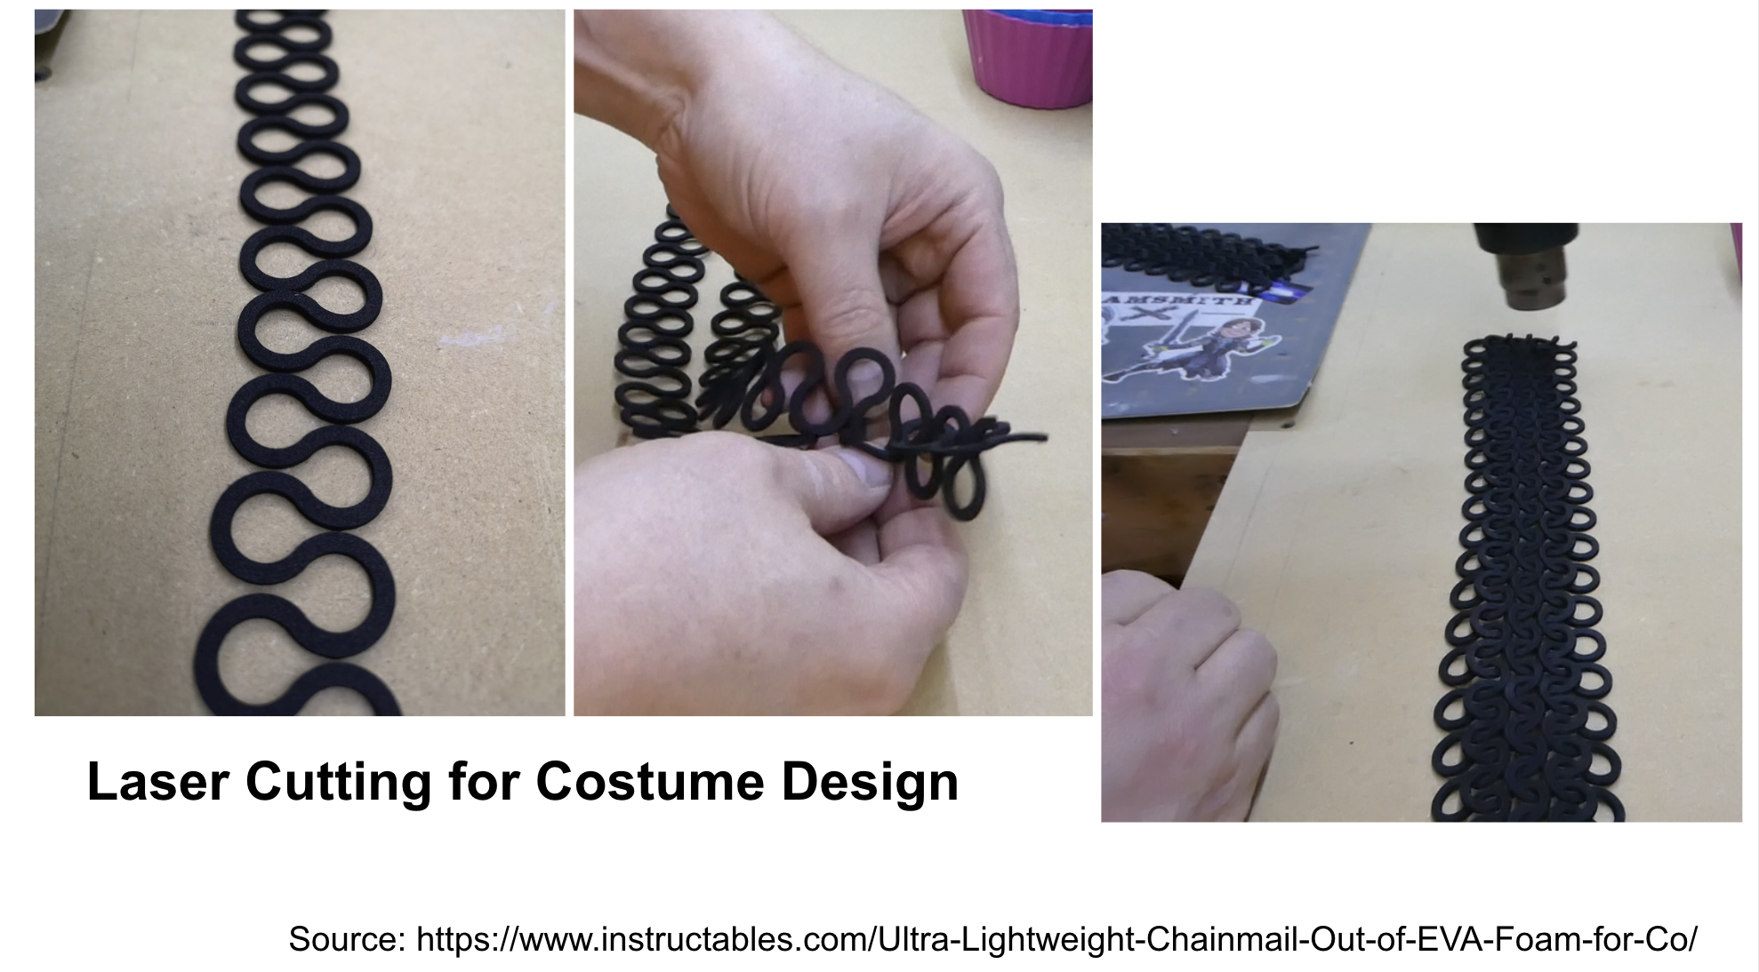
Makerspace
How can Makerspaces support academic courses such as ENG/FST 221?
ENG 221
Show students what’s available
Show the “why” & “how”
  Maker tech in film/theater

Slide 11
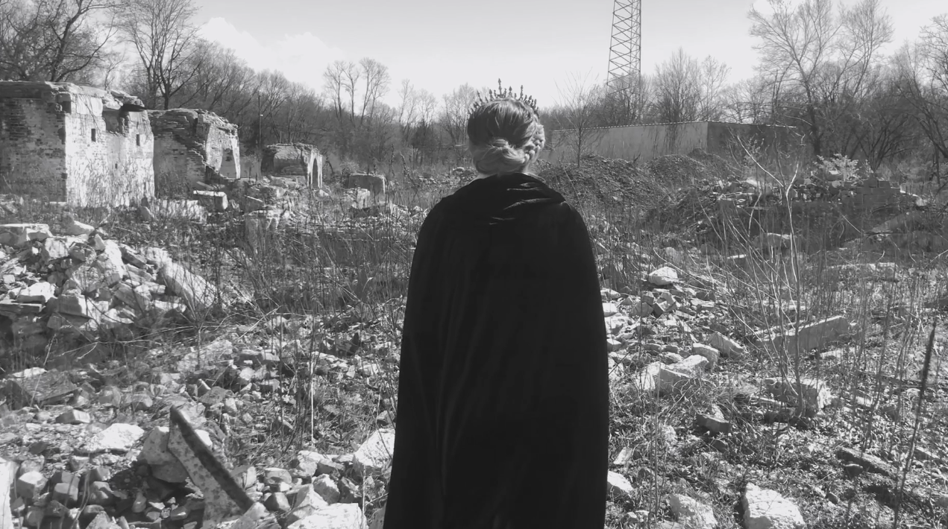
Libraries and Multimodal (Video) Creativity
How can libraries and instructors support creative video projects?
Challenges to Video Creativity
  Recording technology
  Editing software
  Distribution & Copyright
  Assessment/”rigor”?
Katie Elmer (dir), “Macbeth,” 2022. Student work.

Slide 12

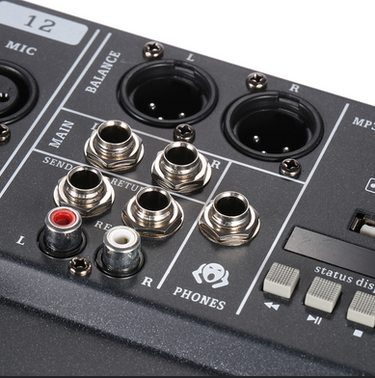

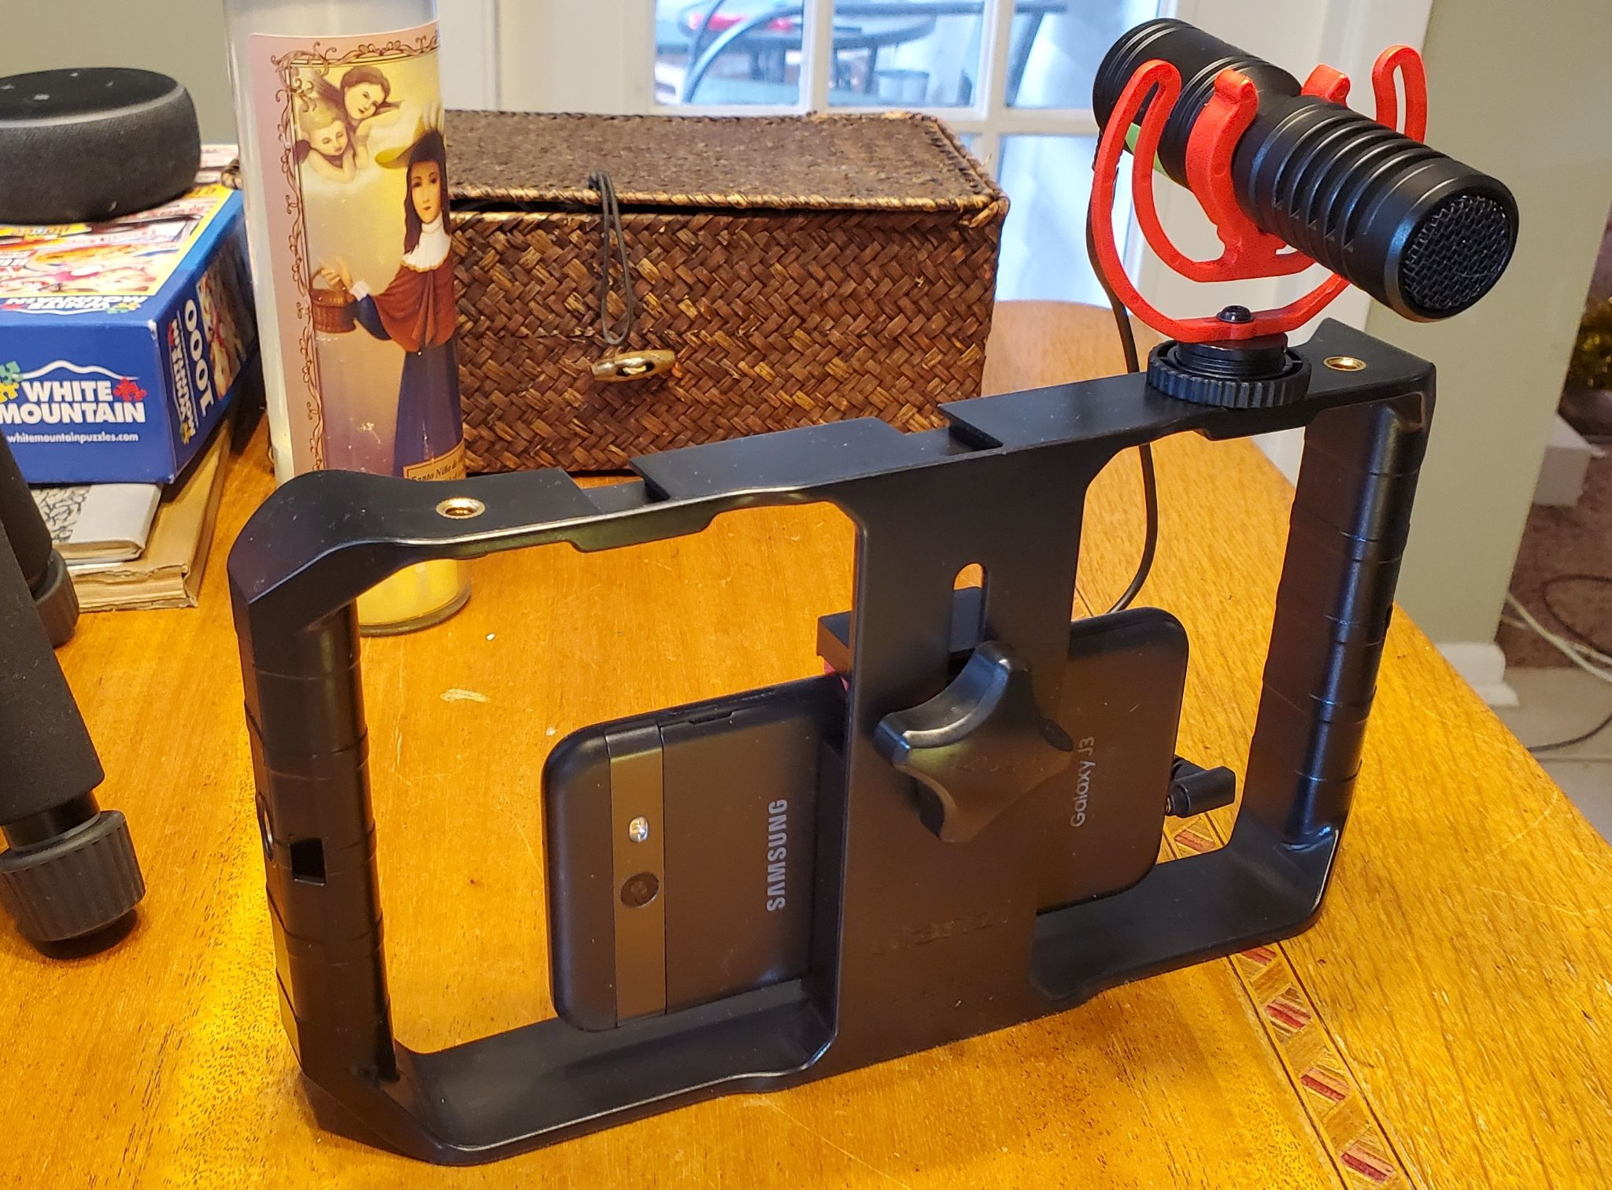

Supporting Video Creativity
Tools and Information
  Loanable software licenses
  Coordinated acquisition
  Putting it all together: what we have, what you need, and how to use it!

Slide 13
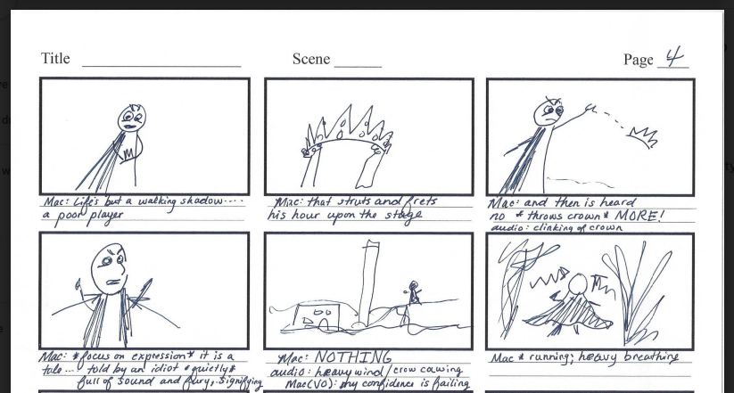
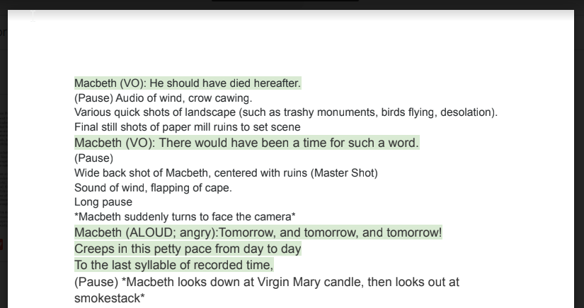
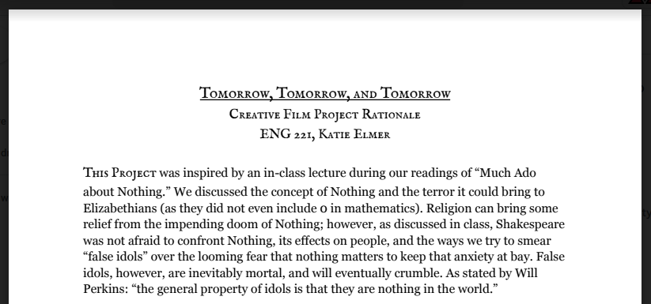
Multimodal Distribution: Collecting and Assessing
Process assessment
Rubrics & examples
Building instructor collections
Copyright/FERPA/Research Consent
  Ethical considerations

Slide 14
Special Collections (2)
What other successes have you had in working with faculty and students on nontraditional, creative projects? How have you collaborated with other library departments in this endeavor?

Slide 15
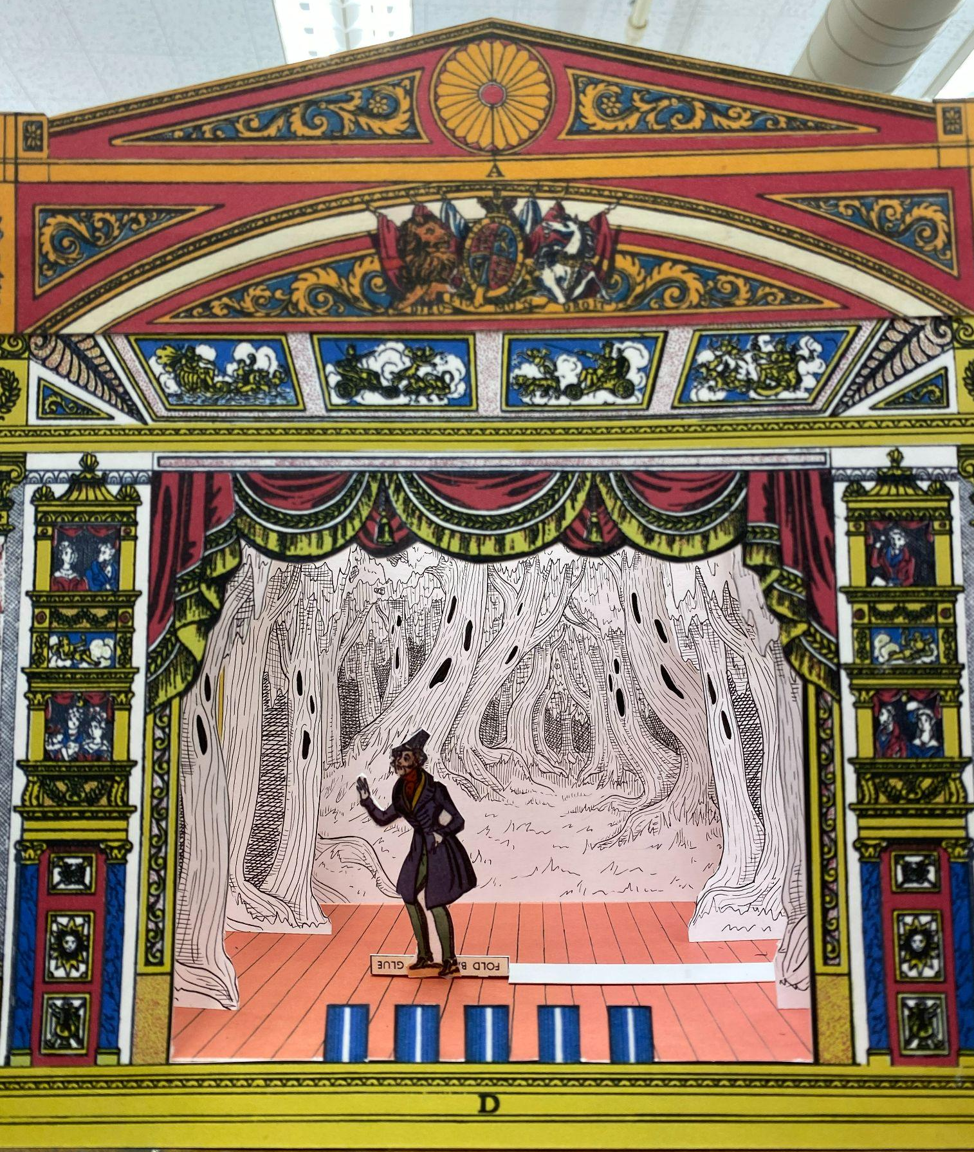
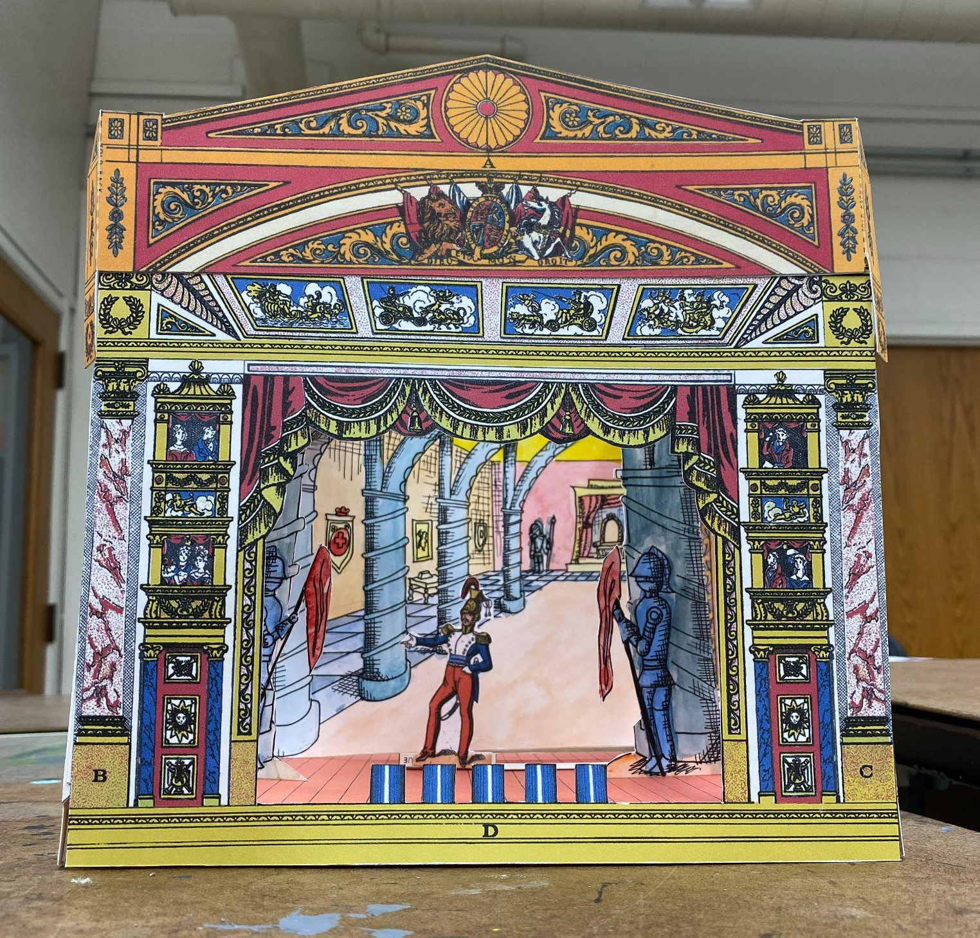
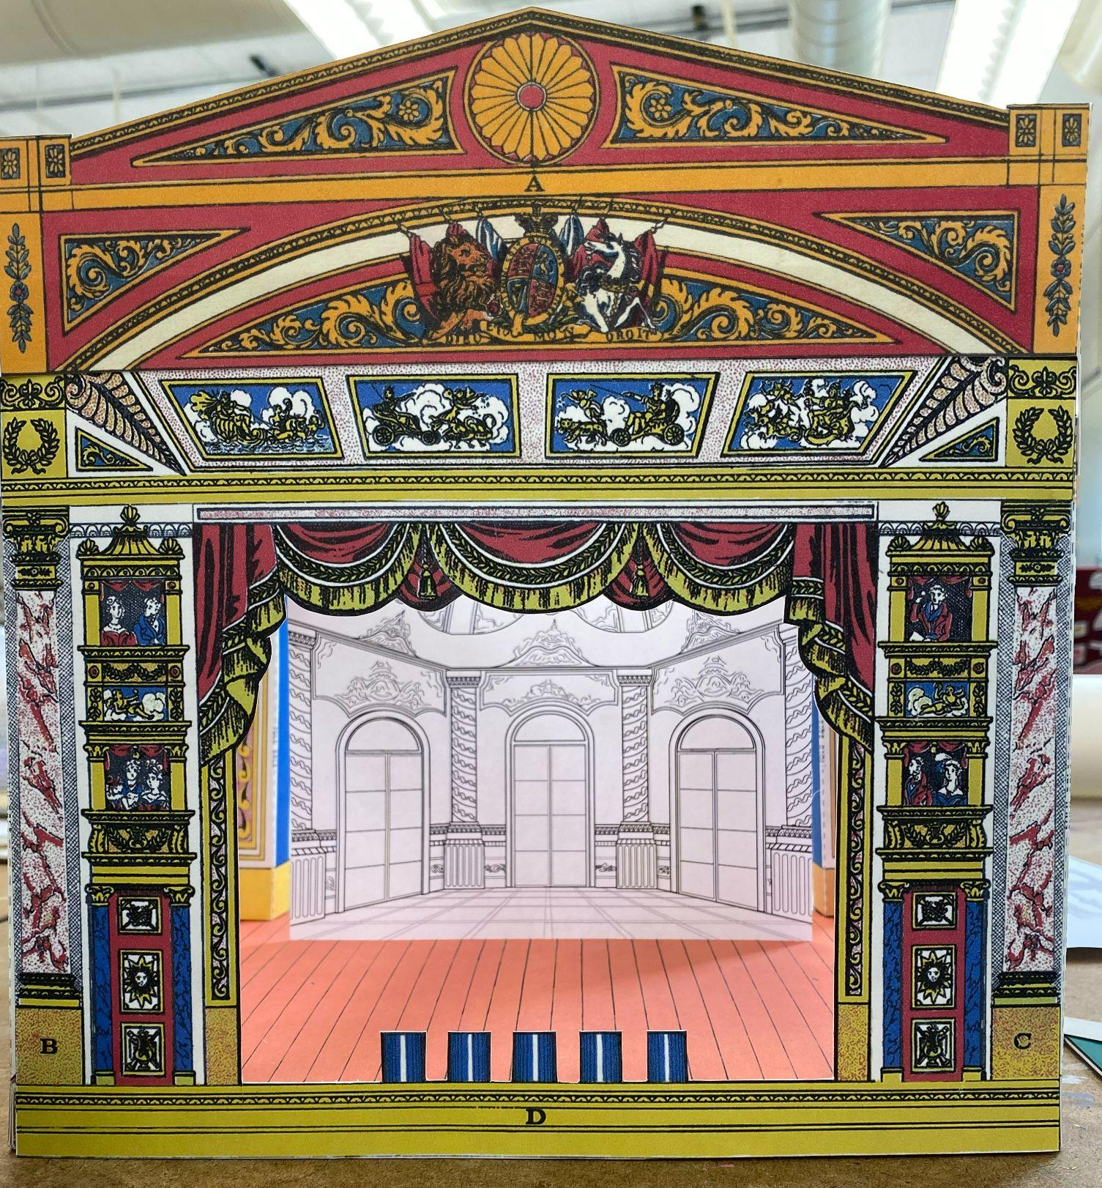
Special Collections (2)
What other successes have you had in working with faculty and students on nontraditional, creative projects? How have you collaborated with other library departments in this endeavor?
Set designs

Slide 16
Special Collections (2)
What other successes have you had in working with faculty and students on nontraditional, creative projects? How have you collaborated with other library departments in this endeavor?
Set designs
The Mexican Revolution

Slide 17
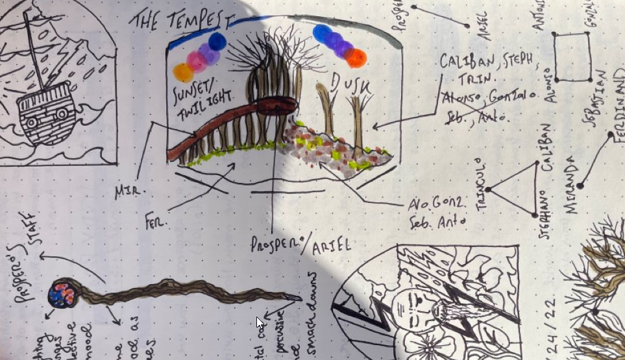
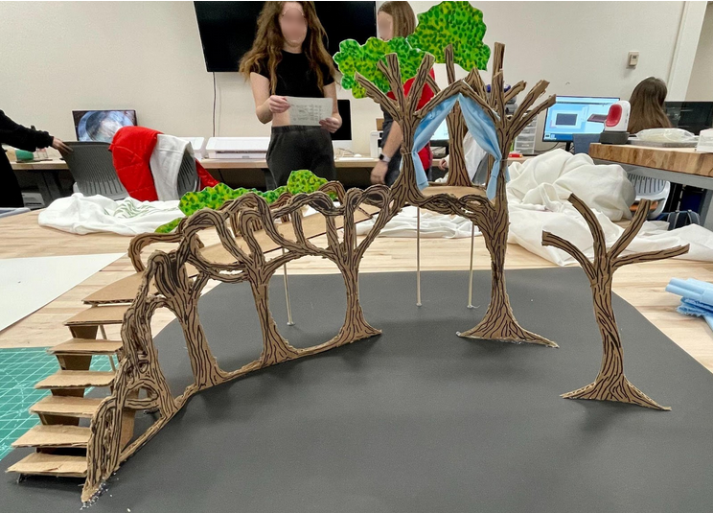
Makerspace
What are the benefits and challenges of supporting maker projects for students in a variety of disciplines?
Inclusivity - reach beyond STEM
Provides students with alternate learning opportunities
Volume of classes
Struggle of one-shot sessions
Annie Bingham, Set design and notes for a production of The Tempest (2021)

Slide 18
Questions: Outro
How have you collaborated across library departments or other boundaries to support creativity?

Slide 19
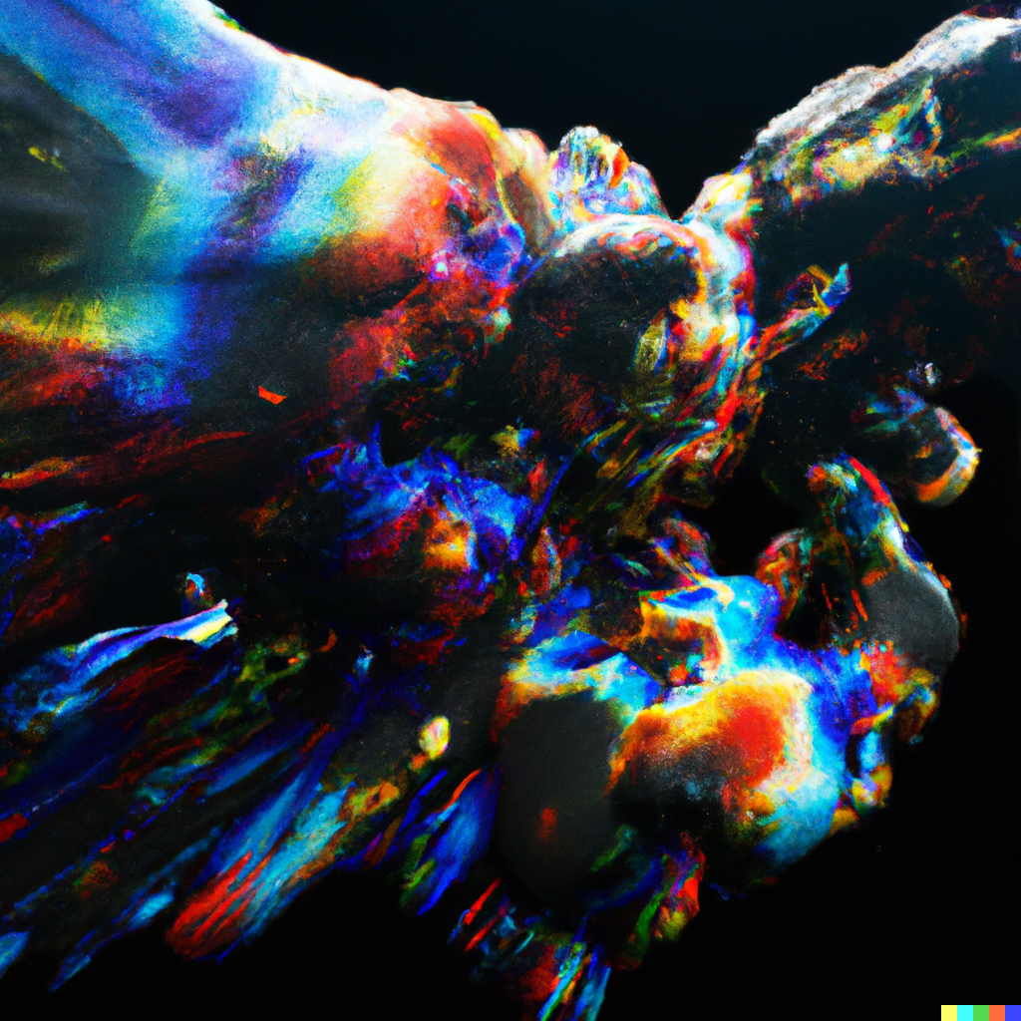
Questions &
Discussion?
DALL-E 2, “The Forms of Things Unknown”
Notes:
Hello; I’m Mark. Welcome!

Slide 20
Further Reading:
Burke, John. “Making Sense: Can Makerspaces Work in Academic Libraries?,” 2015. http://sc.lib.miamioh.edu/handle/2374.MIA/5212.
Dahlquist, Mark. “Toward a Framework for Information Creativity.” College & Research Libraries 84, no. 3 (May 2023). https://doi.org/10.5860/crl.84.3.441.
Clapp, Edward P., Jessica Ross, Jennifer O. Ryan, and Shari Tishman. Maker-Centered Learning: Empowering Young People to Shape Their Worlds. San Francisco: Jossey-Bass, 2017.
DePalma, Michael-John, and Kara Poe Alexander. “A Bag Full of Snakes: Negotiating the Challenges of Multimodal Composition.” Computers and Composition 37 (September 1, 2015): 182–200. https://doi.org/10.1016/j.compcom.2015.06.008.
Fields, Karen E., and Barbara Jeanne Fields. Racecraft: The Soul of Inequality in American Life. London: Verso, 2012. http://catdir.loc.gov/catdir/enhancements/fy1312/2012454634-b.html.
Garcia, Heather. “Sharing Student Work.” OLC, August 9, 2018. https://onlinelearningconsortium.org/sharing-student-work/.
Gopnik, Alison. “Childhood as a Solution to Explore–Exploit Tensions.” Philosophical Transactions of the Royal Society B: Biological Sciences 375, no. 1803 (July 20, 2020): 20190502. https://doi.org/10.1098/rstb.2019.0502.
Myers, Carla. “Acting on IP: Valuing Students Rights as Intellectual Property Creators,” February 10, 2019. http://sc.lib.miamioh.edu/handle/2374.MIA/6325.

Slide 21
Further Reading (continued):
Nagle, Sarah Beth. “Maker Services in Academic Libraries: A Review of Case Studies.” New Review of Academic Librarianship 27, no. 2 (April 3, 2021): 184–200. https://doi.org/10.1080/13614533.2020.1749093.
Nay, Leanne. “In Good Company: Engaging in the Maker Movement Alongside Campus Partners.” College & Undergraduate Libraries 27, no. 2–4 (October 1, 2020): 326–38. https://doi.org/10.1080/10691316.2020.1865859.
Nichols, Jennifer, Marijel (Maggie) Melo, and Jason Dewland. “Unifying Space and Service for Makers, Entrepreneurs, and Digital Scholars.” portal: Libraries and the Academy 17, no. 2 (April 2015): 363-374. https://doi.org/10.1353/pla.2017.0022.
Passehl-Stoddart, Erin, Ashlyn Velte, Kristin J. Henrich, and Annie M. Gaines MLIS. “History in the Making: Outreach and Collaboration Between Special Collections and Makerspaces.” Collaborative Librarianship 10, no. 2 (2018): 8.
Thompson, Ayanna. “Did the Concept of Race Exist for Shakespeare and His Contemporaries?” The Cambridge Companion to Shakespeare and Race, 2021, 1–16.
Vecchione, Amy, Deanna Brown, Gregory Brasier, and Ann Delaney. “Encouraging a Diverse Maker Culture.” In The Makerspace Librarian’s Sourcebook, edited by Elyssa Kroski, 51-71. Chicago: American Library Association, 2017.
Milne-Lane, Stephanie and Amy Vecchione. “Maker Instruction Toolkit.” Accessed May 20, 2021. https://www.boisestate.edu/library-makerlab/makerlab-instruction/maker-instruction-toolkit/.

